Slide 1
INVESTMENT ASSIGNMENT SUBMISSION
Name: Ravi Teja.K

Slide 2
Abstract
To help Spark Funds to take the proper investment decisions
Objective
Is to follow the other investors
Approach
START
Two companies from the Top sectors of each of the Top 3 countries
Findings
Insights of the investment structure in various sectors across the different countries
Value

Slide 3
Problem solving methodology
Data Preparation
Funding Type Analysis
Sector Analysis
Combining the companies and round 2 data to form the master data frame
Comparing the different funding types and finding the suitable one
Mapping the sub sectors to the main sector and finding the top 3 sectors in each of the top 3 countries
Funding Type Analysis
Sector Analysis
Data Preparation
Data Cleaning
Country Analysis
Data Cleaning
Country Analysis
Missing value treatment, filtering the needed investment types from the data, cleaning the data depending on the domain requirements
Finding the Top 9 countries depending on the received investment amount and filtering the top 3 English speaking countries from that list

Slide 4
Data Cleaning
58%
Domain specific cleaning
70%
Filtered the needed funding types
82.6%
Dropped the null entries of raised amount
100%
Total Data set
Dropped the null entries of raised amount
Filtered the needed funding types
Domain specific cleaning
Dropped the close companies
Dropped the entries which has null in the country code and the category_list
Removed the entries which has null in the homepage_url column as we can’t reach those companies.
Didn’t think of imputing these as this is the target variable
Filtered the seed, venture, angel and private_equity funding types from the master data set

Slide 5
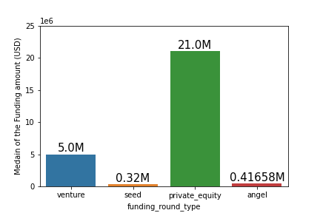
Funding Type Analysis
Mean of the funding amount for each funding type is impacted by the outliers in the data. So chosen the Median as the representative value for the funding types.
Venture Funding type is the best suitable for the Spark Funds investment range (USD 5M-15M)

Slide 6
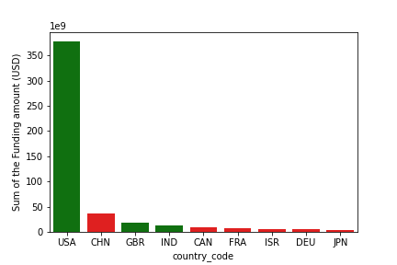
Country Analysis
This analysis has carried out on the “Venture Funding Type” data only.
USA, CHN and GBR are the top 3 countries depending on the sum of the funding amount.
But CHN isn’t the officially English Speaking country.
So USA, GBR and the IND are the top 3 English speaking countries

Slide 7
Sector Analysis
Assumptions:
In the sector mapping file 0 was entered in place of “na” of the category_list
If 0 is presented at the start of string, It is “Na”
Otherwise, it is “na”
Replaced the “.na” with .0 (To handle the Enterprise 2.0 which is the genuine entry of 0)
In the Main Data frame, the some of the entries of the category_list containes multiple sectors spaced with “|”. Took the first sector as the primary sector in that case.
Mapped the primary sector with the major sector by using the mapping file and found the top three sectors in the each country of the three top English speaking countries.

Slide 8
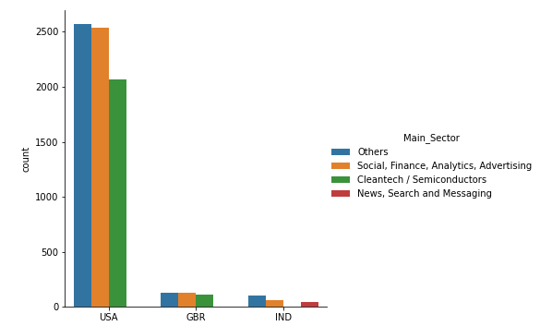
Sector Analysis (Contd..)

Slide 9
Conclusions
Parameter | USA | GBR | IND
Top Sector name (no. of investment-wise) | Others | Others | Others
Second Sector name (no. of investment-wise) | Social, Finance, Analytics, Advertising | Social, Finance, Analytics, Advertising | Social, Finance, Analytics, Advertising
Third Sector name (no. of investment-wise) | Cleantech / Semiconductors | Cleantech / Semiconductors | News, Search and Messaging
Company received the highest investment from in the top sector | Virtustream | Electric Cloud | FirstCry.com
Company received the highest investment from in the second best sector | SST Inc. (Formerly ShotSpotter) | Celltick Technologies | Manthan Systems

