Slide 1


Information Systems Club ( MySQL Workshop );
Tejas Bachhav | Feb 25, 2025

Slide 2
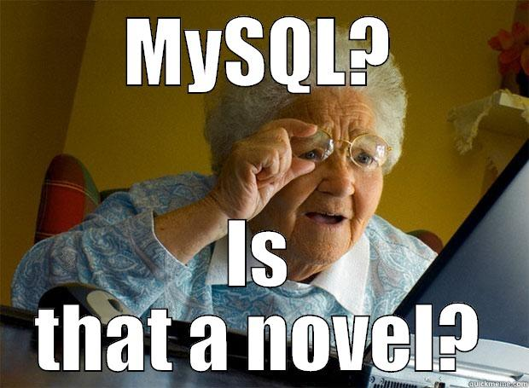

Introduction to MySQL
A popular relational database system (RDBMS)

Slide 3

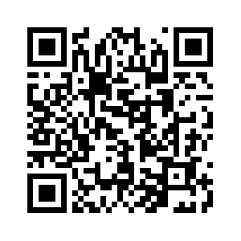
Attendance
Please scan the QR code

Slide 4
Roadmap
Introduction to MySQL
Definition of Database
Brief History
Example of file systems
MySQL installation
Important definitions
Basic Queries
Using Database
Practice
MySQL Datatypes
CRUD Operations with Examples
Exercise

Slide 5
MySQL
MySQL is a very popular, open source database.
Officially pronounced "my Ess Que Ell" (not my sequel).
Handles very large databases; very fast performance.
Why are we using MySQL?
Free (much cheaper than Oracle!)
Each student can install MySQL locally.
Easy to use Shell for creating tables, querying tables, etc.
MySQL is one of many database systems (like PostgreSQL, SQL Server, Oracle Database, etc.) that implement the SQL standard.

Slide 6
Definition of a Database
A database is a collection of data that:
represents certain aspect of the real-world
has data that are logically related
is created for a specific purpose

Slide 7
Definition: A database management system (DBMS) is a set of software used to define, store, manipulate and control the data in a database.
Define data types, structures, and constraints
Store data to support efficient access
Retrieve and update data using a query language
Control access to data
Database System = Database + DBMS

Slide 8
A Brief History Note
Database technology has a history of about 60 years
Database technology has gone through several generations of development
First Generation: File systems, 50's – 60's
A typical file system consists of a set of independent files and application programs

Slide 9
An Example File System
A banking system may have
files for customers, savings accounts, and checking accounts;
application programs to deposit and withdraw money, to find balance, etc.

Slide 10
Problems of File Systems (1)
It is difficult to support new applications. Two existing application programs:
find customers who have a checking account
find customers who have a savings account
You need write a new program to find the customers with both a checking and savings account!

Slide 11
Problems of File Systems (2)
It has no centralized control of all data:
Files are often created for a particular application
Files are created and managed independently

Slide 12
Problems of File Systems (3)
No concurrency control:- necessary to prevent mutual interference of concurrent requests
Example: Two customers may simultaneously try to book the only ticket left for a flight

Slide 13
Database History (Continued)
Second Generation: Hierarchical database systems (HDBS), late 60's – early 70’s
One-to-many relationships between parent records and child records
Records are connected by pointers
e.g., IMS (Information Management System) of IBM
Department
Student
Faculty

Slide 14
Problems with Hierarchical Databases
Example:
Course
Student
Grades
CourseID | Title | Dept | Professor
ID | Name | Address
Homework1 | Homework2 | Exam1 | Exam2
Can’t add a student who has not signed up for any course yet!

Slide 15
Problems with Hierarchical Databases
Department
CS101
CS320
John
Alice
John
Bob
Data redundancy: John is repeated

Slide 16

History of Database (Continued)
Third Generation: Network database systems (NDBS), late 60's – early 70’s
Record types are organized into an acyclic graph
Main problem with HDBS and NDBS: Hard to use
Some commercial NDBSs: IDS II (Honeywell), DMS II (UNISYS)
Charles W. Bachman received
Turing Award for his work on IDS
(Integrated Data Store) in 1973

Slide 17
History of Database (Continued)
Fourth Generation: Relational database systems, early 70's – now
Data are organized into tables (relations)
Example relational DBSs: Oracle, MySQL, Sybase, Informax, DB2, Ingres, ...

Slide 18
Examples of relations
Employees: Emp# Name Dept_Name
123 Bill Sales
234 Bob Service
Departments: Name Location Manager
Sales XY St. John
Service XZ Rd. Mary
Bills Manager

Slide 19
History of Database (Continued)
Fifth Generation: Object-oriented and Object-Relational database systems (OODBS), 80's – now
SQL declared as standard by ANSI(American National Standards Institute)
Became a commercial success as the rapid increase in computer sales boosted the database market
this caused a major decline in the popularity of network and hierarchical database models

Slide 20
MySQL Installation
Installation on Windows 10+:
Reference: Install mysql on windows 11
Installation on MacOS:
Reference: Install mysql on MacOS
We will be using this for workshop
Web Version: SQL Playground - Online SQL Sandbox

Slide 21

IMP definitions
Database: A database is an organized collection of data stored and accessed electronically.
Think of it as a digital filing cabinet where you store related information.
Example: A school database stores data about students, teachers, and courses.

Slide 22
IMP definitions
Table: structured format to store data in rows and columns.
Each table represents a specific entity (e.g., students, products, orders).
Example:
students table might have columns like id, name and age
Each row represents single student’s record
id | name | age
1 | Alice | 20
2 | Bob | 22

Slide 23
IMP definitions
Row (also called a record) represents a single entry in a table.
Each row contains - data related to one instance of the entity.
Example: In the students table, one row represents one student.

Slide 24
IMP definitions
Column: also called (field) – represents specific attribute of the data
Each column has name and data type(ex- integer, text, date)
Example: in students table- columns could be id, name, age
Primary Key: a unique identifier for each row in table
It ensures – no 2 rows have same value for this column
Example:
In students table, see the id column
id | name | age
1 | Alice | 20
2 | Bob | 22

Slide 25
IMP definitions
Foreign key: a column in one table refers to the primary key in another table
Example: a courses table might have a student_id column that links to the id columns in students table
Course_id | Course_name | Student_id(Foreign Key
101 | Math | 1
102 | Science | 2

Slide 26
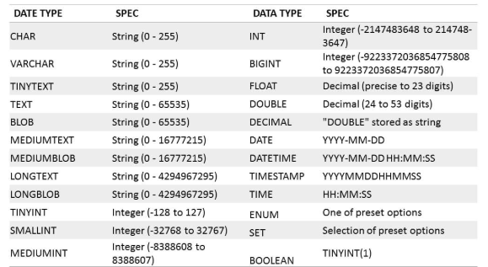
MySQL Datatypes

Slide 27
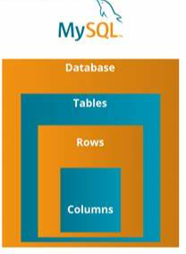
In a nutshell
Visualize it like this:

Slide 28
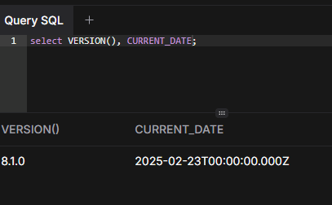
Basic Queries
You can try some simple queries first
1. select version();
Most MySQL commands end with semicolon ( ; )
MySQL returns total number of rows found.

Slide 29
Basic Queries
Keywords may be entered in any lettercase
The following queriers are equivalent:
SELECT VERSION(), CURRENT_DATE;
select version(), current_date;
SeLeCT vErSiOn(), current_DATE;

Slide 30
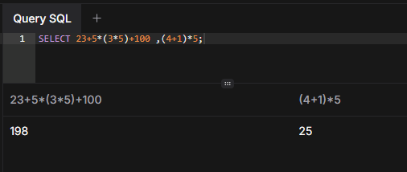
Basic Queries
Here’s another query.
It demonstrates that you can use mysql as a simple calculator
> SELECT 23+5*(3*5)+100 ,(4+1)*5;

Slide 31
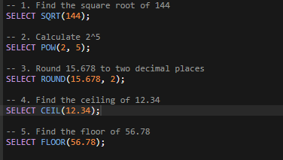
What is output of following queries?
Notes:
-- 1. Find the square root of 144
SELECT SQRT(144);
-- Ans =12
-- 2. Calculate 2^5
SELECT POW(2, 5);
-- Ans =32
-- 3. Round 15.678 to two decimal places
SELECT ROUND(15.678, 2);
-- Ans = 15.68
-- 4. Find the ceiling of 12.34
SELECT CEIL(12.34);
-- Ans =13
-- 5. Find the floor of 56.78
SELECT FLOOR(56.78); -- Ans =56

Slide 32
Basic Queries – Where clause
The MySQL WHERE clause:
Its used to filter records
Can be used to extract specific info
Syntax: SELECT column1, column2, ... FROM table_name WHERE condition;
Example:
Select * from Customers where Country = ‘Mexico’;
Select * from customers where CustomerID = 1;
Notes:
SQL requires single quotes around text values (most database systems will also allow double quotes).
However, numeric fields should not be enclosed in quotes:

Slide 33
Basic Queries – AND , OR , NOT operators
Where clause can be combined with AND OR and NOT
AND , OR – are used to filter records based on multiple conditions
AND – is used to display record if all conditions separated by AND are TRUE
Syntax: SELECT column1, column2,.. FROM table_name WHERE condition1 AND condition2 AND condition3 ...;
Ex: SELECT * FROM Customers WHERE Country = 'Germany' AND City = 'Berlin’;
OR – is used display record if any of the conditions separated by OR is TRUE
Syntax: SELECT column1, column2,.. FROM table_name WHERE condition1 OR condition2 OR condition3 ...;
Ex: SELECT * FROM Customers WHERE City = 'Berlin' OR City = 'Stuttgart';

Slide 34
Basic Queries
NOT – is used to display record if conditions is NOT TRUE
Syntax: SELECT column1, column2, ... FROM table_name WHERE NOT condition;
Ex: SELECT * FROM Customers WHERE NOT Country = 'Germany';

Slide 35
Basic Queries – order by
Order by – used to sort result in ascending or descending order
Sorts records in ascending order by default
Syntax: SELECT column1, column2, FROM table_name ORDER BY column1, column2, ... ASC|DESC;
Ex: SELECT * FROM product_type ORDER BY Country;
For several columns: SELECT * FROM Customers ORDER BY Country, CustomerName;
It orders by Country, but if some rows have the same Country, it orders them by CustomerName:

Slide 36
Basic Queries – Between operator
Between : Selects values within given range. Values can be numbers, text or dates
It’s inclusive: begin & end values are included
Syntax: SELECT column_name(s) FROM table_name WHERE column_name BETWEEN value1 AND value2;
Ex: SELECT * FROM Products WHERE Price BETWEEN 10 AND 20;

Slide 37
Basic Queries – LIKE operator
Like : Used in WHERE clause to search for specific pattern in column
The percent sign (%) represents zero, one, or multiple characters
The underscore sign (_) represents one, single character
Syntax: SELECT column1, column2,FROM table_name WHERE columnN LIKE pattern;
Ex: SELECT * FROM Customers WHERE CustomerName LIKE 'a%';

Slide 38
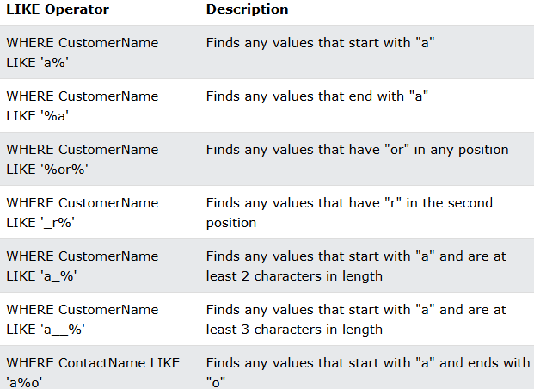
Basic Queries – LIKE operator

Slide 39
Using Database
To get started on your own database, first check which databases currently exists.
Use command “ show databases;” to find out. ( try it now)
To create new DB -> use:
mysql > create database som;
To select database from list of db’s -> use:
mysql > use som;
To list all tables -> use:
mysql > show tables;
To see info about specific table - > use ( if table name = students)
mysql > describe students;

Slide 40
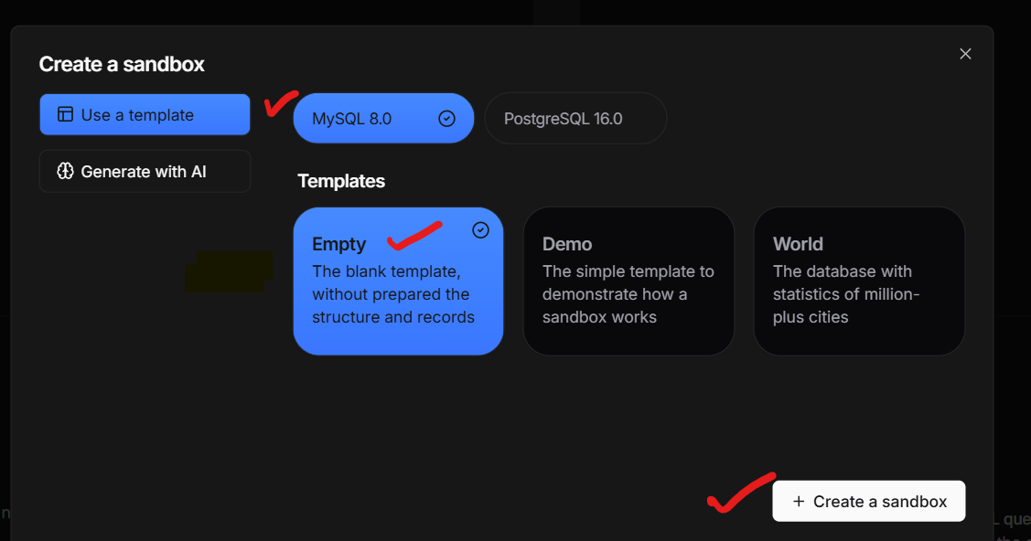
Time to go practice
Copy schema from this website: world.sql
Link: https://github.com/tejas-2232/isc_mysql_workshop
Paste it in sql playground app – sqlplayground.app ( Select Create SandBox Option)

Slide 41
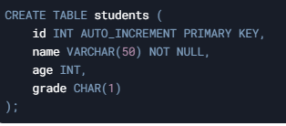

CRUD operations
Create table:
Syntax:
CREATE TABLE table_name ( column1 datatype, column2 datatype, .... );
Insert Data(Create):
Syntax:
INSERT INTO table_name (column1, column2, ...) VALUES (value1, value2, ...);

Slide 42


CRUD operations
Read Data:
Syntax:
Select * from table_name ;
Update Data(Update):
Syntax:
UPDATE table_name SET column1 = value1, column2 = value2, ... WHERE condition;
Note: Be careful when updating records. If you omit the WHERE clause, ALL records will be updated!

Slide 43

CRUD operations
Delete Data(Delete)
Syntax:
DELETE FROM table_name WHERE condition;

Slide 44
Example
Step 1 – Create table
Table name – products
Columns: product_id,
product name, price, quantity
Command: Create table products…
Notes:
CREATE TABLE products (
product_id INT AUTO_INCREMENT PRIMARY KEY,
product_name VARCHAR(100) NOT NULL,
price DECIMAL(10, 2) NOT NULL,
quantity INT DEFAULT 0
);

Slide 45
Example(cont.)
Step2: Insert data
Values: Insert into table_name ( column names) VALUES ( _ , _ ,_), ( _ , _ ,_), ( _ , _ ,_);
product_name | price | quantity
Laptop | 999.99 | 40
Smartphone | 499.99 | 30
Tablet | 699.99 | 50
Notes:
INSERT INTO products (product_name, price, quantity)
VALUES ('Laptop', 999.99, 40),
('Smartphone', 499.99, 30),
('Tablet’, 699.99, 50);

Slide 46
Example(cont.)
Step 3: read data
Retrieve all products:
Retrieve products with price greater than 500; ( > symbol can be used)
Notes:
SELECT * FROM products;
SELECT * FROM products WHERE price > 500;

Slide 47
Example(cont.)
Step 3: Update data
Update price of smartphone to 450.00
Update price of Laptop to 850.00
Notes:
UPDATE products SET price = 450.00 WHERE product_name = 'Smartphone';

Slide 48
Example(cont.)
Step 3: Delete data
Delete tablet from the table
Notes:
UPDATE products SET price = 450.00 WHERE product_name = 'Smartphone';

Slide 49
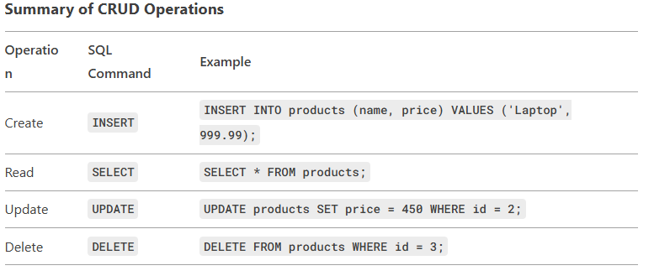
Summary of CRUD

Slide 50
Exercise for you (1)
Open the github link and use world.sql schema
Describe all the information from tables
cities , countries, country_languages
Show all records from each tables
Select cities with population greater than 2 million
Select countries in Asia
Select official language of Japan
Select cities ordered by population in descending order
Select countries ordered by surface area in ascending order
Select languages in Australia ordered by percentage in desc order
Notes:
Describe cities; describe countries;
Select * from cities; ----
Select * from countries where population > 2000000;
SELECT * FROM countries WHERE continent = 'Asia’;
SELECT * FROM country_languages WHERE country_code = ‘JPN' AND is_official = 'T’;
SELECT * FROM cities ORDER BY population DESC;
SELECT * FROM countries ORDER BY surface_area ASC;
SELECT * FROM country_languages WHERE country_code = 'AUS' ORDER BY percentage DESC;

Slide 51
Exercise for you (2)
Like Queries:
Select cities with names starting with B
Select countries with names containing “land”
Select languages with names ending with ‘I’
Between:
Select cities with population between 1 million and 2 million
Select countries with surface area between 500000 and 1000000
Select languages with percentage between 10.0 and 50.0
Notes:
Like:
SELECT * FROM cities WHERE name LIKE 'B%’;
SELECT * FROM countries WHERE name LIKE '%land%’;
SELECT * FROM country_languages WHERE language LIKE '%i';
Between
SELECT * FROM cities WHERE population BETWEEN 1000000 AND 2000000;
SELECT * FROM countries WHERE surface_area BETWEEN 500000 AND 1000000;
SELECT * FROM country_languages WHERE percentage BETWEEN 10.0 AND 50.0;

Slide 52
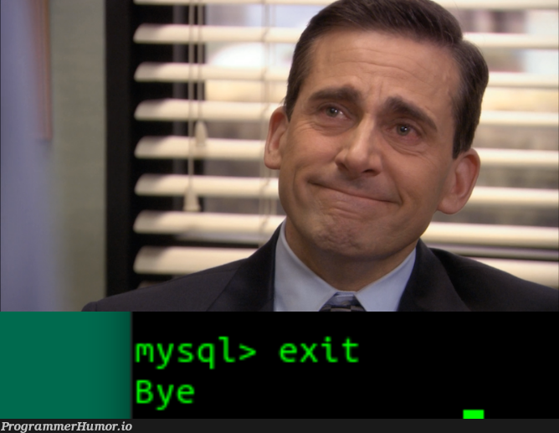
Thank You

Slide 53


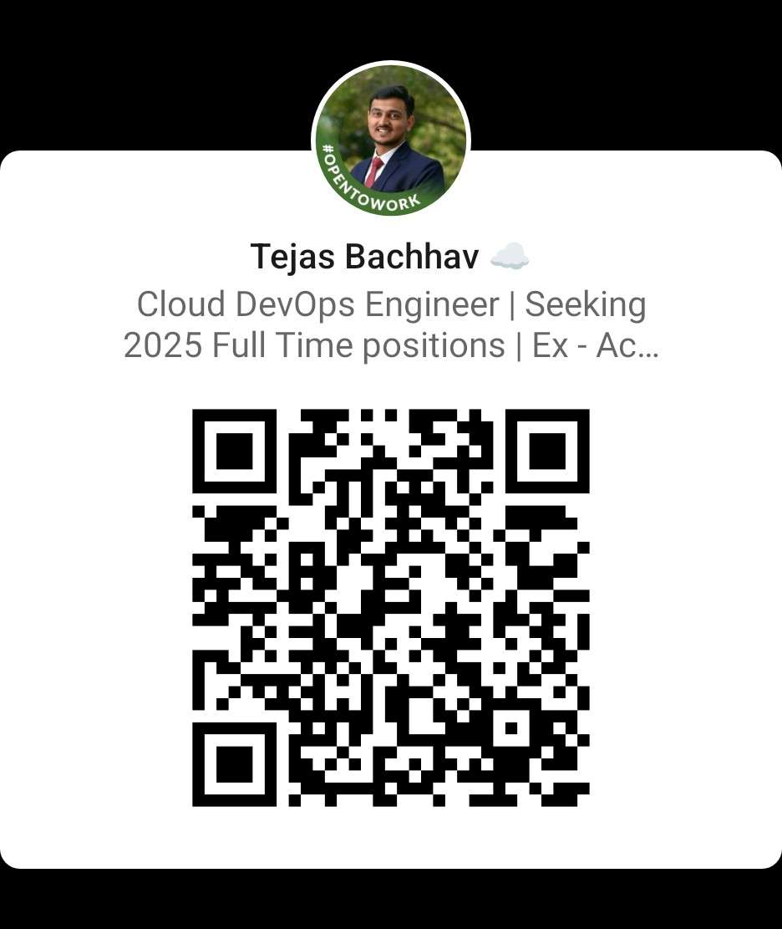
Find us LinkedIn
ISC: https://www.linkedin.com/company/binghamton-information-systems-club/

