Slide 1
Some Basics of Programming

Slide 2
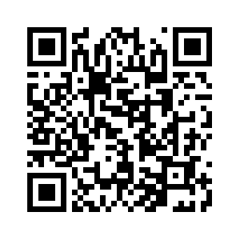
Scan QR code for attendance

Slide 3

Creative Commons Attribution 3.0 License
Copyright 2010- Charles Severance
These slides are a derivative work based on the original slides, “Python for Informatics : Exploring Information”, created by Charles Severance. The original slides are located at www.pythonlearn.com
This modified set of slides was done by John Alexander (2013).
The primary purpose of this derivative work is to make the highest quality Python courseware available to instructors so that they can teach Python, and insure that the slides are properly formatted for easy, out-of-the-box, use by both Microsoft PowerPoint and OpenOffice Impress.
Unless otherwise noted, the content of this course material is licensed under a Creative Commons Attribution 3.0 License (The “BY” variant of the license)
http://creativecommons.org/licenses/by/3.0/.

Slide 4
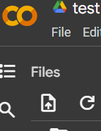
Setting up Python
You can download Python at no charge from www.python.org
Note: Make sure you install the latest version of Python 2.x. (Do NOT install Python 3.x). This course was designed using Python 2.x and some of the examples will not work properly if you use Python 3.x.
Alternative: Use Google Colab

Slide 5
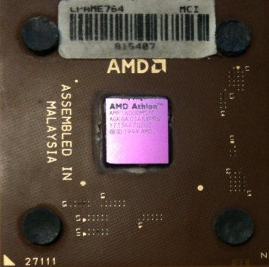





Computers want to be helpful...
Computers are built for one purpose - to do things for us
But we need to speak their language to describe what we want done
Users have it easy - someone already put many different programs (instructions) into the computer and users just pick the ones we want to use
What
Next?
What
Next?
What
Next?
What
Next?
What
Next?
What
Next?

Slide 6
Users .vs. Programmers
Users see computers as a set of tools - word processor, spreadsheet, maps, to-do list, email, etc.
Programmers learn the computer “ways” and the computer language
Programmers have some tools that allow them to build new tools
Programmers sometimes write tools for lots of users and sometimes programmers write little “helpers” for themselves to automate a task

Slide 7
Why be a programmer?
To get some task done(send auto emails) - we are the user and programmer
Help analyze and process data (many programs have APIs)
To produce something for others to use – write programs
Fix an issue with a program

Slide 8
What is Code? Software? A Program?
A sequence of stored instructions
  It is a little piece of our intelligence in the computer
  It is a little piece of our intelligence we can give to others - we figure something out and then we encode it and then give it to someone else to save them the time and energy of figuring it out
A piece of creative art - particularly when we do a good job on user experience

Slide 9
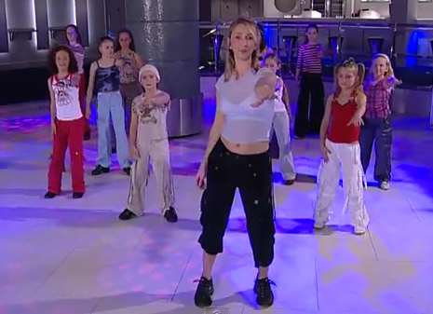
while music is playing:
    Left hand out and up
    Right hand out and up
    Flip Left hand
    Flip Right hand
    Left hand to right shoulder
    Right hand to left shoulder
    Left hand to back of head
    Right hand to back of head
    Left hand to right hit
    Right hand to left hit
    Left hand on left bottom
    Right hand on right bottom
    Wiggle
    Wiggle
    Jump
Programs for Humans...

Slide 10
Program for a Computer (counting words)
name = raw_input('Enter file:')
handle = open(name, 'r')
text = handle.read()
words = text.split()
counts = dict()
for word in words:
counts[word] = counts.get(word,0) + 1
bigcount = Nonebigword = None
for word,count in counts.items():
if bigcount is None or count > bigcount:
bigword = word
bigcount = countprint bigword, bigcount

Slide 11
Hardware Architecture

Slide 12
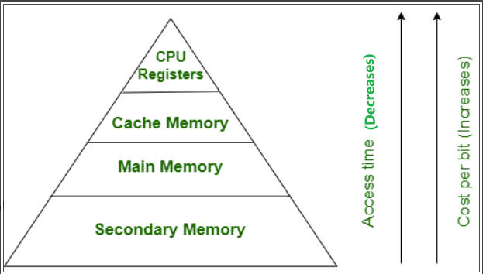
Generic
Computer
Computer
Input
and Output
Devices
Central
Processing
Unit
Secondary
Memory
(Hard disks – 250gb)
Main
Memory
(RAM - 2/4gb)

Slide 13
Definitions
Central Processing Unit: Runs the Program - The CPU is
always wondering “what to do next”? Not the brains
exactly – not smart but very very fast
Input Devices: Keyboard, Mouse, Touch Screen
Output Devices: Screen, Speakers, Printer, DVD Burner
Main Memory: Fast small temporary storage - lost on reboot - aka Random Access Memory (RAM)
Secondary Memory: Slower large permanent storage - lasts until deleted - disk drive / memory stick

Slide 14
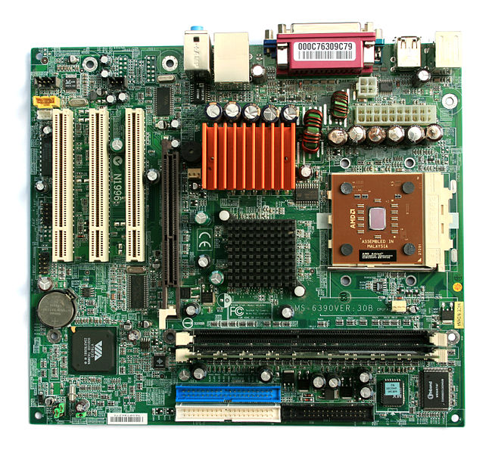
Motherboard
Source: http://commons.Wikimedia.org

Slide 15
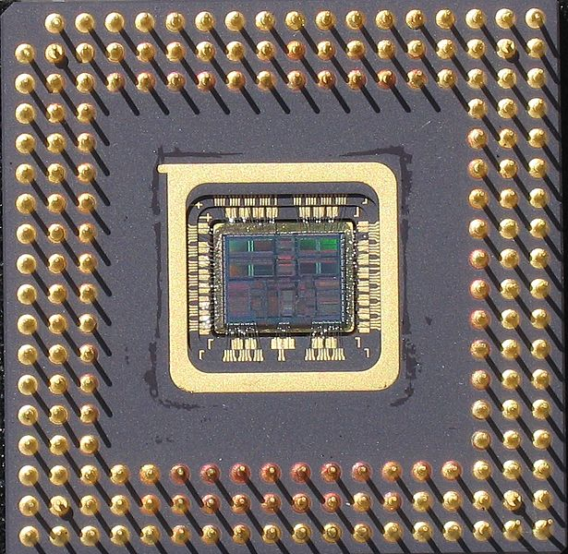
Central Processing Unit (CPU)
Source: http://commons.Wikimedia.org

Slide 16
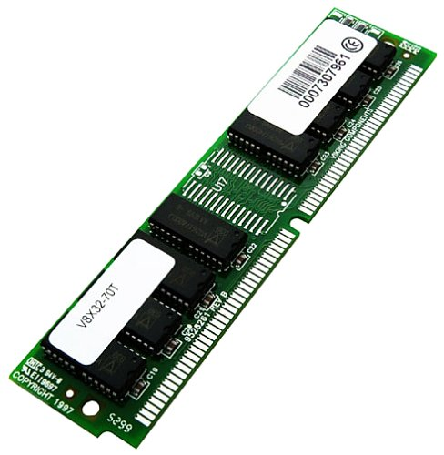
Memory (RAM)
Source: http://commons.wikimedia.org

Slide 17
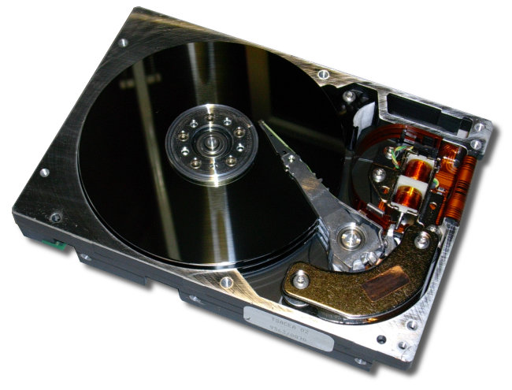
Hard Drive
Source: http://commons.Wikimedia.org

Slide 18
Python as a Language

Slide 19
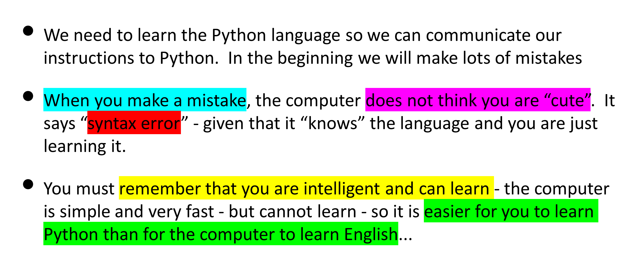
Python: A Computer Language

Slide 20
Talking to Python : The Interpreter

Slide 21
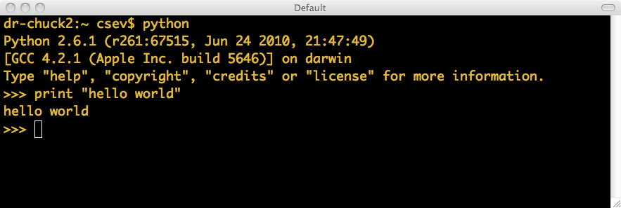
The Prompt ...

Slide 22
Elements of Python
Vocabulary / Words - Variables and Reserved words (Chapter 2)
Sentence structure - valid syntax patterns (Chapters 3-5)
Story structure - constructing a program for a purpose

Slide 23
Reserved Words
You can not use reserved words as variable names / identifiers
and del for is raise assert elif from lambda
return break else global not try class except
if or while continue exec import
pass yield def ﬁnally in print

Slide 24
Statements
x = 2
x = x + 2
print x
Assignment Statement
Assignment with expression
Print statement
Variable
Operator
Constant
Reserved Word

Slide 25
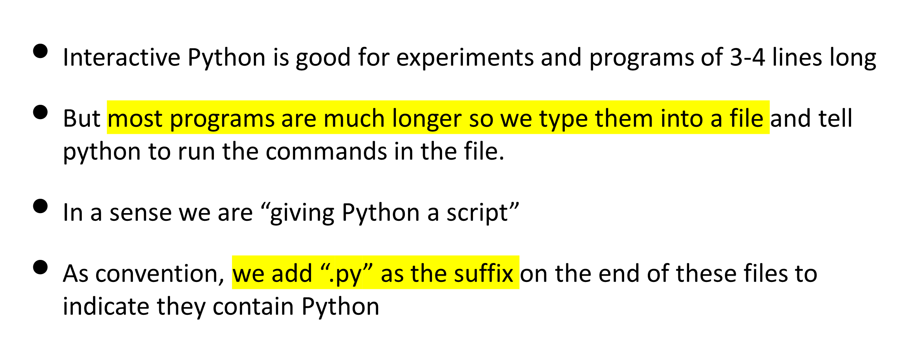
Python Scripts

Slide 26
Interactive vs. Script
Interactive
  - You type directly to Python one line at a time and it responds
Script
  - You enter a sequence of statements (lines) into a file using a text editor and tell Python to execute the statements in the file

Slide 27
Program Steps and Program Flow
Like a recipe or installation instructions, a program is a sequence of steps to be done in sequence
Some steps are conditional
Sometimes a step or group of steps are to be repeated
Sometimes we store a set of steps to be used over and over as needed several places throughout the program

Slide 28
Sequential Steps
x = 1
x = 1
print x
x = x + 1
print x
print x
x = x + 1
print x
When a program is running, it flows from one step to the next. We as programmers set up “paths” for the program to follow.

Slide 29
Conditional Steps
x = 5
X < 10 ?
Yes
print 'Smaller'
X > 20 ?
Yes
print 'Bigger'
print 'Finis'

Slide 30
Repeated Steps
n = 5
No
n > 0 ?
Yes
Program:
n = 5
while n > 0 :
print n
n = n – 1
print 'Blastoff!'
print n
n = n -1
print 'Blastoff'
Loops (repeated steps) have iteration variables that change each time through a loop. Often these iteration variables go through a sequence of numbers.

Slide 31
Stored (and reused) Steps
Program:
def hello():
print 'Hello'
print 'Fun'
hello()
print 'Zip‘
hello()
def
hello():
print 'Hello'
Output:
Hello
Fun
Zip
Hello
Fun
print 'Fun'
hello()
print 'Zip'
hello()
We call these reusable pieces of code “functions”.
Chapter 4

Slide 32
Summary
This is a quick overview of Chapter 1
We will revisit these concepts throughout the course
Focus on the big picture

