Slide 1

Reading Files

Slide 2
Creative Commons Attribution 3.0 License
Copyright 2010- Charles Severance
These slides are a derivative work based on the original slides, “Python for Informatics : Exploring Information”, created by Charles Severance. The original slides are located at www.pythonlearn.com
This modified set of slides was done by John Alexander (2013).
The primary purpose of this derivative work is to make the highest quality Python courseware available to instructors so that they can teach Python, and insure that the slides are properly formatted for easy, out-of-the-box, use by both Microsoft PowerPoint and OpenOffice Impress.
Unless otherwise noted, the content of this course material is licensed under a Creative Commons Attribution 3.0 License (The “BY” variant of the license)
http://creativecommons.org/licenses/by/3.0/.

Slide 3

Software
Input
and Output
Devices
Central
Processing
Unit
Files
Secondary
Memory
Main
Memory

Slide 4
File Processing
A text file can be thought of as a sequence of lines
From stephen.marquard@uct.ac.za Sat Jan 5 09:14:16 2008
Return-Path: <postmaster@collab.sakaiproject.org>
Date: Sat, 5 Jan 2008 09:12:18 -0500To: source@collab.sakaiproject.orgFrom: stephen.marquard@uct.ac.zaSubject: [sakai] svn commit: r39772 - content/branches/Details: http://source.sakaiproject.org/viewsvn/?view=rev&rev=39772

Slide 5
Opening a File
Before we can read the contents of the file we must tell Python which file we are going to work with and what we will be doing with the file
This is done with the open() function
open() returns a “file handle” - a variable used to perform operations on the file
Kind of like “File -> Open” in a Word Processor

Slide 6
Using open()
handle = open(filename, mode)
returns a handle use to manipulate the file
filename is a string
mode is optional and should be 'r' if we are planning reading the file and 'w' if we are going to write to the file.
fhand = open('mbox.txt', 'r')
http://docs.python.org/lib/built-in-funcs.html

Slide 7
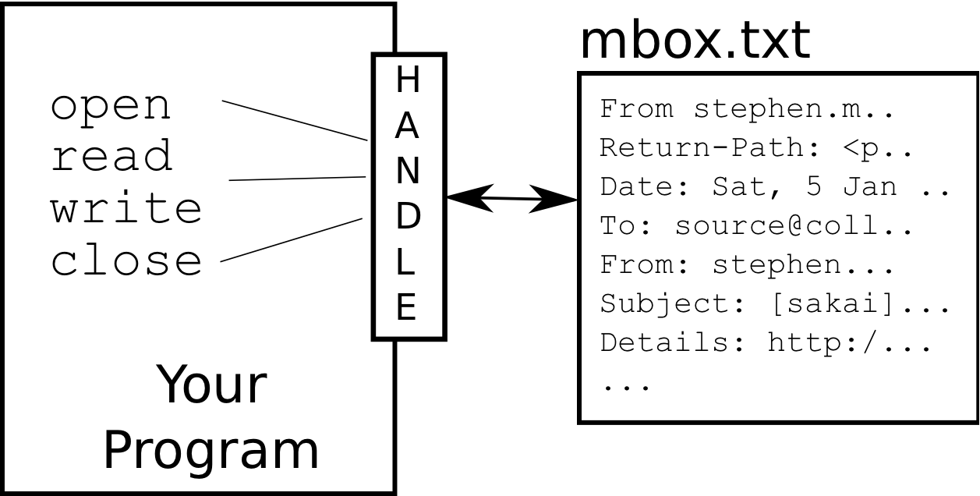
What is a File Handle?
>>> fhand = open('mbox.txt')
>>> print fhand
<open file 'mbox.txt', mode 'r' at 0x1005088b0>

Slide 8
When Files are Missing
>>> fhand = open('stuff.txt')
Traceback (most recent call last): File "<stdin>", line 1, in <module>
IOError: [Errno 2] No such file or directory: 'stuff.txt'

Slide 9
The newline
Character
>>> stuff = 'Hello\nWorld!'
>>> print stuff
Hello
World!
>>> stuff = 'X\nY'
>>> print stuff
X
Y
>>> len(stuff)
3
We use a special character to indicate when a line ends called the "newline"
We represent it as \n in strings
Newline is still one character - not two

Slide 10
File Processing
A text file can be thought of as a sequence of lines
From stephen.marquard@uct.ac.za Sat Jan 5 09:14:16 2008
Return-Path: <postmaster@collab.sakaiproject.org>
Date: Sat, 5 Jan 2008 09:12:18 -0500To: source@collab.sakaiproject.orgFrom: stephen.marquard@uct.ac.zaSubject: [sakai] svn commit: r39772 - content/branches/Details: http://source.sakaiproject.org/viewsvn/?view=rev&rev=39772

Slide 11
File Processing
A text file has newlines at the end of each line
From stephen.marquard@uct.ac.za Sat Jan 5 09:14:16 2008\n
Return-Path: <postmaster@collab.sakaiproject.org>\n
Date: Sat, 5 Jan 2008 09:12:18 -0500\nTo: source@collab.sakaiproject.org\nFrom: stephen.marquard@uct.ac.za\nSubject: [sakai] svn commit: r39772 - content/branches/\nDetails: http://source.sakaiproject.org/viewsvn/?view=rev&rev=39772\n

Slide 12
File Handle as a Sequence
A file handle open for read can be treated as a sequence of strings where each line in the file is a string in the sequence
We can use the for statement to iterate through a sequence
Remember - a sequence is an ordered set
xfile = open('mbox.txt')
for cheese in xfile:
print cheese

Slide 13
Counting Lines in a File
Open a file read-only
Use a for loop to read each line
Count the lines and print out the number of lines
fhand = open('mbox.txt')
count = 0
for line in fhand:
count = count + 1
print 'Line Count:', count
Line Count: 132045

Slide 14
Searching Through a File
We can put an if statement in our for loop to only print lines that meet some criteria
fhand = open('mbox-short.txt')
for line in fhand:
if line.startswith('From:') :
print line

Slide 15
Prompt for File Name
fname = raw_input('Enter the file name: ')
fhand = open(fname)
count = 0
for line in fhand:
if line.startswith('Subject:') :
count = count + 1
print 'There were', count, 'subject lines in', fname
Enter the file name: mbox.txt
There were 1797 subject lines in mbox.txt

Slide 16
End of Files

