Slide 1
SQL PROJECT -
PROPERTY LISTING ANALYSIS FOR PROPERTY RENTAL COMPANY
GROUP 18
Tejas Ingle
Lavesh Ranpise

Slide 2
Important Points
Analysis of property rental data for different trends on the basis on different metrics.
Crucial analysis for a property to be rented.
Insights from the analysis.

Slide 3
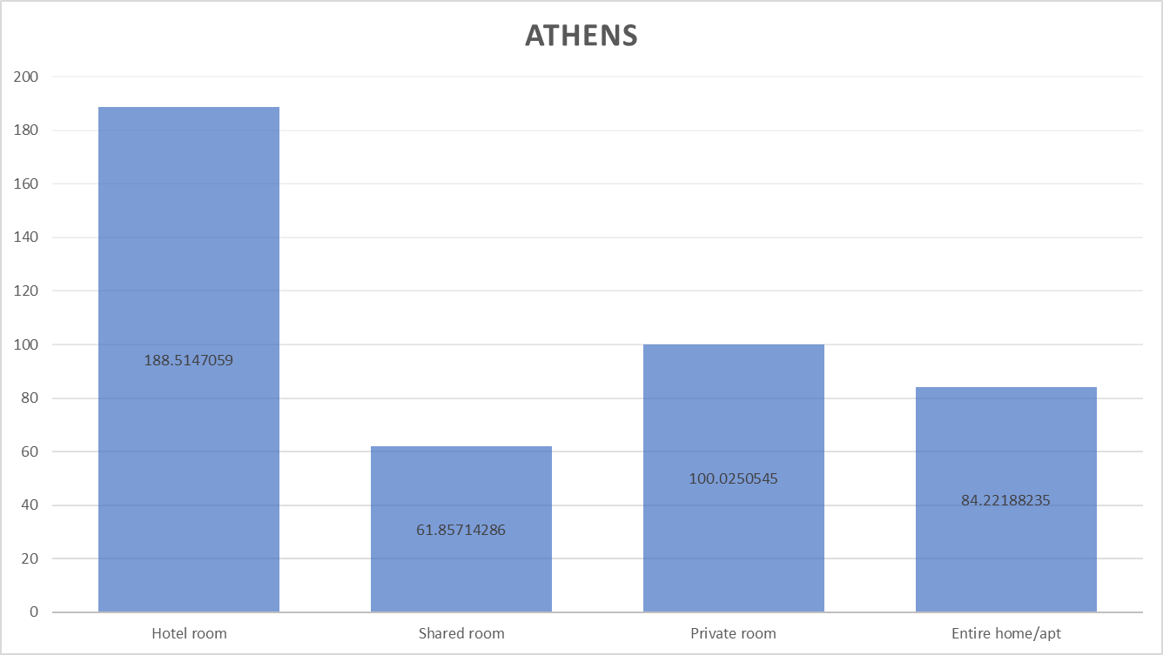
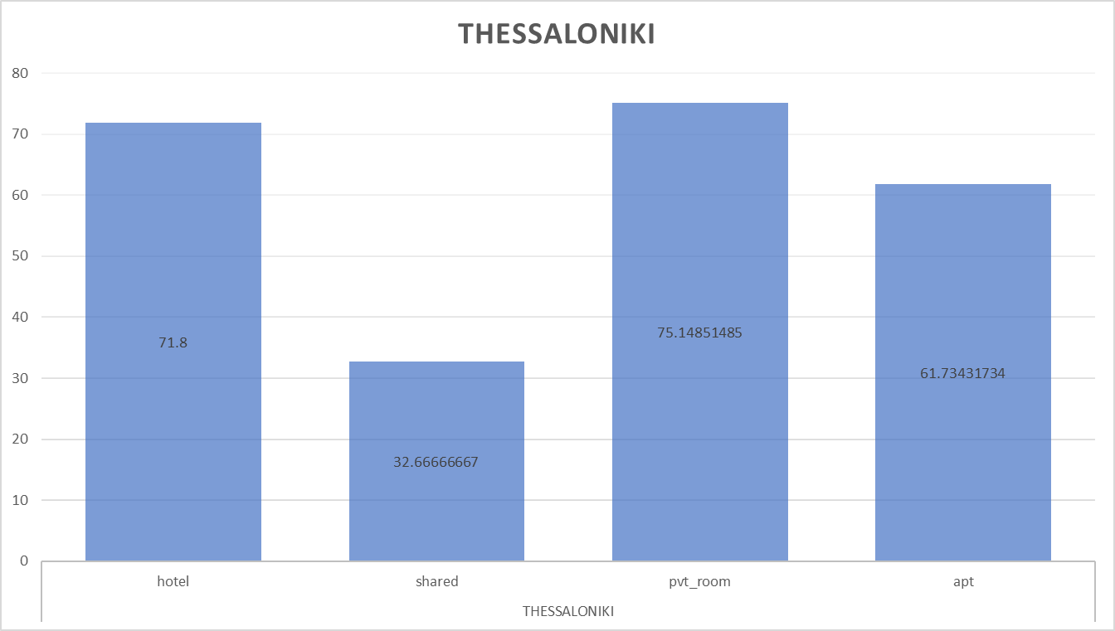
Average price comparison among different room-type
Shared accommodation is cheapest in both cities
Hotel is the costliest accommodation in athens whereas in thessaloniki its private room

Slide 4
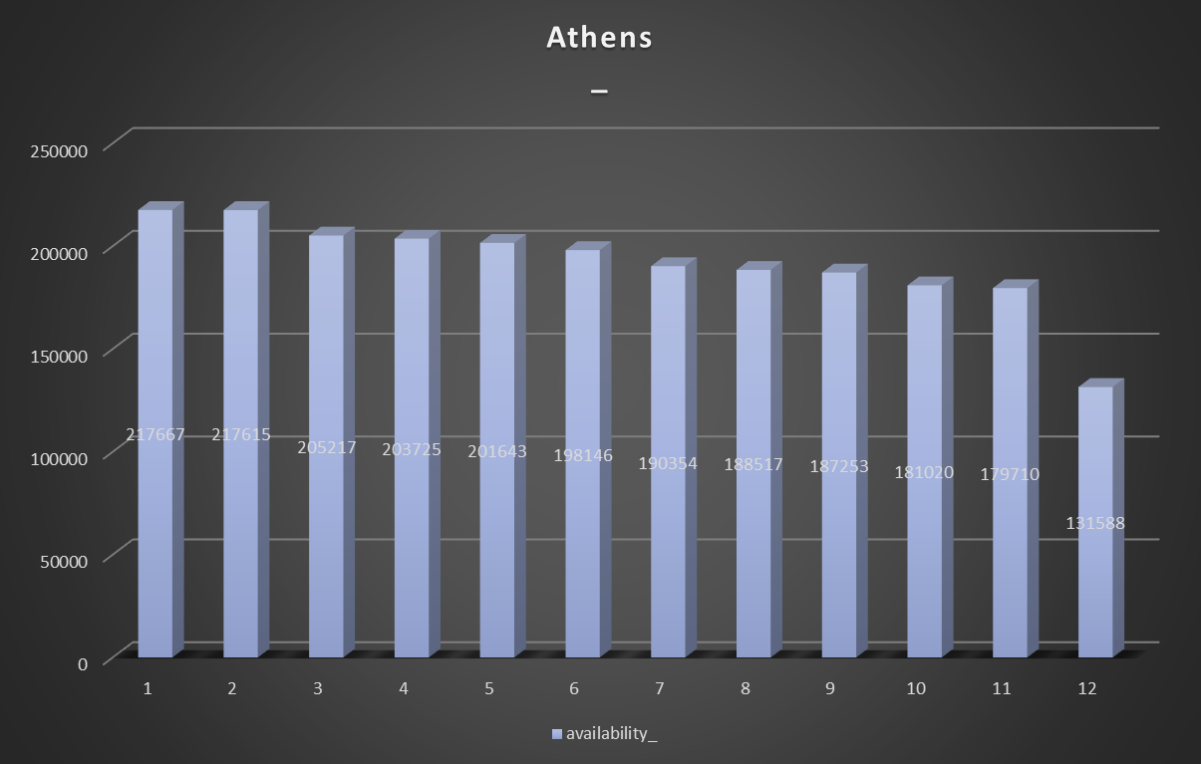
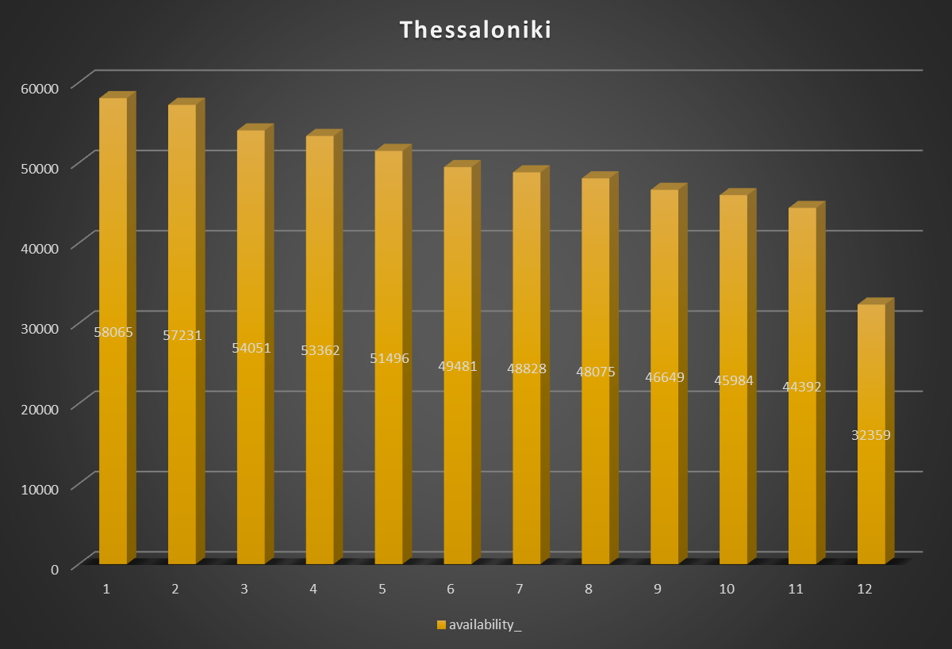
Total Vacancy rate across the months in both cities
Charts shows that there is trend of reduction in vacancy from june onwards
Highest vacancy is in january where as it is lowest in december in both cities

Slide 5
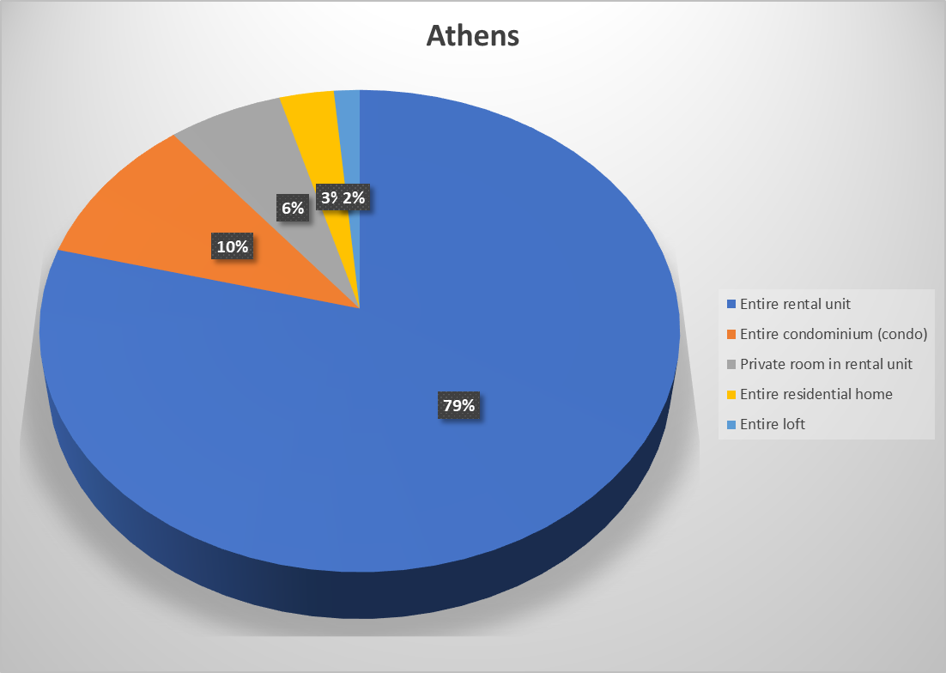
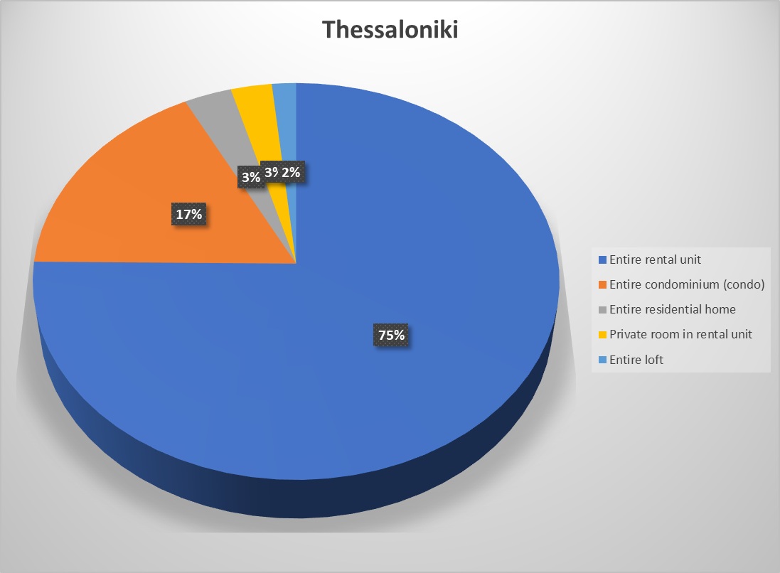
Top 5 preferred properties
The charts shows trend that entire rental unit has most preference by people across both cities
Entire condominium has 2nd priority
remaining properties has preferably low preference

Slide 6
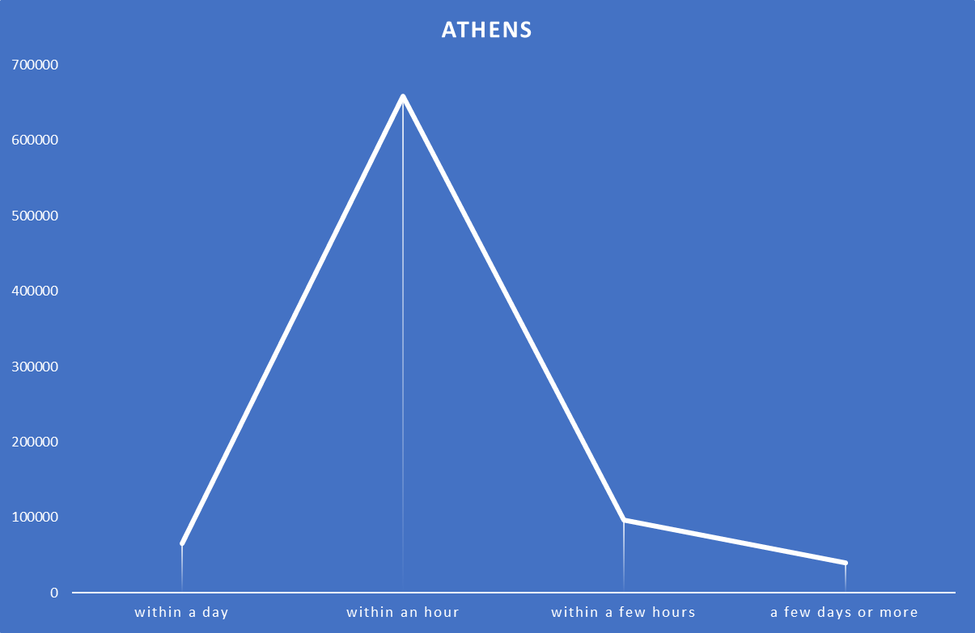
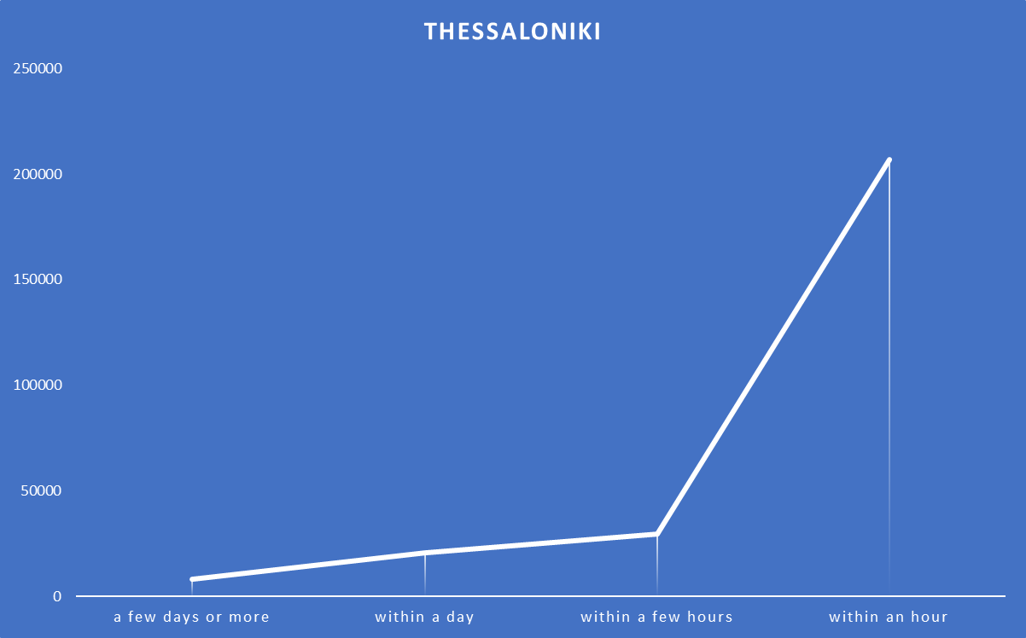
Relation between hosts reply and property being rented
The data clearly shows that speed of hosts reply if directly proportional to property going on rent
The hosts who reply within an hour has a very higher chances to rent their property whereas hosts taking more than a day to reply has lowest rate.

Slide 7
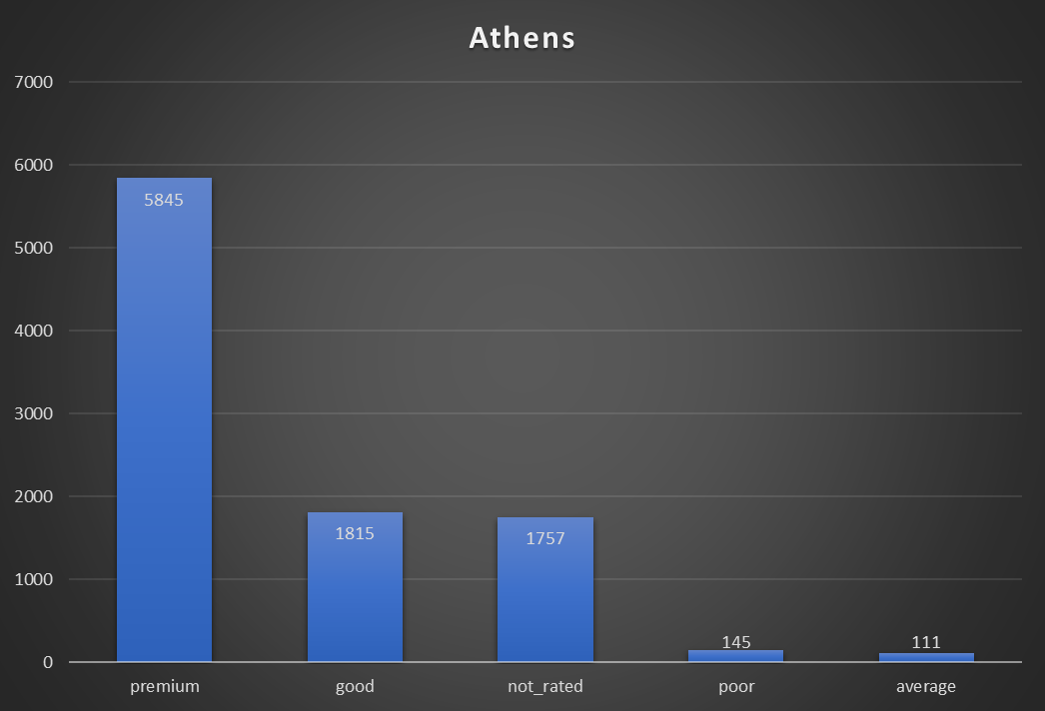
Total property categorization between various categories based on their ratings
So far most property listed on companies website have a premium high ratings.
A very low number of properties have low ratings.

Slide 8
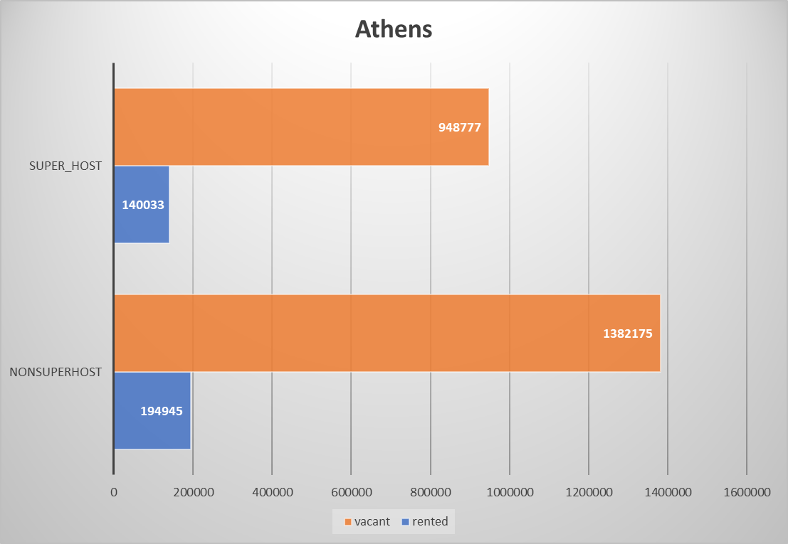
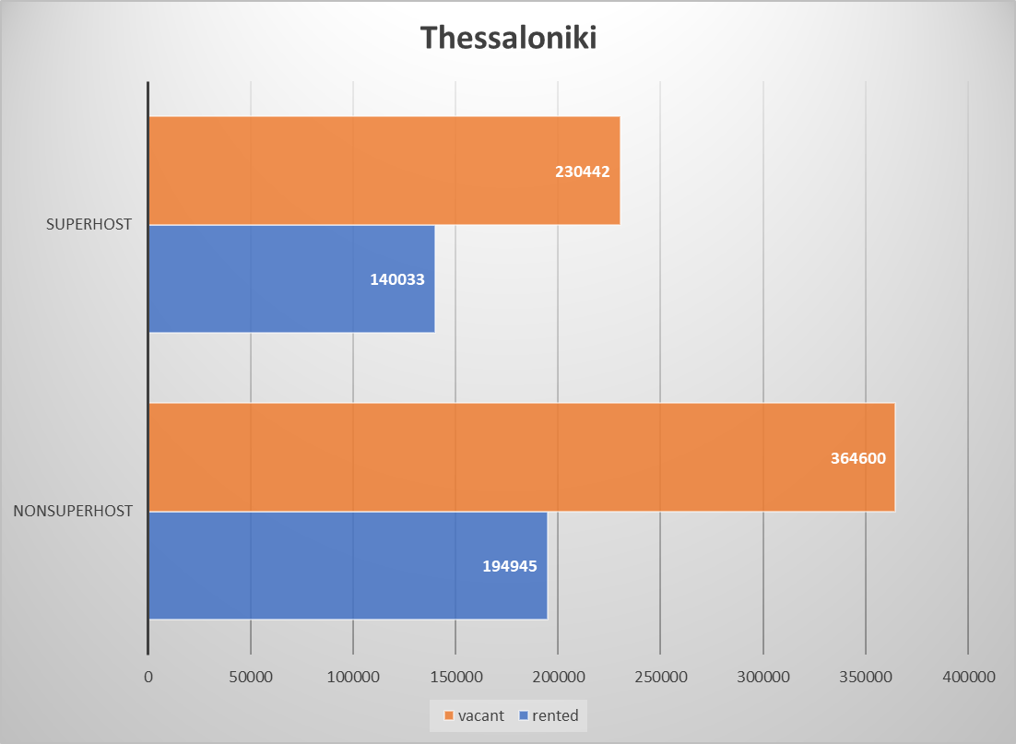
Success of superhost program
There is not any noticeable difference between number of rented property vs vacant property of superhosts and non superhosts.
The rate of rented properties and vacant properties is almost same across both cities

Slide 9
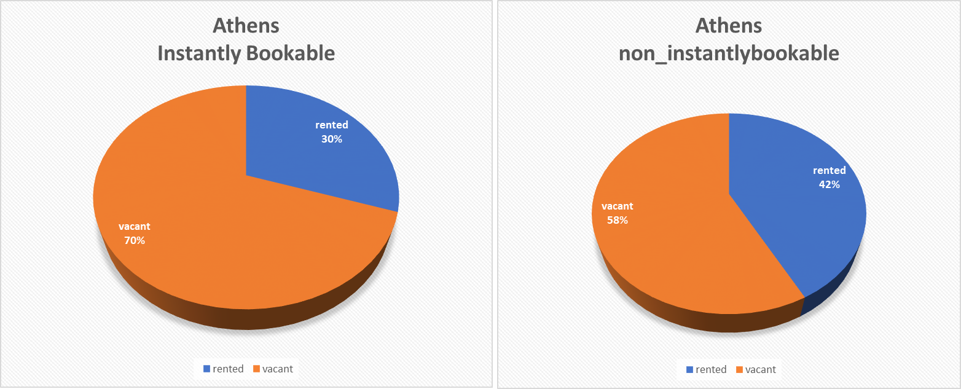
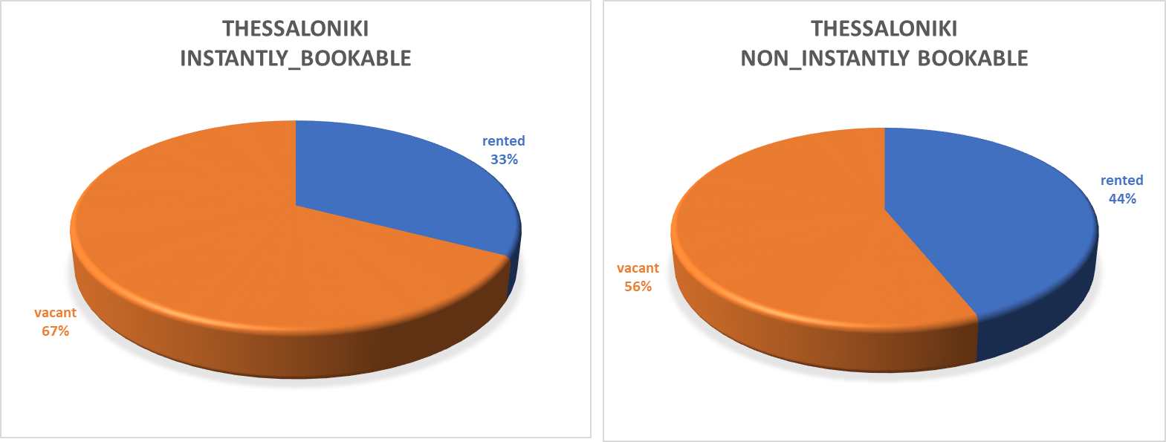
Comparing features instantly bookable with non instantly bookable
There is not any noticeable difference between data of both cities.
There is a trend showing non instantly bookable properties are being rented more frequently.

Slide 10
INSIGHTS
Shared accommodations are cheapest and hotel and private rooms are costliest.
There is trend of decreasing overall vacancy after month of june. There highest shortage of rental properties in december.
Entire rental units are most preferred type of properties.
Hosts replying within an hour have highest chance of their property going on rent. Whereas hosts with slower reply rate have lesser chance.
Most properties (too many) on company database are highly rated.
Superhost program does not have any noticeable advantage yet for the hosts.
Feature of instant booking has not proven to be useful to increase rate of renting properties

Slide 11
THANKYOU

