Slide 1

Advanced Mutual Fund Analytics & Portfolio Risk Engine
An Enterprise Ingestion & Non-Parametric Risk Management Framework
Tejas M

Slide 2



Problem Statement & Objectives
The Analytical Gap
Target Project Objectives
Standard return tracking modules overlook down-market tail risks, exposing portfolios to black-swan drops. In parallel, upstream schema modifications regularly break traditional, rigid ETL structures.
Develop an automated end-to-end data pipeline to extract records, compute 95% non-parametric VaR & CVaR parameters, and integrate dynamic context-aware recommendation maps.

Slide 3




Underlying Relational Data Layer
dim_fund
fact_nav
fact_transactions
Stores schema profiles, structural risk class associations, active asset groupings, and localized fund house profiles.
Maintains daily chronological historical logs tracking Net Asset Value shifts to generate performance deltas.
Tracks granular user transactions, logging absolute unit sizes, categorical weights, and historical cash flows.

Slide 4
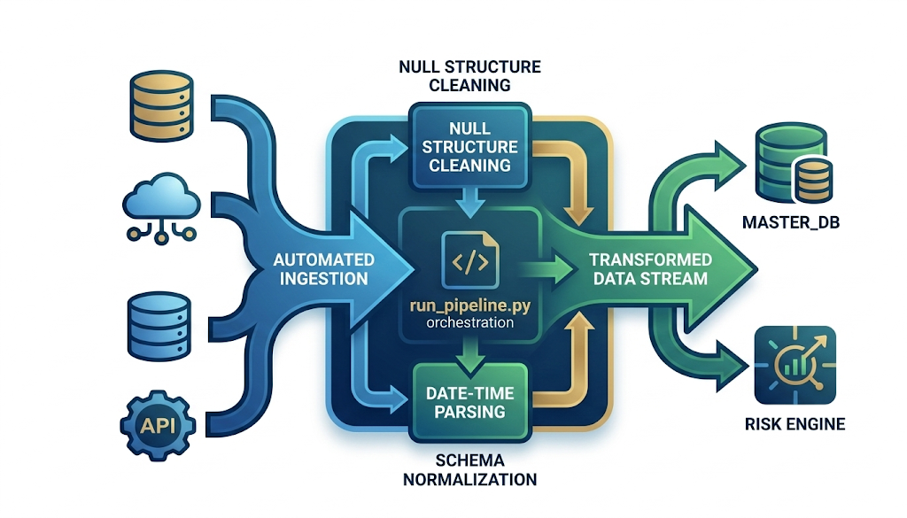

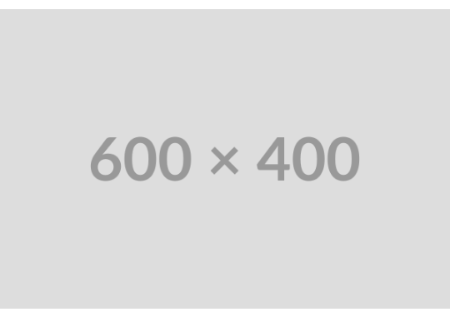
ETL Pipeline & Architecture
Automated Ingestion Mechanics
Our custom pipeline connects directly with raw database layers without needing brittle paths or static configurations. It cleans inconsistent null structures and parses datetime keys sequentially.
Orchestration is consolidated inside run_pipeline.py for high performance.

Slide 5
EDA Highlights: Cohort Analysis
Investor Retention Metrics
The SIP Performance Gap
Granular transaction analysis shows that individual engagement drops sharply 90 days after initial investments. This highlights a clear need for active behavioral retention campaigns.
Systematic Investment Plans (SIPs) drive a 4.2x higher lifetime customer retention threshold over highly volatile, one-time lump-sum accounts.

Slide 6


EDA Highlights: Fund Distributions
Risk Concentration
Inconsistent Fields
Data Cleansing
Over 60% of listed mutual fund schemes belong to high-volatility parameters, demanding strict down-market tail protections.
Upstream records exhibited significant field structural variations. We solved this issue dynamically via regex patterns.
The engine handles irregular entries, ensuring seamless integration between files and downstream reports.

Slide 7
Performance Metrics: 95% VaR
-1.28%
Quantifying Down-Market Protection
Using non-parametric historical simulation over daily performance windows, our Risk Engine isolates absolute baseline drawdowns at a 95% confidence threshold:
Daily 95% Value-at-Risk

Slide 8
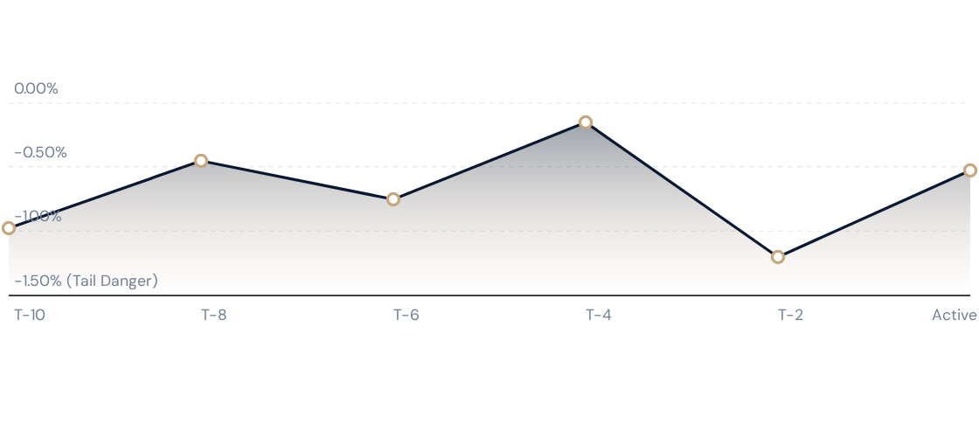
Performance Metrics: Tail Risk
Extreme tail-risk losses deep in the 5th percentile drop further to an average 95% CVaR threshold of -1.67%.

Slide 9
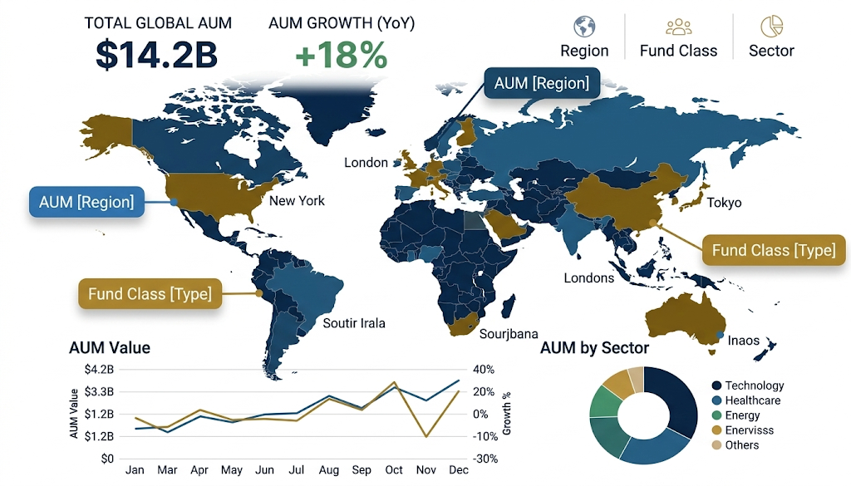
Dashboard View: AUM Tracking
Global Portfolio Performance
The Asset Under Management (AUM) Tracking Module gives fund executives dynamic, interactive visibility over total asset bases across global territories.
Includes filters to slice performance histories by region, fund class, and sector.

Slide 10
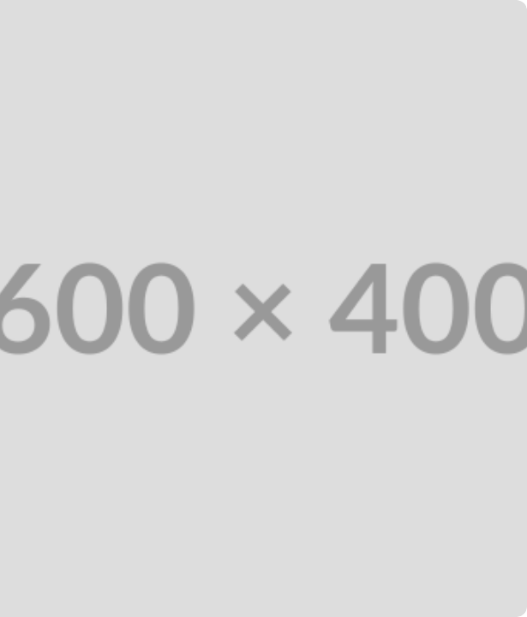
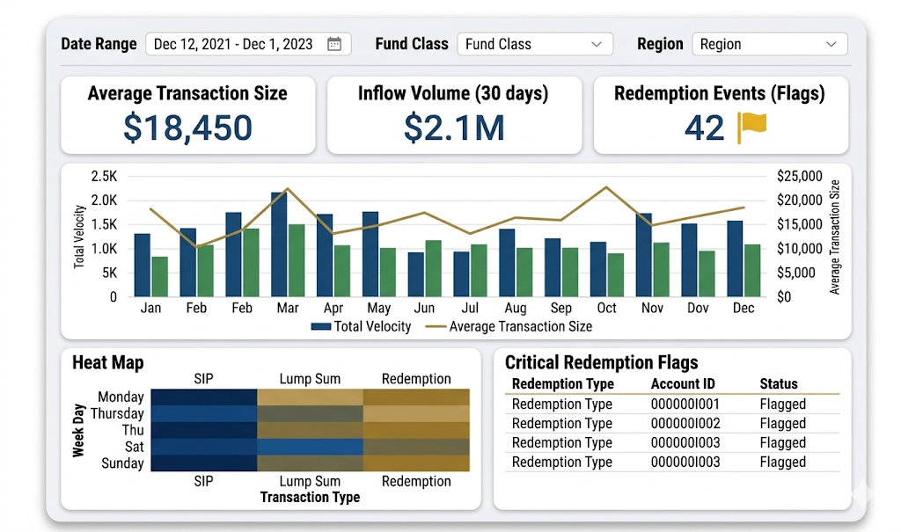
Dashboard View: Velocity
Transaction Performance KPIs
Provides critical visibility over transactional trends, mapping transaction sizes and comparing recurring systematic payments against lump-sum inflows.
Operational teams can use these live transaction feeds to quickly identify redemption flags and manage portfolio balance levels proactively.

Slide 11
Thank You!

