Slide 1

SMART INDIA HACKATHON 2026
TITLE PAGE
Problem Statement ID – SIH26261
Problem Statement Title- AI-Powered Application Validation, Document Authentication and Regulatory Compliance Verification
Theme- Smart Automation
PS Category- Software
Team ID – 198810
Team Name- AnomalyX

Slide 2

PROPOSED SOLUTION
Team AnomalyX
PRAMAAN-X | AICTE EoA REGULATORY SCRUTINY
Problem: Multi-document EoA dossiers can hide missing evidence, cross-campus conflicts and hard-to-verify records.
WHY SCRUTINY IS HARD
4-STEP PRAMAAN-X EVIDENCE PIPELINE
KEY DIFFERENTIATORS
Missing / expired
01
02
03
04
REGULATION-AS-CODE
Mandatory files or dates may be incomplete.
YAML + JSON Schema; cohort-wide What-If simulation.
APP + CHECKLIST
›
PDF FIELD EXTRACTION
›
APH RULES + GRAPH
›
FORENSICS + ISSUER
Record conflicts
5 statutory PDFs
EoA dossier
PyMuPDF + regex
PDF box evidence
12 APH rules
+ NetworkX twin
ELA / pHash / QR
+ mock issuer
IMPOSSIBILITY GRAPH
Faculty, land or facility claims may conflict.
Ghost faculty, land overlap and temporal impossibilities.
Image alteration / reuse
VALIDATION STATUS
FORENSICS
ELA • copy-move • pHash
(Hamming ≤10)
VERIFIED
MISMATCH
EXPIRED
PENDING
SOURCE UNAVAILABLE
MANUAL REVIEW
ELA / pHash / copy-move; QR decode + PDF signature checks.
Source verification gaps
EVIDENCE-LINKED FINDING
TAMPER-EVIDENT RECEIPTS
Issuer records are simulated; no live APIs.
APH clause • PDF box • expected/found • source status
Ed25519 signatures + SHA-256 Merkle chain + DB triggers.
USP: Explainable evidence + impossibility engine + cryptographic receipts. Officer-led; no auto-rejection.

Slide 3



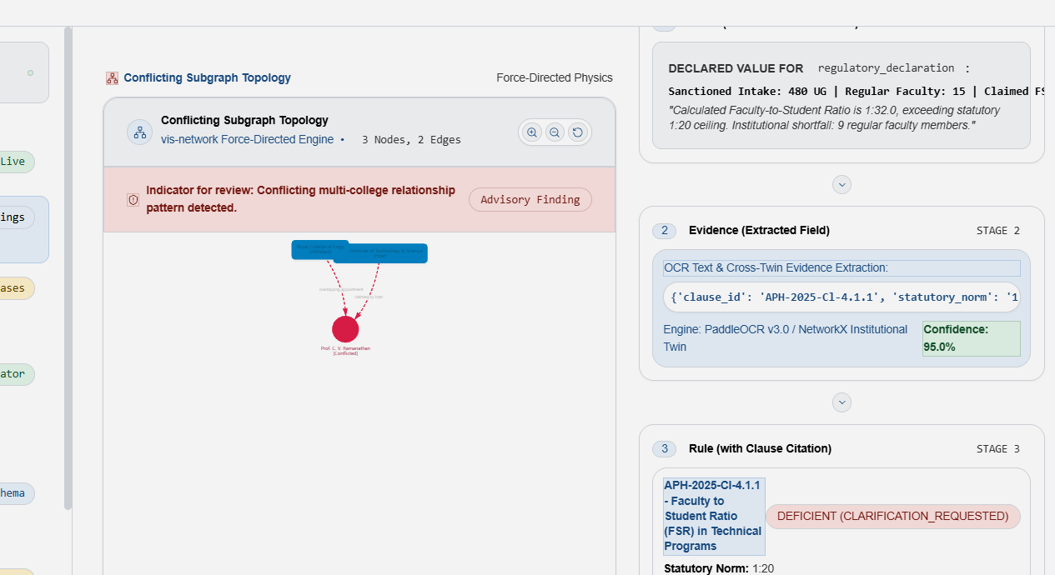
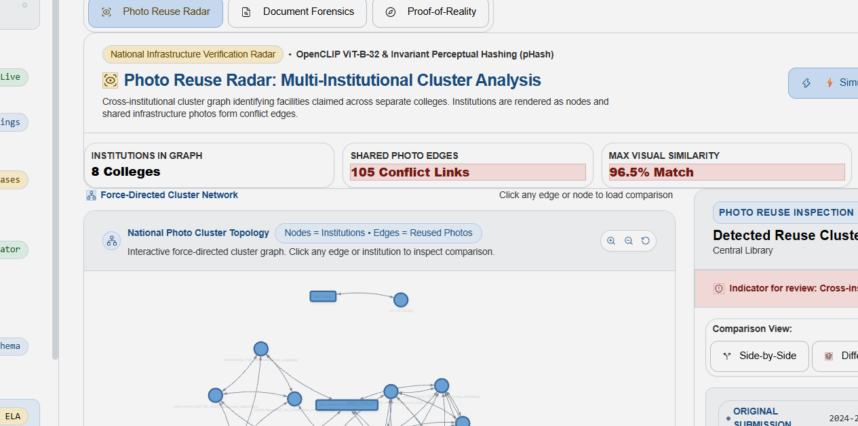
TECHNICAL APPROACH
Team AnomalyX
6 CORE MODULES • SYSTEM ARCHITECTURE • SECURITY CONTROLS
3-LAYER TECHNOLOGY STACK
SYSTEM ARCHITECTURE • REACT + VITE → FASTAPI (REST / JSON) • JWT / RBAC / TENANT ISOLATION
UI / FRONTEND
1
2
3
4
5
6
React 19 • Vite 8 • Tailwind CSS
CHECKLIST
PDF EXTRACTION
REGULATION-AS-CODE
IMPOSSIBILITY GRAPH
FORENSICS
VERIFICATION LEDGER
›
›
›
›
›
API + PDF PARSING
EoA + five statutory PDFs
PyMuPDF + regex
field boxes
12 YAML rules + What-If
Ghost faculty / land / time
ELA • copy-move • pHash
QR • PDF ByteRange
Ed25519 receipt • SHA-256 chain
FastAPI 0.115.6 • JWT • RBAC
DATA + RULES
DATA: SQLite / PostgreSQL • YAML + JSON Schema • NetworkX twin • append-only DB triggers
SQLite / PostgreSQL • YAML • NetworkX
DEMO • 3 SERVICES
https://pramaan-frontend.onrender.com
https://pramaan-backend-y3bl.onrender.com
https://pramaan-mock-issuer.onrender.com
EVIDENCE LENS | Claim → PDF box → Rule → Registry status → Officer action
Evidence Lens — Determination View
Photo Reuse Radar
BUILT & TESTED • 85 API endpoints • 11 views • 5 RBAC roles • tenant isolation • 12 APH rules • 20 defect types • 182 tests

Slide 4
FEASIBILITY AND VIABILITY
Team AnomalyX
FEASIBILITY CHECK
KEY RISKS & MITIGATIONS
CAPABILITY
MVP APPROACH
CONTROL / FALLBACK
CHALLENGE 1 • OCR QUALITY & APPROXIMATE SIGNALS
Document AI
PyMuPDF + RapidOCR
Digital PDF text layer; scan OCR; low-confidence → manual review
APH rules
YAML + schema + dry-run
12 YAML rules + JSON Schema + What-If
RISK RapidOCR handles scans/images; degraded or handwritten pages need review. OpenCLIP similarity and X.509 trust-chain checks are prototype-level; core pHash / ELA / QR checks are fully implemented.
Graph / forensics
NetworkX • ELA • 64-bit pHash
ELA • pHash • copy-move • QR; X.509 trust-chain stub.
MITIGATION
Issuer checks
Fire / land / NBA / affiliation mock issuers
510 mock records; API Setu / DigiLocker not integrated.
✓ Route low-confidence or degraded files to manual review.
✓ Separate real pHash / ELA / QR checks from simulated vector scores.
RESOURCE & OPERATIONAL VIABILITY
RESOURCE
MVP PLAN
VIABILITY GUARDRAIL
CHALLENGE 2 • AUTHORITY ACCESS & STATUTORY PARAMETERS
Test data
Synthetic: 100 institutions / 500 PDFs
No production PII • 5 mock roles
RISK 510 issuer records are synthetic; 12 APH parameters await gazetted sign-off.
Deployment
Local launcher working; Docker Compose config validated (container runtime test pending)
SQLite / PostgreSQL • Docker path
MITIGATION
Rule updates
Versioned YAML rule packs
APH sign-off before deployment
✓ Connect live gateways only after approval.
✓ Mask PAN/Aadhaar; enforce RBAC, tenant isolation and access logs.
✓ Require officer reasons for adverse actions; no auto-rejection.
Test evidence
182 regression tests passed • 0 failed
15 test files • 182 regression tests
COST & SCALE Open-source • Python 3.12 • React 19 • SQLite / PostgreSQL
ROADMAP APH sign-off → authorized pilot → live issuer APIs → multilingual OCR → national rollout with HSM-backed keys.

Slide 5
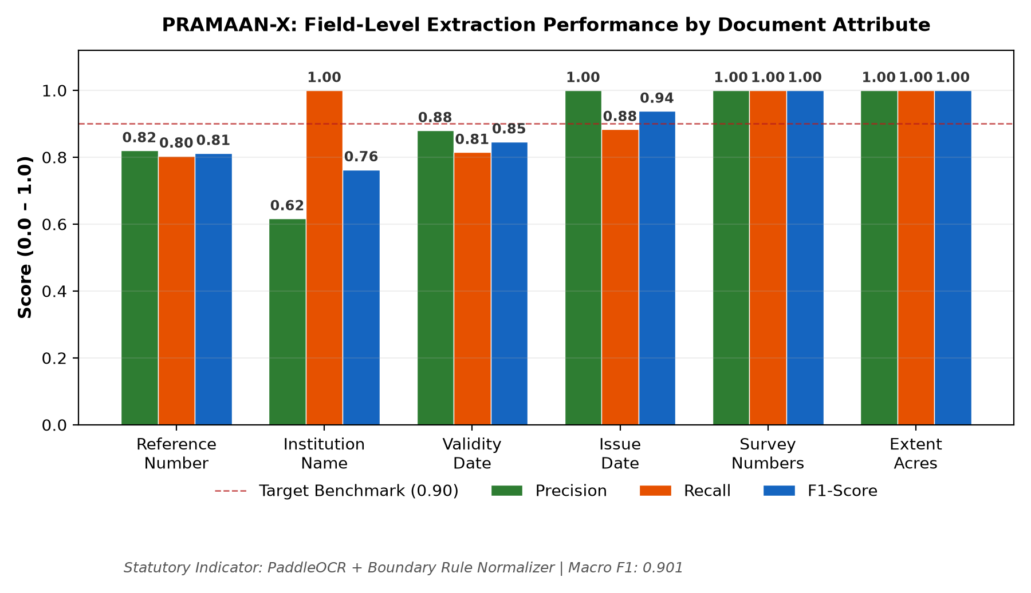
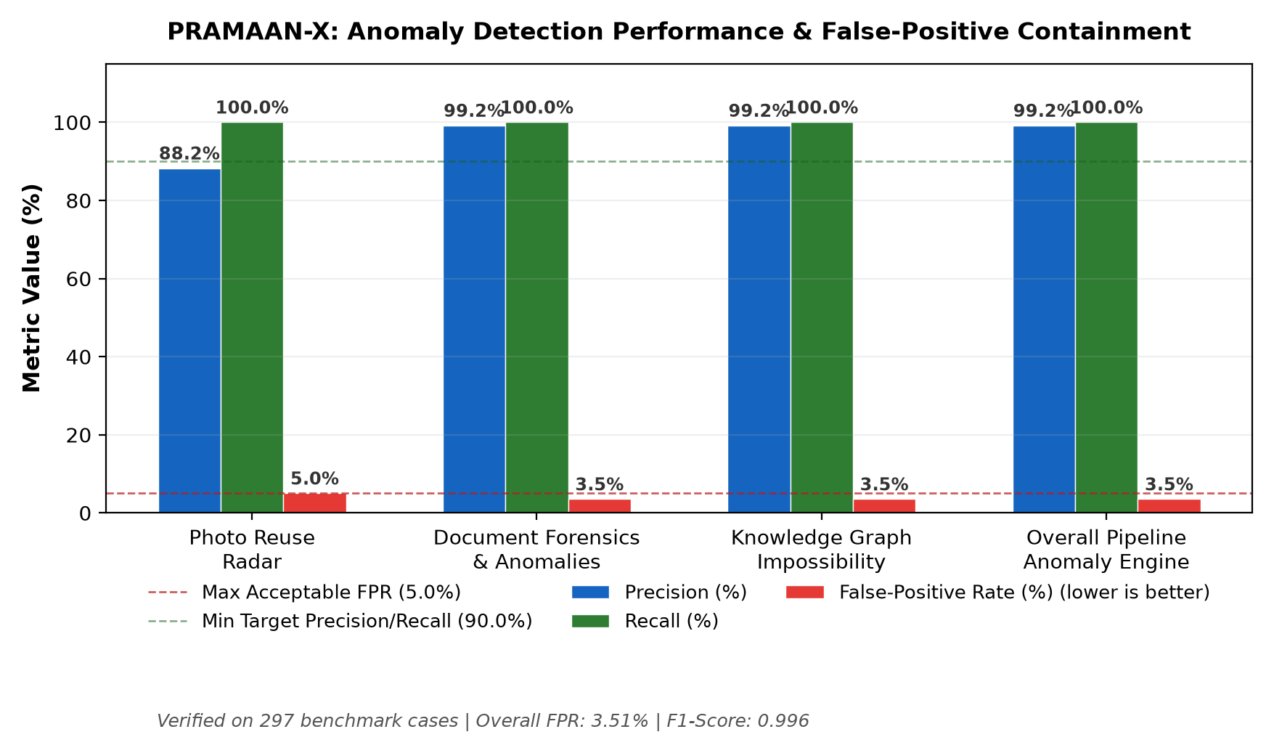
IMPACT AND BENEFITS
Team AnomalyX
HELD-OUT SYNTHETIC BENCHMARK • 100 INSTITUTIONS • 500 DOCUMENTS • NOT FIELD ACCURACY
POTENTIAL IMPACT ON TARGET AUDIENCE
BENEFITS OF THE SOLUTION
• AICTE officers — use risk-ranked queues and evidence-linked flags.
• Explainability — link claim → PDF box → rule → source response.
• Institutions — use the Pre-Flight scorecard and corrective hints.
• Consistency — prototype covers 20 planted defect categories.
• Regional teams — prioritize inspections using geospatial risk signals.
• Auditability — cryptographic receipts and access logs support review.
• Students & public — benefit from consistent, auditable scrutiny.
• Governance — officer action and reasons required; no auto-rejection.
ANOMALY • HELD-OUT SEED 7
FIELD EXTRACTION • 6 FIELDS
PIPELINE + ALERT LATENCY
STATUTORY SAFETY / GOVERNANCE
240 / 240 planted detected • 0 missed
Macro F1 0.9013 • Micro F1 0.8596
2.03 s / dossier
Advisory only • no auto-rejection
P 0.9917 • R 1.0000 • F1 0.9959
TP 199 • FP 38 • FN 27
Alerts: 3.21 ms mean • 3.20 ms median
5 RBAC roles • tenant isolation • PII masking
FPR 3.51% • 2 false flags / 57 controls
Synthetic held-out benchmark only • authority gateways are simulated.
REPOSITORY BENCHMARK CHARTS • HELD-OUT SEED 7
Source: evidence_pack/metrics.json + defect_coverage.csv • synthetic held-out Seed 7 • authority gateways are simulated.

Slide 6
RESEARCH AND REFERENCES
Team AnomalyX
KEY REFERENCES • OFFICIAL GUIDANCE + PROJECT DOCUMENTATION
SOURCE
WHY IT MATTERS
PRAMAAN-X USE
SHORT DOMAIN / REPO
SCOPE / NOTE
AICTE APH 2025-26
Approval criteria
YAML rule packs
aicte-india.org
12 engineering placeholders pending gazetted sign-off.
API Setu
Government API platform
Local mock issuer; live API integration not done.
apisetu.gov.in
Live integration not implemented
DigiLocker issuer APIs
Issuer integration guidance
Planned connector target
digilocker.gov.in
Production APIs not connected; approval required.
PyMuPDF + RapidOCR
Digital PDF text + scan OCR
PyMuPDF text layer; RapidOCR for scans/images
pymupdf.readthedocs.io • github.com/RapidAI/RapidOCR
RapidOCR verified on dev; low-confidence cases route to manual review.
NetworkX
Graph analytics
NetworkX digital twin • cross-campus conflicts
networkx.org/docs
Cross-campus signals support officer review.
NIST AI RMF
AI risk governance
Explainability + oversight
nist.gov/AI-RMF
Human accountability • no automated statutory verdict
NIST CSF 2.0
Security guidance
Access / logs / retention
nist.gov/cyberframework
JWT / RBAC • tenant isolation • PII masking / access logs
PRAMAAN-X repository
Evaluation report + metrics
README + metrics + audit
github.com/tejas-coder28/sih-2.0
182 regression tests • synthetic data • 154-element audit report
Academic prototype • synthetic data • mock authority gateways (see slide 4 for full scope).

