Slide 1
Remote Patient Monitoring System
By Team Technocrats

Slide 2
Problems
Most of present health care system/services require people to be physically present even for a minor examination, which at time would be very difficult due to logistics and need to visit such facilities at a defined interval of time.
At times when patients only require single parameter monitoring they would have to go through all the formalities which would be very time consuming and tiring.
Sometimes patients may not get the required immediate attention due to variation in certain health parameter as they may underestimate the sense of emergency

Slide 3
Objectives
This monitoring system is targeted at elderly or ill patients who would like to avoid long and frequent hospital visits but may need periodic monitoring.
COVID patients who need contact less monitoring
Helps to avoid overcrowding at hospitals

Slide 4
Methodology
The RPMS involves monitoring of patients' vitals remotely by means of sensors. An application on mobile device shall collect data from sensors and transfer the recorded data to cloud, that can be accessed by the Doctors or Nurses to acknowledge remotely in case of a minor condition or get immediate attention in case of severe conditions.
Prediction of potential health issues based on patient's historical data and generic anonymous benchmark data, would lead to optimal utilisation of health care professional and care takers time, which otherwise would be difficult to keep monitoring continuously. This can be achieved using appropriate machine learning algorithms

Slide 5
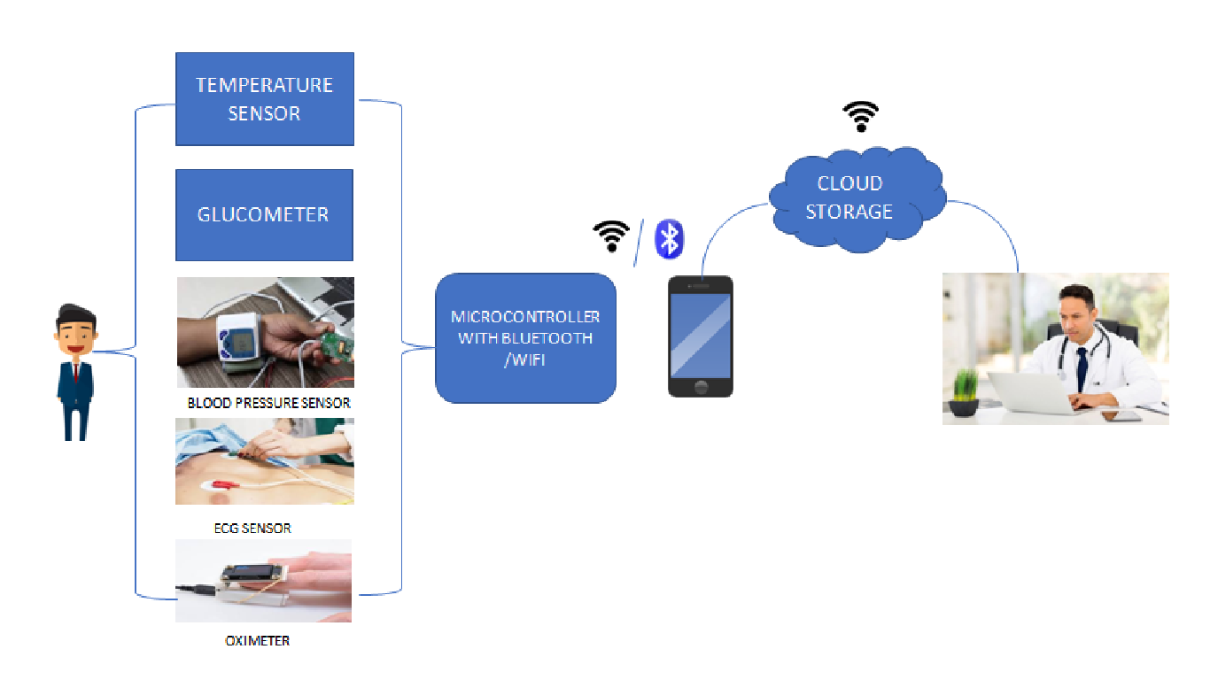
Pictorial representation

Slide 6
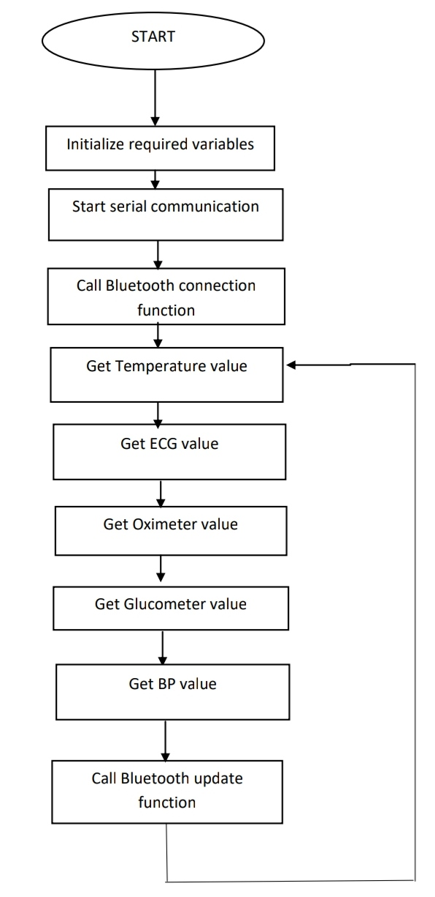
Flow chart representation

Slide 7
Justification
Many don't go for check-up due to several reasons
Afraid to go to hospitals
Transportation challenges
Some places don't have proper medical facilities
Unforeseen circumstances such as pandemics

Slide 8
Resources list
Sensors for capturing the vitals
Bluetooth & Wi-Fi enabled communication devices that will help to collect data using mobile application
Cloud Storage
Mobile Application
Website

Slide 9
Deliverables/Outcome
A compact and easy to access monitoring system which is feasible
Easy to use mobile application(Especially for senior citizens)
The obtained data can be used for further researches

Slide 10
Firebase and Firestore

Slide 11
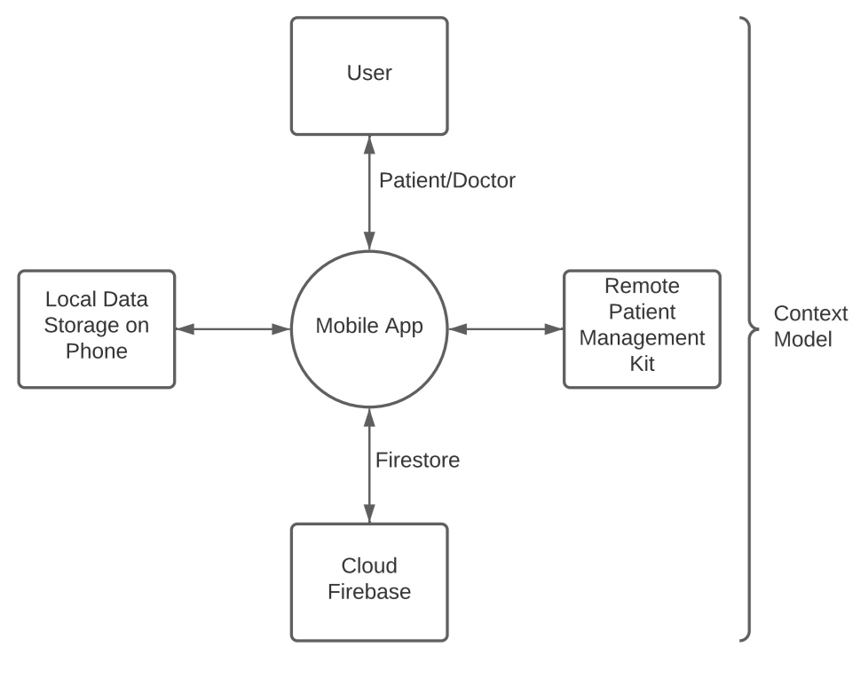
Context of our application

Slide 12

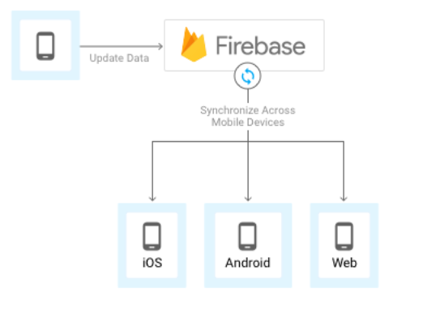
What is ?
Firebase is a fully managed platform for building iOS, Android, and web apps that provides automatic data synchronization, authentication services, messaging, file storage, analytics, and more.

Slide 13
Features
Realtime
Offline
Accessible from client devices
Scalable across multiple databases

Slide 14
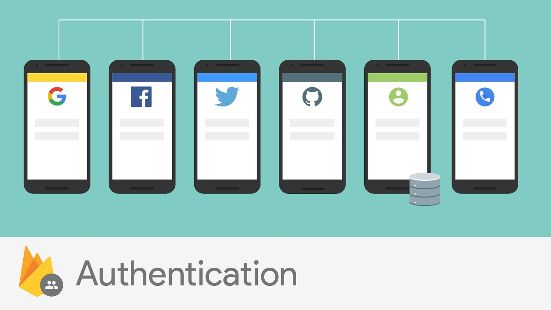
User Authentication
Most apps need to know the identity of a user. Knowing a user's identity allows an app to securely save user data in the cloud and provide the same personalized experience across all of the user's devices.
Firebase Authentication provides backend services, easy-to-use SDKs, and ready-made UI libraries to authenticate users to the app. It supports authentication using passwords, phone numbers, popular federated identity providers like Google, Facebook and Twitter, and more.

Slide 15
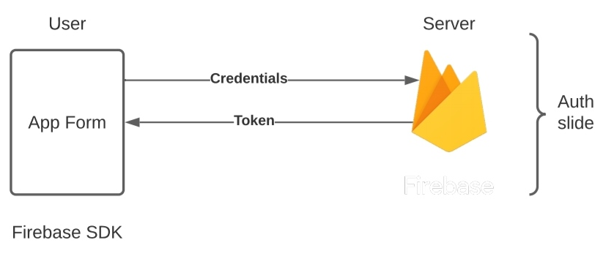
Working of user authentication
To sign a user into the app, first get authentication credentials from the user. These credentials can be the user's email address and password, or an OAuth token from a federated identity provider. Then, pass these credentials to the Firebase Authentication SDK. The backend services will then verify those credentials and return a response to the client.
After a successful sign in, one can access the user's basic profile information, and can control the user's access to data stored in other Firebase products. They can also use the provided authentication token to verify the identity of users in their own backend services.

Slide 16
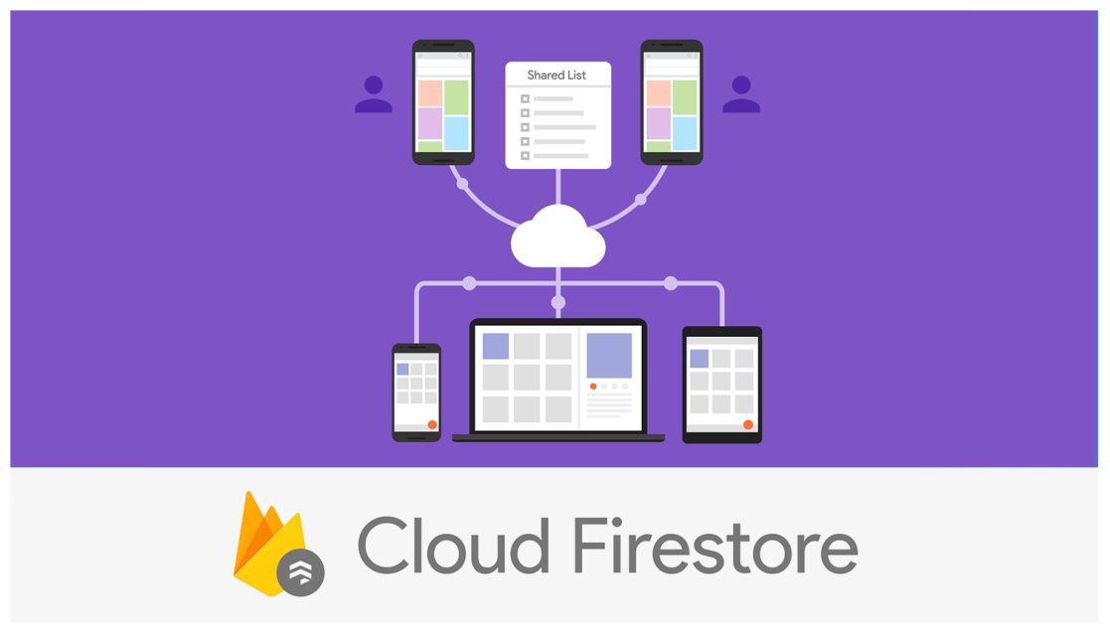
Cloud Firestore
Cloud Firestore is a flexible, scalable database for mobile, web, and server development from Firebase and Google Cloud Platform. Like Firebase Realtime Database, it keeps the data in sync across client apps through Realtime listeners and offers offline support for mobile and web which enables building of responsive apps that work regardless of network latency or Internet connectivity. Cloud Firestore also offers seamless integration with other Firebase and Google Cloud Platform products, including Cloud Functions.

Slide 17
Features of Firestore
Flexibility
Expressive querying
Realtime updates
Offline support
Designed to scale

Slide 18
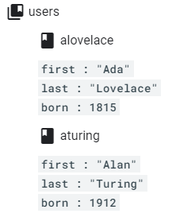
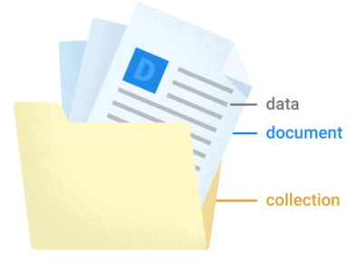
Working
Cloud Firestore is a cloud-hosted, NoSQL database that iOS, Android, and web apps can access directly via native SDKs.
Following Cloud Firestore's NoSQL data model, you store data in documents that contain fields mapping to values. These documents are stored in collections, which are containers for your documents that you can use to organize your data and build queries. Documents support many different data types, from simple strings and numbers, to complex, nested objects. You can also create sub collections within documents and build hierarchical data structures that scale as the database grows

Slide 19
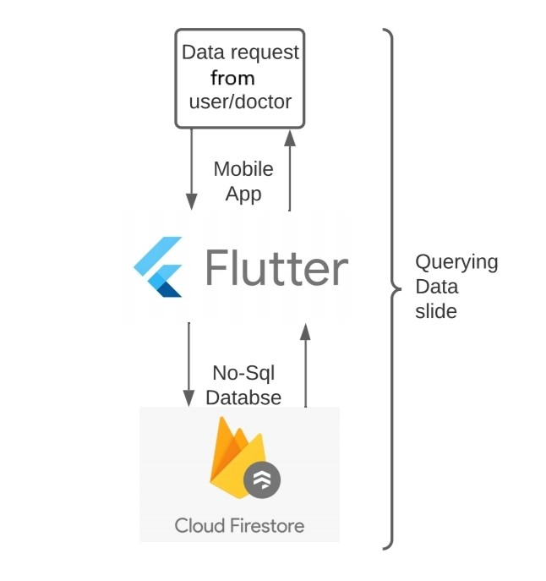
Data Querying
There are two ways to retrieve data stored in Cloud Firestore. Either of these
methods can be used with documents, collections of documents, or the results of
queries:
Call a method to get the data.
Set a listener to receive data-change events.
When a listener is set, Cloud Firestore sends the
listener an initial snapshot of the
data, and then another snapshot
each time the document changes.

Slide 20
Security Rules
Cloud Firestore offers robust access management and authentication through two different methods, depending on the client libraries used.
For mobile and web client libraries, use Firebase Authentication and Cloud Firestore Security Rules to handle serverless authentication, authorization, and data validation.
For server client libraries, use Identity and Access Management (IAM) to manage access to your database.
Firebase Security Rules stand between the data and malicious users. One can write simple or complex rules that protect app's data to the level of granularity that the specific app requires.

Slide 21
Security Rules
Cloud Firestore offers robust access management and authentication through two different methods, depending on the client libraries used.
For mobile and web client libraries, use Firebase Authentication and Cloud Firestore Security Rules to handle serverless authentication, authorization, and data validation.
For server client libraries, use Identity and Access Management (IAM) to manage access to your database.
Firebase Security Rules stand between the data and malicious users. One can write simple or complex rules that protect app's data to the level of granularity that the specific app requires.

Slide 22
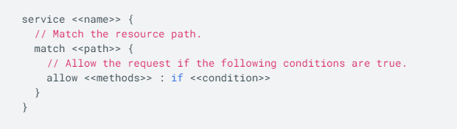
Working
Firebase Security Rules work by matching a pattern against database paths, and then applying custom conditions to allow access to data at those paths. All Rules across Firebase products have a path-matching component and a conditional statement allowing read or write access. One must define Rules for each Firebase product is used in the app.
For Cloud Firestore, Rules use the following syntax:

Slide 23
Pros and Cons
Application can be shared across multiple clients
Queries with limited sorting and filtering functionality can be performed. Cloud firestore assures automatic scaling and can handle 1 million concurrent connections and 10,000 writes/second.
Helps in the easy storing and retrieval of dynamic content.
It offers integration to Google Ads, AdMob, the Play Store, Data Studio. Analytics, crashing reports are also provided by the firebase so that the development teams can stay focused on enhancing the user experience.
Firebase for android app development completely relies on a flat hierarchy of nested data. Relational queries cannot be dealt with ease using firebase.
Difficult to perform complex querying.
Data migration in the application becomes difficult with firebase since it is not like the general SQL database or the object-relational mapping.
Security rules are limited in firebase that makes it very difficult in building enterprise platforms over them.

Slide 24
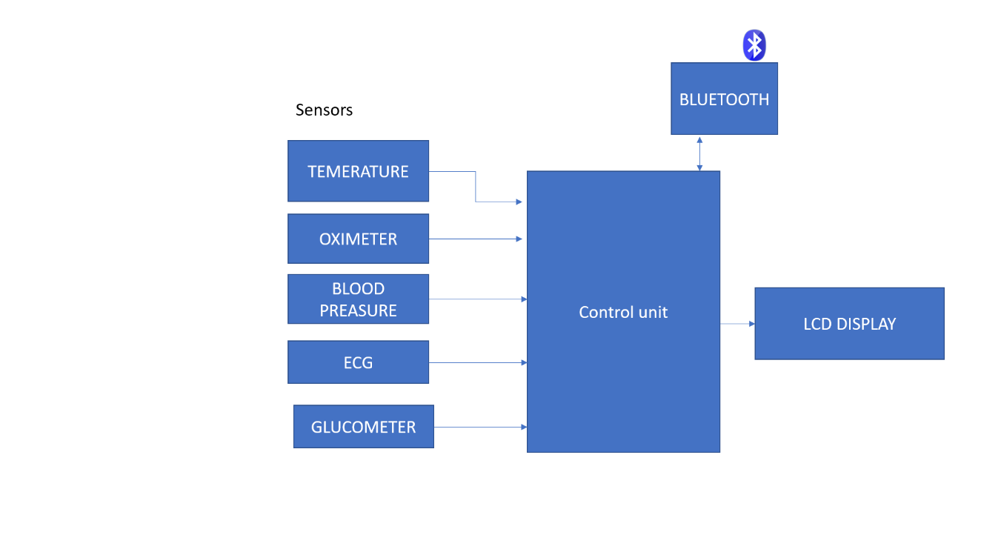
Software block diagram :

Slide 25
Sensors

Slide 26
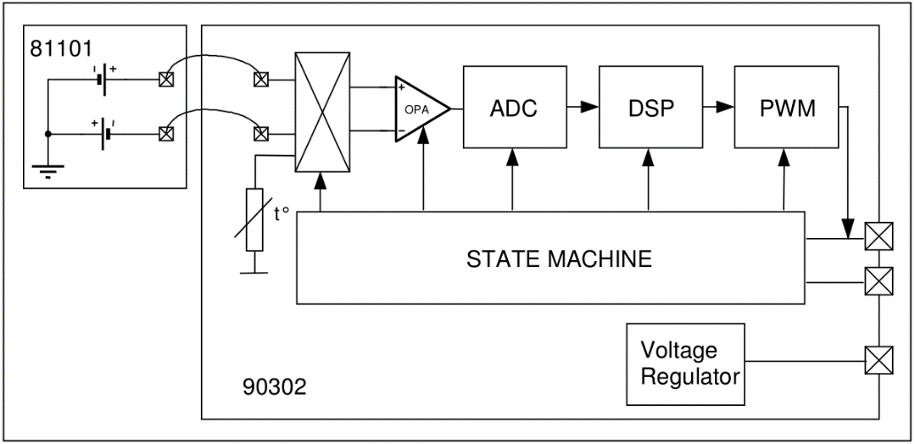
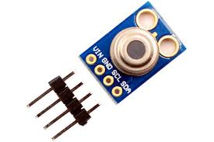
MLX90614 Temperature sensor

Slide 27
The MLX90614 consists of two devices embedded as a single sensor,
one device acts as a sensing unit and the other device acts as a processing
unit. The sensing unit an Infrared Thermopile Detector called
MLX81101 which senses the temperature and the processing unit
is a Single Conditioning ASSP called MLX90302 which converts
the signal from the sensor to digital value and communicates using
I2C protocol.
The MLX90302 has a low noise amplifier, 17-bit ADC
and a powerful DSP which helps the sensor to have high accuracy and
resolution.
The IR sensor work in IR wavelengths of 0.4 microns to 5.8microns
(as most of the objects IR radiation lie between these range).
The IR sensor consists of serial connected thermo-couples with
cold junctions placed at thick chip substrate and hot junctions,
placed over thin membrane. The IR radiation absorbed from the
membrane heats (or cools) it.
The change in voltage difference is taken and sent to the amplifiers
through filters.

Slide 28
The FIR (Finite Impulse Response) filter is provided primarily as a noise control. The IIR (Infinite Impulse Response) filter is useful to control the effect of fast temperature measurement changes. The settling time is a result of both filters working one after the other on the same signal path. Thus the overall settling time is dependent on both filters.
The IIR filter can be used to “smooth” the measurement. Decreasing the signal step allowed to pass the signal-processing path limits the magnitude of spikes. For example, if an object passes through the MLX90614 Field of View (FOV), and measuring that object is not desired, the IIR filter can be limit the disturbance.
Then comes the processing unit ASSP which reads the output voltage and coverts it into digital value. It contains an DSP and analog to digital converter.
The sensor can communicate using the I2c or pwm however the i2c has precision of 0.02 C where as the pwm with 0.14 `C.
The device contains two measurements one ambient and object temperature .(-25 to 125 for ambient and -70 to360 for object)
The sensors EEPROM & RAM can be accessed using the i2c protocol.
Medical accuracy .

Slide 29
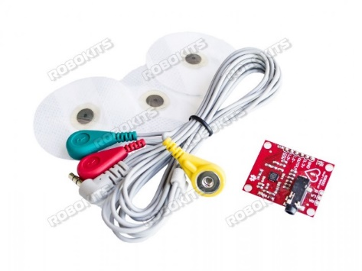
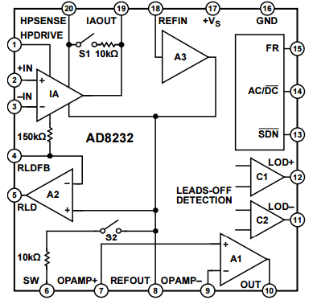
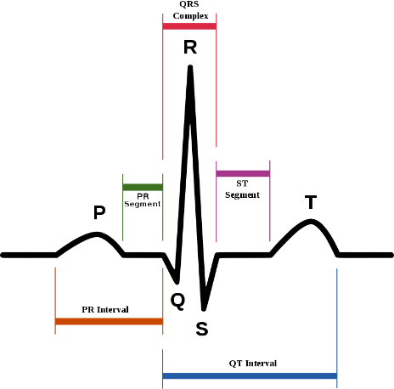
ECG sensor (AD8232)

Slide 30
Electrocardiography is the process of producing an electrocardiogram (ECG or EKG). It is a graph voltage versus time of the electrical activity of the heart using electrodes placed on the skin. These electrodes detect the small electrical changes that are a consequence of cardiac muscle depolarization followed by repolarization during each cardiac cycle (heartbeat). Changes in the normal ECG pattern occur in numerous cardiac abnormalities, including cardiac rhythm disturbances (such as atrial fibrillation and ventricular tachycardia), inadequate coronary artery blood flow (such as myocardial ischemia and myocardial infarction), and electrolyte disturbances (such as hypokalaemia and hyperkalaemia).
Electrodes are placed on the surface of the chest. The overall magnitude of the heart's electrical potential is then measured from different angles ("leads") and is recorded over a period of time (usually ten seconds). In this way, the overall magnitude and direction of the heart's electrical depolarization is captured at each moment throughout the cardiac cycle .
There are three main components to an ECG: the P wave, which represents the depolarization of the atria; the QRS complex, which represents the depolarization of the ventricles and the T wave, which represents the repolarization of the ventricles.
An ECG conveys a large amount of information about the structure of the heart and the function of its electrical conduction system.^{[7]} Among other things, an ECG can be used to measure the rate and rhythm of heartbeats, the size and position of the heart chambers, the presence of any damage to the heart's muscle cells or conduction system, the effects of heart drugs, and the function of implanted pacemakers.

Slide 31
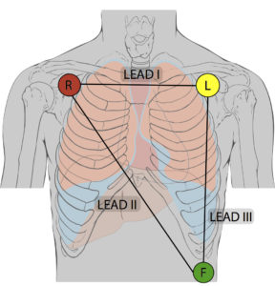
How we produce ECG?
We make use of a 3 electrode probe to measure the electrical signals which is then processed by a highly
efficient and reliable analog signal processing module AD8232.
Electrodes are the actual conductive pads attached to the body surface. Any pair of electrodes can measure the
electrical potential difference between the two corresponding locations of attachment. Such a pair forms a lead.
The AD8232 produces an analog output which is the picked up by the microcontroller.

Slide 32
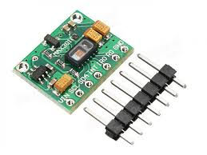
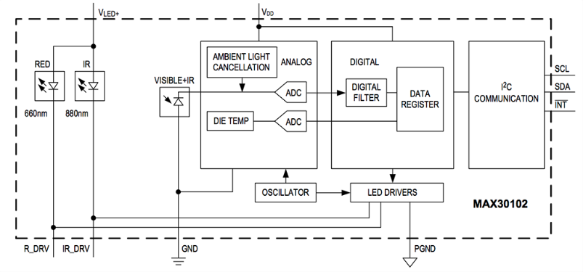
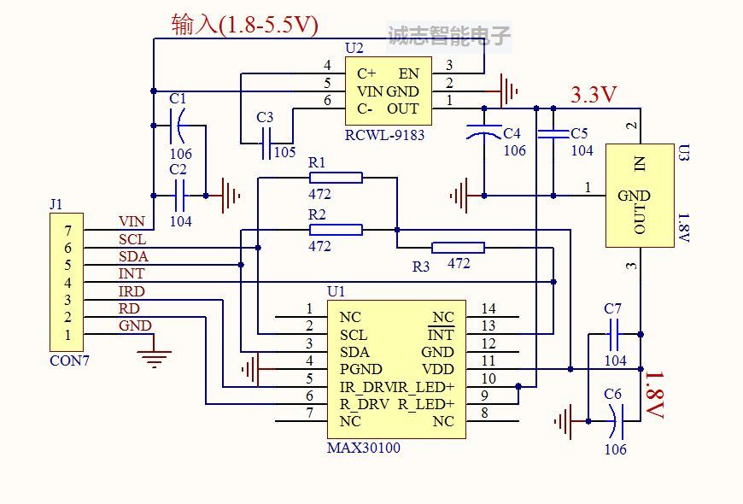
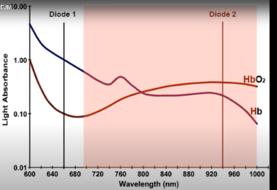
Oximeter MAX30102 (MAX86141)

Slide 33
The MAX30102 is a complete pulse oximetry and heart-rate sensor system solution module designed for the demanding requirements of wearable devices.
The SpO2 subsystem of the MAX30102 contains ambient light cancellation (ALC), a continuous-time sigma-delta ADC, and a proprietary discrete time filter. The ALC has an internal Track/Hold circuit to cancel ambient light and increase the effective dynamic range. The SpO2 ADC has programmable full-scale ranges from 2µA to 16µA. The ALC can cancel up to 200µA of ambient current.
The ADC output data rate can be programmed from 50sps (samples per second) to 3200sps.
The device consists of a photo diode and two light emitting diodes.
One led emits light at 660nm(deoxy hemoglobin)and another is for 880nm(oxyhemoglobin). One helps to measure the oxyhemoglobin concentration another for deoxyhemoglobin, the percentage of oxyhemoglobin is calculated by oxyhemoglobin concentration/total concentration.
The sensor includes ambient light cancelation for more accuracy.

Slide 34
The pulse beat of heart can be calculated with the help of this sensor . For this purpose only
the IR sensor is used.
When the heart pumps their will be increase in oxygenated blood and when it relaxes their
will be decrease in amount of oxygenated blood .
The pulse rate is the time difference between increase and decrease of oxygenated blood.
The sensor uses i2c protocol for transfer of data.
The data is stored in the registers of the sensor which can be accessed
and also several other specifications can be changed

Slide 35
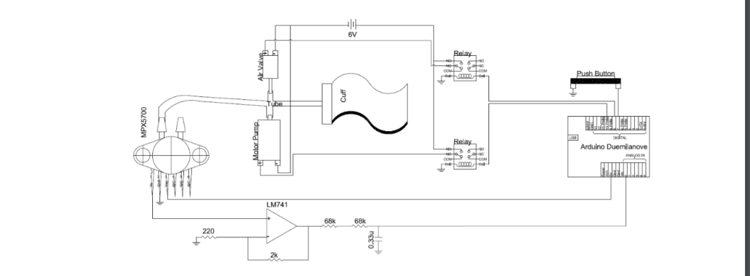
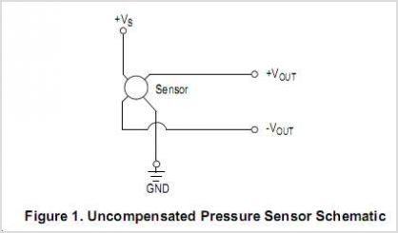
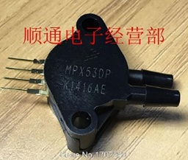
Blood pressure sensor
MPX53DP
The blood pressure is of 2 types one is systolic(generated during heart contraction)
and another is diastolic pressure(during heart relaxation)
The systolic measures generally about 100-120 mm of hg and diastolic pressure measure of 60-80 mm of hg.
The device which measures Bp electronically are based on principle of oscillometer method.
The auscultatory method has been the standard method of determining BP for over 100 years and relies on
the observer to detect the audible sounds (Korotkoff sounds) that occur during constricted blood flow.
The oscillometer method, employed by most clinical-grade automated BP devices, analyzes pulse waves
collected from the cuff during constricted blood flow. In this case, the cuff is the sensor.
The auscultatory and oscillometer methods are two very different approaches to determining the same vital sign.

Slide 36
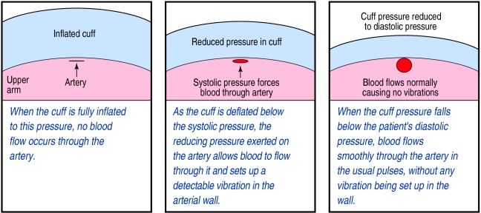
With an oscillatory device, a cuff is inflated over the upper arm or wrist. The new models use “fuzzy logic” to decide how
much the cuff should be inflated to reach a pressure about 20 mm Hg above systolic pressure for any individual
When the cuff is fully inflated to this pressure, no blood flow occurs through the artery. As the cuff is deflated below the
systolic pressure, the reducing pressure exerted on the artery allows blood to flow through it and sets
up a detectable vibration in the arterial wall.
When the cuff pressure falls below the patient's diastolic pressure, blood flows smoothly through the artery in the usual
pulses, without any vibration being set up in the wall
Vibrations occur at any point where the cuff pressure is sufficiently high that the blood has to push the arterial wall
open in order to flow through the artery.
The vibrations are transferred from the arterial wall, through the air inside the cuff, into a transducer in the monitor
that converts the measurements into electrical signals.
These digital devices deflate at about 4 mm Hg per second, making them sometimes seem slower to use than auscultatory
aneroid devices, but they are more accurate.

Slide 37
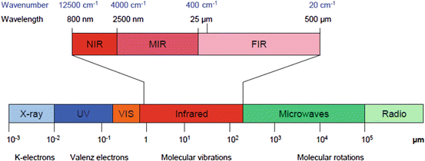
GLUCOMETER
Non Invasive Glucometer
Optical methods are considered to be one of the pain free and the promising methods which can be used for non-invasive blood glucose measuring. In which the Near-infrared (NIR) is considered to be the most widely used optical techniques because of its high penetration in the skin. These techniques are applied in various regions of the body such as earlobe, finger, forearm, and palm. On comparing with other methods, the NIR method finds a good advantage in sensitivity, complexity, power consumption, cost, and accuracy.
OVERVIEW OF NIR SPECTROSCOPY:
The Infrared wave is classified as Near-infrared, Mid-infrared, and Far-infrared.

Slide 38
The NIR light lies in the wavelength range of 750nm – 2500nm. The infrared (NIR) rays can penetrate through the skin at the
wavelength range of 650-1350nm. Some of the regions considered for examination are Earlobe, Forearm, Fingertip, and Palm.
On comparing the considered regions, the accuracy of glucose detection is better at the earlobe, due to its boneless tissue and
small thickness. Near-infrared was passed on one side of the earlobe while the opposite end is the receiver side which receives
the attenuated light. Normally, photodiodes are used for light detection at the receiver side. The variations of glucose
concentration in the blood attenuate the light transmitted, which results in variation of photodiode voltage.
PRINCIPLE OF BLOOD GLUCOSE MEASUREMENT:
When a light ray passes through biological tissues, it is both absorbed and scattered by the tissues. Light scattering occurs
in biological tissues due to the mismatch between the refraction index of extracellular fluid and the membranes of the cells.
Variation in glucose level in blood affects the intensity of light scattered from the tissue. Beer-Lambert Law plays a major
role in absorbance measurement which states that absorbance of light through any solution is in proportion with the concentration
of the solution and the length path travelled by the light ray.
WORKING:
The proposed work is based on NIR optical technique. NIR light source of 940 nm wavelength is chosen because it is suitable
for measuring blood glucose concentration. The sensing unit consists of NIR emitter and NIR receiver (photodetector) positioned
on either side of the measurement site (fingertip) as shown in figure1.When the NIR light is propagated through the fingertip in
which it interacts with the glucose molecule, a part of NIR light gets absorbed depending on the glucose concentration of blood
and remaining part is passed through the finger tip. The amount of NIR light passing through the fingertip depends on the amount
of blood glucose concentration.

Slide 39
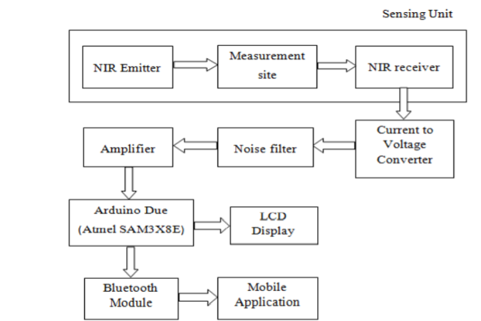
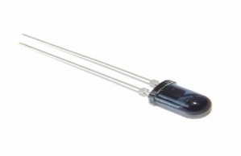
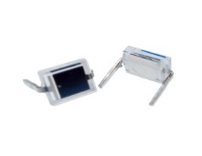
The transmitted signal is detected by the photodetector. The output current
of the photo detector is converted into
voltage signal and then it is filtered and amplified. This amplified signal is fed
into microcontroller.
The inbuilt ADC block is used for converting the received analog signal to
digital form.
This digital signal is processed by using second order regression analysis to
predict the blood
glucose value and the blood glucose value is displayed on the LCD display.
SENSORS USED:
The sensor used here is the NIR sensor. NIR sensor is chosen amongst others is that it does not harm the human skin.
To measure the blood glucose non-invasively the NIR LED and the photodiode is used.
One side of the sensor clip is attached with the NIR LED (TSAL5300) as Transmitter and the opposite side
we have photodiode (BPW34) to measure the attenuated light received after the penetration of NIR waves through our earlobe.

Slide 40
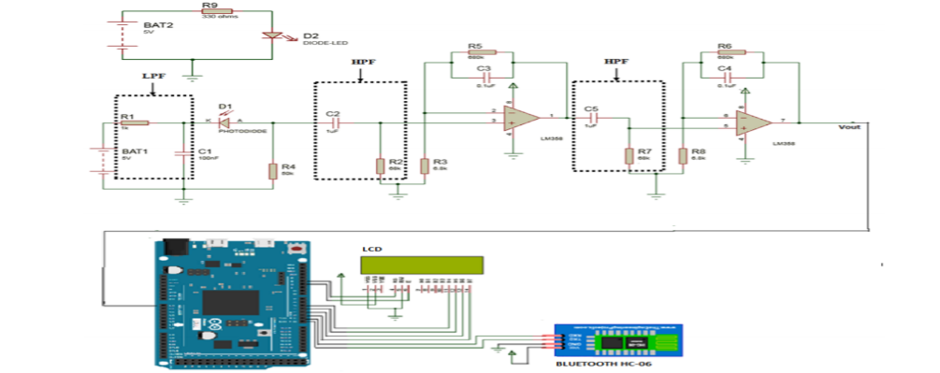
SYSTEM DESIGN:
The circuit diagram of the designed system consists of filtering stage and amplification stage as shown in figure 3. The electrical current obtained from the photo detector is converted into the voltage by placing the load resistance R4= 50kΩ at the anode side of photodiode. The cut-off frequency of high pass filter and low pass filter are designed as 2.34 Hz and 1.59 kHz respectively.
Cut off frequency of LPF = 1/ (2πR1C1) = 1/ [2π (1*103 ) (100*10-9 )] = 1.59 kHz Cut off frequency of HPF = 1/ (2πR2C2) = 1/ [2π (68*103 ) (1*10-6 )] = 2.34Hz Voltage gain = 1 + (Rf / Rin) = 1 + [(680*103 )/ (6.8*103 )] = 101
The amplified output voltage is connected to analog pin of Arduino microcontroller for converting the analog signal into digital values. This digital value corresponds to the glucose level. From this digital value, the actual glucose level is determined using polynomial regression equation. This equation is formed from the glucose levels obtained from the laboratory using invasive measurement. A mobile app is created for displaying and storing the predicted glucose value. Bluetooth module (HC-05) is connected to Arduino microcontroller in order to communicate with the mobile app via Bluetooth.

Slide 41
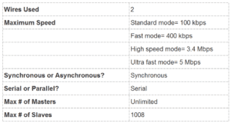
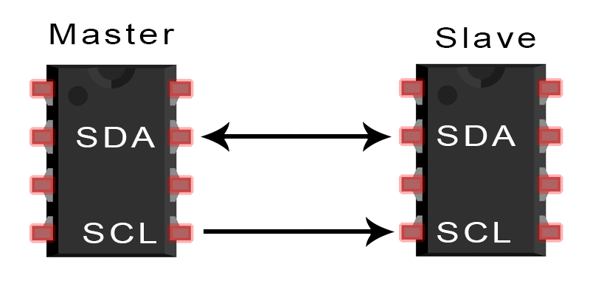
I2C communication .
INTRODUCTION TO I2C COMMUNICATION
I2C combines the best features of SPI and UARTs. With I2C, you can connect multiple slaves to a single master (like SPI) and you can have multiple masters controlling single, or multiple slaves. This is really useful when you want to have more than one microcontroller logging data to a single memory card or displaying text to a single LCD.
Like UART communication, I2C only uses two wires to transmit data between devices:
SDA (Serial Data) – The line for the master and slave to send and receive data.
SCL (Serial Clock) – The line that carries the clock signal.

Slide 42
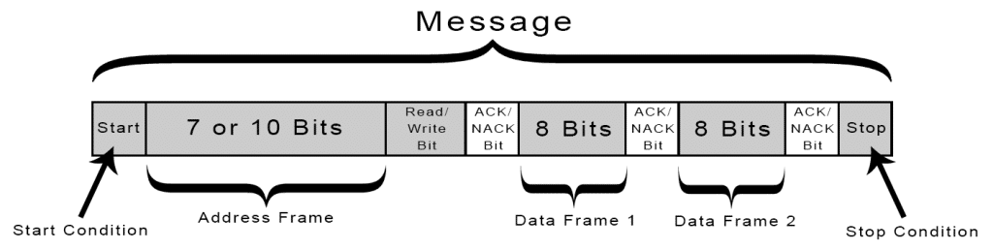
Start Condition: The SDA line switches from a high voltage level to a low voltage level before the SCL line
switches from high to low.
Stop Condition: The SDA line switches from a low voltage level to a high voltage level after the SCL line
switches from low to high.
Address Frame: A 7 or 10 bit sequence unique to each slave that identifies the slave when the master wants to talk to it.
Read/Write Bit: A single bit specifying whether the master is sending data to the slave (low voltage level) or requesting
data from it (high voltage level).
ACK/NACK Bit: Each frame in a message is followed by an acknowledge/no-acknowledge bit.
If an address frame or data frame was successfully received, an ACK bit is returned to the sender from the receiving
device.

Slide 43
ADDRESSING
I2C doesn’t have slave select lines like SPI, so it needs another way to let the slave know that data is being sent to it,
and not another slave. It does this by addressing. The address frame is always the first frame after the start bit in a
new message.
The master sends the address of the slave it wants to communicate with to every slave connected to it. Each slave
then compares the address sent from the master to its own address. If the address matches, it sends a low voltage
ACK bit back to the master. If the address doesn’t match, the slave does nothing and the SDA line remains high.
READ/WRITE BIT
The address frame includes a single bit at the end that informs the slave whether the master wants to write data
to it or receive data from it. If the master wants to send data to the slave, the read/write bit is a low voltage level.
If the master is requesting data from the slave, the bit is a high voltage level.
THE DATA FRAME
After the master detects the ACK bit from the slave, the first data frame is ready to be sent.
The data frame is always 8 bits long, and sent with the most significant bit first. Each data frame is immediately
followed by an ACK/NACK bit to verify that the frame has been received successfully. The ACK bit must be received
by either the master or the slave (depending on who is sending the data) before the next data frame can be sent.
After all of the data frames have been sent, the master can send a stop condition to the slave to halt the
transmission. The stop condition is a voltage transition from low to high on the SDA line after a low to high
transition on the SCL line, with the SCL line remaining high.

Slide 44
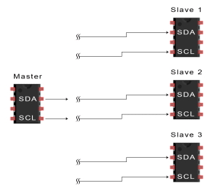
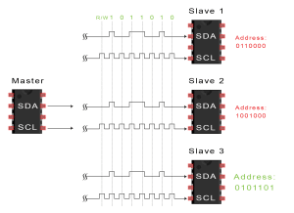
STEPS OF I2C DATA TRANSMISSION
The master sends the start condition to every connected slave by switching the SDA line from a high voltage
level to a low voltage level before switching the SCL line from high to low:
2. The master sends each slave the 7 or 10 bit address of the slave it wants to communicate with,
along with the read/write bit:

Slide 45
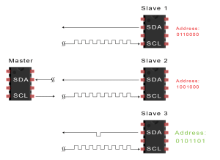
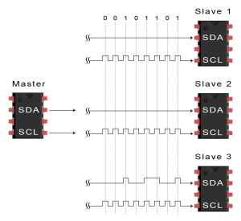
3. Each slave compares the address sent from the master to its own address. If the address matches,
the slave returns an ACK bit by pulling the SDA line low for one bit.
If the address from the master does not match the slave’s own address, the slave leaves the SDA line high.
4. The master sends or receives the data frame:

Slide 46
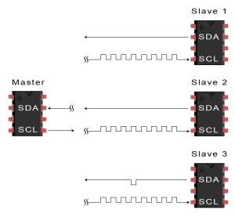
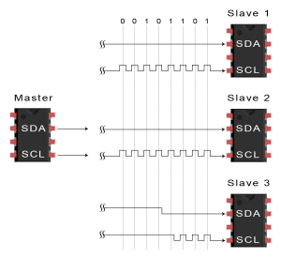
5. After each data frame has been transferred, the receiving device returns another ACK bit to the sender to
acknowledge successful receipt of the frame:
6. To stop the data transmission, the master sends a stop condition to the slave by switching SCL
high before switching SDA high:

Slide 47
ADVANTAGES
Only uses two wires
Supports multiple masters and multiple slaves
ACK/NACK bit gives confirmation that each frame is transferred successfully
Hardware is less complicated than with UARTs
Well known and widely used protocol
DISADVANTAGES
Slower data transfer rate than SPI
The size of the data frame is limited to 8 bits
More complicated hardware needed to implement than SPI

Slide 48
Disease detection and treatments

Slide 49
Pulse Oximeter
Oxygen saturation can drop for many reasons, including:
• suffocation
• choking
• infections, such as pneumonia
• drowning
• diseases, such as emphysema, lung cancer, and lung infections
• inhaling poisonous chemicals
• heart failure or a history of heart attacks
• allergic reactions
• general anaesthesia
Some benefits of pulse oximetry include:
• monitoring oxygen saturation over time
• alerting to dangerously low oxygen levels, particularly in newborns
• offering peace of mind to people with chronic respiratory or cardiovascular
conditions
• assessing the need for supplemental oxygen
• monitoring oxygen saturation levels in people under anesthesia
• indicating dangerous side effects in people taking drugs that affect breathing or
oxygen saturation

Slide 50
Glucometer
Uses:
• Realtime continuous glucose monitoring (RT-CGM) is a useful clinical and
lifestyle aid for people with type 1 diabetes.
• Monitor the effect of diabetes medications on blood sugar levels
• Identify blood sugar levels that are high or low
• Track your progress in reaching your overall treatment goals
• Learn how diet and exercise affect blood sugar levels
• Understand how other factors, such as illness or stress, affect blood sugar levels
Blood Pressure
1. Primary (essential) hypertension
2. Secondary hypertension
Various conditions and medications can lead to secondary hypertension, including:
• Obstructive sleep apnoea
• Kidney problems
• Adrenal gland tumours
• Thyroid problems
• Certain defects you're born with (congenital) in blood vessels
• Certain medications, such as birth control pills, cold remedies, decongestants,
over-the-counter pain relievers and some prescription drugs
• Illegal drugs, such as cocaine and amphetamines

Slide 51
ECG
An ECG can help detect:
• arrhythmias – where the heart beats too slowly, too quickly, or irregularly
• coronary heart disease – where the heart's blood supply is blocked or interrupted
by a build-up of fatty substances
• heart attacks – where the supply of blood to the heart is suddenly blocked
• cardiomyopathy – where the heart walls become thickened or enlarged

Slide 52
Team Members
JSS Academy of Technical Education Bengaluru
Shishir Bagalkot (CSE)
Sweekruth K M (CSE)
Tejas A (ECE)
Vinod B G (ECE)

