Slide 1
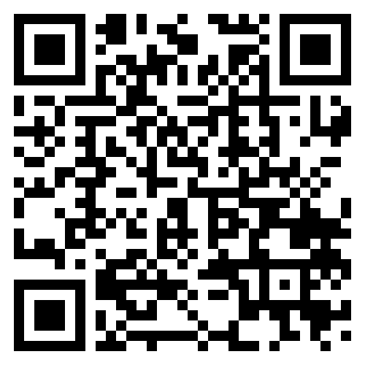
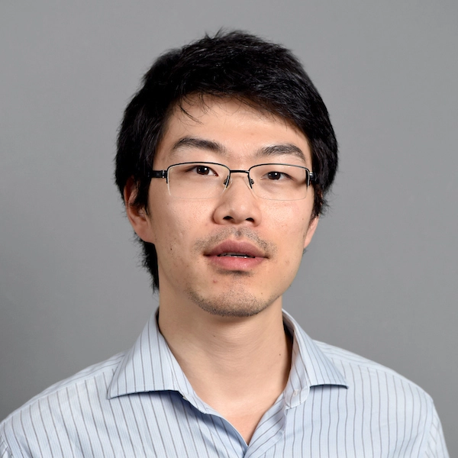


PPR Seminar Advances in Perception, Prediction, and Reasoning
Dr. Yezhou Yang Associate Professor, School of Computing & AI, Arizona State University
https://yezhouyang.engineering.asu.edu/
Visual Concept Learning Beyond Appearances: Modernizing a Couple of Classic Ideas
February 8, 2024 3:30 – 4:30 PM
ITE 325-B or Webex: https://umbc.webex.com/meet/gokhale
Abstract: The goal of Computer Vision, as coined by Marr, is to develop algorithms to answer "What are", "Where at", "When from" visual appearance. The speaker, among others, recognizes the importance of studying underlying entities and relations beyond visual appearance, following an Active Perception paradigm. This talk will present the speaker's efforts over the last decade, ranging from (1) reasoning beyond appearance for vision and language tasks (VQA, captioning, T2I, etc.), and addressing their evaluation misalignment, through (2) reasoning about implicit properties, to (3) their roles in a Robotic visual concept learning framework. The talk will also feature the Active Perception Group (APG)’s projects addressing emerging challenges of the nation in automated mobility and intelligent transportation domains.
About the Speaker: Yezhou (YZ) Yang is an Associate Professor and a Fulton Entrepreneurial Professor in the School of Computing and Augmented Intelligence (SCAI) at Arizona State University. He directs the ASU Active Perception Group, serves as the topic lead (situation awareness) at the Institute of Automated Mobility, Arizona Commerce Authority and as the thrust lead (AVAI) at Advanced Communications Technologies (a Science and Technology Center under the New Economy Initiative, Arizona). His work includes exploring visual primitives and representation learning in visual understanding, grounding them by natural language, high-level reasoning over the primitives for intelligent systems, secure/robust AI, and V&L model evaluation alignment. Yang is a recipient of the Qualcomm Innovation Fellowship 2011, NSF CAREER award 2018, and the Amazon AWS Machine Learning Research Award 2019. He received his Ph.D. from the University of Maryland and B.E. from Zhejiang University, China. He is a co-founder of ARGOS Vision Inc, an ASU spin-off company.
PPR Seminar: https://www.tejasgokhale.com/seminar.html Hosted by Dr. Tejas Gokhale gokhale@umbc.edu

