Slide 1
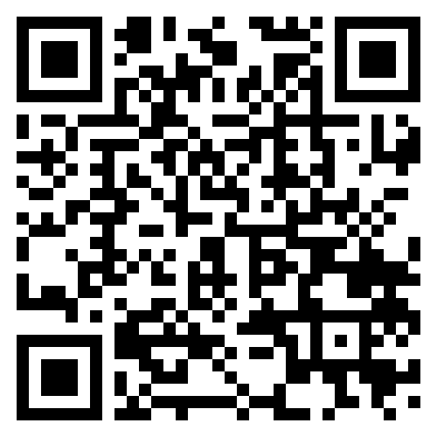

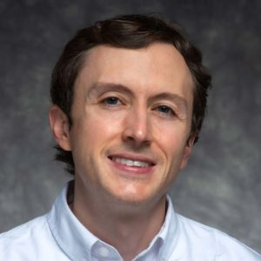

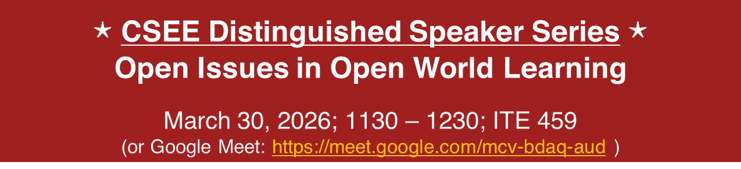
PPR Seminar Perception, Prediction, and Reasoning
Walter J. Scheirer
Dennis O. Doughty Collegiate Professor of Engineering
University of Notre Dame
https://www.wjscheirer.com/
$⋆$ CSEE Distinguished Speaker Series $⋆$
Open Issues in Open World Learning
March 30, 2026; 1130 – 1230; ITE 459
(or Google Meet: https://meet.google.com/mcv-bdaq-aud )
Abstract: Meaningful progress has been made in open world learning (OWL), enhancing the ability of agents to detect, characterize, and incrementally learn novelty in dynamic environments. However, novelty remains a persistent challenge for agents relying on state-of-the-art learning algorithms. This talk considers the current state of OWL, drawing on insights from a recent DARPA research program on this topic. I identify open issues that impede further advancements spanning theory, design, and evaluation. In particular, I emphasize the challenges posed by dynamic scenarios that are crucial to understand for ensuring the viability of agents designed for real-world environments. The talk provides suggestions for setting a new research agenda that effectively addresses these open issues.
The Speaker: Dr. Scheirer’s research interests within computer science include artificial intelligence, computer vision, machine learning, and digital humanities. His research has helped establish the areas of open set recognition & open world learning in computer vision. He serves on the IEEE CS Board of Governors, CTO of the Computer Vision Foundation, and Chair Emeritus of IEEE PAMI-TC. He received his Ph.D. from the University of Colorado and his M.S. and B.A. degrees from Lehigh University. Prof. Scheirer is also a recognized cultural critic and historian, commenting on the social context of emerging technologies, such as his most recent book: A History of Fake Things on the Internet.
PPR Seminar: https://www.tejasgokhale.com/seminar.html Hosted by Prof. Tejas Gokhale: gokhale@umbc.edu

