Slide 1
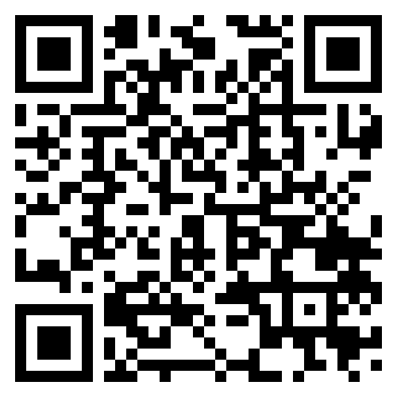
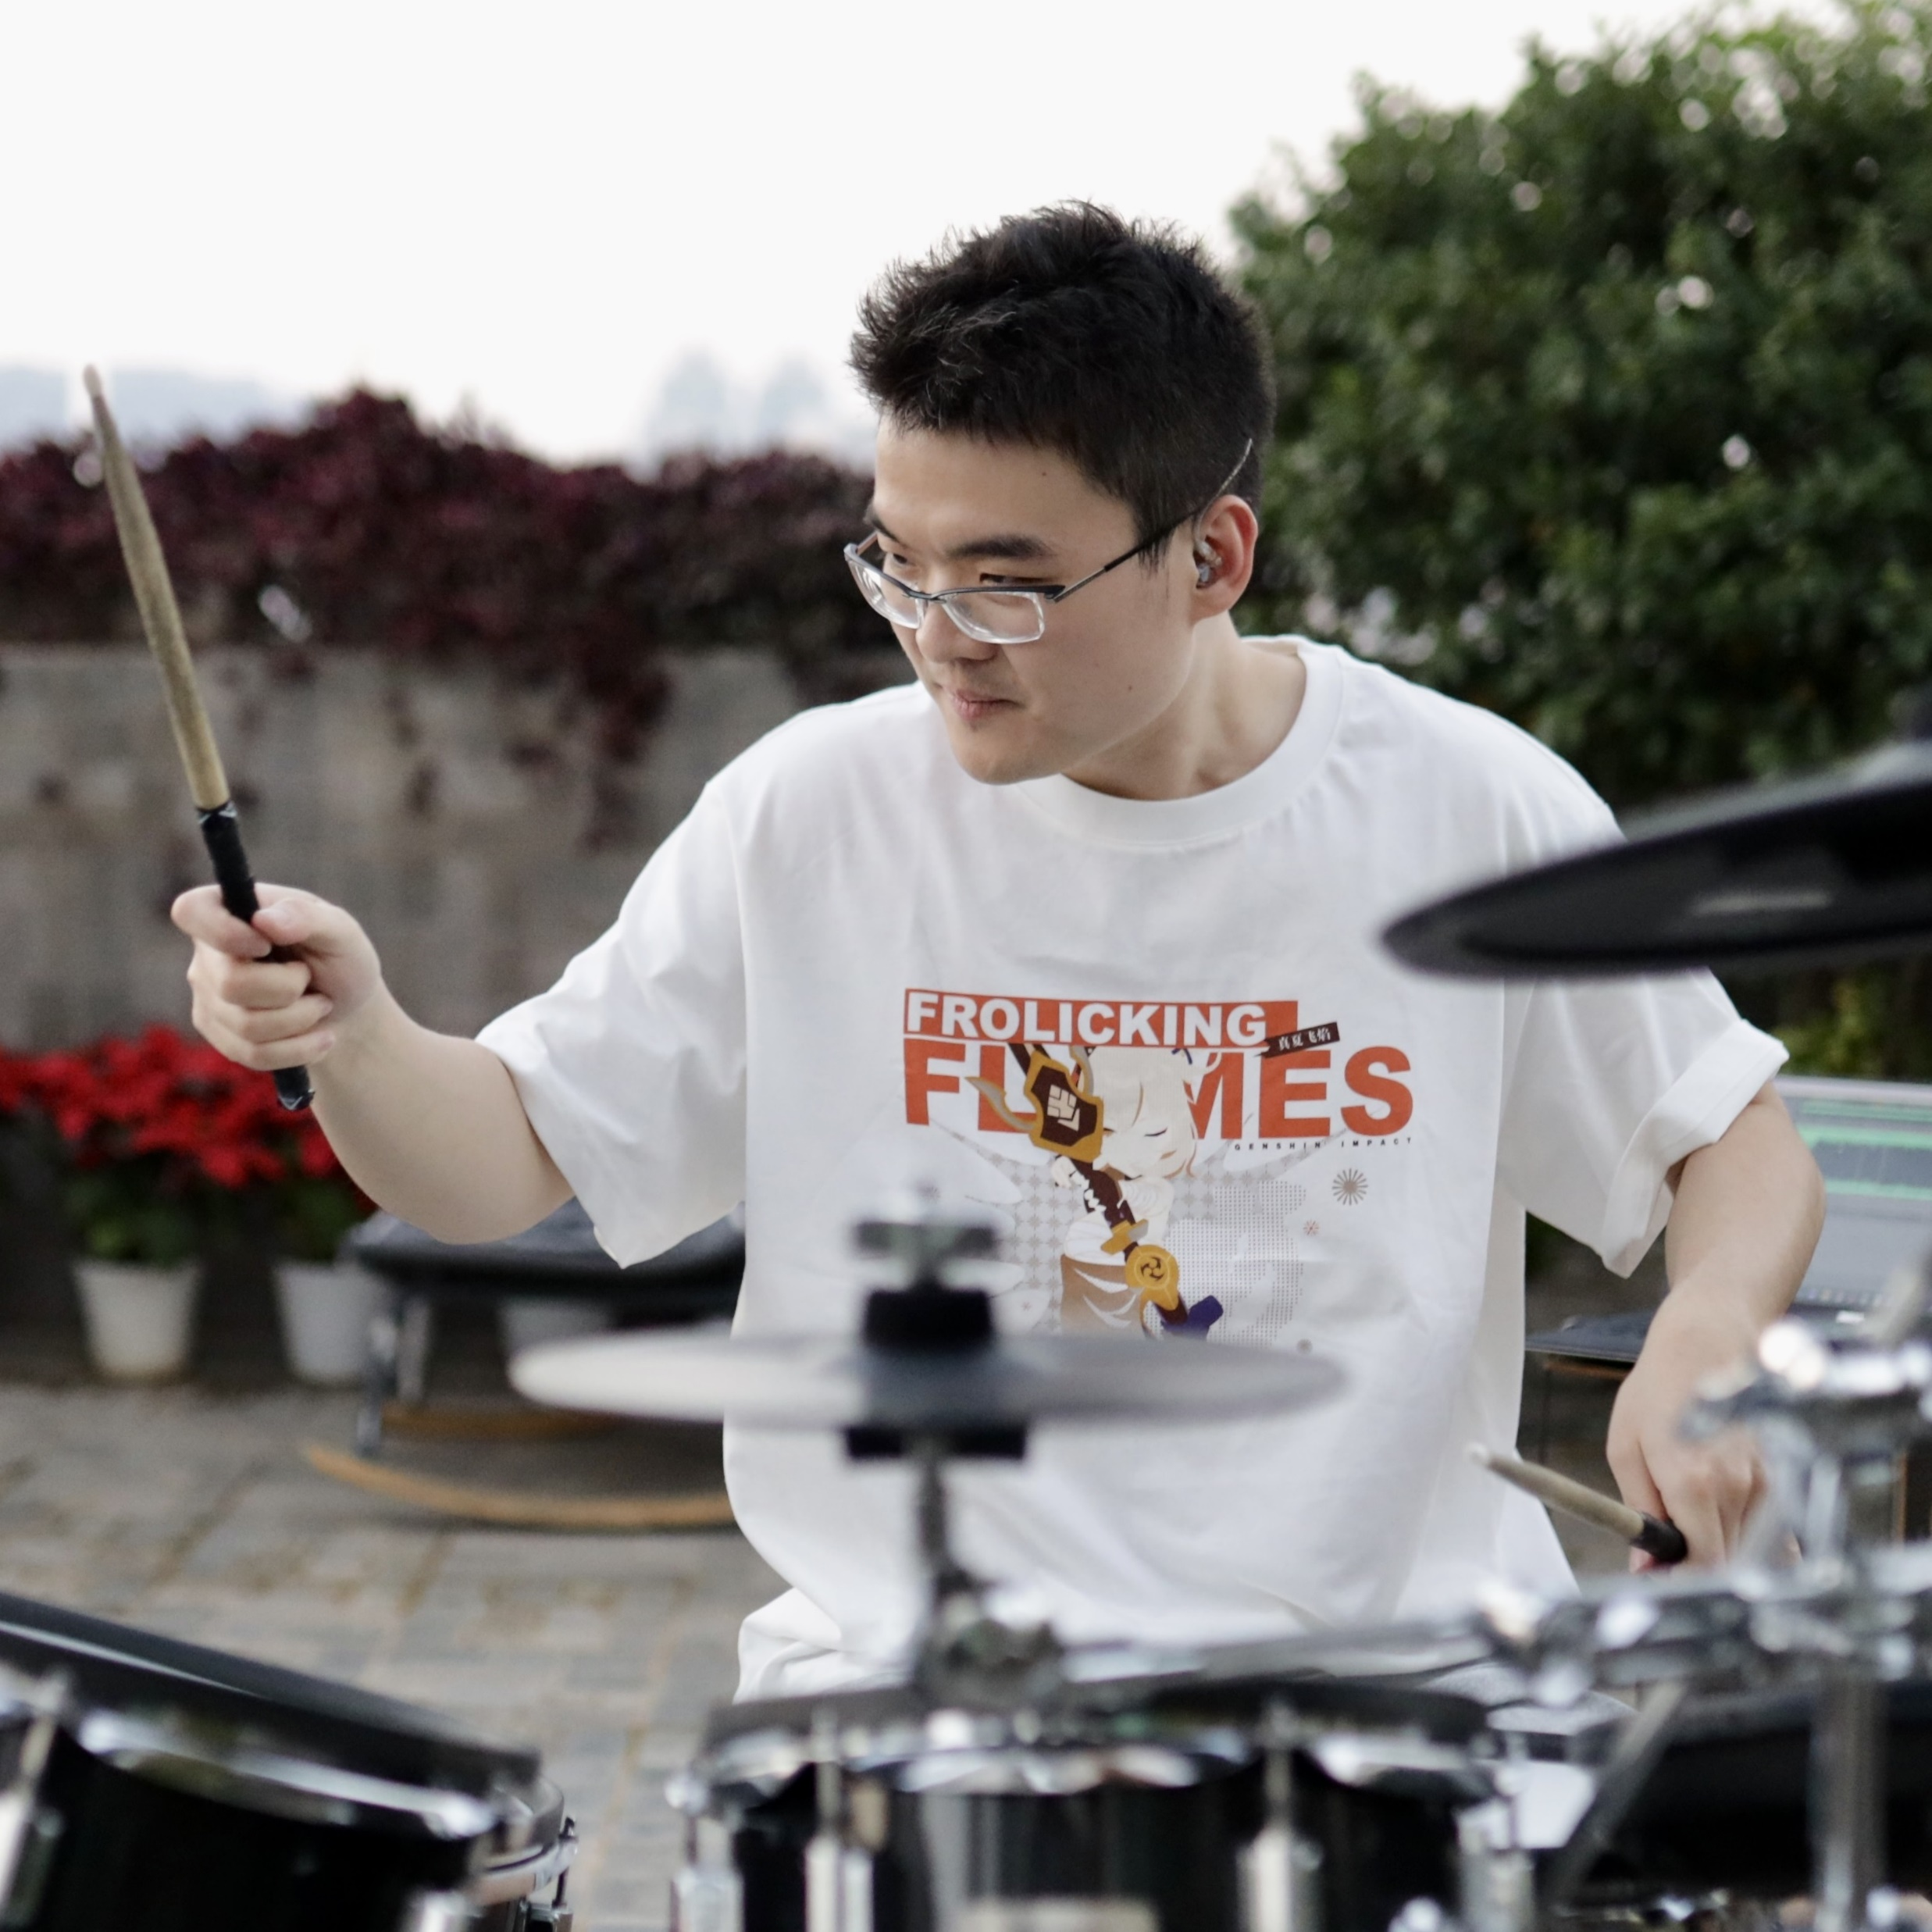


PPR Seminar Advances in Perception, Prediction, and Reasoning
Li “Harry” Zhang Ph.D. Candidate University of Pennsylvania
https://zharry29.github.io/
Structured Event Reasoning with Large Language Models
March 5, 2024 2:15 – 3:15 PM
ITE 325-B or Webex: https://umbc.webex.com/meet/gokhale
Abstract: Reasoning about real-life events is a unifying challenge in AI and NLP that has profound utility in a variety of domains, while any fallacy in high-stake applications like law, medicine, and science could be catastrophic. Able to work with diverse text in these domains, large language models (LLMs) have proven capable of answering questions and solving problems. In this talk, I demonstrate that end-to-end LLMs still systematically fail on reasoning tasks of complex events. Moreover, their black-box nature gives rise to little interpretability and user control. To address these issues, I propose two general approaches to use LLMs in conjunction with a structured representation of events. The first is a language-based representation involving relations of sub-events that can be learned by LLMs via fine-tuning. The second is a symbolic representation involving states of entities that can be leveraged by either LLMs or deterministic solvers. On a suite of event reasoning tasks, I show that both approaches outperform end-to-end LLMs in terms of performance and trustworthiness.
About the Speaker: Li "Harry" Zhang is a 5th-year PhD student working on Natural Language Processing (NLP) and artificial intelligence at the University of Pennsylvania advised by Prof. Chris Callison-Burch. He earned his Bachelor's degree at the University of Michigan mentored by Prof. Rada Mihalcea and Prof. Dragomir Radev. He has published more than 20 papers in NLP conferences that have been cited more than 1,000 times. He has reviewed more than 50 papers in those venues and has served as Session Chair and Program Chair in many conferences and workshops. Being a musician, producer, content creator of over 50,000 subscribers, he is also passionate in the research of AI music.
PPR Seminar: https://www.tejasgokhale.com/seminar.html Hosted by Dr. Tejas Gokhale gokhale@umbc.edu

