Slide 1

NLP Based Emotion Recognition using Mobile Models
Team: Hathi Dev Rajeshbhai PES1UG21CS813
Neeraj Gopalakrishnan PES1UG21CS824
Thushar M PES1UG20CS471
Tejas Goyal PES1UG20CS466

Slide 2
The problem statement
Alexithymia is a condition where individuals have difficulty recognizing and expressing their own emotions, as well as understanding the emotions of others. This can lead to difficulties in personal and professional relationships, as well as an increased risk of mental health problems.
One common way people with alexithymia communicate their emotions is through text messages, as it allows them to express themselves without the pressure of face-to-face interaction. However, accurately interpreting the emotions behind written text can be challenging for both the individual with alexithymia and their conversational partners.
The objective of this presentation is to propose a solution for improving emotional understanding in text-based communication for individuals with alexithymia.

Slide 3

Motivation
To enable the people with alexithymia to be able to understand emotion based of the texts that they have with others.
To demonstrate how your android application can help people with alexithymia improve their emotional and social skills by detecting emotions and sarcasm in text
To create an application that uses NLP and ML techniques to perform emotion and sarcasm detection on sentences on a phone locally
To create an easy way for people to access a custom ML model on their device without any sort of information collection

Slide 4
The dataset
Sarcasm
Emotion
The sarcasm dataset was created from multiple sources:
Sarcasm Headline Dataset
ISarcasm Dataset
Twitter Dataset for Sarcasm Classification
Additional to this we also have custom dataset made from scratch of around 1500 sarcastic and non-sarcastic labelled sentences.
The emotion dataset used in this project is Goemotions dataset made by Google.
It is a human-annotated dataset of 58k Reddit comments extracted from popular English-language subreddits and labeled with 27 emotion categories.
To make the classification much more user friendly we mapped the emotion as per the ‘Ekman Emotion Theory’.

Slide 5
Models Used

Slide 6
Sarcasm Model
Average Word Vector Model
The average word vector model is a technique for text representation that generates a sentence vector using a weighted average of words. The quality of this representation is measured in a text classification task using FastText and Word2Vec models.
In this technique, each word in a sentence is represented as a vector. These vectors are then averaged to create a single vector that represents the entire sentence. Then we can use the dimensions as sarcastic and not to detect the class.
Accuracy on training: 75.49%
Accuracy on testing: 74.94%
Mobile Bert Model
MobileBERT is a compressed and accelerated version of the popular BERT model that can be deployed on resource-limited mobile devices. Like the original BERT, MobileBERT is task-agnostic and can be generically applied to various downstream NLP tasks.
The MobileBERT model uses a teacher-student training strategy where a smaller student model is trained to mimic the behavior of a larger teacher model. Just feeding the model with dataloaded as bert input, i,e tokenized vocabulary will generate classes.
Accuracy on training: 89.28%
Accuracy on testing: 83.87%

Slide 7
Emotion Model
Mobile Bert Model
MobileBERT is a compressed and accelerated version of the popular BERT model that can be deployed on resource-limited mobile devices. Like the original BERT, MobileBERT is task-agnostic and can be generically applied to various downstream NLP tasks.
The MobileBERT model uses a teacher-student training strategy where a smaller student model is trained to mimic the behavior of a larger teacher model. Just feeding the model with dataloaded as bert input, i,e tokenized vocabulary will generate classes.
Accuracy on training: 74.47%
Accuracy on testing: 69.58%
Bert Model
BERT uses a method of masked language modeling to keep the word in focus from "seeing itself" -- that is, having a fixed meaning independent of its context. BERT is then forced to identify the masked word based on context alone. In BERT words are defined by their surroundings, not by a pre-fixed identity.
Accuracy on training : 78.78%
Accuracy on testing : 69.64%

Slide 8
Results and Inferences
Sarcasm:
From the 2 models and its accuracy between test and training we can see that the models don’t overfit and also see that the mobileBERT handily beats the average word vector model in terms of accuracy
As for the tradeoff of space to performance it is better to go for mobile bert over average word vector model as in real life applications the model performs very poorly.
Emotion:
Out of the models of Bert and MobileBert we can clearly see that for 5 times the size of mobile bert we don't see any significant increase in accuracy in order to validate the use of BERT model over MobileBert, But this would change with bigger and more textual embedding to be added to the vocabulary of the model as there is a higher limit to the mobileBERT and not the regular BERT.

Slide 9
Consideration To Deploy
When we were deploying the model we had to calculate the ratio score of accuracy/size as the metric to see the best models:
mobileBERT for sarcasm : 4.45
Average Word Vector for sarcasm : 7.4
BERT for emotion : 3.75
mobileBERT for emotion : .79
Even thought from the 2 sarcasm model the average word vector seems too good to be true this is due to the fact that the model is too small and creates erroneous detection unless it finds a strong sense of sarcasm.
And for the emotion as seen by the ratio score the mobileBERT is better to be deployed in a mobile environment but it will hit its limit as the dataset grows.

Slide 10
EmotionEase Android Application
A demo of models on Mobile system

Slide 11
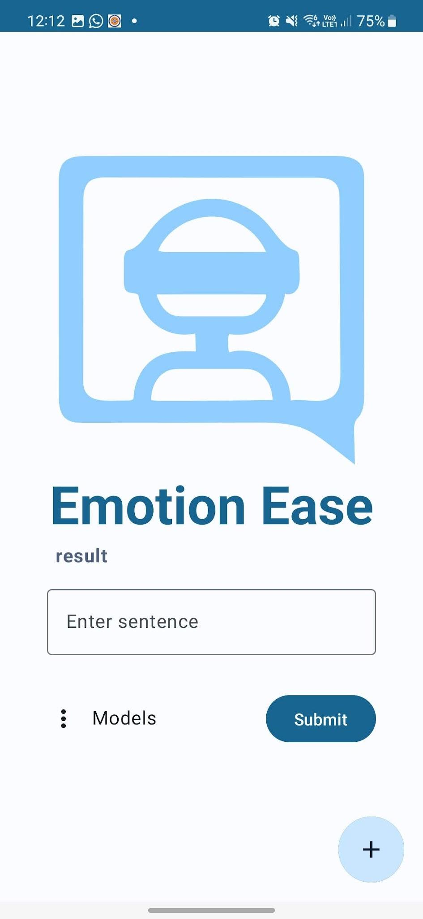
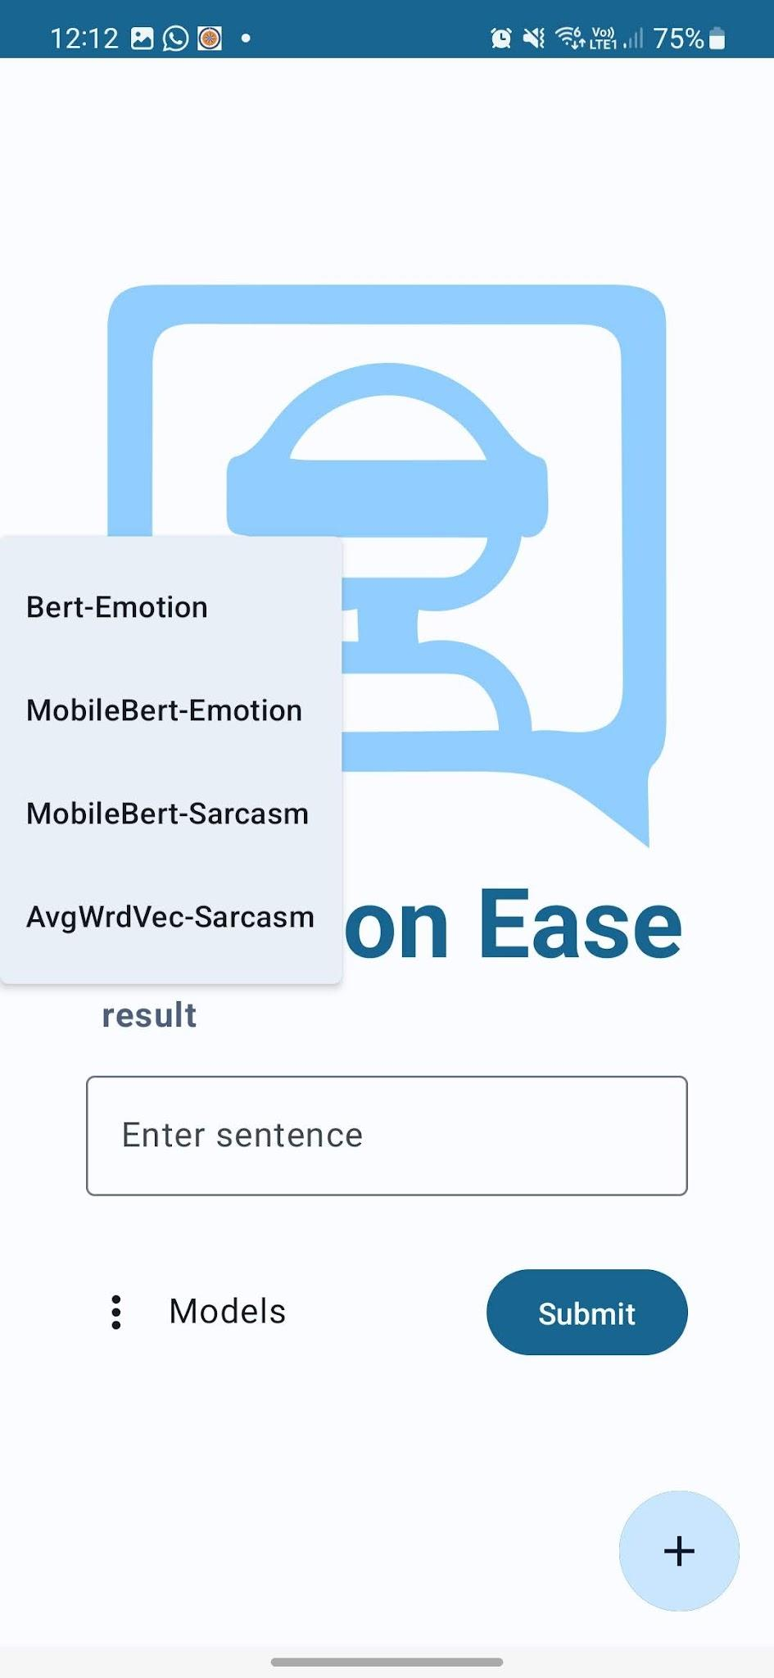
Homepage and Navigation

Slide 12
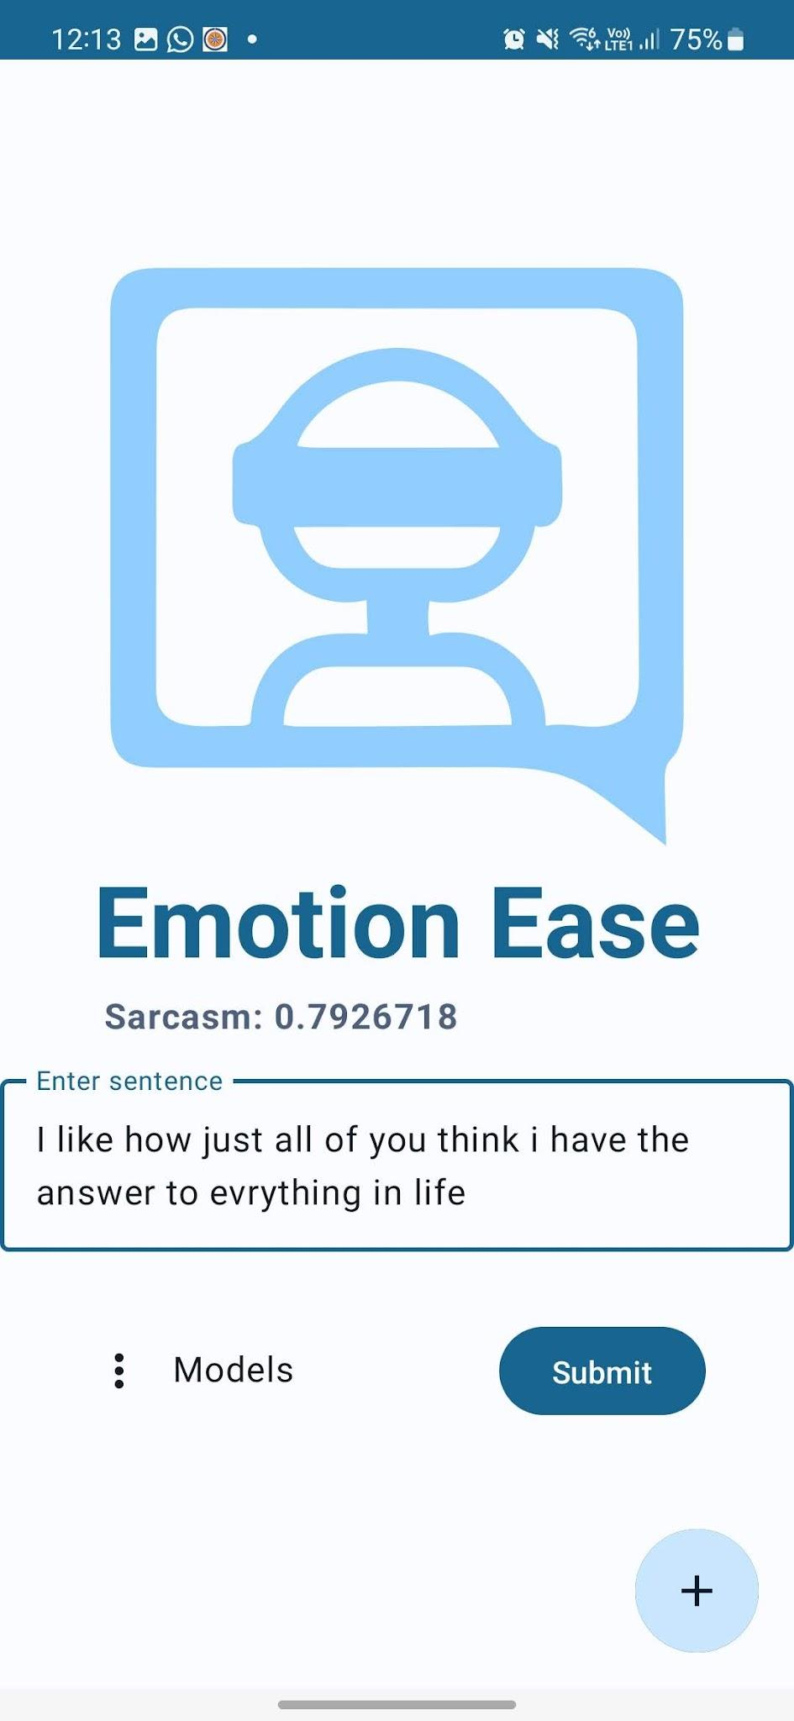
Sarcasm Result

Slide 13
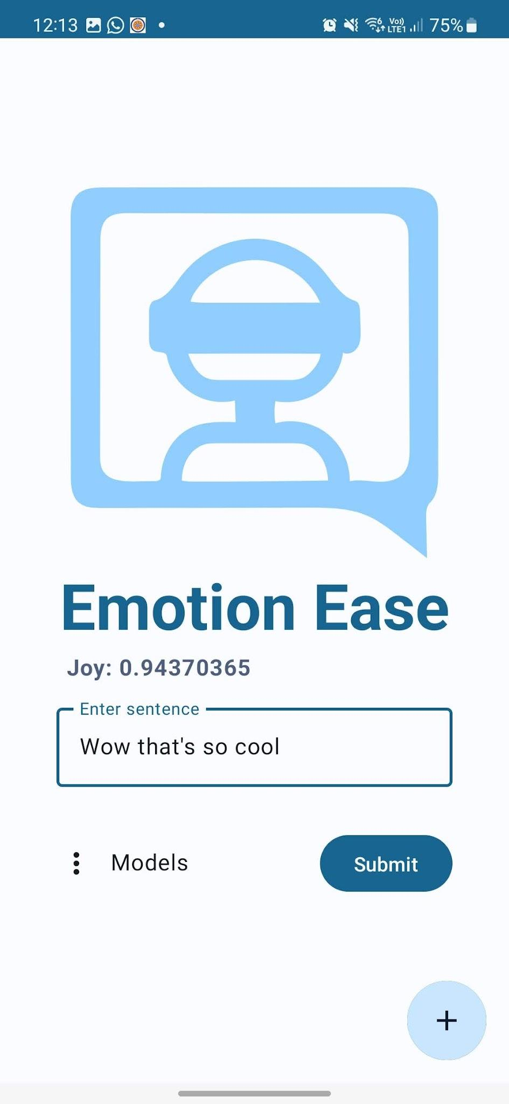
Emotion Result

Slide 14
Future Work
We believe that by addressing the issues in the implementation, we can further improve our application and make it more useful and accessible for people with alexithymia. We hope that our project can contribute to the advancement of NLP and ML research and applications, as well as to the well-being and quality of life of people with alexithymia.
We would like to make the android app with an android background service that helps to auto-interpret the classes rather than the user doing it manually.
We would also like to port the application to IOS. The application was made using Kotlin which is cross-platform compatible with IOS, hence making it possible to do the same.
We can further develop a better and custom model that would benefit for the same by improving upon the MobileBERT model made in this project.

Slide 15
Conclusion
The project helps enable the people with alexithymia better understand the way they express themselves and also in understanding how others perceive feelings of oneself.
By leveraging existing technology and improving upon it for a specific application we are able to enable emotion recognition and create an accessibility feature for the people suffering from such neurodevelopmental disorder. This shouldn't make them social outcasts but help them mingle as much as the regular human can.
By making this application available in mobile device and running service locally helps the user preserve their privacy and also make it a better platform for their communication.

Slide 16
THANK YOU!
Joy : 0.9927712

