Slide 1

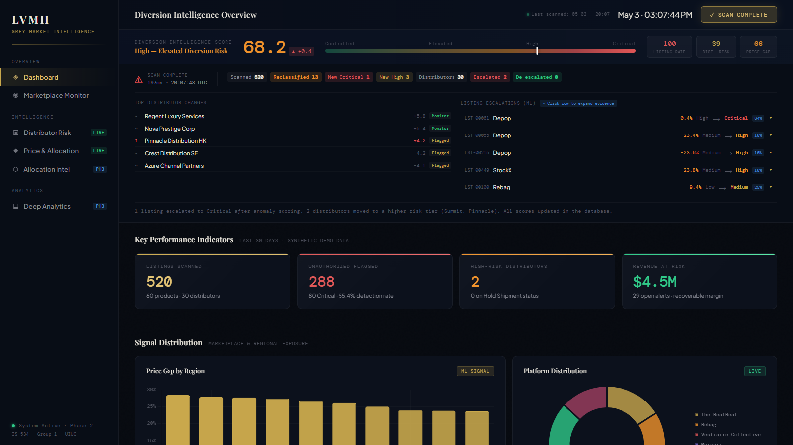
Prototype Demo: Diversion Intelligence Dashboard
Live scan view with executive KPIs, distributor deltas, and ML listing escalations.
The dashboard turns the class recommendation into a visible operating cockpit for grey-market intervention.

Slide 2
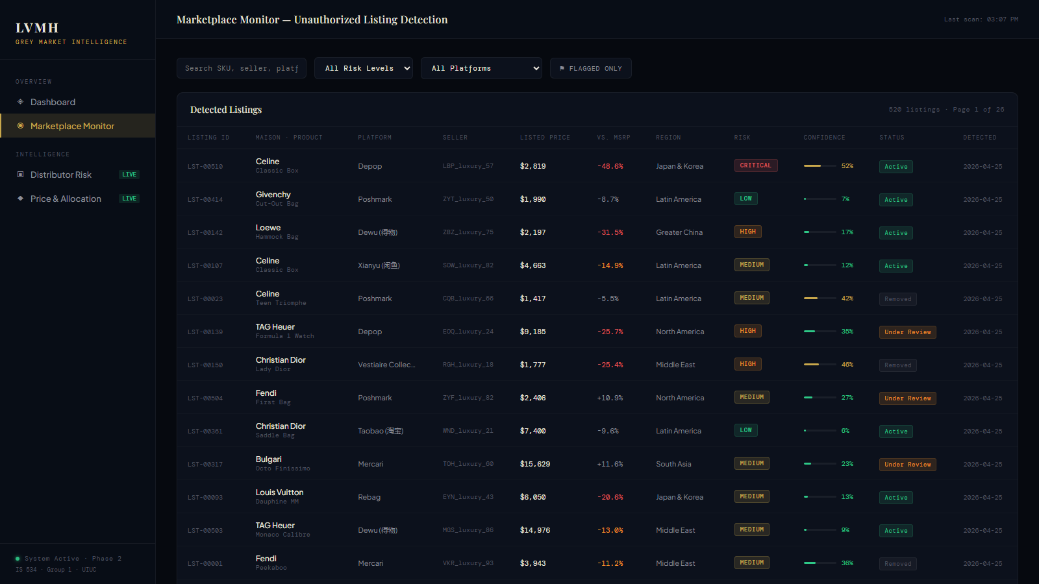
Prototype Demo: Marketplace Monitoring
Listing-level detection across platforms, sellers, regions, confidence, status, and risk tier.
Marketplace monitoring gives the team an analyst-ready queue instead of a static report.

Slide 3
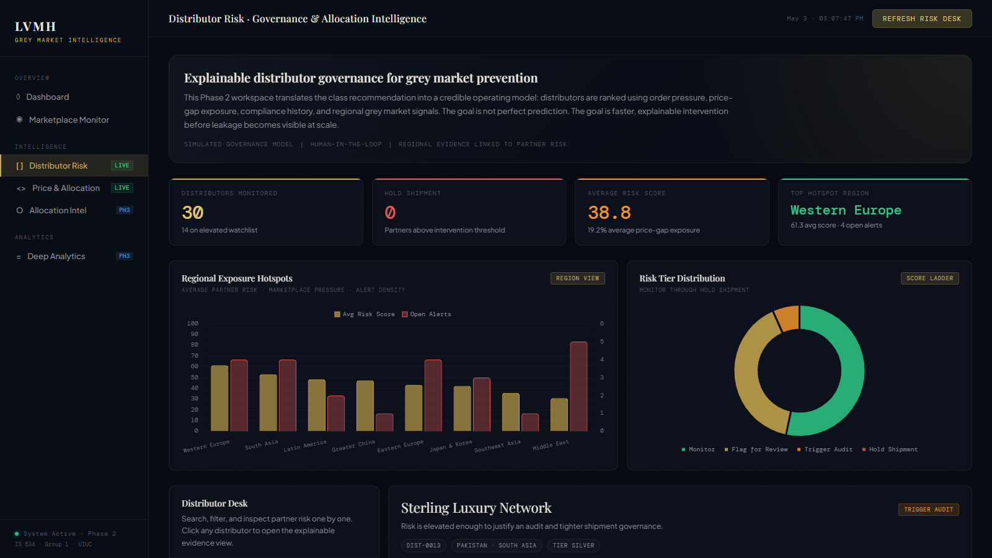
Prototype Demo: Distributor Risk Scoring
Explainable diversion intelligence score with tier changes, score drivers, and recommended action.
Distributor scoring connects marketplace signals back to channel governance decisions.

