Slide 1
Capstone Project - The Battle of Neighbourhoods
Data Analysis of Geo-Location data to start-up a Cafe in Toronto City
-Tejas mulay

Slide 2

Introduction
Background: In the competitive world, it is of utmost importance to know the surroundings and take necessary steps leading to the success of a venture. Such is the case with Cafés, which are currently popular among youths and profitable business for entrepreneurs. Yet, a decent location and favorable surroundings contribute heavily to the success.
Problem: Data acquisition of geo-location using foursquare and boroughs data o Wikipedia page to analyze and cluster the existing cafés and acquiring favorable locations to start-up a café.

Slide 3

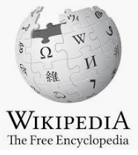
Data Acquisition
The data acquired for this project is a combination of two sources. The first data source being Wikipedia data on boroughs of Ontario and second, being foursquare data.

Slide 4
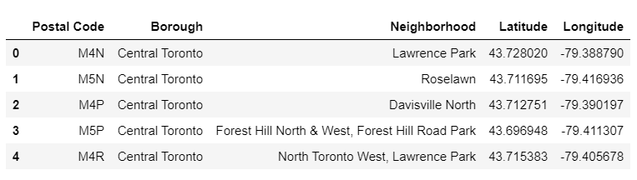
Data Cleaning
The dataset of boroughs of Ontario can be scraped from Wikipedia page using pandas or beautiful soap library in python. The following is the screenshot of the dataset on boroughs. Later the geocoder data of longitude and latitudes are acquired for the given location of postal code. Merging the datasets, we get -

Slide 5
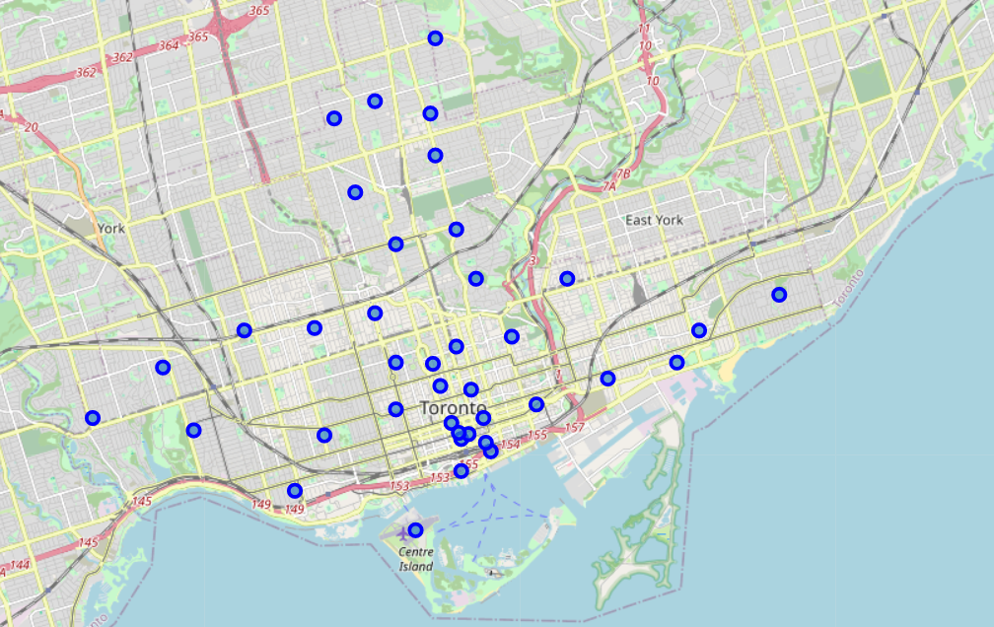
Exploratory Data Analysis
The neighborhood of Toronto:
The neighborhoods are plotted on the map using folium maps and the location of each neighborhood is observed as well as validated to get an idea of clustering to be performed further

Slide 6
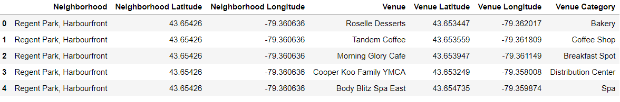
Exploratory Data Analysis
Boroughs of Toronto:
After acquiring foursquare data on venues around Toronto City the data was analyzed to get the category the neighborhood belongs to. The categories of all the neighborhoods being attained are observed by getting a count and the category 'Café' was selected for analysis.

Slide 7
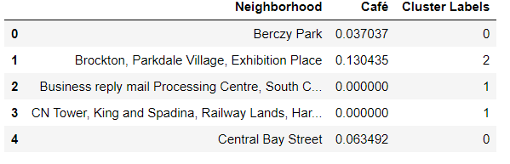
Clustering
K-means Algorithm:
The data is clustered for the neighborhoods with category 'Café' using the k-means algorithm with k=3. The clustered data was then labeled according to their cluster and merged up with the location data.

Slide 8
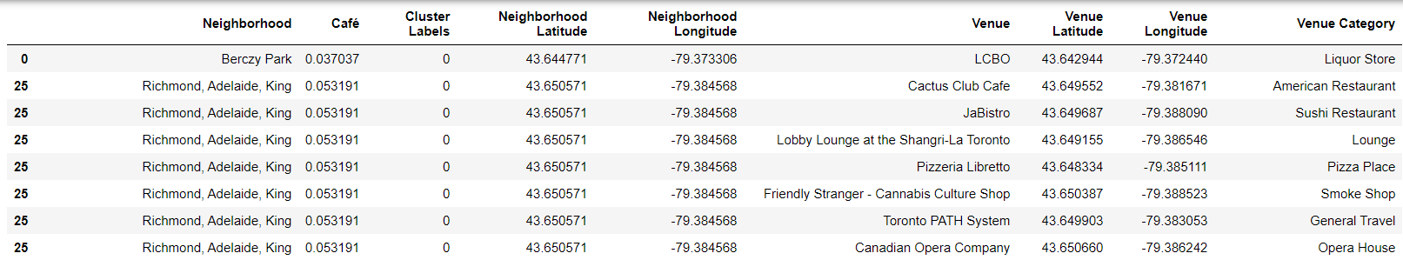
Results
After running the K-means clustering the data is clustered into 3 clusters which can be looked upon by observing the map or the datasets-
Cluster-0

Slide 9
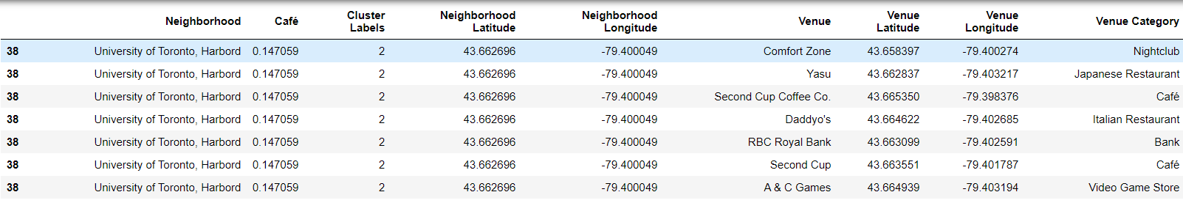
Results
Cluster-2

Slide 10
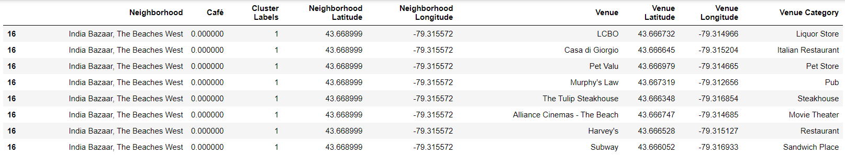
Results
Cluster-1

Slide 11
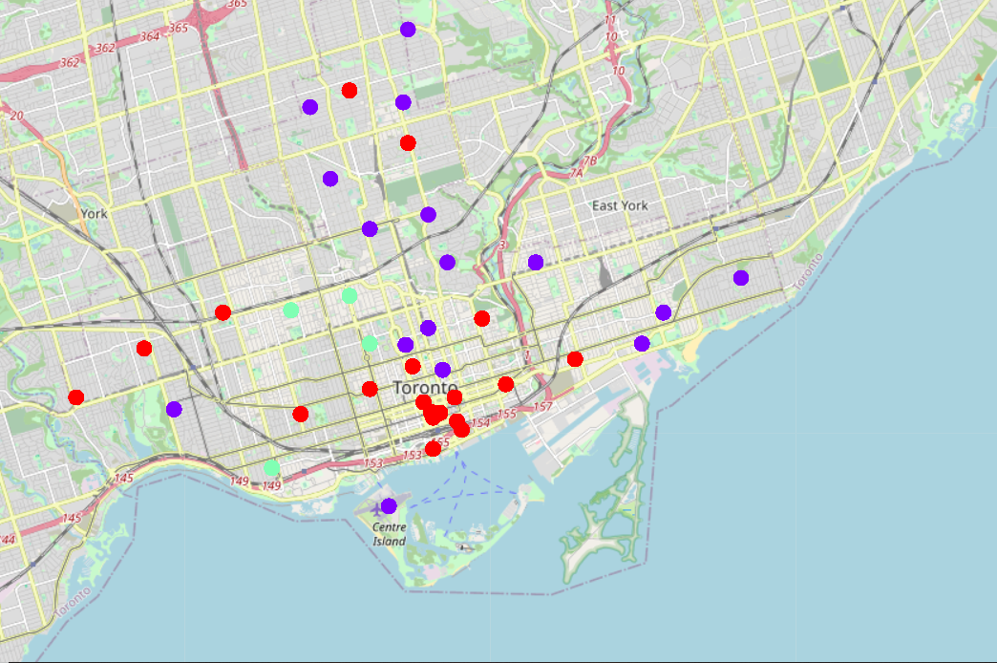
Data Visualization
Map:
Cluster-0: Red - Neighbourhoods with more Cafés
Cluster-1: Purple - Neighbourhoods with more Cafés
Cluster-2: Light Green - Neighbourhoods with very few Cafés

Slide 12
Discussion
Based on the café geolocation and venue foursquare data, the visualization of clustered data can be done using folium maps. The following insights can be drawn from the clustered data. The cluster-0 and cluster-1 seem way denser I comparison to cluster-2. As a result, there are more no of existing cafés in those region leading to the recommendation of the cluster-2 neighborhood to be utilized for starting a new café. The cluster-2 region includes the following neighborhood- University of Toronto, Harbord, Christie, Brockton, Parkdale Village, Exhibition Place.

Slide 13
Conclusion
The project enables entrepreneurs to get a better understanding of the neighborhood for the existing Cafés. This helps them to gain knowledge of the surroundings and to chalk out a region or neighborhood to venture into a new enterprise in the form of a café. This project takes the help of technology and data to draw insights out of data to be one step ahead in the competition.

Slide 14
Thank You!

