Slide 1
Fake Product Detection Using Image Processing In Blockchain
Project By-
Guided By -
***************
Department of
Computer Engineering
************

Slide 2
INDEX
Introduction
Problem Statement
Project Goal
Objectives
Literature Survey
Scope of the Project
Proposed System
System Architecture
Hardware & Software Requirements
Methodology
DFD Diagram
UML Diagram
Conclusion
References

Slide 3
Introduction
Blockchain technology or the distributed, secure ledger technology has gained much attention in recent years.
This paper presents a detailed survey of blockchain technology literature and its applications.
The sources of blockchain literature examined for this survey include research papers, books and book chapters, journal papers, specific cryptocurrency sites and wikis, conference papers, company ‘Point of View’s (PoVs), whitepapers published by various organizations implementing and experimenting in Blockchain.
Blockchain being a much hyped and experimented technology a lot of literature is found in content hosted on proprietary forums such as company websites, web articles, etc.
This survey is extensive and covers the various aspects of blockchain including consensus algorithms and their variations as well as currently implemented and possible future applications.

Slide 4
Problem Statement
To design and developed a system for supply chain management using blockchain technology, in this work system carried out three different modules like suppler, vendor and admin as well. Each transaction has stored into the blockchain which eliminate all network data attacks in P2P environment for health care systems.

Slide 5
Objectives
To study and analysis the basic execution of blockchain in distributed databases environment
To develop system for supply chain management for medicine using custom blockchain.
To design new hash generation, smart contract and mining approach for proposed blockchain.
To validate the system with various consensus algorithm in Peer to Peer (P2P) environment.

Slide 6
Literature review
Sr. No | Title and Authors | Conference Name and Publication Year | Topic Reviewed/ Algorithms or methodology used | Future Scope
1 | “Blockchain for Giving Patients Control Over Their Medical Records” Madine, Mohammad Moussa, et al | Khalifa University of Science and Technology, Vol. 8, pp. 193102 – 193115, 2020 | A blockchain-based architecture to manage access control of PHR systems. Our proposed approach decentralizes all the patient-doctor interactions. | By lowering the cost of monitoring, configuration and maintaining a central server for the data and the administration maintaining the medical data. The use of blockchains in clinical settings will dramatically cut down on processing time.
2 | "Blockchain-based secure storage and access scheme for electronic medical records in IPFS.“ Sun, Jin, et al. | IEEE Access, Volume: 8, pp 59389 – 59401, 24 March 2020 | In this system it propose a new encryption scheme for secure storage and efficient sharing of electronic medical records based on the attribute based encryption system, blockchain technology, and the Inter Planetary File System (IPFS) storage platform. | Future study aimed to look at developing a more ideal and Diverse Blockchain Smart Healthcare Governance framework that takes into mind diverse culture and technical backgrounds.

Slide 7
Literature review
Sr. No | Title and Authors | Conference Name and Publication Year | Topic Reviewed/ Algorithms or methodology used | Future Scope
3 | Health Record Management through Blockchain Technology Harshini V M, Shreevani Danai, Usha H R, Manjunath R K | Proceedings of the Third International Conference on Trends in Electronics and Informatics , 23-25 April 2019 | Hospital admin as one end user and the patient as another party. There are three steps of executing the smart contract namely, Invoking, Record creation, and Validation. This paper suggests Blockchain technology as one of the possible solutions for the efficient maintenance of health records. implementation of Blockchain in all domains making the lives easier. | Future Blockchain studies not only aids in decentralizing data, but also provides real-time data access, maintains data confidentiality, efficiently processes large volumes of data, and authenticates and authorizes data.

Slide 8
Literature review
Sr. No | Title and Authors | Conference Name and Publication Year | Topic Reviewed/ Algorithms or methodology used | Future Scope
4 | A Blockchain- Based Medical Data Sharing And Protection Scheme Xiaoguang Liu, Ziqing Wang , Chunhua Jin , Fagen Li , And Gaoping Li | IEEE Bombay Section Signature Conference, Vol. 7, pp. 118943 – 118953, 26 August 2019 | At the time of registration, the hospital or patient will be checked to ensure that all participators of the network are legitimate. After the hospital registers with SM,SM will generate a pseudo identity for the hospital. When one patient sees a doctor, doctor will also compute a pseudo identity for the patient. Thus, user privacy will be protected since the pseudo identity is used instead of true identity in the subsequent processes. | Fine-grained access and privacy control policies with rich semantics. Attribute-based encryption is a feasible solution for Medical records which contain multiple fields with different sensitivity

Slide 9
Literature review
Sr. No | Title and Authors | Conference Name and Publication Year | Topic Reviewed/ Algorithms or methodology used | Future Scope
5 | Healthy block: Blockchain Based IT Architecture for Electronic edical Records Resilient to Connectivity Failures Omar Gutiérrez, Giordy Romero, Luis Pérez, Augusto Salazar | International Journal of Environmental Research and Public Health, Vol. 17, 2020 | Healthy Block is proposed as an architecture based on blockchain networks that allows the development of electronic medical record systems shared between different clinical providers, with resilience in data integrity in the event of connectivity failures and with usability, security, and privacy characteristics. | Since it presently functions as a common linked list with a high size projected to arrive, future work will propose the establishment of a new data structure for the blockchain, which provides not only data security but also a more efficient query. It is proposed to Continue investigating other Consensus algorithms.

Slide 10
Proposed System
The system contains following modules:
Admin
Make transaction
Block Generation and blockchain validation
Consensus Algorithm validation and block chain recovery
Results Generation
This system highlights the implementation of e-transaction system using blockchain for such a proposal from a practical point view in both development/deployment and usage contexts.
Concluding this work is a potential roadmap for blockchain technology to be able to support complex applications.

Slide 11
Continue..
In the system carried out transaction system for online user, where end user easily access the system and make the transaction without using any third party validation .
The system can’t be generating any high level hardware configuration requirement, it possible to make vote using traditional configuration.
The able to perform the transaction without any hardware device with drastic security manner.
In this data is processed in multiple servers so the transactions are processed in sequencing P2P distributed network. This illuminates the quality of service issue and time limits.
This is a middleware system in which the processing environment in which the load will be balanced using threads.

Slide 12
Continue..
The request generated will be parallels saved on all nodes in a Blockchain manner
We use the Hash generation algorithm and the Hash will be generated for the given string.
Before executing any transaction, we use peer to peer verification to validate the data.
If any chain is invalid then it will recover or update the current server blockchain.
This will validate till the all nodes are verified and commit the query.
Mining algorithm is used for checking the hash generated for the query till the valid hash is generated.

Slide 13
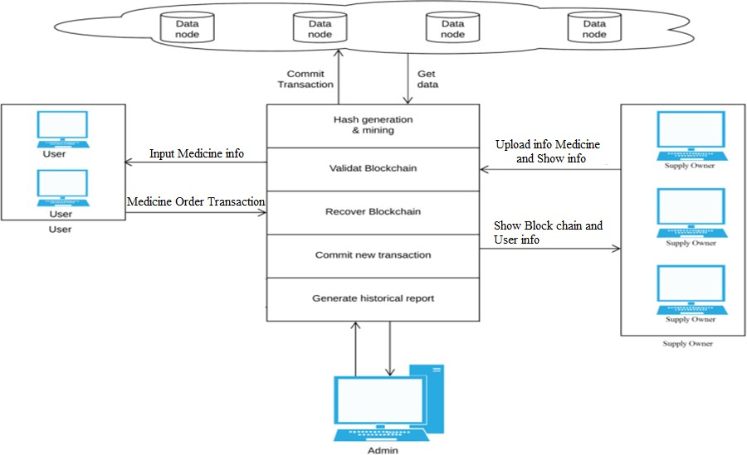
System Architecture

Slide 14
Methodology
The central outline of the proposed algorithm is the implementation of ration distribution data storage using block chain.
System creates the trustworthy communication between multiple parties without using any third party interface.
We use the Hash generation algorithm and the Hash will be generated for the given string.
Before executing any transaction, we use peer to peer verification to validate the data.
If any chain is invalid then it will recover or update the current server blockchain.
This will validate till the all nodes are verified and commit the query.
Mining algorithm is used for checking the hash generated for the query till the valid hash is generated.

Slide 15
Hardware & Software Requirements
1)Hardware interfaces:
= Processor: Intel Pentium 4 or above = Coding Language: Java
= Memory: 2 GB or above = Database: MySQL
= Printer = Services: Web Based
= Hard Disk: 10GB = IDE: Eclipse Juno
= OS: Windows 7 = Front end JSP/Servlet
2) Software interfaces:
*Front End- * Back End-
= JDK 1.7.0 = MySQL 5.1
= Eclipse 7.4.1
= Internet Explorer 7.0 or above

Slide 16
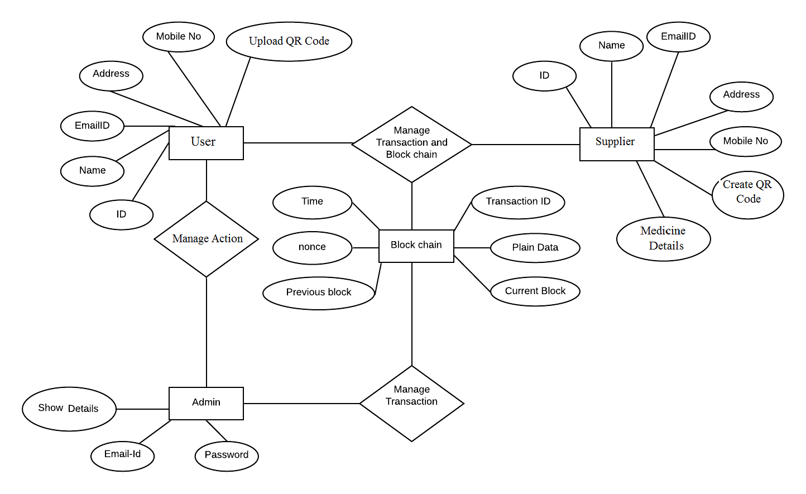
Entity Relationship Diagram

Slide 17
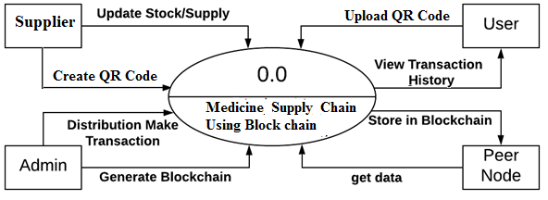
Data Flow Diagrams
DFD Zero

Slide 18
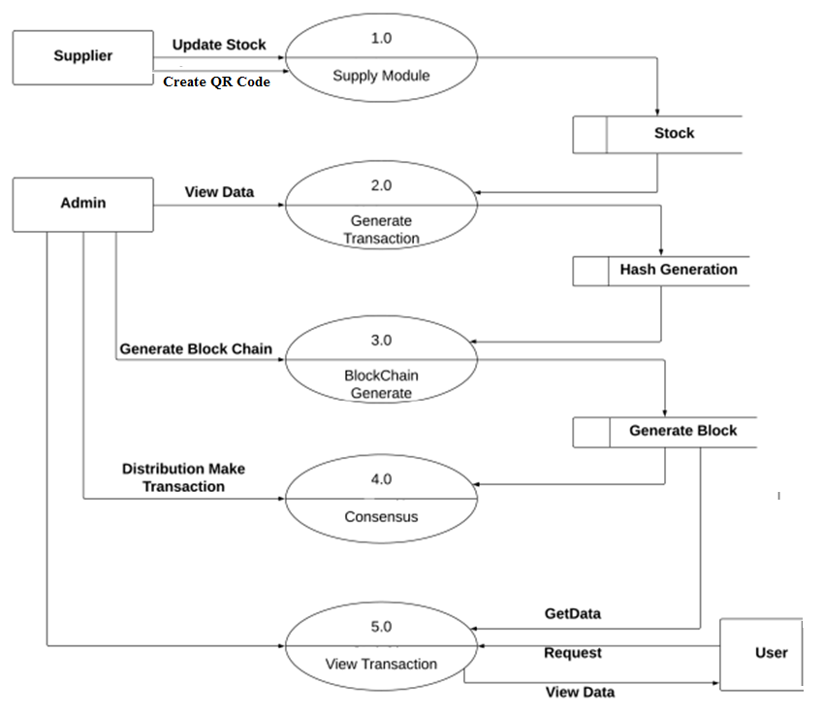
DFD Multilevel

Slide 19
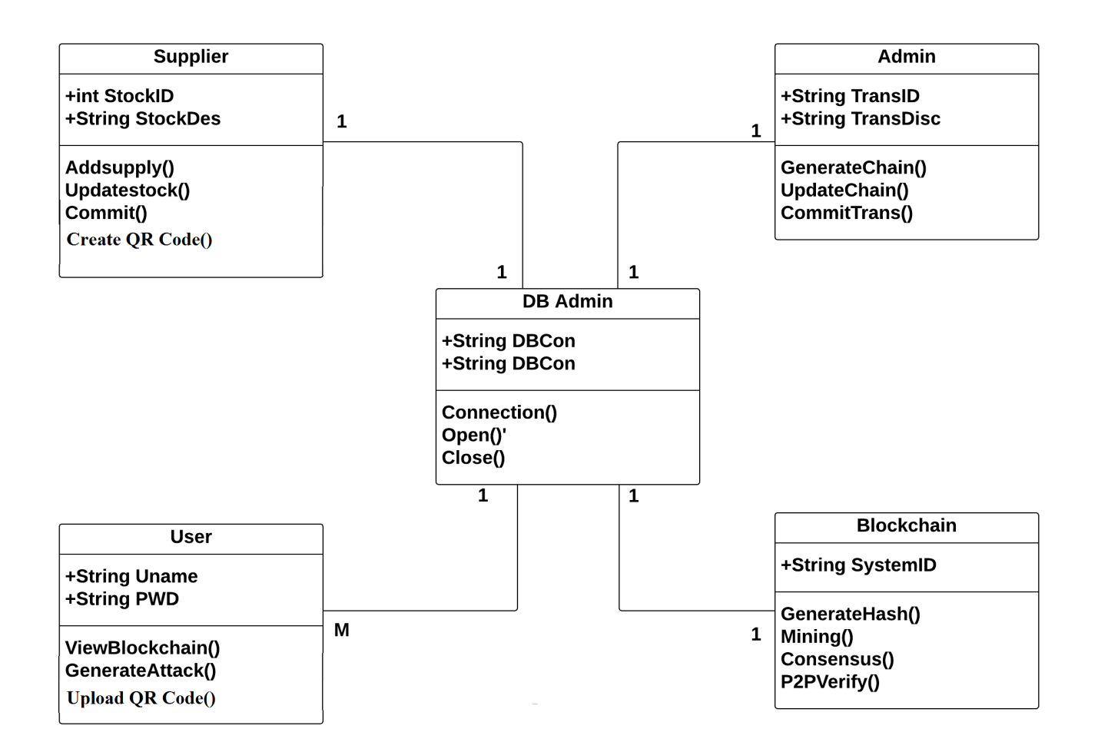
UML Diagram
Class Diagram

Slide 20
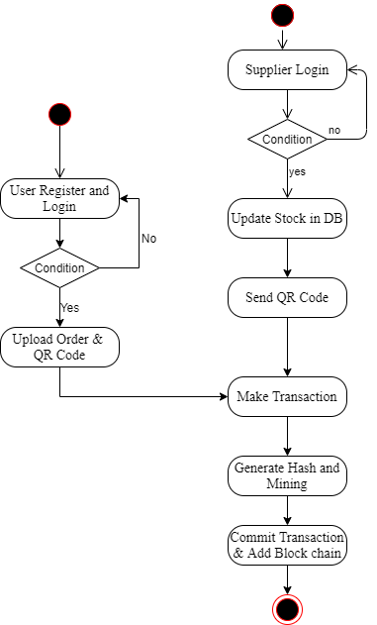
Activity Diagram

Slide 21
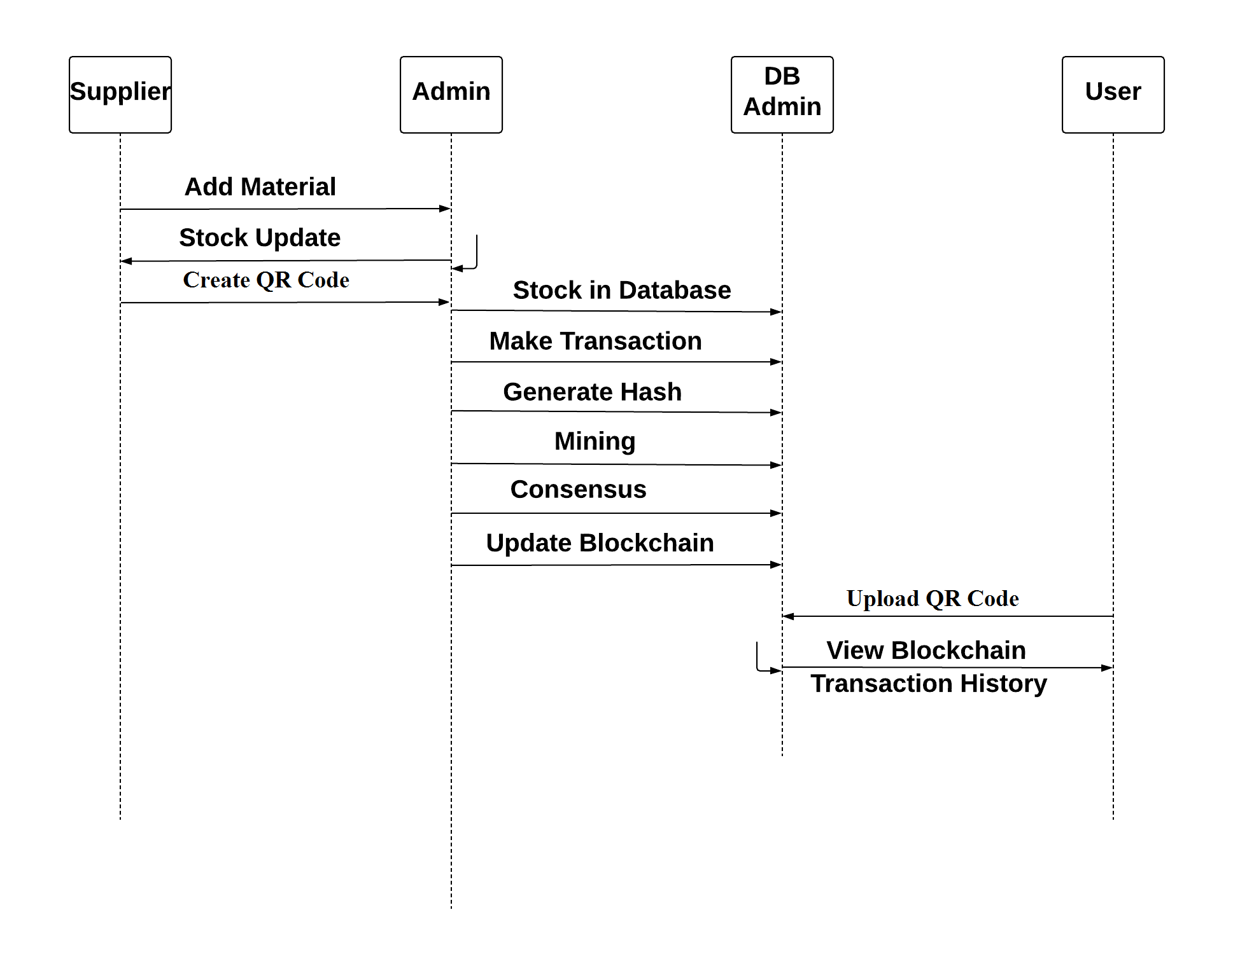
Sequence Diagrams

Slide 22
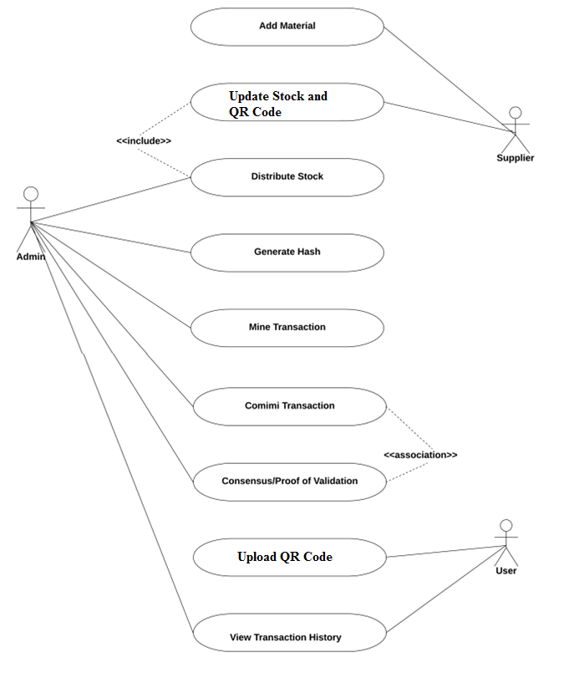
Use Case Diagrams

Slide 23
Conclusion
Because of the complexities of this area and the need for more stable and efficient information management frameworks, there are several research directions to apply Blockchain technology to the transaction industry. In several cases of transaction usage that face similar data exchange and communication problems, an interoperable architecture will certainly play a significant role. Further research on safe and efficient software practise for the use of Blockchain technology in transactions is also required to educate software engineers and domain experts on the potential and also limitations of this new technology, whether to build a decentralised application using an established Blockchain. The algorithm has chosen the acceptable complexity, efficiency and complexity of implementation to operate the system. Through empirical studies, we have a better understanding of the pace of knowledge creation in the supply chain. There are several important hurdles to getting on the blockchain reaching its full potential and applying it to health is the most important issue technology scalability and data controls

Slide 24
References
[1] Madine, Mohammad Moussa, et al. "Blockchain for giving patients control over their medical records." IEEE Access 8 (2020): 193102-193115.
[2]Sun, Jin, et al. "Blockchain-based secure storage and access scheme for electronic medical records in IPFS." IEEE Access 8 (2020): 59389-59401.
[3]Harshini, V. M., et al. "Health record management through blockchain technology." 2019 3rd International Conference on Trends in Electronics and Informatics (ICOEI). IEEE, 2019.
[4] Liu, Xiaoguang, et al. "A blockchain-based medical data sharing and protection scheme." IEEE Access 7 (2019): 118943-118953.
[5] Gutiérrez, Omar, et al. "HealthyBlock: Blockchain-Based IT Architecture for Electronic Medical Records Resilient to Connectivity Failures." International Journal of Environmental Research and Public Health 17.19 (2020): 7132.

