Slide 2
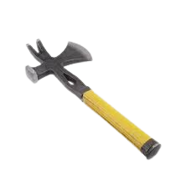
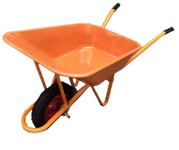
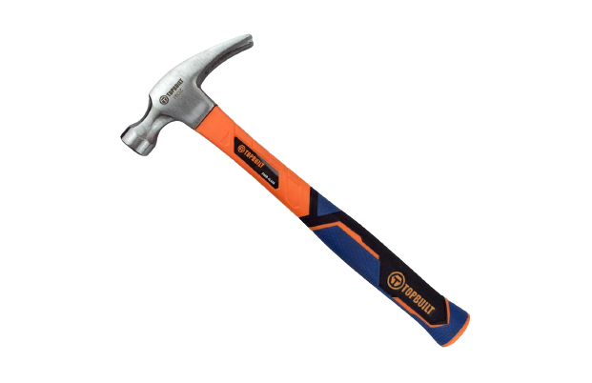
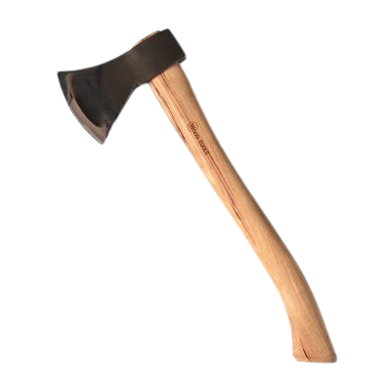
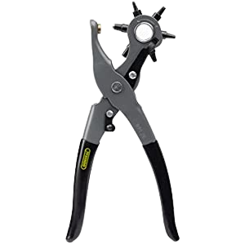
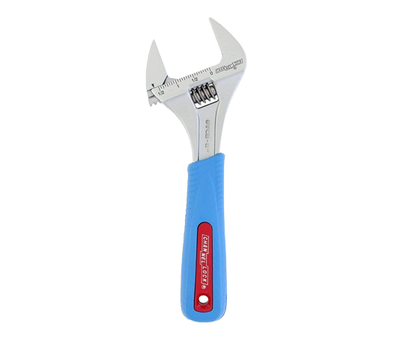
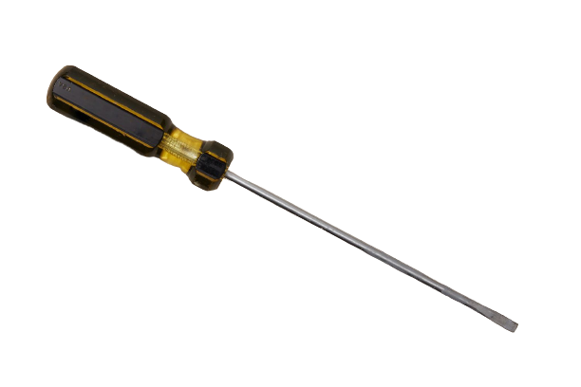

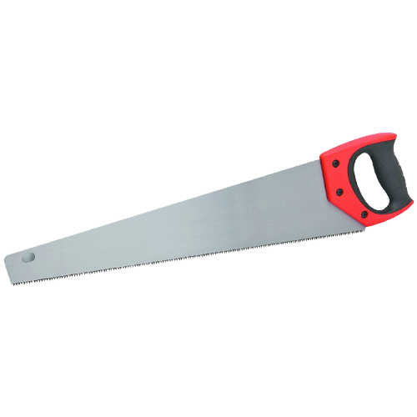
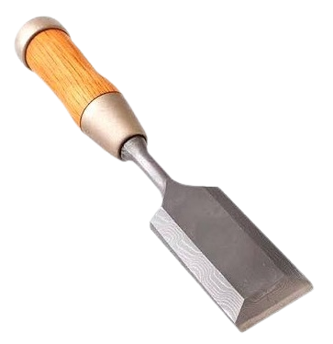
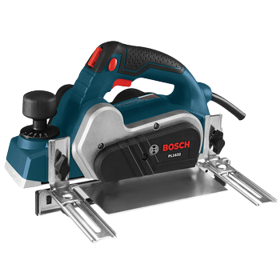
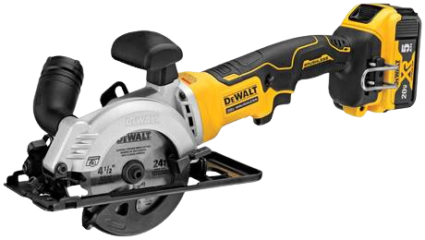

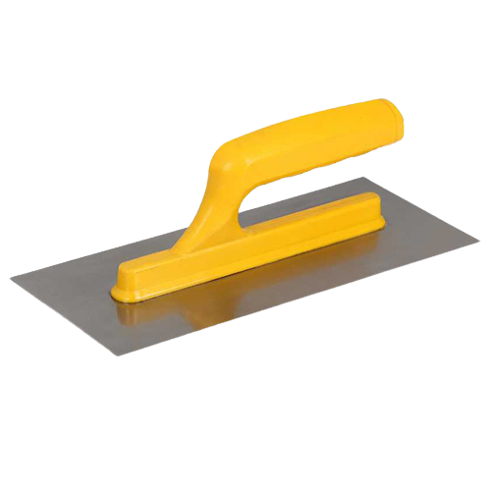
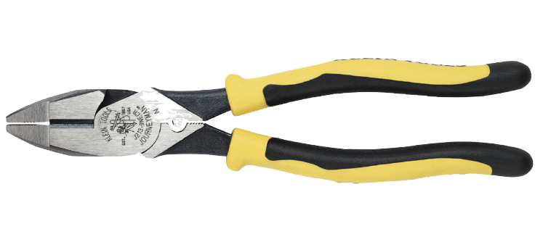
$4
$8
$5
$6
$7
Tool = Graph Node
$9
$14
$8
$10
$13
$12
$12
$11
$15
$16

Slide 3
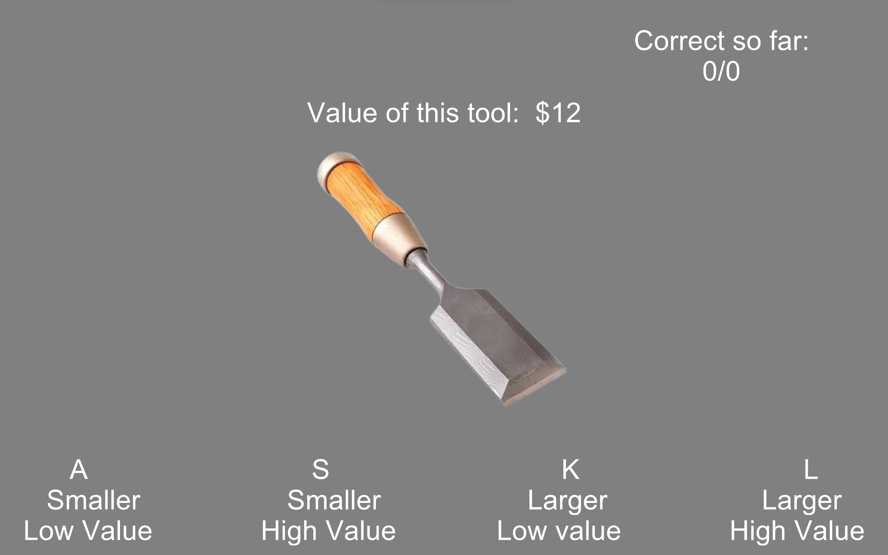

Is the tool smaller or larger than a shoebox?
Is the tool’s value lower or higher than $10?
Green checkmark Feedback = Correct
Red crossmark feedback = Incorrect
On
Response
Keypress
Stimulus order: Eulerian walk (each edge visited exactly once) through the Graph Structure.

Slide 4
$4
$4
Switch Tool Order
One tool smaller than, other larger than shoebox
(update response keys)
vs
Both tools smaller or larger than shoebox
(same response keys)
$8
$5
$8
$5
$6
$7
$6
$7
$9
$14
$9
$14
$8
$10
$13
$12
$8
$10
$13
$12
$12
$11
$15
$16
$12
$11
$15
$16

Slide 5
$4
$11
Switch Tool Rewards
One tool valued less than, other greater than $10
(update response keys)
vs
Both tools valued less or greater than $10
(same response keys)
$8
$5
$8
$5
$6
$7
$6
$7
$9
$14
$9
$14
$8
$10
$13
$12
$8
$10
$13
$12
$12
$11
$15
$16
$12
$4
$15
$16

Slide 6
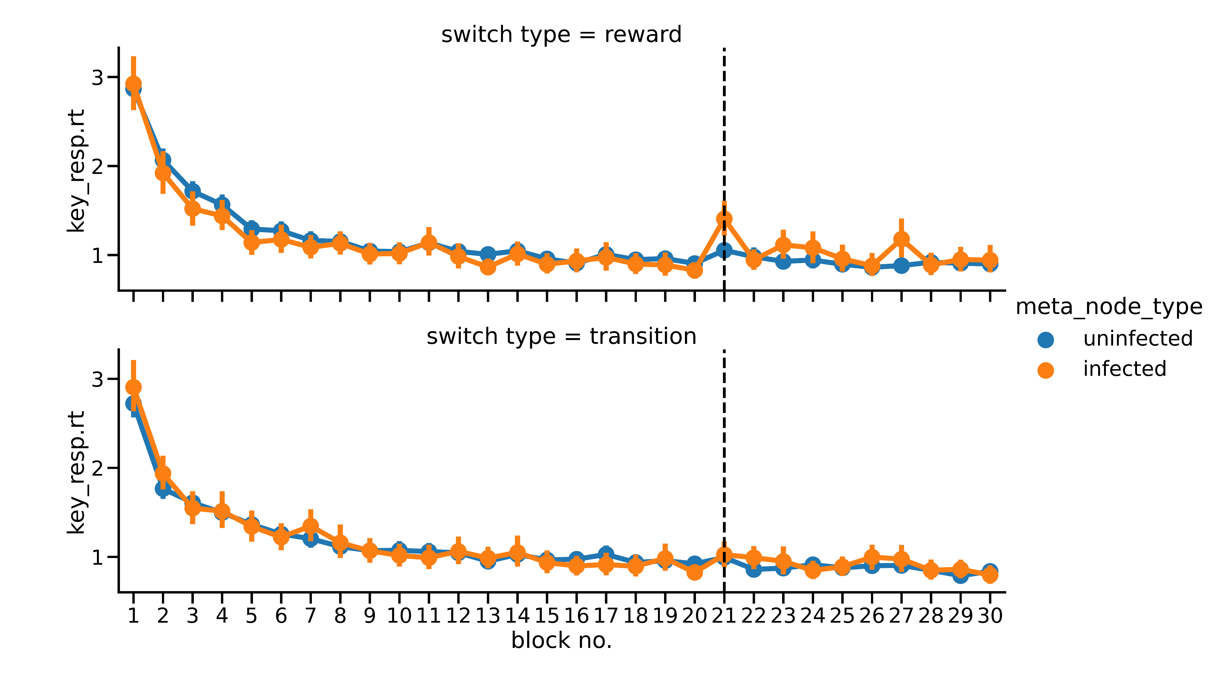
Reward Switch
Initial Exposure
Node Type
Response Time
Transition Switch
Unchanged
Changed
Initial Exposure
Block (Eulerian path) Number

Slide 7
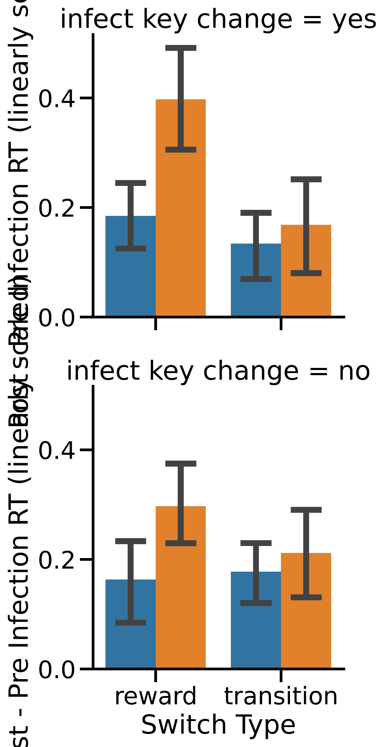
*
Correct Response Key Changed
Unchanged node
Reward
Switch
Transition
Switch
Changed node
Post – Pre Switch Response Time
*
Correct Response Key Unchanged
Reward
Switch
Transition
Switch

