Slide 2
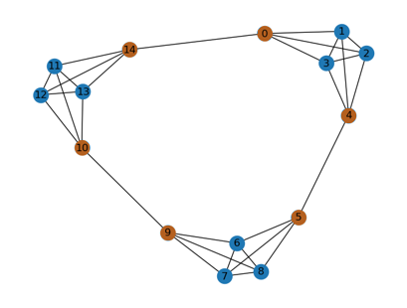
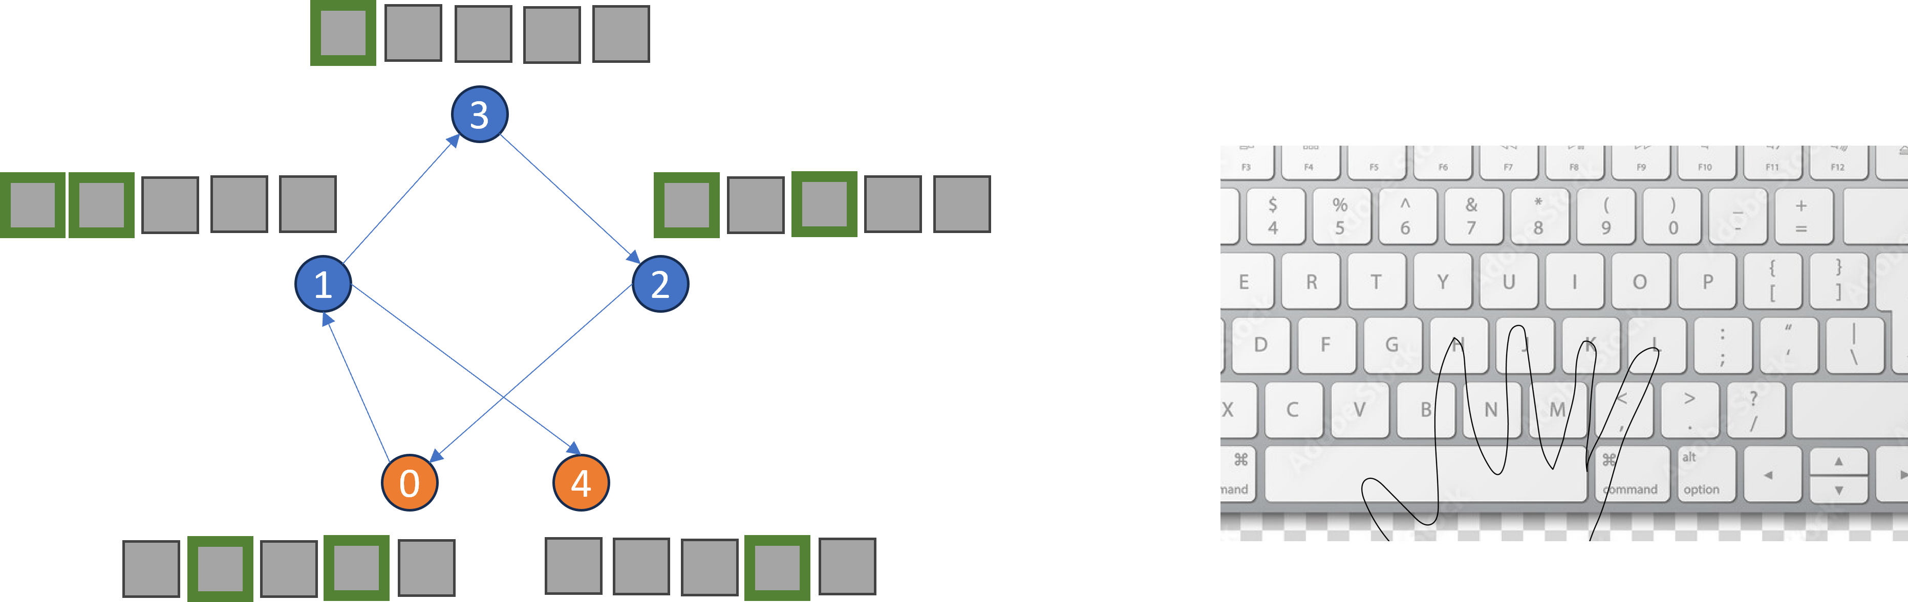
Underlying Transition Structure
Randomly assigned node-to-arrangement stimuli.
Keypress Response

Slide 3
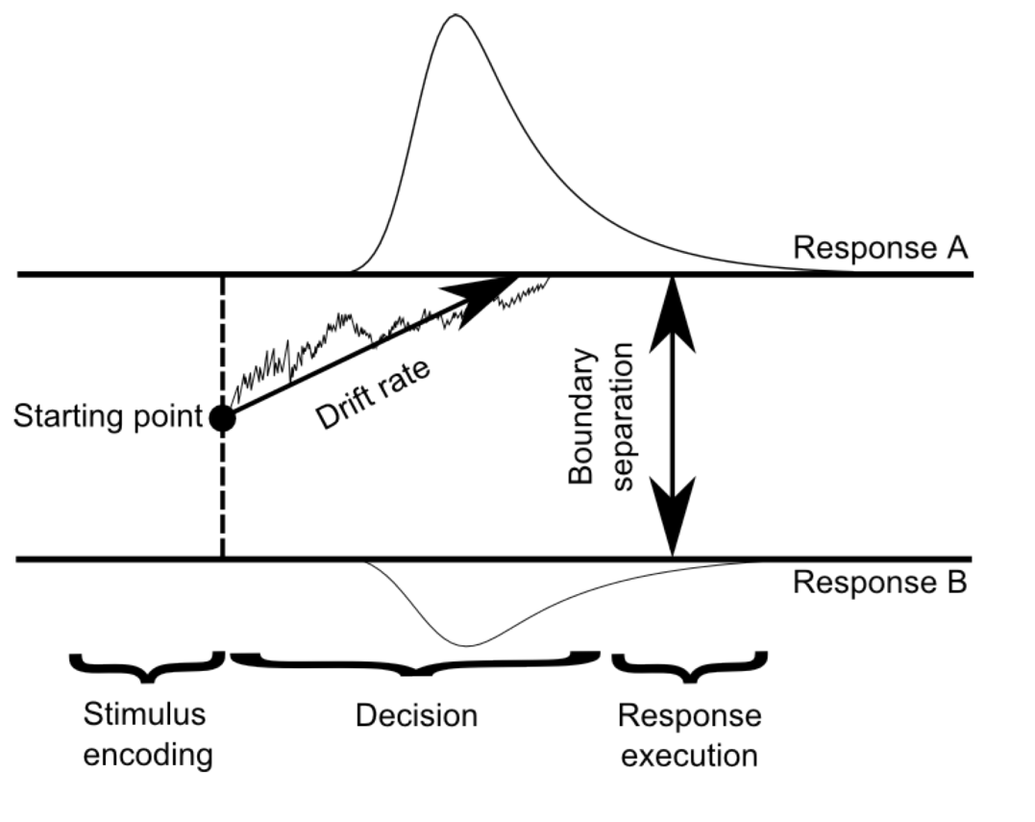
‘Old’
a
z
v
‘New’
ter

Slide 4
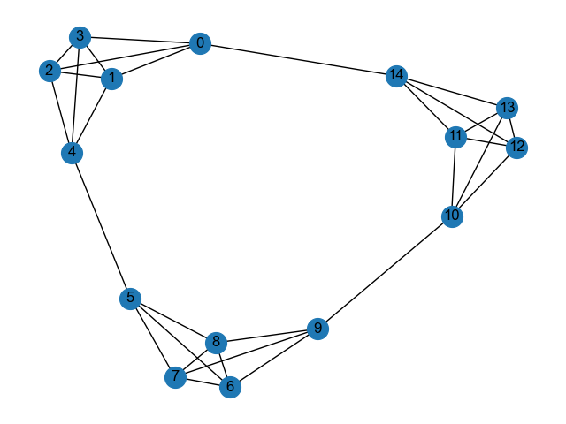
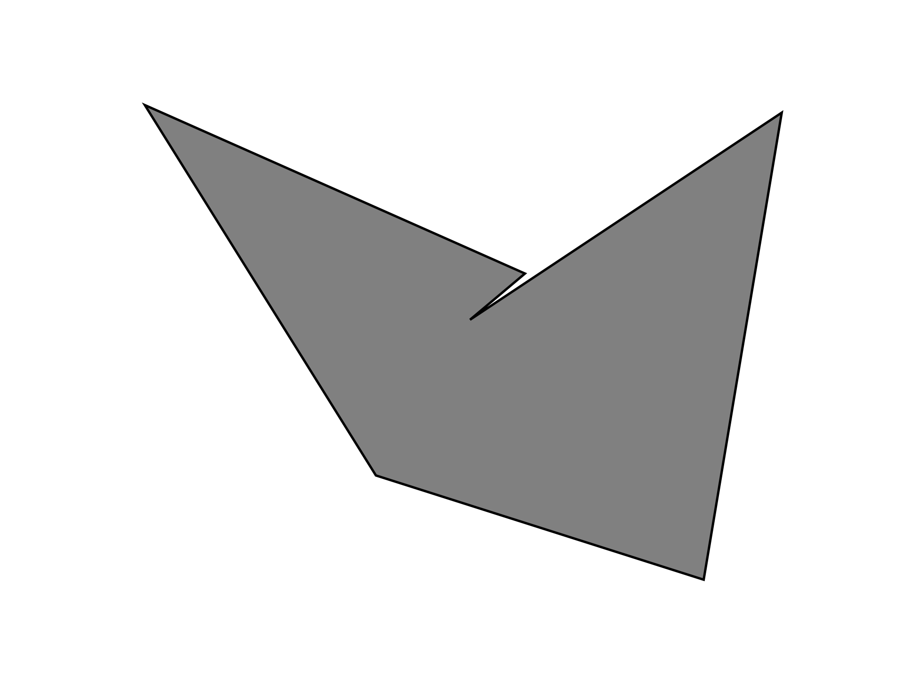
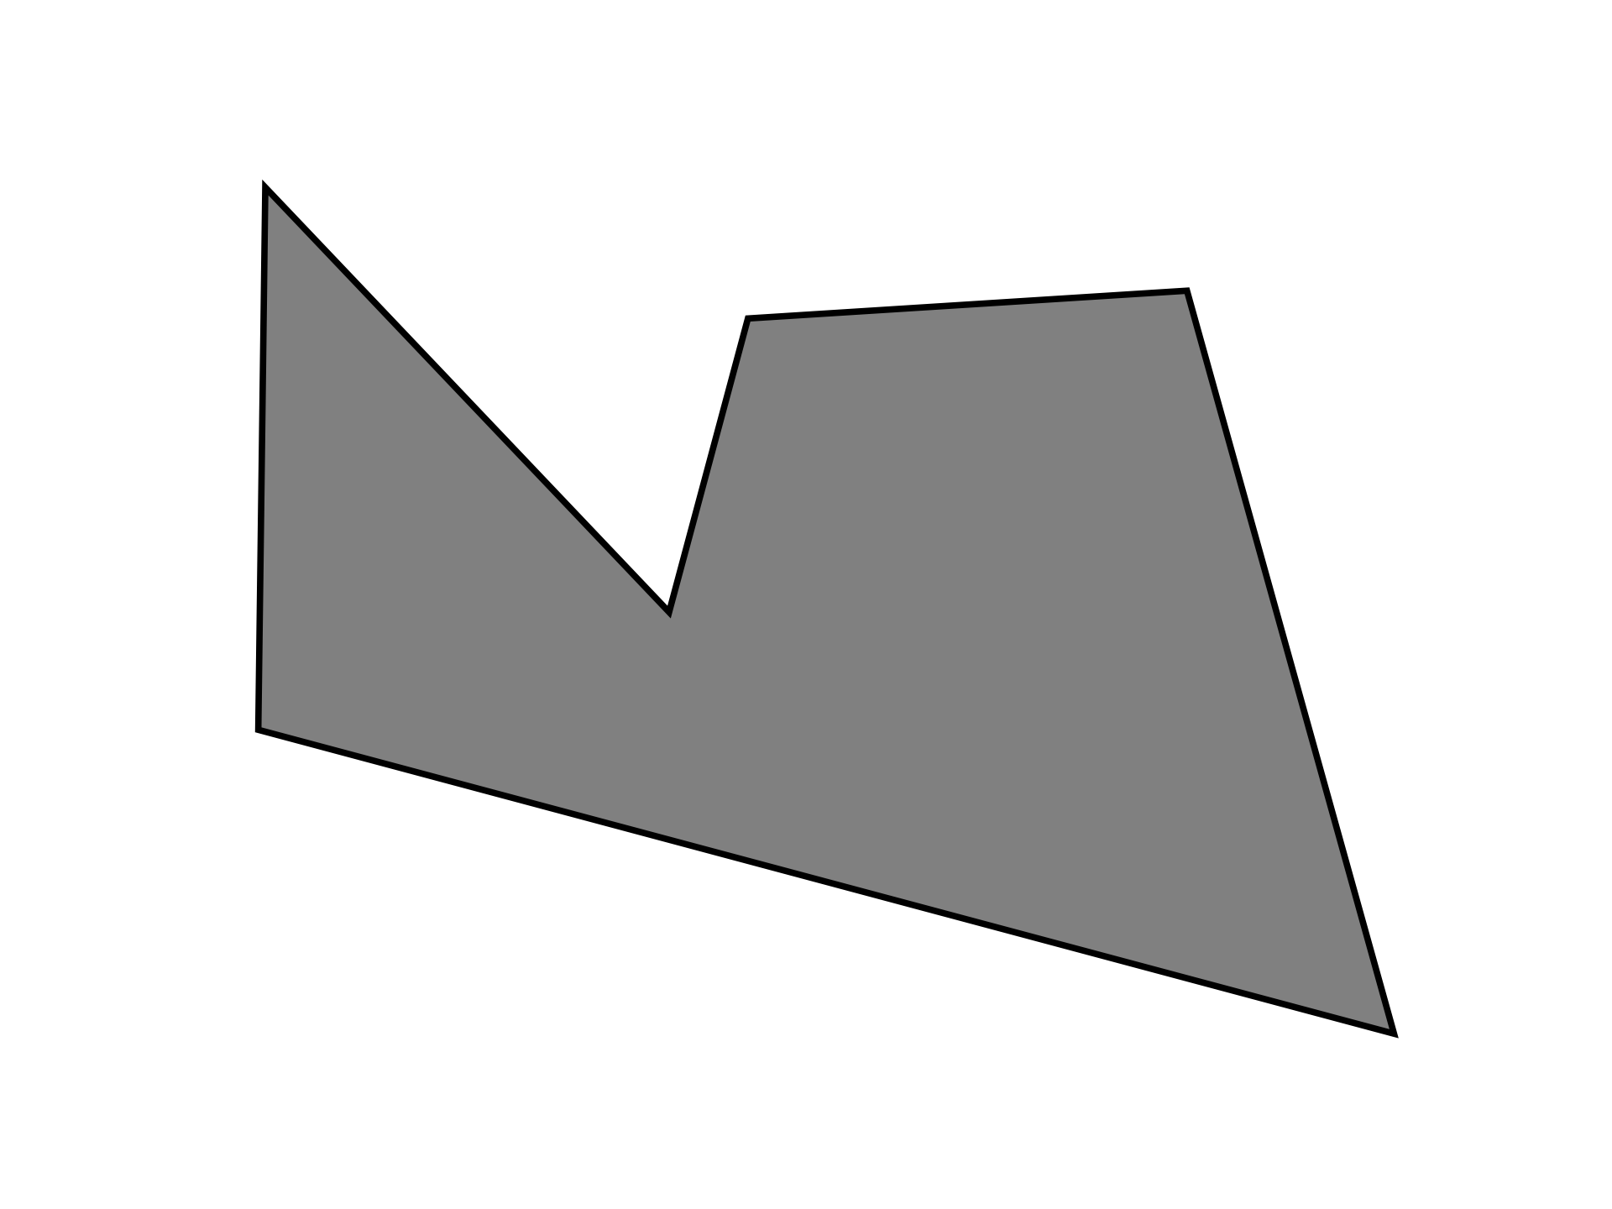
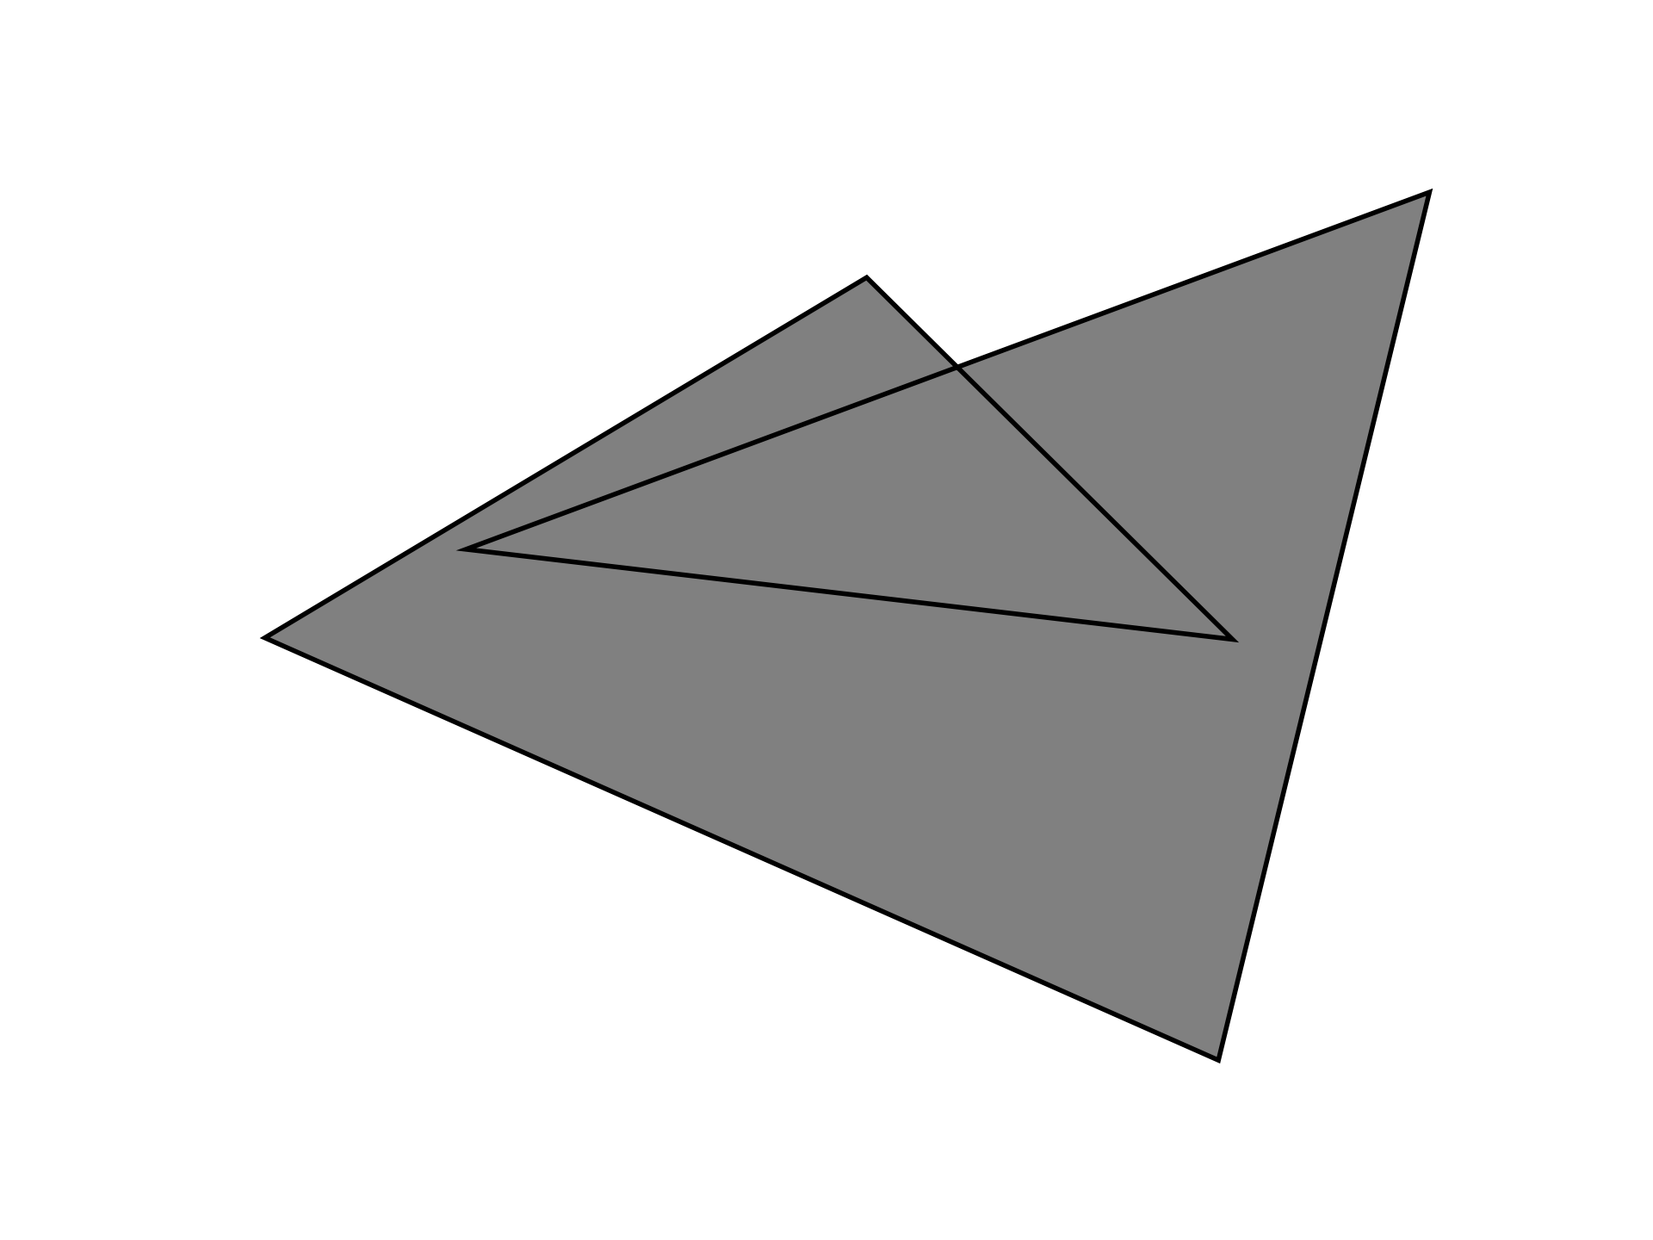
Item presentation order determined by random walk through the graph
Exposure
Is this item rotated?
Recognition Test
Was this an old item (one of the items you had seen before) or a new item (an item you haven't seen before)?
30 trials, 15 old
250 Trials

Slide 5
Exposure
Is this item rotated?
Distance Judgment Test
After seeing this item
Which of the following items was likely to appear first?
300 Trials

Slide 6

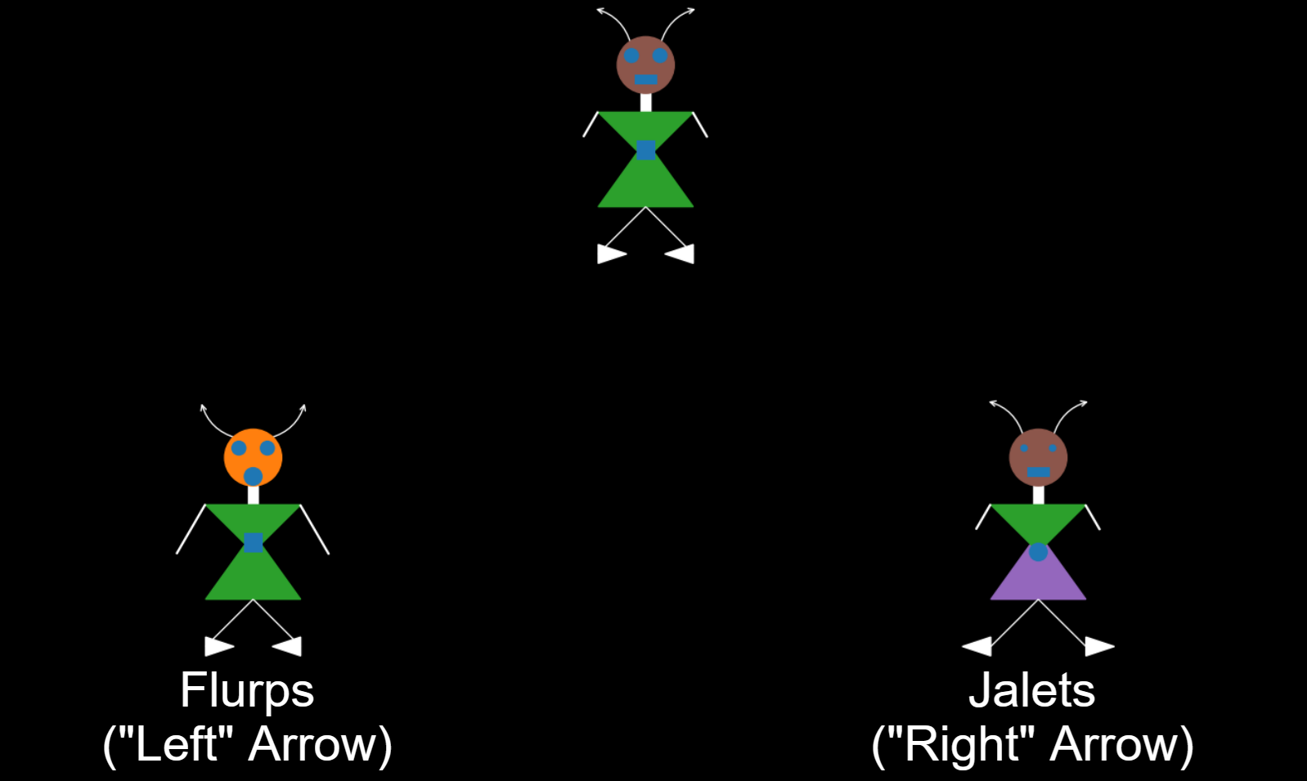


Exposure
Categorization Test
Which category does this alien belong to?
300 trials

Slide 7
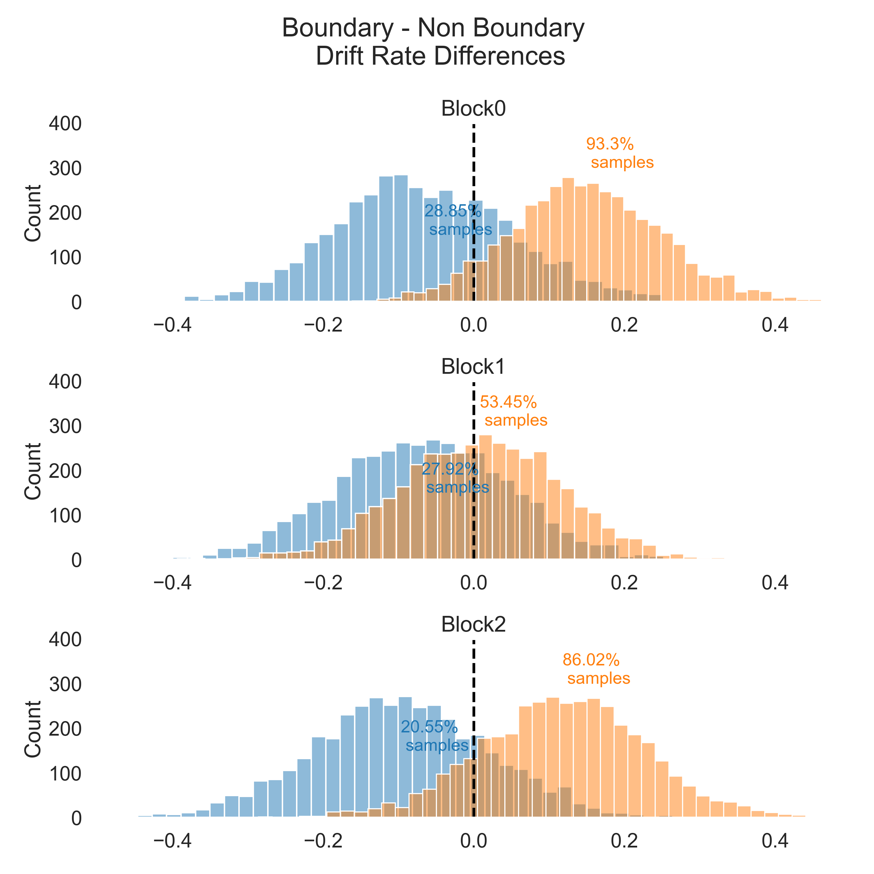
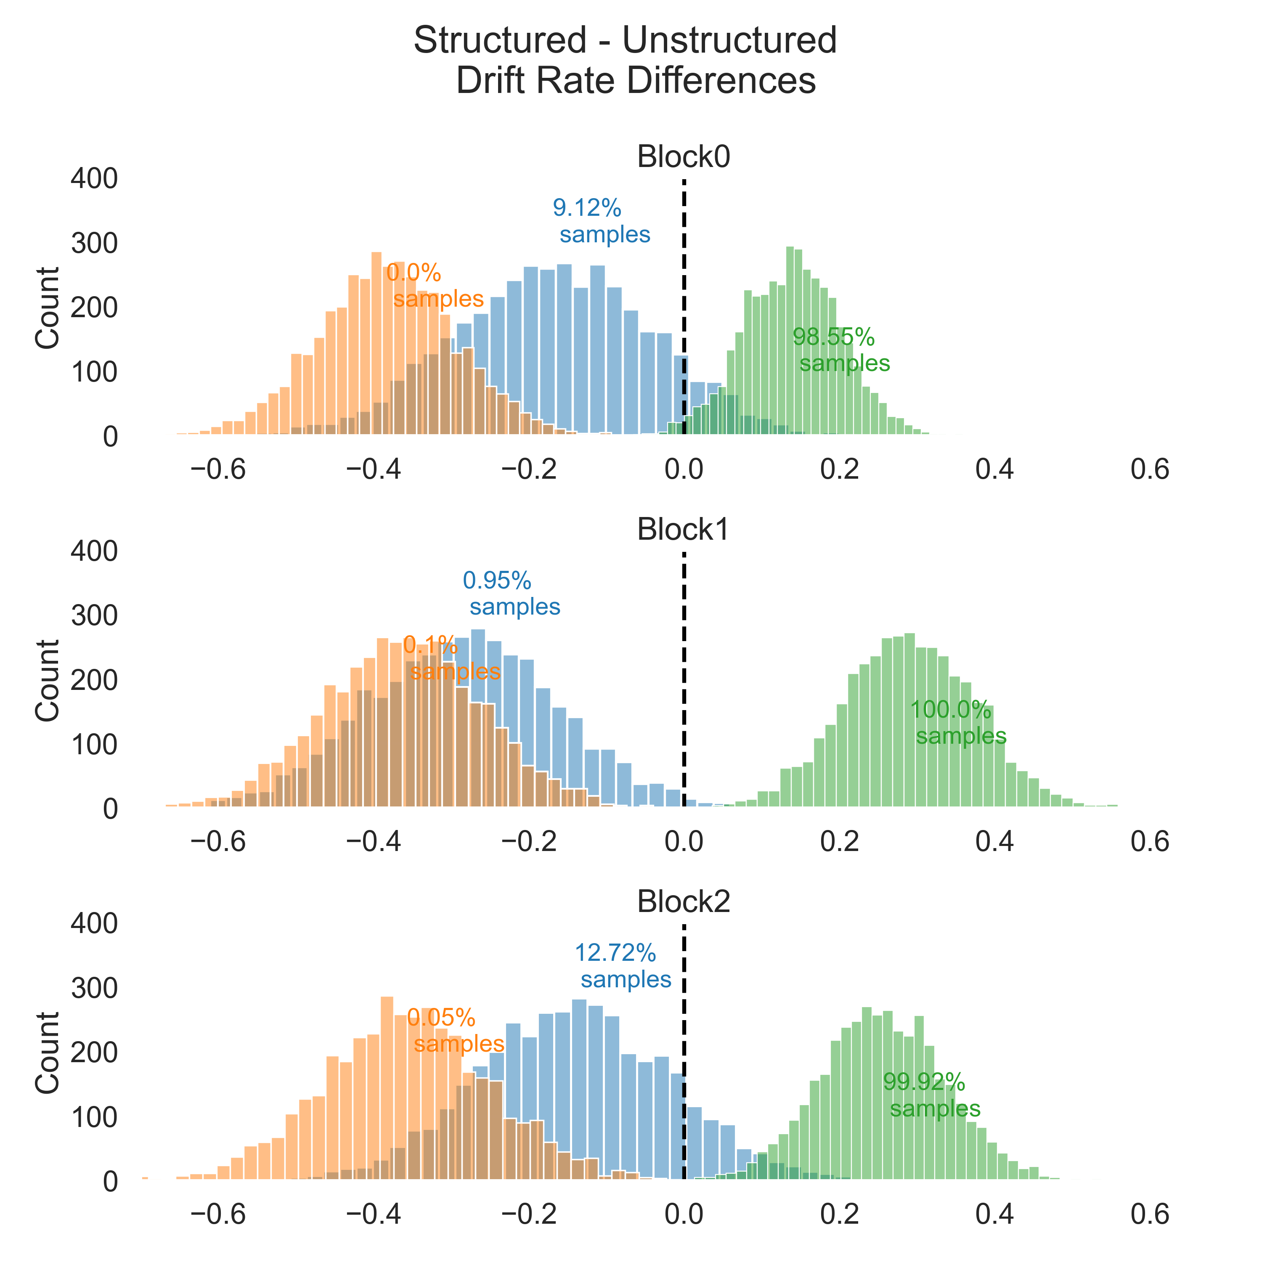
Unstructured
Structured
Nonboundary
Boundary
New
Unstructured
Structured
Nonboundary
Boundary
New
Unstructured
Structured
Nonboundary
Boundary
New

Slide 8
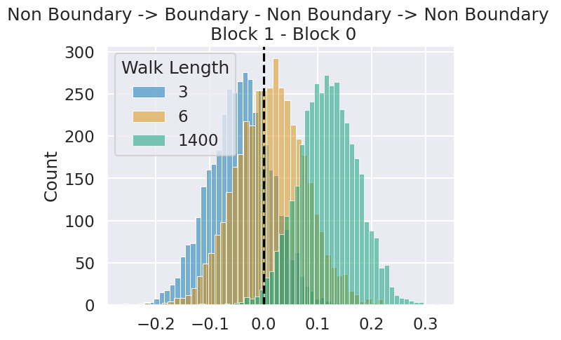
Boundary – Non Boundary Nodes
Block 1 – Block 0

Slide 9
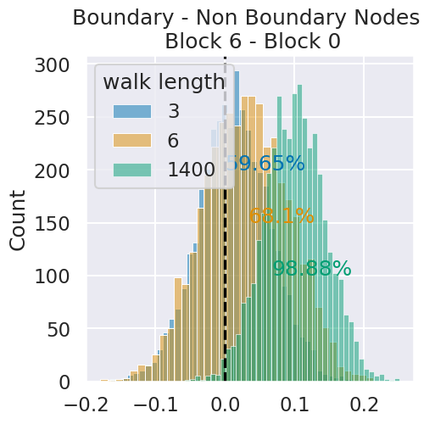

Slide 10
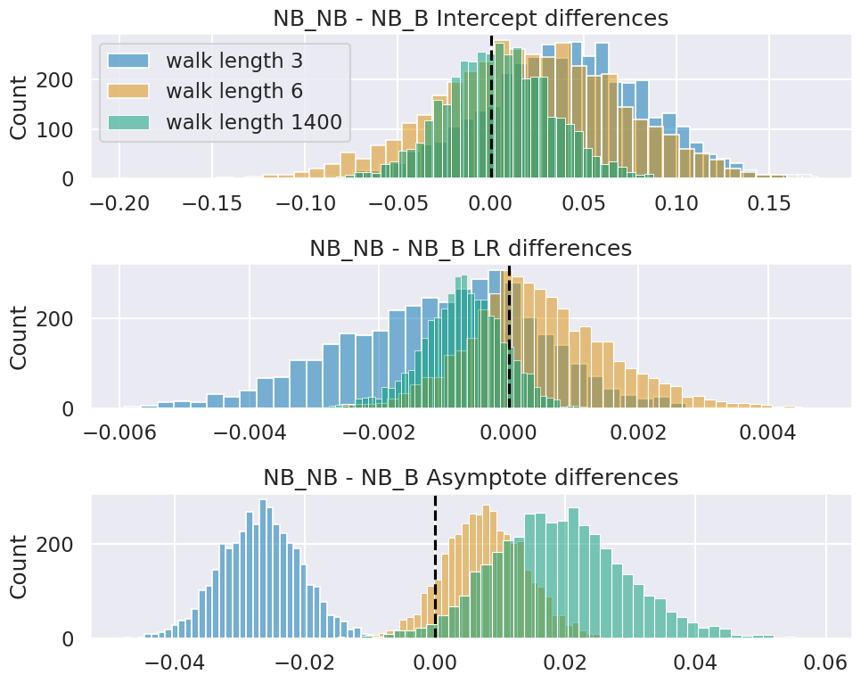
Exponential Model

Slide 11


