Slide 2
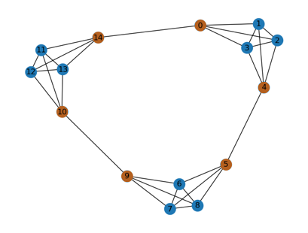
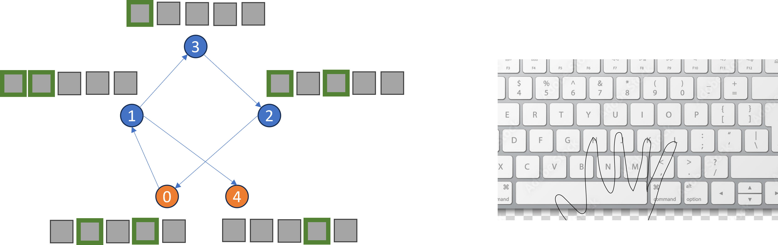
Underlying Transition Structure
Randomly assigned node-to-arrangement stimuli.
Keypress Response

Slide 3
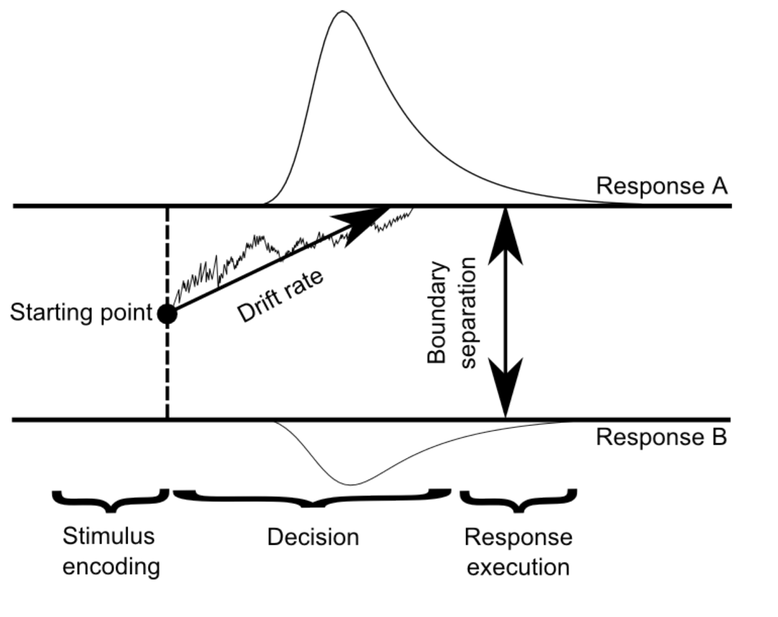
‘Old’
a
z
v
‘New’
ter

Slide 4
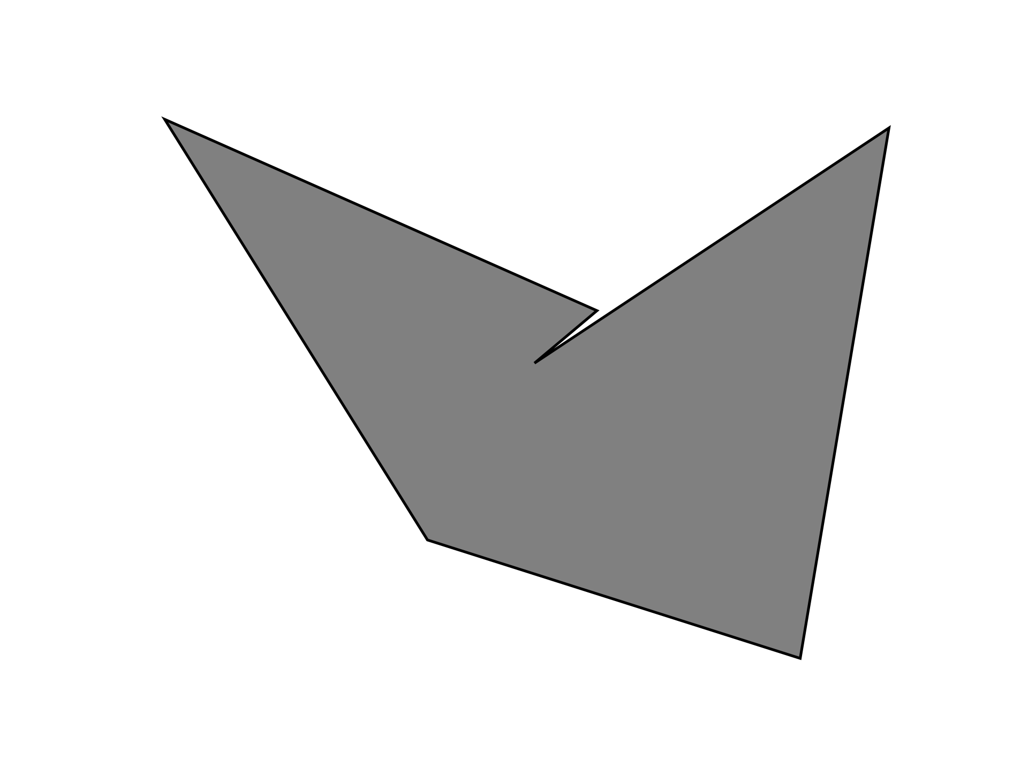
Exposure
Is this item rotated?
Recognition Test
Was this an old item (one of the items you had seen before) or a new item (an item you haven't seen before)?
250 Trials
30 trials, 15 old

Slide 5
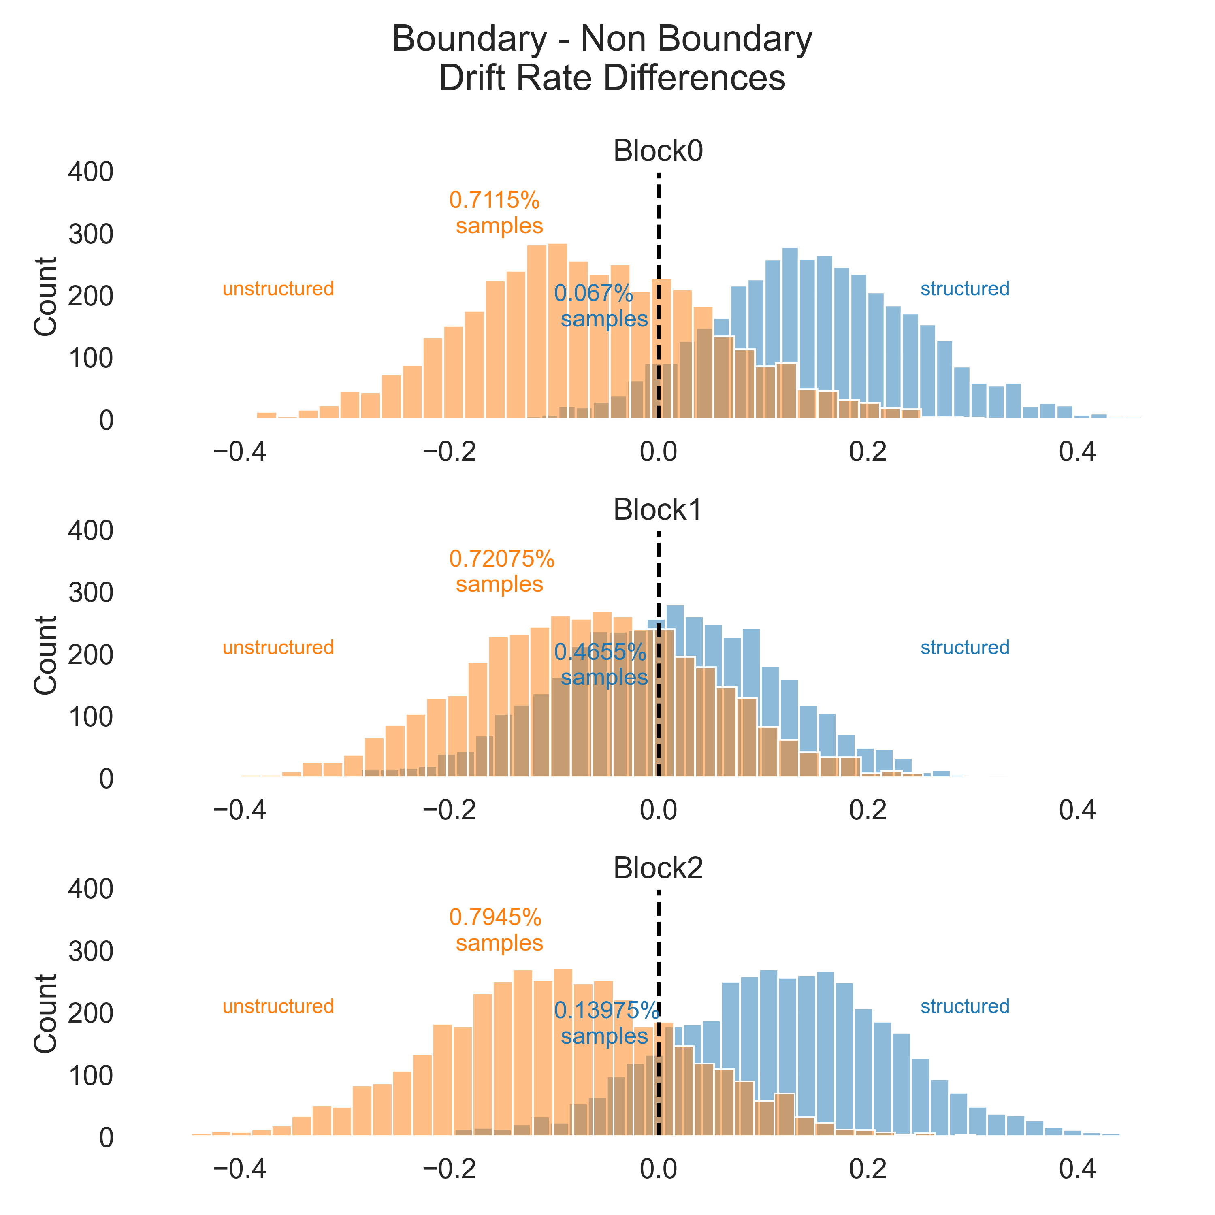
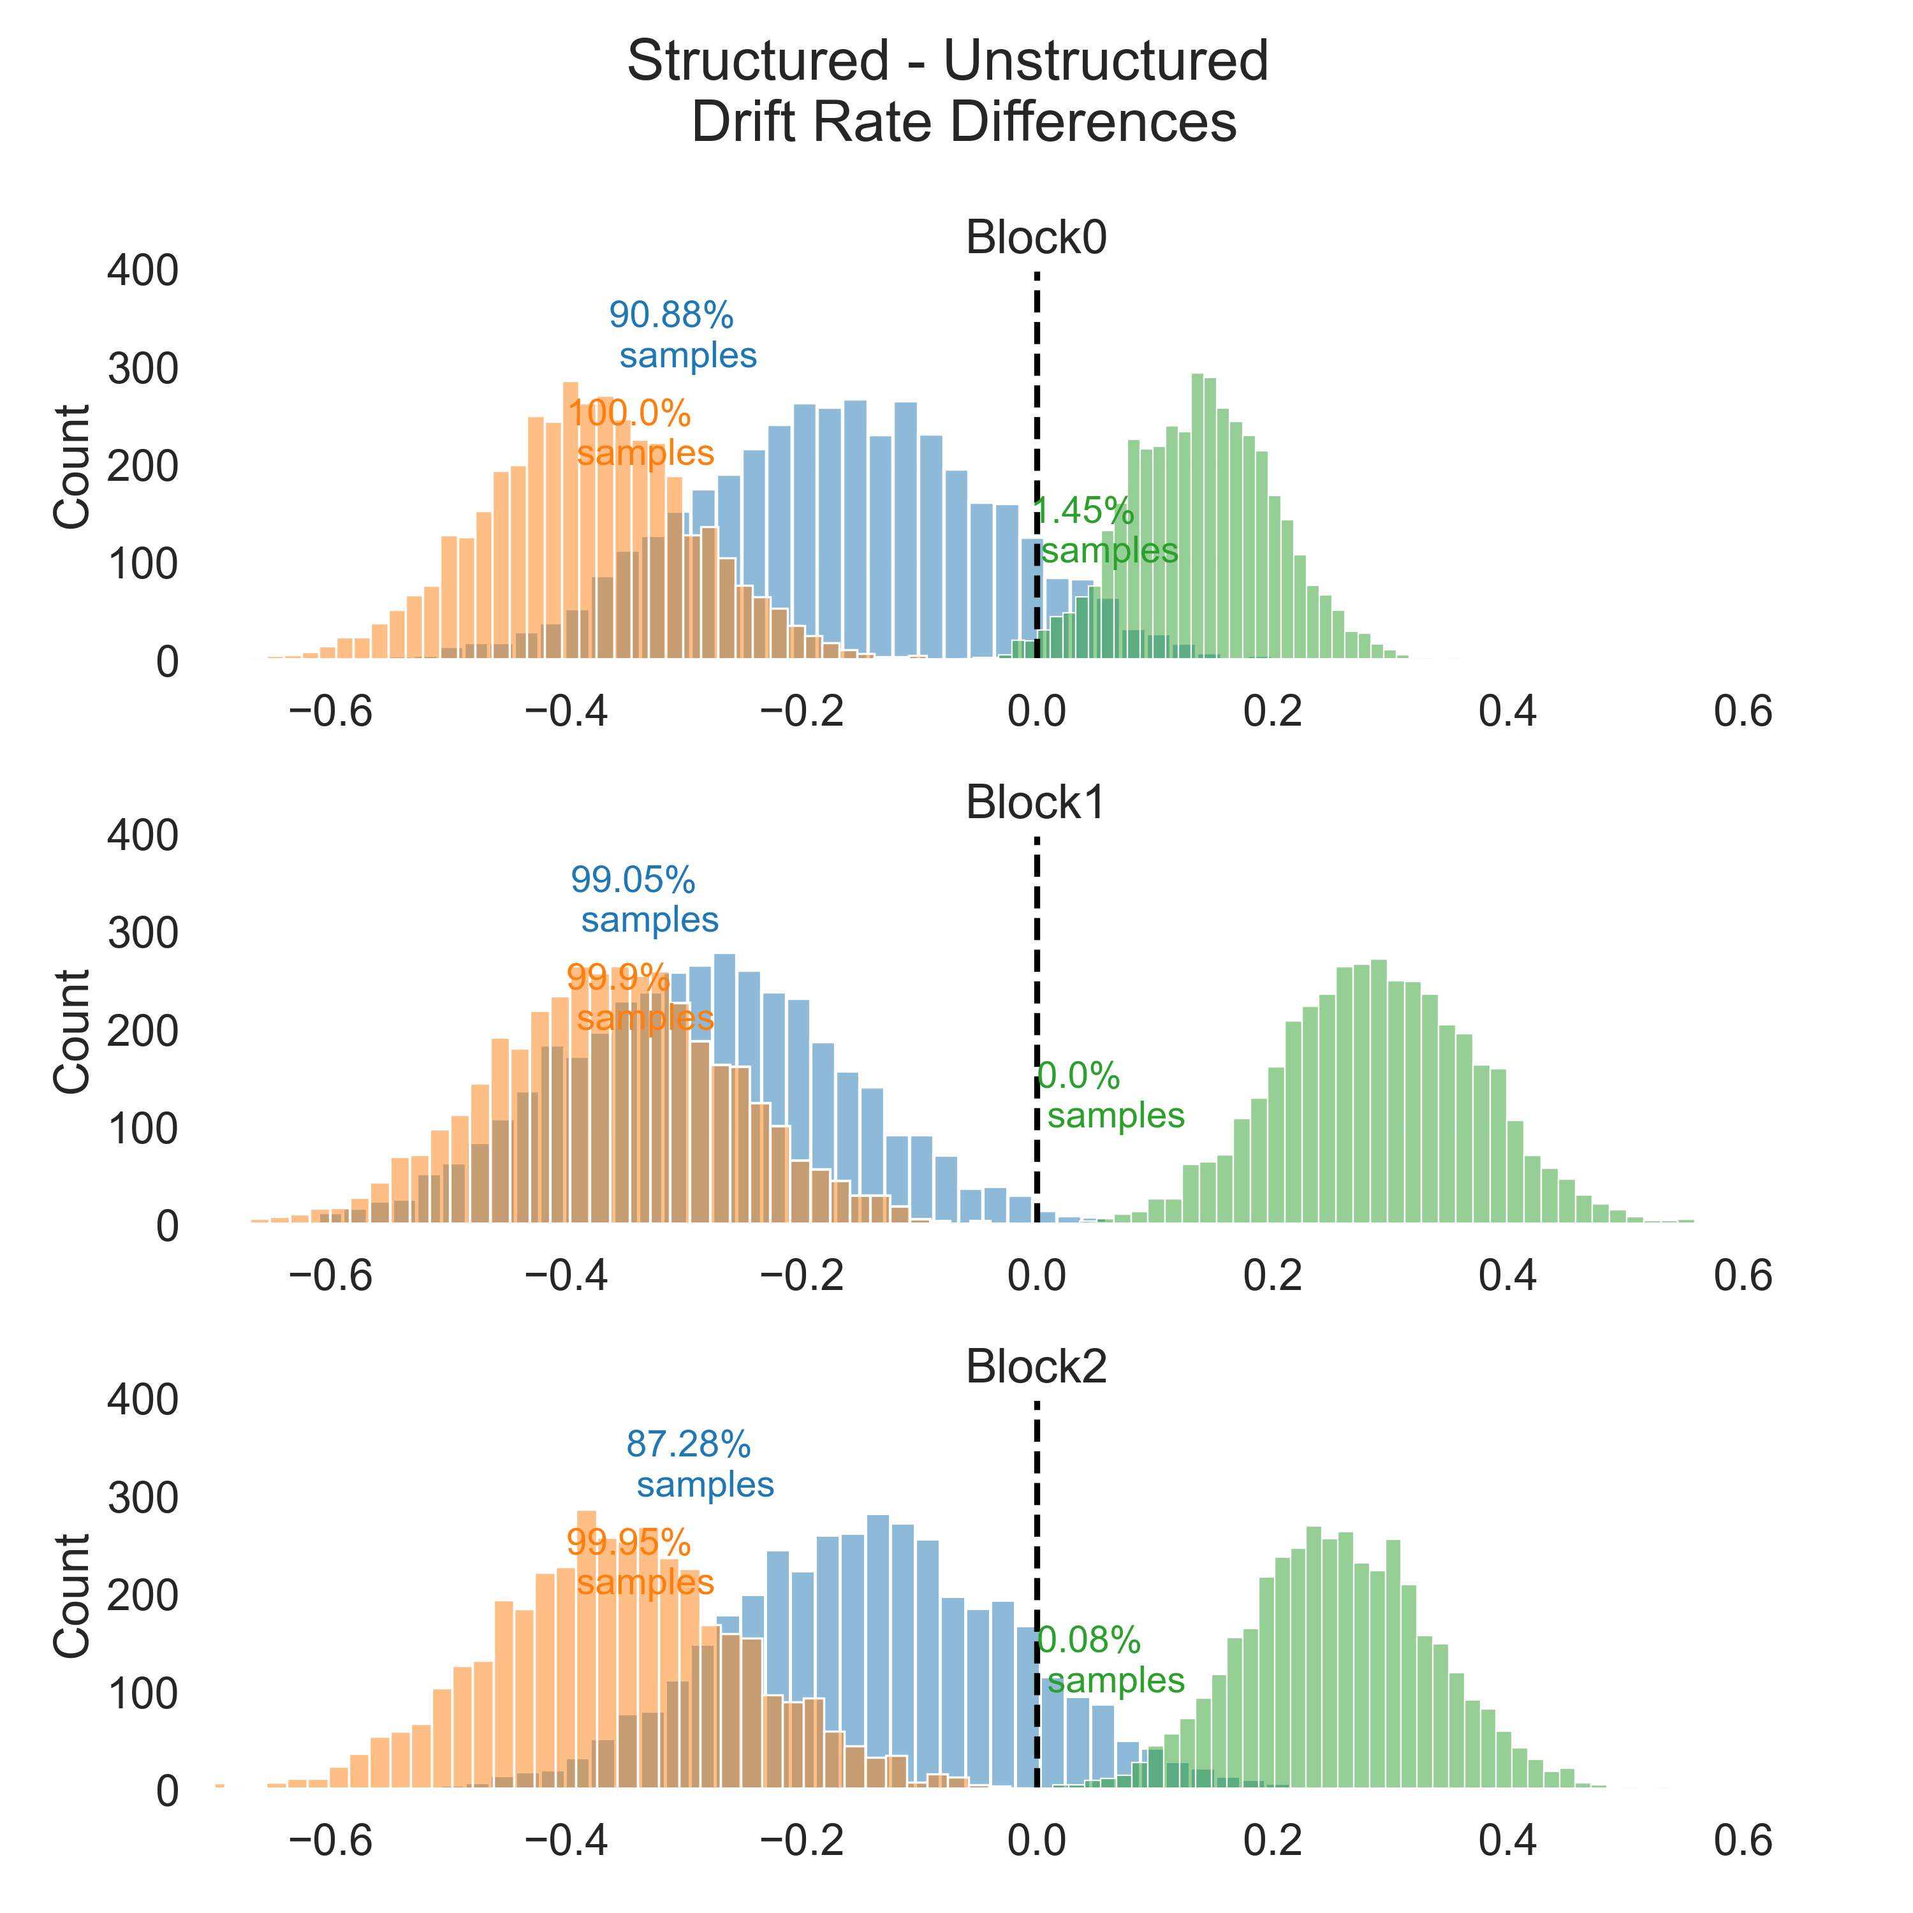
Unstructured
Structured
Nonboundary
Boundary
New
Unstructured
Structured
Nonboundary
Boundary
New
Unstructured
Structured
Nonboundary
Boundary
New

