Slide 2
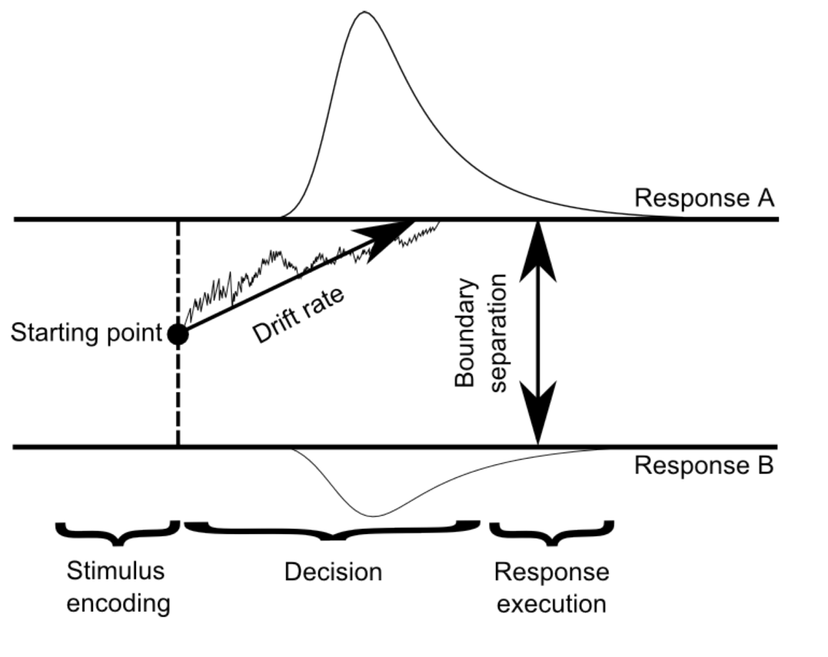
‘Old’
a
z
v
‘New’
ter

