Slide 1
Design and Analysis of Algorithms
Vandana M L
Department of Computer Science & Engineering

Slide 2

DESIGN AND ANALYSIS OF ALGORITHMS
Important Problem Types
Slides courtesy of Anany Levitin
Vandana M L
Department of Computer Science & Engineering

Slide 3
Design and Analysis of Algorithms
Important Problem Types
sorting
searching
string processing
graph problems
combinatorial problems
geometric problems
numerical problems

Slide 4
Design and Analysis of Algorithms
Important Problem Types: Sorting
Rearrange the items of a given list in ascending order.
Input: A sequence of n numbers <a1, a2, …, an>
Output: A reordering <a´₁, a´₂, …, a´_{n}> of the input sequence such that a´₁≤ a´₂ ≤ … ≤ a´_{n.}
Why sorting?
Help searching
Algorithms often use sorting as a key subroutine.
Sorting key
A specially chosen piece of information used to guide sorting.
Example: sort student records by SRN.

Slide 5
Design and Analysis of Algorithms
Important Problem Types: Sorting
Rearrange the items of a given list in ascending order.
Examples of sorting algorithms
Selection sort
Bubble sort
Insertion sort
Merge sort
Heap sort …
Evaluate sorting algorithm complexity: the number of key comparisons.
Two properties
Stability: A sorting algorithm is called stable if it preserves the relative order of any two equal elements in its input.
In place : A sorting algorithm is in place if it does not require extra memory, except, possibly for a few memory units.

Slide 6
Design and Analysis of Algorithms
Important Problem Types: Searching
Find a given value, called a search key, in a given set.
Examples of searching algorithms
Sequential searching
Binary searching…

Slide 7
Design and Analysis of Algorithms
Important Problem Types: String Processing
A string is a sequence of characters from an alphabet.
Text strings: letters, numbers, and special characters.
String matching: searching for a given word/pattern in a text.
Text: I am a computer science graduate
Pattern: computer

Slide 8
Design and Analysis of Algorithms
Important Problem Types: Graph Problems
Definition
Graph G is represented as a pair G= (V, E),
where V is a finite set of vertices and E is a finite set of edges
Modeling real-life problems
Modeling WWW
communication networks
Project scheduling …
Examples of graph algorithms
Graph traversal algorithms
Shortest-path algorithms
Topological sorting

Slide 9
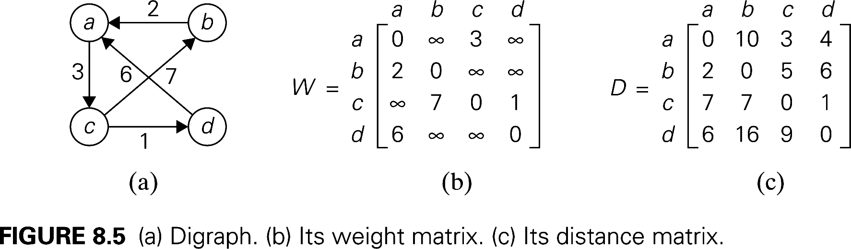
Design and Analysis of Algorithms
Important Problem Types:
Shortest paths in a graph
To find the distances from each vertex to all other vertices.

Slide 10
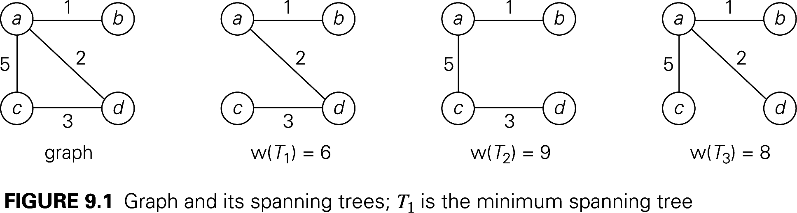
Design and Analysis of Algorithms
Important Problem Types: Combinatorial Problems
Minimum cost spanning tree
A spanning tree of a connected graph is its connected acyclic sub graph (i.e. a tree).

Slide 11
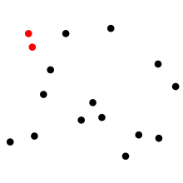
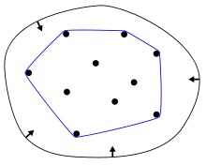
Design and Analysis of Algorithms
Important Problem Types: Geometric Problems
Closest Pair problem
Convex Hull Problem

Slide 12
Design and Analysis of Algorithms
Important Problem Types: Numerical Problems
Solving Equations
Computing definite integrals
Evaluating functions

Slide 13

THANK YOU
Vandana M L
Department of Computer Science & Engineering
vandanamd@pes.edu

