Slide 1

DESIGN AND ANALYSIS OF ALGORITHMS
Analysis Framework
Slides courtesy of Anany Levitin
Dr.Preethi.P
Department of Computer Science & Engineering

Slide 2
Design and Analysis of Algorithms
Analysis Framework
What do you mean by analysing an algorithm?
Investigation of Algorithm’s efficiency with respect to two resources
Time
Space
What is the need for Analysing an algorithm?
To determine resource consumption
CPU time
Memory space
Compare different methods for solving the same problem before actually implementing them and running the programs.
To find an efficient algorithm

Slide 3
Design and Analysis of Algorithms
Complexity of an Algorithm
A measure of the performance of an algorithm
An algorithm’s performance depends on
internal factors
Time required to run
Space (memory storage)required to run
external factors
Speed of the computer on which it is run
Quality of the compiler
Size of the input to the algorithm

Slide 4
Design and Analysis of Algorithms
Performance of Algorithm
important Criteria for performance:
Space efficiency - the memory required, also called, space complexity
Time efficiency - the time required, also called time complexity

Slide 5
Design and Analysis of Algorithms
Space Complexity
S(P)=C+SP(I)
Fixed Space Requirements (C) Independent of the characteristics of the inputs and outputs
instruction space
space for simple variables, fixed-size structured variable, constants
Variable Space Requirements (SP(I)) dependent on the instance characteristic I
number, size, values of inputs and outputs associated with I
recursive stack space, formal parameters, local variables, return address
An instance characteristic is a (typically numeric) measure of the properties of the input data that has a bearing on performance.

Slide 6
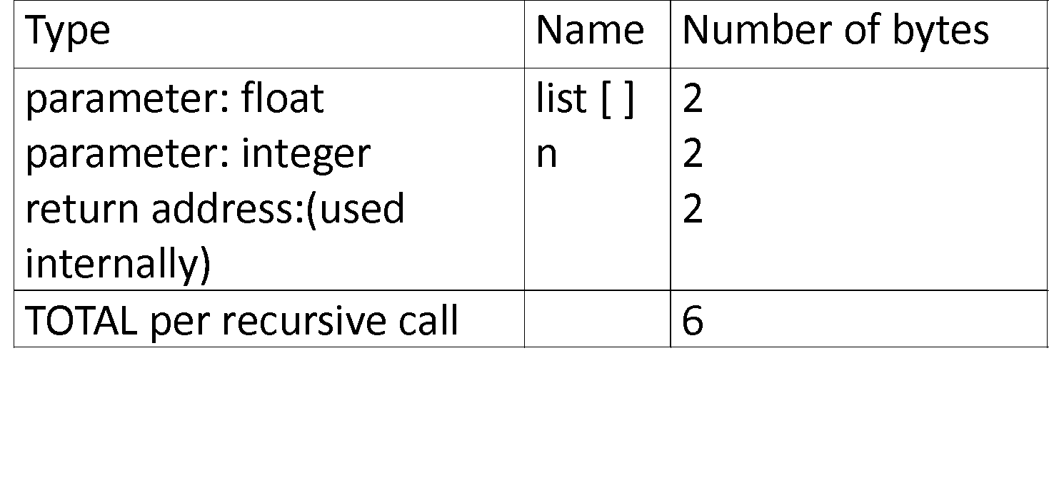
Design and Analysis of Algorithms
Space Complexity
S(P)=C+S_{P}(I)
float rsum(float list[ ], int n) { if (n)
return rsum(list, n-1) + list[n-1] return 0 }
S_{sum}(I)=S_{sum}(n)=6n

Slide 7
Design and Analysis of Algorithms
Time Complexity
How to measure time complexity?
Theoretical Analysis
Experimental study

Slide 8
Design and Analysis of Algorithms
Time Complexity
T(P)=C+T_{P}(I)
Compile time (C) independent of instance characteristics
run (execution) time TP

Slide 9
Design and Analysis of Algorithms
Time Complexity
Experimental study
Write a program implementing the algorithm
Run the program with inputs of varying size and composition
Get an accurate measure of the actual running time
Use a method like System.currentTimeMillis()
Plot the results

Slide 10
Design and Analysis of Algorithms
Limitations of Experimental study
It is necessary to implement the algorithm, which may be difficult
Results may not be indicative of the running time on other inputs not included in the experiment.
In order to compare two algorithms, the same hardware and software environments must be used
Experimental data though important is not sufficient

Slide 11
Design and Analysis of Algorithms
Theoretical Analysis
Uses a high-level description of the algorithm instead of an implementation
Characterizes running time as a function of the input size, n.
Takes into account all possible inputs
Allows us to evaluate the speed of an algorithm independent of the hardware/software environment

Slide 12
Design and Analysis of Algorithms
Theoretical Analysis
Two approaches:
Order of magnitude/asymptotic categorization –
This uses coarse categories and gives a general idea of performance.
If algorithms fall into the same category, if data size is small,
or if performance is critical, use method 2
2.Estimation of running time -
operation counts - select operation(s) that are executed most frequently and determine how many times each is done.
step counts - determine the total number of steps, possibly lines of code, executed by the program.

Slide 13
Design and Analysis of Algorithms
Analysis Framework
Measuring an input’s size
Measuring running time
Orders of growth (of the algorithm’s efficiency function)
Worst-base, best-case and average efficiency

Slide 14
Design and Analysis of Algorithms
Measuring an input’s size
Efficiency is defined as a function of input size.
Input size depends on the problem.
Example 1, what is the input size of the problem of sorting n numbers?
Example 2, what is the input size of adding two n by n matrices?
The number of operations depends directly on n, such as comparisons and swaps.
The algorithm must compare and rearrange n elements to achieve a sorted order.
The algorithm must process all elements in both matrices to compute their sum.
The number of operations (additions) grows with the total number of elements, which is n2n^2n2.

Slide 15
Design and Analysis of Algorithms
Units for Measuring Running Time
Measure the running time using standard unit of time measurements, such as seconds, minutes?
Depends on the speed of the computer.
count the number of times each of an algorithm’s operations is executed.
(step count method)
Difficult and unnecessary
count the number of times an algorithm’s basic operation is executed.
Basic operation: the most important operation of the algorithm, the operation contributing the most to the total running time.
For example, the basic operation is usually the most time-consuming operation in the algorithm’s innermost loop.

Slide 16
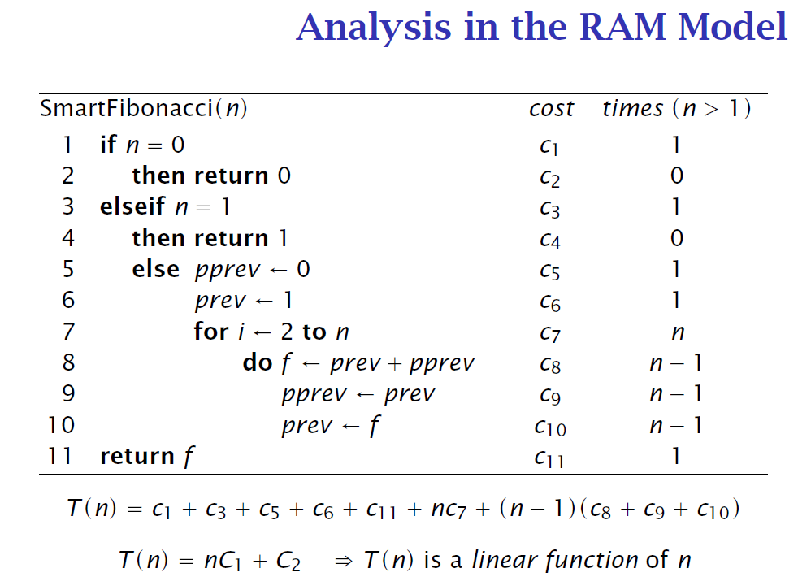
Design and Analysis of Algorithms
Measuring Running Time: Step Count Method

Slide 17
Input Size and Basic Operation Examples
Design and Analysis of Algorithms
Measuring Running Time: Basic operation count
Problem | Input size measure | Basic operation
Search for a key in a list of n items | Number of items in list, n | Key comparison
Add two n by n matrices | Dimensions of matrices, n² | addition
multiply two matrices | Dimensions of matrices, n² | multiplication

Slide 18
Design and Analysis of Algorithms
Theoretical Analysis of Time Efficiency: Basic operation count
Time efficiency is analyzed by determining the number of repetitions of the basic operation as a function of input size.
Assuming C(n) = (1/2)n(n-1),
how much longer will the algorithm run if we double the input size?
input size
T(n) ≈ c_{op}C (n)
running time
execution time
for the basic operation
Number of times the basic operation is executed

Slide 19
Design and Analysis of Algorithms
Order of Growth
C(n) Basic Operation Count
The efficiency analysis framework ignores the multiplicative constants of C(n) and focuses on the orders of growth of the C(n).
Simple characterization of the algorithm's efficiency by identifying relatively significant term in the C(n).

Slide 20
Design and Analysis of Algorithms
Order of Growth
Why do we care about the order of growth of an algorithm’s efficiency function, i.e., the total number of basic operations?
Because, for smaller inputs, it is difficult to distinguish inefficient algorithms vs. efficient ones.
For example, if the number of basic operations of two algorithms to solve a particular problem are n and n² respectively, then
if n = 2, Basic operation will be executed 2 and 4 times respectively for algorithm1 and 2.
Not much difference!!!
On the other hand, if n = 10000, then it does makes a difference whether the number of times the basic operation is executed is n or n².

Slide 21
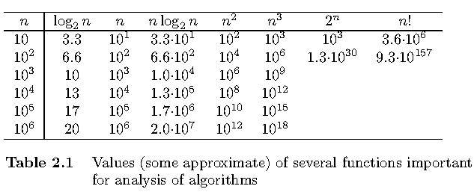
Design and Analysis of Algorithms
Order of Growth
Exponential-growth functions
Orders of growth:
consider only the leading term of a formula
ignore the constant coefficient.

Slide 22
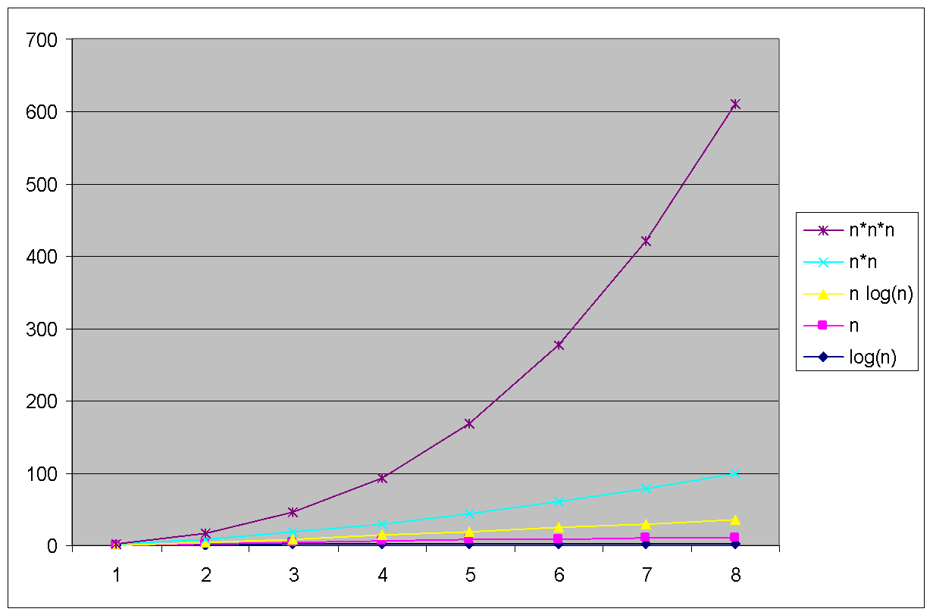
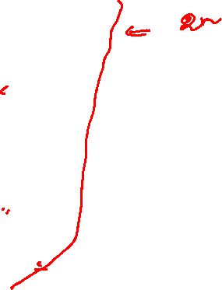
Design and Analysis of Algorithms
Order of Growth

Slide 23
Design and Analysis of Algorithms
Basic Efficiency Classes
1 | constant
log n | logarithmic
n | linear
n log n | n-log-n
n² | quadratic
n³ | cubic
2^{n} | exponential
n! | factorial

Slide 24
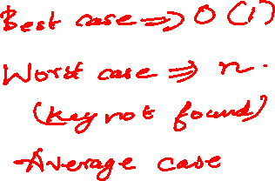
Design and Analysis of Algorithms
Best, Worst and Average case Analysis
Algorithm efficiency depends on the input size n
For some algorithms efficiency depends on type of input.
Example: Sequential Search
Problem: Given a list of n elements and a search key K, find an element equal to K, if any.
Algorithm: Scan the list and compare its successive elements with K until either a matching element is found (successful search) or the list is exhausted (unsuccessful search)
Given a sequential search problem of an input size of n,
what kind of input would make the running time the longest?
How many key comparisons?

Slide 25
Design and Analysis of Algorithms
Best, Worst and Average case Analysis
Worst case Efficiency
Efficiency (# of times the basic operation will be executed) for the worst case input of size n.
The algorithm runs the longest among all possible inputs of size n.
Best case
Efficiency (# of times the basic operation will be executed) for the best case input of size n.
The algorithm runs the fastest among all possible inputs of size n.
Average case:
Efficiency (#of times the basic operation will be executed) for a typical/random input of size n.
NOT the average of worst and best case
How to find the average case efficiency?

Slide 26
Design and Analysis of Algorithms
Best, Worst and Average case Analysis
ALGORITHM SequentialSearch(A[0..n-1], K)
//Searches for a given value in a given array by sequential search
//Input: An array A[0..n-1] and a search key K
//Output: Returns the index of the first element of A that matches K or –1 if there are no matching elements
i ← 0
while i < n and A[i] ‡ K do
i ← i + 1
if i < n //A[I] = K
return i
else
return -1

Slide 27
Design and Analysis of Algorithms
Best, Worst and Average case Analysis: Sequential Search
Worst-Case: Cworst(n) = n
Best-Case: Cbest(n) = 1
Average-Case
from (n+1)/2 to (n+1)

Slide 28
Design and Analysis of Algorithms
Average case Analysis: Sequential Search
Let ‘p’ be the probability that key is found in the list
Assumption: All positions are equally probable
Case1: key is found in the list
C_{avg,case1}(n) = p*(1 + 2 + … + n) / n=p*(n + 1) / 2
Case2: key is not found in the list
C_{avg, case2}(n) = (1-p)*(n)
C_{avg}(n) = p(n + 1) / 2 + (1 - p)(n)

Slide 29
THANK YOU
Vandana M L
Department of Computer Science & Engineering
vandanamd@pes.edu

