Slide 1

Design and Analysis of Algorithms
Vandana M L
Department of Computer Science & Engineering

Slide 2
DESIGN AND ANALYSIS OF ALGORITHMS
Asymptotic Notations
Slides courtesy of Anany Levitin
Vandana M L
Department of Computer Science & Engineering

Slide 3
Orders of growth of an algorithm’s basic operation count is important
How do we compare order of growth??
Using Asymptotic Notations
A way of comparing functions that ignores constant factors and small input sizes
O(g(n)): class of functions f(n) that grow no faster than g(n)
Ω(g(n)): class of functions f(n) that grow at least as fast as g(n)
Θ (g(n)): class of functions f(n) that grow at same rate as g(n)
o(g(n)): class of functions f(n) that grow at slower rate than g(n)
ω(g(n)): class of functions f(n) that grow at faster rate than g(n)

Slide 4
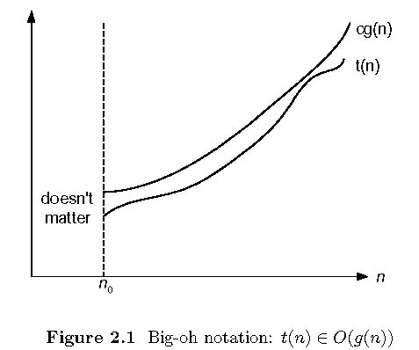
O-notation

Slide 5
O-notation
Formal definition
A function t(n) is said to be in O(g(n)), denoted t(n) ∈O(g(n)),
if t(n) is bounded above by some constant multiple of g(n) for all large n,
i.e., if there exist some positive constant c and some nonnegative integer n₀ such that
t(n) ≤ cg(n) for all n ≥ n₀
Exercises: prove the following using the above definition
10n² ∈ O(n²)
10n² + 2n ∈ O(n²)
100n + 5 ∈ O(n²)
5n+20 ∈ O(n)

Slide 6
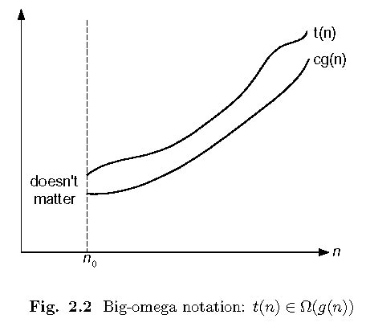
Ω-notation

Slide 7
Ω-notation
Formal definition
A function t(n) is said to be in Ω(g(n)), denoted t(n) ∈ Ω(g(n)), if t(n) is bounded below by some constant multiple of g(n) for all large n,
i.e., if there exist some positive constant c and some nonnegative integer n₀ such that
t(n) ≥ cg(n) for all n ≥ n₀
Exercises: prove the following using the above definition
10n² ∈ Ω(n²)
10n² + 2n ∈ Ω(n²)
10n³ ∈ Ω(n²)

Slide 8
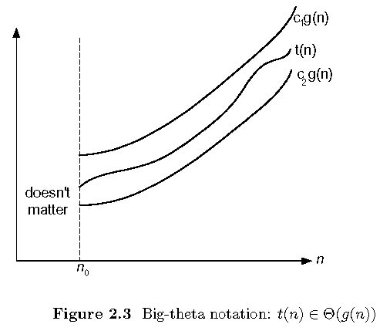
Θ-notation

Slide 9
Θ-notation
Formal definition
A function t(n) is said to be in Θ(g(n)), denoted t(n) ∈ Θ(g(n)), if t(n) is bounded both above and below by some positive constant multiples of g(n) for all large n,
i.e., if there exist some positive constant c₁ and c₂ and some nonnegative integer n₀ such that
c₂ g(n) ≤ t(n) ≤ c₁ g(n) for all n ≥ n₀
Exercises: prove the following using the above definition
10n² ∈ Θ(n²)
10n² + 2n ∈ Θ(n²)
(1/2)n(n-1) ∈ Θ(n²)

Slide 10
>=
Ω(g(n)), functions that grow at least as fast as g(n)
=
Θ(g(n)), functions that grow at the same rate as g(n)
g(n)
<=
O(g(n)), functions that grow no faster than g(n)

Slide 11
Little-o Notation
Formal Definition:
A function t(n) is said to be in Little-o(g(n)), denoted t(n) ∈o(g(n)),
if for any positive constant c and some nonnegative integer n₀
0 ≤ t(n) < cg(n) for all n ≥ n₀

Slide 12
Little-o Notation
Example: f(n) = 2n² and g(n) = n² and c = 2
f(n) = O (g(n)) - Big-O
f(n) ≠ o(g(n)) - little-o
If f(n) = 2n & g(n) = n²,
then for any value of c>0,
f(n) <c(n²)
f (n) ≠ o(g(n))
Note : For non-negative functions, f(n) and g(n),
f(n) is little o of g(n), if and only if,
f(n) = O (g(n)) and f(n) ≠ θ ( g(n) )
[ strict upper bound, no lower bound]

Slide 13
Little Omega Notation
Formal Definition:
A function t(n) is said to be in Little- ω(g(n)), denoted t(n) ∈ ω(g(n)),
if for any positive constant c and some nonnegative integer n₀
t(n) >cg(n) ≥0 for all n ≥ n₀

Slide 14
Little Omega Notation
Example : If f(n) = 3 n²+ 2, g(n) = n
then for any value of c>0
f(n)> cg(n)
f(n) = ω(n)
Note : For non-negative functions, f(n) and g(n),
f(n) is little ω of g(n), if and only if
f(n) = Ω (g(n)) and f(n) ≠ θ ( g(n) )
[ strict lower bound, no upper bound]

Slide 15
Theorems
If t₁(n) ∈ O(g₁(n)) and t₂(n) ∈ O(g₂(n)), then
t₁(n) + t₂(n) ∈ O(max{g₁(n), g₂(n)}).
For example,
5n² + 3nlogn ∈ O(n²)
If t1 ( n) ∈ Θ ( g 1 ( n)) and t2 ( n) ∈ Θ ( g2 ( n)) , then
t1 ( n) + t2 ( n) ∈ Θ(max{ g 1 ( n), g2 ( n)})
t1(n) ∈ Ω(g1(n)) and t2(n) ∈ Ω(g2(n)), then
t1(n) + t2(n) ∈ Ω(max{g1(n), g2(n)})
Implication: The algorithm’s overall efficiency will be determined by the part with a larger order of growth, I.e., its least efficient part.

Slide 16
THANK YOU
Vandana M L
Department of Computer Science & Engineering
vandanamd@pes.edu

