Slide 1
Design and Analysis of Algorithms
Vandana M L
Department of Computer Science & Engineering

Slide 2
DESIGN AND ANALYSIS OF ALGORITHMS
Introduction to Algorithms,
Design Techniques and Analysis
Slides courtesy of Anany Levitin
Vandana M L
Department of Computer Science & Engineering

Slide 3
Design and Analysis of Algorithms
Text Books
Book Type | Code | Title & Author | Publication Information
 |  |  | Edition | Publisher | Year
Text Book | T1 | “Introduction to the Design and Analysis of Algorithms”, Anany Levitin, Pearson Education, Delhi (Indian Version) | 3 | Pearson Education | 2012
Reference Book | R1 | Introduction to Algorithms Thomas H. Cormen, Charles E. Leiserson, Ronald L. Rivest and Clifford Stein | 3 | Prentice-Hall India | 2009
Reference Book | R2 | Fundamentals of Computer Algorithms Horowitz, Sahni, Rajasekaran, | 2 | Universities Press | 2007
Reference Book | R3 | Algorithm Design Jon Kleinberg, Eva Tardos, | 1 | Pearson Education | 2006

Slide 4
Design and Analysis of Algorithms
Syllabus
UNIT I (14 Hours)
Introduction, Fundamentals of Algorithmic Problem solving, Problem Types
Analysis of Algorithm Efficiency,
Brute Force
UNIT II (14 Hours)
Decrease-and-Conquer
Divide-and-Conquer
UNIT III (14 Hours)
Transform-and-Conquer
Space and Time Tradeoffs
Greedy Technique
UNIT IV (14 Hours)
Limitations of Algorithm Power
Coping with the Limitations of Algorithm Power
Dynamic Programming

Slide 5
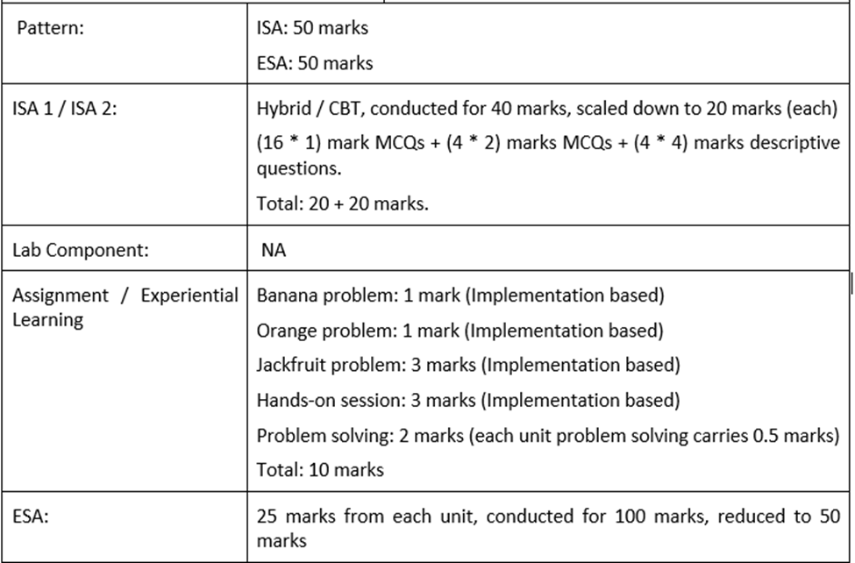
Design and Analysis of Algorithms
Evaluation Policy
Jackfruit Problem:
Problem Solving Certification on Hackerrank
(In College Assessment Centre)
All implementations and certification (use only C language)

Slide 6
Design and Analysis of Algorithms
Algorithm
What is an algorithm?
An algorithm is a sequence of unambiguous instructions for solving a problem,
i.e., for obtaining a required output for any legitimate input in a finite amount of time
Important Points about Algorithms
The non-ambiguity requirement for each step of an algorithm cannot be compromised
The range of inputs for which an algorithm works has to be specified carefully.
The same algorithm can be implemented in several different ways
There may exist several algorithms for solving the same problem.

Slide 7
Design and Analysis of Algorithms
Characteristics of Algorithm
Input: Zero or more quantities are externally supplied
Definiteness: Each instruction is clear and unambiguous
Finiteness: The algorithm terminates in a finite number of steps.
Effectiveness: Each instruction must be primitive and feasible
Output: At least one quantity is produced

Slide 8
Design and Analysis of Algorithms
Algorithm
Why do we need Algorithms?
It is a tool for solving well-specified Computational Problem.
Problem statement specifies in general terms relation between input and output
Algorithm describes computational procedure for achieving input/output relationship This Procedure is irrespective of implementation details
Why do we need to study algorithms?
Exposure to different algorithms for solving various problems helps
develop skills to design algorithms for the problems for which
there are no published algorithms to solve it

Slide 9
Design and Analysis of Algorithms
Basic Issues related to Algorithms
How to design algorithms
How to express algorithms
Proving correctness of designed algorithm
Efficiency
Theoretical analysis
Empirical analysis

Slide 10
Design and Analysis of Algorithms
Basic Issues related to Algorithms
How to design algorithms
How to express algorithms
Proving correctness of designed algorithm
Efficiency
Theoretical analysis
Empirical analysis

Slide 11
Design and Analysis of Algorithms
Algorithm Design Technique
What do you mean by Algorithm Design Techniques?
General Approach to solving problems algorithmically .
Applicable to a variety of problems from different areas of computing
Various Algorithm Design Techniques
Brute Force
Divide and Conquer
Decrease and Conquer
Transform and Conquer
Dynamic Programming
Greedy Technique
Branch and Bound
Backtracking
Importance Framework for designing and analyzing algorithms
for new problems

Slide 12
Design and Analysis of Algorithms
Basic Issues related to Algorithms
How to design algorithms
How to express algorithms
Proving correctness of designed algorithm
Efficiency
Theoretical analysis
Empirical analysis

Slide 13
Design and Analysis of Algorithms
Methods of Specifying an Algorithm
Natural language
Ambiguous
Pseudocode
A mixture of a natural language and programming language-like structures
Precise and succinct.
Pseudocode in this course
omits declarations of variables
use indentation to show the scope of such statements
as for, if, and while.
use 🡨 for assignment
Flowchart
Method of expressing algorithm by collection of
connected geometric shapes

Slide 14
Euclid’s Algorithm
Design and Analysis of Algorithms
Methods of Specifying an Algorithm
Problem: Find gcd(m,n), the greatest common divisor of two nonnegative,
not both zero integers m and n
Examples: gcd(60,24) = 12, gcd(60,0) = 60, gcd(0,0) = ?
Euclid’s algorithm is based on repeated application of equality
gcd(m,n) = gcd(n, m mod n)
until the second number becomes 0, which makes the problem trivial.
Example: gcd(60,24) = gcd(24,12) = gcd(12,0) = 12

Slide 15
Two descriptions of Euclid’s algorithm
Design and Analysis of Algorithms
Methods of Specifying an Algorithm
Euclid’s algorithm for computing gcd(m,n)
Step 1 If n = 0, return m and stop; otherwise go to Step 2
Step 2 Divide m by n and assign the value of the remainder to r
Step 3 Assign the value of n to m and the value of r to n. Go to step 1.
ALGORITHM Euclid(m,n)
//computes gcd(m,n) by Euclid’s method
//Input: Two nonnegative,not both zero integers
//Output:Greatest common divisor of m and n
while n ≠ 0 do
r ← m mod n
m← n
n ← r
return m

Slide 16
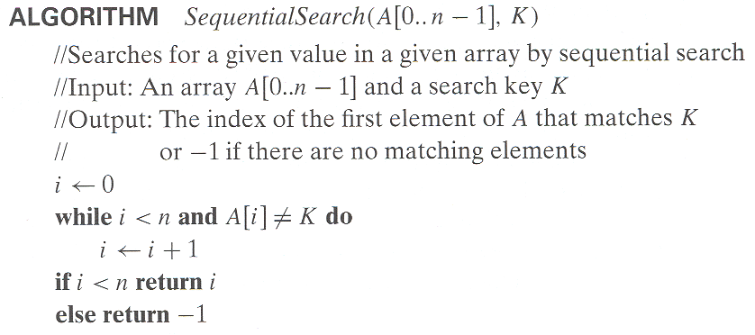
Design and Analysis of Algorithms
Algorithm for Sequential Search

Slide 17
Design and Analysis of Algorithms
Basic Issues related to Algorithms
How to design algorithms
How to express algorithms
Proving correctness of designed algorithm
Efficiency
Theoretical analysis
Empirical analysis

Slide 18
Design and Analysis of Algorithms
Basic Issues related to Algorithms
How to design algorithms
How to express algorithms
Proving correctness of designed algorithm
Efficiency
Theoretical analysis
Empirical analysis

Slide 19
Design and Analysis of Algorithms
Need of Analysis
To determine resource consumption
CPU time
Memory space
Compare different methods for solving the same problem before actually implementing them and running the programs.
To find an efficient algorithm for solving the problem

Slide 20
Design and Analysis of Algorithms
Complexity of an algorithm
A measure of the performance of an algorithm
An algorithm’s performance is characterized by
Time complexity
How fast an algorithm maps input to output as a function of input
Space complexity
amount of memory units required by the algorithm in addition to the memory needed for its input and output

Slide 21
Design and Analysis of Algorithms
Complexity of an algorithm
How to determine complexity of an algorithm?
Experimental study(Performance Measurement)
Theoretical Analysis (Performance Analysis)

Slide 22
Design and Analysis of Algorithms
Limitations of Performance Measurement
It is necessary to implement the algorithm, which may be difficult
Results may not be indicative of the running time on other inputs not included in the experiment.
In order to compare two algorithms, the same hardware and software environments must be used
Experimental data though important is not sufficient

Slide 23
Design and Analysis of Algorithms
Performance Analysis
Uses a high-level description of the algorithm instead of an implementation
Characterizes running time as a function of the input size, n.
Takes into account all possible inputs
Allows us to evaluate the speed of an algorithm independent of the hardware/software environment

Slide 24
THANK YOU
Vandana M L
Department of Computer Science & Engineering
vandanamd@pes.edu

