Slide 1

Microprocessor & Computer Architecture (μpCA)
UE23CS251B
Session - 10

Slide 2
Microprocessor & Computer Architecture (μpCA)
UE23CS251B
Instruction Encoding - 1

Slide 3
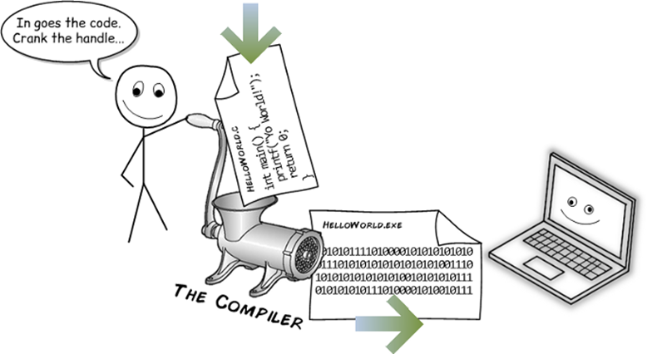
Instruction Encoding
You showed me
ADD R0,R0,R1
But what is this in Binary

Slide 4
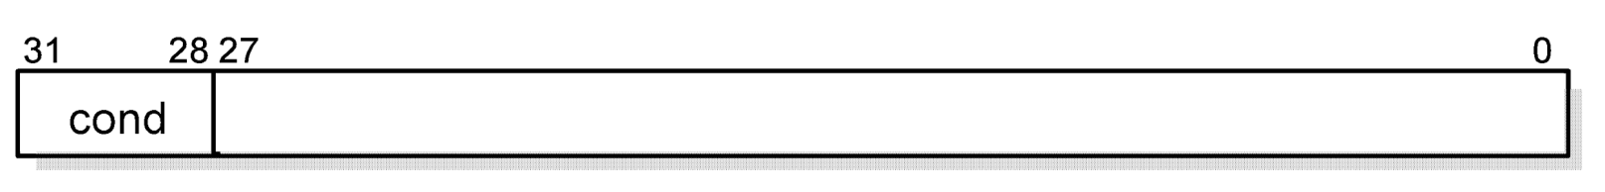
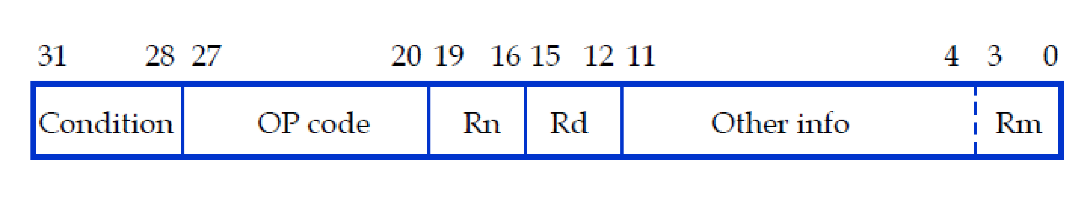
What is an ARM Instruction?
OPcode{condition}{S} Rd,Operand1,Operand2
Example: Data Processing Instruction
An instruction specifies a Conditional Execution Code (Condition), the OP Code, Two or Three Registers (Rn, Rd, and Rm), and some other information

Slide 5
Condition
Fifteen different conditions may be used: these are listed in Condition code summary.
The sixteenth (1111) is reserved, and must not be used.
In the absence of a suffix, the condition field of most instructions is set to "Always" (sufix AL). This means the instruction will always be executed regardless of the CPSR condition codes.
The ARM condition code field
31
28
24
20
16
12
8
4
0
Cond

Slide 6
The Condition Field
31
28
24
20
16
12
8
4
0
Cond
0000 = EQ - Z set (equal)
0001 = NE - Z clear (not equal)
0010 = HS / CS - C set (unsigned higher or same)
0011 = LO / CC - C clear (unsigned lower)
0100 = MI -N set (negative)
0101 = PL - N clear (positive or zero)
0110 = VS - V set (overflow)
0111 = VC - V clear (no overflow)
1000 = HI - C set and Z clear (unsigned higher)
1001 = LS - C clear or Z (set unsigned lower or same)
1010 = GE - N set and V set, or N clear and V clear (>or =)
1011 = LT - N set and V clear, or N clear and V set (>)
1100 = GT - Z clear, and either N set and V set, or N clear and V set (>)
1101 = LE - Z set, or N set and V clear,or N clear and V set (<, or =)
1110 = AL - always
1111 = NV - reserved.

Slide 7
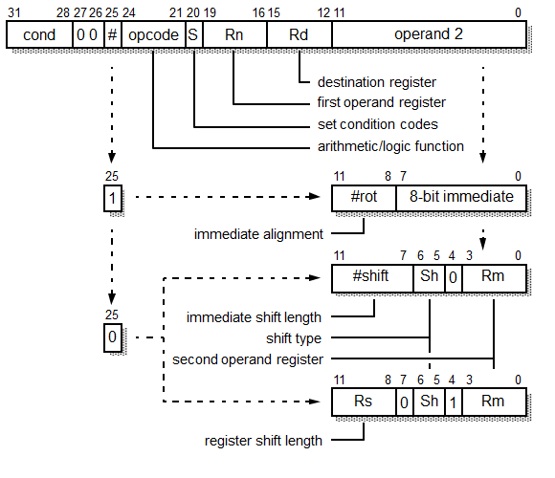
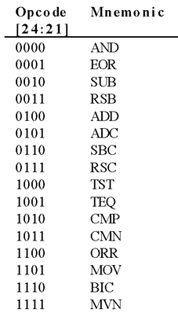
Data Processing Instruction

Slide 8
Data Processing Instruction Example 01:
Ex:
ADD R1, R0, R2
1110 000 0100 S Rn Rd 00000000 Rm
1110 0000 1000 0000 0001 0000 0000 0010
E0801002
R2
Always
ADD
R0
R1

Slide 9
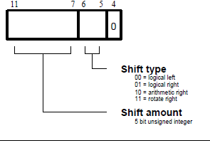
Data Processing Instruction

Slide 10
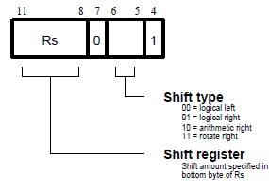
Data Processing Instruction

Slide 11
Data Processing Instruction Example 02:
Ex:
ADDS R1, R0, R2 LSR #2
1110 000 0100 S Rn Rd Shift Rm
1110 000 0100 S Rn Rd 00010 01 0 Rm
1110 0000 1001 0000 0001 0001 0010 0010
ADDS
R0
R1
#2
LSR
R2
E0901122
Shift is specified as immediate

Slide 12
Data Processing Instruction Example 03:
Ex:
ADDS R1, R0, R2 LSR R4
1110 000 0100 S Rn Rd Shift Rm
1110 000 0100 S Rn Rd 0100 0 01 1 Rm
1110 0000 1001 0000 0001 0100 0011 0010
ADDS
R0
R1
R4
LSR
R2
E0901432
Shift is specified in Register

Slide 13

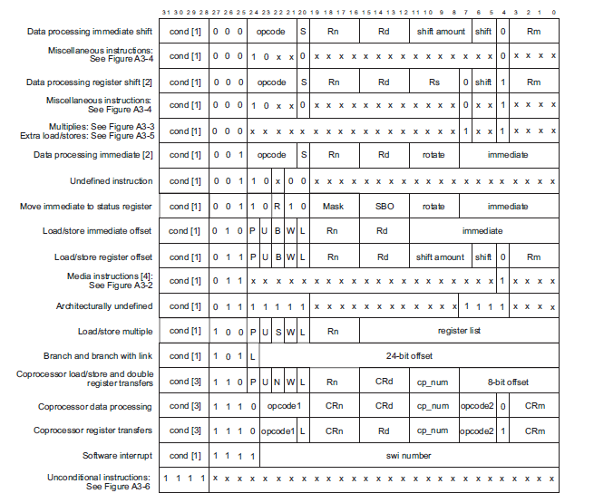
√
√
√
√
√
√

Slide 14

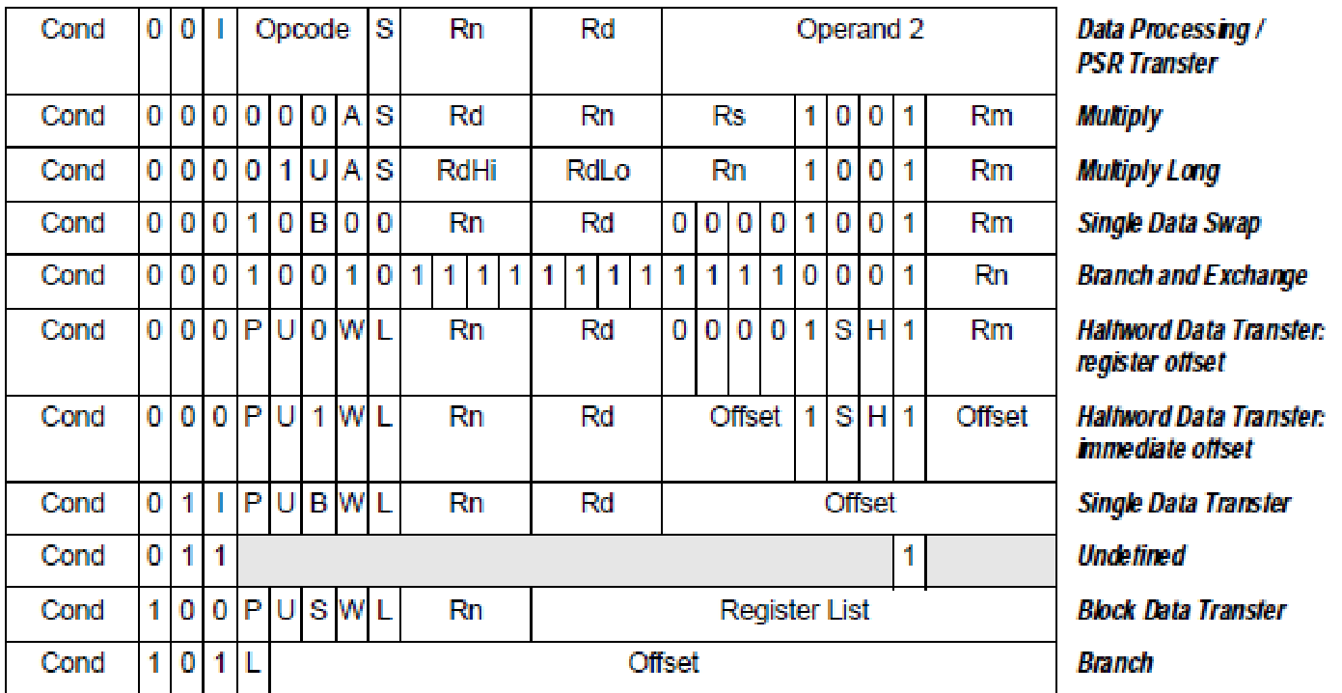

Slide 15

THANK YOU
V R BADRI PRASAD
badriprasad@pes.edu
Department of Computer Science and Engineering

