Slide 1

Microprocessor & Computer Architecture (μpCA)
UE23CS251B
Team – RR Campus
Session - 1.1
Prof. V R Badri Prasad (1) – Theory Anchor
Dr. Chaitra Nagaraj (1)
Prof. Chitra G M (2)
Prof. Jayashree S (2) – Lab Anchor
Prof. Chandravva Hebbi (2)
Prof. Swetha A M(2)
Prof. Ashwati T(2)
Dr.Chethana Srinivas (2)
Prof. Mamatha L (1)
Prof. Vivek Kashyap (3)
Team – EC Campus
Dr. Prajwala T R (2) – Theory Co-Anchor
Prof. Deepti C (2) – Lab Co-Anchor
Dr. Charu kathuria (3)
Prof. Surabhi Choudhary (2)
Prof. Swetha Patil (2)
Prof. Swathi Priya (2)

Slide 2
Microprocessor & Computer Architecture (μpCA)
UE23CS251B
Introduction
Cousre Instructor
Prof. V R Badri Prasad

Slide 3
What we Know? [studied in 3 sem ]
Digital Design!
In DDCO course, increase logic circuit speed, decrease logic resources required and decrease power consumed.
Goal is to Optimize fundamental physical quantities of time, space and energy.
Computer Organization !
Hardware Abstraction above Digital Logic and below Operating System.
Hardware details which are required by programmers, such as Control signals, Interfaces and Memory

Slide 4
What we study - Syllabus
Unit 1: Architecture
Introduction, ISA Classification - RISC and CISC, Memory Addressing, Operands - Types and Size, Instruction Set - Operations, Control Flow, Instruction Encoding, Case Study - ARM/ MIPS/ x86 Processor. 14 Hours
Unit 2: Pipeline
3- Stage Pipelining, 5 - Stage Pipelining, Pipeline Datapath and Control, Data Hazards – Forwarding vs. Stalling, Control Hazards, Branch Prediction Mechanisms and Exceptions, Performance Metrics. 14 Hours
Unit 3 : Memory Hierarchy & Cache Optimizations:
Basics of Caches - Fully Associative, Direct Mapped and Set Associativity, Cache Performance, Basic Cache Optimization- Reduce in Miss Rate. Basic Cache Optimization- Reduce Miss Penalty, Reduce Hit Time. 14 Hours
Unit 4: Advances in Architecture
Introduction to Parallel Computing, PC – Applications, Memory architecture, Flynn’s taxonomy, parallel programming models, Shared memory programming OpenMP-Introduction, loop-level parallelism, CUDA C, Program structure-vector kernel addition, device global memory and Data transfer, Hardware Multi threading, Parallel examples: matrix multiplication, PC-Design Issues, Amdahl’s Law, Gustafson Law, Multi-Core, Architecture, Introduction to GPU computing. 14 Hours
Course Information
Course Syllabus

Slide 5
Evaluation Policy
ISA1 - 40 Marks - Reduced to 20 Marks : Syllabus - Unit1, Unit2
ISA2 - 40 Marks - Reduced to 20 Marks : Syllabus - Unit3, Unit4
Theory Assignments: 2 numbers x 5 marks each = 10 marks
ISA -> ISA1 + ISA2 + Theory Assignments = 20 + 20 + 10 = 50 marks
FSA -> Laboratory Marks - 10 marks : Lab Programs - 5 numbers : 07 marks
Lab Assignment - 5 numbers : 03 marks
Mini Project Marks - 10 Marks
Sub Total - 20 marks
ESA -> Conducted for 100 marks and reduced to 50 marks
Total Marks : ISA + FSA + ESA
50 + 20 + 50 = 120 Marks
Final Grade is awarded by reducing 120 Marks to 100 Marks.

Slide 6
Microprocessor & Computer Architecture (μpCA)
UE23CS251B
Introduction to
Microprocessors and Microcontrollers
RISC and CISC Architectures
Session - 1.11

Slide 7


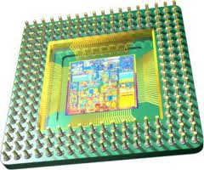
Is MICROPROCESSOR
Brain or Heart
of a computer System
???
Statutory Warning: does not resemble anyone over here

Slide 8
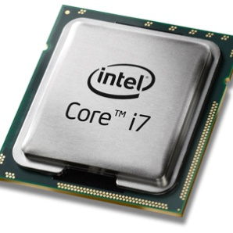
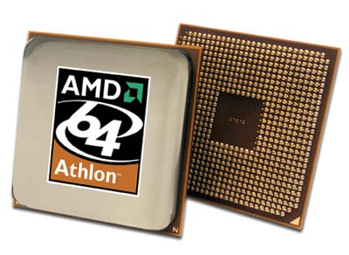
What we study?
What is a μicroProcessor?
Brain of the Computer
Basic Computing Unit on an Integrated Chip (IC)
Three basic characteristics differentiate microprocessors:
Instruction set , Bandwidth, Clock speed
What is Computer Architecture ?
The engineering decisions and tradeoffs that must be made in order to produce a “Good" Design”.
i.e Execution Time, Space and Resource

Slide 9

Why Study Microprocessor?
Everywhere we have devices which are controlled by
“Microprocessor” or “Microcontroller”
Because its part of the Curriculum!!! ☺

Slide 10

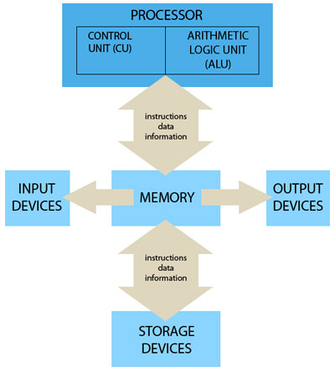
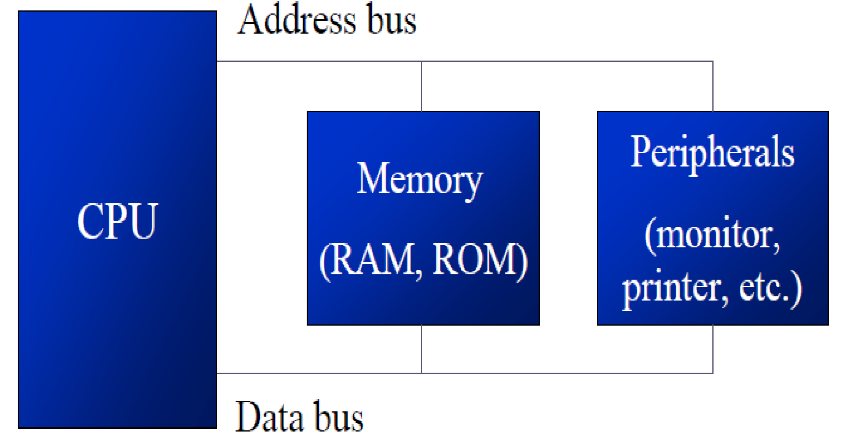
Microprocessor & Computer Architecture Computer Organization & Computer Architecture
Computer Organization refers to the Operational Units and their
interconnections that realize or recognize the specifications of Computer Architecture.
Organizational attributes includes Hardware details transparent to the programmer such as control signals , Interface between computers and peripherals and the memory technology used.
Computer Architecture refers to those attributes of a system visible to a programmer, the other way those attributes that have direct impact on the logical execution of the program.
Architectural attributes include the instruction set, the no of bits used to represent the data types, Input Output mechanism and technique for addressing memories.

Slide 11
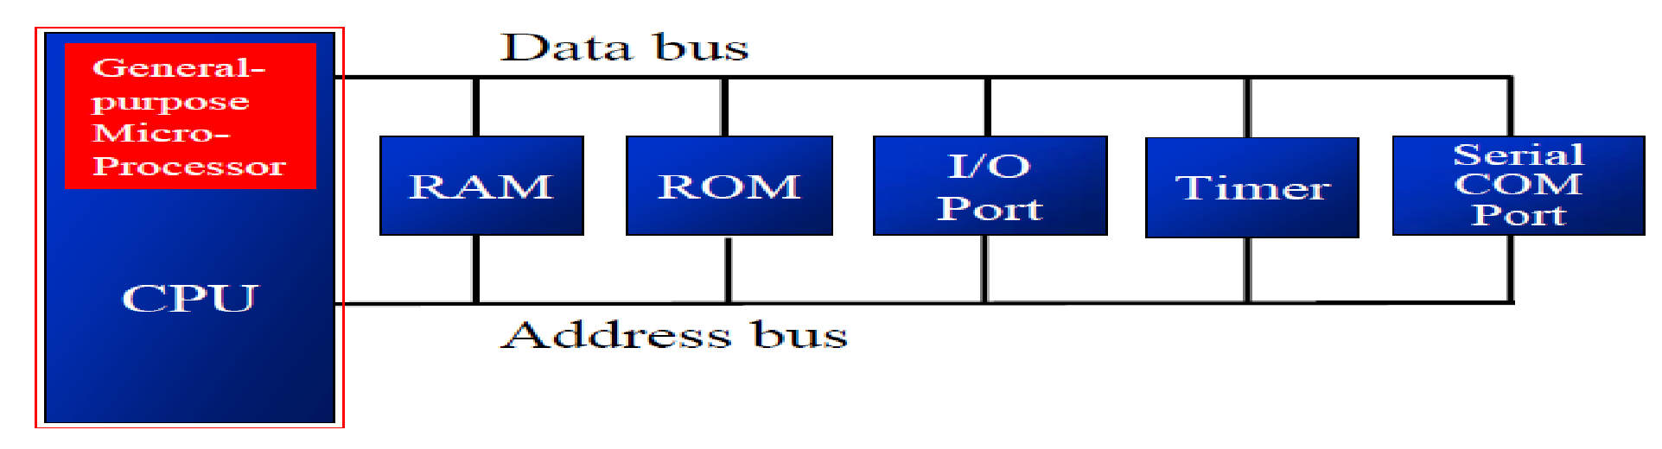
Microprocessor & Computer Architecture Microprocessor
Accepts digital data as input, processes it according to instructions stored in its memory, and provides results as output.
Don’t have RAM, ROM, and other peripheral on the chip.
Memory , I/O and other components need to be connected externally.
Cannot be used in compact systems.
Power Consumption is High.

Slide 12
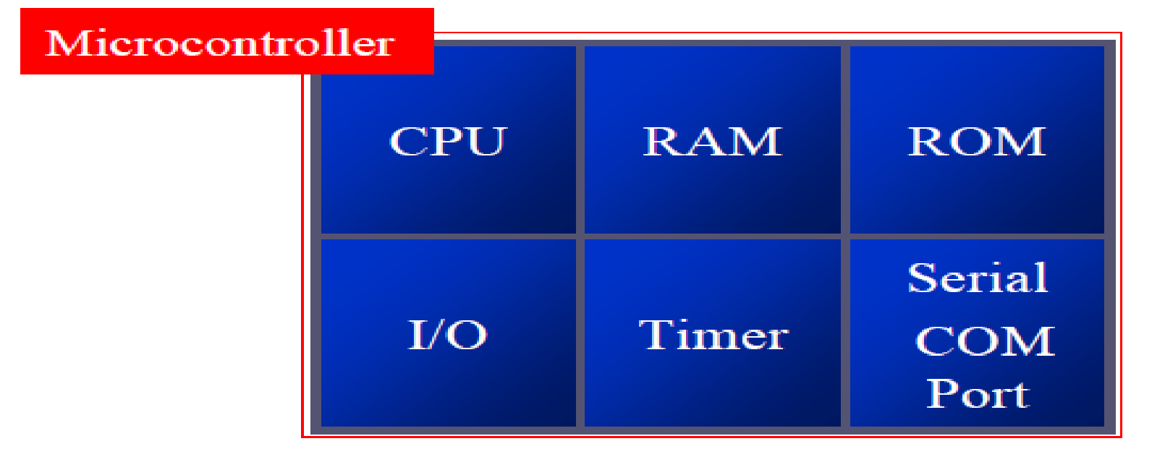
Microprocessor & Computer Architecture Microcontroller
Comprises of CPU, in addition with a fixed amount of RAM, ROM and other
peripherals all embedded on a single chip.
Also termed as a mini computer or a computer on a single chip.
Designed to perform specific tasks.
Requires small resources like RAM, ROM, I/O ports etc. and hence can be embedded
on a single chip.
Reduces the size and the cost.

Slide 13
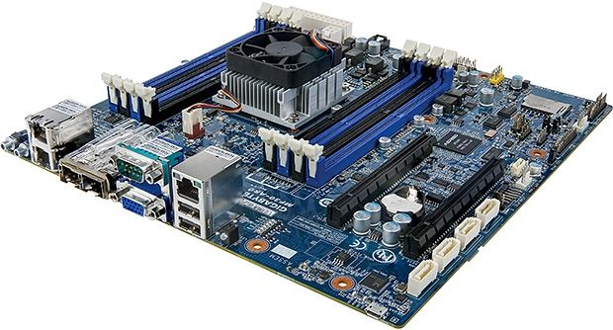
Microprocessor, Where am I?

Slide 14
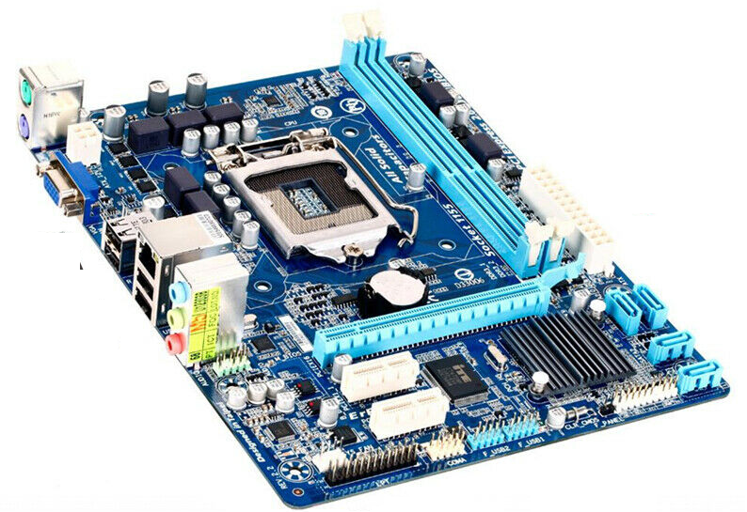
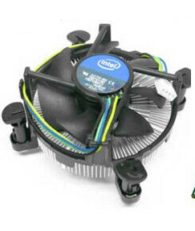
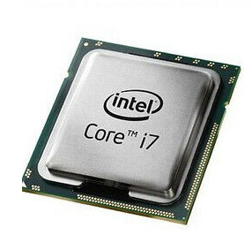
Microprocessor, Where am I?

Slide 15
Microprocessor - Evolution
4004 | Nov. 15,1971
8008 | April 1972
8080 | April 1974
8085 | March 1976
8086 | June 8, 1978
8088 | June 1979
80286 | Feb. 1982
i80386 | 1985 - 1990
I80486 | 1989 - 1992
Intel Pentium | 1993 - 1999
Intel Pentium MMX | 1996 - 1999
Intel Atom | 2008 - 2009 (as Centrino Atom), 2008–present (as Atom)
Intel Celeron | 1998–present
Intel Pentium Pro | 1995 - 1998
Intel Pentium II | 1997 - 1999
Intel Pentium III | 1999 - 2003
Intel Xeon | 1998–present
Pentium 4 | 2000 - 2008
Pentium 4 | 2000 - 2008
Pentium M | 2003 - 2008
Pentium D/EE | 2005 - 2008

Slide 16
Microprocessor - Evolution
Intel Pentium Dual-Core | 2006 - 2009
Intel Pentium (2009) | 2009–present
Intel Core | 2006 - 2008
Intel Core 2 | 2006 - 2011
Intel Core i3 | 2010–present
Intel Core i5 | 2009–present
Intel Core i7 | 2008–present
Intel Core i7 (Extreme Edition) | 2011–present
Intel Core i9 | 2018–present
Intel Core i9 (Extreme Edition) | Q3 2017–present

Slide 17
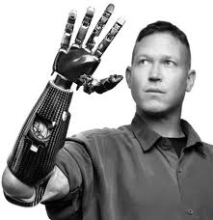
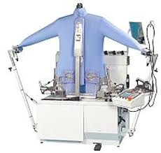


Why Study Microprocessor ?
Because its part of the Curriculum!!! ☺
Everywhere we have devices which are controlled by “Microprocessor” or “Microcontroller”

Slide 18
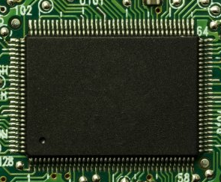
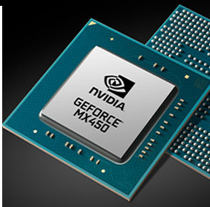
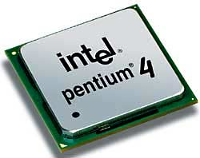
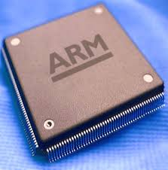
Classification of Microprocessors
CISC: Complex Instruction Set Computer
RISC: Reduced Instruction Set Computer
Microprocessor
Special Purpose
CISC
RISC

Slide 19
How to Classify Microprocessors?
Three basic characteristics differentiate microprocessors:
Instruction set: The set of instructions that the microprocessor can execute.
Bandwidth : The number of bits processed in a single instruction.
Clock Speed : How many instructions per second the processor can execute.
Given in megahertz (MHz),

Slide 20
Instruction Set Architecture (ISA)
The complete collection of instructions that are understood by a CPU
Example: Data Movement, Data Processing, Branch Instruction……etc
Designers decide the ISA for respective Microprocessor.
It is responsibility of Compiler to generate correct and Optimized code for respective Microprocessor.
Main criteria to classify CISC & RISC Processor

Slide 21

CISC – Complex Instruction Set Computer
Preamble
Earliest machines were programmed in assembly language and memory was slow and expensive.
The CISC philosophy made sense, and was commonly implemented in such large computers as the PDP-11 and the DEC system 10 and 20 machines.
Most common microprocessor designs such as the Intel 80x86 and Motorola 68K series followed the CISC philosophy.
But recent changes in software and hardware technology have forced a reexamination of CISC and many modern CISC processors are hybrids, implementing many RISC principles and vive versa.
CISC was developed to make compiler development simpler. It shifts most of the burden of generating machine instructions to the processor.

Slide 22
CISC: Complex Instruction Set Computer
CISC processors were evolved in the 1970s.
During this period, the computer memory used to be ‘small’ and ‘very expensive’.
Philosophy of CISC processors is to simplify the code and make it shorter in order to reduce the memory requirement.
In a CISC processor, a single instruction has ‘several low-level operations. This makes the CISC instructions short but ‘complex’.

Slide 23
CISC: Complex Instruction Set Computer
Architecture
CISC processors typically had variable length instruction sets with many formats.
Typically allowed values in memory to be used as operands in data processing instructions.
A 2-operand instruction format
Register sets were getting larger, but none was as large as RISC and most processors had different registers for different purposes.
CISC Organization
Microprogrammed control instruction decode logic.
It was easier to implement and less expensive.
CISC processors allowed little, if any, overlap between consecutive instructions.
The ease of microcoding new instructions allowed designers to make CISC machines upwardly compatible
May take many clock cycles to complete a single instruction.
Microprogram instruction sets can be written to match the constructs of high-level languages, the compiler does not have to be complicated.
Pentium is considered a modern CISC processor.

Slide 24
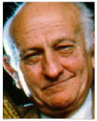

RISC – Reduced Instruction Set Computer
John Cocke - (May 30, 1925 – July 16, 2002), was an
American computer scientist recognized for his large contribution
on computer architecture and optimizing compiler design.
Originated the RISC concept in 1974.
Considered by many to be "the father of RISC architecture.”
Proved that about 20% of the instructions in a computer did 80% of the work.
The term RISC is credited to David Patterson, a teacher at
the University of California in Berkeley. The concept was used in
Sun Microsystems' SPARC microprocessors and led to the
founding of what is now MIPS Technologies, part of Silicon Graphics.
A number of current microchips now use the RISC concept.

Slide 25
RISC: Reduced Instruction Set Computer
Idea of RISC processors was originated in the 1974 and Implemented in 1980’s.
Philosophy of RISC processors is to simplify operation of Individual Instruction.
Separate Instruction for Load and Store (Data Movement)
Number of lines of code in the program increases but Amount of work done by individual instruction is REDUCED.

Slide 26
RISC – Reduced Instruction Set Computer
Architecture
A fixed (32-bit).
A load-store architecture where instructions that process data, operate only on registers and are separate from instructions that access memory.
A large register bank (thirty-two 32-bit registers).
Instruction size with few formats.
RISC Organization
Hard-wired instruction decode logic (design of the control unit).
Pipelined execution.
Single-cycle execution.
RISC Advantages
A smaller die size.
A shorter development time.
A higher performance.
RISC Drawbacks
Poor code density.
Do not execute x86 code.

Slide 27
RISC Vs CISC Machines Today
With the rise of embedded systems and mobile computing, the terms RISC and CISC have lost their significance
Both architectures almost seem to have adopted the strategies of the other.
Some RISC systems provide more extravagant instruction sets than some CISC systems.
CISC chips are now able to execute more than one instruction within a single clock, including Pipelining.
The RISC Vs CISC debate started when chip-area and processor design complexity were issues – now energy and power are the issues.
The two top competitors today are ARM and Intel – Intel focuses on performance and ARM focuses on efficiency (British company – Acron RISC Machine)

Slide 28
RISC – Reduced Instruction Set Computer
State of the art processor technology has changed significantly since RISC chips were first introduced in the early '80s.
A number of advancements are used by both RISC and CISC processors.
The lines between the two architectures have begun to blur.
In fact, the two architectures almost seem to have adopted the strategies of the other.
Since, the processor speeds have increased, CISC chips are now able to execute more than one instruction within a single clock.
This also allows CISC chips to make use of pipelining.
With other technological improvements, it is now possible to fit many more transistors on a single chip.

Slide 29
RISC vs CISC
RISC
Simple instructions, few in number.
Fixed length instructions.
Multiple register sets.
Three operands per instruction.
Parameter passing through register windows.
Single-cycle instructions.
Hardwired control.
Highly pipelined.
Complexity in compiler.
Only LOAD/STORE instructions access memory.
Few addressing modes.
CISC
Many complex instructions.
Variable length instructions.
Single register set.
One or two register operands per instruction.
Parameter passing through memory.
Multiple cycle instructions.
Microprogrammed control.
Less pipelined.
Many instructions can access memory.
Many addressing modes.

Slide 30
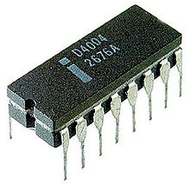
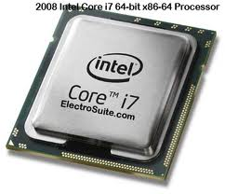
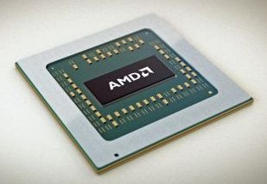
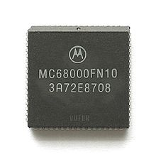
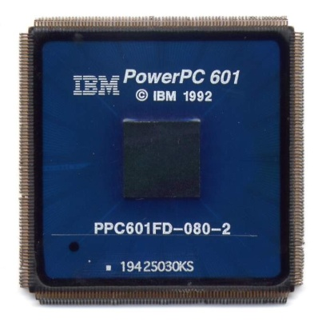
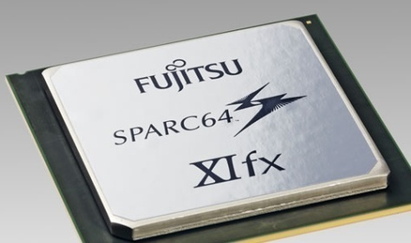
Our Choice-> ARM
Mostly on----------------🡪

Slide 31

THANK YOU
V R BADRI PRASAD
Department of Computer Science and Engineering

