Slide 1

Microprocessor & Computer Architecture (μpCA)
UE23CS251B
Session - 2
Cousre Instructor
Prof. V R Badri Prasad

Slide 2
Microprocessor & Computer Architecture (μpCA)
UE23CS251B
Processor design trade-offs

Slide 3

Processor design trade-offs
What does the processor do?
Misconception - computers spend their time computing, i.e., carrying out arithmetic operations on user data.
Although they do a fair amount of arithmetic, most of this is with addresses in order to locate the relevant data items and program routines.
- Then, having found the user's data, most of the work is in moving it
around rather than processing it in any transformational sense.
Consider a Scenario : The programmer generally wants to express his or her program in as abstract a way as possible, using a high-level language which supports ways of handling concepts that are appropriate to the problem.
- Modern trends towards functional and object-oriented languages move the level of abstraction higher.
- The semantic gap between a high-level language construct and a machine instruction is
bridged by a compiler ( A computer program that translates a high level language program into a
sequence of machine instructions).
- Hence, the processor designer should define a good instruction set.

Slide 4
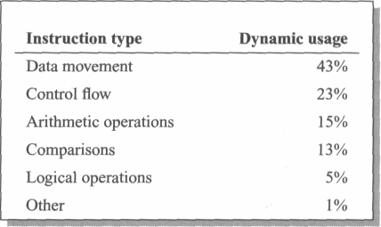
Processor design trade-offs
A typical set of statistics is shown below were gathered running a print preview program on an ARM instruction emulator, but are broadly typical of what may be expected from other programs and instruction sets.
Instructions to optimize are those concerned with data movement, either between the processor registers and memory or from register to register.
Secondly, the control flow instructions such as branches and procedure calls.
Arithmetic operations are down at 15%, as are comparisons at 13%.

Slide 5
Processor design trade-offs
Now, that it is clear what processors spend their time doing, is there a way to make the processor work faster ?
The most important of these is pipelining.
A very effective way of exploiting concurrency in a general-purpose processor.
Another important technique is the use of a cache memory.
A CPU cache is a cache used by the CPU to reduce the average time to access data from the main memory.
A third technique, super-scalar instruction execution.
A superscalar processor executes more than one instruction during a clock cycle by simultaneously dispatching multiple instructions to different execution units on the processor.

Slide 6
Microprocessor & Computer Architecture (μpCA)
UE23CS251B
ARM ISA:
Instruction Set Architecture

Slide 7
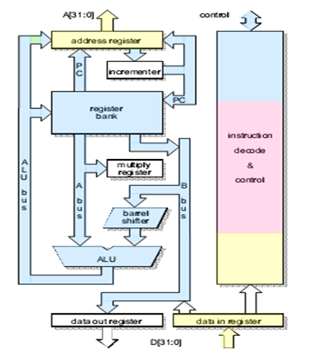



ARM Processor – 3 stage Pipeline Architecture
The ARM [Acorn Risc Machine] is a RISC processor
3 stages of Pipeline
The RISC features incorporated by ARM.
A load-store architecture.
Fixed-length 32-bit instructions.
3-address instruction formats.

Slide 8
Organization of ARM – 3 stage PP
The register bank, which stores the processor state.
Two read ports and One write port - to access any register
Plus an additional read port and an additional write port that give special access to r15
The barrel shifter, which can shift or rotate one operand by any number of bits.
The ALU, which performs the arithmetic and logic functions required by the instruction set.
The address register and incrementer, which select and hold all memory addresses and generate sequential addresses when required.
The data registers, which hold data passing to and from memory.
The instruction decoder and associated control logic.

Slide 9
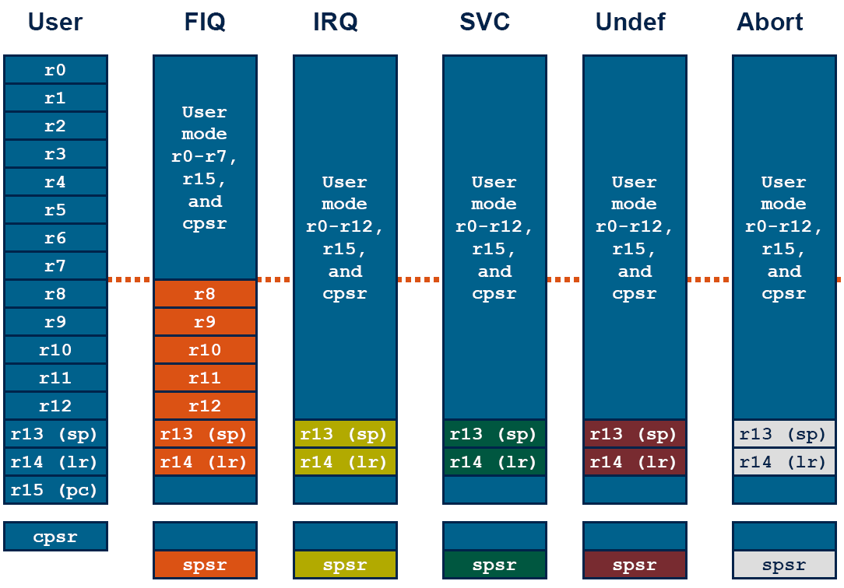
Register organization & Modes
The RISC Features rejected by ARM. • Register windows. • RISC processors incorporated a large number of registers. • Procedure entry and exit instructions moved the visible 'window' to give each procedure access to new registers. • Thereby reducing the data traffic between the processor and memory resulting from register saving and restoring. • The principal problem with register windows is the large chip area occupied by the large number of registers. This feature was therefore rejected on cost grounds.

Slide 10
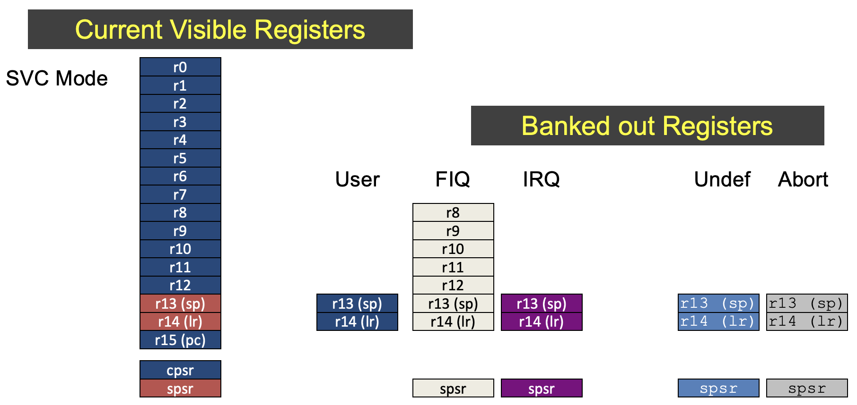
The ARM Register Set – SVC Mode

Slide 11
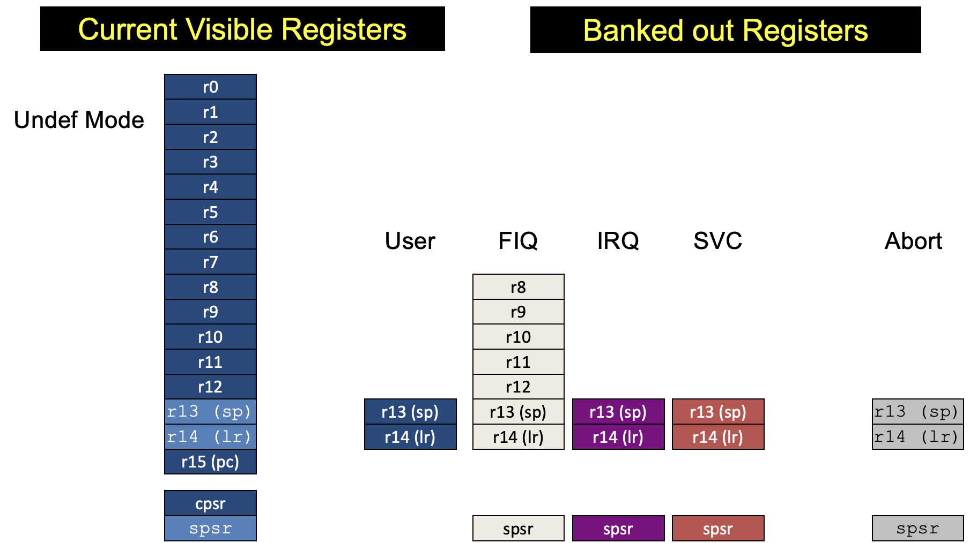
The ARM Register Set – Undef Mode

Slide 12
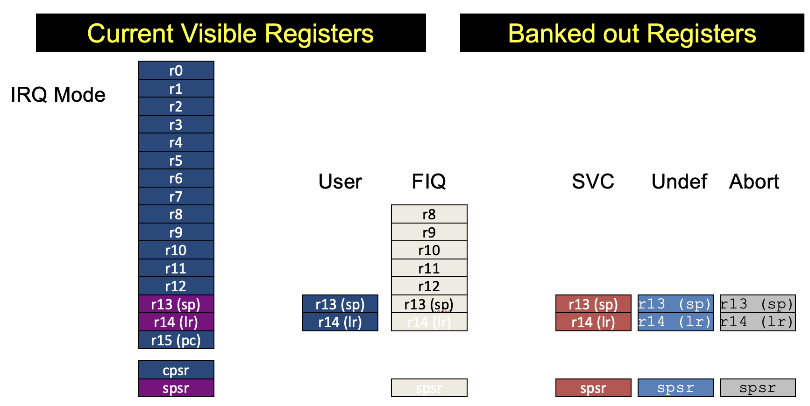
The ARM Register Set – IRQ Mode

Slide 13
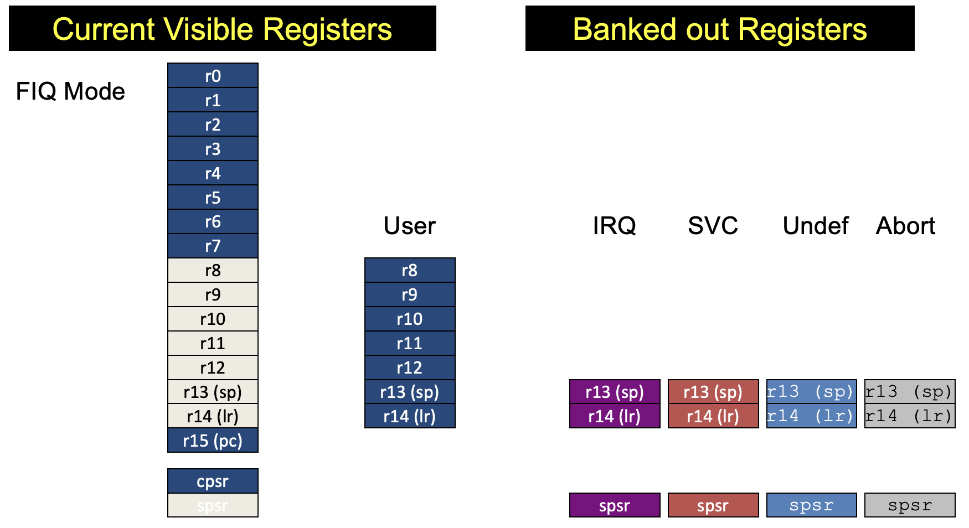
The ARM Register Set – FIQ Mode

Slide 14
The ARM Register Set – SVC Mode
Current Visible Registers
SVC Mode
r0
r1
r2
r3
Banked out Registers
r4
r5
r6
User
FIQ
IRQ
Undef
Abort
r7
r8
r8
r9
r9
r10
r10
r11
r11
r12
r12
r13 (sp)
r13 (sp)
r13 (sp)
r13 (sp)
r13 (sp)
r13 (sp)
r14 (lr)
r14 (lr)
r14 (lr)
r14 (lr)
r14 (lr)
r14 (lr)
r15 (pc)
cpsr
spsr
spsr
spsr
spsr
spsr

Slide 15
The ARM Register Set – Undef Mode
Current Visible Registers
Banked out Registers
Undef Mode
r0
r1
r2
r3
r4
r5
r6
User
FIQ
IRQ
SVC
Abort
r7
r8
r8
r9
r9
r10
r10
r11
r11
r12
r12
r13 (sp)
r13 (sp)
r13 (sp)
r13 (sp)
r13 (sp)
r13 (sp)
r14 (lr)
r14 (lr)
r14 (lr)
r14 (lr)
r14 (lr)
r14 (lr)
r15 (pc)
cpsr
spsr
spsr
spsr
spsr
spsr

Slide 16
The ARM Register Set – IRQ Mode
Current Visible Registers
Banked out Registers
IRQ Mode
r0
r1
r2
r3
r4
r5
r6
User
FIQ
SVC
Undef
Abort
r7
r8
r8
r9
r9
r10
r10
r11
r11
r12
r12
r13 (sp)
r13 (sp)
r13 (sp)
r13 (sp)
r13 (sp)
r13 (sp)
r14 (lr)
r14 (lr)
r14 (lr)
r14 (lr)
r14 (lr)
r14 (lr)
r15 (pc)
cpsr
spsr
spsr
spsr
spsr
spsr

Slide 17
The ARM Register Set – FIQ Mode
Current Visible Registers
Banked out Registers
FIQ Mode
r0
r1
r2
r3
r4
r5
r6
User
IRQ
SVC
Undef
Abort
r7
r8
r8
r9
r9
r10
r10
r11
r11
r12
r12
r13 (sp)
r13 (sp)
r13 (sp)
r13 (sp)
r13 (sp)
r13 (sp)
r14 (lr)
r14 (lr)
r14 (lr)
r14 (lr)
r14 (lr)
r14 (lr)
r15 (pc)
cpsr
spsr
spsr
spsr
spsr
spsr

Slide 18
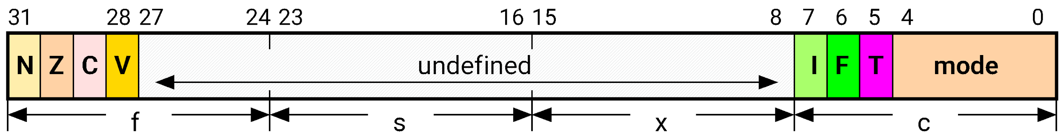
Status Register (SR)
SR fields are divided into four fields, each 8-bit wide:
Flags (f)
Status (s) : Reserved for Future
Extension (x) : Reserved for Future
Control (c).

Slide 19
Status Register (SR)
N: Negative: Set to 1 if the Result of previous instruction is Negative.
Z: Zero: Set to 1 if the Result of previous instruction is Zero.
C: Carry: Set to 1, if result of either an Arithmetic or Shifter produce a carry-out,
• V: oVerflow: Set to 1, if previous instruction produce an overflow into the sign bit.
Mode bits
10000 User
10001 FIQ
10010 IRQ
10011 Supervisor
10111 Abort
11011 Undefined
11111 System
Interrupt Disable bits.
I = 1: Disables the IRQ.
F = 1: Disables the FIQ.
T Bit (Arch. with Thumb mode only)
T = 0: Processor in ARM state
T = 1: Processor in Thumb state

Slide 20
Status Register (SR)
Thumb state
Thumb is a 16-bit instruction set
Optimized for code density from C code (~65% of ARM code size)
Improved performance from memory with a narrow data bus
Subset of the functionality of the ARM instruction set
Only Low Registers R0-R7 are used
Constants are of limited size.
Inline barrel shifter not used.

Slide 21

Status Register : CPSR & SPSR
Current Program Status Register: CPSR
ARM core uses CPSR to monitor & control internal operations.
The current status of the program under execution, such as, result of current execution instruction is zero/ -ve are captured here.
Saved Program Status Register: SPSR
Processor, While Shifting one mode to another mode, CPSR will be copied to SPSR.
SPSR will be copied back to CPSR when it return back to previous mode.
Example:
Suppose Processor is in USER mode of operation and if IRQ request arrives then processor has to switch itself to IRQ mode of operation. First CPSR is get copied to SPSR then processor will serve IRQ mode. After serving IRQ mode processor should return to USER mode and should resume its working. So SPSR is get copied again into CPSR to serve USER mode.

Slide 22
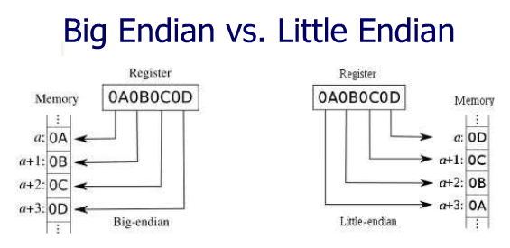
The Memory System
ARM processor supports both little endian & big endian methods for storing data in memory.
ARM processors support six data types.
• 8-bit signed and unsigned bytes.
• 16-bit signed and unsigned half-words; these are aligned on 2-byte boundaries.
• 32-bit signed and unsigned words; these are aligned on 4-byte boundaries.

Slide 23
ARM Instruction Set Architecture - Features
All ARM instructions are 32 bits wide.
The load-store architecture.
3-Address data processing instructions (that is, the two source operand registers and the result register are all independently specified).
Conditional execution of every instruction.
Inclusion of very powerful load and store multiple register instructions.
Ability to perform a general shift operation and a general ALU operation in a single instruction that executes in a single clock cycle.

Slide 24
Load-store architecture
The instruction set will only process [ADD, SUB] values which are in registers [Immediate data] and will always place the results of such processing into a register.
LOAD instructions operations which apply to memory state are ones which copy memory values into registers.
STORE instructions copy register values into memory.
ARM does not support 'memory-to-memory' operations.
ARM instructions fall into one of the following 3 categories.
Data processing instructions.
Ex: MOV, ADD, SUB, CMP, etc.,
Data transfer instructions.
Ex: LDR, STR
Control flow instructions
Ex: B, BGT, BEQ, BL, etc.,

Slide 25
The RISC Features rejected by ARM.
Register windows.
RISC processors incorporated a large number of registers.
Procedure entry and exit instructions moved the visible 'window' to give each procedure access to new registers.
Thereby reducing the data traffic between the processor and memory resulting from register saving and restoring.
The principal problem with register windows is the large chip area occupied by the large number of registers.
This feature was therefore rejected on cost grounds.

Slide 26
The RISC Features rejected by ARM.
Delayed branches.
Branches cause pipelines problems since they interrupt the smooth flow of instructions.
RISC processors ameliorate the problem by using delayed branches where the branch takes effect after the following instruction has executed.
Work well on single issue pipelined processors
But, do not scale well to super-scalar implementations &
can interact badly with branch prediction mechanisms.
Single-cycle execution of all instructions.
ARM executes most data processing instructions in a single clock cycle,
many other instructions take multiple clock cycles.
A simple load or store instruction requires at least two memory
accesses.
Single cycle operation of all instructions is only possible with separate data and instruction memories.

Slide 27

THANK YOU
V R BADRI PRASAD
badriprasad@pes.edu
Department of Computer Science and Engineering

