Slide 1

Microprocessor & Computer Architecture (μpCA)
UE23CS251B
Session - 6.1

Slide 2
Microprocessor & Computer Architecture (μpCA)
UE23CS251B
Multiplication Instruction

Slide 3
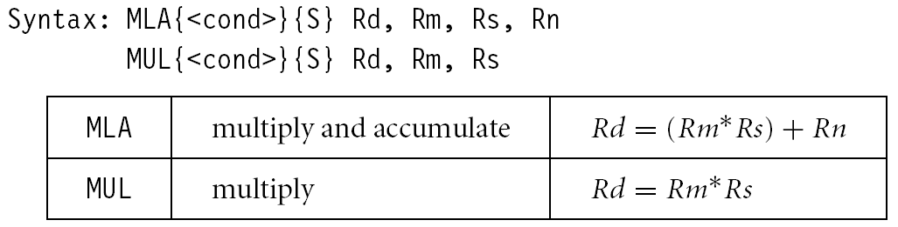
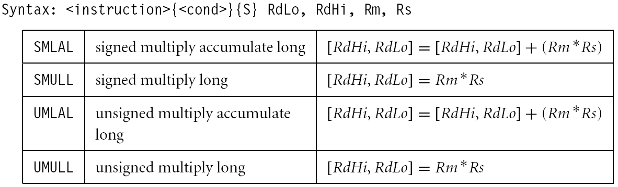
Multiplication

Slide 4
Multiplication – MUL - Instruction
MUL R0, R1, R2
@ R0 = (R1xR2)_{[31:0]}
Features:
Second operand can’t be immediate
The result register must be different from the first operand
Cycles depends on core type
If S bit is set, C flag is meaningless

Slide 5
Multiplication Instruction
There are 2 classes of multiply - producing 32-bit and 64-bit results
32-bit versions on an ARM7TDMI will execute in 2 - 5 cycles
MUL r0, r1, r2 ; r0 = r1 * r2
MLA r0, r1, r2, r3 ; r0 = (r1 * r2) + r3
64-bit multiply instructions offer both signed and unsigned versions
For these instruction there are 2 destination registers
[U|S]MULL r4, r5, r2, r3 ; r5:r4 = r2 * r3
[U|S]MLAL r4, r5, r2, r3 ; r5:r4 = (r2 * r3) + r5:r4

Slide 6
Multiplication of Corresponding elements in an array
.DATA
A: .word 1,3,5
B: .word 2,4,6
C: .word
.TEXT
LDR R5,=A
LDR R6,=B
LDR R7,=C
MOV R3, #3 ; number of elements in array
MOV R4, #0
Loop:
LDR R1, [R5], #4
LDR R2, [R6], #4
MUL R0, R1, R2 ;multiple R1 And R2 And Store Result In R0
ADD R4, R4, R0
STR R4, [R7], #4
SUB R3, R3, #1
TEQ R3, #0 ; Test For Equality
BNE Loop
SWI 0x11 ; Interrupt For Termination Of Program

Slide 7
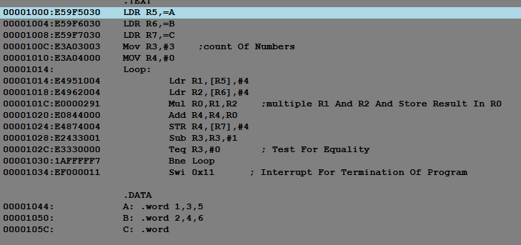
C = C + A [i] * B [i]

Slide 8
MLA Example – Matrix Representation in memory
1
00000000
1 2 3 A(0,0) A(0,1) A(0,2)
A = 4 5 6 => A(1,0) A(1,1) A(1,2)
7 8 9 A(2,0) A(2,1) A(2,2)
Row Major Order for a 3 x 3 matrix :
A [ 2, 2] = Row Num. x No. of elements per row + Column Num.
2 x 3 + 2 = 8th location.
Since each location is of 4 bytes, the address of the 3rd element in the 2nd row is
8 x 4 = 32.
This is achieved in ARM processor, using MLA instruction as follows.
MLA R1, R2, R3, R4
Mnemonic Dst Row # # of elements per row col #
To get consecutive data elements in a @D Array.
2
00000001
3
4
5
6
7
8
00000020
9

Slide 9
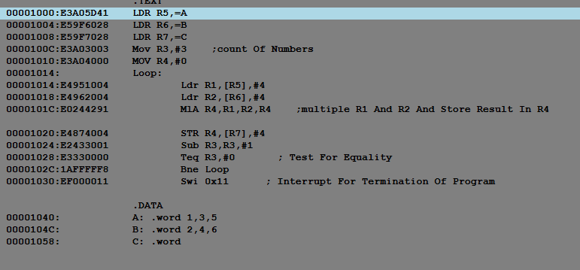
Multiply-Accumulate c=c+a[i]*b[i]
<MLA> Rd, Rf, Rn, Rm @ Rd= RfxRn+Rm
MLA R4, R1, R2, R4 @ R4 = R1xR2+R4

Slide 10
Microprocessor & Computer Architecture (μpCA)
UE23CS252B
Session - 6.2
Conditional Execution

Slide 11
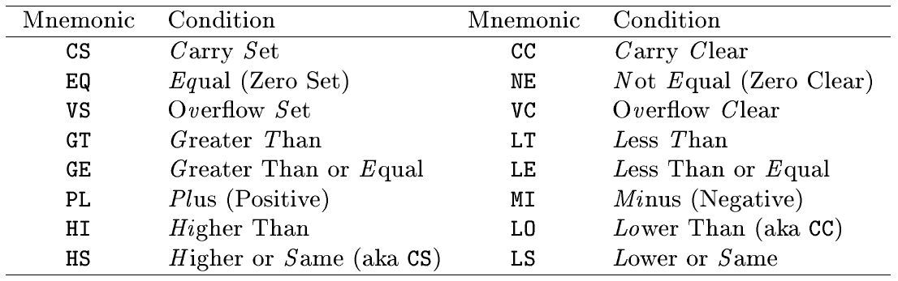
Conditional Execution
Almost all ARM instructions have a condition field which allows it to be executed conditionally.
MOVCS R0, R1

Slide 12
Conditional Execution - Example 01
; Convert the C statement to ARM instructions.
if (R0!=5) {R1=R1+R0-R2}
CMP R0, #5
BEQ bypass
ADD R1, R1, R0
SUB R1, R1, R2
bypass: …
CMP R0, #5
ADDNE R1, R1, R0
SUBNE R1, R1, R2
; smaller and faster
Rule of thumb: if the conditional sequence is three instructions
or less, it is better to use conditional execution than a branch.

Slide 13
Conditional Execution - Example 02
if ((R0==R1) && (R2==R3)) R4++
CMP R0, R1
BNE skip
CMP R2, R3
BNE skip
ADD R4, R4, #1
skip: …
CMP R0, R1
CMPEQ R2, R3
ADDEQ R4, R4, #1

Slide 14

THANK YOU
Team MPCA
Department of Computer Science and Engineering

