Slide 1

Microprocessor & Computer Architecture (μpCA)
UE23CS251B
Session - 8

Slide 2
Microprocessor & Computer Architecture (μpCA)
UE23CS251B
Procedure Call or Subroutine Call or Function Call

Slide 3

Procedure Call or Subroutine Call or Function Call
The single variant on the branch theme is the option to perform a link operation before the branch is executed. (BL)
This simply means storing the current value of R15 (PC) in R14 before the branch is taken, so that the program can resume its operation.
Procedure call is invoked using a BL instruction .
Branch with link, BL instruction i.e.,
BL subroutine

Slide 4
Procedure Call or Subroutine Call or Function Call
ARM has no dedicated stack.
It copies R15 into R14
If the called Routine needs to use R14 for something, it can save it on the stack explicitly.
The ARM method has the advantage that subroutines which don't need to save R14 can be called return very quickly.
The disadvantage is that all other routines have the overhead of explicitly saving R14.
To return from a subroutine, the program simply has to move R14 back into register R15.
MOV R15, R14 or MOV PC, LR
MOVS R15, R14 or MOV PC, LR

Slide 5
Procedure Call
Main Procedure
0x0000 Instruction 1
0x0004 Instruction 2
0x0008 Instruction 3
0x000C Procedure Call
0x0010 Instruction 4
0x0014 Instruction 5
:::::::::::::::::::
Instruction Last
R0-R7
R8-R12
R13 (SP)
R14 (LR)
R15 (PC) | 0x0010
CPSR
Called Procedure
0x0020 Instruction 1
0x0024 Instruction 2
0x0028 Instruction 3
0xxxxx Return Instruction

Slide 6
General Structure of Procedure Call:
Main Procedure
0x0000 Instruction 1
0x0004 Instruction 2
0x0008 Instruction 3
0x000C Procedure Call
0x0010 Instruction 4
0x0014 Instruction 5
:::::::::::::::::::
Instruction Last
R0-R7
R8-R12
R13 (SP)
R14 (LR) | 0x0010
R15 (PC) | 0x0020
CPSR
Called Procedure
0x0020 Instruction 1
0x0024 Instruction 2
0x0028 Instruction 3
0xxxxx Return Instruction
LR=PC
PC= Address of the 1st Instruction

Slide 7
General Structure of Procedure return:
Main Procedure
0x0000 Instruction 1
0x0004 Instruction 2
0x0008 Instruction 3
0x000C Procedure Call
0x0010 Instruction 4
0x0014 Instruction 5
:::::::::::::::::::
Instruction Last
R0-R7
R8-R12
R13 (SP)
R14 (LR)
R15 (PC) | 0x0010
CPSR
Called Procedure
0x0020 Instruction 1
0x0024 Instruction 2
0x0028 Instruction 3
0xxxxx Return Instruction
PC=LR

Slide 8
General Structure of Procedure call and return:
Main Procedure
0x0000 Instruction 1
0x0004 Instruction 2
0x0008 Instruction 3
0x000C BL Procedure
0x0010 Instruction 4
0x0014 Instruction 5
:::::::::::::::::::
Instruction Last
Called Procedure
0x0020 Procedure: Instruction 1
0x0024 Instruction 2
0x0028 Instruction 3
0xxxxx MOV PC LR
or
BX LR

Slide 9
Procedure Call Example:01
MOV R1, #3
BL FOOO
ADD R2, R0, R1
SWI 0x11
FOOO:
MOV R0, #2
BX LR
MOV R1, #3
BL FOOO
ADD R2, R0, R1
SWI 0x11
FOOO:
MOV R0, #2
MOV PC, LR

Slide 10
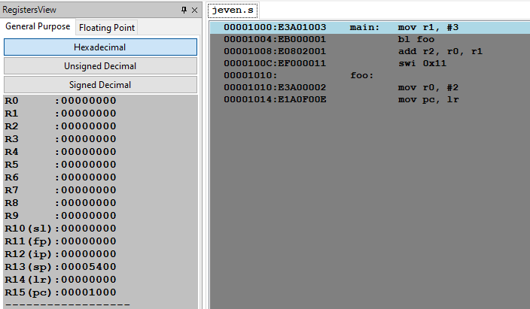
Procedure Call Example:01

Slide 11
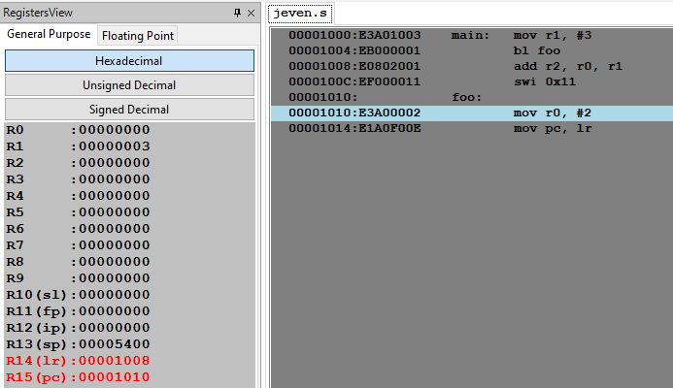
Procedure Call Example:01

Slide 12
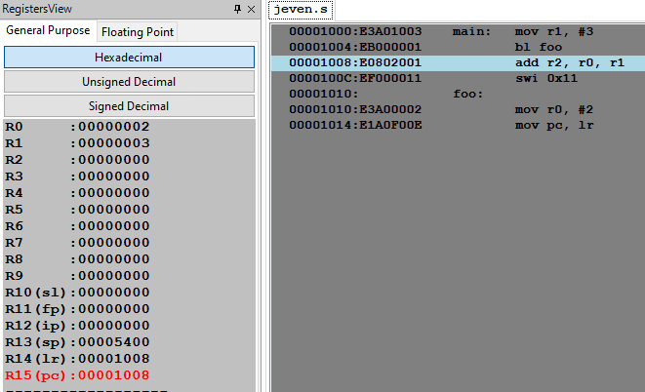
Procedure Call Example:01

Slide 13
Parameter passing to procedures using stack
LDR R4, =A
MOV R1, #25 ; parameter1
MOV R2, #25 ; parameter2
STMFD R13!, { R1, R2} ; parameters are PUSHed on stack.
BL LINK
STR R0, [R4] ; return value in Reg. R0.
SWI 0x11
LINK: LDMFD R13!, { R4, R5} ; parameters are POPed from the stack
ADD R0, R4, R5 ; Result is in register R0.
MOV PC, LR
A: .WORD 0
.END

Slide 14
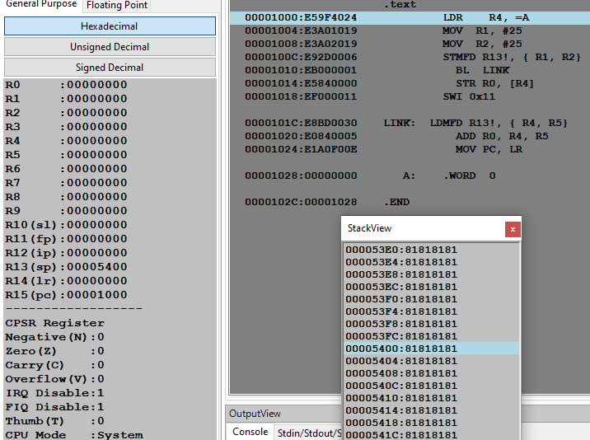
Parameter passing to procedures using stack

Slide 15
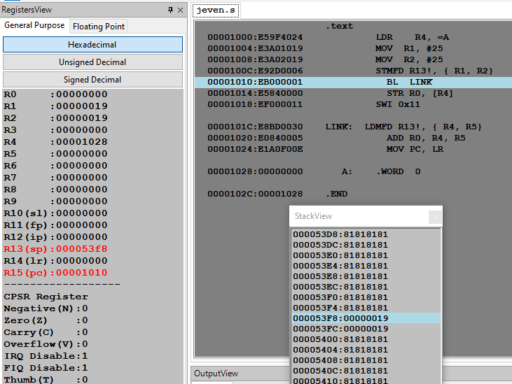
Parameter passing to procedures using stack

Slide 16
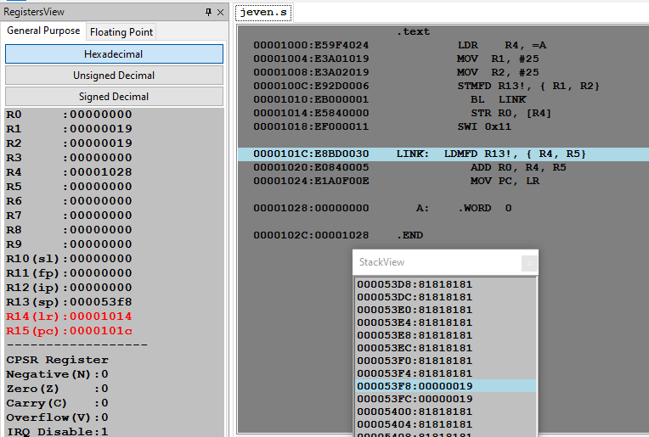
Parameter passing to procedures using stack

Slide 17
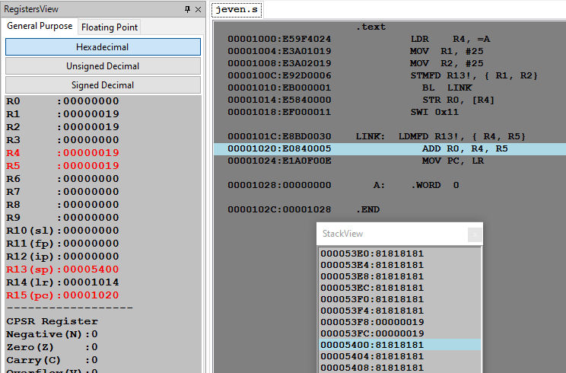
Parameter passing to procedures using stack

Slide 18
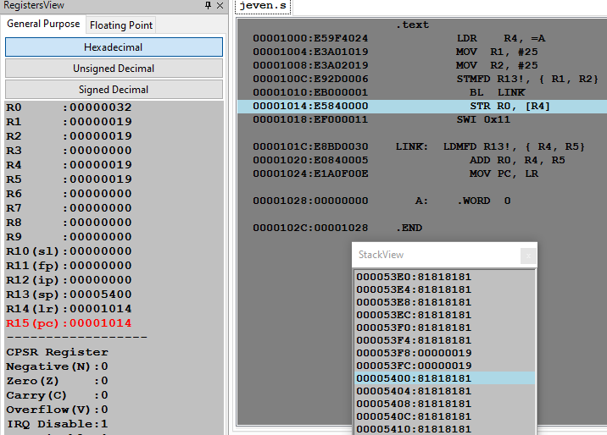
Parameter passing to procedures using stack

Slide 19
Nested Procedure Call
.TEXT ; MAIN Procedure
LDR R4, =A
MOV R1, #11
MOV R2, #10
MOV R3, #02
STMFD R13!, {R1,R2,R3}
BL ADDFun ; Call to ADD Procedure
STR R0, [R4]
SWI 0x11
.DATA
A: .WORD 0
ADDFun: LDMFD R13!, { R4, R5,R6} ; ADD Procedure
ADD R0, R4, R5
STMFD R13!, {R0,R6,LR}
BL MULFun ; Call to MUL Procedure
MOV PC, LR ; Return to Main Procedure
MULFun: LDMFD R13!, { R4, R5,LR}
MUL R0, R4, R5
MOV PC, LR ; Return to ADD Procedure

Slide 20
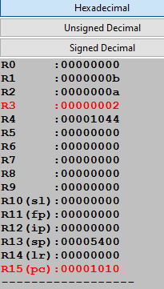
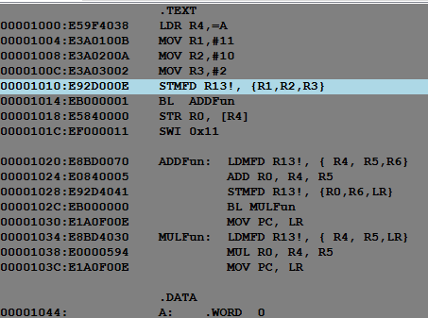
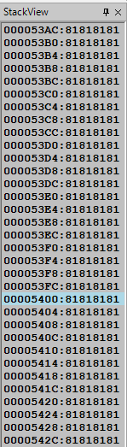
Nested Procedure Call

Slide 21
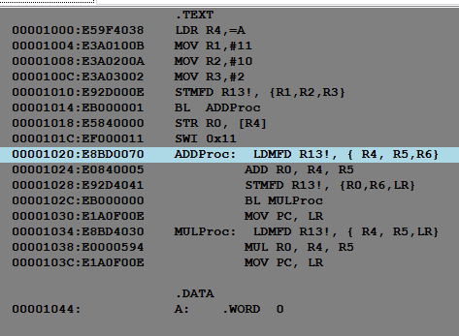
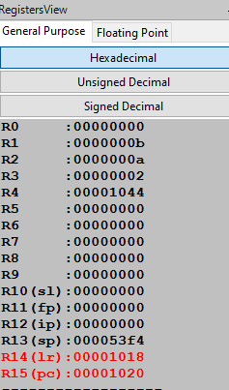
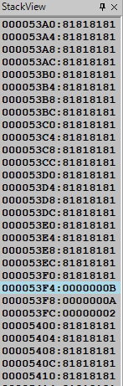
Nested Procedure Call

Slide 22
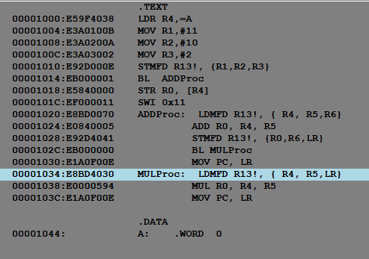
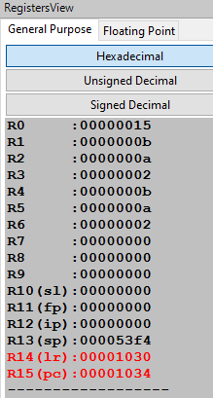
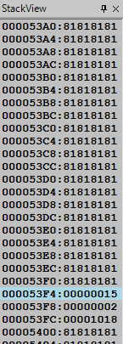
Nested Procedure Call

Slide 23
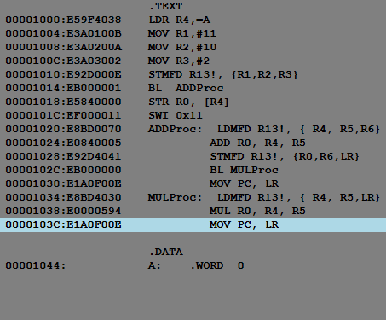
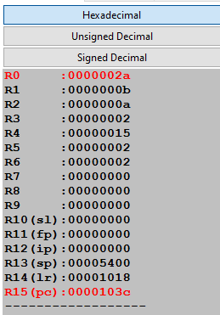
Nested Procedure Call

Slide 24
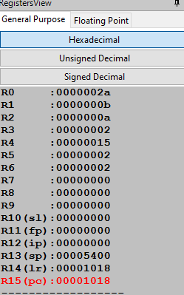
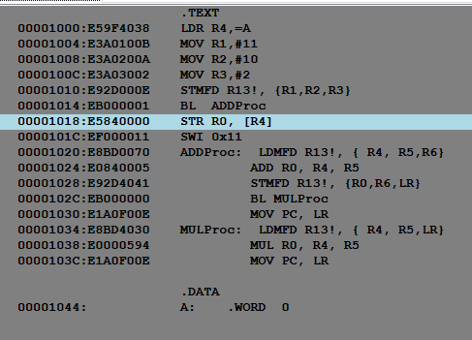
Nested Procedure Call

Slide 25

THANK YOU
Team MPCA
Department of Computer Science and Engineering

Slide 26
Microprocessor & Computer Architecture (μpCA)
UE23CS251B
Software Interrupts
Session - 8.2

Slide 27



What is Interrupt/Exception?
Main ()
{
:
Doing something
(e.g.
browsing)
:
} ring
Can happen anytime
Depends on types of interrupts
Phone rings
Phone rings
_isr() // Interrupt service routine
{
some tasks (e.g. answer
telephone)
} //when finished,
//goes back to main

Slide 28
IMPORTANT INTERRUPTS
Interrupts
Reset
(or power up)
Software
Interrupt
SWI-XX
Hardware
Interrupt
FIQ,IRQ
Timer
ADC
External
Interrupt
EINT
SWI
Triggered by the software instruction SWI x
Triggered by hardware sources
Triggered by power_up/
reset_key

Slide 29
Interrupts and exception:
The terms are used differently by various manufacturers
Traditionally exception means
The normal operation of a program is interrupted and the processor will execute another piece of software (exception handling) somewhere.
Interrupt (hardware interrupt) is an exception caused by some hardware condition happening outside the processor (e.g. external hard interrupt, IRQ FIQ).
Software interrupt (SWI) is an exception caused by an assembly software instruction (SWI 0x?? exception call instruction) written in the software code.
Trap is an exception caused by a failure condition of the processor (e.g. abort “pre-fetch , data” , undefined instruction, divided_by_zero, or stack overflow etc)

Slide 30
Important Interrupts in words
Reset, a special interrupt to start the system– happens at power up , or reset button depressed)
Software interrupt SWI :
Similar to subroutine – happens when “SWI 0x??”
is written in the program
Hardware interrupt
FIQ (fast interrupt) or IRQ (external interrupt), when
the external interrupt request pin is pulled low, or
an analogue to digital conversion is completed, or
A timer/counter has made a regular request

Slide 31
Compare hardware and software interrupt
Hardware interrupt, e.g.
Software interrupt
A falling edge at EINT3 will trigger the
execution of the interrupt service routine
__irq IRQ_Eint1()
IRQ_Eint1()
{
::
}
Computer
EINT3
Computer
Main{
:
SWI N
:
}
An instruction “SWI N” in
the program will trigger the
execution of
the N-th-sys-routine
(system routine)
N-th-sys-routine()
{
::
}

Slide 32
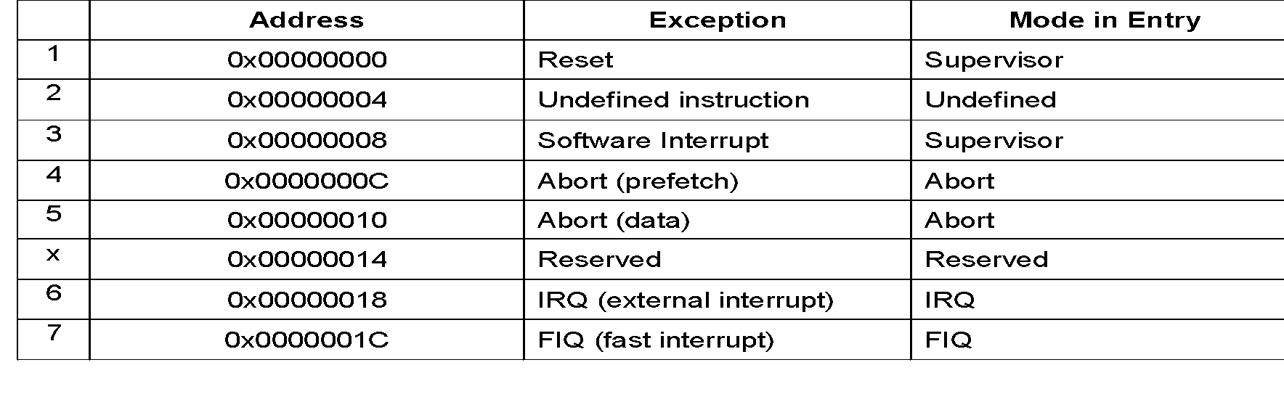
Exception (interrupt) Modes
ARM supports 7 types of exceptions and has a privileged processor mode for each type of exception.
ARM Exception (interrupt) vectors
INTERRUPT VECTOR TABLE:
SWI

Slide 33
SWI Interrupt Procedures(enter the supervisor mode)
SWI (software interrupt )
Caused by “SWI 0x??” in your program
Arm completes the current instruction.
Goto SWI exception address 0x08 (short form for 0x 0000 0008)
{Change to supervisor op. mode :CPSR (bit0-4)
:
:
Return from interrupt
MOVS pc, lr
return to main}

Slide 34
Software Interrupts - 'Supervisor Call’
Whenever a program requires input or output, for instance to send some text to the display, it is normal to call a supervisor routine.
To read data from the keyboard or to display the contents on the console
The supervisor is a program which operates at a privileged level, which means that it can do things that a user-level program cannot do directly.
The limitations on the capabilities of a user-level program vary from system to system, but in many systems the user cannot access hardware facilities directly.
The supervisor provides trusted ways to access system resources which appear to the user-level program rather like special subroutine accesses.

Slide 35
Software Interrupts - 'Supervisor Call’
The instruction set includes a special instruction, SWI, to call these functions, (SWI stands for 'Software Interrupt', but is usually pronounced 'Supervisor Call').
Note: In privileged modes there is another register for each mode called Saved Processor Status Register (SPSR).
The SPSR is used to save the current CPSR before changing modes.
SWI interrupt occurs when the SWI instruction has been fetched and decoded successfully, and none of the other higher priority exceptions/interrupts have been flagged.
Upon entry to the handler the CPSR will be set to SVC mode.
Note: If a SWI calls another SWI (which is a common occurrence), then to avoid corruption, the link register (LR & SPSR) must be stacked away before branching to the nested SWI.

Slide 36
Example 01
A procedure to compute the statement in high level language using ARM ALP.
if (R0==R1) R2++;
MOV R0, #10
MOV R1, #10
BL GREAT
SWI 0x11 ; terminate the program / logical end.
GREAT: CMP R0, R1
ADDEQ R2, R2, #1
MOV PC, LR

Slide 37
Example 02
A program to display a string on the screen using ARM ALP.
System.out.print (“ Hello World”);
LDR R1, =A
LOOP: LDRB R0, [R1], #1
CMP R0, #0
SWINE 0x00 ; display a character on the screen.
BNE LOOP
SWI 0x11 ; terminate the program.
.DATA
A: .ASCIZ “HELLO WORLD”

Slide 38
Example 03
A procedure to display a string on the screen using ARM ALP.
// System.out.print (“ Hello World”);
LDR R1, =A
BL strprint ; call display routine
SWI 0x11 ; terminate the program.
strprint: LDRB R0, [R1], #1
CMP R0, #0
SWINE 0x00 ; display a character on the screen.
BNE strprint
MOV PC, LR
.DATA
A: .ASCIZ “HELLO WORLD”

Slide 39
Example 03
A procedure to display a string on the screen using ARM ALP using routine 0x02.
LDR R0, =A
SWI 0x02 ; display a string on the screen
SWI 0x11
.DATA
A: .ASCIZ “HELLO WORLD”

Slide 40
THANK YOU
Team MPCA
Department of Computer Science and Engineering

