Slide 1

Microprocessor & Computer Architecture (μpCA)
UE23CS251B
Session - 8.2

Slide 2
Microprocessor & Computer Architecture (μpCA)
UE23CS251B
PSR & SWAP Instructions

Slide 3
PSR Instructions
Move to Register from Status Register (MRS): Read from either CPSR or SPSR
Example:
MRS R0, CPSR
MRS R1, SPSR
Move to Status Register from Register (MSR):
_field
_c: Control Field (0:7)
_f: Flag Field(24:31)
_x: Extension (8:15)
_s:Status (16:23)
Example:
MSR CPSR_field, R0
MSR SPSR_field, R1

Slide 4
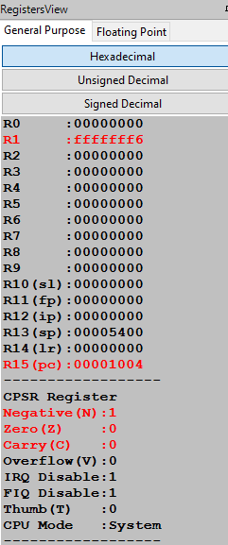
PSR Instructions
.text
MOVS R1,#-10
MRS R0,CPSR ; Take a copy of the CPSR.
AND R0,R0,#0000 ; Clear the mode bits.
MSR CPSR_F,R0 ; Write back the modified CPSR.
.end

Slide 5
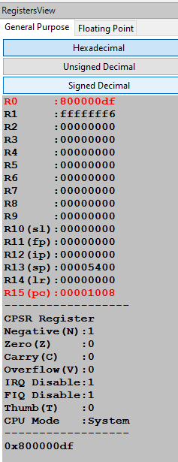
PSR Instructions
.text
MOVS R1,#-10
MRS R0,CPSR ; Take a copy of the CPSR.
AND R0,R0,#0000 ; Clear the mode bits.
MSR CPSR_F,R0 ; Write back the modified CPSR.
.end

Slide 6
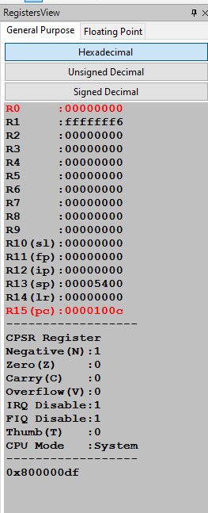
PSR Instructions
.text
MOVS R1,#-10
MRS R0,CPSR ; Take a copy of the CPSR.
AND R0,R0,#0000 ; Clear the mode bits.
MSR CPSR_F,R0 ; Write back the modified CPSR.
.end

Slide 7
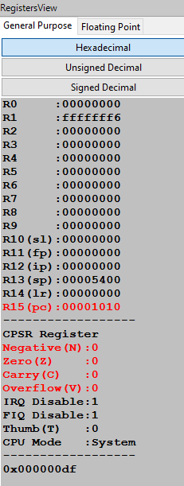
PSR Instructions
.text
MOVS R1,#-10
MRS R0,CPSR ; Take a copy of the CPSR.
AND R0,R0,#0000 ; Clear the mode bits.
MSR CPSR_F,R0 ; Write back the modified CPSR.
.end

Slide 8

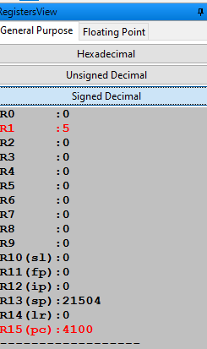
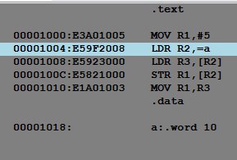
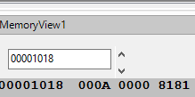
SWAP :A & R1

Slide 9

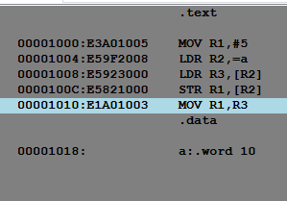
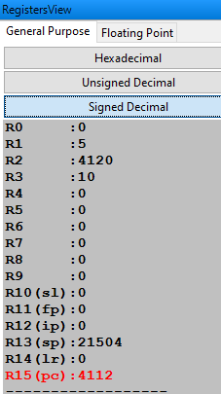
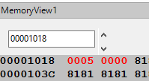
SWAP :A & R1

Slide 10
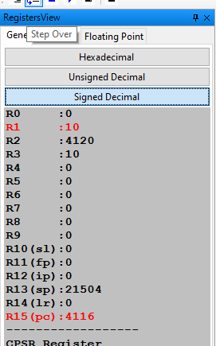
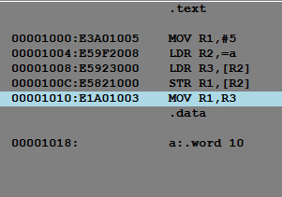
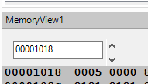
SWAP :A & R1

Slide 11
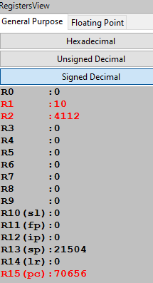
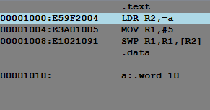
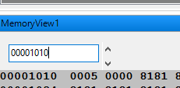
Swap Instruction
SWP <Swap Destination>, <Original>, [<address>]
.text
LDR R2, =a
MOV R1, #5
SWP R1, R1, [R2]
.data
a:.word 10
After Swapping

Slide 12

THANK YOU
V R BADRI PRASAD
badriprasad@pes.edu
Department of Computer Science and Engineering

