Slide 1

Microprocessor & Computer Architecture (μpCA)
UE23CS251B
Session - 2.2

Slide 2
Microprocessor & Computer Architecture (μpCA)
UE23CS251B
3 Stage & 5 Stage ARM Processor

Slide 3

Quick Recap 🡪 Single Cycle vs Multiple Cycle
Cycle 1
Cycle 2
Clk
Single Cycle Implementation:
Load
Store
Waste
Cycle 1
Cycle 2
Cycle 3
Cycle 4
Cycle 5
Cycle 6
Cycle 7
Cycle 8
Cycle 9
Cycle 10
Clk
Multiple Cycle Implementation:
Load
Store
R-type
IF
ID
EX
MEM
IF
ID
EX
WB
MEM
WB

Slide 4
ARM Processors
ARM7TDMI
Instruction
Fetch
ARM decode
Reg
Read
Reg
Write
Thumb→ARM decompress
Shift
ALU
Reg Select
FETCH
DECODE
EXECUTE
ARM9TDMI
ARM or Thumb Inst Decode
Instruction
Fetch
Shift + ALU
Memory
Access
Reg
Write
Reg
Decode
Reg
Read
FETCH
DECODE
EXECUTE
MEMORY
WRITE
ARM10
Branch
Prediction
ARM or
Thumb
Instruction
Decode
Reg Read
Shift + ALU
Memory
Access
Reg
Write
Instruction
Fetch
Multiply
Multiply Add
FETCH
ISSUE
DECODE
EXECUTE
MEMORY
WRITE

Slide 5
ARM7TDMI – 3 Stage
Instruction
Fetch
ARM decode
Reg
Read
Reg
Write
Thumb→ARM decompress
Shift
ALU
ALU
Reg Select
FETCH
DECODE
EXECUTE
Fetch (IF)
The instruction is fetched from memory and placed in the instruction pipeline
Decode (ID)
The instruction is decoded and the datapath control signals prepared for the next cycle.
Execute (EX)
The register bank is read, an operand shifted, the ALU result generated and written back into a destination register

Slide 6
ARM9TDMI- 5 Stage
ARM or Thumb Inst Decode
Instruction
Fetch
Shift + ALU
Memory
Access
Reg
Write
Reg
Decode
Reg
Read
FETCH
DECODE
EXECUTE
MEMORY
WRITE

Slide 7
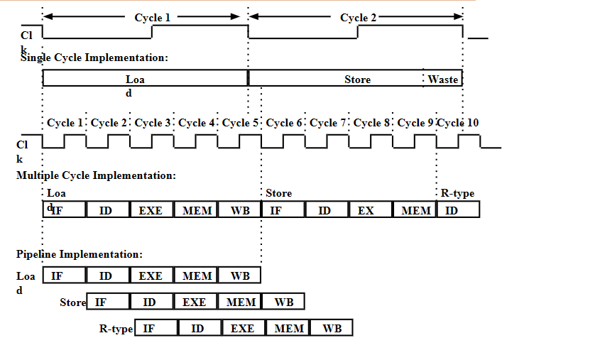
Single Cycle, Multiple Cycle, vs. Pipeline

Slide 8
Pipelined Execution
K stage | T1 | T2 | T3 | T4 | T5 | T6 | T7 | T8 | T9
IF | I1 | I2 | I3 | I4 | I5
ID |  | I1 | I2 | I3 | I4 | I5
EX |  |  | I1 | I2 | I3 | I4 | I5
MB |  |  |  | I1 | I2 | I3 | I4 | I5
WB |  |  |  |  | I1 | I2 | I3 | I4 | I5

Slide 9
Pipelined Execution
K stage | T1 | T2 | T3 | T4 | T5 | T6 | T7 | T8 | T9
IF | I1 | I2 | I3 | I4 | I5
ID |  | I1 | I2 | I3 | I4 | I5
EX |  |  | I1 | I2 | I3 | I4 | I5
MB |  |  |  | I1 | I2 | I3 | I4 | I5
WB |  |  |  |  | I1 | I2 | I3 | I4 | I5

Slide 10
Pipelined Execution
K stage | T1 | T2 | T3 | T4 | T5 | T6 | T7 | T8 | T9
IF | I1 | I2 | I3 | I4 | I5
ID |  | I1 | I2 | I3 | I4 | I5
EX |  |  | I1 | I2 | I3 | I4 | I5
MB |  |  |  | I1 | I2 | I3 | I4 | I5
WB |  |  |  |  | I1 | I2 | I3 | I4 | I5

Slide 11
Pipelined Execution
K stage | T1 | T2 | T3 | T4 | T5 | T6 | T7 | T8 | T9
IF | I1 | I2 | I3 | I4 | I5
ID |  | I1 | I2 | I3 | I4 | I5
EX |  |  | I1 | I2 | I3 | I4 | I5
MB |  |  |  | I1 | I2 | I3 | I4 | I5
WB |  |  |  |  | I1 | I2 | I3 | I4 | I5

Slide 12
Pipelined Execution
K stage | T1 | T2 | T3 | T4 | T5 | T6 | T7 | T8 | T9
IF | I1 | I2 | I3 | I4 | I5
ID |  | I1 | I2 | I3 | I4 | I5
EX |  |  | I1 | I2 | I3 | I4 | I5
MB |  |  |  | I1 | I2 | I3 | I4 | I5
WB |  |  |  |  | I1 | I2 | I3 | I4 | I5

Slide 13
Pipelined Execution
K stage | T1 | T2 | T3 | T4 | T5 | T6 | T7 | T8 | T9
IF | I1 | I2 | I3 | I4 | I5
ID |  | I1 | I2 | I3 | I4 | I5
EX |  |  | I1 | I2 | I3 | I4 | I5
MB |  |  |  | I1 | I2 | I3 | I4 | I5
WB |  |  |  |  | I1 | I2 | I3 | I4 | I5

Slide 14
Pipelined Execution
K stage | T1 | T2 | T3 | T4 | T5 | T6 | T7 | T8 | T9
IF | I1 | I2 | I3 | I4 | I5
ID |  | I1 | I2 | I3 | I4 | I5
EX |  |  | I1 | I2 | I3 | I4 | I5
MB |  |  |  | I1 | I2 | I3 | I4 | I5
WB |  |  |  |  | I1 | I2 | I3 | I4 | I5

Slide 15
Pipelined Execution
K stage | T1 | T2 | T3 | T4 | T5 | T6 | T7 | T8 | T9
IF | I1 | I2 | I3 | I4 | I5
ID |  | I1 | I2 | I3 | I4 | I5
EX |  |  | I1 | I2 | I3 | I4 | I5
MB |  |  |  | I1 | I2 | I3 | I4 | I5
WB |  |  |  |  | I1 | I2 | I3 | I4 | I5

Slide 16
Pipelined Execution
K stage | T1 | T2 | T3 | T4 | T5 | T6 | T7 | T8 | T9
IF | I1 | I2 | I3 | I4 | I5
ID |  | I1 | I2 | I3 | I4 | I5
EX |  |  | I1 | I2 | I3 | I4 | I5
MB |  |  |  | I1 | I2 | I3 | I4 | I5
WB |  |  |  |  | I1 | I2 | I3 | I4 | I5

Slide 17
Pipelined Execution
K stage | T1 | T2 | T3 | T4 | T5 | T6 | T7 | T8 | T9
IF | I1 | I2 | I3 | I4 | I5
ID |  | I1 | I2 | I3 | I4 | I5
EX |  |  | I1 | I2 | I3 | I4 | I5
MB |  |  |  | I1 | I2 | I3 | I4 | I5
WB |  |  |  |  | I1 | I2 | I3 | I4 | I5
5*1*1
(5-1)*1
1ST instruction take 5 CLOCK (Each stage, 1 clock time Tc)
Rest will take 1 more than the previous instruction
Execution time on pipeline processor: =Kstage * 1 instuction + (n-1) :
= 5*1+4= 9 clocks
Execution on a non-pipeline processor: =Kstage * n Instructions
= 5*5= 25 clocks

Slide 18
Pipelined Execution
K stage | T1 | T2 | T3 | T4 | T5 | T6 | T7 | T8 | T9
IF | I1 | I2 | I3 | I4 | I5
ID |  | I1 | I2 | I3 | I4 | I5
EX |  |  | I1 | I2 | I3 | I4 | I5
MB |  |  |  | I1 | I2 | I3 | I4 | I5
WB |  |  |  |  | I1 | I2 | I3 | I4 | I5
k*tc*1
(n-1)*tc
Number of stages= k
Clock Cycle = tc
Number of Instructions = n
Execution time_{pipeline} = k*tc*1 + (n-1)*tc=[k+(n-1)]t_{c}
Execution time_{unpipeline} = n* t_{p} =n*k* t_{c}

Slide 19
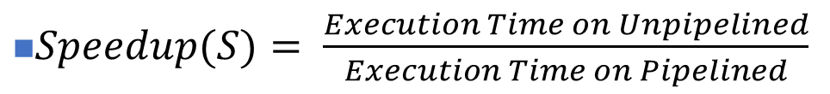
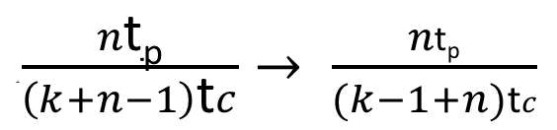
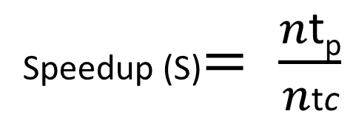
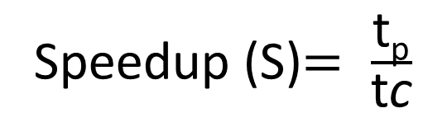
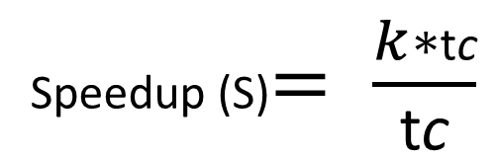
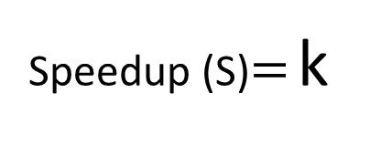
Speedup vs # of Stages in Pipeline Processor
If n is too big or as number of instructions increases n>k-1 will tend to n
MEANING: Lengthy programs will have more number of instructions which is almost negligible compared to the number of stages of the pipeline.

Slide 20
Pipeline Execution
Compute the Execution time on 5 Stage processor (Pipeline vs Non Pipeline Processor):
Number of instructions = 100.
Cycle Time Tc= 60
Solution:
Execution on a non-pipeline processor: = Kstage* Tc* n Instructions
= 5*60*100= 30000 clocks
Execution Time on Pipeline Processor: = Kstage * 1 instruction *Tc + (n-1)* Tc :
= (5*1*60)+(99*60)= 300+5940=6240 clocks
Clock time per stage= Cycle time= Tc

Slide 21
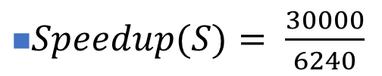

Speedup vs # of Stages in Pipeline Processor

Slide 22
Design issue 1
Clock Cycle Time of all the stages cannot be same!
Example
IF | ID | EXE | MEM | WB
300 ps | 400 ps | 350 ps | 550 ps | 100 ps
200 ps | 150 ps | 100 ps | 190 ps | 140 ps
Leads to imbalance latency
Solution:
Make Length of each stage equal to Length of Longest stage or slowest Stage

Slide 23
Pipeline Throughput and Latency
IF
ID
EX
MEM
WB
150 ns
120ns
160 ns
140 ns
130 ns
I1
IF
(0-150)
ID
(150-270)
EX
(270-430)
MEM
(430-570)
ID
(570-700)
L(I1=700)
I2
IF
(150-300)
ID
(300-420)
X
(10)
EX
(430-590)
MEM
(590-730)
ID
(730-860)
L(I2=860-150)=710)
I3
IF
(300-450)
ID
(450-570)
X
(20)
EX
(590-750)
MEM
(750-890)
ID
(890-1020)
L(I3=1020-300= 720)
I4
IF
(450-600)
ID
(600-720
X
(30)
EX
(750-910)
MEM
(910-1050)
ID
(1050-1180)
L(I3=1180-450= 730)
Uneven latency and Throughput= 1180

Slide 24
Processor
Pipeline Throughput and Latency
IF
ID
EX
MEM
WB
160 ns
160ns
160 ns
160 ns
160 ns
IF
ID
EX
MEM
WB
L(I1=800)
IF
ID
EX
MEM
WB
L(I2=800+160)= 960
IF
ID
EX
MEM
WB
L(I2=960+160)= 1120
IF
ID
EX
MEM
WB
L(I2=1120+160)= 1280
Balanced latency and Throughput= 1280 instead of 1180

Slide 25
Evaluating 5-Stage Pipeline Processor
A 5 stage pipeline processor has stage delays as 150, 120, 160, 140 and 130 ns.
What is the time taken to execute 100 instructions.
What is the Speed up of pipeline processor?
Solution:
Execution on a non-pipeline processor: (150+120+160+140+130) * 100= 700*100=70000ns
Execution on a pipeline processor:
Slowest stage: Max(150,120,160,140,130)= 160ns
Clock time Tc of each stage = 160 ns
=(1*Tc*#stages)+((IC-1)*Tc)
=(1*160*5)+(99*160)
= 800+15840
= 16640 ns

Slide 26
Performance of 5-Stage Pipeline Processor
Execution on a non-pipeline processor
(150+120+160+140+130) * 100= 362*100=70000ns
Execution on a pipeline processor:
(1*160*5)+(99*160)= 800+15840= 16640ns
Speedup(S): 70000/16640= 4.2

Slide 27
Design issue 2: Pipeline Register Overhead
IF
ID
EX
MEM
WB
IF/ID
ID/EX
EX/MEM
MEM/WB
We shall refer to the pipeline registers that are set between two stages with the names of the stages. So, we will have IF/ID, ID/EX, EX/MEM and MEM/WB registers.
They serve the purpose of transferring outputs produced in a phase to the subsequent phase in the multi-cycle implementation.
These registers must be large enough to contain all data moving from one phase to the following one

Slide 28
Design issue 2: Pipeline Register Overhead
Pipeline overhead: combination of pipeline register delay and
the clock skew.
Pipeline registers delay: Setup time that triggers a write or when data input changes and propagation delay to the clock.
Clock skew: Maximum delay between when the clock arrives at any two registers.

Slide 29
Evaluating 5-Stage Pipeline Processor With Register Overhead
A 5 stage pipeline processor has stage delays as 150, 120, 160, 140 and 130 ns. The register overhead is 5 ns each.
What is the time taken to execute 100 instructions.
What is the Speed up of pipeline processor?
Solution:
Execution on a non-pipeline processor:(150+120+160+140+130) * 100= 700*100=70kns
Execution on a pipeline processor:
Slowest stage: Max(150,120,160,140,130)= 160ns
Clock time Tc of each stage = 160 ns
Register overhead of each stage= 5ns
Clock time Tc of each stage = 165 ns
Execution on a pipeline processor: =(1*Tc*#stages)+((IC-1)*Tc)
=(1*165*5)+(99*165)
= 825+16335
= 17160 ns

Slide 30
Performance of 5-Stage Pipeline Processor
Execution on a non-pipeline processor
(150+120+160+140+130) * 100= 362*100=70000ns
Execution on a pipeline processor:
(1*165*5)+(99*165)= 825+15840= 17160ns
Speedup(S): 70000/17160= 4.07

Slide 31
Microprocessor & Computer Architecture (μpCA)
UE23CS251B
Session - 2.21

Slide 32
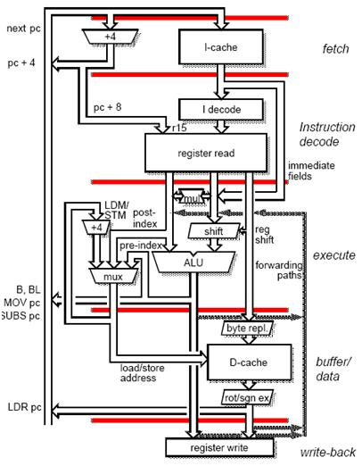
ARM 5-stage (ARM 9 Architecture)
Fetch - [IF]
Decode – [ID]
Execute – [EX]
Buffer/Data or Memory Access-[MEM]
Write back – [WB]
Harvard Architecture
Instruction & Data Memory?
Split

Slide 33
ARM Architecture - 5 Stage Pipelining - Fetch - [IF], Decode – [ID]
Fetch - [IF]
The instruction is fetched from memory and placed in the instruction pipeline.
Update the PC to the next sequential PC by adding 4 to PC.
Decode – [ID]
The instruction is decoded and register operands read from the register files. There are 3 operand read ports in the register file so most ARM instructions can source all their operands in one cycle.
Do the equality test on the registers as they are read, for a possible branch.
Sign extend the offset field of the instruction in case it is needed.

Slide 34
ARM Architecture - 5 Stage Pipelining- Decode stage - [ID]
Compute the possible branch target address by adding the sign-extended offset to the incremented PC.
Further, the branch can be completed by the end this stage by storing the branch target address into the PC if condition yielded true.
Decoding is done in parallel with reading registers, as the register specifiers are at fixed location in a RISC architecture.

Slide 35
ARM Architecture - 5 Stage Pipelining Execute – [EX]
Also called as execute / effective address cycle.
The ALU operates on the operands prepared in the previous cycle, performing of the three functions depending on the instruction type.
Memory Reference: the ALU adds the base register and the offset to form the effective address.
Register – Register ALU instruction: The ALU performs the operation specified by the opcode on the values read from the register file.
Register – Immediate ALU instruction: The ALU performs the operations specified by the opcode on the first value read from the register file and the sign extended immediate.

Slide 36
Buffer/Data or Memory Access-[MEM]
Data memory is accessed if required. Otherwise the ALU result is simply buffered for one cycle.
If the instruction is a LOAD, the memory does a read using effective address computed in the previous cycle.
If the instruction is a STORE, then the memory writes the data from the second register read using the effective address.

Slide 37
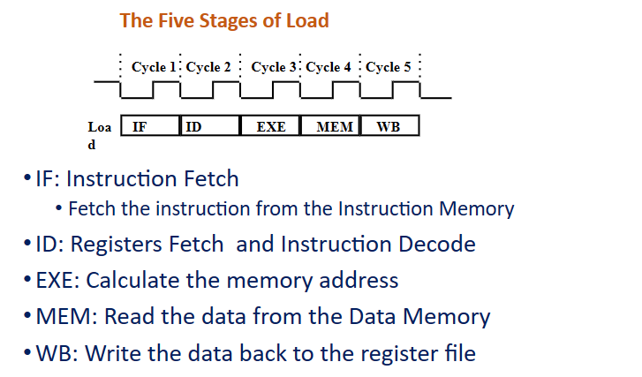
Buffer/Data or Memory Access-[MEM]

Slide 38
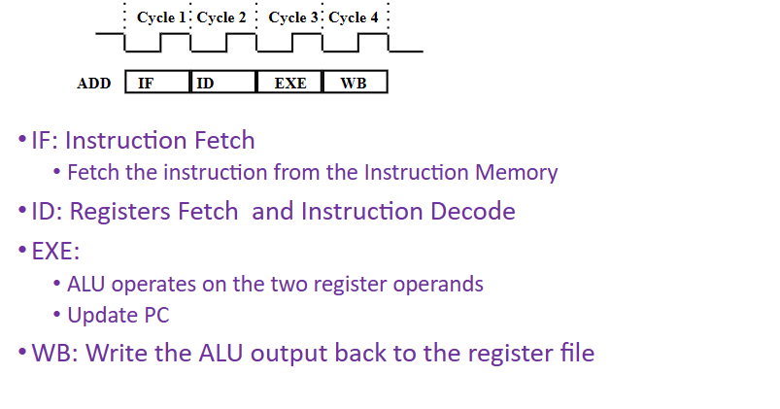
The Four Stages of Data Processing

Slide 39
ARM Architecture - 5 Stage Pipelining - Write back – [WB]
The result generated by the instruction is written back to the register file.
The data may come either from memory system [for LOAD], or from the ALU [ for an ALU instruction].

Slide 40

THANK YOU
Team MPCA
Department of Computer Science and Engineering

