Slide 1

Microprocessor & Computer Architecture (μpCA)
UE23CS251B
Session - 2.4

Slide 2
Microprocessor & Computer Architecture (μpCA)
UE23CS251B
Pipeline Processor: Data Hazard 1

Slide 3

Data Hazards
Consider a Scenario
Suppose initially, register i holds the number 2i
(ie. R3 = 6; R6=12; R8 = 16…)
What happens when the following sequence is executed in 5-stage pipeline?
add R3, R10, R11
ldr R8, [R3, #50]
sub R11, R8, R7
- this should add 20 + 22, putting result 42 into r3
- this should load r8 from memory location 42+50 = 92
- this should subtract 14 from that just-loaded value from Mem[92]

Slide 4
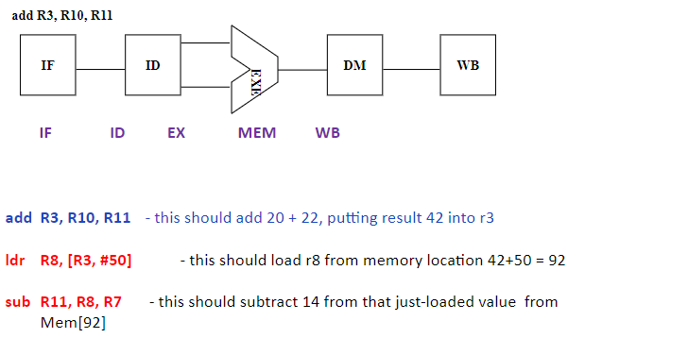
Cycle 1

Slide 5
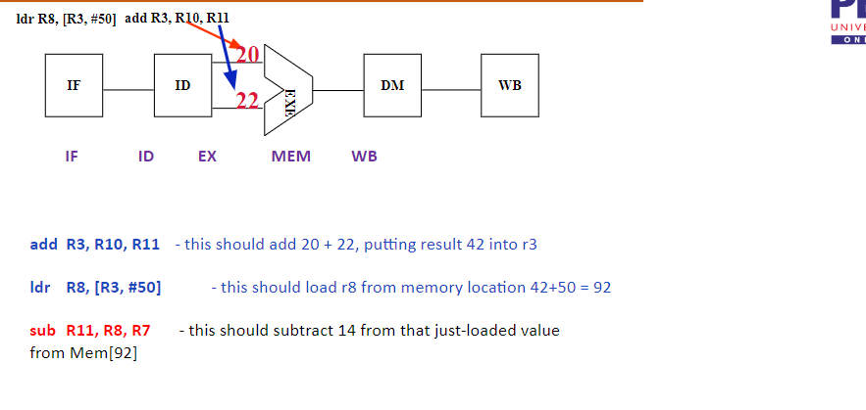
Cycle 2

Slide 6
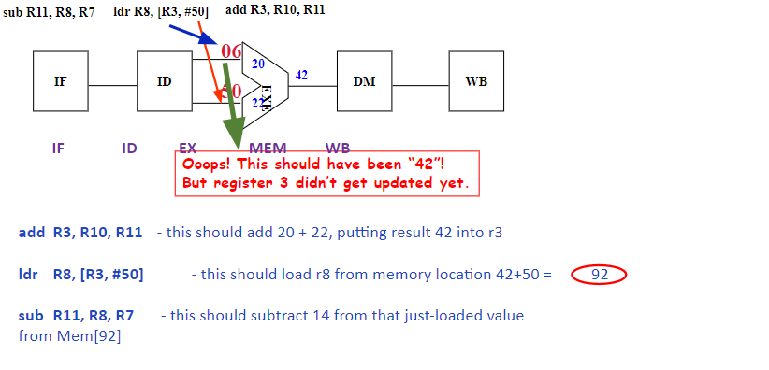
Cycle 3

Slide 7
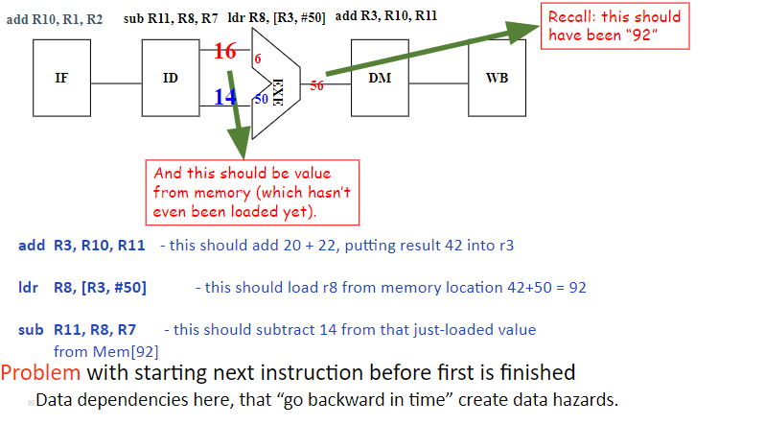
Cycle 4

Slide 8
EXAMPLE
Consider the following sequence:
sub R2, R1, R3 and R12, R2, R5 orr R10, R6, R2 add R4, R2, R2 str R5, [R2, #100]
IF ID EX MEM WB
IF ID EX MEM WB
IF ID EX MEM WB
IF ID EX MEM
IF ID EX
DEPTH OF HAZARD = 3 cycles

Slide 9
Data Dependency
I
n
s
t
r.
O
r
d
e
r
add r1,r2,r3
WB
IF
ID
EXE
MEM
sub r4,r1,r3
IF
ID
EXE
MEM
WB
and r6,r1,r7
IF
ID
EXE
MEM
WB
or r8,r1,r9
IF
ID
EXE
MEM
WB
xor r10,r1,r11
IF
ID
EXE
MEM
WB

Slide 10
Data Dependencies
Three types of data dependencies defined in terms of how succeeding instruction depends on preceding instruction
RAW: Read after Write or Flow dependency
(True Dependency)
WAR: Write after Read or anti-dependency
(Anti Dependency)
WAW: Write after Write
(Output Dependency)

Slide 11
Data Dependencies
Read After Write (RAW) Instr_{J} tries to read operand before Instr_{I} writes it
Caused by a “Dependence” (in compiler nomenclature). This hazard results from an actual need for communication.
I: add r1,r2,r3
J: sub r4,r1,r3

Slide 12
Data Dependencies
Example program (a) with two instructions
i1: load r1, a;
i2: add r2, r1,r1;
Program (b) with two instructions
i1: mul r1, r4, r5;
i2: add r2, r1, r1;
Both cases we cannot read in i2 until i1 has completed writing the result
In (a) this is due to load-use dependency
In (b) this is due to define-use dependency

Slide 13
Data Dependencies
Write After Read (WAR) Instr_{J} writes operand before Instr_{I} reads it
Called an “anti-dependence” by compiler writers. This results from reuse of the name “r1”.
Can’t happen if in pipeline:-
All instructions take 5 stages, and
Reads are always in stage 2, and
Writes are always in stage 5
I: sub r4,r1,r3
J: add r1,r2,r3
K: mul r6,r1,r7

Slide 14
Data Dependencies
Write After Write (WAW) Instr_{J} writes operand before Instr_{I} writes it.
Called an “output dependence” by compiler writers This also results from the reuse of name “r1”.
Can’t happen if in pipeline:
All instructions take 5 stages, and Writes are always in stage 5
I: sub r1,r4,r3
J: add r1,r2,r3
K: mul r6,r1,r7
If Executed Out of order by the Compiler, may lead to wrong results

Slide 15
WAR and WAW Dependency
Example program (a):
i1: mul r1, r2, r3;
i2: add r2, r4, r5;
Example program (b):
i1: mul r1, r2, r3;
i2: add r1, r4, r5;
both cases we have dependence between i1 and i2
in (a) due to r2 must be read before it is written into
in (b) due to r1 must be written by i2 after it has been written into by i1

Slide 16
WAR and WAW Dependency
Problem:
i1: mul r1, r2, r3;
i2: add r2, r4, r5;
Is this really a dependence/hazard ?

Slide 17
WAR and WAW Dependency
Solution: Rename Registers
i1: mul r1, r2, r3;
i2: add r6, r4, r5;
Register renaming can solve many of these false dependencies
note the role that the compiler plays in this
specifically, the register allocation process--i.e., the process that assigns registers to variables

Slide 18
EXAMPLE
Consider the following sequence:
sub R2, R1, R3 and R12, R2, R5 orr R10, R6, R2 add R4, R2, R2 str R5, [R2, #100]
IF ID EX MEM WB
IF ID EX MEM WB
IF ID EX MEM WB
IF ID EX MEM
IF ID EX
DEPTH OF HAZARD = 3 cycles

Slide 19

THANK YOU
Team MPCA
Department of Computer Science and Engineering

