Slide 1

Microprocessor & Computer Architecture (μpCA)
UE23CS251B
Session - 2.6

Slide 2
Microprocessor & Computer Architecture (μpCA)
UE23CS251B
Pipeline Processor: Control Hazard

Slide 3

Control Hazards
When the flow of instruction addresses is not sequential (i.e., PC = PC + 4); incurred by change of flow instructions
Conditional branches ( beq, bne )
Unconditional branches ( b, bal)
Exceptions
Undesirable instructions get into the pipeline even before branch instruction is fetched, if branch is taken (Compare and Change PC in EX Stage)
Decision is taken here
Ex:
add R1, R2, R3
beq R1, R2, target
sub R1, R4, R5
orr R2, R7, R8
….
target: add R1, R4, R5
IF ID EX MEM WB
IF ID EX MEM WB
IF ID EX MEM WB
IF ID EX MEM WB
IF ID EX MEM WB
Flush these!!
Next Instruction to be fetched

Slide 4
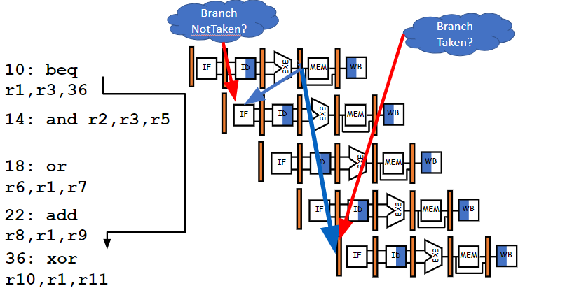
Control Hazard on Branches: Three Stage Stall

Slide 5
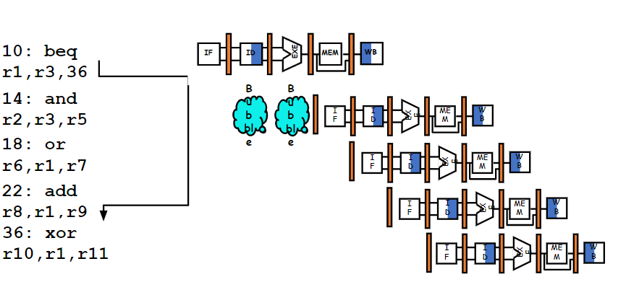
Control Hazard on Branches: Safe Decision

Slide 6
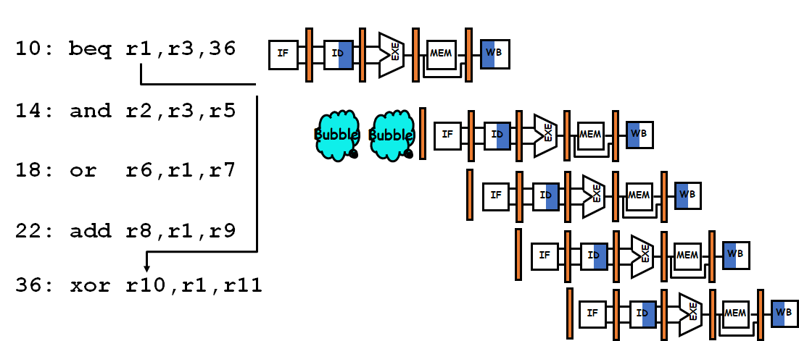
All branches waste 2 cycles irrespective of whether branch is taken or not.
Wasteful..
Better way???
Reduce stall cycles
Guess or Predict

Slide 7
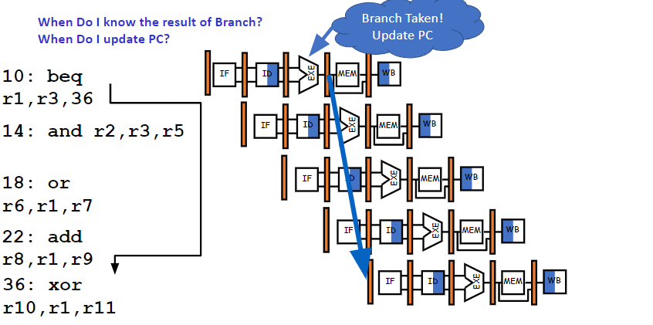
Control Hazard on Branches

Slide 8
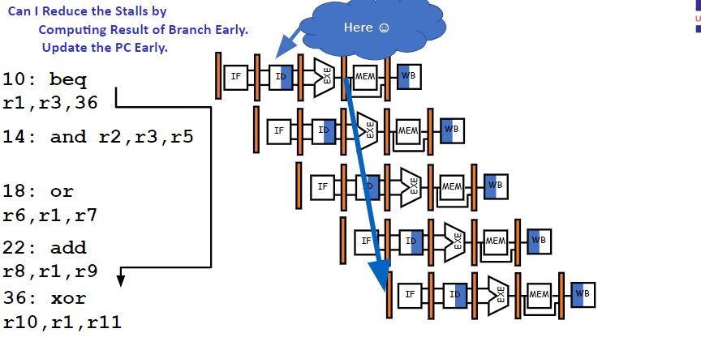
Control Hazard on Branches

Slide 9
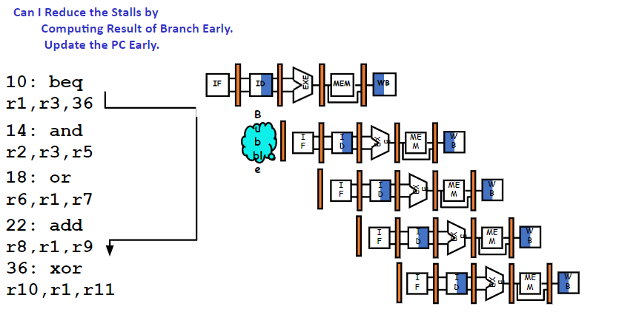
Control Hazard on Branches: Safe Decision

Slide 10
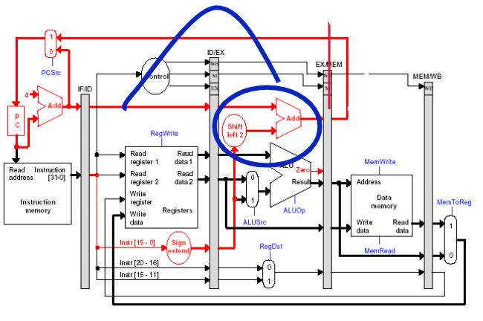
Reduce Stall Cycles?
By moving updating of PC from EX to ID???
Branch Delay = 1 cycle

Slide 11
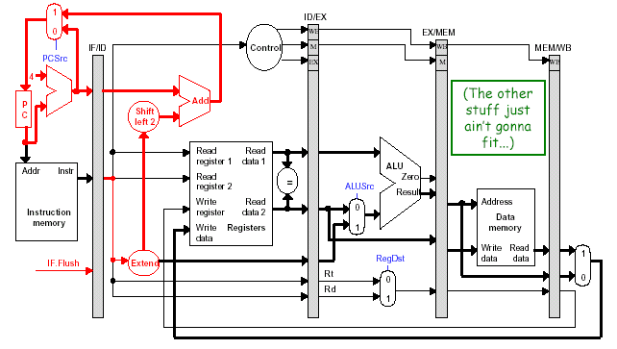
Reduce Stall Cycles
By moving updating of PC from EX to ID???
Branch Delay = 1 cycle
NO
Can we reduce it further by moving the updating of PC from ID to IF???

Slide 12
Example
Assume the following instruction mix:
Type Frequency
Arith/Logic 40%
Load 30% of which 25% are followed immediately by
an instruction using the loaded value
Store 10%
branch 20% of which 45% are taken
What is the resulting CPI for the pipelined processor with forwarding and branch address calculation in ID stage?
CPI = Ideal CPI + Pipeline stall clock cycles per instruction
= 1 + stalls by loads + stalls by branches
= 1 + .3x.25x1 + .2 x .45x1
= 1 + .075 + .09
= 1.165

Slide 13
Delayed Branching
Similar to insert no-ops
Compiler inserts….??
Used to eliminate branch stalls
Instruction after branch is known as delay slot
Instruction in delay slot is always executed
Fill the slots with useful instructions

Slide 14
Control Hazard on Branches: Delay Slot
10: beq r1,r3,36
IF
ID
EXE
MEM
WB
14: and r2,r3,r5
IF
ID
EXE
MEM
WB
18: or r6,r1,r7
IF
ID
EXE
MEM
WB
22: add r8,r1,r9
IF
ID
EXE
MEM
WB
36: xor r10,r1,r11
IF
ID
EXE
MEM
WB
Identify the Instruction which can be executed out of order fashion i.e will not change the meaning of the program or not violate register write
48: and r3,r1,r4

Slide 15
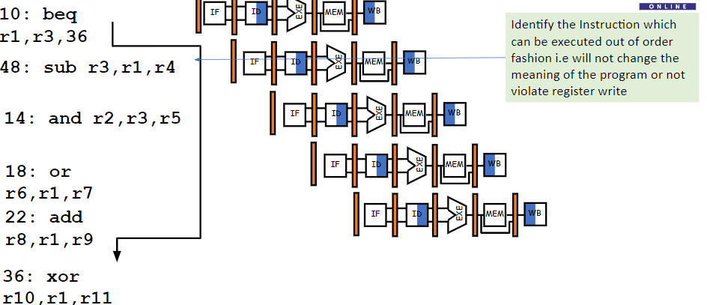
Control Hazard on Branches: Delay Slot

Slide 16
Scheduling Branch Delay Slots
A. From before branch
B. From branch target
C. From fall through
add R1,R2,R3
if R2=0 then
sub R4,R5,R6
add R1,R2,R3
if R1=0 then
delay slot
delay slot
add R1,R2,R3
if R1=0 then
orr R7,R8,R9
delay slot
sub R4,R5,R6
becomes
becomes
becomes
if R2=0 then
add R1,R2,R3
if R1=0 then
add R1,R2,R3
sub R4,R5,R6
add R1,R2,R3
if R1=0 then
orr R7,R8,R9
sub R4,R5,R6
sub R4,R5,R6
A is the best choice, fills delay slot and reduces IC
In B and C, the sub instruction may need to be copied, increasing IC
In B and C, must be okay to execute sub when branch fails

Slide 17
A: Filling the delay slot Before Branch
MUL R3, R4, R5
SUB R2, R1, R0
ADD R1, R2, R2
BEQZ R1, R7, there
ADD R1, R4, R7
there:
Delay Slot
In case, the compiler is not able to find suitable instruction, then
MUL R3, R4, R5
SUB R2, R1, R0
ADD R1, R2, R2
BEQZ R1, R7, there
NOP
ADD R1, R4, R7
there:
SUB R2, R1, R0
ADD R1, R2, R2
BEQZ R1, R7, there
MUL R3, R4, R5
ADD R1, R4, R7
there:

Slide 18
B: Filling the delay slot From Branch Target
SUB R2, R1, R0
ADD R1, R2, R2
BEQZ R1, R7, there
ADD R1, R4, R7
there: MUL R3, R4, R5
Delay Slot
Branch Not Taken Part
SUB R2, R1, R0
ADD R1, R2, R2
BEQZ R1, R7, there
MUL R3, R4, R5
ADD R1, R4, R7
there:
Branch Taken Part
Useful when it is predicted, 80 % Branch Taken & 20% Not Taken
It should ensure no Register write violation in the Not Taken part of the instructions
If Branch is not taken, then FLUSH i.e Waste of Cycle time

Slide 19
C: Filling the delay slot From Fall through
SUB R2, R1, R0
ADD R1, R2, R2
BEQZ R1, R7, there
ADD R1, R4, R7
there:
Delay Slot
Branch Not Taken Part
MUL R3, R4, R5
SUB R2, R1, R0
ADD R1, R2, R2
BEQZ R1, R7, there
MUL R3, R4, R5
ADD R1, R4, R7
there:
Branch Taken Part
Useful when it is predicted, 80 % Branch Not Taken & 20% Taken
It should ensure no Register write violation in the Not Taken part of the instructions
If Branch is not taken, then FLUSH i.e Waste of Cycle time

Slide 20

THANK YOU
Team MPCA
Department of Computer Science and Engineering

