Slide 1

Microprocessor & Computer Architecture (μpCA)
UE22CS252B
Session - 2.8

Slide 2
Microprocessor & Computer Architecture (μpCA)
UE22CS252B
Pipeline Performance with Stalls - Excercises

Slide 3


Theoretical Claim – Quick Recap

Slide 4
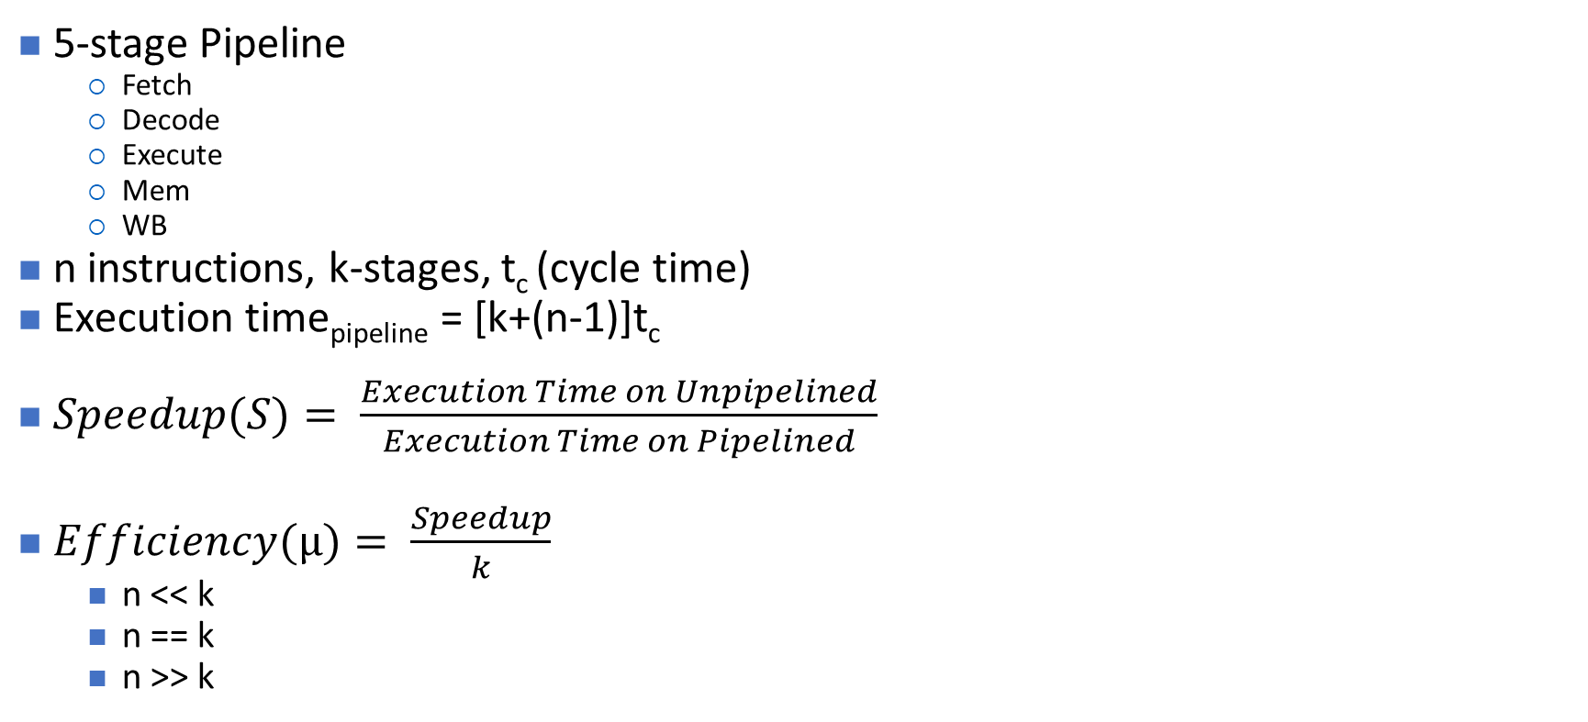

Pipelining – Quick Recap

Slide 5
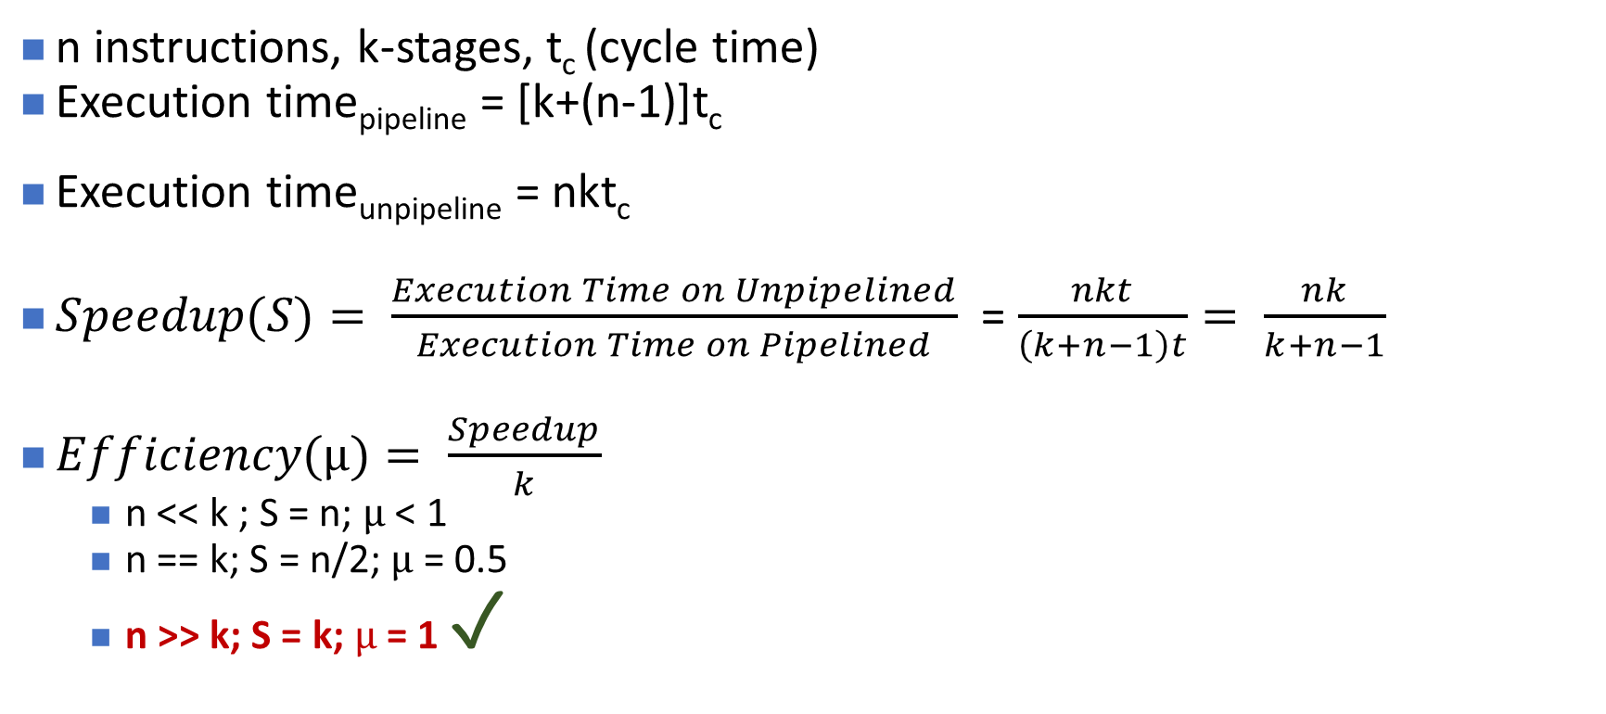

Pipelining – Quick Recap
Notes:
If n<<k.. Then better to take sequential execution .. So s=n then eff=small number/larger number so less than 1.
If n==k then speedup= n power2 /2n= n/2 then eff=n/2 /n=0.5
If n>>k then speedup= number of stages in pipeline then eff=larger number/ small number =1
Efficiency- how well the system is utilized

Slide 6
Pipeline Performance with Stalls – Quick Recap
A stall causes the pipeline performance to degrade the ideal performance.
Average instruction time unpipelined
Speedup from pipelining = ------------------------------------------------
Average instruction time pipelined
CPI _{unpipelined} * Clock Cycle Time _{unpipelined}
= --------------------------------------------------------
CPI _{pipelined} * Clock Cycle Time _{pipelined}
CPI _{unpipelined}
= ----------------------------------------------------
1+ Pipeline stall cycles per instruction
Note 1: Ignoring the cycle time overhead of pipelining and assume the stages are all perfectly balanced, then the cycle time of the two machines are equal
Note 2: Ideal CPI of pipeline processor is almost always =1
CPI_{pipelined} = Ideal CPI + Pipeline stall clock cycles per instruction
= 1 + Pipeline stall clock cycles per instruction

Slide 7
Pipeline Performance with Stalls – Quick Recap
If all instructions take the same number of cycles, which must also equal the number of pipeline stages ( the depth of the pipeline) then unpipelined CPI is equal to the depth of the pipeline
Pipeline depth
Speedup = -----------------------------------------------------
1 + Pipeline stall cycles per instruction
If there are no pipeline stalls, this leads to the intuitive result that pipelining can improve performance by the depth of pipeline.

Slide 8
Exercise-1
Consider an instruction pipeline with four stages with the stage delay 8 nsec respectively. Assume that the delay of an inter-stage register stage of the pipeline is Nill. What is the approximate speedup of the pipeline in the steady state under ideal conditions as compared to the corresponding non-pipelined implementation when 100 instructions are executed?
Solution:

Slide 9
Exercise-1
Consider an instruction pipeline with four stages with the stage delay 8 nsec respectively. Assume that the delay of an inter-stage register stage of the pipeline is Nill. What is the approximate speedup of the pipeline in the steady state under ideal conditions as compared to the corresponding non-pipelined implementation when 100 instructions are executed?
Solution:
Time taken to execute N instructions in non-pipelined implementation will
be KxTcxN = 8x4x100=3200.
Time taken for the pipelined implementation = (K+N-1)*Tc
= (4+100-1)*8
= 824
Speedup = 3200/ 824 = 3.8

Slide 10
Exercise- 2
Consider an instruction pipeline with four stages with the stage delays 5 nsec, 6 nsec, 11 nsec, and 8 nsec respectively. What is the approximate speedup of the pipeline in the steady state under ideal conditions as compared to the corresponding non-pipelined implementation when 100 instructions are executed?
Solution:

Slide 11
Exercise- 2
Consider an instruction pipeline with four stages with the stage delays 5 nsec, 6 nsec, 11 nsec, and 8 nsec respectively. The delay of an inter-stage register stage of the pipeline is 2. What is the approximate speedup of the pipeline in the steady state under ideal conditions as compared to the corresponding non-pipelined implementation when 100 instructions are executed?
Solution:
Time taken to execute N instructions in non-pipelined implementation will be (5 + 6 + 11 + 8)N = 30N= 30x100=3000.
Clock period for pipelined implementation = max{5,6,11,8} = 11.
Time taken for the pipelined implementation = (K+N-1)*Tc
= (4+N-1)*11
= (4 + 99)*11 = 1133
Speedup = 3000/ 1133 = 2.6

Slide 12
Exercise -3
Consider an instruction pipeline with four stages with the stage delays 5 nsec, 6 nsec, 11 nsec, and 8 nsec respectively. The delay of an inter-stage register stage of the pipeline is 2. What is the approximate speedup of the pipeline in the steady state under ideal conditions as compared to the corresponding non-pipelined implementation when 100 instructions are executed?
Solution:

Slide 13
Exercise -3
Consider an instruction pipeline with four stages with the stage delays 5 nsec, 6 nsec, 11 nsec, and 8 nsec respectively. The delay of an inter-stage register stage of the pipeline is 2. What is the approximate speedup of the pipeline in the steady state under ideal conditions as compared to the corresponding non-pipelined implementation when 100 instructions are executed?
Solution:
Time taken to execute N instructions in non-pipelined implementation will be (5 + 6 + 11 + 8)N = 30N= 30x100=3000.
Clock period for pipelined implementation = max{5,6,11,8} = 11.
Clock period for pipelined implementation with register overhead= 11+2=13
Time taken for the pipelined implementation = (K+N-1)*Tc
= (4+N-1)*13
= (4 + 99)*11 = 1339
Speedup = 3000/ 1339 = 2.2

Slide 14
Exercise - 4
Consider an instruction pipeline for the MIPS32 processor where data references constitute 42% of the instructions, and the ideal CPI ignoring memory structural hazards is 1.25. How much faster is the ideal machine without the memory structural hazard versus the machine with the hazard?
Solution:

Slide 15
Exercise - 4
Consider an instruction pipeline for the MIPS32 processor where data references constitute 42% of the instructions, and the ideal CPI ignoring memory structural hazards is 1.25. How much faster is the ideal machine without the memory structural hazard versus the machine with the hazard?
Solution:
Speedup = (Ideal CPI x Pipeline Depth) / (Ideal CPI + Stall cycles per instr)
So, Speedup_ideal= 1.25 x K / (1.25 + 0) = K
Speedup_real = 1.25 x K / (1.25 + 0.42 x 1)
= 1.25 x K/ 1.67
Required answer = K / (1.25 x K/ 1.67 )
= 1/(1.25/1.67)
=1.67 / 1.25
= 1.34

Slide 16
Exercise - 5 : With Stalls
Consider the following constraints wrt the pipeline processor.
Pipeline contains 5 stages: IF, ID, EX, M and WB
Each stage requires one clock cycle;
Calculate how many clock cycles will take execution of this segment on the regular (nonpipelined) architecture.
// ADD TWO INTEGER ARRAYS
LDR R4, =A
L1: LDR R1, [R4] ; Load first operand
LDR R2, [R4,#400] ; Load second operand
ADD R3, R1, R2 ; Add operands
STR R3, [R4] ; Store result
SUB R4, R4, #4 ; Calculate address of next element
BNEZ R4, L1 ; Loop if (R4) != 0

Slide 17
Exercise - 5 : With Stalls – continued..
Calculate how many clock cycles will take execution of this segment on the regular (nonpipelined) architecture. Show calculations:
// ADD TWO INTEGER ARRAYS
LDR R4, =A
L1: LDR R1, [R4]
LDR R2, [R4,#400]
ADD R3, R1, R2
STR R3, [R4]
SUB R4, R4, #4
BNEZ R4, L1
Solution
Number of cycles = [Initial instruction + (Number of instructions in the loop L1) x
number of loop cycles] x number of clock cycles
= [ 1 + ( 6 ) x 400/4 ] x 5 c.c. = 3005 c.c.

Slide 18
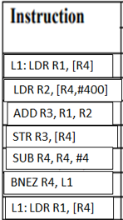
Exercise - 6
Calculate how many clock cycles will take execution of this segment on the simple pipeline without forwarding or bypassing when result of the branch instruction (new PC content) is available after WB stage. Show timing of one loop cycle in Table

Slide 19
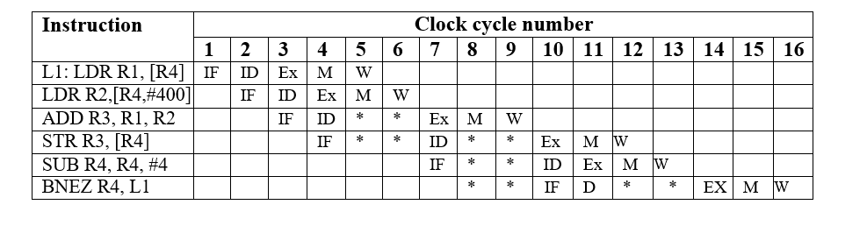
Exercise - 6
Calculate how many clock cycles will take execution of this segment on the simple pipeline without forwarding or bypassing when result of the branch instruction (new PC content) is available after WB stage. Show timing of one loop cycle in Table
Solution:
Note: overlap of write back and decode is used. If overlap of WB and ID is not used for instruction 3 in ID phase stall continues till cycle 7
L1: LDR R1, [R4]
LDR R2, [R4,#400]
ADD R3, R1, R2
STR R3, [R4]
SUB R4, R4, #4
BNEZ R4, L1

Slide 20
Comments
Number of cycles in the loop = 16 c.c.
Number of clock cycles for segment execution on pipelined processor =
= 1 c.c. (IF stage of the initial instruction) + (Number of clock cycles in the loop L1) x Number of loop cycles
= 1 + 16 x 400/4 = 1601 c.c.
Speedup = 3005 c.c. / 1601 = 2 times (approx.)

Slide 21
Exercise - 7
Calculate how many clock cycles will take execution of this segment on the simple pipeline with normal forwarding and bypassing when result of branch instruction (new PC content) is available after completion of the ID stage. Show timing of one loop cycle in Table.
Instruction
L1: LDR R1, [R4]
LDR R2, [R4,#400]
ADD R3, R1, R2
STR R3, [R4]
SUB R4, R4, #4
BNEZ R4, L1
L2 : LDR R1, [R4]

Slide 22
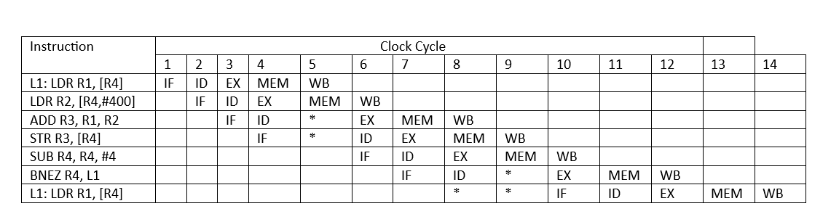
Exercise - 7
Calculate how many clock cycles will take execution of this segment on the simple pipeline with normal forwarding and bypassing when result of branch instruction (new PC content) is available after completion of the ID stage. Show timing of one loop cycle in Table.
NOTE: Please read * (stall cycle ) in 9th clock cycle as ID and 8th clock cycle as *(stall).
and for the last LDR instruction, in the above sequence, read label L1 as l as L2 and IF at 9th clock cycle.

Slide 23
Comments:
Data (R2) for the ADD is ready after “M” stage of the LDR R2. During the “WB” stage the requested operand will be written to the R2 and operation register (e.g. Reg. A) of the ALU.
ID stage for the SW is delayed because it is busy with ADD.
BNEZ can initiate IF stage of the LDR R1, [R4] because new PC-content is ready after 9 c.c.
Number of cycles in the loop = 9 c.c.
Speedup =3005 c.c. / (1 c.c. + 400/4 x 9 c.c.) = 3005 / 901 = 3.4 times

Slide 24
Exercise - 8
Schedule the segment instructions including branch-delay slot to get minimum processing time assuming that pipeline has normal forwarding and bypassing hardware. It is possible to reorder instructions and change position of loop label (L1) but not name of registers or op-code modification. Show scheduled segment, position of L1 and pipeline timing diagram in Figure 1.3 and calculate number of clock cycles needed to execute this task segment.
L1: LDR R1, [R4]
LDR R2, [R4,#400]
SUB R4, R4, #4
ADD R3, R1, R2
BNEZ R4, L1
STR R3, [R4]
L1: LDR R1, [R4]

Slide 25
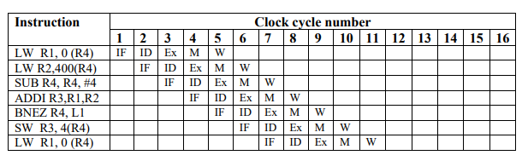
Exercise - 8
Schedule the segment instructions including branch-delay slot to get minimum processing time assuming that pipeline has normal forwarding and bypassing hardware. It is possible to reorder instructions and change position of loop label (L1) but not name of registers or op-code modification. Show scheduled segment, position of L1 and pipeline timing diagram in Figure 1.3 and calculate number of clock cycles needed to execute this task segment.
L1: LDR R1, [R4]
LDR R2, [R4,#400]
SUB R4, R4, #4
ADD R3, R1, R2
BNEZ R4, L1
STR R3, [R4]
L1: LDR R1, [R4]

Slide 26
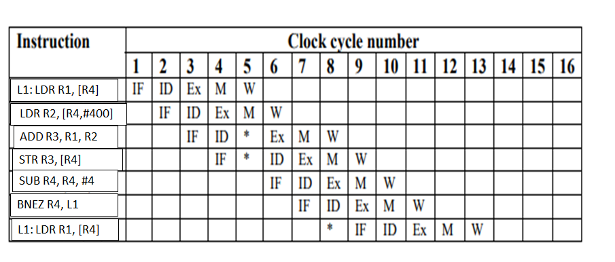
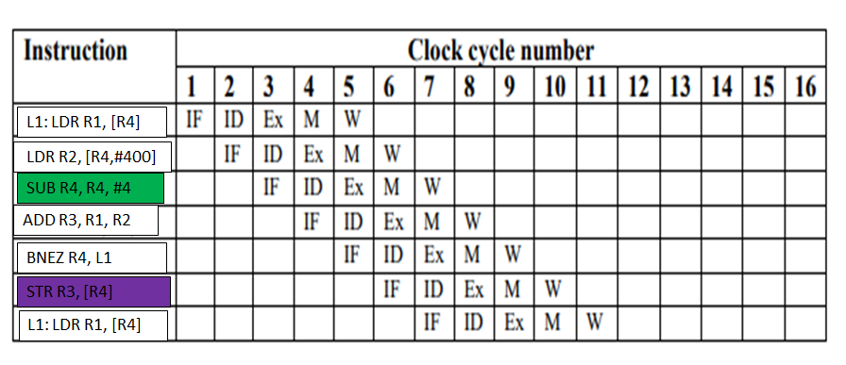
Vs

Slide 27
The maximum speedup comparing with non-pipelined processor is = 3005 / (1+ 6 x 100) = 5 times It means that all stages of 5-stage pipeline are always busy (no stalls) during the task segment execution

Slide 28

THANK YOU
Team MPCA
Department of Computer Science and Engineering

