Slide 1
KAGGLE REGRESSION CHALLENGE
Predicting a Heavy-Tailed Target
A Sign-Coupled Two-Stage Model — How submission_ts_signc_s06.csv won
0.07434
sign-coupled
5-fold
±3,300
FINAL private R² (winner)
magnitude + borrowed sign
CV: read the median
prediction range
Sofia University · Machine Learning · Spring 2026

Slide 2
THE TASK
Predict a continuous target from 15 anonymous features
Data
Metric
2,500 train rows · 2,500 test rows. 15 numeric features x0–x14 with no domain meaning. ~1–1.5% values missing per feature.
R² on the RAW target. 1.0 = perfect, 0 = predicting the mean, < 0 = worse than the mean. Squared errors → the tail dominates.
Constraint
Goal
5 submissions/day. Public slice scores the live board; a hidden PRIVATE slice decides the final rank. Keep a high-upside bet AND a safe hedge.
Beat the baseline of 0.040. Final private result: 0.07434 (the sign-coupled model).
Sofia ML · Spring 2026 · Sign-Coupled Two-Stage Regression
2

Slide 3
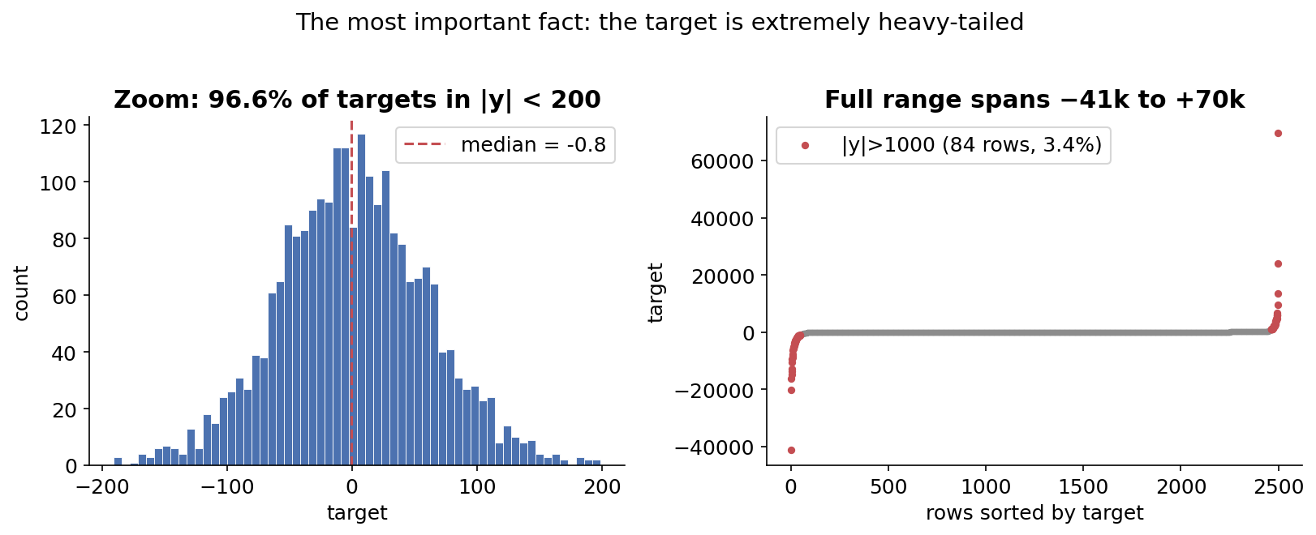
EDA · 1
The one fact that controls everything
Why it matters: R² is built on squared errors, so the ~84 giant rows (3.4%) dominate the score. Model the tail acceptably and the score moves; nail the other 96% but botch the tail and it barely budges.
Sofia ML · Spring 2026 · Sign-Coupled Two-Stage Regression
3

Slide 4
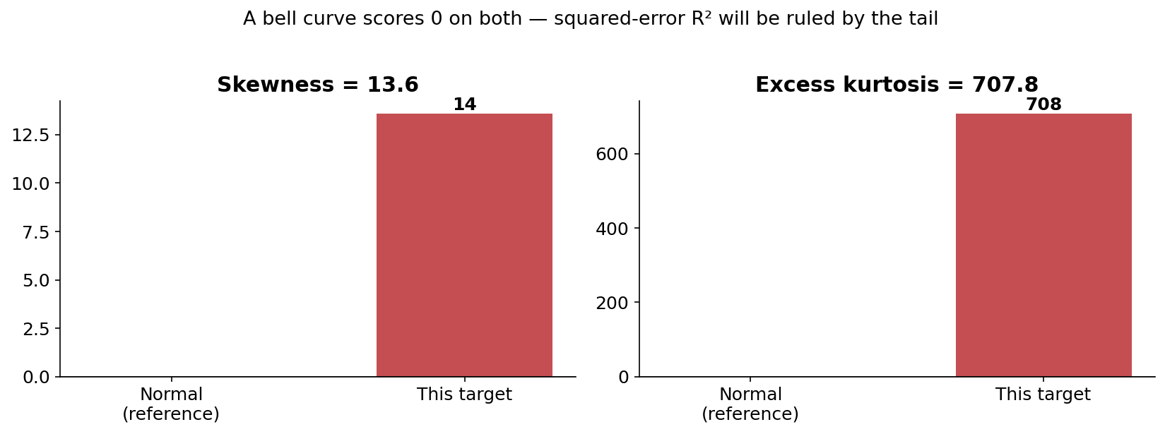
EDA · 2
Off-the-chart skew and kurtosis
Takeaway: Skew 13.6 and kurtosis 708 vs. 0 for a bell curve. The extreme tail IS the signal the metric rewards — and also what destabilises training.
Sofia ML · Spring 2026 · Sign-Coupled Two-Stage Regression
4

Slide 5
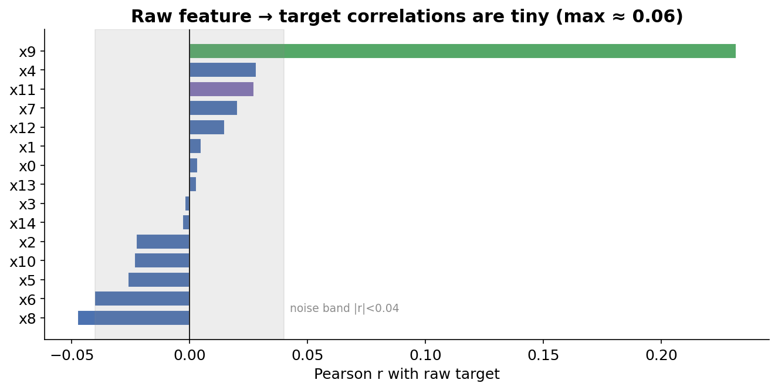
EDA · 3
Raw features barely correlate with the target
Implication: No single feature carries signal (max |r| ≈ 0.06). Linear models on raw features cap near 0.03 — signal must live in curvature and interactions.
Sofia ML · Spring 2026 · Sign-Coupled Two-Stage Regression
5

Slide 6
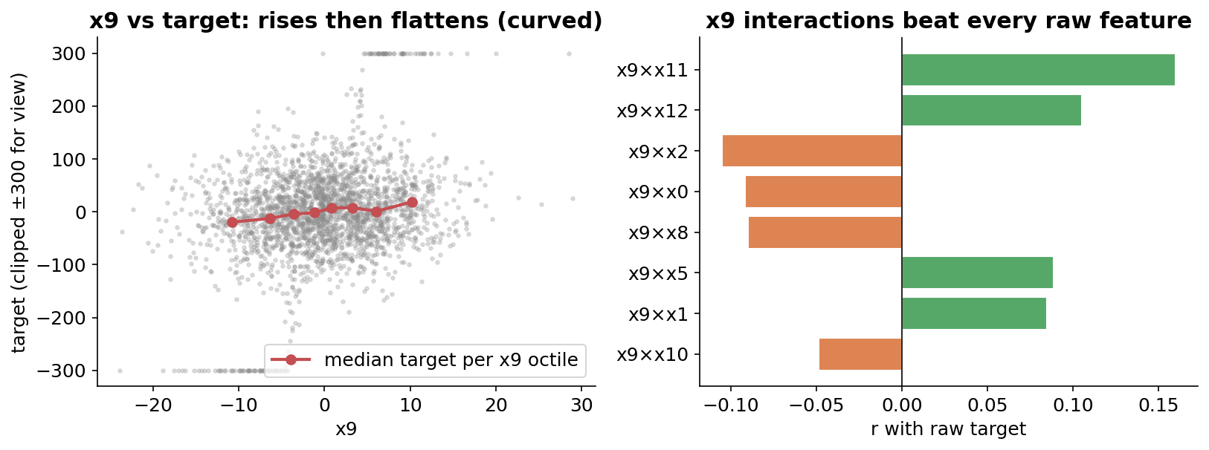
EDA · 4
The signal hides in x9 — curved, and as a multiplier
Discovery: x9 has a curved (diminishing) relationship, and x9 × other-features beat every raw feature. x11 is near-zero alone but strongest once multiplied by x9 — a latent 'direction' gate.
Sofia ML · Spring 2026 · Sign-Coupled Two-Stage Regression
6

Slide 7
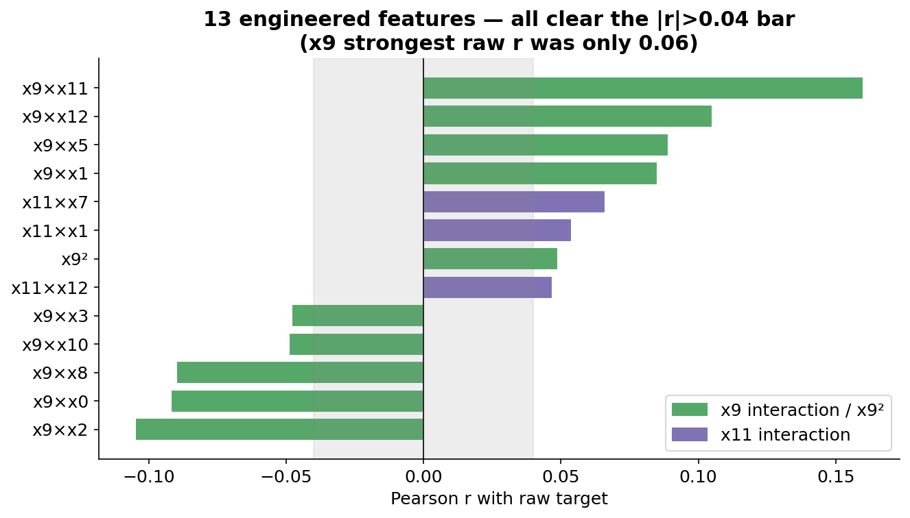
FEATURE ENGINEERING
15 raw → 28 features: curvature + interactions
x9² Captures the diminishing-returns curve a straight line can't. (log rejected — x9 goes negative.)
1
9 × x9 interactions x9 acts as a multiplier; x9×x11 (r=0.16) is stronger than any raw feature.
2
3 × x11 interactions x11 is a latent amplifier — weak alone, strong gating others.
3
Inclusion rule |r| > 0.04 At n=2,500 that's the noise floor. All 105 pairwise terms were tested — the extras only added noise and hurt.
4
Sofia ML · Spring 2026 · Sign-Coupled Two-Stage Regression
7

Slide 8
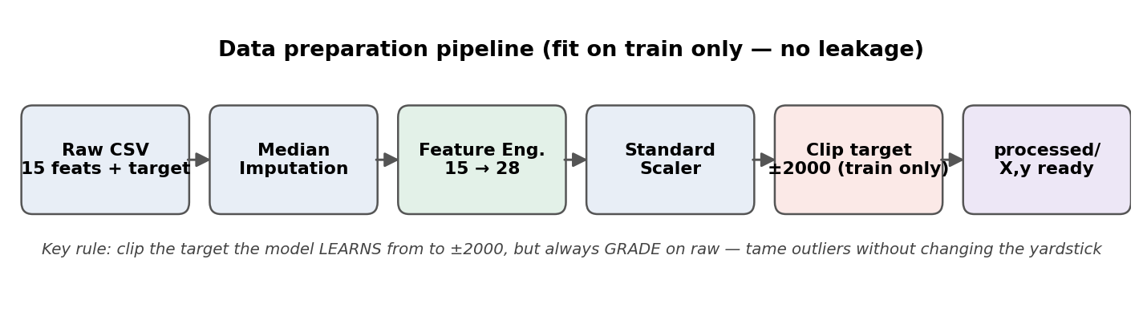
DATA PREPARATION
Leak-free pipeline, fit on train only
Core trick: Median impute (features are MCAR & independent), engineer, standard-scale, then CLIP the training target to ±2000 — tame the giants while the model learns, but always GRADE on raw.
Sofia ML · Spring 2026 · Sign-Coupled Two-Stage Regression
8

Slide 9
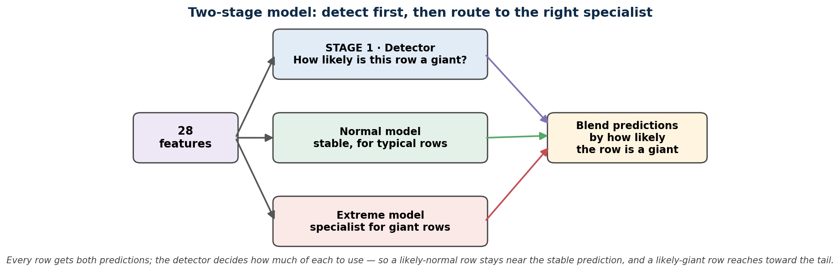
MODEL ARCHITECTURE
Two-stage: detect first, then route to a specialist
The idea: A single model can't handle both the calm majority and the rare giants. Stage 1 flags likely-giant rows; Stage 2 blends a stable normal model with a specialist extreme model, weighted by how likely each row is to be a giant.
Sofia ML · Spring 2026 · Sign-Coupled Two-Stage Regression
9

Slide 10
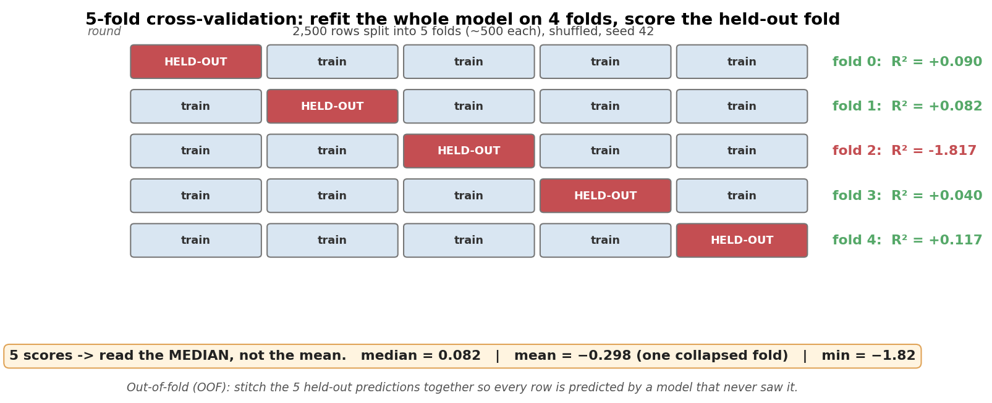
TRAINING & EVALUATION
How 5-fold cross-validation actually runs
Read the median, not the mean: Each round refits the WHOLE model (backbone + magnitude Ridge + classifier) on 4 folds and scores the 5th. One held-out fold of unseen giants collapses, so the mean misleads — the median is what tracks the real board.
Sofia ML · Spring 2026 · Sign-Coupled Two-Stage Regression
10

Slide 11
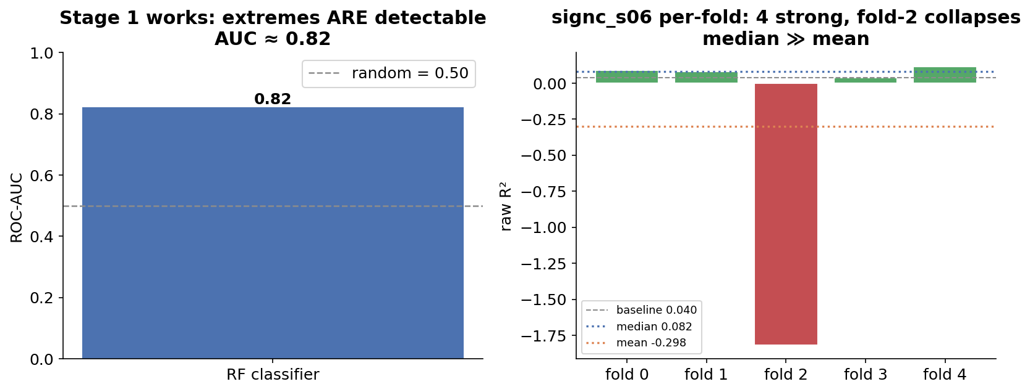
VALIDATION
The detector works; the magnitude is the risk
Profile of signc_s06: Extremes ARE detectable (AUC 0.82). Four folds reach 0.06–0.12 but fold-2 craters to −1.82 (unseen giants, wrong size). Median 0.082 ≫ mean −0.298 — a high-upside, fat-tail bet.
Sofia ML · Spring 2026 · Sign-Coupled Two-Stage Regression
11

Slide 12
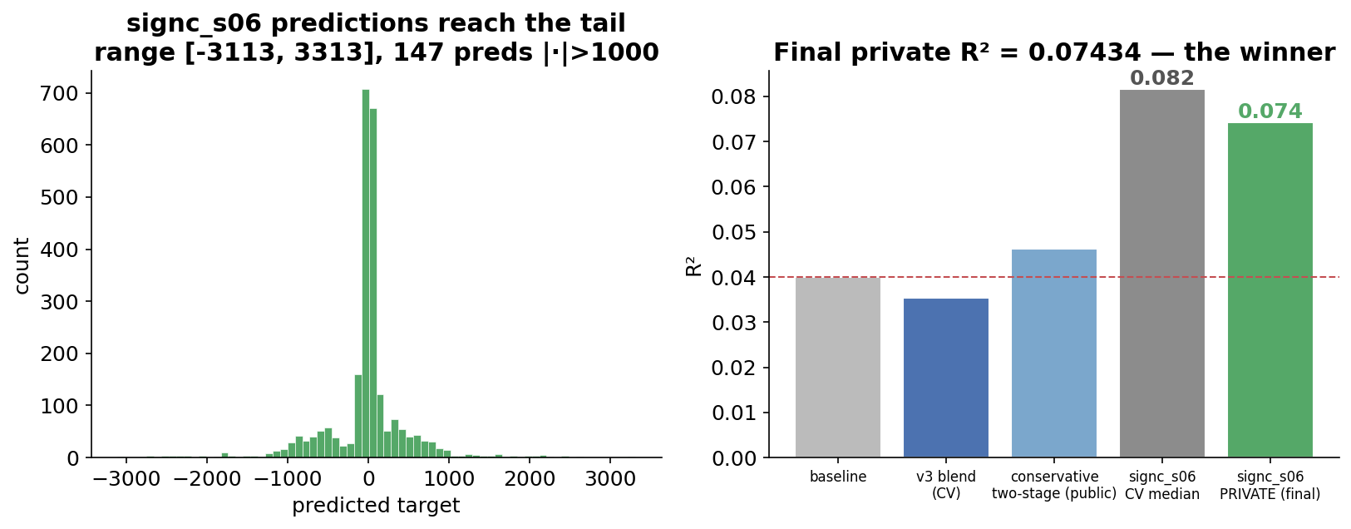
FINAL OUTPUT
submission_ts_signc_s06.csv → private R² 0.07434
The payoff: Public scoring punished the bold predictions, but the PRIVATE slice behaved like a typical (good) fold — so the aggressive bet landed at 0.07434, almost exactly its CV median (0.082). The median was right all along.
Sofia ML · Spring 2026 · Sign-Coupled Two-Stage Regression
12

Slide 13
KEY TAKEAWAYS
What made the submission win
1
Match training to the metric
2
Sign-couple the specialist
Train (in clipped form) on the raw target you're graded on — don't ace a transformed proxy.
Let the extreme model size the giants; borrow their SIGN from the stable backbone to kill the worst errors.
3
Read the per-fold MEDIAN
4
Public ≠ private
The mean (−0.30) said reject; the median (0.082) said winner. One collapsed fold poisons the mean.
Bold predictions lost publicly but won on the hidden private slice (0.07434) — keep the high-upside bet.
Final private R² 0.07434 · best entry · ~2× the 0.040 baseline

