Slide 1
Breast Cancer Prediction Project - using Breast cancer Wisconsin (diagnostic) dataset
-Dr. TEJAS. J
Professor,
Dept. of Forensic Medicine and Toxicology,
Karpaga Vinayaga Institute of Medical Sciences and Research Center

Slide 2
Data: Introduction
Data Set Characteristics:
Number of Instances: 569
Number of Attributes: 30 numeric, predictive attributes and the class
Attribute Information:
radius (mean of distances from center to points on the perimeter)
texture (standard deviation of gray-scale values)
perimeter
area
smoothness (local variation in radius lengths)
compactness (perimeter^2 / area - 1.0)
concavity (severity of concave portions of the contour)
concave points (number of concave portions of the contour)
symmetry
fractal dimension ("coastline approximation" - 1)

Slide 3
Data: Introduction
The mean, standard error, and "worst" or largest (mean of the three worst/largest values) of these features were computed for each image, resulting in 30 features. For instance, field 0 is Mean Radius, field 10 is Radius SE, field 20 is Worst Radius.
class:
Malignant
Benign
Features are computed from a digitized image of a fine needle aspirate (FNA) of a breast mass. They describe characteristics of the cell nuclei present in the image.

Slide 4
Exploratory Data Analysis
Total 569 entries and 31 features (including target)
All independent features are float type and target is integer type with 2 classes 0 (Benign) and 1 (Malignant)
No duplicates or missing values
Distribution: Standard error data is right skewed # needs transformation
Datatypes: float64(30), int64(1)
Memory usage: 137.9 KB
Numerical columns: Index(['mean radius', 'mean texture', 'mean perimeter', 'mean area', 'mean smoothness', 'mean compactness', 'mean concavity', 'mean concave points', 'mean symmetry', 'mean fractal dimension', 'radius error', 'texture error', 'perimeter error', 'area error', 'smoothness error', 'compactness error', 'concavity error', 'concave points error', 'symmetry error', 'fractal dimension error', 'worst radius', 'worst texture', 'worst perimeter', 'worst area', 'worst smoothness', 'worst compactness', 'worst concavity', 'worst concave points', 'worst symmetry', 'worst fractal dimension'], dtype='object’)
Categorical Columns: Index(['target'], dtype='object')

Slide 5
 | mean | std | min | 25% | 50% | 75% | max
mean radius | 14.12729 | 3.524049 | 6.981 | 11.7 | 13.37 | 15.78 | 28.11
mean texture | 19.28965 | 4.301036 | 9.71 | 16.17 | 18.84 | 21.8 | 39.28
mean perimeter | 91.96903 | 24.29898 | 43.79 | 75.17 | 86.24 | 104.1 | 188.5
mean area | 654.8891 | 351.9141 | 143.5 | 420.3 | 551.1 | 782.7 | 2501
mean smoothness | 0.09636 | 0.014064 | 0.05263 | 0.08637 | 0.09587 | 0.1053 | 0.1634
mean compactness | 0.104341 | 0.052813 | 0.01938 | 0.06492 | 0.09263 | 0.1304 | 0.3454
mean concavity | 0.088799 | 0.07972 | 0 | 0.02956 | 0.06154 | 0.1307 | 0.4268
mean concave points | 0.048919 | 0.038803 | 0 | 0.02031 | 0.0335 | 0.074 | 0.2012
mean symmetry | 0.181162 | 0.027414 | 0.106 | 0.1619 | 0.1792 | 0.1957 | 0.304
mean fractal dimension | 0.062798 | 0.00706 | 0.04996 | 0.0577 | 0.06154 | 0.06612 | 0.09744
radius error | 0.405172 | 0.277313 | 0.1115 | 0.2324 | 0.3242 | 0.4789 | 2.873
texture error | 1.216853 | 0.551648 | 0.3602 | 0.8339 | 1.108 | 1.474 | 4.885
perimeter error | 2.866059 | 2.021855 | 0.757 | 1.606 | 2.287 | 3.357 | 21.98
area error | 40.33708 | 45.49101 | 6.802 | 17.85 | 24.53 | 45.19 | 542.2
smoothness error | 0.007041 | 0.003003 | 0.001713 | 0.005169 | 0.00638 | 0.008146 | 0.03113
compactness error | 0.025478 | 0.017908 | 0.002252 | 0.01308 | 0.02045 | 0.03245 | 0.1354
concavity error | 0.031894 | 0.030186 | 0 | 0.01509 | 0.02589 | 0.04205 | 0.396
concave points error | 0.011796 | 0.00617 | 0 | 0.007638 | 0.01093 | 0.01471 | 0.05279
symmetry error | 0.020542 | 0.008266 | 0.007882 | 0.01516 | 0.01873 | 0.02348 | 0.07895
fractal dimension error | 0.003795 | 0.002646 | 0.000895 | 0.002248 | 0.003187 | 0.004558 | 0.02984
worst radius | 16.26919 | 4.833242 | 7.93 | 13.01 | 14.97 | 18.79 | 36.04
worst texture | 25.67722 | 6.146258 | 12.02 | 21.08 | 25.41 | 29.72 | 49.54
worst perimeter | 107.2612 | 33.60254 | 50.41 | 84.11 | 97.66 | 125.4 | 251.2
worst area | 880.5831 | 569.357 | 185.2 | 515.3 | 686.5 | 1084 | 4254
worst smoothness | 0.132369 | 0.022832 | 0.07117 | 0.1166 | 0.1313 | 0.146 | 0.2226
worst compactness | 0.254265 | 0.157336 | 0.02729 | 0.1472 | 0.2119 | 0.3391 | 1.058
worst concavity | 0.272188 | 0.208624 | 0 | 0.1145 | 0.2267 | 0.3829 | 1.252
worst concave points | 0.114606 | 0.065732 | 0 | 0.06493 | 0.09993 | 0.1614 | 0.291
worst symmetry | 0.290076 | 0.061867 | 0.1565 | 0.2504 | 0.2822 | 0.3179 | 0.6638
worst fractal dimension | 0.083946 | 0.018061 | 0.05504 | 0.07146 | 0.08004 | 0.09208 | 0.2075
Data Description

Slide 6
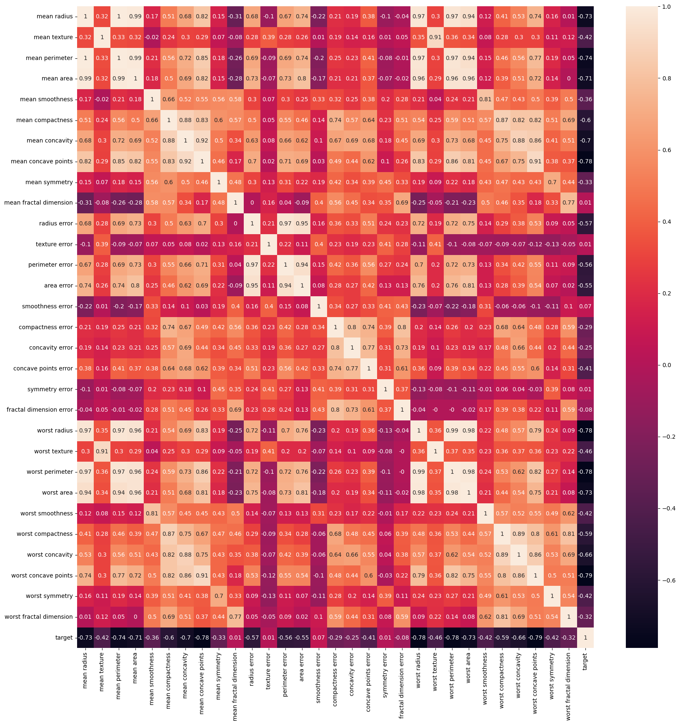
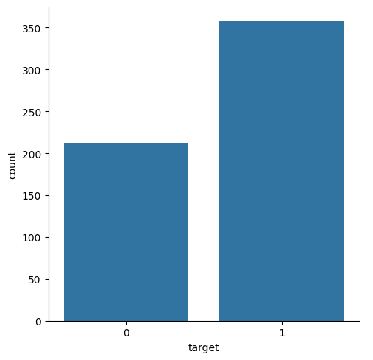
Exploratory Data Analysis
Some features are highly correlated # PCA
Target has class imbalance # requires balancing

Slide 7
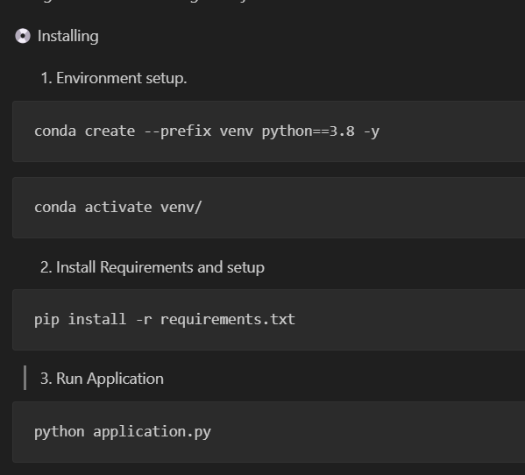
Project Setup

Slide 8
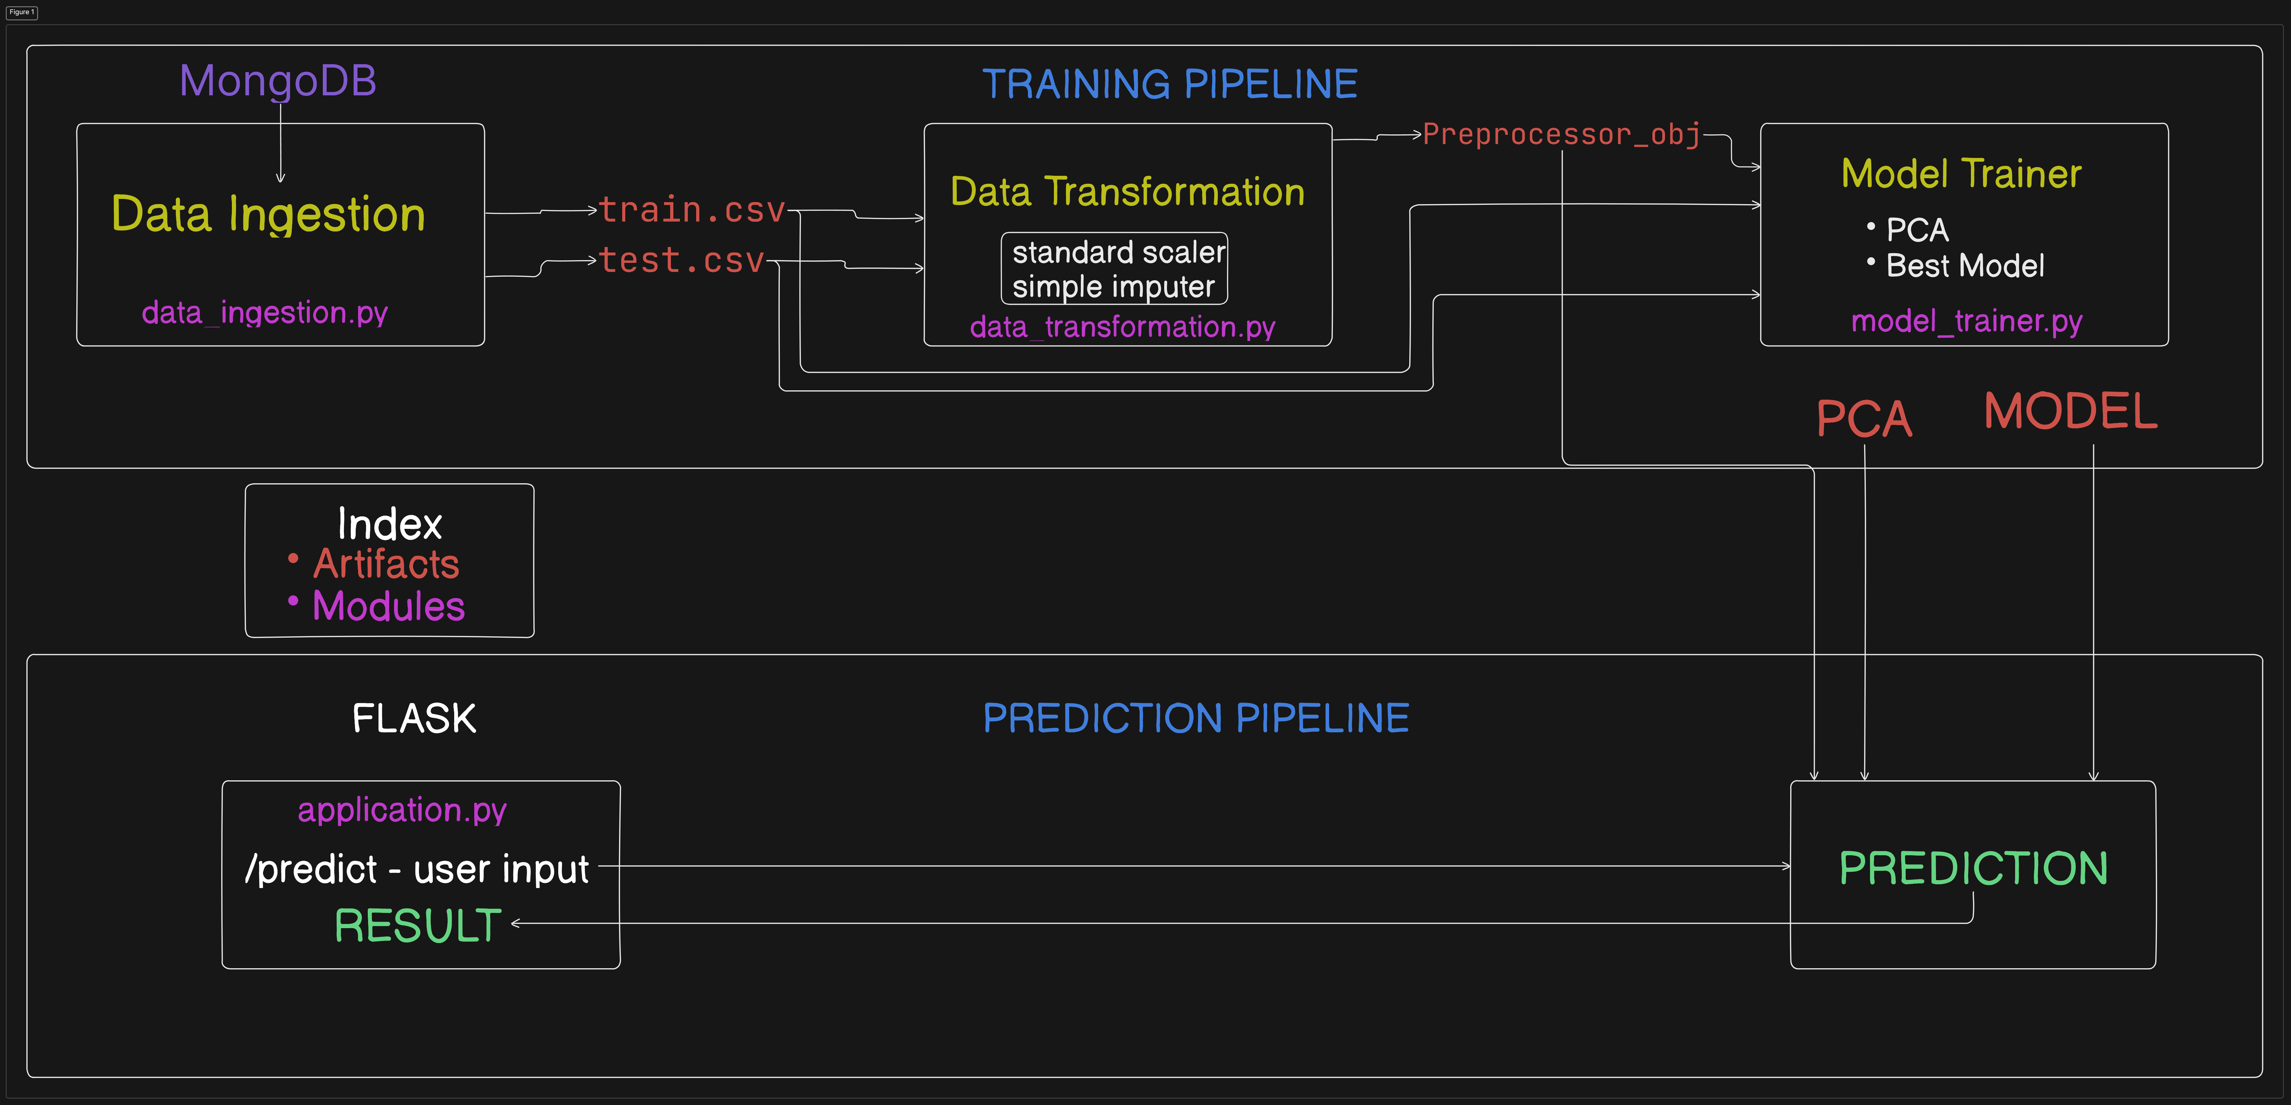
Project Workflows

Slide 9
Requirements
pandas
numpy
flask
ipykernel
seaborn
scikit-learn
database_connect
pymongo
imblearn
xgboost

Slide 10
Data Ingestion Module – Mongodb connect
def get_database():
# Provide the mongodb atlas url to connect python to mongodb using pymongo
CONNECTION_STRING = MongoUrl.client_url
# Create a connection using MongoClient. You can import MongoClient or use pymongo.MongoClient
client = MongoClient(CONNECTION_STRING)
# Create the database for our example (we will use the same database throughout the tutorial
return client['demoDB']

Slide 11
Data Ingestion Module – Pull data from Mongodb
def get_data():
# Get the database
dbname = get_database()
collection = dbname['breast_cancer_prediction']
cursor = collection.find()
data = []
for doc in cursor:
data.append(doc)
df = pd.DataFrame.from_records(data).drop('_id',axis=1)
return df

Slide 12
Data Ingestion Module
def initiate_data_ingestion(self):
df = pd.read_csv(os.path.join('notebooks/data','breast_cancer.csv’)) os.makedirs(os.path.dirname(self.ingestion_config.raw_data_path),exist_ok=True)
df.to_csv(self.ingestion_config.raw_data_path,index=False) train_set , test_set = train_test_split(df,test_size=0.3 , random_state=42)
train_set.to_csv(self.ingestion_config.train_data_path,index =False,header = True)
test_set.to_csv(self.ingestion_config.test_data_path,index =False,header = True) return (
self.ingestion_config.train_data_path,
self.ingestion_config.test_data_path
)

Slide 13
Data Transformation Module
def initiate_data_transformation(self,train_data_path,test_data_path):
train_df = pd.read_csv(train_data_path)
test_df = pd.read_csv(test_data_path)
preprocessing_obj=self.get_data_transformation_object()
target_column = 'target'
drop_columns = [target_column]
##dividing the dataset into independent and dependent features
## Training data
input_feature_train_df = train_df.drop(columns=drop_columns,axis=1)
target_feature_train_df = train_df[target_column]
## Test data
input_feature_test_df = test_df.drop(columns=drop_columns,axis=1)
target_feature_test_df = test_df[target_column]

Slide 14
Data Transformation Module
## Data transformation
input_feature_train_arr = preprocessing_obj.fit_transform(input_feature_train_df)
input_feature_test_arr = preprocessing_obj.transform(input_feature_test_df)
train_arr = np.c_[input_feature_train_arr,np.array(target_feature_train_df)]
test_arr = np.c_[input_feature_test_arr,np.array(target_feature_test_df)]
save_object(
file_path=self.data_transformation_config.preprocessor_obj_file_path,
obj = preprocessing_obj)
return (
train_arr ,
test_arr ,
self.data_transformation_config.preprocessor_obj_file_path
)

Slide 15
Model Trainer Module
def initiate_model_training(self,train_arr,test_arr):
X_train , y_train , X_test , y_test = (
train_arr[:,:-1],
train_arr[:,-1],
test_arr[:,:-1],
test_arr[:,-1]
)
#based on scree plot the best number of principal components = 5
pca = PCA(n_components=5)
X_train = pca.fit_transform(X_train)
X_test = pca.transform(X_test)

Slide 16
Model Trainer Module
models={
'LogisticRegression':LogisticRegression(),
'RidgeClassifier':RidgeClassifier(),
'BernoulliNB':BernoulliNB(),
'DecisionTreeClassifier':DecisionTreeClassifier(),
'KNeighborsClassifier':KNeighborsClassifier(),
'AdaBoostClassifier':AdaBoostClassifier(),
'GradientBoostingClassifier':GradientBoostingClassifier(),
'BaggingClassifier':BaggingClassifier(),
'RandomForestClassifier':RandomForestClassifier(),
'SVC':SVC(),
'XGBClassifier':XGBClassifier()
}

Slide 17
Model Trainer Module
model_report:dict = evaluate_model(X_train,y_train,X_test,y_test,models)
best_model_score = max(sorted(model_report.values()))
best_model_name = list(model_report.keys())[list(model_report.values()).index(best_model_score)]
best_model = models[best_model_name]
save_object(file_path=self.model_trainer_config.trained_model_file_path,obj = best_model)
save_object(file_path=self.model_trainer_config.trained_pca_file_path,obj=pca)

Slide 18
Training Pipeline
obj = DataIngestion()
train_data_path , test_data_path = obj.initiate_data_ingestion()
print(train_data_path , test_data_path)
data_transformation = DataTransformation()
train_arr ,test_arr , obj_path = data_transformation.initiate_data_transformation(train_data_path,test_data_path)
model_trainer = ModelTrainer()
model_trainer.initiate_model_training(train_arr,test_arr)

Slide 19
Prediction Pipeline
def predict(self,features):
preprocessor_path = os.path.join('artifacts','preprocessor.pkl')
model_path = os.path.join('artifacts','model.pkl')
pca_path = os.path.join('artifacts','pca.pkl')
preprocessor = load_object(preprocessor_path)
model = load_object(model_path)
pca = load_object(pca_path)
data_scled = preprocessor.transform(features)
data_scled = pca.transform(data_scled)
pred = model.predict(data_scled)
return pred

Slide 20
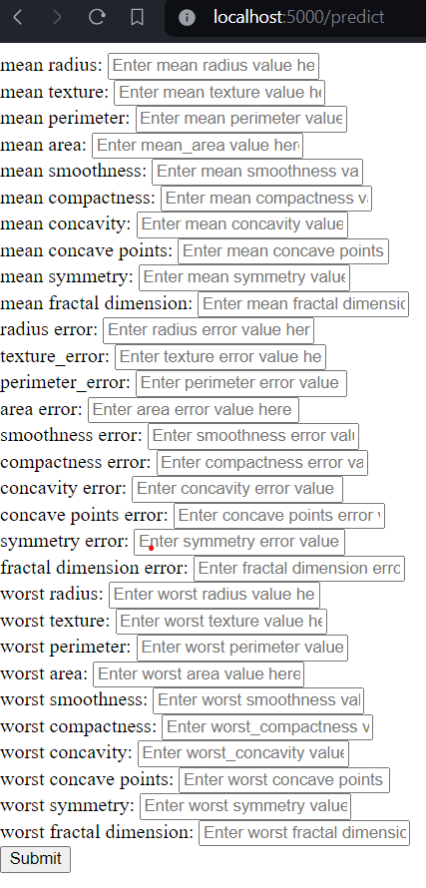
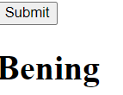
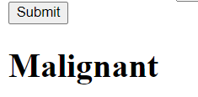
Flask end point – application.py
PREDICTION

Slide 21
Frame Works Used
- flask
- Python 3.8
- Scikit learn
- pandas
- numpy

