Slide 1
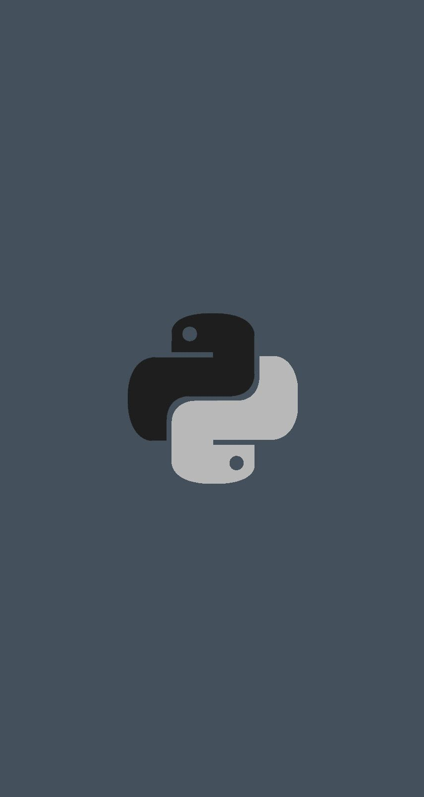
Python Introduction 2
Tuesday, 6 December 2022

Slide 2
“An investment in knowledge pays the best interest“
- Benjamin Franklin

Slide 3
Today’s Agenda
Version History
Python 2 v/s Python 3
Introduction To Predefined Functions And Modules
How print() function works ?
How To Remove Newline From print( ) ?
Types Of Errors In Python
Rules For Identifiers
Python Reserved Words

Slide 4
Python Version History
First released on Feb-20th -1991 ( version 0.9.0)
Python 1.0 launched in Jan-1994
Python 2.0 launched in Oct-2000
Python 3.0 launched in Dec-2008
Python 2.7 launched in July 2010
Python 3.6.5 launched on March-2018
Python 3.7 launched on June-2018
Python 3.8 launched on Oct – 2019
Python 3.9 launched on Oct – 2020
Python 3.10 launched on Oct – 2021
Python 3.11 launched on Oct – 2022 [Latest version]

Slide 5
The Two Versions Of Python
As you can observe from the previous slide , there are 2 major versions of Python , called Python 2 and Python 3
Python 3 came in 2008 and it is not backward compatible with Python 2
This means that a project which uses Python 2 will not run on Python 3.
This means that we have to rewrite the entire project to migrate it from Python 2 to Python 3

Slide 6
Some Important Differences
In Python 2
print “Hello iNeuron”
In Python 3
print(“Hello iNeuron”)
In Python 2
5/2 →2
5/2.0→2.5
In Python 3
5/2→ 2.5
The way of accepting input has also changed and like this there are many changes

Slide 7
The Two Versions Of Python
So to prevent this overhead of programmers , PSF decided to support Python 2 also.
But this support will only be till Jan-1-2020
You can visit https://pythonclock.org/ to see exactly how much time is left before Python 2 retires

Slide 8
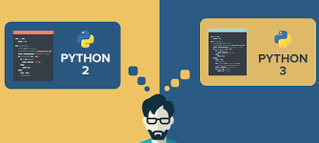
Which Version Should I Use ?
For beginners , it is a point of confusion as to which Python version they should learn ?
The obvious answer is Python 3

Slide 9
Why Python 3 ?
We should go with Python 3 as it brings lot of new features and new tricks compared to Python 2
Moreover as per PSF, Python 2.x is legacy, Python 3.x is the present and future of the language
All major future upgrades will be to Python 3 and , Python 2.7 will never move ahead to even Python 2.8

Slide 10
Types Of Predefined Function Provided By Python
Python has a very rich set of predefined functions and they are broadly categorized to be of 2 types
Built In Functions
Functions Defined In Modules

Slide 11
Built In Functions
Built in functions are those functions which are always available for use .
For example , print() is a built-in function which prints the given object to the standard output device (screen)
As of version 3.6 , Python has 68 built-in function and their list can be obtained on the following URL :
https://docs.python.org/3/library/functions.html

Slide 12
What Is print( ) And How It Is Made Available To Our Program ?
x = ("apple", "banana", "cherry") print(x)

Slide 13
How To Remove newline From print() ?
print("Hello User")
print("Python Rocks")
If we closely observe , we will see that the 2 messages are getting displayed on separate lines , even though we have not used any newline character.
This is because the function print() automatically appends a newline character after the message it is printing.

Slide 14
How To Remove newline From print() ?
If we do not want this then we can use the print() function as shown below:
print(“Hello User”, end=“”)
print(“Python Rocks”)

Slide 15
How To Remove newline From print() ?
The word end is called keyword argument in Python and it’s default value is “\n”.
But we have changed it to empty string(“”) to tell Python not to produce any newline.
Similarly we can set it to “\t” to generate tab or “\b” to erase the previous character

Slide 16
Some Examples
1.
print("Hello User",end="\t")
print("Python Rocks")
2.
print("Hello User",end="\b")
print("Python Rocks")

Slide 17
Types Of Errors In Python
Just like any other programming language , Python also has 2 kinds of errors:
Syntax Error
Runtime Error

Slide 18
Syntax Error
Syntaxes are RULES OF A LANGUAGE and when we break these rules , the error which occurs is called Syntax Error.
Examples of Syntax Errors are:
Misspalled keywords.
Incorrect use of an operator.
Omitting parentheses in a function call.

Slide 19
Runtime Errors (Exceptions)
As the name says, Runtime Errors are errors which occur while the program is running.
As soon as Python interpreter encounters them it halts the execution of the program and displays a message about the probable cause of the problem.

Slide 20
Runtime Errors (Exceptions)
They usually occurs when interpreter counters a operation that is impossible to carry out and one such operation is dividing a number by 0.
Since dividing a number by 0 is undefined , so ,when the interpreter encounters this operation it raises ZeroDivisionError as follows:

Slide 21
Functions Defined In Modules
A Module in Python is collection of functions and statements which provide some extra functionality as compared to built in functions.
We can assume it just like a header file of C/C++ language.
Python has 100s of built in Modules like math , sys , platform etc which prove to be very useful for a programmer

Slide 22
Functions Defined In Modules
For example , the module math contains a function called factorial( ) which can calculate and return the factorial of any number.
But to use a module we must first import it in our code using the syntax :
import <name of the module>
For example: import math
Then we can call any function of this module by prefixing it with the module name
For example: math.factorial(5)

Slide 23
Rules For Identifiers
What is an identifier ?
Identifier is the name given to entities like class, functions, variables , modules and any other object in Python.
Rules for identifiers:
Identifiers can be a combination of letters in lowercase (a to z) or uppercase (A to Z) or digits (0 to 9) or an underscore (_)
No special character except underscore is allowed in the name of a variable

Slide 24
Rules For Reserved Words
What is a Reserved Word?
A word in a programming language which has a fixed meaning and cannot be redefined by the programmer or used as identifiers
How many reserved words are there in Python ?
Python contains 33 reserved words or keywords
The list is mentioned on the next slide
We can get this list by using help() in Python Shell

Slide 25
Rules For Reserved Words
These 33 keywords are:
False , True , None ,def,
del ,import ,return , and , or ,
not ,if, else , elif , for , while ,
break , continue, is , as , in ,
global , nonlocal ,yield ,
try ,except , finally, raise,
lambda ,with ,assert ,class ,
from , pass
Some Important Observations:
Except False , True and None all the other keywords are in lowercase
We don’t have else if in Python , rather it is elif
There are no switch and do-while statements in Python

Slide 26
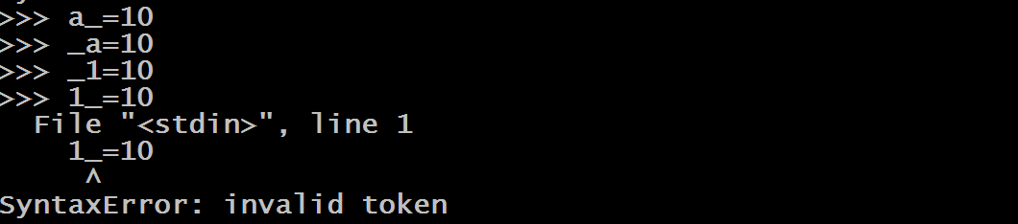
Rules For Identifiers
It must compulsorily begin with a underscore ( _ ) or a letter and not with a digit . Although after the first letter we can have as many digits as we want. So 1a is invalid , while a1 or _a or _1 is a valid name for an identifier.

Slide 27
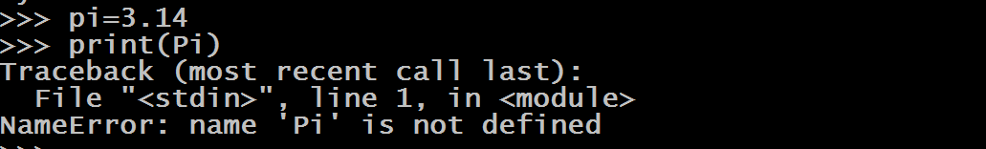
Rules For Identifiers
Identifiers are case sensitive , so pi and Pi are two different identifiers.

Slide 28
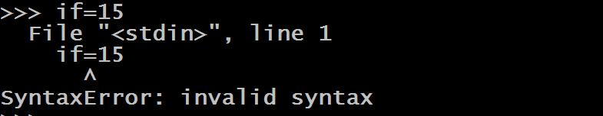
Rules For Identifiers
Keywords cannot be used as identifiers
Identifier can be of any length.

Slide 29
Thank you

