Slide 1
Global Layoffs Analysis (2020–2025)
Advanced SQL Data Cleaning &
Exploratory Data Analysis of Global Layoffs
Data Analyst Portfolio Project | TEJAS BHAVSAR

Slide 2
Project Objective & Scope
Goal
Scope
The primary objective is to transform raw, messy, real-world layoff data into clean, structured, and extract actionable insights using advanced SQL techniques.
Data Volume: Starting with 4,126 raw entries from the Layoffs.fyi dataset.
Timeframe: Covering a 5-year period (2020-2025) to capture recent economic shifts.
Data Transformation: From raw data to clean and structured, so its ready for analysis
Coverage: Encompassing multi-country and multi-sector data, providing a broad global perspective on workforce changes.
Actionable Insights: Deriving meaningful conclusions from the cleaned data.

Slide 3
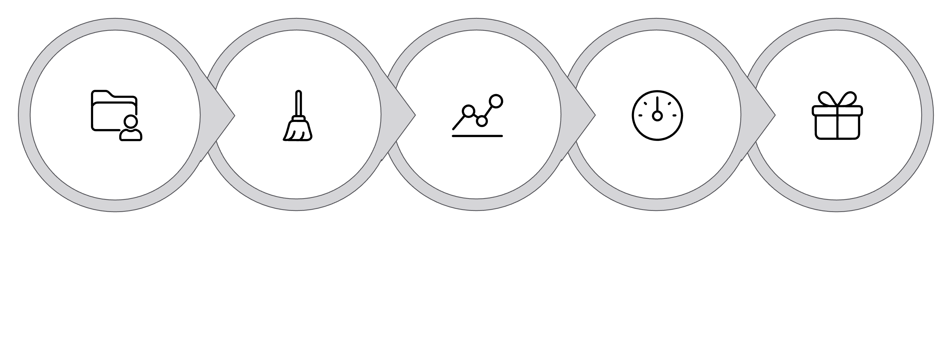





Methodology Overview
The approach to analyzing global layoffs involves following a structured, multi-stage process, ensuring data integrity and the derivation of actionable business insights.
Data Collection
Exploratory Analysis
KPI Extraction
Insight Storytelling
Cleaning
Keywords: Deduplication, Null Handling, Type Conversion, SQL Analytics, Visualization

Slide 4
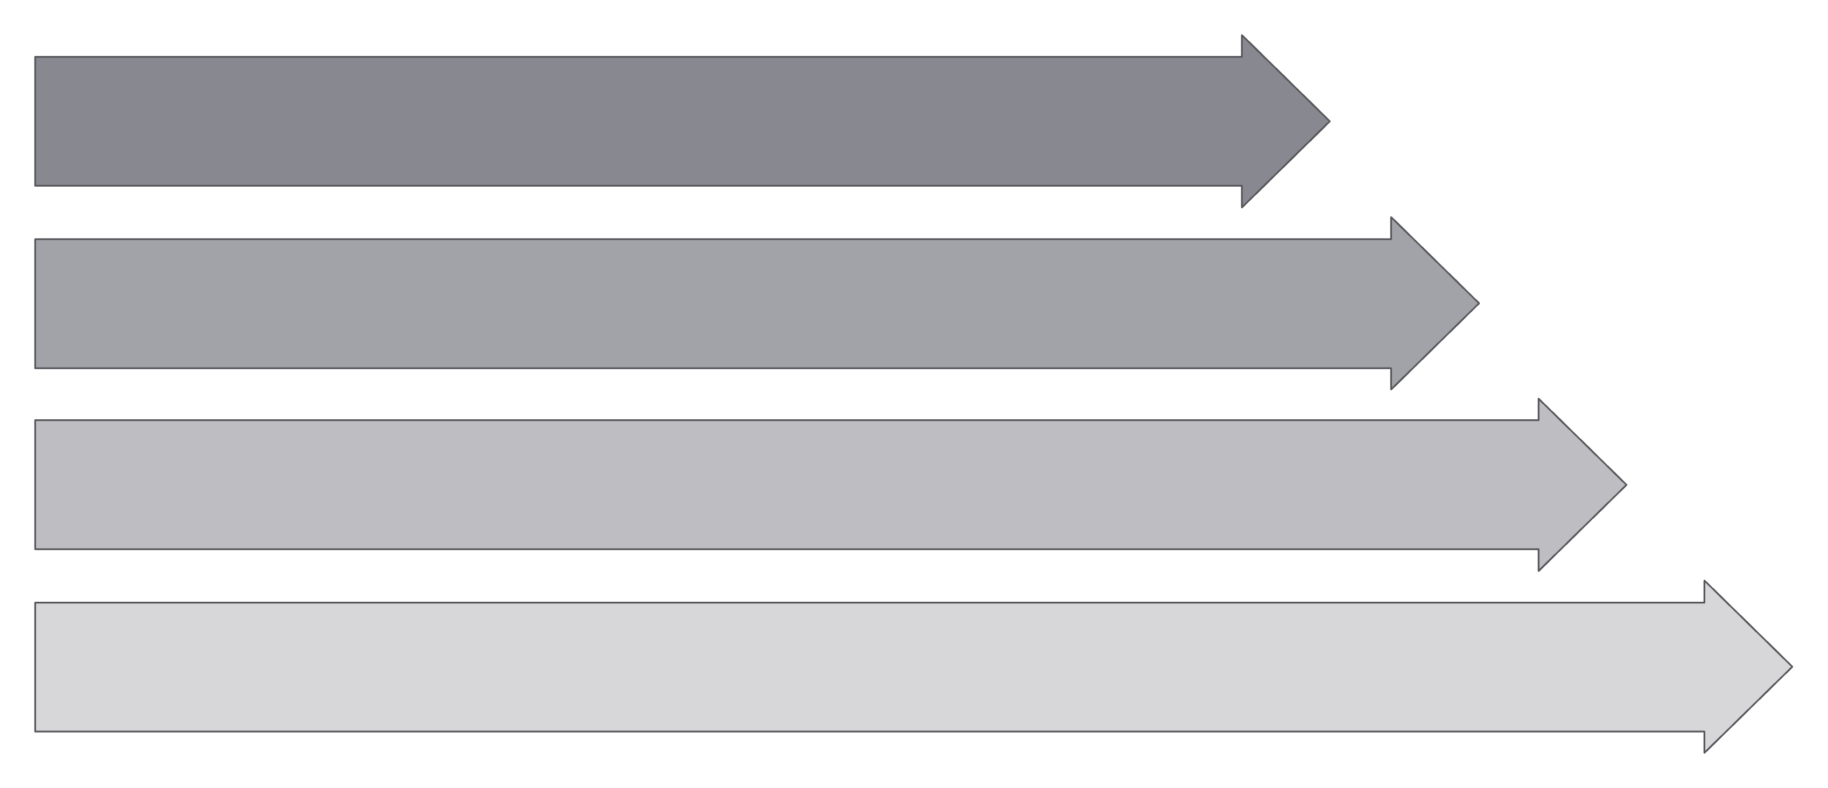
Data Cleaning Workflow
Standardize Columns
Remove Duplicates
Handle Missing Values
Finalize & Report

Slide 5
Data Cleaning - SQL Query
Deduplication & Null Handling
Deduplication
Null Handling
#1 To create staging tables where cleaning will be done:
CREATE TABLE layoffsp_staging LIKE layoffsp;
INSERT INTO layoffsp_staging
SELECT * FROM layoffsp;
ALTER TABLE layoffsp_staging
ADD COLUMN row_num INT;
#2 Adding Row_Number field to find duplicates - when row_number > 1, then duplicates exist:
INSERT INTO layoffsp_staging2 (company, location, industry, total_laid_off, percentage_laid_off, date, stage, country, funds_raised_millions, row_num)
SELECT company, location, industry, total_laid_off, percentage_laid_off, date, stage, country, funds_raised_millions,
ROW_NUMBER() OVER(PARTITION BY company, location, industry, total_laid_off, percentage_laid_off, date, stage, country, funds_raised_millions) AS row_num
FROM layoffsp_staging;
DELETE FROM layoffsp_staging2
WHERE row_num > 1;
UPDATE layoffsp_staging2 AS t1
JOIN layoffsp_staging2 AS t2
ON t1.company = t2.company
SET t1.industry = t2.industry
WHERE t1.industry IS NULL AND t2.industry IS NOT NULL;
DELETE FROM layoffsp_staging2
WHERE total_laid_off = '' AND percentage_laid_off = ‘’ “ ;
-- This involves removing the data wherever both variables are null. This is because having either total laid off number or percentage laid off will provide some insights but if both are absent there is no significance of the data
Outcome: Redundant data and blanks removed, resulting in a cleaner dataset for analysis.

Slide 6
Data Cleaning - SQL QUERY
Type Conversion, Date Standardization, Column Fixes
Convert data types for numerical columns
ALTER TABLE layoffsp_staging2
MODIFY total_laid_off INT, MODIFY percentage_laid_off DECIMAL(5,2);
Standardize date format to 'YYYY-MM-DD’
UPDATE layoffsp_staging2
SET date = STR_TO_DATE(date, '%m/%d/%Y’);
Further clean-up for consistency
UPDATE layoffs_cleanedSET industry = 'Others' WHERE industry = ‘’;
This ensures all entries are consistent and ready for aggregation.
Final row count: 3,446 | Data completeness: 94.5%
These steps are crucial for enabling accurate numerical calculations, temporal analyses and KPI extraction.

Slide 7
Data Cleaning - Outcome
4,126
3,446
215
>90%
Raw Records
Cleaned Records
Duplicates Removed
Data Completeness
Initial dataset entries before any cleaning operations.
Retained, validated, and analysis-ready data entries.
Ensuring unique and accurate data points.
All critical fields are populated and consistent.
The cleaning process involved meticulously handling nulls, blanks, and inconsistencies across various columns, transforming the raw dataset into a high-quality, analysis-ready format. This clean and formatted foundation is critical for extracting reliable KPIs and generating meaningful business insights.

Slide 8
KPI 1 - Temporal Trends: SQL Code
Extracting Monthly/Yearly Layoffs
Total layoffs and events by year
SELECT YEAR(date) AS layoff_year, SUM(total_laid_off) AS total_layoffs, COUNT(*) AS layoff_events
FROM layoffsp_staging2
GROUP BY YEAR(`date`)
ORDER BY layoff_year;
Monthly total and rolling total layoffs
WITH months_CTE AS ( SELECT DATE_FORMAT(date, '%Y-%m') AS months,
SUM(total_laid_off) AS monthly_total
FROM layoffsp_staging2 GROUP BY months)
SELECT months, monthly_total, SUM(monthly_total) OVER (ORDER BY months) AS rolling_total
FROM months_CTE
ORDER BY months;
These queries allow us to observe high-level annual patterns and granular monthly trends, including cumulative impacts over time, essential for identifying cyclical and event-driven layoff spikes.

Slide 9
KPI 1 - Temporal Insights
Analyzing the temporal distribution of layoffs reveals distinct patterns and correlations with major global economic and social events.
Peak Layoffs: January 2023 saw the highest number of layoffs (89,709), largely driven by a correction in Tech Industry after over hiring in past two years, and poor global macroeconomic conditions
COVID-19 Impact: A significant wave of layoffs occurred in March 2020 (26,710 layoffs), coinciding with the initial global lockdown.
Cyclical Spikes: Observe recurring spikes in Q1, often linked to board meetings, fiscal recalibrations, and post-earnings announcements.

Slide 10

KPI 2 – Geographical Hotspots: SQL Query
To find out the geographical distribution of layoffs, I used the following SQL query. This query aggregates layoff events and total laid-off personnel by country, ordering the results to highlight regions with the highest impact.
SELECT country, COUNT(*) AS layoff_events, SUM(total_laid_off) AS total_layoffs
FROM layoffsp_staging2
GROUP BY country
ORDER BY total_layoffs DESC;
This query is foundational for identifying global layoff hotspots

Slide 11
KPI 2 - Geographical Insights
Geographic Risk: Layoffs & Concentrated Challenge
The United States accounts for a significant majority of layoffs, with 522,464 individuals affected, representing 68.8% of the total.
Within the US, the San Francisco Bay Area, New York City, and Seattle exhibit the highest concentrations of layoff risk, primarily due to their dense tech and finance ecosystems.
While India, Germany, and the UK follow, their layoff figures trail far behind. Notably, India's contribution is rising, reflecting volatility within its rapidly expanding tech sector. This data underscores the concentrated nature of layoff risk in key global economic hubs.

Slide 12

KPI 3 – Industry-Wise Breakdown: SQL Query
To analyse industry-specific layoff trends, we executed the following SQL query. This command groups layoff events and total affected employees by industry, providing a clear picture of sector vulnerability.
SELECT industry, COUNT(*) AS layoff_events, SUM(total_laid_off) AS total_layoffs
FROM layoffsp_staging2
GROUP BY industry
ORDER BY total_layoffs DESC;
This query helps pinpoint industries facing the most significant workforce reductions.

Slide 13
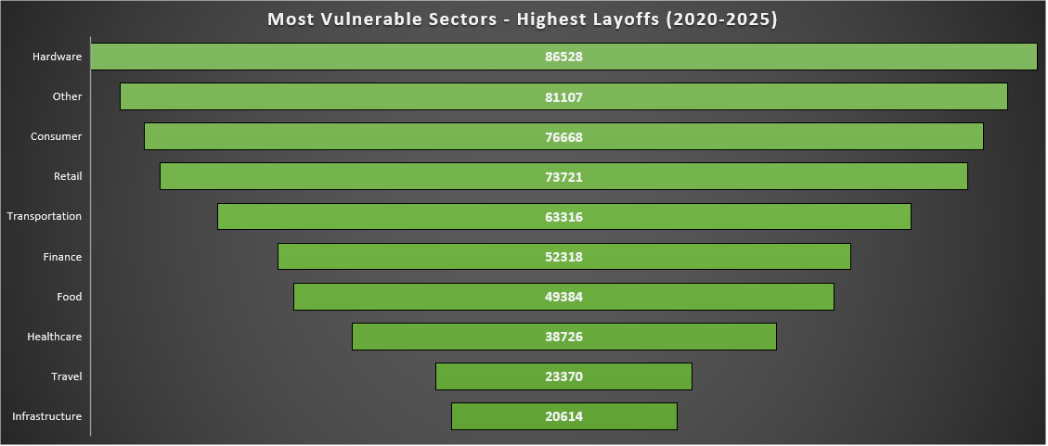
KPI 3 - Industry Insights
Sector Vulnerability: Hardware Sector Employees Hit the Worst
The Hardware sector leads in layoffs, with 86,528 affected employees, driven by supply chain shocks and cyclical chip market fluctuations.
Post-tech correction, the Finance sector has also seen a notable rise in layoffs, reflecting broader economic adjustments. This pattern highlights the varied triggers for workforce reductions across different industries.
The Retail, Consumer, and Transportation industries experienced significant impacts during the COVID-19 pandemic due to shifting consumer behaviors, preference for digital over physical, and disrupted logistics.

Slide 14

KPI 4 - Company Breakdown: SQL Query
To identify the companies with the highest number of layoffs, we executed the following SQL query. This query groups layoff events and total laid-off employees by company, limiting the results to the top 10 to focus on the most impactful entities.
SELECT company, COUNT(*) AS layoff_events, SUM(total_laid_off) AS total_layoffs
FROM layoffsp_staging2
GROUP BY company
ORDER BY total_layoffs DESC LIMIT 10;
This query highlights companies with significant workforce reductions, indicating potential systemic issues or market shifts.

Slide 15
KPI 4 - Company Insights
Companies Leading the Layoff Wave
Analysis of company-specific layoff data reveals several major players with substantial workforce reductions.
Intel: Leading with 43,000 layoffs across 9 distinct events, signaling persistent restructuring efforts to remain competitive and find its place
Microsoft: Follows with 30,000 layoffs, driven by strategic shifts, AI focus and market adjustments.
Amazon: Accounted for 28,000 layoffs, mainly concentrated in its e-commerce and corporate divisions.
Meta: Experienced 25,000 layoffs, largely due to shifts in investment focus, AI focused restructuring and market downturns.
Tesla: Reported 14,000 layoffs, influenced by production adjustments and market demand.
The occurrence of multiple layoff events within companies like Intel suggests ongoing challenges and strategic realignment induced reorganization
Company | Layoff Events | Total Layoffs
Intel | 9 | 43115
Microsoft | 9 | 30013
Amazon | 9 | 27940
Meta | 4 | 24700
Tesla | 3 | 14500
Cisco | 4 | 14300
Google | 8 | 13547
Dell | 2 | 12650
Salesforce | 8 | 12140
SAP | 2 | 11000

Slide 16

KPI 5 – Stage-Wise Company Analysis: SQL Query
To understand the relationship between company maturity and layoff risk, we executed the following SQL query. This query aggregates layoff events and total affected personnel by the company's funding stage, providing insights into vulnerability across different growth phases.
SELECT stage, COUNT(*) AS layoff_events, SUM(total_laid_off) AS total_layoffs
FROM layoffsp_staging2
GROUP BY stage
ORDER BY total_layoffs DESC;
This analysis helps determine if certain company stages are more susceptible to layoffs.

Slide 17
KPI 5 – Insights on Company Stage
Maturity & Market Pressure: Post-IPO Vulnerability
This analysis indicates that Post-IPO companies account for a significant portion of all layoffs, representing 58.5% of the total. This trend suggests that publicly traded companies, often under pressure to demonstrate profitability and efficiency to shareholders, are more prone to workforce reductions during economic shifts or market downturns.
Furthermore, the data reveals a clear correlation between funding cycles and layoffs, particularly impacting companies in various "series" funding rounds during periods of "funding winter" or tightened venture capital markets. This highlights the direct influence of market liquidity on employment stability within private enterprises.

Slide 18

KPI 6 - Shutdowns: SQL Query
To pinpoint companies that have entirely ceased operations, leading to 100% layoffs, the following SQL query was executed. This command selects companies where the percentage of laid-off employees equals 100%, offering a direct view into complete shutdowns.
SELECT company, location, date, total_laid_off, percentage_laid_off
FROM layoffsp_staging2
WHERE percentage_laid_off = 100.00;
This query is vital for identifying total business failures and their associated details.

Slide 19
KPI 6: Insights on Shutdown by Layoffs
1,150(33.37%) Companies Completely Eliminated
Analysis reveals a significant number of complete company shutdowns, highlighting the severity of recent economic shifts. Early-stage startups, particularly those heavily reliant on venture capital, have been severely affected during periods of funding winter and macro-economic shocks.
Geographic concentration of these shutdowns is notably high in established tech hubs. The largest single shutdown recorded was Redbox, impacting 1,000 employees.
Shutdown Analysis: 1,150 companies experienced complete shutdowns, predominantly early-stage/startups heavily impacted by recessions and tech pivots. These closures spike during funding winters, with a 33.37% failure rate underscoring the fragility of the early-stage ecosystem.

Slide 20
KPI 7 - Competitive Intelligence Companies with Largest Layoffs Each Year
SQL Query for Top 5 Layoff Companies
To identify the companies with the largest layoffs annually, we utilised the following SQL query. This query leverages window functions to rank companies by the total number of employees laid off each year, providing crucial competitive intelligence.
WITH top5layoff_CTE AS ( SELECT company, YEAR(date) AS Years, total_laid_off, percentage_laid_off,
DENSE_RANK() OVER(PARTITION BY YEAR(date) ORDER BY total_laid_off DESC) AS Rankings
FROM layoffsp_staging2)
SELECT Years, company, total_laid_off, Rankings
FROM top5layoff_CTE
WHERE Rankings <= 4
ORDER BY Years ASC, total_laid_off DESC;
This SQL code snippet allows us to efficiently extract and analyze the top five companies with the most significant layoff events on a yearly basis. Such insights are invaluable for benchmarking, market analysis, and understanding competitive landscape shifts.

Slide 21
Competitive Intelligence: Top Layoff Companies by Year
The analysis of top layoff companies each year provides critical competitive intelligence, highlighting specific market segments and organizations undergoing significant restructuring. This data informs strategic responses and risk assessments.
YEARS | COMPANY | TOTAL_LAID_OFF | RANKINGS
2020 | BOOKING.COM | 4375 | 1
2020 | UBER | 6700 | 2
2020 | GROUPON | 2800 | 3
2020 | AIRBNB | 1900 | 4
2021 | KATERRA | 2434 | 1
2021 | ZILLOW | 2000 | 2
2021 | INSTACART | 1877 | 3
2021 | BYTEDANCE | 3600 | 4
2022 | META | 11000 | 1
2022 | AMAZON | 10000 | 2
2022 | CISCO | 4100 | 3
2022 | PHILIPS | 4000 | 4
2023 | GOOGLE | 12000 | 1
2023 | META | 10000 | 2
2023 | MICROSOFT | 10000 | 2
2023 | AMAZON | 9000 | 3
2023 | ERICSSON | 8500 | 4
2024 | INTEL | 15000 | 1
2024 | TESLA | 14000 | 2
2024 | SAP | 8000 | 3
2024 | DELL | 6000 | 4
2025 | INTEL | 22000 | 1
2025 | MICROSOFT | 15000 | 2
2025 | INTEL | 5000 | 3
2025 | META | 3600 | 4
The table above showcases the top 4 of companies with significant layoff events for each year, demonstrating how major players across various sectors have been affected by economic shifts and strategic realignments. Observing these patterns helps anticipate future market dynamics and competitive pressures.

Slide 22
Key Insights Extracted
This comprehensive analysis provides critical insights into layoff patterns, transforming raw data into actionable business intelligence. Understanding these trends enables more precise workforce planning and risk mitigation strategies.
Major Findings:
Risk Assessment of Companies:
Cyclical Nature: Layoffs follow predictable economic patterns, often aligning with recessionary phases and market corrections.
High Risk: Characterised by Post-IPO status, presence in Hardware/Consumer sectors, and Q1 timing, indicating periods of significant exposure.
Geographic Risk: US tech hubs exhibit systemic vulnerability, serving as epicenters for layoff events due to high concentration of volatile industries.
Moderate Risk: Associated with VC-funded companies, the broader Tech sector, and periods of general economic uncertainty.
Industry Disruption: Hardware and consumer sectors face structural challenges, indicating a need for adaptation amidst evolving market demands.
Shutdown Risk: Predominantly affects early-stage companies, often linked to multiple previous layoff events and critical funding gaps.
Maturity Risk: Post-IPO companies demonstrate greater volatility than private entities, often reacting more sharply to market pressures.

Slide 23
Real-World Event Correlation
Layoff Patterns Match Economic Conditions
The correlation between global economic events and layoff patterns is undeniable. This timeline analysis highlights how major macro-economic shifts directly influence workforce restructuring across industries.
2020 - COVID-19 Pandemic
1
The onset of the pandemic triggered an immediate surge in layoffs during April, followed by a gradual workforce stabilization. Sectors like travel, hospitality, and retail were disproportionately affected by lockdowns and altered consumer behaviour.
2
2022-2023 - Tech Correction
Rising interest rates exerted profitability pressure, leading to a significant VC funding freeze. January 2023 marked the peak of this crisis, with 89,709 layoffs in a single month as tech companies recalibrated their strategies.
2024-2025 - AI Transformation
3
Current and future trends indicate ongoing workforce restructuring driven by automation and AI adoption. Strategic repositioning in highly competitive markets, and flattening of organization structures will lead to continued volatility, particularly within the tech sector as roles evolve.
4
Board & Earnings Cycles
Layoff spikes often align with corporate decision-making cycles: Q1 surges reflect post-budget planning, August increases follow Q2 earnings reactions, and year-end adjustments prepare for new fiscal years, indicating strategic rather than purely reactive moves.
This relationship indicates Agile workforce strategies are essential to anticipate economic shifts, preventing over-hiring and sudden layoffs, and ensuring that staffing decisions remain aligned with strategic priorities.

Slide 24
Conclusion
Key Takeaways & Strategic Implications
Our comprehensive analysis of layoff trends provides robust conclusions and actionable strategic implications for all corporate stakeholders. The data unequivocally points to interconnected economic and industry-specific factors driving workforce adjustments.
Primary Conclusions:
Business Value Generated:
Predictable Patterns: Layoffs are cyclical events, deeply tied to broader economic shifts and market conditions, making them more predictable than often perceived.
Risk Quantification: This analysis enables data-driven assessment of workforce vulnerability, allowing organizations to proactively identify and quantify potential risks – done via sector, stage, temporal and geographical breakdowns and a Severity Band based analysis.
Concentration Risk: The US tech ecosystem plays a significant role in global volatility, acting as a key driver for layoff events due to its inherent dynamism and investment patterns, especially for AI.
Timing Intelligence: By correlating layoffs with economic cycles, one can provide precise timing insights for strategic human resource planning and Restructuring
Industry Evolution: Traditional sectors are actively adapting to digital disruption, indicating a continuous evolution of job roles and workforce structures – not just a huge headcount reduction
Maturity Correlation: Publicly traded companies exhibit greater sensitivity to market pressures, often leading to more immediate and pronounced workforce adjustments.
Competitive Analysis: The framework offers detailed company performance benchmarking, providing insights into competitors' resilience and strategic moves during downturns, and Technology Shifts
These insights are designed to empower organizations with the foresight needed to navigate complex economic landscapes and maintain a competitive edge.

Slide 25
Skills Developed
Portfolio Value & Technical Competencies
This project has significantly enhanced our technical and professional capabilities, demonstrating a robust skill set applicable to complex data analysis and strategic business intelligence.
SQL Skills Demonstrated:
Analytical Capabilities:
Professional Skills:
Data Cleaning: Complex SQL Queries for deduplication, null handling, and precise type conversion.
Pattern Recognition: Identifying and interpreting temporal and cross-sectional trends in layoff data.
Project Management: Executing end-to-end analytical projects from conception to delivery.
Documentation: Creating comprehensive technical and business documentation for clarity and explainability.
Window Functions: Application of rolling calculations, ranking, and cumulative analysis for deeper insights.
Business Intelligence: Developing key performance indicators (KPIs) and generating actionable insights from complex datasets.
Strategic Thinking: Integrating business context into analytical findings and extracting insights from output of data analysis.
CTEs: Development of complex, multi-step analytical workflows using Common Table Expressions.
Data Storytelling: Translating findings into compelling business insights with graphs, and explanations for business users and managers

