Slide 1



Exploring the Company SQL Dataset
Get ready to dive into the company's SQL dataset and its tables. Learn about the structure, relationships, and valuable insights hidden within.
TS
by Tejas Saitwal

Slide 2


Introduction
•Purpose of the project
•Overview of the company
•Importance of SQL datasets
Project Objectives
•Explanation of the project goals
•Use cases of SQL datasets in the project

Slide 3
Database Design and Implementation
•Design principles for an optimized SQL database
•Considerations for query performance
SQL Queries and Analysis
•Execution of SQL queries on the dataset
•Analysis of the results and data visualization

Slide 4
Understanding the Dataset
1
Dataset Overview
Discover the details and purpose of the company SQL dataset. Gain insights into the data it contains and its potential applications.
2
Looking at Tables
Explore the structure and contents of key tables such as company_region and company_division. Uncover the power of these interconnected tables.

Slide 5
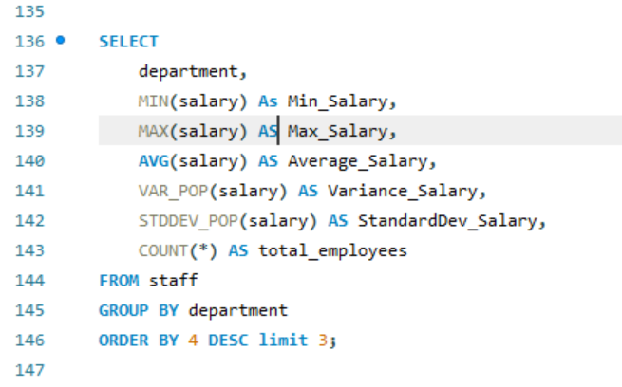
count
Q. How spread out those salary around the average
salary in each department ?

Slide 6
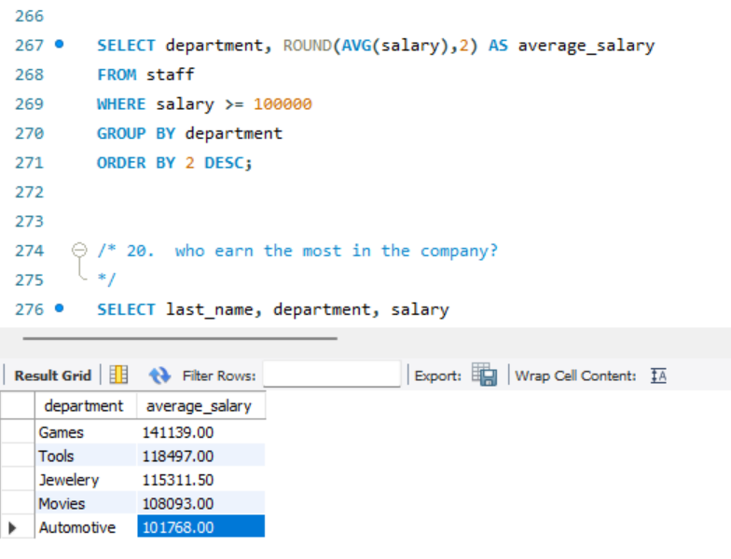
Q. Assume that people who earn at latest 100,000 salary is Executive . We want to
know the average salary for executives for each department.

Slide 7
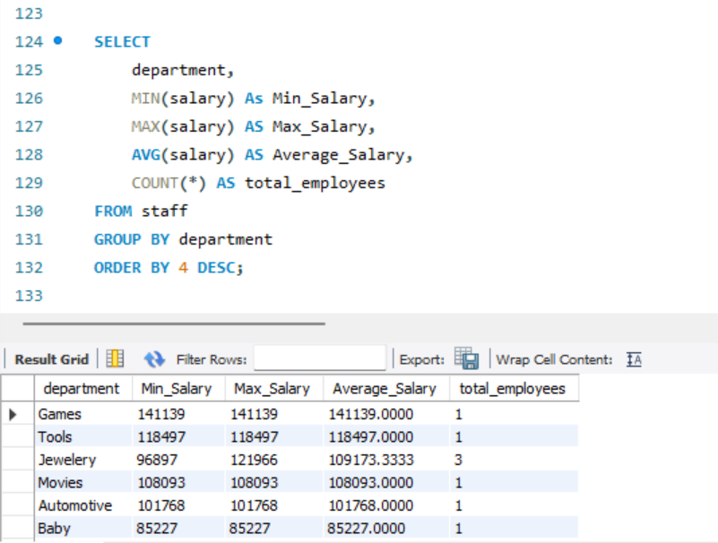
Q. Want to know distribution of min, max average salary by department.

Slide 8
Analyzing the Dataset
Patterns & Trends
Optimization Opportunities
Data-Driven Decision Making
Identify patterns and trends within the dataset to gain meaningful insights into the company's operations.
Discover potential areas for optimization and improvement based on results obtained from analyzing the dataset.
Explore how leveraging the dataset can empower data-driven decision-making within the company.

Slide 9

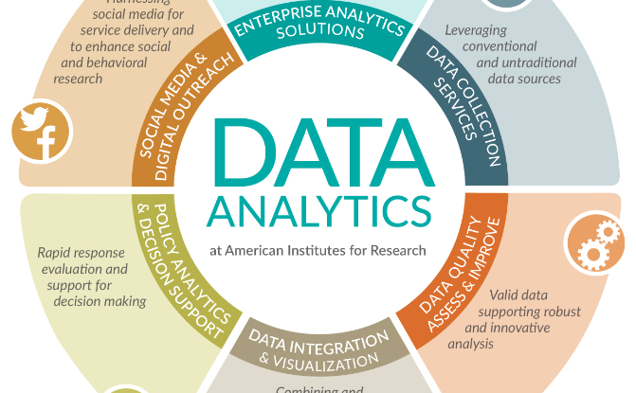
Conclusion
Global Impact
Unlocked Potential
Reflect on the significance of the company SQL dataset and the potential positive global impact it can have.
Embrace the power of data analytics and the endless possibilities it opens up for the company's future success.

Slide 10

Thank You!
Expressing gratitude for the audience's attention and the opportunity to share insights about the company SQL dataset.

