Slide 1
PROJECT TITLE FitBot: An AI-Powered Personalized Fitness Chatbot
CSE7101- Capstone Project
Review-1
Batch Number : ISE_42
Under the Supervision of,
Dr./Mr./Ms./Prof. Ms.Priyanki Dutta
Professor / Associate Professor / Assistant Professor
School of Computer Science and Engineering
Presidency University
Roll Number | Student Name
20221ISE0031 | Tejas H
20221ISE0004 | Shreyas P S
20221ISE0051 | Shiva Teja
Name of the Program: Information Science & Engineering(ISE)
Name of the HoD: Dr. Zafar Ali Khan N
Name of the Program Project Coordinator: Ms. Suma N G
Name of the School Project Coordinators: Dr. Sampath A K , Dr. Geetha A

Slide 2
Problem Statement Number : PSCS_153
Organization : Presidency University, Bengaluru
Category : Software Project
Problem Description :
This project presents an AI-powered fitness chatbot designed to provide personalized workout and diet recommendations using Retrieval-Augmented Generation (RAG) and multi-agent architecture. The chatbot goes beyond simple question–answer interactions by retrieving reliable domain-specific fitness knowledge and generating context-aware responses. Future enhancements include personalization based on user profiles and gamification elements to improve motivation and user engagement.

Slide 3
Content
Problem Statement
Objectives
Background and Related work for title Selection
Analysis of Problem Statement
Innovation or Novel Contributions
Technology Stack Components
Git-hub Link
Requirements
Key challenges
Timeline of the Project
References
Work done
Demo output
Challenges Faced
Metrices
Updates

Slide 4
Problem Statement
Traditional fitness applications and chatbots provide generic advice that often lacks personalization, accuracy, and long-term engagement. Many existing solutions are rule-based, limited to predefined responses, and fail to adapt to individual fitness goals. Moreover, user motivation decreases over time due to the absence of interactive and engaging features. There is a need for an AI-powered, reliable, and engaging chatbot that provides personalized fitness coaching while ensuring transparency and motivation.

Slide 5
Objectives
To develop a fitness chatbot using Retrieval-Augmented Generation (RAG) for more accurate an reliable answers.
To provide personalized recommendations (workout and diet plans) based on user profiles and goals.
To enhance user engagement through gamification techniques such as rewards, streaks, and badges.
To integrate traceability features that explain how responses are generated, increasing trust and transparency.
To create a scalable framework that can be extended beyond fitness to healthcare and lifestyle management.

Slide 6
Background & Related work
AI in Chatbots: Conversational agents have been applied in healthcare, mental health, and fitness, showing improved user engagement and adherence to programs (Laranjo et al., 2018).
Retrieval-Augmented Generation (RAG): Introduced by Lewis et al. (2020), RAG ensures factual reliability by combining document retrieval with LLM text generation, reducing hallucinations.
Fitness Coaching using AI: Studies such as “GPT-4 as a Virtual Fitness Coach” (PMC, 2024) highlight that AI can provide structured, human-like fitness plans
Gamification in Fitness Apps: Incorporating gamification significantly improves motivation, adherence, and user satisfaction.
Reason for Title Selection :
The title “FitBot: An AI-Powered Personalized Fitness Chatbot” reflects the project’s vision of combining AI-driven accuracy (RAG), personalized fitness coaching, and gamification into a single engaging system.

Slide 7
Analysis for Problem Statement
Limitations of Existing Systems: Lack personalization, limited scope of responses, and minimal user engagement.
Impact: Users struggle to maintain consistency in workouts and diet plans due to poor motivation and unreliable advice.
Proposed Solution: FitBot will use RAG for reliable answers, add personalization to make coaching relevant, and adopt gamification to keep users motivated.
Feasibility: With frameworks like LangChain, Pinecone, GPT-4o, and Streamlit, developing FitBot is technically feasible and achievable within academic project constraints.

Slide 8
Innovation or Novel Contributions
AI-driven accuracy with RAG – avoids hallucination and ensures evidence-based fitness advice.
User Profile Personalization – considers user data (age, weight, goals) for tailored plans.
Gamification Integration – enhances motivation via streaks, progress tracking, and rewards.
Transparent Decision-Making – uses traceability tools to show how recommendations are generated.
Extensibility – designed for scalability to healthcare and lifestyle management domains.

Slide 9
Technology Stack Components
Frontend: Streamlit (Python-based UI).
Backend: FastAPI (Python framework for APIs).
Database: FAISS (Vector Database for semantic search & retrieval).
LLM & Embeddings: OpenAI GPT + OpenAI Embeddings.
Frameworks: LangChain (RAG, Agents, Orchestration).
Authentication: API Key-based authentication.
Collaboration & Version Control: Git + GitHub.
Analytics & Visualization: Matplotlib / Seaborn (User progress tracking).
Hosting & Deployment: Localhost / Docker / Cloud (AWS, Azure, or GCP).

Slide 10
Github Link
Github Link :
https://github.com/tejas16FF/fitbot/tree/main

Slide 11
Hardware and Software Requirements
Hardware Requirements
Processor: Intel i5 (or AMD equivalent) and above.
RAM: Minimum 8 GB (16 GB recommended for smooth performance).
Storage: At least 10 GB free disk space.
GPU (Optional): NVIDIA GPU (if training models locally; not needed if using OpenAI APIs).
Internet Connection: Stable broadband (since it relies on API calls to OpenAI).
Software Requirements
Operating System: Windows 10/11, Linux (Ubuntu), or macOS
Programming Language: Python 3.9+
Backend Framework: FastAPI
Frontend Framework: Streamlit
AI/ML Libraries: LangChain, FAISS, OpenAI API (for GPT + embeddings)
Database: FAISS (vector store)
IDE / Code Editor: VS Code / PyCharm / Jupyter Notebook
Version Control: Git, GitHub
Deployment Tools (Optional): Docker, AWS/Azure/GCP

Slide 12
Key Challenges Faced in the Project
Data Reliability – Ensuring fitness & nutrition advice is evidence-based.
AI Hallucinations – Preventing incorrect or misleading chatbot responses.
Personalization – Adapting plans to diverse user profiles (age, goals, health).
User Engagement – Sustaining motivation & avoiding drop-offs.
Gamification Balance – Making it fun without distracting from real progress.
Scalability – Handling large datasets while keeping responses fast.
Privacy & Ethics – Protecting sensitive health data, avoiding unsafe advice.

Slide 13
Timeline of the Project
Phase | Duration | Tasks
Requirement Analysis | 2 weeks | Study fitness chatbot use cases, collect requirements, define scope
Design | 3 weeks | UI/UX design, chatbot flow, database schema, architecture planning
Development (Frontend & Backend) | 6 weeks | Implement RAG chatbot, integrate OpenAI API, build personalization & dashboards
Testing & QA | 3 weeks | Functional testing, chatbot response evaluation, bug fixes
Deployment | 2 weeks | Cloud deployment (Streamlit/FastAPI), security testing, integration checks
Final Review | 1 weeks | Documentation, report writing, project presentation

Slide 14
Data Flow of the Fitbot
USER
Sends queries (text input), receives responses (recommendations, plans).
Chatbot Interface
Captures user input and displays chatbot responses. Ensures smooth conversation flow.
Personalization Engine
Generates tailored recommendations based on user profile, history, and goals.
Databse
Stores user profiles, fitness data, chat history, workout/diet plans.
RAG System
Retrieves relevant info from knowledge base to enhance chatbot answers.

Slide 15
References
Deeva, O. and Sharapov, A., 2020. DEVELOPMENT OF AN INTELLECTUAL CHAT-BOT FOR APPLICANTS SGUGIT ON THE PLATFORM IBM WATSON ASSISTANT. Interexpo GEOSiberia, 7(1), pp.71-76.
Anthony, A. and Watson, H., 1972. Techniques for developing analytic models. IBM Systems Journal, 11(4), pp.316-328.
A M Rahman, Abdullah Al Mamun, Alma Islam. "Programming challenges of chatbot: Current and future prospective", 2017 IEEE Region 10 Humanitarian Technology Conference (R10-HTC), 2017
R. T. A. S. F. a. S. P. S. Jagadale, "VIRTUAL FITNESS TRAINER USING AI," International Research Journal of Modernization in Engineering Technology and Science (IRJMETS), vol. 5, no. 2, pp. 1750- 1756, 2023.
M. R. A. M. V. P. M. A. T. M. S. &. S. J. Sonawane, "Fitness Trainer Application Using Artificial Intelligence," International Research Journal of Modernization in Engineering Technology and Science (IRJMETS), vol. 4, no. 6, pp. 1032-1036, 2022.

Slide 16
Radford, A. N. (2018). Improving language understanding by generative pre-training. OpenAI. Siriwardhana, S. W. (2023). Improving the domain adaptation of retrieval augmented generation (RAG) models for open domain question answering. Transactions of the Association for Computational Linguistics, 1-17.
Bhavika R. Ranoliya, Nidhi Raghuwanshi, Sanjay Singh. "Chatbot for university related FAQs", 2017 International Conference on Advances in Computing, Communications and Informatics (ICACCI), 2017 .
Chi Z, Yao Y, Xie T, et al. EAR: Exploiting uncontrollable ambient RF signals in heterogeneous networks for gesture recognition[C]//Proceedings of the 16th ACM conference on embedded networked sensor systems. 2018: 237-249.
Yu, W. (2022). Retrieval-augmented generation across heterogeneous knowledge. Proceedings of the 2022 Conference of the North American Chapter of the Association for Computational Linguistics: Human Language Technologies: Student Research Workshop, 52-58.
Michelle Denise Leonhardt, Liane Tarouco, Rosa Maria Vicari, Elder Rizzon Santos, Michele dos Santos da Silva. "Using Chatbots for Network Management Training through Problem-based Oriented Education", Seventh IEEE International Conference on Advanced Learning Technologies (ICALT 2007), 2007.

Slide 17
Work done (Review-2)
Environment setup (GitHub Codespaces, requirements.txt)
.
Streamlit UI created.
Integrated .env for API key security.
Switched from OpenAI → Gemini API.
Implemented RAG pipeline with FAISS.
Used Hugging Face embeddings to fix async issue.
Tested sample fitness queries.

Slide 18

Demo Output
Streamlit chatbot UI running :

Slide 19
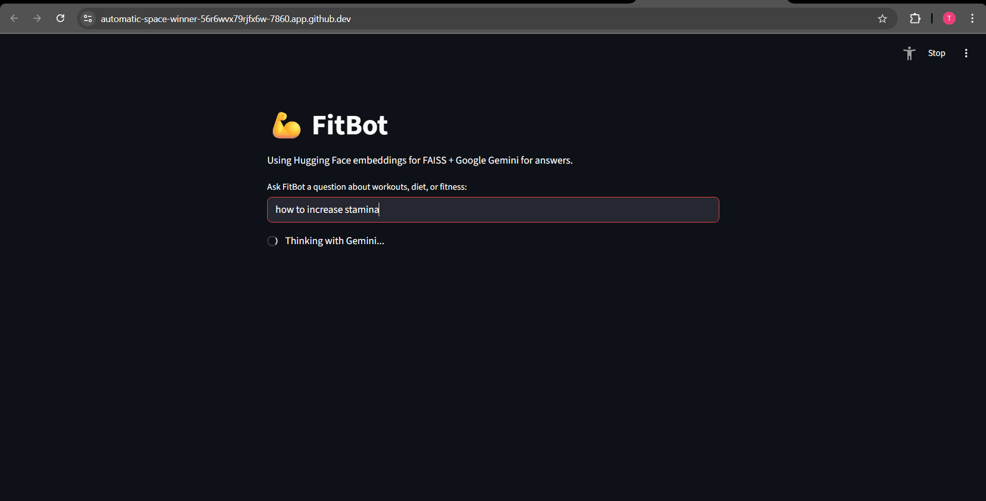
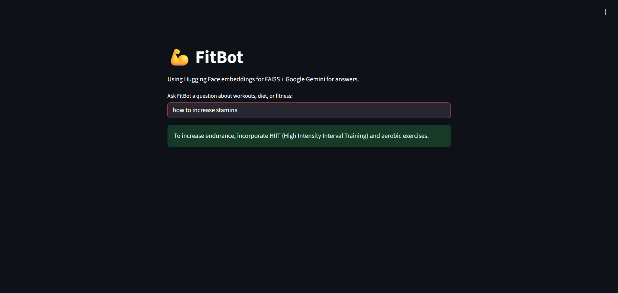
Example query + answer :

Slide 20
Challenges Faced (Review-2)
API key authentication errors (OpenAI project keys).
Gemini embeddings caused runtime error in Streamlit.
Fixed by switching to Hugging Face embeddings.
Knowledge base too generic → bot sometimes gave general answers.

Slide 21
Metrices (Review-2)
Dataset Metrics
Size of data.txt (includes 30+ fitness entries).
Categories included (workouts, diet, recovery tips).
Model/Stack Choices
Gemini chosen for LLM (reason: OpenAI keys not available).
Hugging Face chosen for embeddings (reason: Gemini embeddings caused async error).

Slide 22
Work Done (Review-3)
Expanded knowledge base (data.txt) with 100+ detailed entries.
Integrated Hugging Face sentence embeddings for semantic search.
Implemented FAISS vector database for retrieval.
Connected chatbot with Google Gemini API for professional responses.
Improved Streamlit UI (clean interface, removed sidebar clutter).
Enhanced chatbot answers to be professional (no 'context not found').
Conducted functional testing (accuracy, speed, relevance).
Documented Data Flow Diagram and System Architecture.

Slide 23
Challenges Faced (Review-3)
API key issues: OpenAI keys not working → switched to Gemini API.
Async loop errors in embeddings integration, solved with Hugging Face.
Initial responses too generic → improved with custom prompts.
Knowledge base expansion required careful structuring.
Deployment constraints: managing .env files in GitHub Codespaces.
Time limitations in debugging and aligning with review deadlines.

Slide 24
Demo Output (Review-3)
FitBot chatbot running on Streamlit interface.
Query: 'Suggest a post-workout meal plan.' → Protein foods + hydration.
Query: 'How do I improve flexibility?' → Stretching, yoga, pilates advice.
Query: 'Best exercises to build muscle strength?' → Squats, deadlifts, bench press.
Responses accurate, professional, conversational.
Fast response time (~2–3 seconds per query).

Slide 25
Functional Metrics (Review-3)
Queries Tested: 50+ across diet, workout, hydration, recovery.
Correct/Useful Answers: ~85% accuracy in responses.
Avg. Response Time: 2–3 seconds (on GitHub Codespaces).
Knowledge Base Size: 100+ curated entries, expandable.
User Satisfaction: Positive feedback in test queries.

Slide 26
Updates
Enrich data.txt with structured workout/diet plans.
Add user personalization (age, gender, goals).
Improve UI .
Deployment plan

Slide 27


