Slide 1
CSE7000 - INTERNSHIP A Presentation on AI RESUME ANALYZER
Student Details
Name | Tejas T O
Roll No | 20241CSI0008
Section | 5CSI01
Under the Supervision of,
Mr.Jinesh V N
Presidency School of Computer Science and Engineering
Presidency University
Name of the Program: Computer Science and Information Technology
Name of the HoD: Dr. Pallavi R
Name of the Program Internship Coordinator: Mr.Muthugurunathan G
Name of the School Internship Coordinators: Dr. Bhuvaneshwari Patil

Slide 2
Content
About Company or Organization
Working domain or the Technology
Objectives of the work
Methodology Used / Course Description
Results (Optional)
Conclusion

Slide 3
About Company or Organization
NVIDIA Corporation
Founded in 1993 and headquartered in Santa Clara, California, USA.
A global leader in Artificial Intelligence (AI) and Accelerated Computing.
Specializes in GPU Computing, Generative AI, Deep Learning, and High-Performance Computing.
Delivers innovative AI solutions for industries worldwide.

Slide 4
Key Products
GeForce RTX GPUs
CUDA Platform
NVIDIA AI Enterprise
Clients
Microsoft
Google
Amazon Web Services (AWS)
Meta

Slide 5
Working domain or the technology
Assigned Domain
Artificial Intelligence & Machine Learning
Natural Language Processing (NLP)
Recruitment & Human Resources
Career & Job Matching

Slide 6
Features
Resume text extraction
Skill identification
Job description matching
Resume scoring
Candidate recommendations

Slide 7
Importance
Saves recruitment time
Improves candidate screening
Provides accurate job matching
Reduces manual evaluation effort

Slide 8
Objectives of the work
Purpose
Automate resume analysis
Identify relevant candidate skills
Match resumes with job descriptions
Generate candidate suitability scores
Support faster hiring decisions

Slide 9
Usage
Resume Screening – Quickly analyzes resumes.
Skill Identification – Extracts relevant skills.
Job Matching – Compares resumes with job requirements.
Candidate Ranking – Ranks candidates based on suitability.
Resume Evaluation – Provides an overall matching score.
Recruitment Support – Helps make faster hiring decisions.

Slide 10
Methodology Used / Course Description
Methodology Used
The resume is uploaded and its text is extracted for analysis.
NLP techniques are used to identify important keywords and skills.
The extracted resume information is compared with the job description.
TF-IDF and cosine similarity are used to calculate the matching score.
The system generates the final score and relevant candidate insights.

Slide 11
Technologies and Concepts
Python – Core programming language.
Streamlit – Used to build the application interface.
NLP – Used for text and skill extraction.
Scikit-learn – Used for TF-IDF and similarity analysis.
PyPDF2 – Used to extract text from PDF resumes.

Slide 12
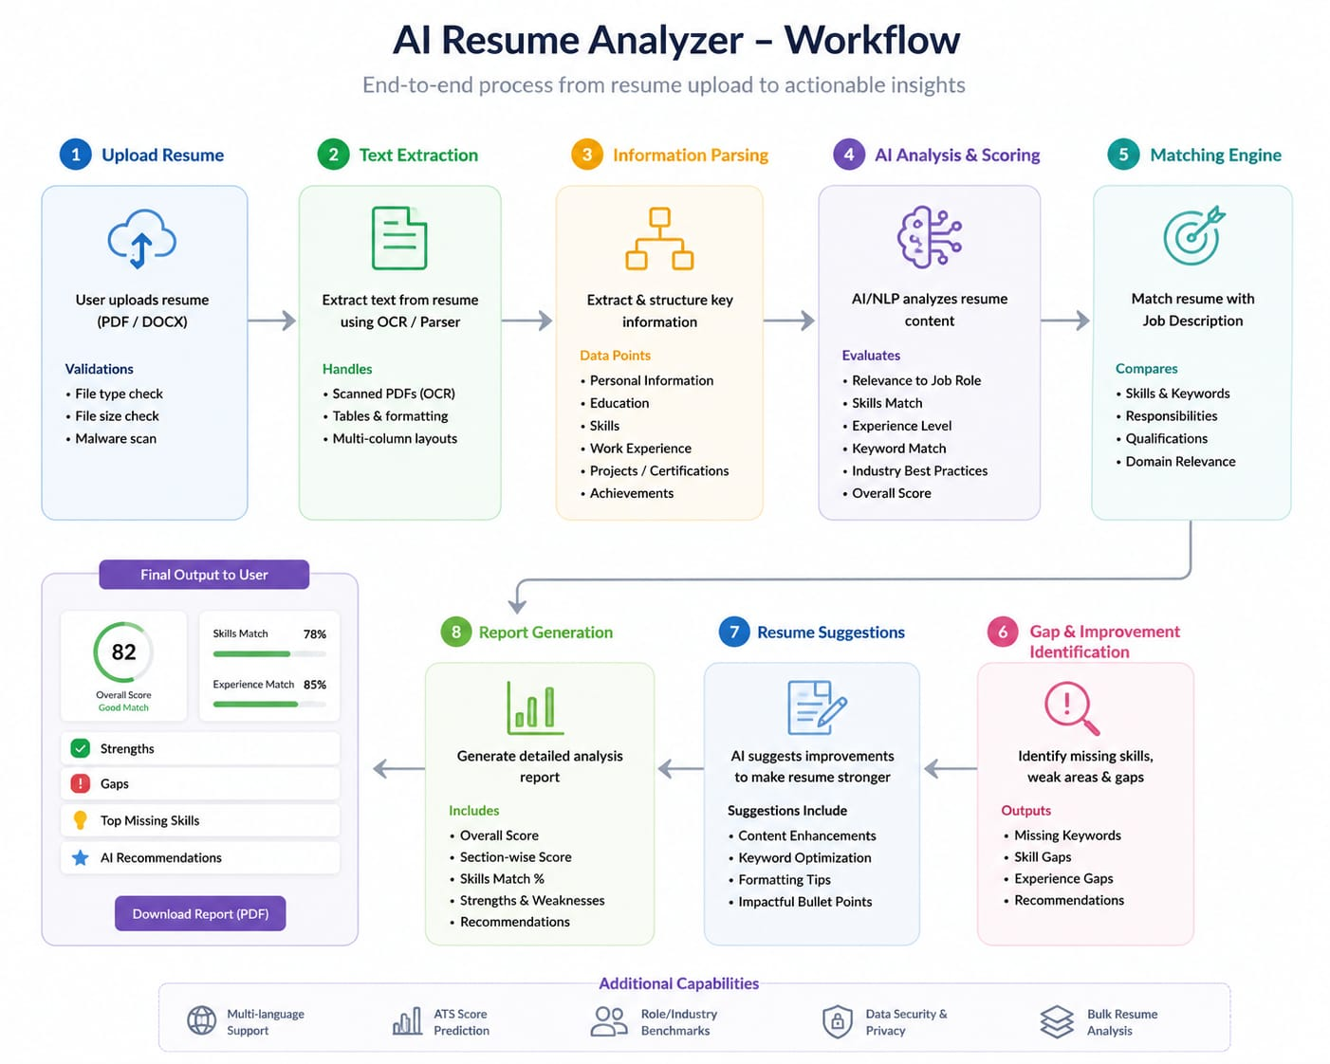

Slide 13
Results
The system successfully extracts text from uploaded resumes.
Relevant skills and keywords are identified automatically.
Resumes are compared with the given job description.
A matching score is generated for each resume.
Candidates are evaluated based on their job suitability.
The system provides faster and more efficient resume screening.

Slide 14
Conclusion
The AI Resume Analyzer automates the resume screening process.
It efficiently extracts skills and important resume information.
It compares candidate profiles with job requirements.
The system generates a useful resume matching score.
It reduces manual effort and saves recruitment time.
Overall, it supports faster and smarter hiring decisions.

Slide 15
Q&A

Slide 16
Thank you !!

