Slide 1

Photography Portfolio Website
CSI1007 – Software Engineering Principles Laboratory
Reg. no:22MIC0160
Name:S.Ravishankar

Slide 2
Photography Portfolio Website
Description of the Project:
Photography Portfolio discover a collection of captivating images that tell stories through my lens.
From landscapes to portraits, my work reflects creativity and passion for detail. Explore my gallery,
learn about my journey, and connect for collaborations or services.Let’s capture the beauty of life together!
Scope of the Project:
Aim:
To create a professional and visually appealing photography portfolio website that showcases our skills, attracts potential clients, and establishes a strong online presence.
Objectives :
1. Showcase Creativity: Present a curated gallery of high-quality photographs that highlight diverse styles and themes.
2. Attract Clients and Opportunities: Provide clear information about photography services, packages, and contact details for bookings and collaborations.
3. Build Personal Branding: Establish our skill and passionate photographer through an engaging "About Me" section and a professional design.
4. Enhance User Experience: Design a user-friendly interface with intuitive navigation for easy exploration of the portfolio.
.

Slide 3
Photography Portfolio Website
5. Engage the Audience: Include features like a blog or insights section to connect with visitors and share the stories behind the work.
6. Expand Reach: Integrate social media links and optimize the website for search engines to attract a global audience.
7. Support Professional Growth: Use the portfolio as a tool for securing job opportunities, partnerships, or participation in exhibitions. These aims and objectives align with creating a platform that reflects your artistry while driving growth and engagement
Impact of the developing Project:
Economic Impact: Generates income through paid photography services and print sales. Expands market reach to global clients.
Social Impact: Builds community engagement and fosters cultural appreciation. Inspires others to explore photography and creativity.
Technological Impact: Enhances digital presence with advanced tools and techniques. Increases accessibility across devices and platforms.
Environmental Impact: Promotes environmental awareness through photography. Reduces resource use by replacing physical portfolios with digital ones.

Slide 4
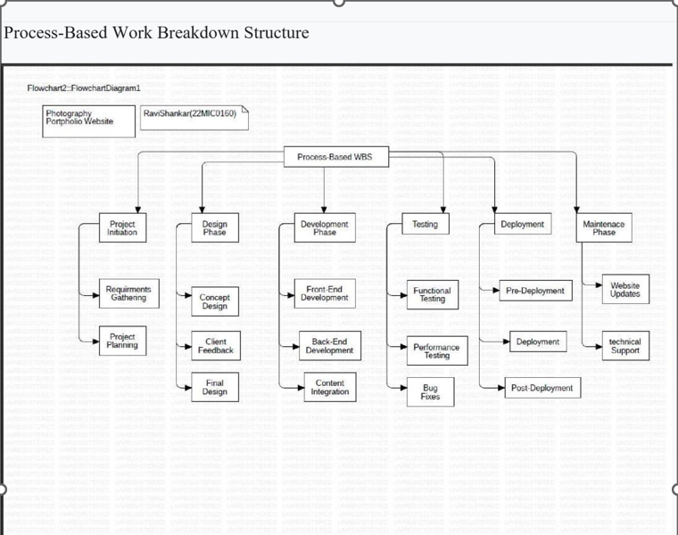
Work Breakdown Structure
Process-Based Work Breakdown Structure:

Slide 5
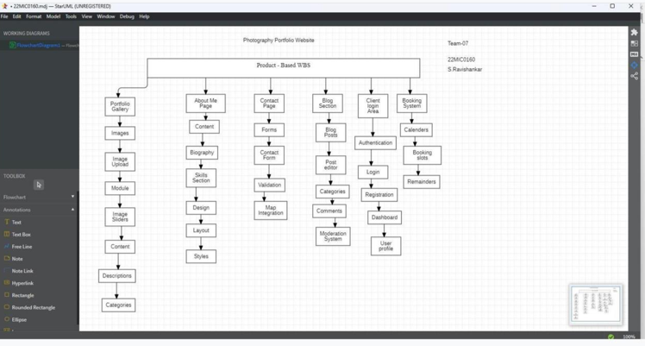
Work Breakdown Structure
Product-Based Work Breakdown Structure:

Slide 6
SRS Document
Functional Requirements:
Index Page:
Display a visually appealing hero section with a featured photo or slideshow.
Showcase key sections: Portfolio, Blog, About Me, and Contact.Include navigation links to all major pages.
Blog Page:
Display a list of blog posts with titles, thumbnails, and short excerpts.
Ability to click and view the full blog post.
About Me Page:
Provide a personal introduction with a bio, photo, and background information.
Highlight the photographer's experience, expertise, and achievements.
Include a call to action for booking or contacting.
Contact Page
A contact form with fields: Name, Email, Subject, Message.
Integration with email notifications for incoming messages.
Display of contact details: email, phone number, and location.
Links to social media profiles.

Slide 7
SRS Document
Functional Requirements:
Portfolio Page
Categorized galleries (e.g., Portrait, Landscape, Events).
Ability to view images in full screen with a preview feature.
Photographer Login Page
Secure authentication with username/email and password.
Access restriction to authorized photographers only.
Photographer Dashboard
Photo Management : Upload photos.
Categorize photos for portfolio organization.
Create blog posts.
Add tags, categories to blog posts

Slide 8
SRS Document
Non-Functional Requirements:
Performance Requirements :
Page load time shall be under 3 seconds.
System shall handle up to 500 concurrent users without degradation.
Safety Requirements :
Regular database backups shall be scheduled.
Error handling mechanisms shall prevent crashes
Security Requirements
Data transmission shall be encrypted using SSL/TLS.
User accounts shall have 2FA (Two-Factor Authentication) support.
IP-based access control shall be implemented for the admin panel.
Software Quality Attributes
Usability: Clean UI, accessible design.
Scalability: Supports future growth in traffic and storage.
Maintainability: Modular architecture for easy updates.

Slide 9
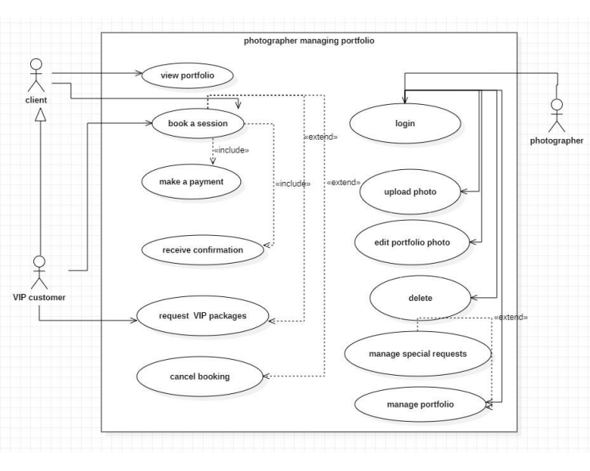
UML - Diagrams
Use-case diagram:

Slide 10
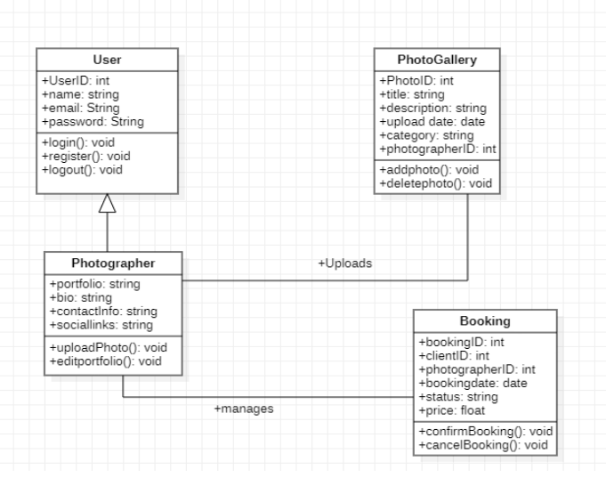
UML - Diagrams
Class diagram:

Slide 11
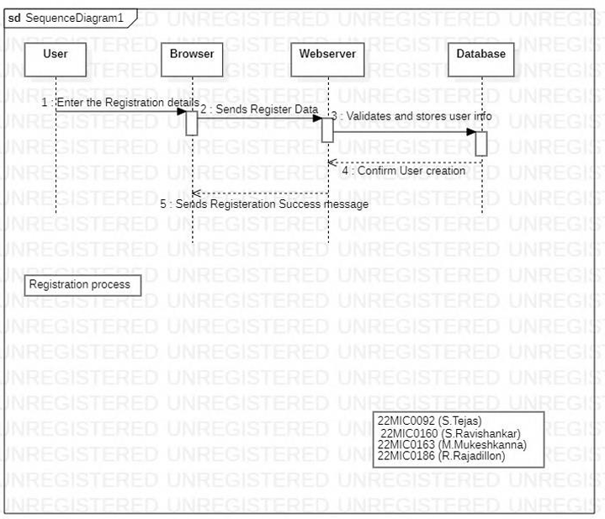
UML - Diagrams
Sequence diagram:

Slide 12
Testing
Comprehensive testing for any two scenarios in your project:
Test Case 1: Verify Client Login Functionality
Test Case ID: TC001
Test Scenario: Verify login functionality with valid and invalid credentials.
Test Case Description: Ensure the login system accepts correct credentials and rejects incorrect inputs.
Test Steps:
1. Open the photography website login page.
2. Enter a username.
3. Enter a password.
4. Click the "Login" button.
Test Data:
• Valid Case: Username: client user, Password: Client@123
• Invalid Case: Username: wrong user, Password: wrong pass Test
Expected Result:
• If valid credentials are entered, the user should be redirected to the Client Dashboard.
• If invalid credentials are entered, an error message "Invalid Username or Password" should appear.
Actual Result:
• Valid credentials: Redirected to the Client Dashboard.
• Invalid credentials: Received error message "Invalid Username or Password". Pass/Fail: Pass

Slide 13
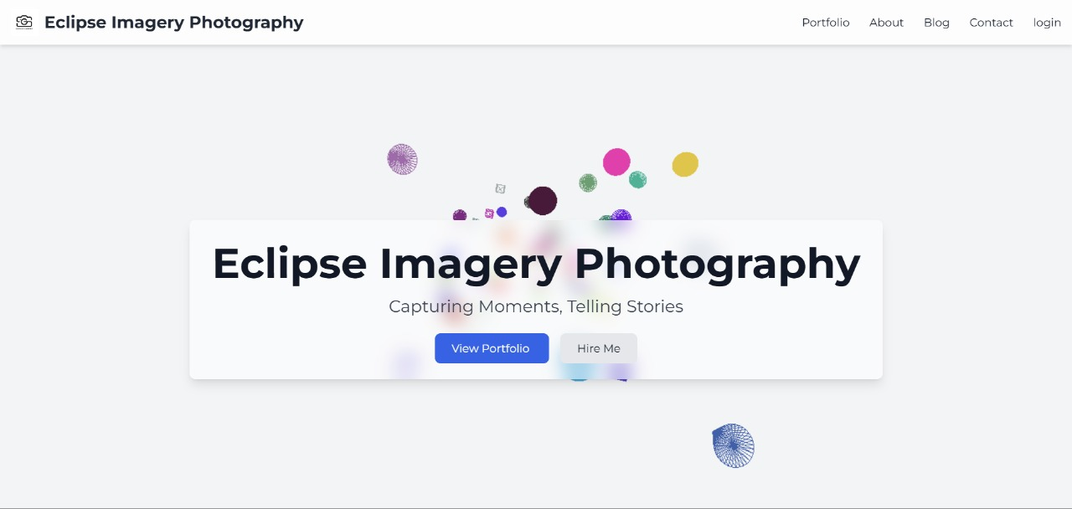
Project – UI Screenshots

Slide 14
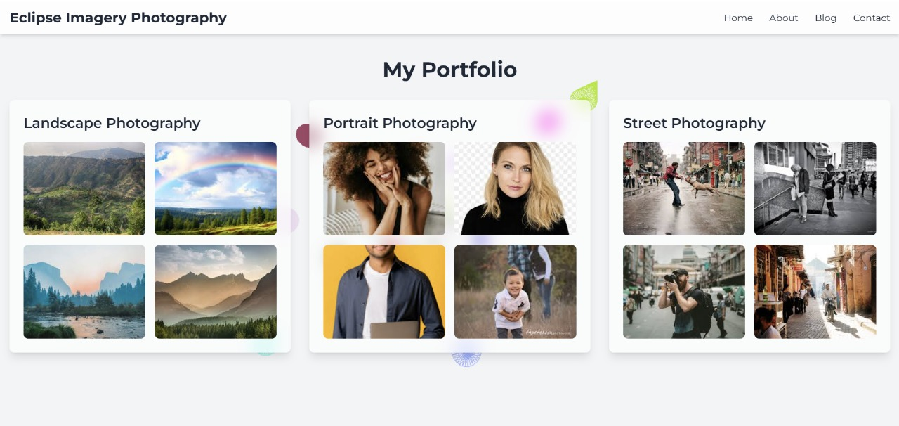
Project – UI Screenshots

Slide 15
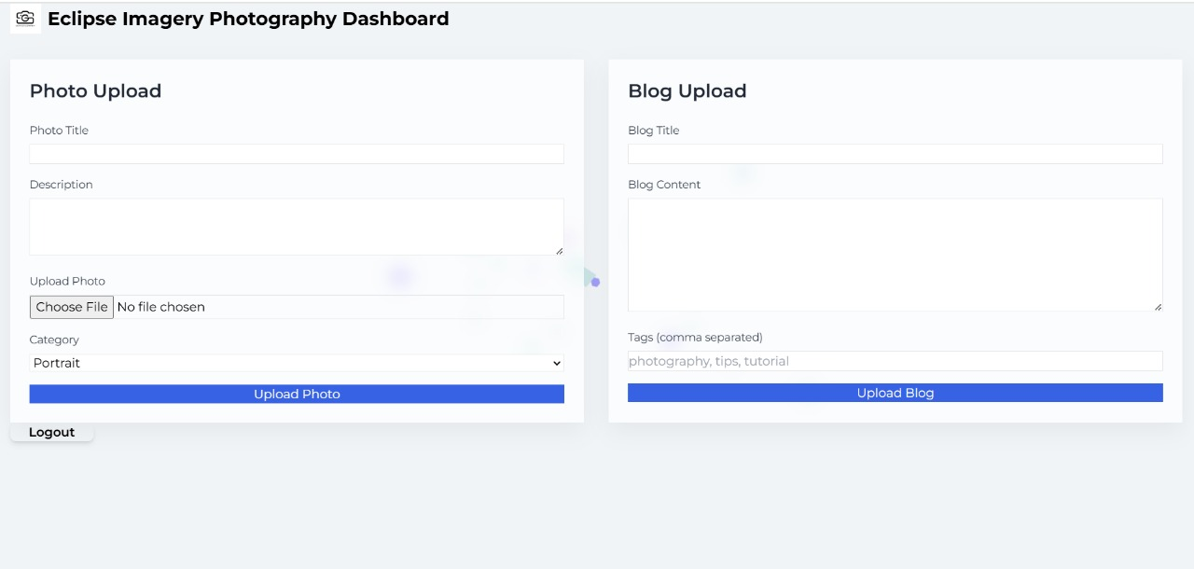
Project – UI Screenshots

Slide 16
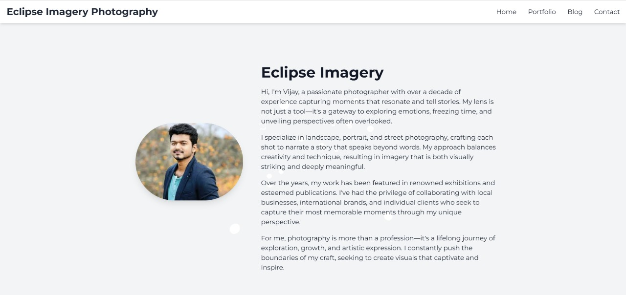
Project – UI Screenshots

Slide 17
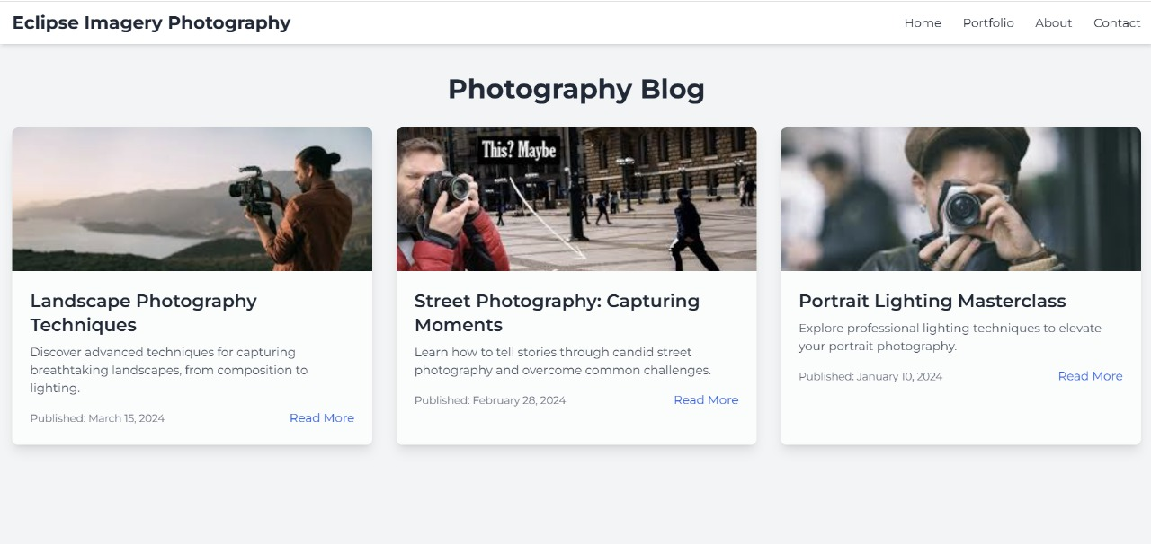
Project – UI Screenshots

Slide 18
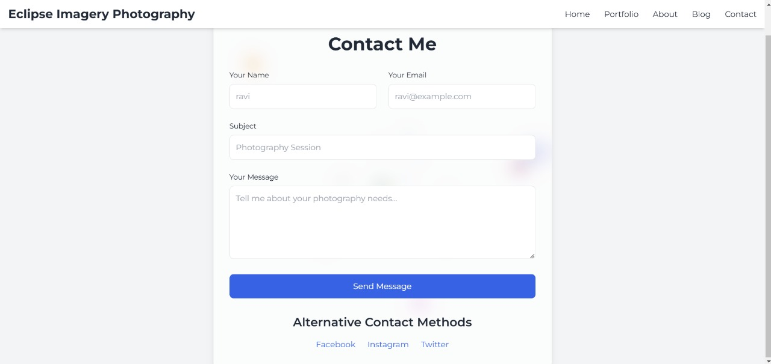
Project – UI Screenshots

Slide 19
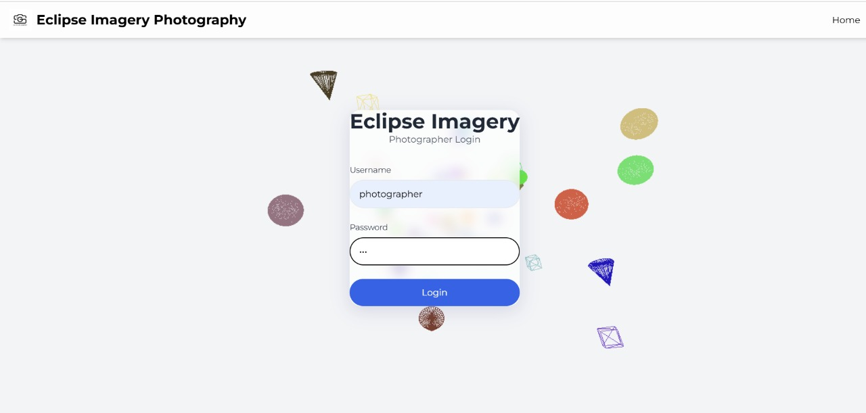
Project – UI Screenshots

