Slide 1
IMPLEMENTATION OF ARP
~ Tejaskumar Thulasidas

Slide 2
What is ARP?
ARP stands for Address Resolution Protocol. It’s primary goal is to find the MAC address of a device from the IP address of that device.
ARP is used when the host does not have MAC address for the device it’s trying to communicate in the ARP cache table.
The host device sends out an ARP request containing the IP address of the destination device.

Slide 3
What is ARP?
All the device on the LAN will receive this message but only the device that has the IP will respond back with its MAC address.
After that, the host will store the MAC in a table called “ARP cache” table. So that the next time it doesn't have to go through all this tedious process.
ARP request are sent using broadcast address (FF:FF:FF:FF:FF:FF) for ethernet broadcast and (255.255.255.255.255) using IP broadcast.

Slide 4
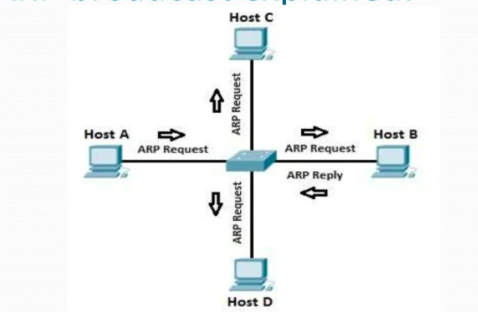
ARP EXPLAINED!

Slide 5
Let us consider the above figure. We can see that host A sends out an ARP request to all the system present in its local area.
Host A doesn’t know the MAC of host B. So it sends out the IP of host B asking every hosts on its LAN whether that system is host B.
All the other hosts reject the request other than the host B. Once the host identifies its IP, it will immediately do an ARP reply to host A, giving its own MAC address.

Slide 6
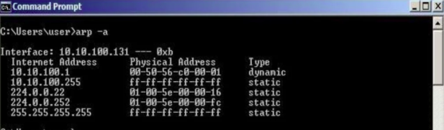
Once the Host finds the MAC address it will then store it on a table called “ARP cache” so that it does not have to go through all the work to find the MAC address rather it will just look up on its ARP cache table.
To see the ARP entry on windows just type “arp -a”

Slide 7
ARP spoofing
As innocent as this operation looks, you might wonder how possibly could this be used against for malicious purposes.
One of the most common cyber attacks known as Man-In-The-Middle or MITM can be used in for this operation and it is known as ARP spoofing.
ARP spoofing is when the malicious user poisons the ARP cache table of his target host in such a way that whenever a request is made, the requests gets redirected to the malicious user and then the malicious actor gets to decide what to do with the request, essentially being the middleman, hence the name Man-In-The-Middle.

Slide 8
ARP spoofing
In order to carry out a successful ARP spoofing attack the malicious actor must know his victims IP address and the IP he/she will try to communicate (eg: router)
The malicious user will then replace the router’s MAC address with the MAC address of attacker’s machine corresponding to router’s IP.
Because of this, whenever a request is made, it first goes to the attacker machine and then the attacker gets to decide what to do with the request.

Slide 9
Mitigations
Static ARP Tables
Encryption
Network Isolation
Switch Security

Slide 10
THANK YOU!

