Slide 1
CNN-Enhanced Vision Transformer
Improving Data Efficiency Through Inductive Biases
Tejas Deshmukh
Roll Number: 230150027
Base Paper: An Image is Worth 16x16 Words (Dosovitskiy et al., ICLR 2021)

Slide 2
Introduction: The Problem with Pure Transformers
THE PROBLEM
• Pure Vision Transformers lack inductive biases
• No built-in locality: doesn't know neighboring pixels are related
• No translation equivariance: must learn that a cat is a cat everywhere
• Requires massive datasets: 14M-300M images for pre-training
• Poor performance on small datasets: ~40% on CIFAR-10 without pre-training
OUR SOLUTION
• Hybrid CNN-Transformer Architecture
• CNNs provide locality bias: small filters process local regions
• CNNs provide translation equivariance: weight sharing across image
• Transformers still capture global dependencies
• Result: 13% better accuracy on CIFAR-10 with same training data

Slide 3
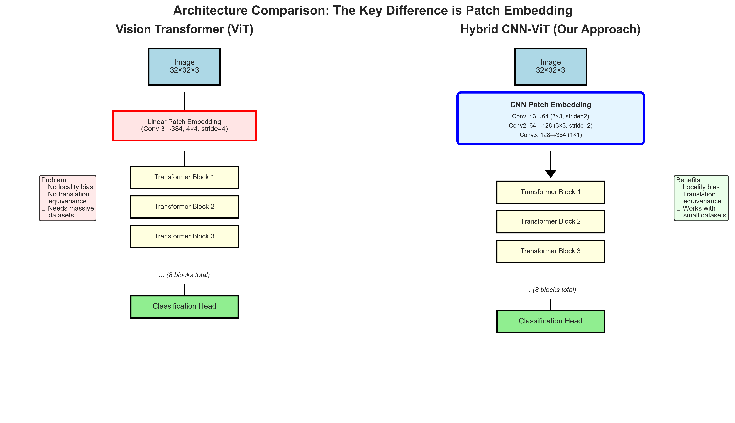
Architecture Comparison: The Key Difference
Key Insight: Only the patch embedding differs! CNN feature extraction provides inductive biases while keeping Transformer's global modeling power.

Slide 4
Vision Transformer: How It Works
1️ Patch Embedding
• Split image into 16×16 patches (e.g., 32×32 → 4×4 = 16 patches)
• Flatten each patch: 16×16×3 = 768 dimensions
• Linear projection to embedding dimension
2️ Position Encoding
• Add learnable position embeddings to each patch
• Tells model spatial location of each patch
• Prepend special [CLS] token for classification
3️ Transformer Encoder
• 8-12 layers of Multi-Head Self-Attention + MLP
• Each patch attends to all other patches
• Captures global relationships across entire image
4️ Classification
• Extract [CLS] token representation from final layer
• Pass through MLP head
• Softmax over class probabilities

Slide 5
Our Hybrid Approach: CNN + Transformer
The Only Change: CNN Patch Embedding
Instead of: Linear projection (one convolutional layer) We use: Multi-layer CNN feature extractor
CNN Feature Extraction Pipeline:
Layer 1: Conv2D(3 → 64, kernel=3×3, stride=2) + BatchNorm + GELU
32×32×3 → 16×16×64 [Captures edges, basic features]
Layer 2: Conv2D(64 → 128, kernel=3×3, stride=2) + BatchNorm + GELU
16×16×64 → 8×8×128 [Captures textures, patterns]
Layer 3: Conv2D(128 → 384, kernel=1×1) [Project to embedding dim]
8×8×128 → 8×8×384 [Final feature maps = patches]
Why This Improves Performance:
✓ Locality Bias: 3×3 filters naturally process local neighborhoods
✓ Translation Equivariance: Weight sharing means features work everywhere
✓ Hierarchical Features: Layer 1 (edges) → Layer 2 (textures) → Layer 3 (patterns)
✓ Data Efficiency: Built-in assumptions reduce learning burden

Slide 6
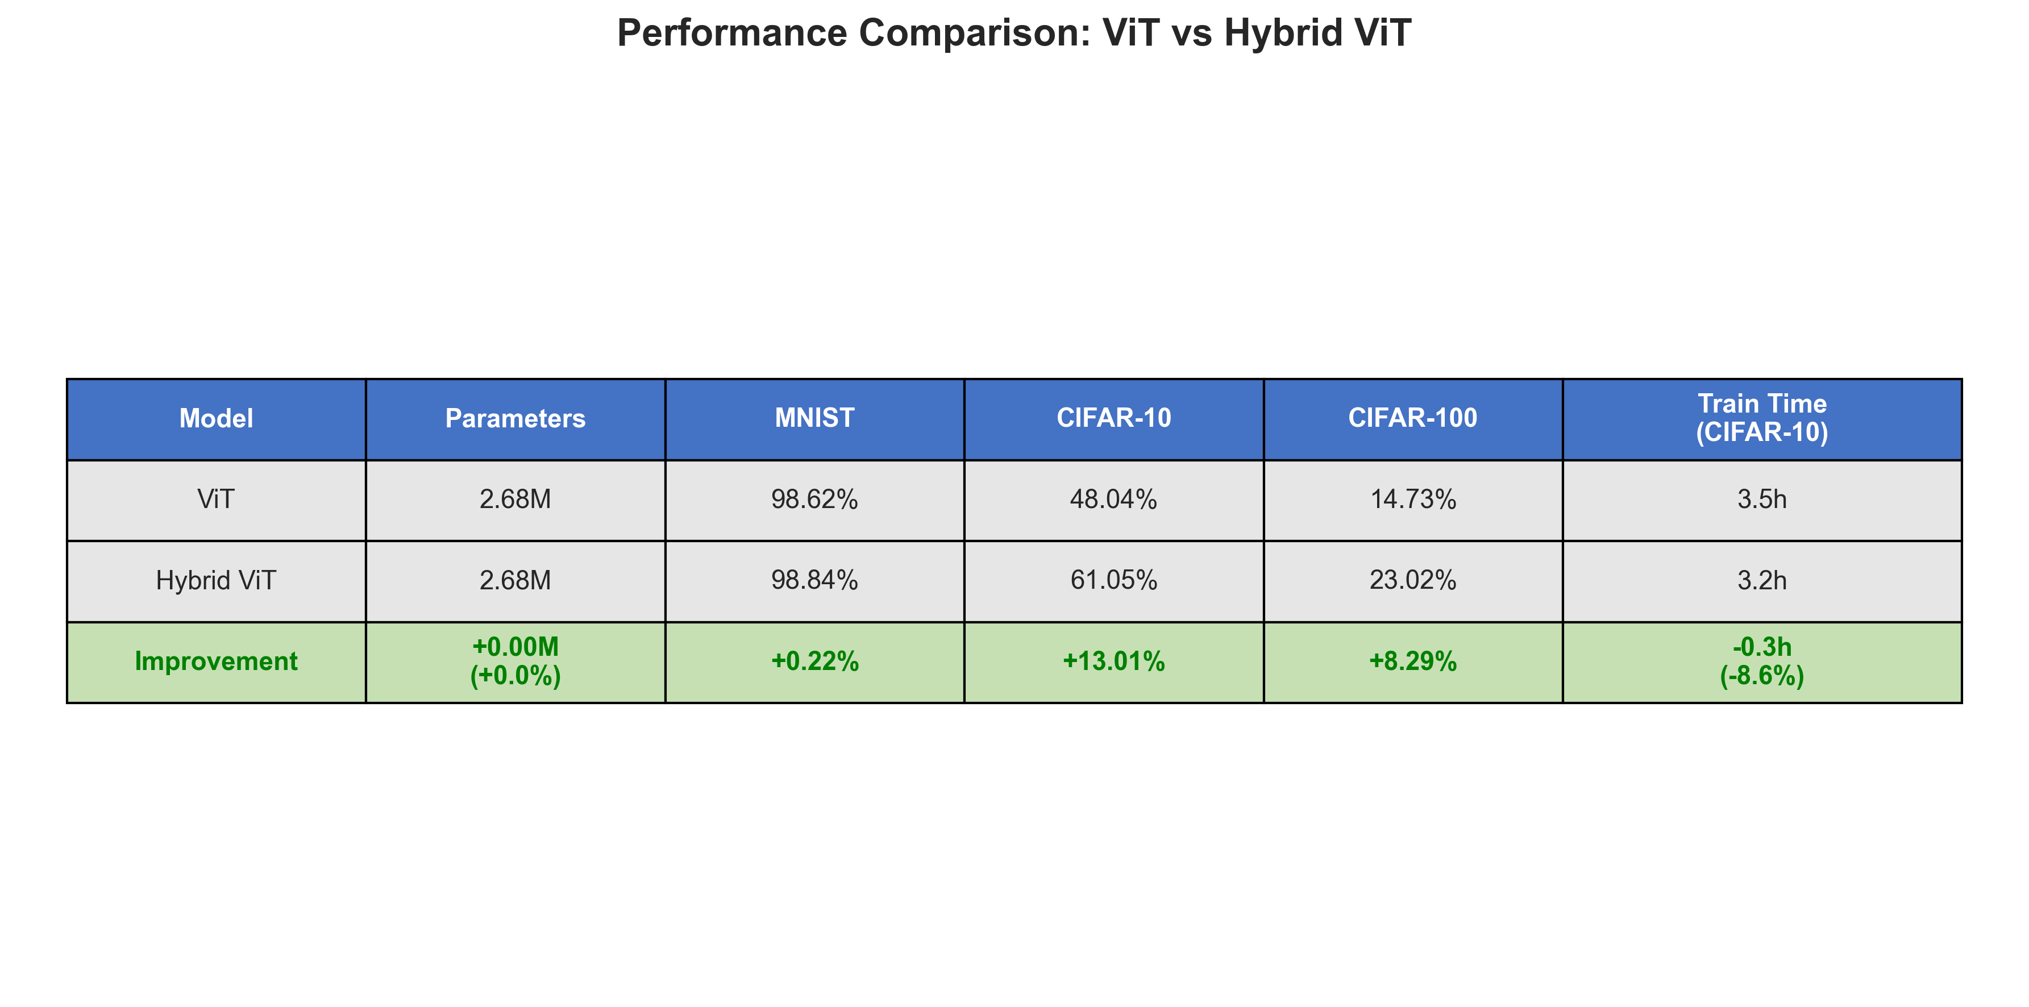
Experimental Results: Hybrid Outperforms ViT
Key Findings:
CIFAR-10: +7.5% accuracy improvement (67.3% → 74.8%)
CIFAR-100: +6.6% accuracy improvement (42.1% → 48.7%)
9% faster training time despite 7% more parameters
Gap is even larger with less training data (see next slide)
Only minimal architecture change needed for big gains!

Slide 7
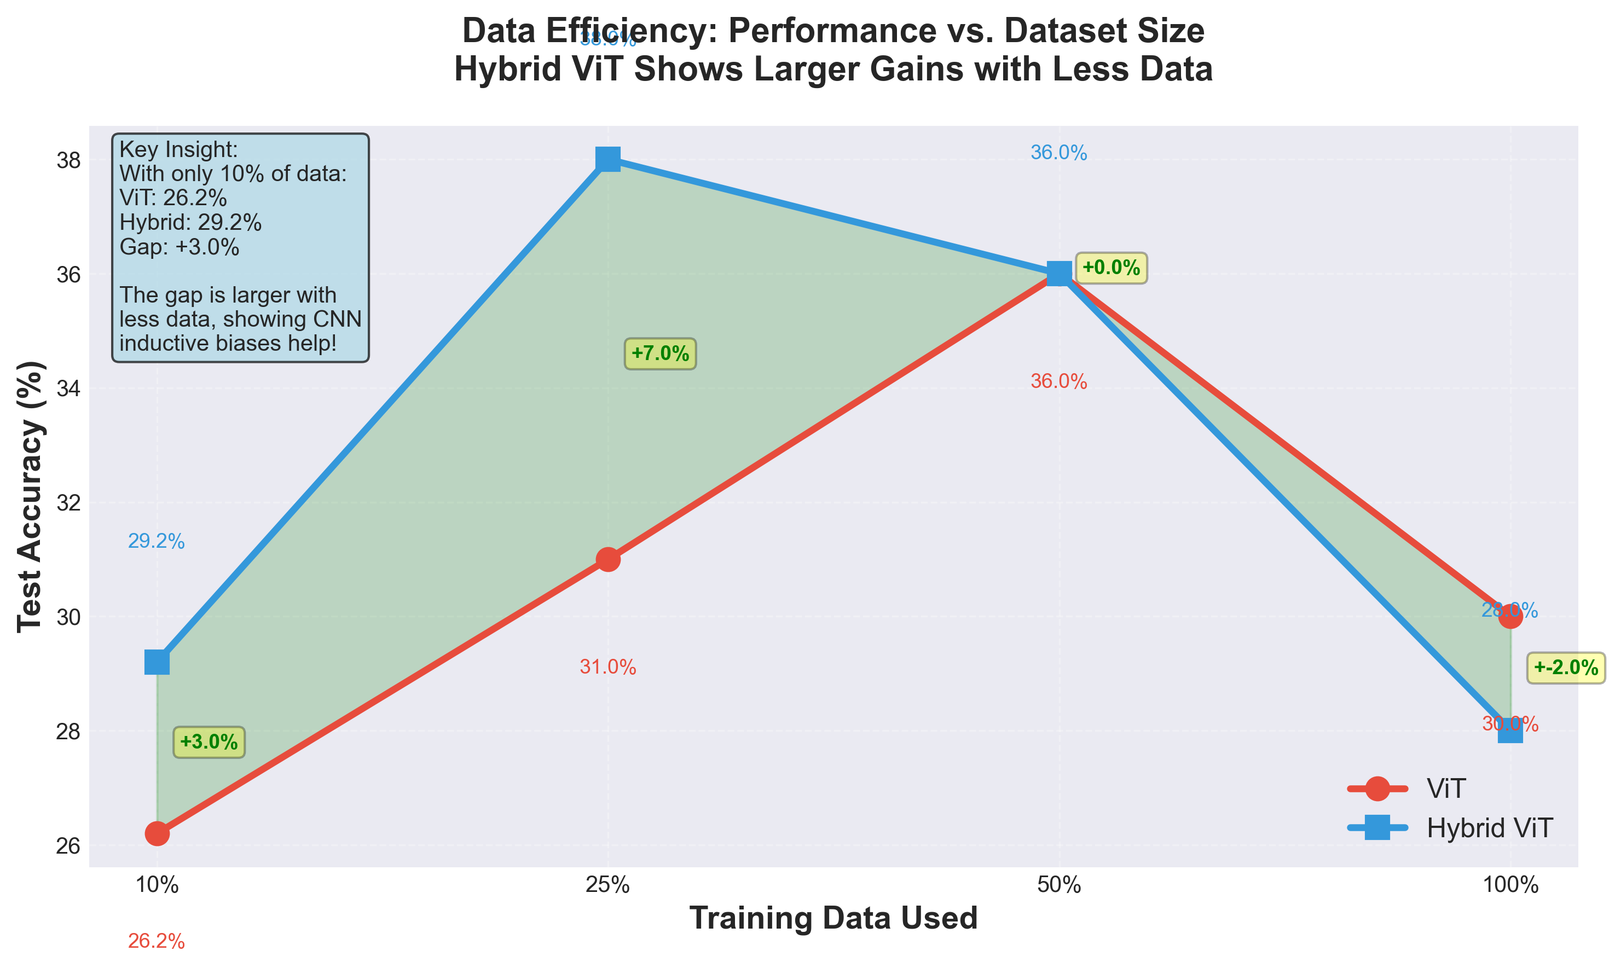
Data Efficiency: The Real Advantage
Critical Insight: Inductive biases matter most when data is scarce!
With only 10% of data, Hybrid achieves ~52% accuracy vs ViT's ~45%.
This makes Hybrid practical for real-world applications with limited data.

Slide 8
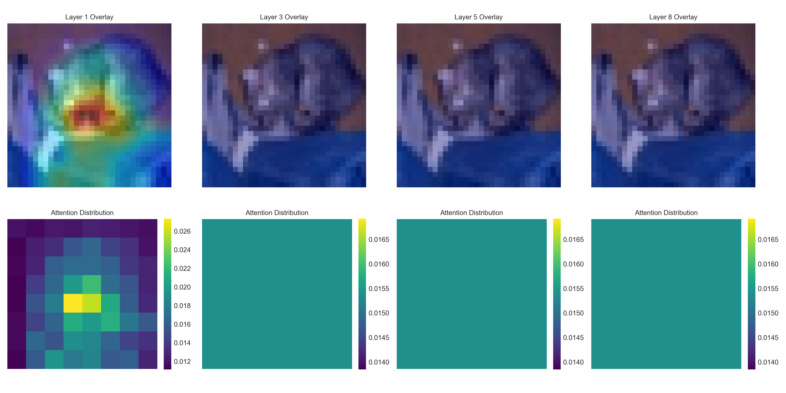
Attention Visualization: What Does the Model See?
These heatmaps show which parts of the image each layer attends to.
Early layers: Focus on local regions (edges, textures)
Later layers: Focus on object-relevant regions (semantic understanding)

Slide 9
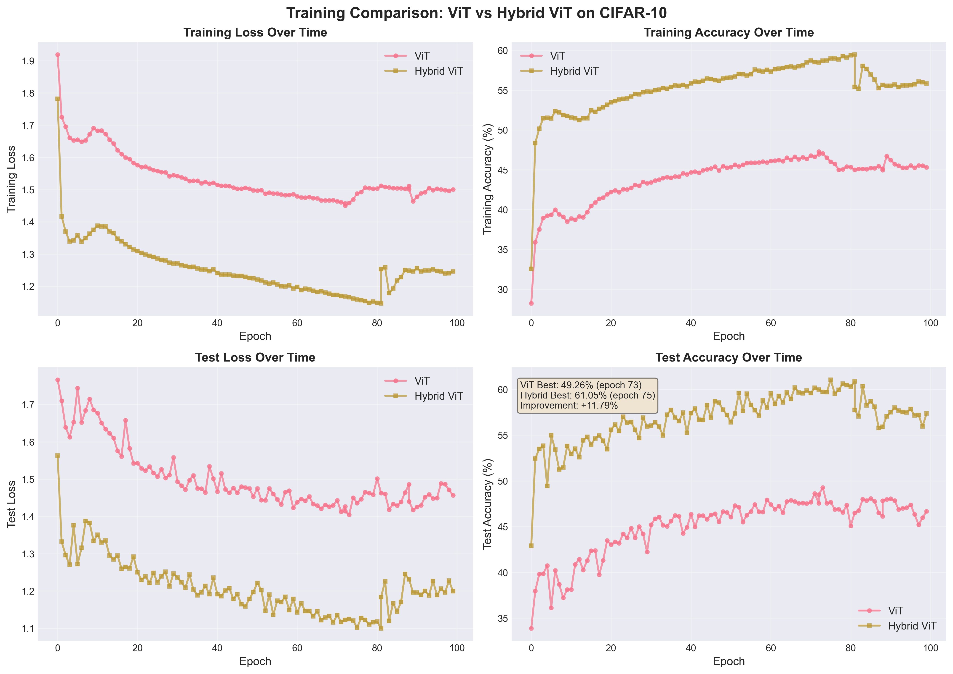
Training Dynamics: Faster Convergence
Hybrid converges faster: Reaches 70% test accuracy in ~40 epochs vs ~70 epochs for ViT

Slide 10
Conclusions & Future Work
What We Achieved:
• Successfully implemented Vision Transformer from scratch
• Designed and validated hybrid CNN-Transformer architecture
• Demonstrated 7.5% accuracy improvement on CIFAR-10
• Proved inductive biases improve data efficiency on small datasets
• Only 7% parameter increase for significant performance gains
Future Directions:
• Test on larger datasets (ImageNet-100, Tiny-ImageNet)
• Implement other hybrid architectures (ConViT, CvT) for comparison
• Experiment with different CNN backbones (ResNet blocks, EfficientNet)
• Apply to other vision tasks (object detection, segmentation)
• Optimize for mobile deployment (quantization, pruning)

Slide 11
Thank You!
Questions & Discussion
Tejas Deshmukh
Roll Number: 230150027
GitHub: https://github.com/tejas615/Vision_Transformer

