Slide 1
MazeBank – Banking System
Review 1 : Project Setup, Database, and UI
Team Name : Code&Coffee
Team Lead : Tejas Singh Nirvan
Member 2 : Rajdeep Singh
Member 3 : Aditya Raj

Slide 2
Project Overview
• Online banking system built using Java
• Two user types: Admin & Customer
• MySQL database for storage
• GUI interface via Java Swing
• Follows layered architecture for maintainability

Slide 3
JDK & IDE Setup
• Java SE 23 as the development kit
• IDE: Visual Studio Code (VS Code) with Java Extension Pack
• MySQL Community Server for database management
• JDBC Connector for Java-MySQL integration
• VS Code Terminal and Debugger used for testing and execution

Slide 4
Project Structure
model/ – Data models (User, Account, Transaction, BankingService)
dao/ – Database operation classes (UserDAO, AccountDAO, TransactionDAO, etc.)
Ui/ – Java Swing GUI screens (Login, Registration, Dashboards)
util/ – Utility classes (DatabaseConnection)
main/ – Main launcher class (Main.java)
database/ – SQL schema for tables

Slide 5
Customer Features
• Check balance
• Deposit / Withdraw / Transfer
• Transaction history
• Loan and banking services
• Update profile
• Change password

Slide 6
Admin Features
• System dashboard
• Manage users
• View all transactions
• Configure banking rules
• Service Approvals i.e loans, credit cards, etc

Slide 7
Technologies Used
• Java (Core + Swing)
• MySQL Database
• JDBC Connector
• MVC Architecture
• DAO Pattern

Slide 8
GUI Design: Screenshots
Login Screen
Customer Dashboard
Transaction History
Banking Services
Profile Management
Admin Dashboard
User Management
Service Approval (Admin)

Slide 9
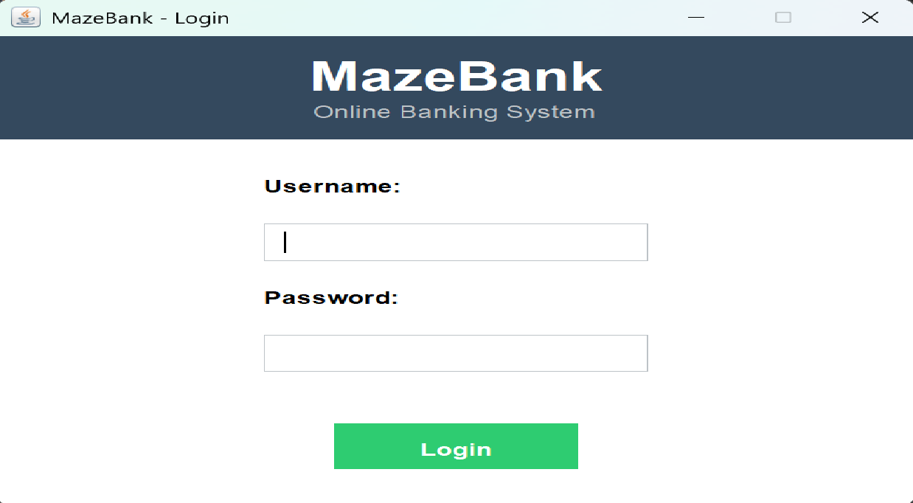
Login Screen

Slide 10
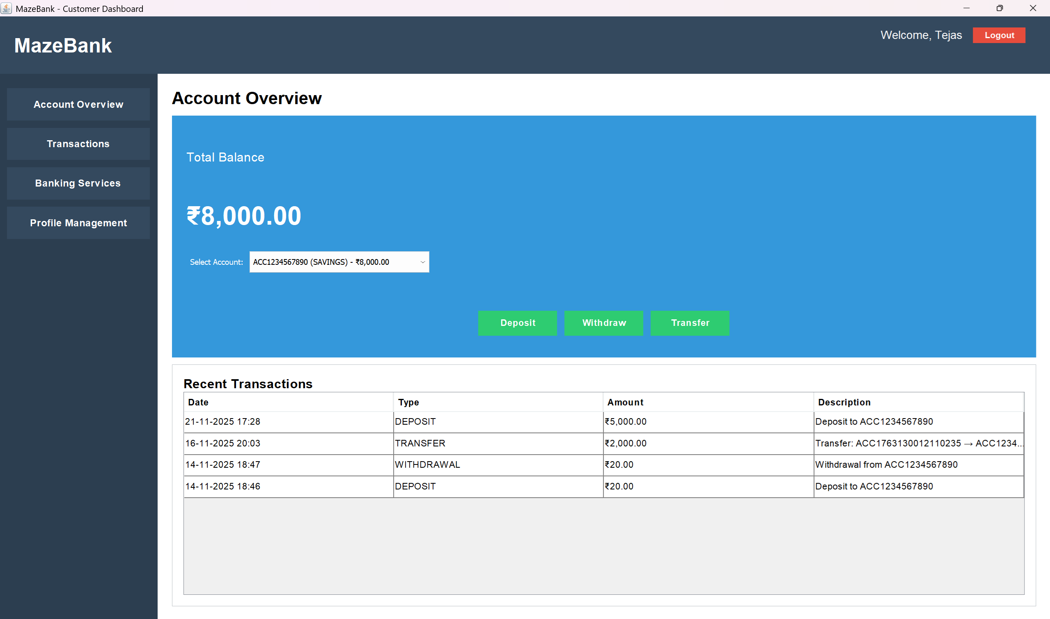
Customer Dashboard

Slide 11
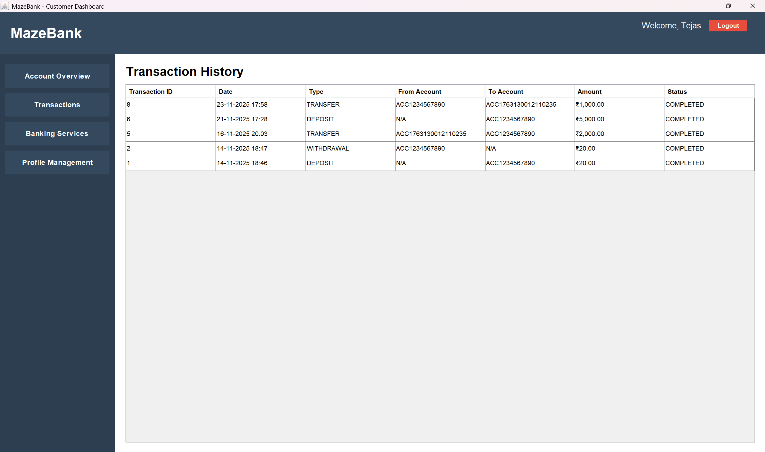
Transaction History

Slide 12
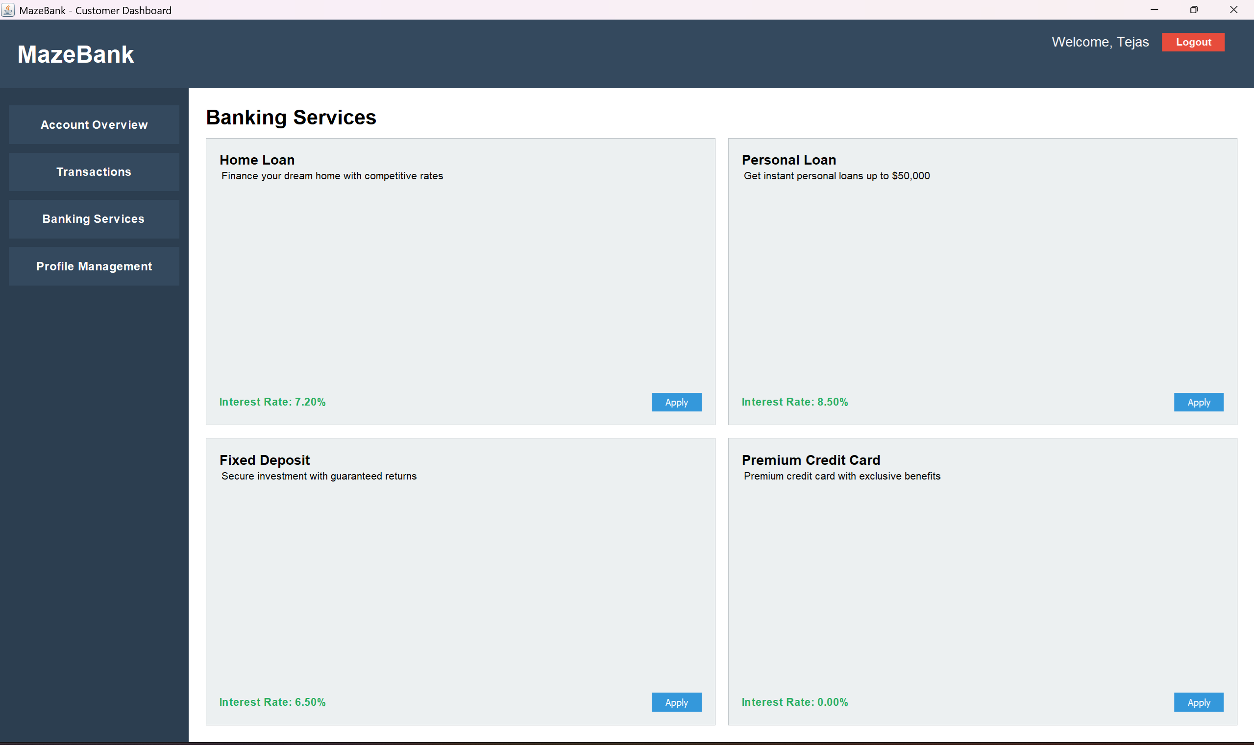
Banking Services

Slide 13
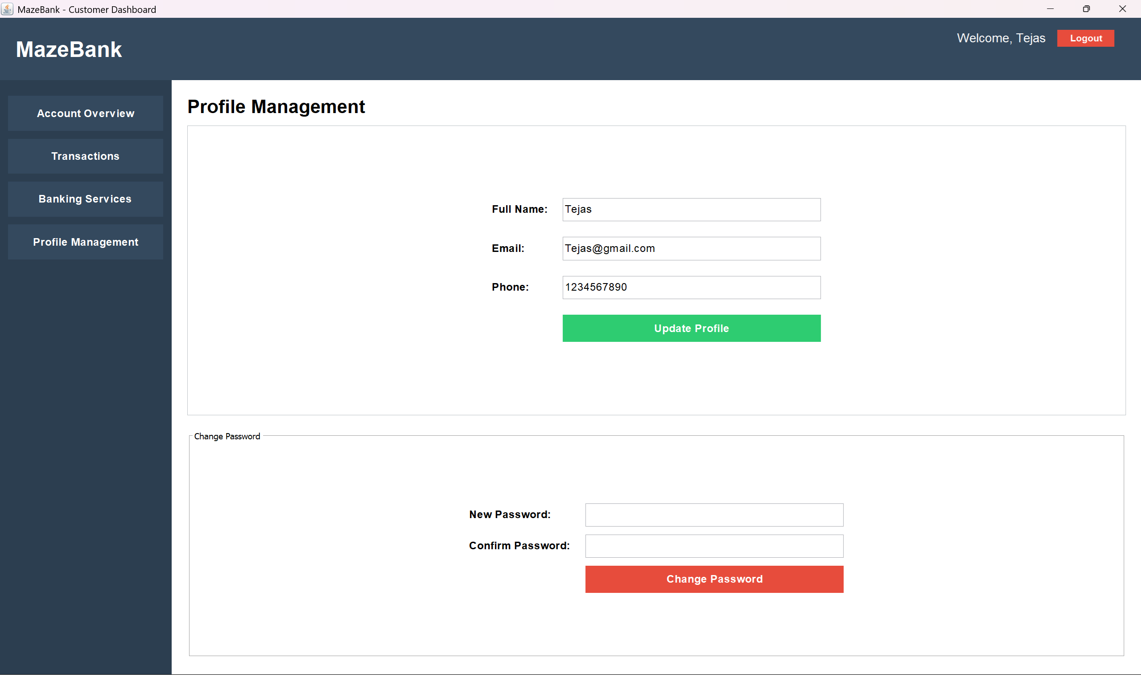
Profile Management

Slide 14
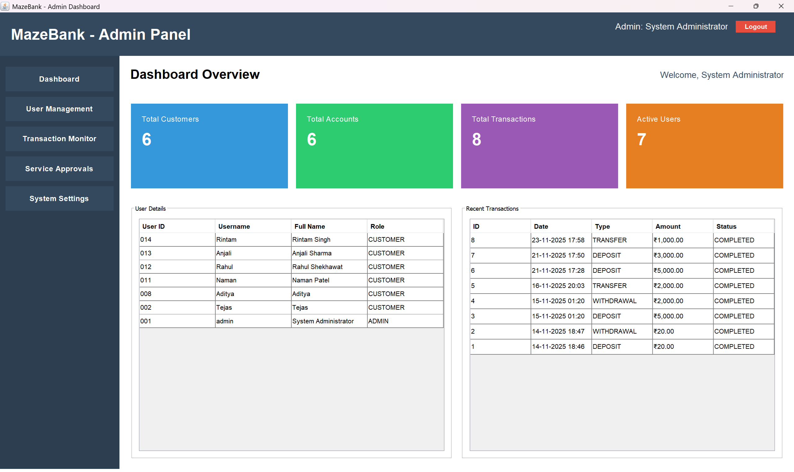
Admin Dashboard

Slide 15
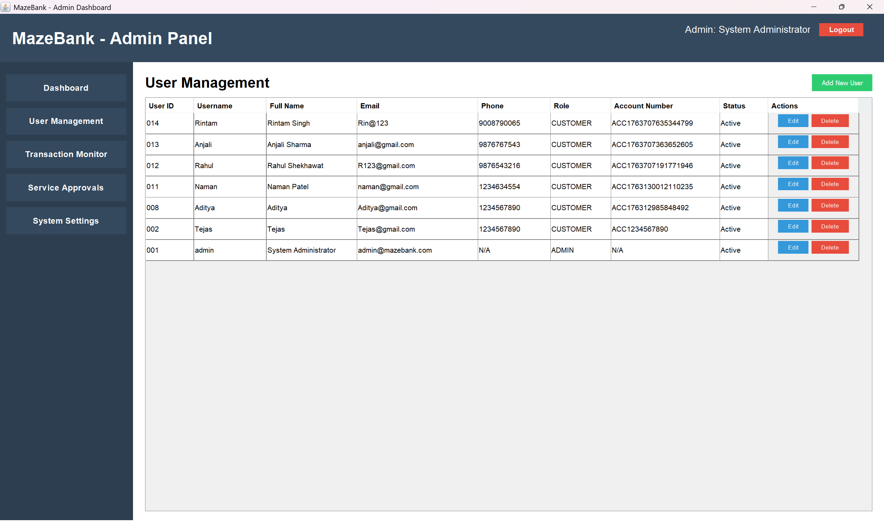
User Management

Slide 16
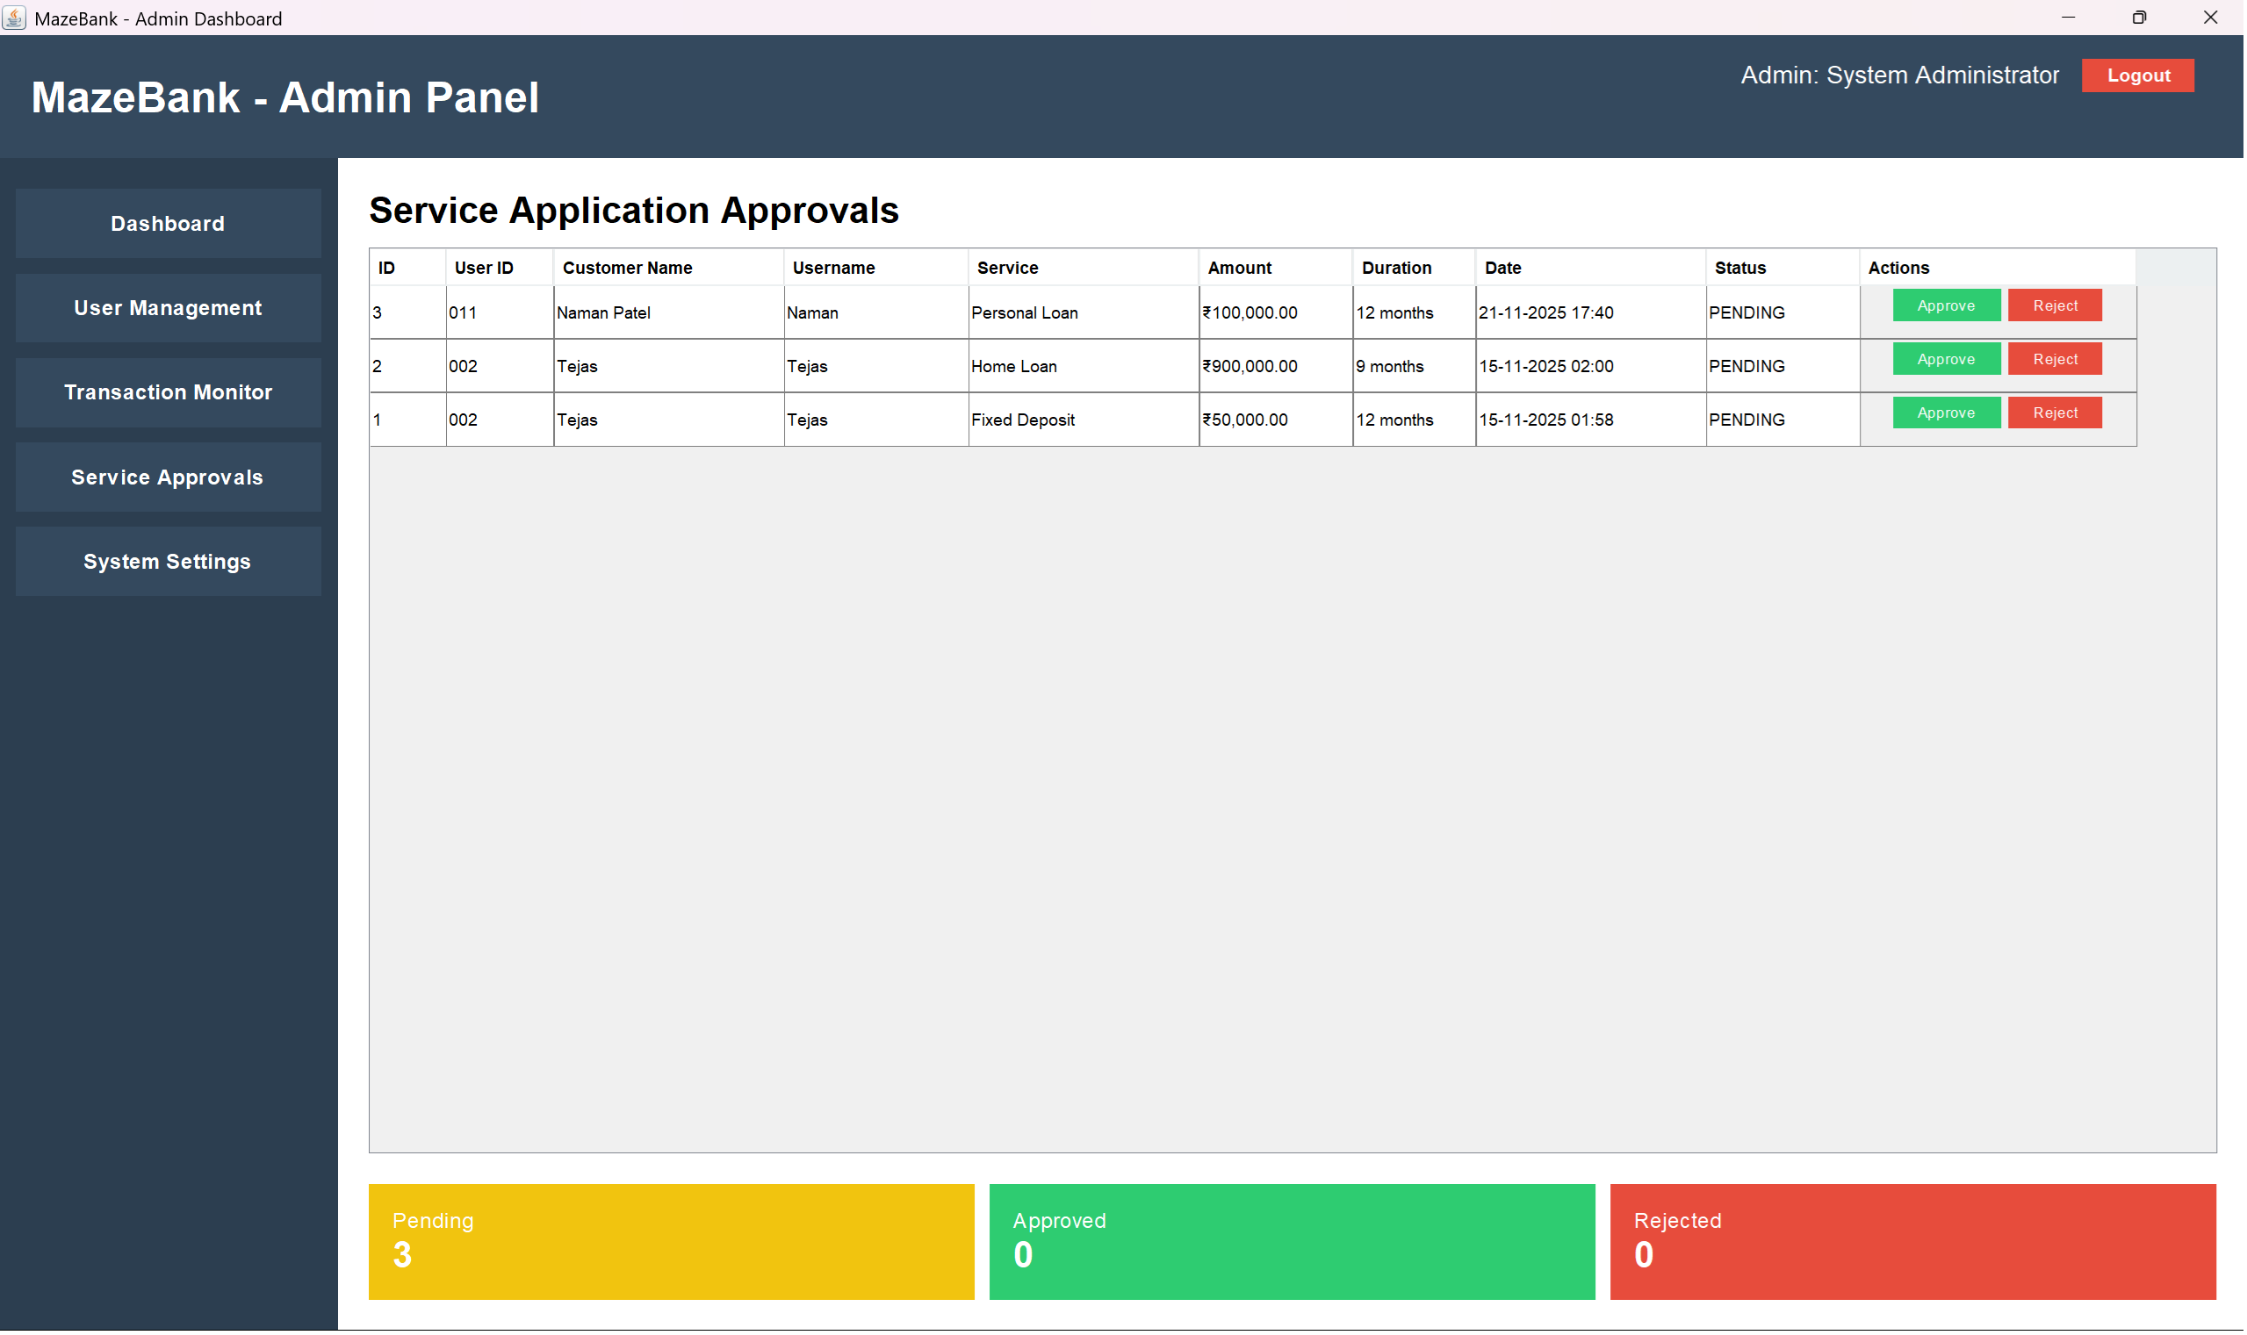
Service Approval (Admin)

Slide 17
Conclusion
MazeBank demonstrates a complete, real-world banking workflow at academic level.
Demonstrates real-world OOP + DB concepts
It includes secure operations, admin controls, and scalable architecture.
Suitable for academic and learning use

Slide 18


