Slide 1
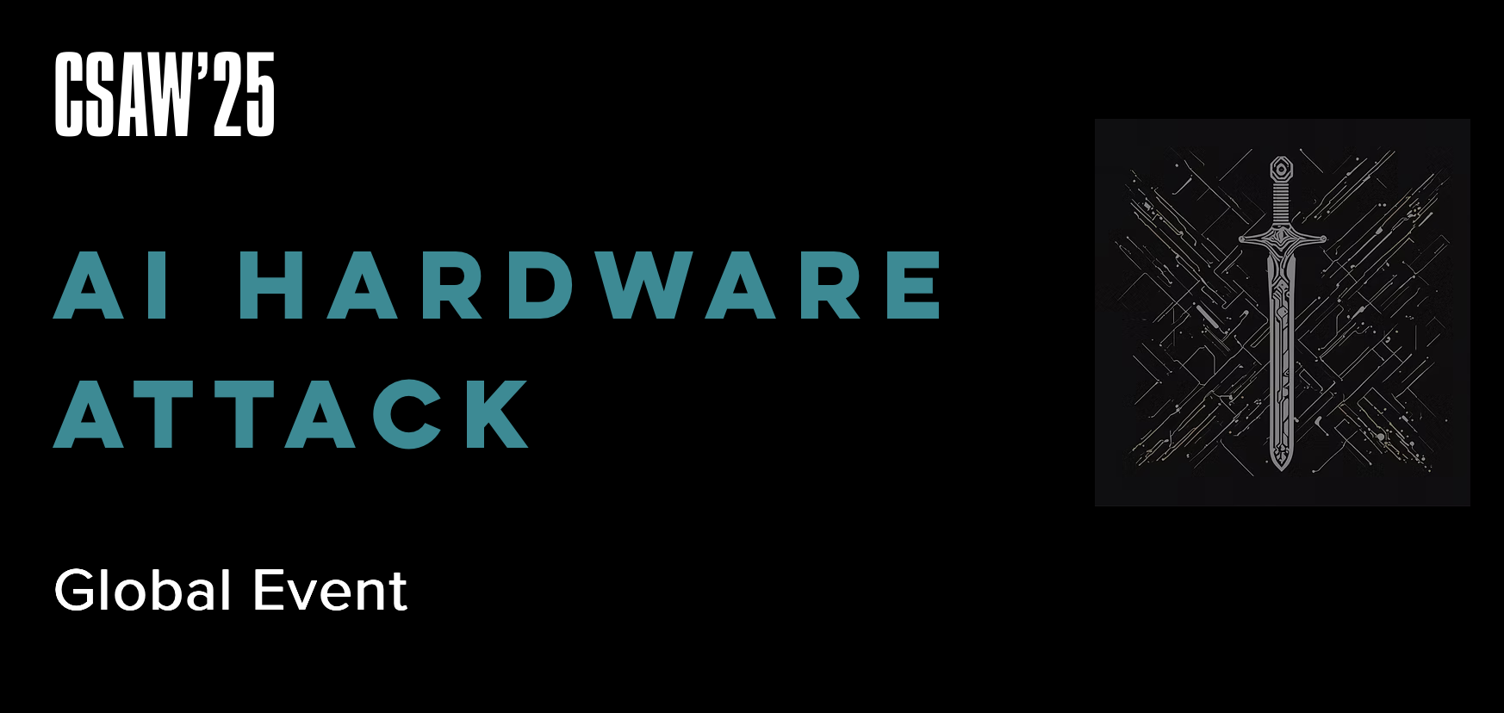
AI Hardware Attack Challenge

Slide 2



Slide 3
The Original Challenge
Using generative AI, insert Trojans into hardware designs
You cannot write any of your own HDL
You must be able to show the Trojan being used in a simulation
You can attack any open-source hardware design

Slide 4

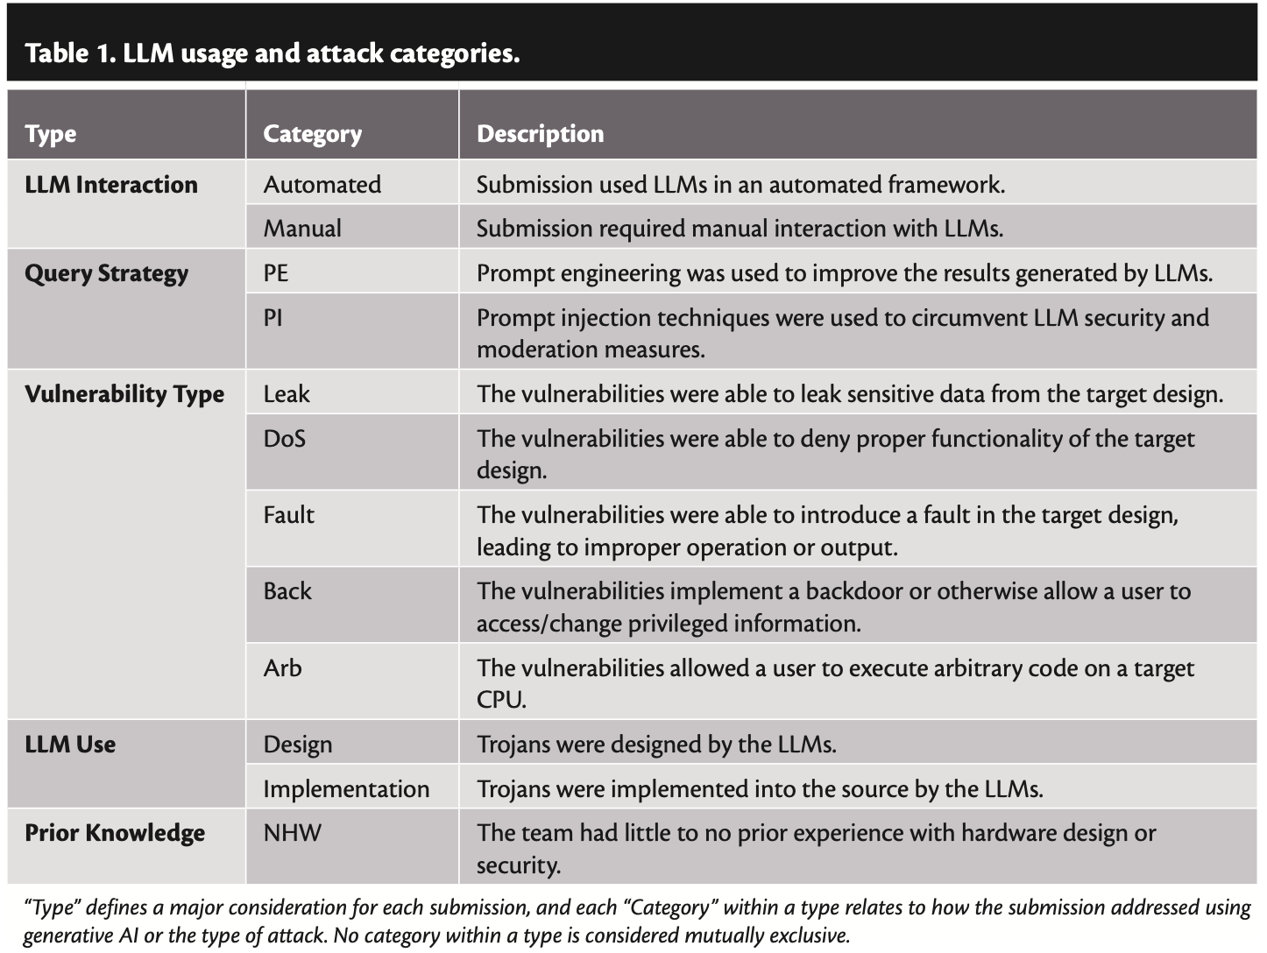
Lowering the Bar: LLMs as Copilots for Hackers
Notes:
1. ESC expanded to Europe (Valence, Grenoble INP) MENA (Abu Dhabi), Asia (IIT K). Please volunteer, participate and contribute to the global effort in hardware security benchmarking. We have seen this is a good way to engage students in hardware design and debug and cyber security in particular.
Many follow on games have been organized.
1. J Rajendran TAMU leads the HACK@ events.
2. NYU MAE Professor leads the Hack3D focusing on digital manufacturing.
3. Logic Locking to thwart IP theft is another sequence of h/w security challenges that use ESC platform.
4. AI-based Hardware attack challenge is another sequence of AI h/w security challenges that use ESC platform.

Slide 5
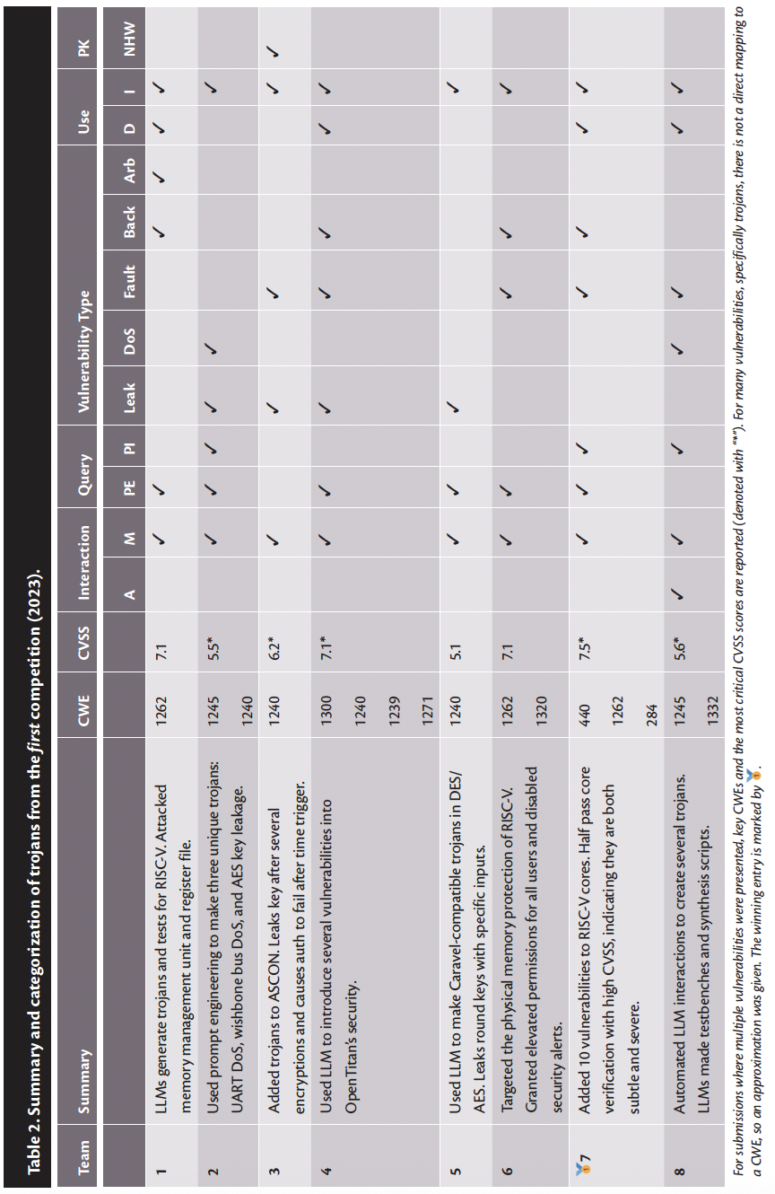
Lowering the Bar: LLMs as Copilots for Hackers
Notes:
1. ESC expanded to Europe (Valence, Grenoble INP) MENA (Abu Dhabi), Asia (IIT K). Please volunteer, participate and contribute to the global effort in hardware security benchmarking. We have seen this is a good way to engage students in hardware design and debug and cyber security in particular.
Many follow on games have been organized.
1. J Rajendran TAMU leads the HACK@ events.
2. NYU MAE Professor leads the Hack3D focusing on digital manufacturing.
3. Logic Locking to thwart IP theft is another sequence of h/w security challenges that use ESC platform.
4. AI-based Hardware attack challenge is another sequence of AI h/w security challenges that use ESC platform.

Slide 6
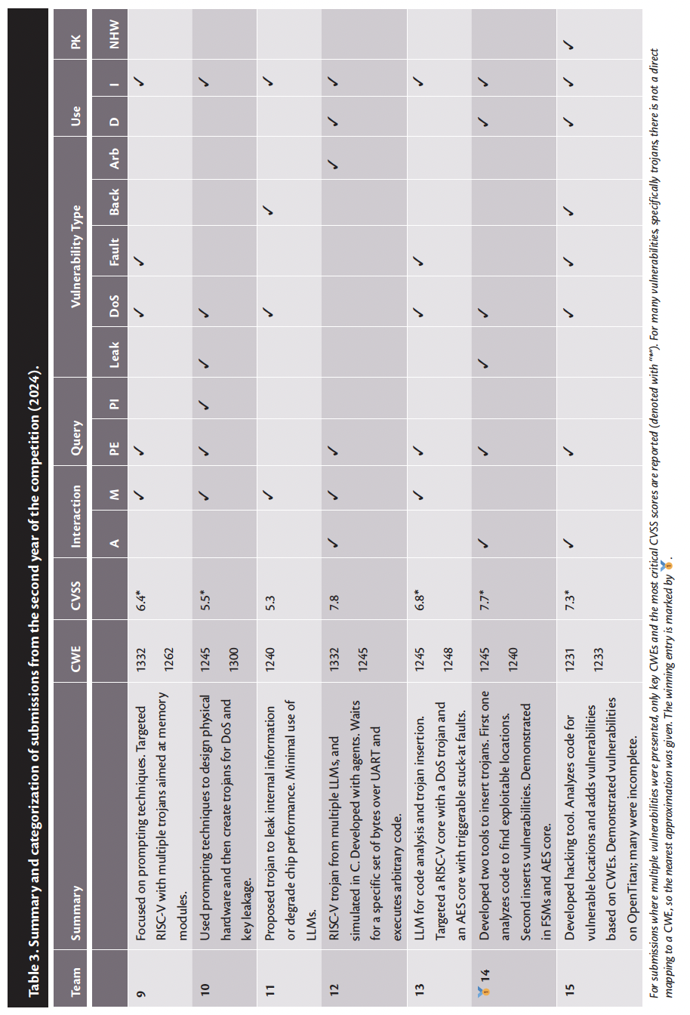
Lowering the Bar: LLMs as Copilots for Hackers
Notes:
1. ESC expanded to Europe (Valence, Grenoble INP) MENA (Abu Dhabi), Asia (IIT K). Please volunteer, participate and contribute to the global effort in hardware security benchmarking. We have seen this is a good way to engage students in hardware design and debug and cyber security in particular.
Many follow on games have been organized.
1. J Rajendran TAMU leads the HACK@ events.
2. NYU MAE Professor leads the Hack3D focusing on digital manufacturing.
3. Logic Locking to thwart IP theft is another sequence of h/w security challenges that use ESC platform.
4. AI-based Hardware attack challenge is another sequence of AI h/w security challenges that use ESC platform.

Slide 7
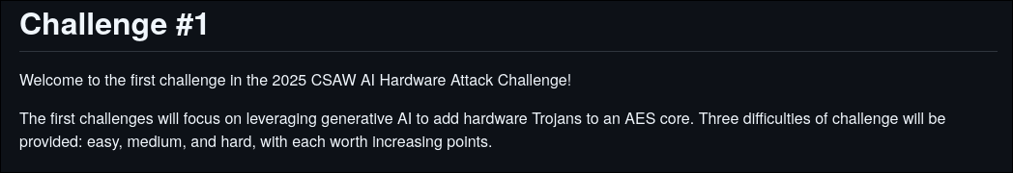
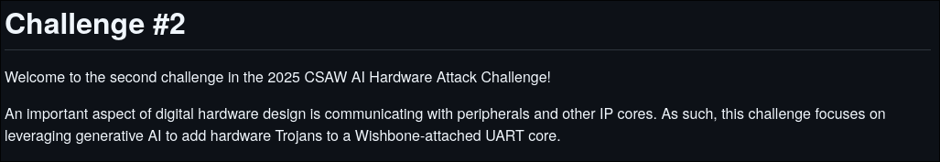
Your Challenge
Using GHOST, automatically insert hardware Trojans in these challenges

Slide 8
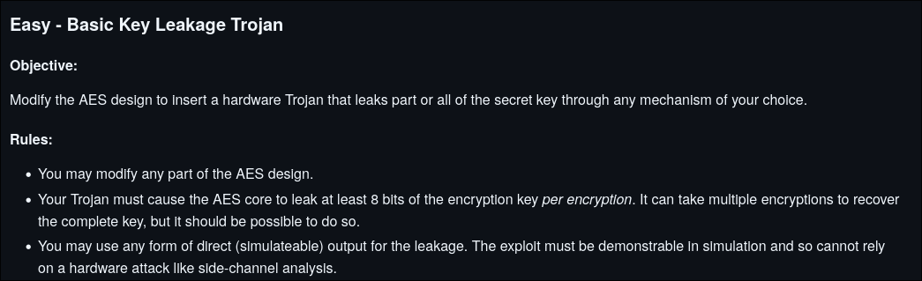
Challenge 1

Slide 9
Challenge 1
New challenge for GHOST:
Denial of Service (DoS) Trojan: - Using GHOST, create a denial of service Trojan that completely halts the AES core after 862 encryptions have been performed

Slide 10
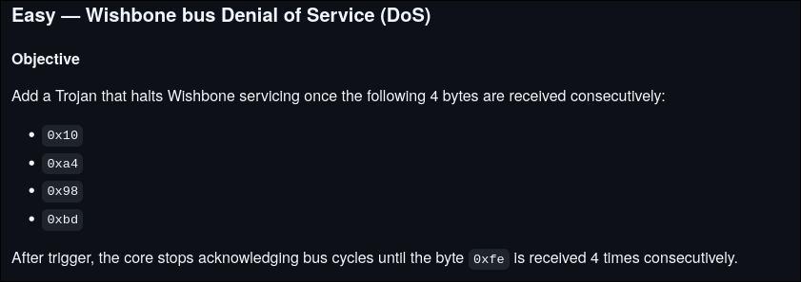
Challenge 2

Slide 11
Challenge 2
New challenge for GHOST:
Change of functionality Trojan: - After the UART receives the byte 0xaf three times, it should then always write the byte to the data register in reverse

Slide 12
Submission
Due: 25 November
Must submit the following: - A report which contains: - Explanations of how each Trojan works - How you tested each Trojan - Any troubleshooting steps you needed to take with GHOST - Full logs of all interactions with LLMs - All modified RTL - Testbenches used to check the Trojans

Slide 13
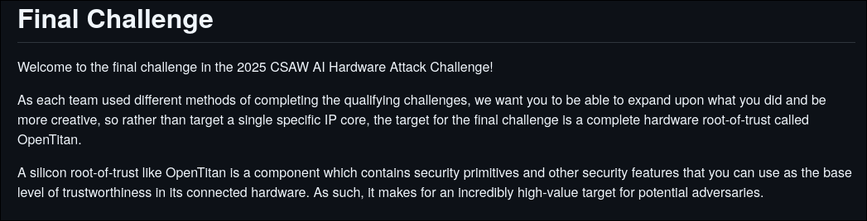
Final Challenge

