Slide 1

LLM-Aided Testbench Generation

Slide 2
Introduction to Testbenches
Testing is important
Pentium FDIV bug
More test engineers than design engineers
Lecture objective: writing testbenches to apply test vectors

Slide 3
Introduction to Testbenches
As logic designs become complex, comprehensive, up front verification becomes critical to the success of the design project.
When simulation is used right at the start of the project, you will have a much easier time with synthesis, and you will spend far less time re-running time-intensive processes, such as FPGA place-and-route tools and other synthesis related software.

Slide 4
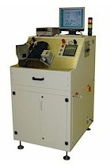
Introduction to Testbenches
To simulate your project, you will need to develop an additional verilog program called a test bench.
Testbenches emulate a hardware breadboard into which you will “install” your synthesizable design description for the purpose of verification.
A Testbench can be thought of as a “Virtual Tester” into which you plug your design for verification.
RC5
Unit Under Test (UUT)
Testbench

Slide 5
Introduction to Testbenches
Can be simple– applying a sequence of inputs to the circuit over time.
Can be complex– reading test data from a disk file and writing test results to a screen and to a report file.

Slide 6
Successful Testbench
A successful Testbench should be able to automatically:
Read input stimulus (test vectors) from an input file and apply it to the unit under test.
Compare the outputs from the unit under test with a file that contains the expected results.
Display to the user all errors so that they can be fixed.

Slide 7
Primer on verilog Testbenches
Create module with no ports
Define regs for inputs to Design Under Test (DUT),
Define wires for outputs
Define instance of DUT
Create an initial block which defines input traces
Simulate and check outputs are correct

Slide 8
Testbenches for verilog example (or_and)
module test_or_and;
reg a,b,c;
Test I/O signals
module or_and (
input wire a,b,c,
output wire o
);
wire d;
assign d = a | b;
assign o = d & c;
endmodule
wire o;
or_and oa (
.a(a), .b(b), .c(c), .o(o)
Instance of Design under test
);
initial begin: TEST_BLOCK
a <= 0;
b <= 0; //correct output o=0
c <= 0;
Input test traces
#10;
a <= 1;
b <= 0; //correct output o=0
c <= 0;
#10;
//etc: do all 8 possibilities
end
endmodule
10 unit delay

Slide 9
Testbenches for or_and
a <= 1;
b <= 1;
c <= 0; //correct output o = 0 #10
a <= 0;
b <= 0;
c <= 1; //correct output o = 0 #10
a <= 1;
b <= 0;
c <= 1; //correct output o = 1 #10
a <= 0;
b <= 1;
c <= 1; //correct output o = 1 #10
a <= 1;
b <= 1;
c <= 1; //correct output o = 1
end
endmodule
module test_or_and; reg a,b,c;
wire o;
or_and oa (.a(a), .b(b), .c(c), .o(o)
);
initial begin: TEST_BLOCK
a <= 0;
b <= 0;
c <= 0; //correct output o = 0
#10
a <= 1;
b <= 0;
c <= 0; //correct output o = 0
#10
a <= 0;
b <= 1;
c <= 0; //correct output o = 0

Slide 10
Testbench for nandxor example
module test_nandxor; reg a,b,c;
wire d;
a <= 1;
b <= 1;
c <= 0; //correct output d = 0
#10
a <= 0;
b <= 0;
c <= 1; //correct output d = 0
#10
a <= 1;
b <= 0;
c <= 1; //correct output d = 0
#10
a <= 0;
b <= 1;
c <= 1; //correct output d = 0
#10
a <= 1;
b <= 1;
c <= 1; //correct output d = 1
end
endmodule
nandxor n
(.a(a), .b(b), .c(c), .d(d)
);
initial begin: TEST_BLOCK
a <= 0;
b <= 0;
c <= 0; //correct output d = 1
#10
a <= 1;
b <= 0;
c <= 0; //correct output d = 1
#10a <= 0;
b <= 1;
c <= 0; //correct output d = 1

Slide 11
Auto Testbench for Verilog
module auto_test_nandxor;
reg a,b,c; wire d;
nandxor n (
.a(a), .b(b), .c(c), .d(d)
);
initial begin: TEST_BLOCK
a <= 0;
b <= 0;
c <= 0;
#10
if (d !== 1) $fatal(); #10
#10
a <= 0;
b <= 1;
c <= 0;
#10
if (d !== 1) $fatal(); #10
//etc …..
a <= 1;
b <= 1;
c <= 1;
#10
if (d !== 1) $fatal();
$display("All tests passed"); end
Execution time
Print on completion
Automatically check output,
$fatal() will terminate sim. on error
endmodule

Slide 12
Real World – High Level Design Flow (1)
Design Specification – Specifying the behavior expected of the final design
Designer puts enough detail into the specification so that the design can be built.
Coordinated with software and other devices that communicate with chip.
HDL Capture
Designer enters verilog code for entities of the design and checks them for correct syntax.
Designer loads verilog into an automatic testbench that thoroughly applies stimulus and checks the results.
Designer runs simulation for as long as needed to generate enough output data to determine if the design is correct. At the beginning of the design process, this may be only a few vectors to make sure the design resets properly. But later, more and more of the vectors are run as the design starts to function properly.
RTL Simulation:
Verify correctness of the RTL verilog description
verilog simulator reads the verilog description, compiles it into an internal format, and executes the compiled format using test vectors.
Designer can look at the output of the simulation and determine whether or not the design is initially working properly.

Slide 13
Real World – High Level Design Flow (2)
RTL Synthesis – The synthesis tools convert the verilog description into a netlist in the target FPGA or ASIC technology.
The synthesis step creates a design that implements the functionality and matches the designer’s constraints in speed, area, or power.
The synthesis tools generate a timing report and area report
Timing report – shows the timing of the critical paths of the design. The designer examines the timing of the critical paths closely because these paths ultimately determine how fast the design can run.
Area report – Shows the designer how much of the resources of the chip the design has consumed. The designer can tell if the design is too big for a particular chip; the designer needs to target a larger chip.

Slide 14
Real World – High Level Design Flow (3)
Functional Gate Simulation
Designer quickly checks the output of the synthesis tool to make sure that the synthesis tool produced a design that is functionally correct.
If proper design rules are followed for the input verilog description, the synthesis tool should never generate an output that is functionally different from the RTL verilog input, unless the tool has a bug.
To do this, the designer reads the output verilog netlist from the synthesis tool, plus a library of the synthesis primitives into the verilog simulator and runs the simulation using the RTL verification vectors.
For a completely functional simulation no timing is back annotated.

Slide 15
Real World – High Level Design Flow (4)
Place and Route (P&R)
P&R tools take the design netlist and implement the design in the target tech device.
P&R tools place each primitive (gate, LUT, etc.) from the netlist into appropriates location on the target device and route signals between primitives to connect the devices according to netlist.
P&R tools are typically very architecture and device dependant. FPGA vendors provide these tools because the differences in architectures are large enough that writing a common tool for all architectures would be very difficult.
Inputs to the P&R tools are the netlist (EDIF), timing/placement constraints.
Timing constraints–Gives the P&R tools an indication of which signals have critical timing associated with them and to route these nets in the most timing efficient manner.
Placement constraints –P&R tools allow the designer to specify the placement of large parts of the design. This is known as floorplanning. Floorplanning allows the designer to pick locations on the chip for large blocks so that routing wires are as short as possible.
The other output from the P&R tools is a file used to generate the timing file. This file describes the actual timing of the programmed FPGA device of the final ASIC device. The most common format is standard delay format (SDF).

Slide 16
Real World – High Level Design Flow (5)
Post Layout Timing Simulation
After place and route process has completed, the designer will want to verify the results of the place and route process.
This simulation combines the netlist used for place and route with the timing file (SDF) from the place and route process into a simulation that checks both the functionality and timing of the design.
Post route gate-level simulation, if done properly, also uses the same simulator as the RTL simulation. (Same testbench)
Static Timing
For designs of 10k-100k gates, post route timing simulation is a good method of verifying design functionality and timing. However, as designs gets larger, or if the designer does not have test vectors, the designer can use static timing analysis to make sure design meets timing requirements.
A static timing analyzer traces each path in the design and keeps track of the timing from a clock edge or an input. A timing report is then generated.

Slide 17
Real World – High Level Design Flow (6)
On chip Debug –
This technique provides the designers with the ability to debug their design in the target system, at target speed, at the RTL level.
The veriolog for the device is read into a tool that automatically creates and inserts a small debug core into the device that probes internal signals.
The debug core is created based on information from the designer about what signals are to be probed.
The debug core communicates through the JTAG port on the device to an HDL debugger executing on a host platform.
The HDL debugger sends and receives data from the debug core and displays this data in context with an HDL for the design.
Waveforms of the internal device can also be displayed, providing the ability to trace down problems in the design.

Slide 18
Motivation
Testing RTL → Testbench Generation
Design Verification is time consuming task
Coming up with relevant test patterns
Validating result against Design Specification
Improve Coverage using relevant test cases
Catch functional RTL bugs

Slide 19
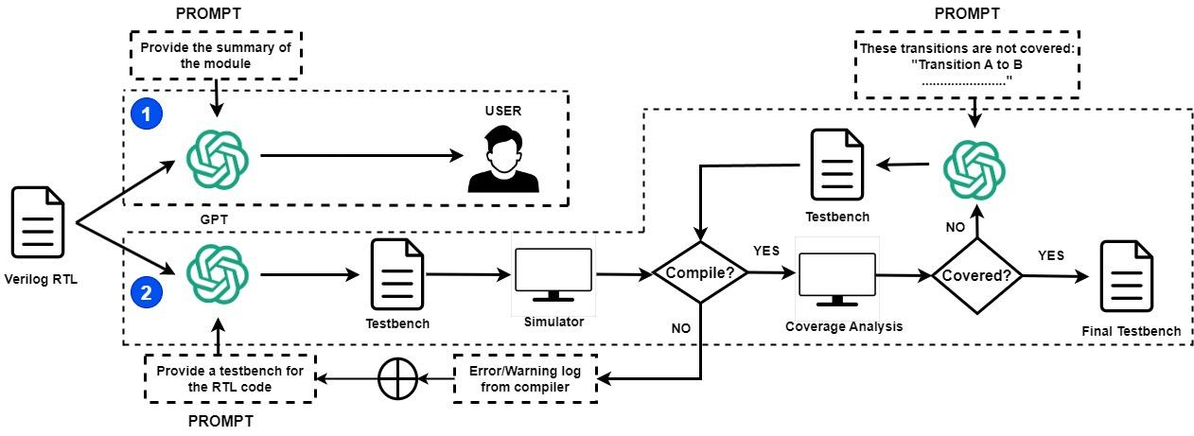
Proposed Flow

Slide 20
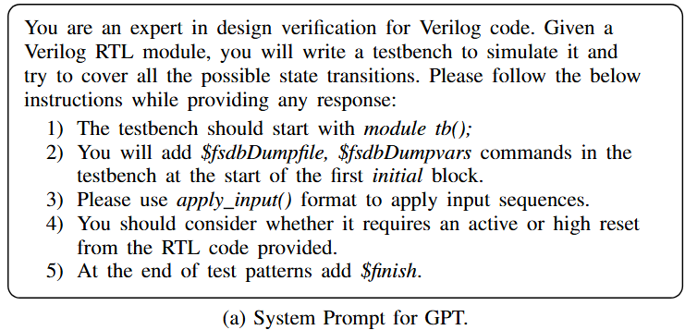
Prompts: Testbench Template

Slide 21
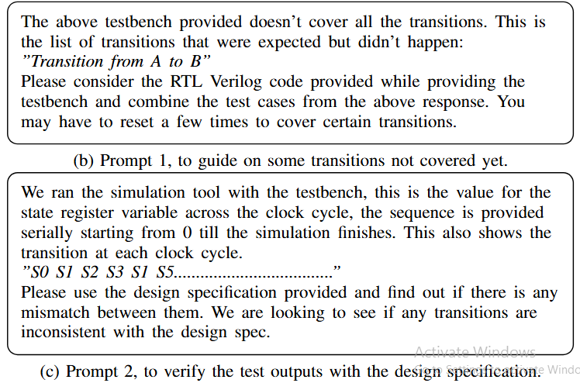
Prompts: Improve Test Case Generation

Slide 22
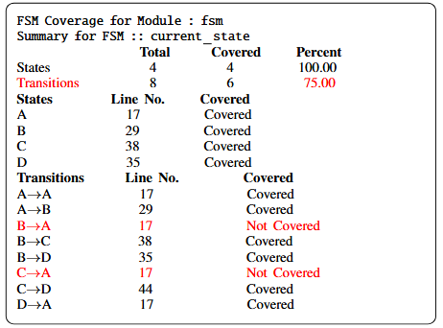
Feedback to Improve FSM Coverage

Slide 23
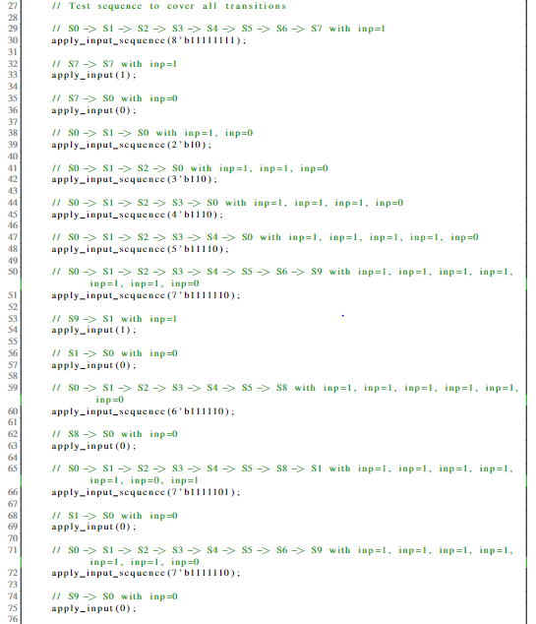
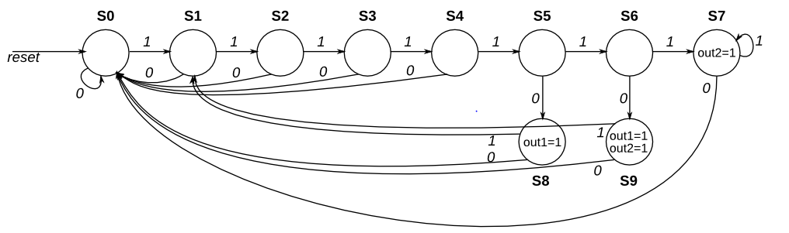
Example of Generated Test Pattern

Slide 24
Conclusion
Large FSMs with many states/transitions cause LLMs to repeat responses and miss coverage
No readily available combined RTL–testbench datasets; labeling “good vs. bad” testbenches requires full EDA runs
Use resets (“reset after X transitions”) and EDA tool feedback (“focus on uncovered transitions”) to guide LLMs effectively
Providing underlying RTL helps LLMs contextualize testbenches, with prompts playing a critical role in quality bug detection

Slide 25
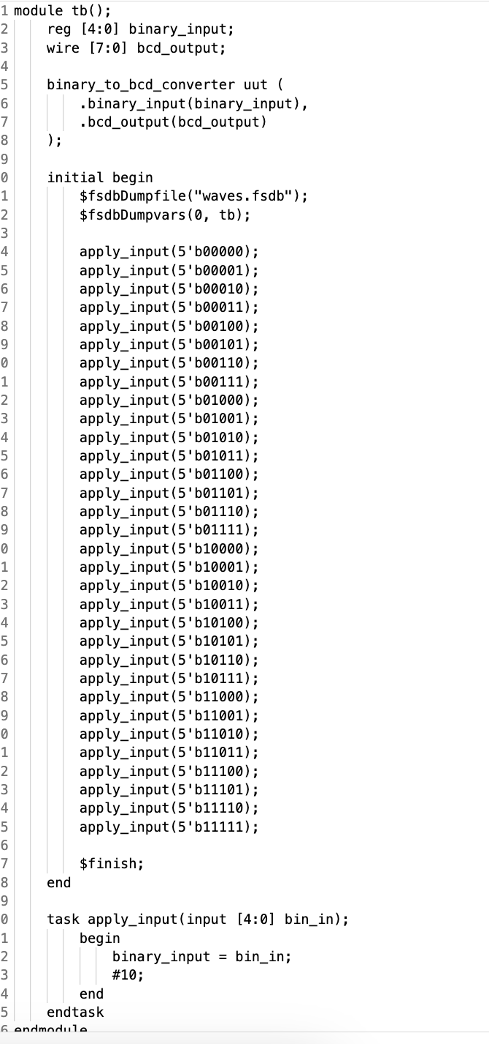
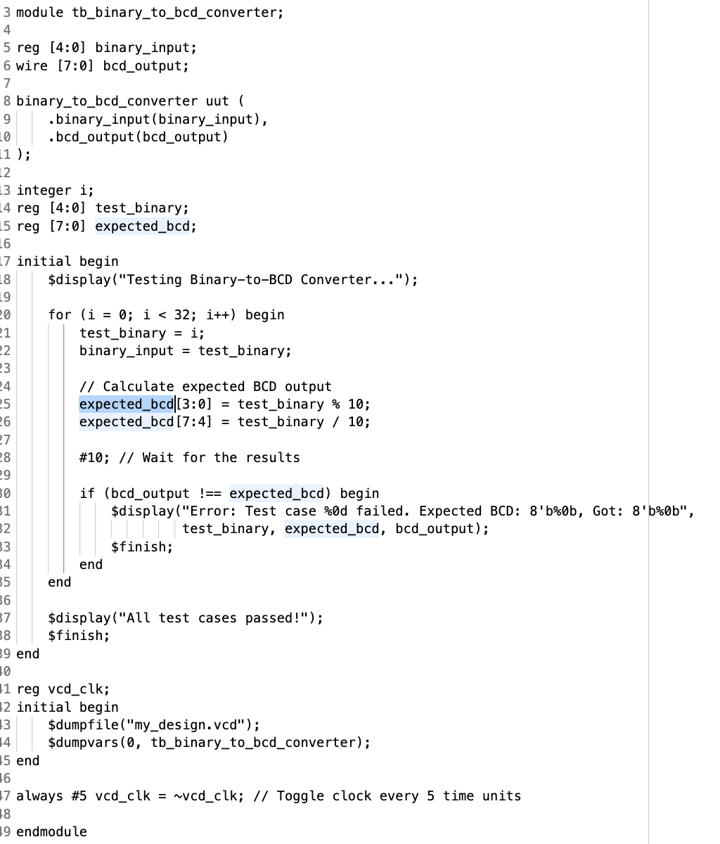
Example 1 from ChipChat
Correct Module Instantiation
Test All Input Pattern
Golden Testbench
LLM Testbench

Slide 26
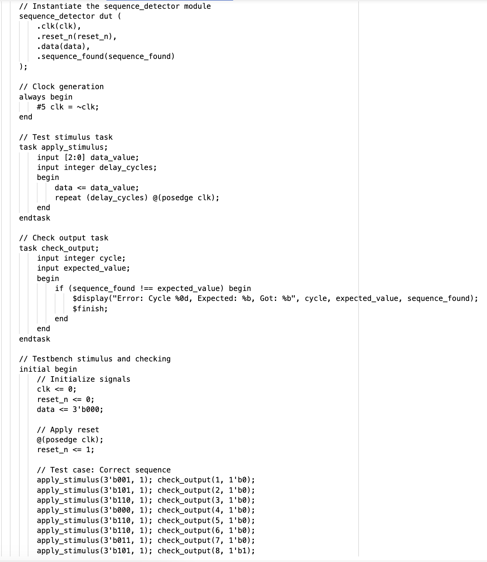
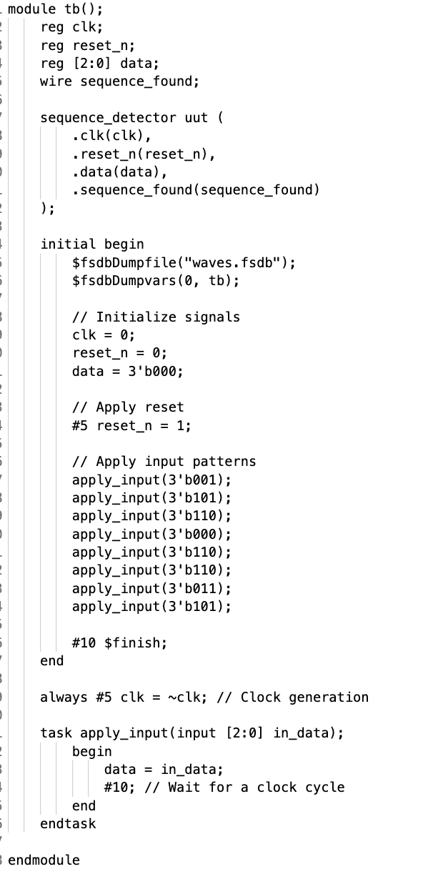
Example 2 from ChipChat
Correct Module Instantiation
Test All Input Pattern
Golden Testbench
LLM Testbench

