Slide 1

conceptmentor
A clearer next step
after a wrong answer
JEE physics and mathematics diagnosis
Cline Hackathon Finals
conceptmentor
01
Notes:
Concept Mentor is a controlled local JEE foundations prototype. The core uses deterministic evidence rules. No learner-outcome claims.

Slide 2
The scale of the study decision
16.05 lakh
Unique candidates registered for JEE Main 2026
After a wrong answer, what should the learner study next?
Source: NTA, 20 April 2026. Both sessions combined.
conceptmentor
02
Notes:
Source: National Testing Agency, press release 20 April 2026. https://www.nta.ac.in/Download/Notice/Notice_20260420194021.pdf . 1,604,854 unique candidates registered across January/April JEE Main 2026. Registered is not appeared. Scale does not establish product demand.

Slide 3
Foundational gaps persist into Class VIII
45.8%
could do the assessed
division task in 2024
Rural Class VIII students.
Broader context, not a JEE study.
Source: ASER 2024 National findings, pp. 47–48
conceptmentor
03
Notes:
Source: ASER 2024 National findings, printed pp47–48. https://asercentre.org/wp-content/uploads/2022/12/ASER-2024-National-findings.pdf . Rural Class VIII students able to do assessed basic division: 44.1% (2018), 44.7% (2022), 45.8% (2024). These are not JEE aspirants. Do not extrapolate prevalence to the target population.

Slide 4
One wrong answer, several explanations
“I got the projectile
question wrong.”
01
An older concept needs attention
02
A known idea is hard to apply
03
The chosen model does not fit
Illustrative learner scenario
04
A condition was misread
A score alone cannot select the right repair
conceptmentor
04
Notes:
A wrong projectile-motion answer can reflect prerequisite difficulty, a problem applying a known idea, a wrong model or a misread condition. This is a reasoning illustration, not an observed learner result. A score alone cannot distinguish these explanations.

Slide 5
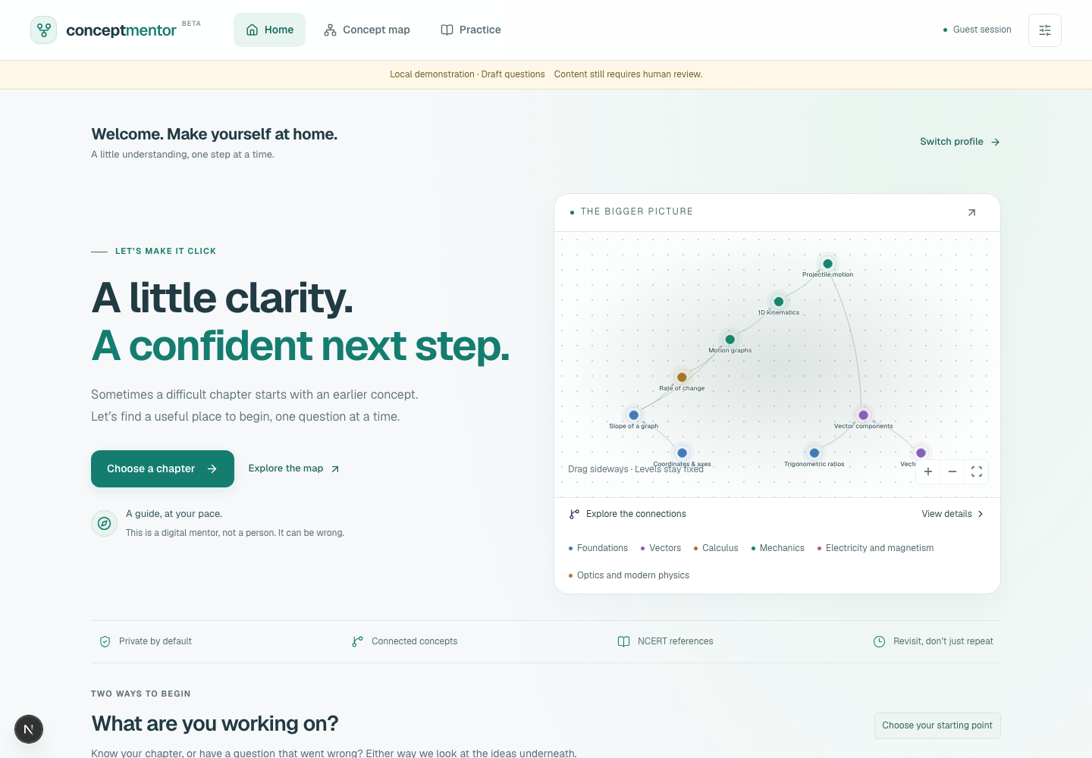
The diagnosis and repair loop
01 Start with a topic or mistake
02 Check relevant prerequisites
03 Choose a focused repair
04 Check again and revisit later
At most six diagnostic probes
conceptmentor
05
Notes:
Actual local app screenshot captured for this presentation. Guest mode with no learner history. Loop: wrong-question or topic entry, bounded prerequisite checks, honest outcome, targeted contrast and NCERT/teacher routing, immediate recheck and later review. Coverage is nine concept nodes, subject to content approval.

Slide 6
Changed context tests when a method applies
Angle measured from
the horizontal
Angle measured from
the vertical
Fₓ = 10 cos 30°
Fₓ = 10 sin 30°
The reference axis changed.
Does the method change with it?
Illustrative check: a 10 N force in the first quadrant
conceptmentor
06
Notes:
Illustrative mechanism, not an approved bank item: force magnitude 10 N. If angle 30 degrees is from horizontal, horizontal component is 10 cos(30 degrees). If angle is from vertical, horizontal component is 10 sin(30 degrees). Knowing a familiar formula is different from identifying its conditions.

Slide 7
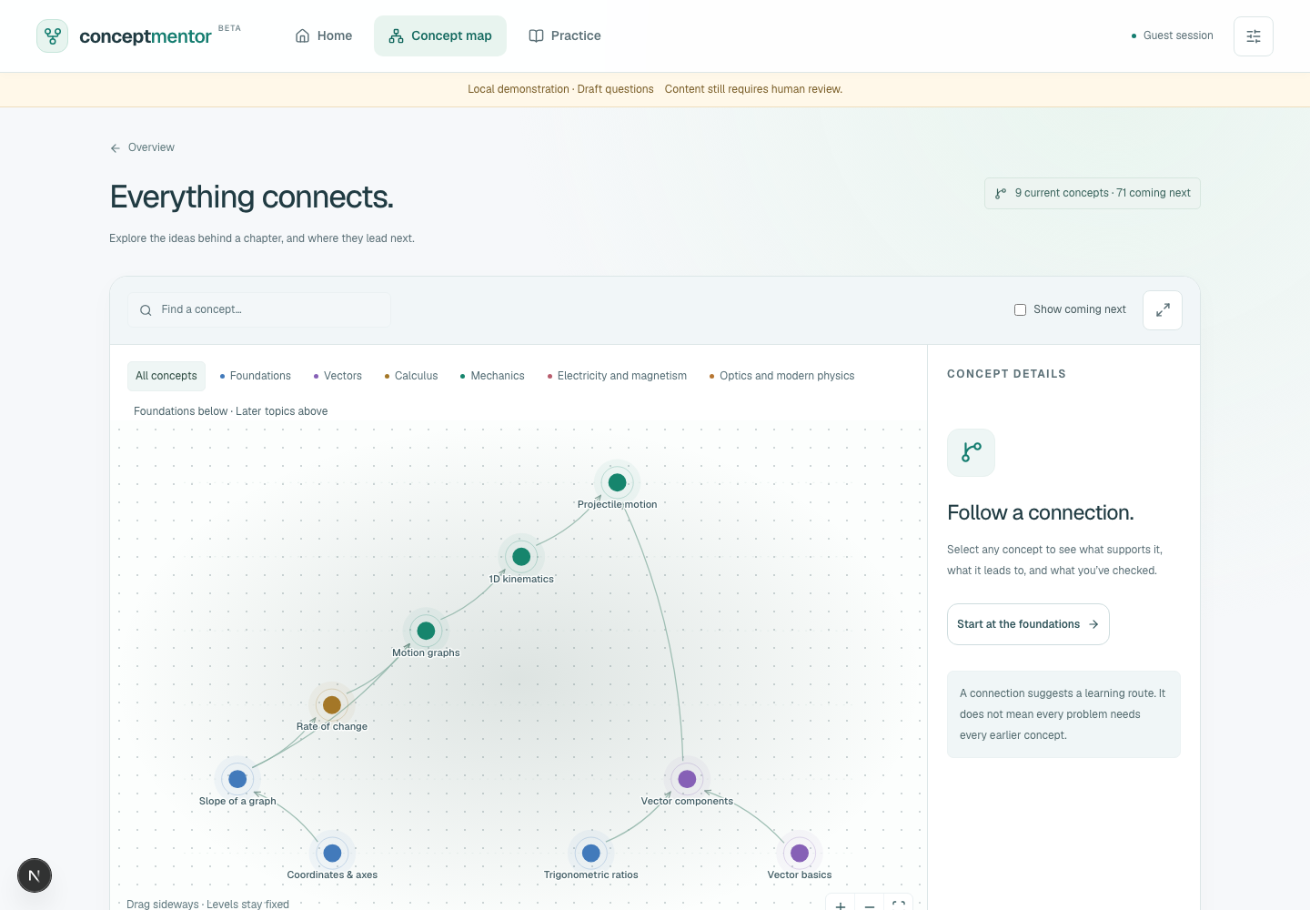
The concept behind the mistake
Projectile motion
Vector components
Trigonometric ratios
Vector basics
A suspected gap guides the next check
Illustrative path; actual interface at right
conceptmentor
07
Notes:
Left: illustrative prerequisite path, not an observed user result. Actual graph relationships: projectile depends on vector components and 1D kinematics. Vector components depend on trig and vector basics. The simplified diagram highlights the components branch only. Right: actual local concept-map interface, guest mode, not learner evidence.

Slide 8
A diagnosis the learner can dispute
Suspected contributing gap
No prerequisite difficulty found
Inconclusive or outside coverage
The learner can dispute the explanation
Immediate check passed; retention untested
conceptmentor
08
Notes:
The system permits suspected contributing gap, no prerequisite difficulty found, inconclusive, out of coverage and student-disputed outcomes. A successful immediate repair check establishes immediate performance only. No diagnostic certainty or retention claim.

Slide 9
Cline suggests the route
Code controls the evidence
Student response
Server grading
Evidence state
Cline SDK suggestions
Probe order and repair choice
Validated before use; deterministic fallback
Also implemented: question-bank writer / solver pipeline with an approval gate
Live model performance remains unverified in this snapshot
conceptmentor
09
Notes:
Local implementation sources: app/lib/mentor/run.ts, schemas.ts and tools.ts; app/lib/items.ts and app/lib/probe.ts. Bounded Cline SDK agents suggest entry/probe ordering/repair choice from structured context. Validation accepts a permitted suggestion or falls back. Only graded evidence changes state. Question-bank writer/solver code exists; human approval remains separate. Live model performance was not verified in this presentation preparation.

Slide 10
The core mechanism is implemented
9
27
concept nodes
authored diagnostic entries
247
0
passing automated tests
final content approvals
Controlled local prototype. Educator review and learner validation are next.
conceptmentor
10
Notes:
Local snapshot 10 October 2026: GRAPH has 9 nodes; content/qbank.json has 28 entries, including 27 authored diagnostic entries (9 A, 9 B1, 9 B2) and one additional verified entry. No bank entry has final status approved plus approvedBy. Current test run passed 247 tests across 28 files. TypeScript errors remain in a bank script/test fixtures. Neither unit tests nor bank counts establish learner gains, live integration success or production readiness.

Slide 11
A next study step
the learner can explain
Planned validation
Observe an adult learner complete the loop without coaching.
Check whether the route improves their next study decision.
Watch the controlled demo
conceptmentor
11
Notes:
This is a planned validation step, not an existing pilot or measured result. Observe adult learners completing a diagnosis-to-recheck loop without coaching. Measure completion, abandonment, ability to explain the next action and later changed-context performance. Compare with the learner’s usual approach before claiming learning or efficiency gains.

Slide 12
Readiness and limits
Implemented
Evidence engine, server grading, concept map, profiles, review scheduling
Content gate
27 authored diagnostic entries plus 1 other entry; 0 final approvals
Engineering
247 tests passed; TypeScript issues remain in script and test fixtures
Still to verify
Live SDK performance, clean production build and learner outcomes
Deployment
Local controlled prototype; AI access restricted to adults
conceptmentor
12
Notes:
Evidence snapshot 10 October 2026. Product source files and current vitest / TypeScript results. AI mode remains controlled adult-only. Provider suitability for minors remains an open gate. No legal compliance, school readiness or public deployment claim.

Slide 13
Sources and evidence definitions
NTA · JEE Main 2026
Unique registrations across both sessions, press release 20 April 2026
Official NTA press release
ASER 2024 · National findings, pp. 47–48
Rural Class VIII division assessment. This does not measure JEE aspirants.
Official ASER national findings
Local implementation snapshot · 10 October 2026
Implementation counts describe scope. Learner efficacy remains unvalidated.
conceptmentor
13
Notes:
NTA: https://www.nta.ac.in/Download/Notice/Notice_20260420194021.pdf . ASER: https://asercentre.org/wp-content/uploads/2022/12/ASER-2024-National-findings.pdf . Local: app/content/graph.ts, app/content/qbank.json, app/lib/items.ts, app/lib/probe.ts, app/lib/mentor/run.ts and 10 Oct 2026 test/type-check results.

