Slide 1
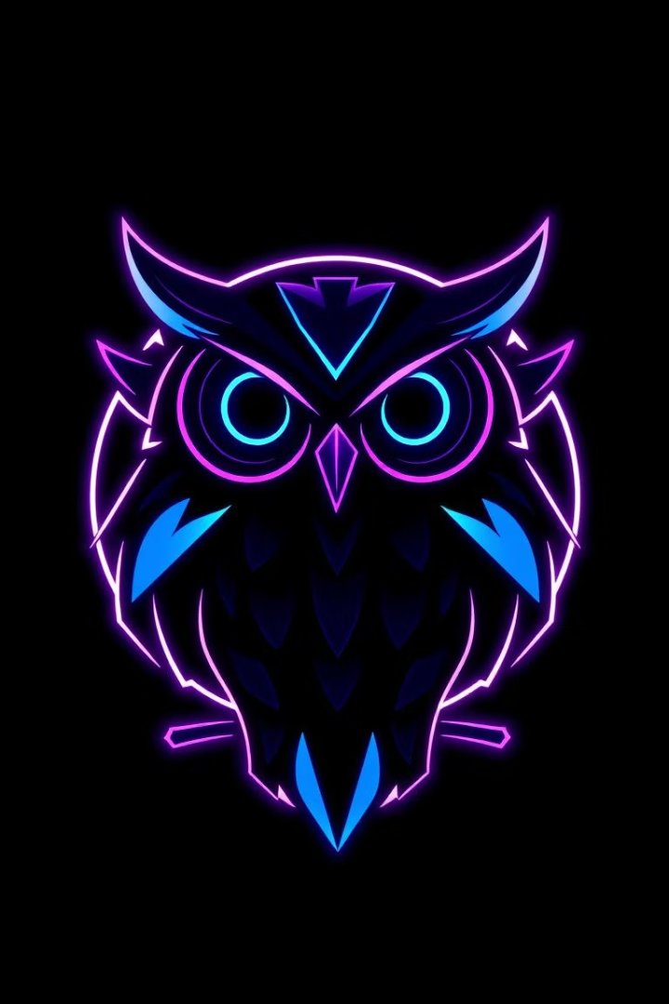
Night Owl Canteen: Code Walkthrough
HTML5, CSS3 & JavaScript Features

Slide 2

Project Overview
This presentation showcases the essential HTML, CSS, and JavaScript features used in the Night Owl Canteen website. It is designed for web development students and enthusiasts, offering insights into modern web practices.
Goal
Highlight core web development features.
Website
Night Owl Canteen project.
Audience
Students and enthusiasts.
Tech Stack
HTML5, CSS3, JavaScript.

Slide 3

HTML5 Structure
Semantic HTML5 tags are used for clear content organization. This improves SEO and accessibility, allowing search engines and assistive technologies to better understand the page content.
Semantic Tags
Content Organization
<header>
<article>
<nav>
<aside>
<main>
<section>
<footer>
Improves SEO & accessibility

Slide 4

CSS3 Styling: Variables
CSS Variables (Custom Properties) ensure theme consistency across the entire website. They allow for easy customization and maintainability, making design changes efficient.
Theme Consistency
Easy Customization
Maintainability
Variables like --primary-color: #6a5acd; and --background-color: #0a0a1a; define the website's dark theme.
Changing a single variable updates the value everywhere it's used, simplifying theme adjustments.
Centralized color definitions reduce redundancy and make code easier to manage and debug.

Slide 5





CSS3 Styling: Layout & Responsiveness
Flexbox and Grid are used for dynamic page layouts. Media queries ensure the website adapts to various screen sizes, providing a consistent user experience.
Flexbox
CSS Grid
Media Queries
For one-dimensional layouts.
For two-dimensional layouts.
Example: @media (max-width: 768px) for mobile.
Responsiveness
Optimized for all devices.

Slide 6








CSS3 Styling: Transitions & Animations
CSS transitions create smooth hover effects on interactive elements. Keyframe animations add subtle movements, enhancing user engagement and visual appeal.
Subtle Movements
User Experience
Adds dynamism.
More interactive.
Hover Effects
Visual Engagement
Smooth visual feedback.
Captivates attention.

Slide 7

JavaScript: DOM Manipulation
JavaScript dynamically loads content, validates forms, and handles user interactions. This creates an interactive and responsive user experience on the Night Owl Canteen website.
Dynamic Content
Loading content without full page reloads.
Form Validation
Ensuring correct user input.
Event Handling
Responding to user actions like clicks.
Interactive UI
Responsive user interface elements.

Slide 8
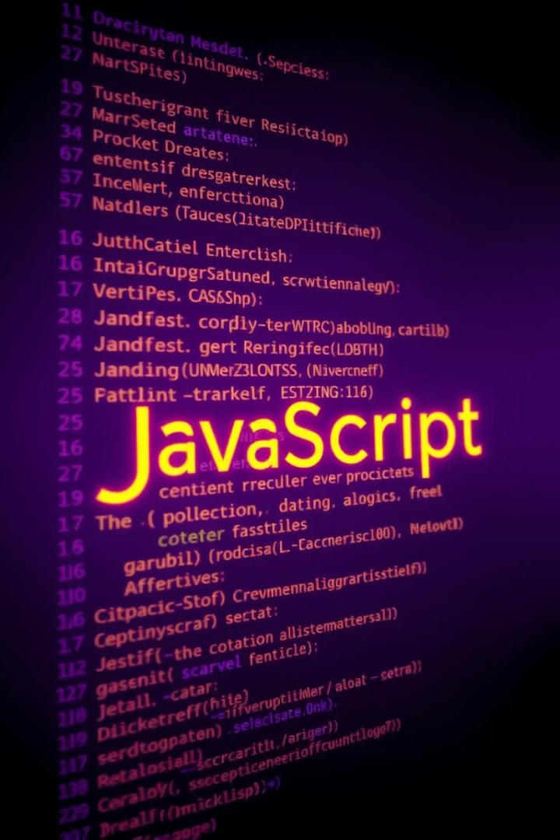




JavaScript: Modern Syntax
The Night Owl Canteen uses modern ES6+ features like const, let, arrow functions, and async/await. These elements improve code readability and maintainability, ensuring a robust codebase.
const & let
Block-scoped variables.
Arrow Functions
Concise function syntax.
async/await
Cleaner asynchronous code.
Readability
Easier to understand.

Slide 9



JavaScript: Asynchronous Operations
The Fetch API is used for efficient data fetching from external sources. Promises and async/await handle asynchronous operations, ensuring smooth data retrieval and display.
Data Fetching
1
Fetch API for external data.
Promises
2
Handling future results.
Async/Await
3
Simplified asynchronous patterns.

Slide 10
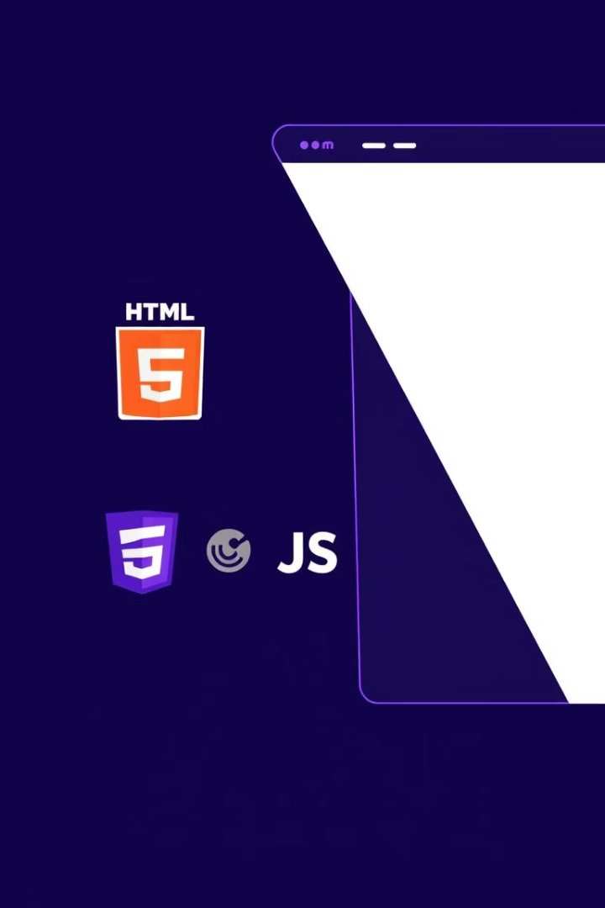
Conclusion
The Night Owl Canteen website is a testament to modern web development. It integrates semantic HTML5, robust CSS3 styling, and dynamic JavaScript features. This project serves as a showcase of best practices in web design and functionality.
HTML5
Semantic structure for content.
CSS3
Styling, layout, and animations.
JavaScript
Dynamic features & operations.

