Slide 1

Light Up
(Akari)
1

Slide 2
Working of the Game
Rules
Grid: Black cells and white cells on a rectangle.
  Goal: Place bulbs so all white cells are lit.
  Light: Bulbs shine up/down/left/right, stopped by black cells or edges.
  Rule: Bulbs cannot shine on each other (no clear line-of-sight).
  Clues: Numbers in black cells show exact count of bulbs touching that cell's sides.
2

Slide 3
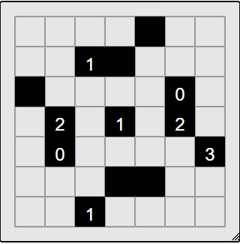
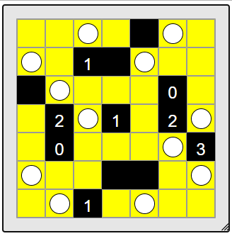
Initial Puzzle
After Solving
3

Slide 4
The Algorithm
DOC
4

Slide 5
Motivation Behind 2 Graphs
The Light Up puzzle involves two fundamentally different relationships:
  Visibility relationships (who can see whom)
  Numerical constraints (how many bulbs are allowed)
Using a single graph would mix these concerns and make reasoning difficult.
Therefore, we divide the problem into:
    A Visibility Graph (Gᵥ)
    A Constraint Graph (G꜀)
5

Slide 6
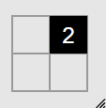
Motivation Behind 2 Graphs
1
2
Gᵥ
G_{c}
1
2,2
2,2 (2)
1,1
2
2,1
2,2
2,2
5

Slide 7
Graph Construction
6

Slide 8
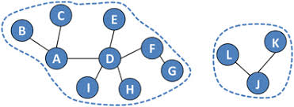
Connected Components
Connected components are maximal, separate groups of nodes (vertices) in a graph where every node within a group is reachable from every other node in that same group, but no node connects to nodes outside its group.
7

Slide 9
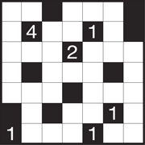

Connected Components
We apply BFS on the Visibility Graph to find connected components.
Each connected component represents:
A visibility region
A set of cells where no two bulbs can coexist
A region that can be fully lit by strategically placing bulbs.
This breaks down our problem of solving the entire grid into smaller sub parts. Any Bulb placement in one component does NOT affect the nodes of another component.
8

Slide 10
Connected Components
9

Slide 11
Forced Constraint Propagation
We initialize a queue with all numbered black cells.
For each numbered cell x :
If remaining(x) = free(x),
then all remaining adjacent cells must contain bulbs.
This step places mandatory bulbs that are logically unavoidable, reducing the problem size early and safely.
10

Slide 12
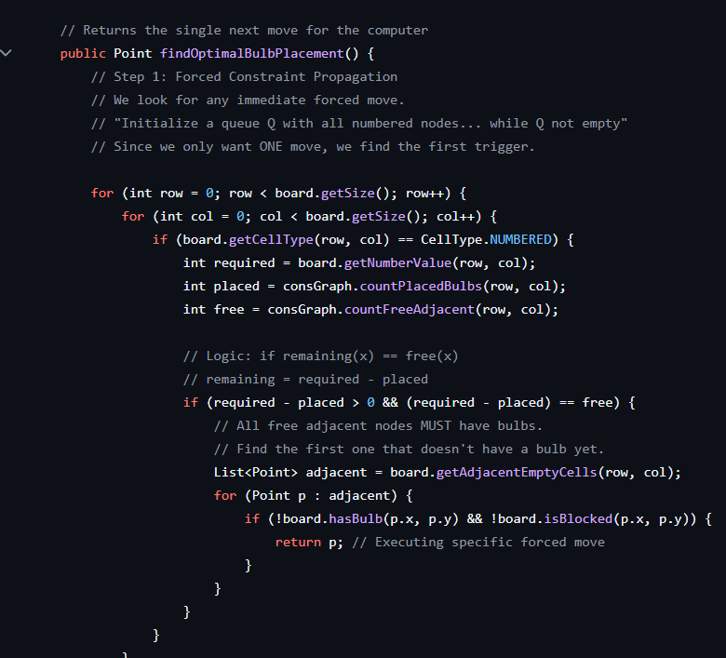
Forced Constraint Propagation
11

Slide 13
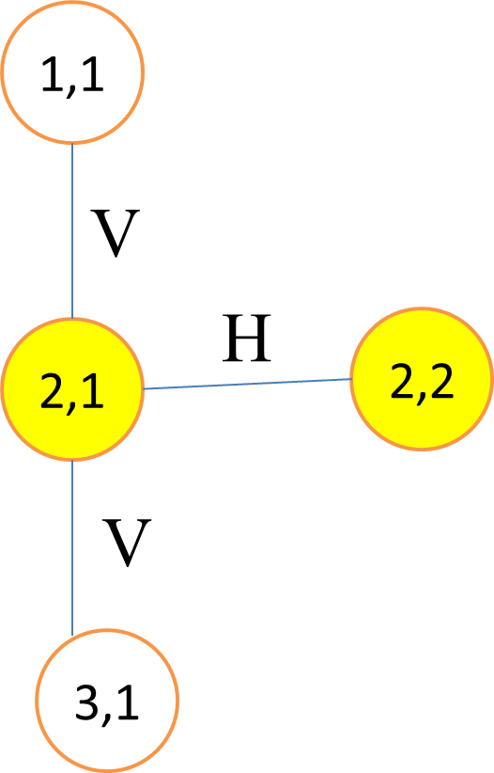
Sorting Visibility Components
After forced placements, some cells may still remain unlit.
We compute for each component C:
score(C) = |C| − number of lit nodes in C
Components are sorted in descending order of score so that:
  The largest unlit regions are handled first
  Each bulb placement maximizes global lighting impact
Sorting is done using Insertion Sort.
13

Slide 14
Modified BFS
1,1
Whenever a bulb is placed:
A Modified BFS is run on Gᵥ
BFS is performed twice:
  Once using only horizontal (H) edges
  Once using only vertical (V) edges
This ensures:
All visible cells are marked as lit.
Conflicting cells are marked as blocked.
The modification prevents incorrect visibility assumptions across turns.
V
H
2,1
2,2
V
3,1
12

Slide 15
Bulb Selection Within a Component
1,1
Within each component:
Compute a node score based on outgoing visibility edges
Sort nodes using Merge Sort
Select a node u such that:
  u is not blocked
  Constraints in G꜀ are not violated
  The number of newly lit cells is maximized
V
H
2,1
2,2
V
3,1
place bulb at u
Modified BFS on G_{v} from u to:
mark nodes as lit
mark conflicting nodes as blocked
update remaining and free values
14

Slide 16
Bulb Selection Within a Component
15

Slide 17
Termination Condition
The algorithm terminates when:
All empty cells are lit
All numbered black cells have remaining(x) = 0
At this point, the algorithm returns the set of bulb placements as a valid solution.
16

Slide 18
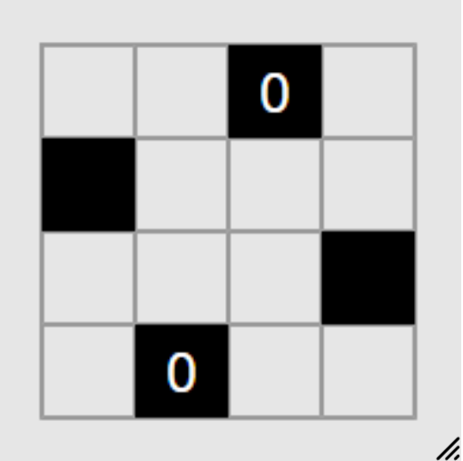
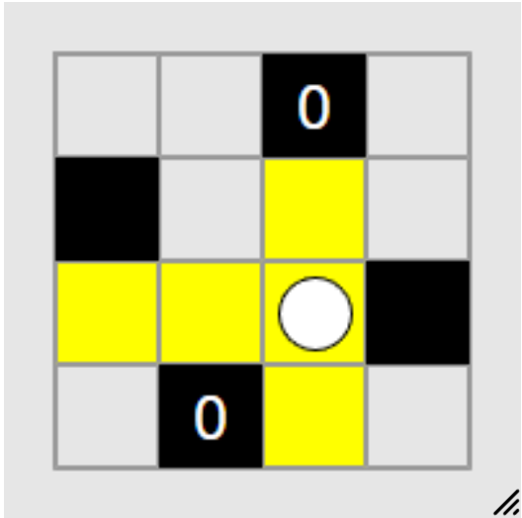
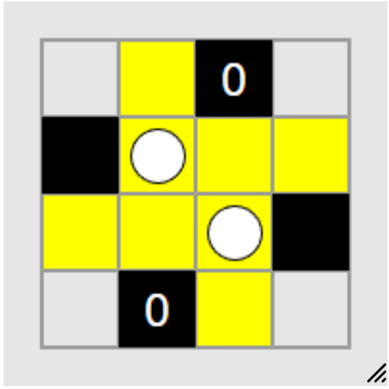
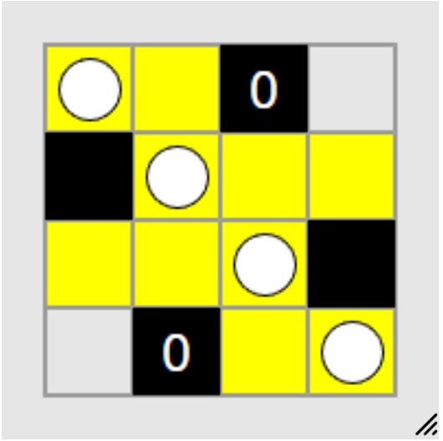
Counter Example – Where this algorithm Fails
Step 1 — Graph construction
All empty cells belong to one visibility component
Step 2 — Sort visibility components
Only one component
It has many unlit cells → highest priority
Step 3 — Bulb placement inside component
Compute score(u) = number of visible cells.
Sort according to the scores.
Pick the cell that maximizes visibility.
  That cell is: (3,3) (Score = 5). So we place a bulb there.
  The next cell that maximizes visibility is (2,2).
  We place bulbs at (1,1) and (4,4) to light them up
  (Least scores).
  After placing a bulb at 2,2 ,
  WE STILL HAVE NODES (4,1) and (1,4) unlit, and bulbs cannot be placed there due to the constraint.
  THE PUZZLE REMAINS UNSOLVED.
17

Slide 19
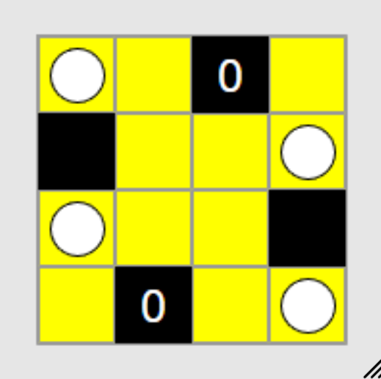
But a valid solution does exist.
18

Slide 20
Why did our algorithm fail to find a solution?
Our rule in Step 4.3 ensures maximum visibility.
This local optimization ignores whether remaining unlit cells retain any feasible lighting source.
Early high-visibility placements block or eliminate low-visibility but essential cells.
Since the algorithm performs no lookahead or backtracking, it cannot recover.
As a result, the puzzle becomes unsatisfiable despite a valid solution existing.
19

Slide 21
Light Up
(Akari)
Divide & Conquer Approach
1

Slide 22
The Algorithm
Step 1 : Forced Constraint Propagation
Step 2 : Divide phase
  Base case : 2 x 2 grid (or) 2 x 1 grid
    Try placing a bulb in each white cell
    Check immediate violations, first locally, then globally
    Select the first valid placement greedily
  Recursive Case :
    Choose a separator
      (Heuristic: row/column with many black cells, tie – braker : Higher number)
    Split grid into:
        G₁
        Separator S
        G₂

Slide 23
The Algorithm
Step 2 : Divide phase : Handing Dependancy
    Now, we have two subproblems G1 and G2, but they are NOT INDEPENDENT. To solve this, we introduce “INTERFACE STATES”
    Each separator white cell can be in 4 possible states:
        Bulb placed (1)
        Illuminated from left/up (2)
        Illuminated from right/down (3)
        Not illuminated / forbidden (4)
      An interface state is a complete assignment of these states to all separator cells simultaneously. If S has n white cells, 4^n possible I.S

Slide 24
The Algorithm
Step 2 : Divide phase : Handing Dependancy
    For each interface state I:
      Apply boundary conditions to G₁ and G₂
      Run deduction locally
      If contradiction occurs → discard I
      Recursively apply FindSafeBulb on subgrids
      Division continues until all branches reach 2×2 base cases
      Greedy placements bubble upward, first validate it with the local subgrid, and then gradually validate with the global one. Any contradiction -> Alter greedy placement
      Any contradiction invalidates the interface state, move to the next I.S

Slide 25
The Algorithm
Step 2 : Divide phase : Handing Dependancy
    If all I.S fails , then Choose a different separator, redo the algorithm with the new separator.
    If all separator fails -> No safe move exists, so the puzzle is unsolvable.

Slide 26
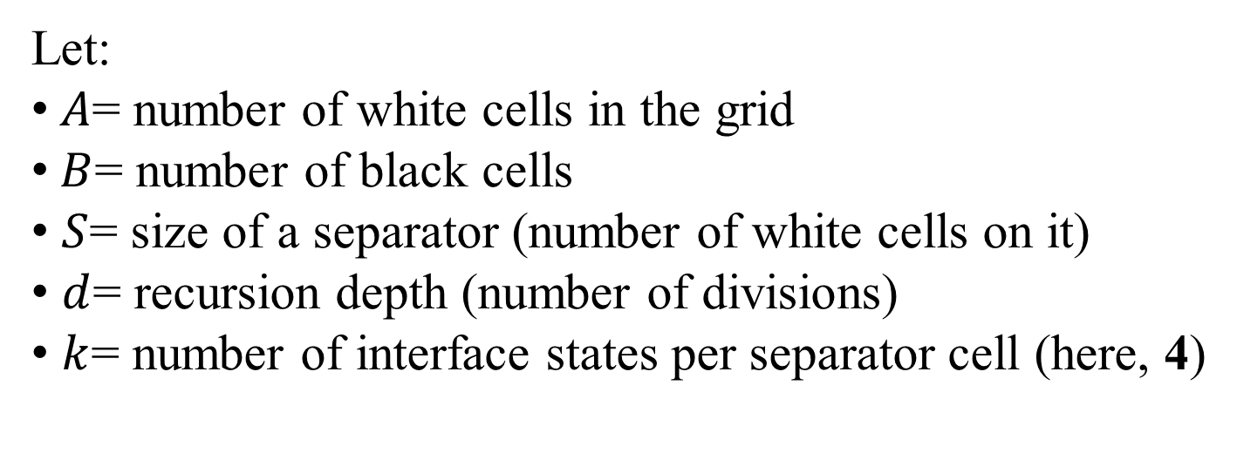


Analysis
Let:
$A$= number of white cells in the grid
$B$= number of black cells
$S$= size of a separator (number of white cells on it)
$d$= recursion depth (number of divisions)
$k$= number of interface states per separator cell (here, 4)
Phase 1 : Forced Constraints : All white and Black cells to be scanned.
$$O (A+B)$$
Phase 2 : Interface State Explosion
      For a separator with white cells: Each cell has 4 possible interface states.
      Total interface states:
$$4^{S}$$

Slide 27
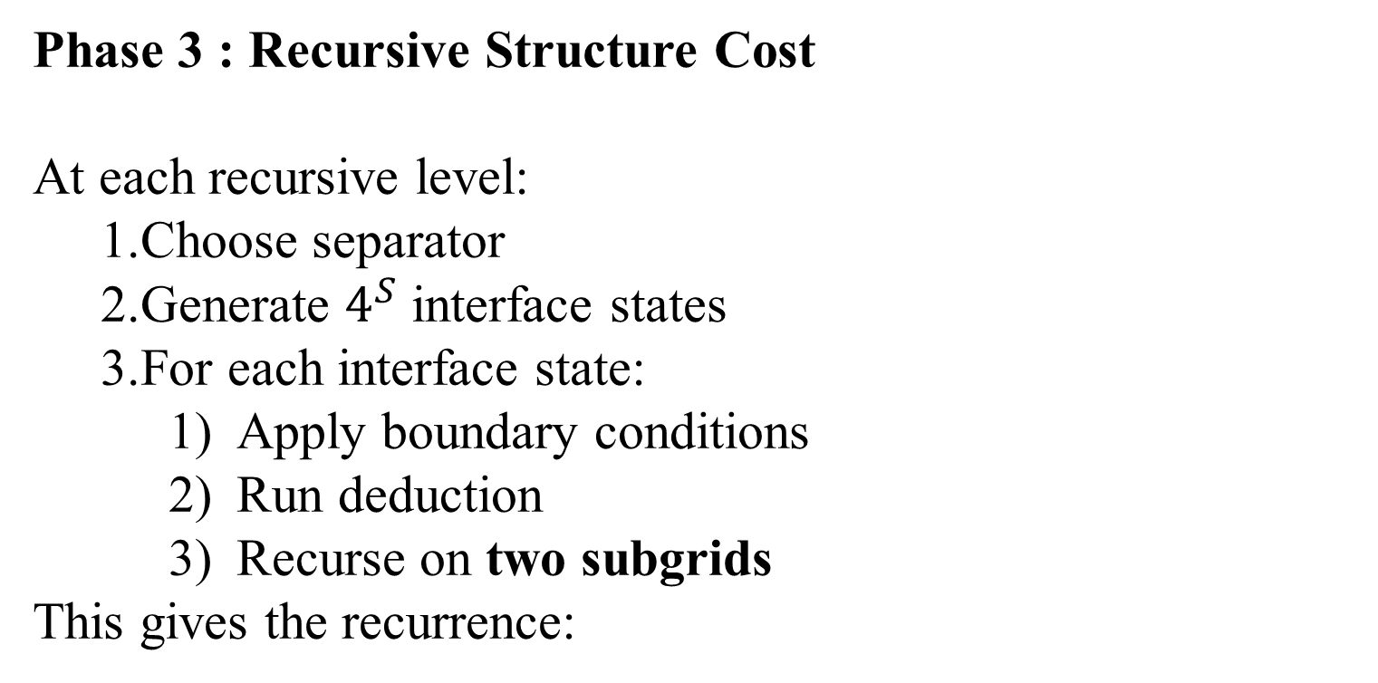
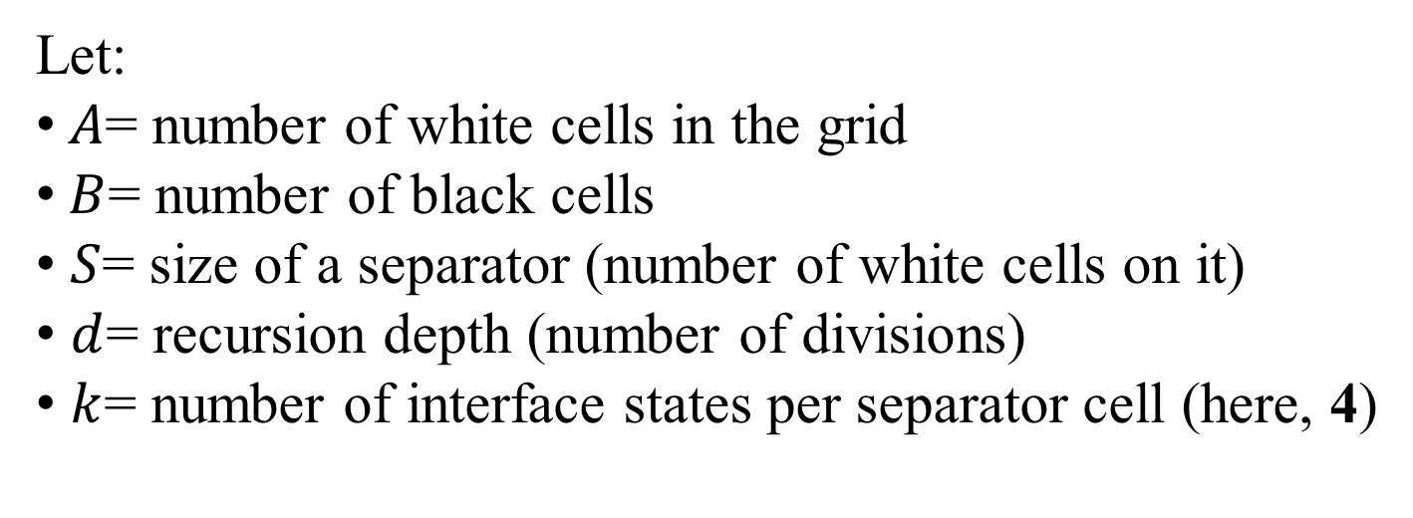
Analysis
Let:
$A$= number of white cells in the grid
$B$= number of black cells
$S$= size of a separator (number of white cells on it)
$d$= recursion depth (number of divisions)
$k$= number of interface states per separator cell (here, 4)
Phase 3 : Recursive Structure Cost
At each recursive level:
  Choose separator
  Generate $4^{S}$ interface states
  For each interface state:
    Apply boundary conditions
    Run deduction
    Recurse on two subgrids
This gives the recurrence:
$$T\left(A\right)=4^{S}⋅\left(T\left(A_{1}\right)+T\left(A_{2}\right)\right)+O\left(A+B\right)$$

Slide 28
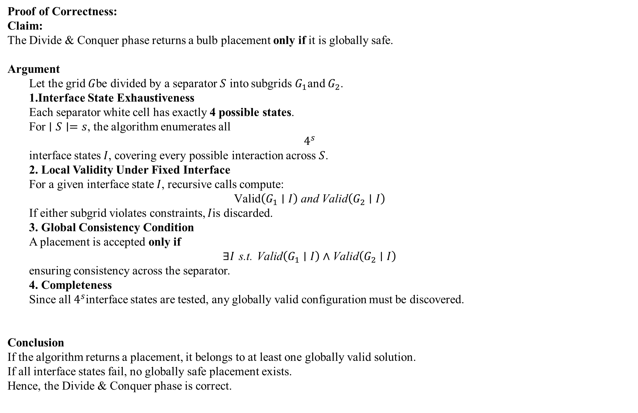
Analysis
Proof of Correctness:
Claim:
The Divide & Conquer phase returns a bulb placement only if it is globally safe.
Argument
  Let the grid $G$be divided by a separator $S$ into subgrids $G_{1}$and $G_{2}$.
  Interface State Exhaustiveness
  Each separator white cell has exactly 4 possible states.
  For $∣S∣=s$, the algorithm enumerates all
  $$4^{s}$$
  interface states $I$, covering every possible interaction across $S$.
  2. Local Validity Under Fixed Interface
  For a given interface state $I$, recursive calls compute:
  $$\text{Valid}\left(G_{1}∣I\right) \text{and} \text{Valid}\left(G_{2}∣I\right)$$
  If either subgrid violates constraints, $I$is discarded.
  3. Global Consistency Condition
  A placement is accepted only if
  $$∃I \text{s}\text{.}\text{t}\text{. }\text{Valid}\left(G_{1}∣I\right)∧\text{Valid}\left(G_{2}∣I\right)$$
  ensuring consistency across the separator.
  4. Completeness
  Since all $4^{s}$interface states are tested, any globally valid configuration must be discovered.
Conclusion
If the algorithm returns a placement, it belongs to at least one globally valid solution.
If all interface states fail, no globally safe placement exists.
Hence, the Divide & Conquer phase is correct.

Slide 29
Improvements from the Greedy Approach
Greedy Graph-Based Algorithm
Builds visibility and constraint graphs and uses BFS for propagation
Chooses bulb positions based on local heuristics such as maximum visibility
Prioritizes large unlit regions and places bulbs greedily
Decisions are final and cannot be revised
Works only with immediate, local information
Can block low-visibility but essential cells
May fail even when a valid solution exists
Fast and simple, but does not guarantee correctness
Divide & Conquer Algorithm
Applies logical deduction first, then uses recursive grid decomposition
Splits the grid using separators to manage long-range illumination effects
Explicitly considers all interface states (4 per separator cell)
A bulb is placed only if it remains valid under all recursive checks
Detects contradictions early and rejects unsafe moves
Guarantees safe bulb placement at every step
More computationally expensive, but logically reliable
The greedy approach is efficient but unsafe, while the Divide & Conquer approach sacrifices speed to guarantee correctness by validating every move against all possible global interactions.

